Slide 1
VIDEO

Slide 2
COLOUR SPACES
A monochrome image requires just one number to indicate the brightness or luminance of each spatial sample.
Color images, on the other hand, require at least three numbers per pixel position to represent color accurately.
  RGB
  YCbCr

Slide 3
YCbCr
The human visual system (HVS) is less sensitive to color than to luminance (brightness).
In the RGB color space the three colors are equally important and so are usually all stored at the same resolution
But it is possible to represent a color image more efficiently by separating the luminance from the color information and representing luma with a higher resolution than color.

Slide 4
The YCbCr color space and its variations (sometimes referred to as YUV) is a popular way of efficiently representing color images. Y is the luminance (luma) component and can be calculated as a weighted average of R, G and B:
  Y = kr R + kgG + kbB
    where k are weighting factors.
The color information can be represented as color difference (chrominance or chroma) components, where each chrominance component is the difference between R, G or B and the luminance Y:
    Cb = B − Y
    Cr = R − Y
    Cg = G − Y
This representation has little obvious merit since we now have four components instead of the three in RGB.
However, Cb + Cr + Cg is a constant and so only two of the three chroma components need to be stored or transmitted since the third component can always be calculated from the other two.
YCbCr has an important advantage over RGB, that is the Cr and Cb components may be represented with a lower resolution than Y.

Slide 5
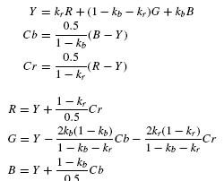
An RGB image may be converted to YCbCr after capture in order to reduce storage and/or transmission requirements.
  Note that there is no need to specify a separate factor kg (because kb + kr + kg = 1)
Before displaying the image, it is usually necessary to convert back to RGB.

Slide 6
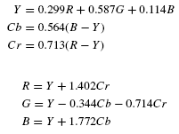
ITU-R recommendation BT.601 defines kb = 0.114 and kr = 0.299. Substituting into the above equations gives the following widely-used conversion equations:

Slide 7
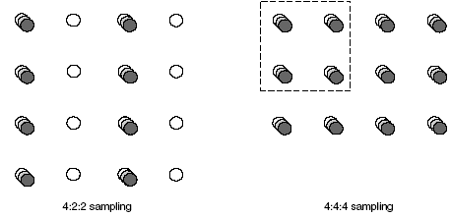
YCbCr Sampling Formats
4:4:4 sampling means that the three components (Y, Cb and Cr) have the same resolution and hence a sample of each component exists at every pixel position.
  The numbers indicate the relative sampling rate of each component in the horizontal direction, i.e. for every four luminance samples there are four Cb and four Cr samples.
In 4:2:2 sampling, the numbers 4:2:2 mean that for every four luminance samples in the horizontal direction there are two Cb and two Cr samples.
  4:2:2 video is used for high-quality color reproduction.

Slide 8
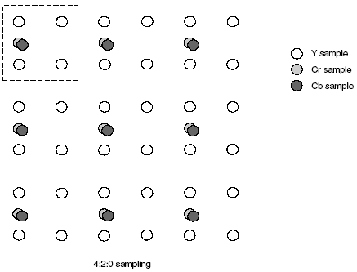
The term ‘4:2:0’ is rather confusing because the numbers do not actually have a logical interpretation.
4:2:0 sampling is widely used for consumer applications such as video conferencing, digital television and digital versatile disk (DVD) storage.

Slide 9
4:2:0 sampling is sometimes described as ‘12 bits per pixel’.
  The reason for this can be seen by examining a group of four pixels.
    Using 4:4:4 sampling, a total of 12 samples are required, four each of Y, Cb and Cr, requiring a total of 12 × 8 = 96 bits, an average of 96/4 = 24 bits per pixel.
  Using 4:2:0 sampling, only six samples are required, four Y and one each of Cb, Cr, requiring a total of 6 × 8 = 48 bits, an average of 48/4 = 12 bits per pixel.

Slide 10
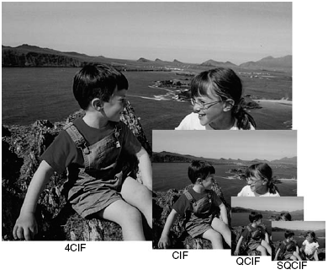
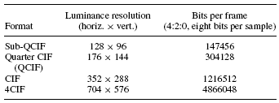
4CIF (Common Intermediate Format) is appropriate for standard-definition television and DVD-video.
CIF and QCIF are popular for videoconferencing applications.
QCIF or SQCIF are appropriate for mobile multimedia applications where the display resolution and the bitrate are limited.

Slide 11
Video Coding Concepts
What is CODEC?
  Compression involves a complementary pair of systems, a compressor (encoder) and a decompressor (decoder).
  The encoder converts the source data into a compressed form prior to transmission or storage
  The decoder converts the compressed form back into a representation of the original video data.
  The encoder/decoder pair is often described as a CODEC (enCOder/ DECoder)

Slide 12
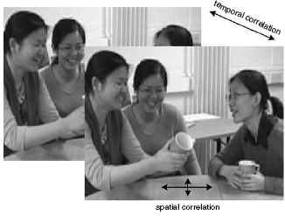
Spatial and temporal correlation in a video sequence
Most video coding methods exploit both temporal and spatial redundancy to achieve compression.

Slide 13
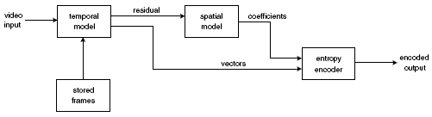
Video encoder
A video encoder consists of three main functional units:
  a temporal model,
  a spatial model and
  an entropy encoder.

Slide 14
Temporal Model
The input to the temporal model is an uncompressed video sequence.
The temporal model attempts to reduce temporal redundancy by exploiting the similarities between neighboring video frames, usually by constructing a prediction of the current video frame.
In MPEG-4 Visual and H.264, the prediction is formed from one or more previous or future frames and is improved by compensating for differences between the frames (motion compensated prediction).
The output of the temporal model is a residual frame (created by subtracting the prediction from the actual current frame) and a set of model parameters, typically a set of motion vectors describing how the motion was compensated.

Slide 15
Spatial Model
The residual frame forms the input to the spatial model which makes use of similarities between neighboring samples in the residual frame to reduce spatial redundancy.
In MPEG-4 Visual and H.264 this is achieved by applying a transform to the residual samples and quantizing the results.
The transform converts the samples into another domain in which they are represented by transform coefficients.
The coefficients are quantized to remove insignificant values, leaving a small number of significant coefficients that provide a more compact representation of the residual frame.
The output of the spatial model is a set of quantized transform coefficients.

Slide 16
Entropy Encoder
The parameters of the temporal model (typically motion vectors) and the spatial model (coefficients) are compressed by the entropy encoder.
A compressed sequence consists of coded motion vector parameters, coded residual coefficients and header information.

Slide 17
TEMPORAL MODEL
Prediction from the Previous Video Frame
Changes due to Motion (pixel level)
Block-based Motion Estimation and Compensation
Motion Compensated Prediction of a Macroblock

Slide 18
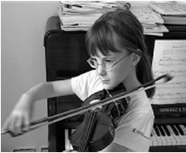

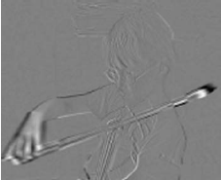
Prediction from the Previous Video Frame
Frame1 Frame2 Difference
The obvious problem with this simple prediction is that a lot of energy remains in the residual frame (indicated by the light and dark areas) and this means that there is still a significant amount of information to compress after temporal prediction.
Much of the residual energy is due to object movements between the two frames and a better prediction may be formed by compensating for motion between the two frames.

Slide 19
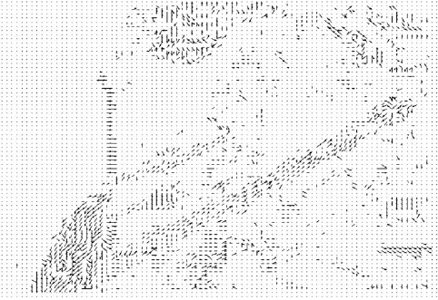
Changes due to Motion (pixel level)
Changes between video frames may be caused by
  object motion (rigid object motion, for example a moving car, and deformable object motion, for example a moving arm),
  camera motion (panning, tilt, zoom, rotation),
  uncovered regions (for example, a portion of the scene background uncovered by a moving object) and
  lighting changes.

Slide 20
With the exception of uncovered regions and lighting changes, these differences correspond to pixel movements between frames.
It is possible to estimate the trajectory of each pixel between successive video frames, producing a field of pixel trajectories known as the optical flow.
However, this is not a practical method of motion compensation for several reasons.
  An accurate calculation of optical flow is very computationally intensive
  it would be necessary to send the optical flow vector for every pixel to the decoder in order for the decoder to re-create the prediction frame (resulting in a large amount of transmitted data and negating the advantage of a small residual).

Slide 21
Block-based Motion Estimation and Compensation
A practical and widely-used method of motion compensation is to compensate for movement of rectangular sections or ‘blocks’ of the current frame.
The following procedure is carried out for each block of M × N samples in the current frame:
  Search an area in the reference frame (past or future frame, previously coded and transmitted) to find a matching block.
    This process of finding the best match is known as motion estimation.

Slide 22
The chosen candidate region becomes the predictor and is subtracted from the current block to form a residual block (motion compensation).
The residual block is encoded and transmitted and the offset between the current block and the position of the candidate region (motion vector) is also transmitted.

Slide 23
Block-based motion compensation is popular for a number of reasons:
  It is relatively straightforward and computationally tractable,
  it fits well with rectangular video frames and with block-based image transforms (e.g. the Discrete Cosine Transform), and
  it provides a reasonably effective temporal model for many video sequences.
There are however a number of disadvantages,
  for example ‘real’ objects rarely have neat edges that match rectangular boundaries
  objects often move by a fractional number of pixel positions between frames
  many types of object motion are hard to compensate for using block-based methods (e.g. deformable objects, complex motion such as a cloud of smoke).

Slide 24
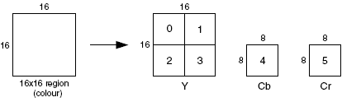
Motion Compensated Prediction of a Macroblock
Macroblock (4:2:0)
The macroblock, corresponding to a 16×16-pixel region of a frame, is the basic unit for motion compensated prediction in a number of important visual coding standards including MPEG-1, MPEG-2, MPEG-4 Visual, H.261, H.263 and H.264.

Slide 25
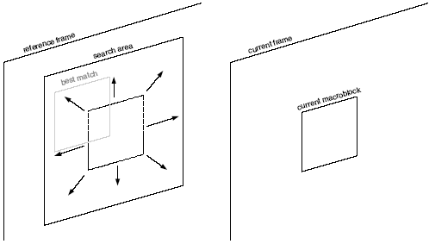
Motion estimation

Slide 26
Motion Compensation
The selected ‘best’ matching region in the reference frame is subtracted from the current macroblock to produce a residual macroblock (luminance and chrominance) that is encoded and transmitted together with a motion vector.
Where there is a significant change between the reference and current frames (for example, a scene change),
  it may be more efficient to encode the macroblock without motion compensation and so an encoder may choose intra mode (encoding without motion compensation) or
  inter mode (encoding with motion compensated prediction) for each macroblock.

Slide 27
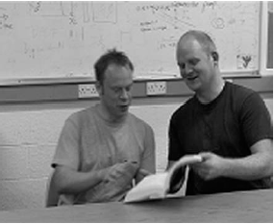
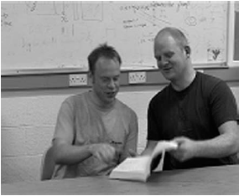
Motion Compensation Block Size
Smaller motion compensation block sizes can produce better motion compensation results.
Frame 1
Frame 2

Slide 28
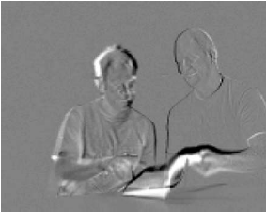
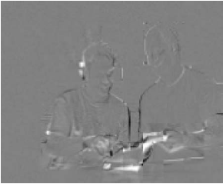
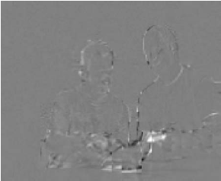
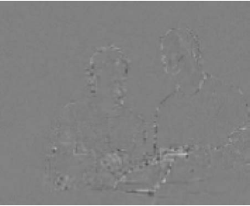
Residual (no motion compensation)
Residual (16 × 16 block size)
Residual (8 × 8 block size)
Residual (4 × 4 block size)

Slide 29
However, a smaller block size leads to increased complexity (more search operations must be carried out) and an increase in the number of motion vectors that need to be transmitted.

Slide 30
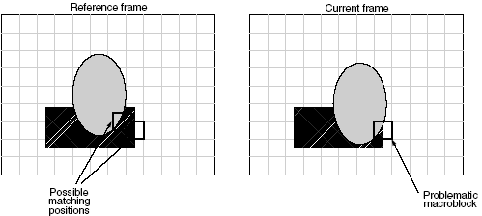
Region-based Motion Compensation
Moving objects in a ‘natural’ video scene are rarely aligned neatly along block boundaries but are likely to be irregular shaped.
This problem is illustrated by the following figure, in which the oval-shaped object is moving and the rectangular object is static.
  It is difficult to find a good match in the reference frame for the highlighted macroblock, because it covers part of the moving object and part of the static object.

Slide 31
There are however a number of practical difficulties that need to be overcome in order to use region-based motion compensation,
  including identifying the region boundaries accurately and consistently (segmentation),
  encoding the contour of the boundary to the decoder and encoding the residual after motion compensation.
MPEG-4 Visual includes a number of tools that support region-based compensation and coding

Slide 32
Video Objects
One of the key contributions of MPEG-4 Visual is a move away from the ‘traditional’ view of a video sequence as being merely a collection of rectangular frames of video.
Instead, MPEG-4 Visual treats a video sequence as a collection of one or more video objects.
MPEG-4 Visual defines a video object as a flexible ‘entity that a user is allowed to access (seek, browse) and manipulate (cut and paste)’.
A video object (VO) is an area of the video scene that may occupy an arbitrarily-shaped region and may exist for an arbitrary length of time.

Slide 33
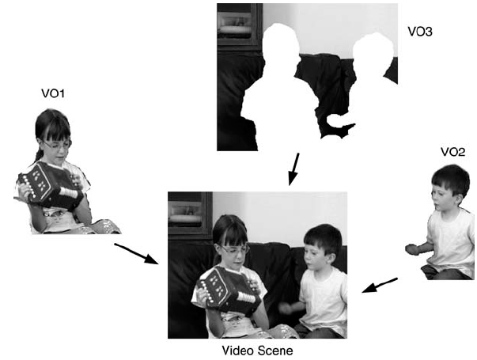
Video scene consisting of three VOs

Slide 34
Segmentation
The object-based functionalities of MPEG-4 require a video scene to be segmented into objects. Segmentation methods usually fall into three categories:
  Manual segmentation
  Semi-automatic segmentation
  Fully-automatic segmentation

Slide 35
Manual segmentation
Manual segmentation: this requires a human operator to identify manually the borders of each object in each source video frame,
    a very time-consuming process that is obviously only suitable for ‘offline’ video content.
    This approach may be appropriate, for example, for segmentation of an important visual object that may be viewed by many users and/or re-used many times in different composed video sequences.

Slide 36
Semi-automatic segmentation
Semi-automatic segmentation: a human operator identifies objects and perhaps object boundaries in one frame;
a segmentation algorithm refines the object boundaries (if necessary) and tracks the video objects through successive frames of the sequence.

Slide 37
Fully-automatic segmentation
An algorithm attempts to carry out a complete segmentation of a visual scene without any user input,
  based on (for example) spatial characteristics such as edges and temporal characteristics such as object motion between frames.

