Slide 1
Camera

Slide 2
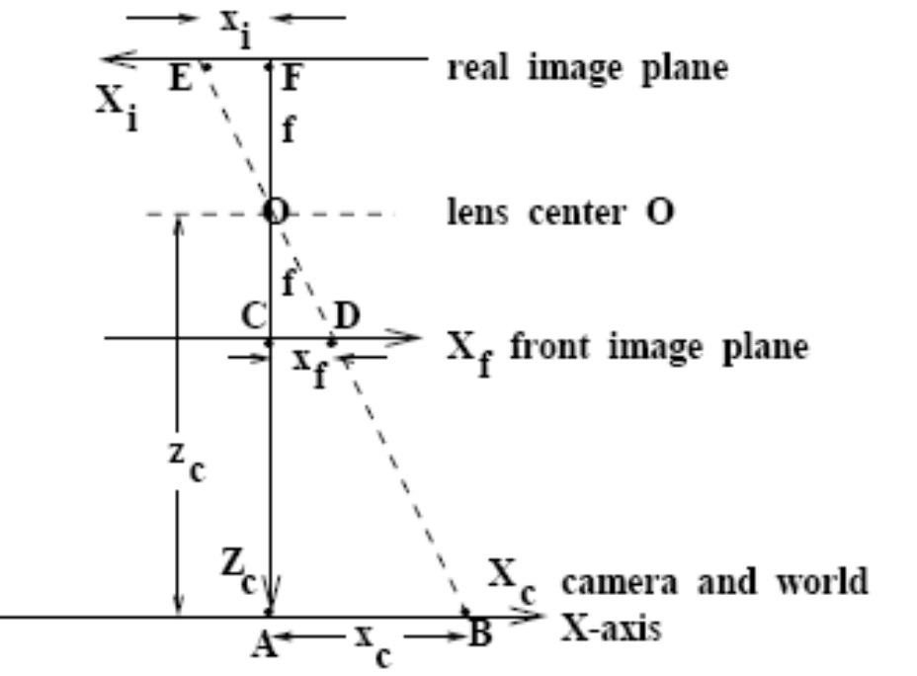

The Perspective Imaging Model
The sensor observes a point B which projects to image point E.
Point B images a distance xi from the image center.
f is the focal length.
It is convenient to think of a front image plan rather than the actual image plane so that the image is not inverted in direction relative to the world.

Slide 3
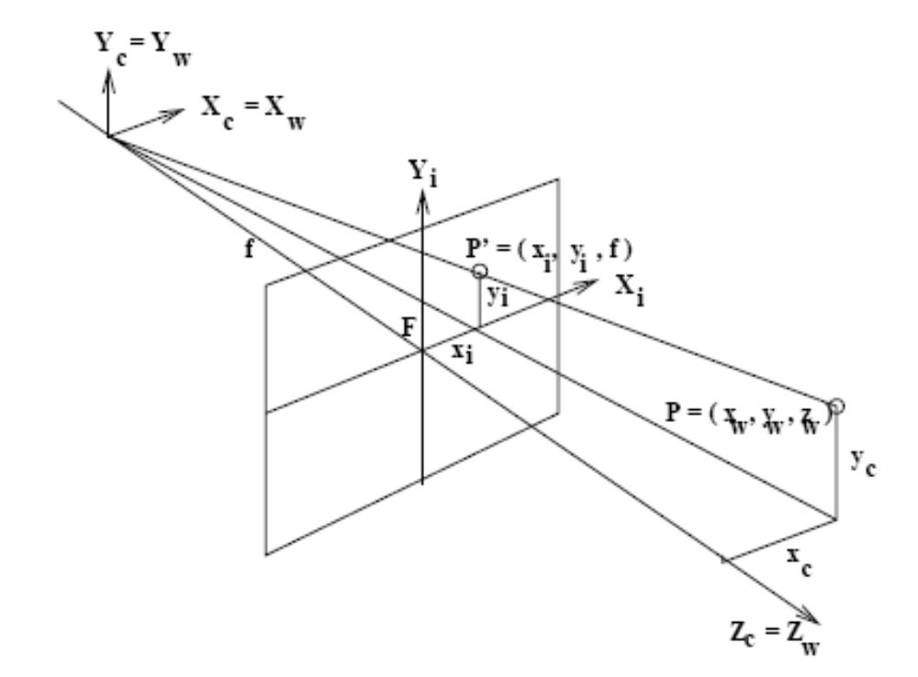
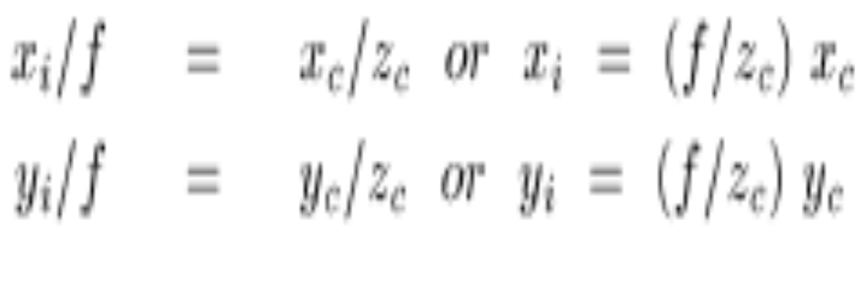
General model of perspective projection to a 2D image
All 3D points along the same ray from an image point out into the 3D space image to the same 2D image point and thus a great deal of 3D information is lost in the process.
If the camera views planar material at a constant distance zc=c1 away, then the image is a simple scaling of that plane.
  Setting c2=f/c1 yields the simple relations xi = c2*xc and yi = c2*yc

Slide 4

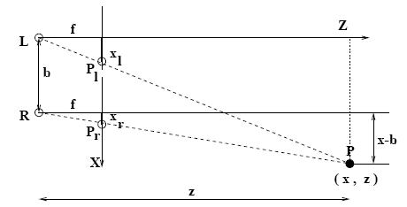
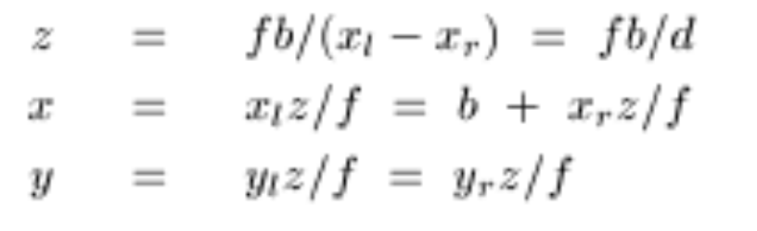
Depth Perception from Stereo
d = disparity =xl-xr
Distance goes to infinity as disparity goes to zero
Problems:
  The case where a point P is not visible in both images
  Too few points are available for smooth objects with no texture such as a snow-covered hill

Slide 5
The most difficult part of a stereo vision system is not the depth calculation, but the determination of the correspondences used in the depth calculation.

Slide 6
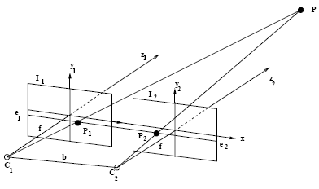
The Epipolar Constraint
Simple Case: Point P1 on Image I1 and point P2 on image I2, which share the same image plane that is parallel to the baseline between the cameras.
  The optical axes are perpendicular to the baseline and parallel to each other.
In this case, given a point P1=(x1,y1) in image I1, the corresponding point P2=(x2,y2) in image I2 is known to lie on the same scan line; that is, y1=y2.
  We call this a normal image pair.

Slide 7
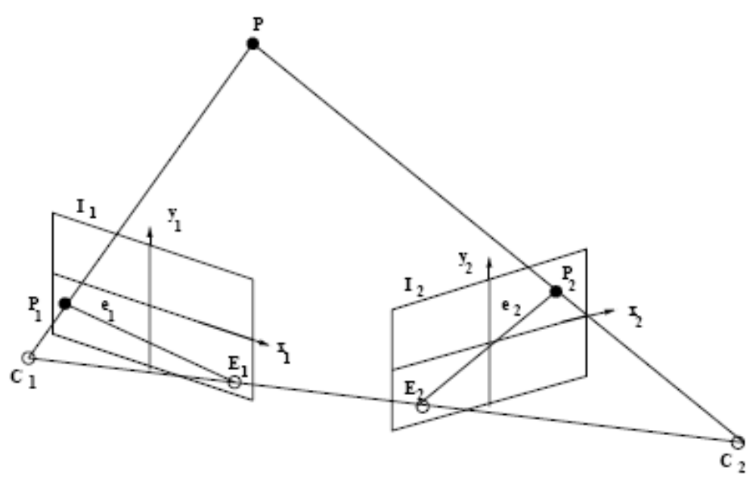
While the normal set up makes the geometry simple, it is not always possible to place cameras in this position, and it may not lead to big enough disparities to calculate accurate depth information.
Definition: The plane that contains the 3D point P, the two optical centers (or cameras) C1 and C2, and the two image points P1 and P2 to which P projects is called the epipolar plane.
Definition: The two lines e1 and e2 resulting from the intersection of the epipolar plane with the two image planes I1 and I2 are called epipolar lines.

Slide 8
Given the point P1 on epipolar line e1 in image I1 and knowing the relative orientations of the cameras (how?), it is possible to find the corresponding epipolar line e2 in image I2 on which the corresponding point P2 must lie.
  If another point P1' in image I1 lies in a different epipolar plane from point P1, it will lie on a different epipolar line.
Definition: The epipole of an image of a stereo pair is the point at which all its epipolar lines intersect.
  Points E1 and E2 are the epipoles of images I1 and I2, respectively.

Slide 9
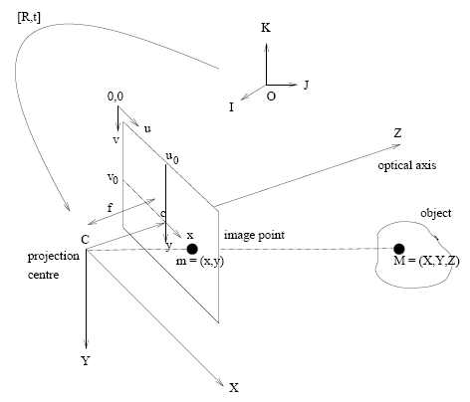
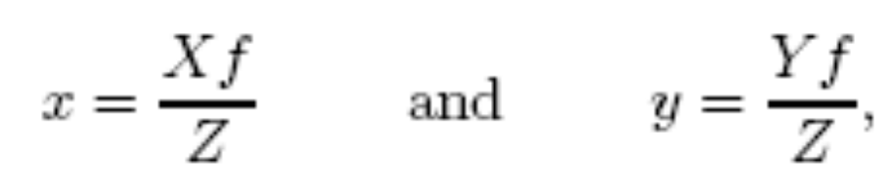
This coordinate system is called the standard coordinate system of the camera. A point M on an object with coordinates (X, Y, Z) will be imaged at some point m = (x, y) in the image plane.
These coordinates are with respect to a coordinate system whose origin is at the intersection of the optical axis and the image plane, and whose x and y axes are parallel to the X and Y axes. The relationship between the two coordinate systems (c, x, y) and (C,X, Y, Z) is given by

Slide 10
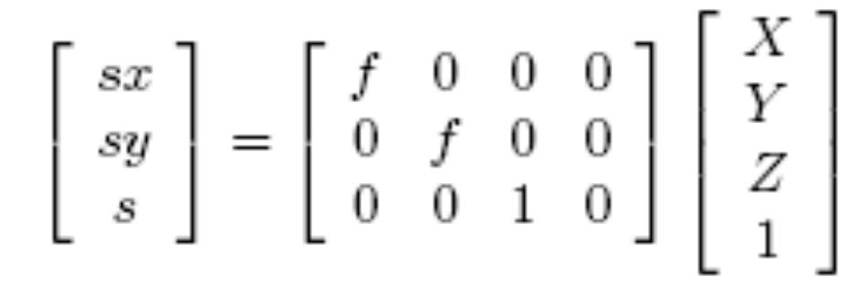

Now, the actual pixel coordinates (u, v) are defined with respect to an origin in the top left hand corner of the image plane, and will satisfy

Slide 11
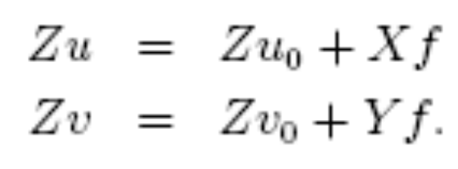

We can express the transformation from three dimensional world coordinates to image pixel coordinates using a 3 × 4 matrix (where the scaling factor s has value Z)
There are three camera parameters, namely the focal length f, the parameter u0 which is the u pixel coordinate at the principal point, and the parameter v0 which is the v pixel and the parameter v0 which is the v pixel.
The parameters f, u0 and v0 do not depend on the position and orientation of the camera in space, and are thus called the intrinsic parameters.

Slide 12

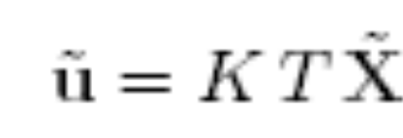
In general, the three dimensional world coordinates of a point will not be specified in a frame whose origin is at the centre of projection and whose Z axis lies along the optical axis. Some other, more convenient frame, will more likely be specified, and then we have to include a change of coordinates from this other frame to the standard coordinate system.
Thus we have
The top 3 × 3 corner is a rotation matrix R and encodes the camera orientation with respect to a given world frame; the final column is a homogeneous vector t capturing the camera displacement from the world frame origin. The matrix T has six degrees of freedom, three for the orientation, and three for the translation of the camera.
These parameters are known as the extrinsic camera parameters.

Slide 13
The 3 × 4 camera matrix K and the 4 × 4 homogeneous transform T combine to form a single 3 × 4 matrix C, called the camera calibration matrix.

Slide 14
Some old-fashioned CCD cameras have non-square pixels.
These types of cameras are said to have aspect ratio other than 1 and would give rise to different scalings in the u and v-axes (e.g., a sphere would appear as an ellipse in the image).
  For these types of cameras, two terms, fu and fv, would be required to describe the effective focal length.
  The term fu is the effective focal length in the u pixel units and
  fv is the effective focal length in the v pixel units.
As all modern cameras have unit aspect ratio, we can safely assume fu = fv = f.

Slide 15
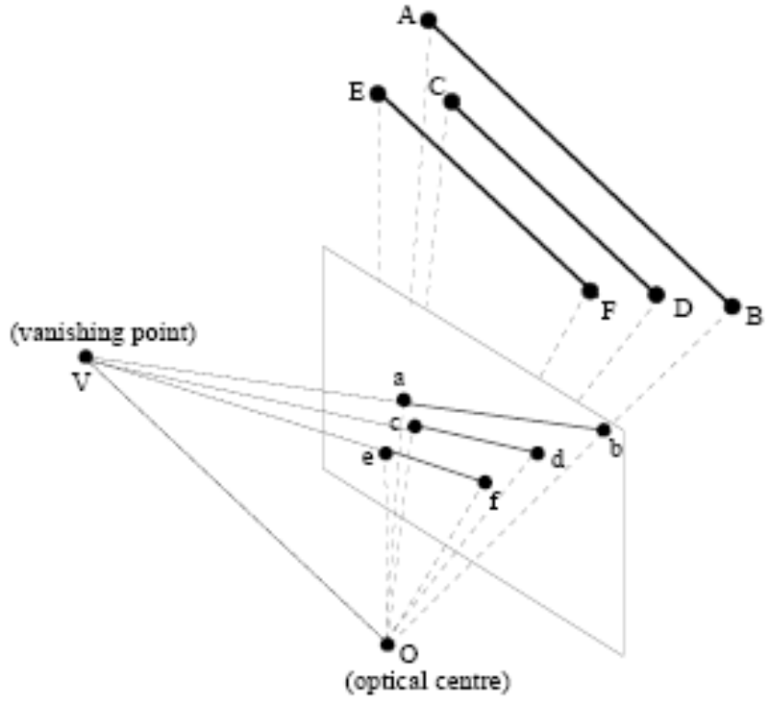

Vanishing Points
Parallel lines in the scene meet at a vanishing point in the image plane.
  Note that the vanishing point can be (and is often) outside the image boundary.
Geometrically, the vanishing point is the intersection point of the image plane with one of these parallel lines that passes through the optical centre of the camera.
For instance, the line OV , which has the same direction as lines AB, CD, and EF and which contains the optical centre O, intersects the image plane at the vanishing point V .

Slide 16
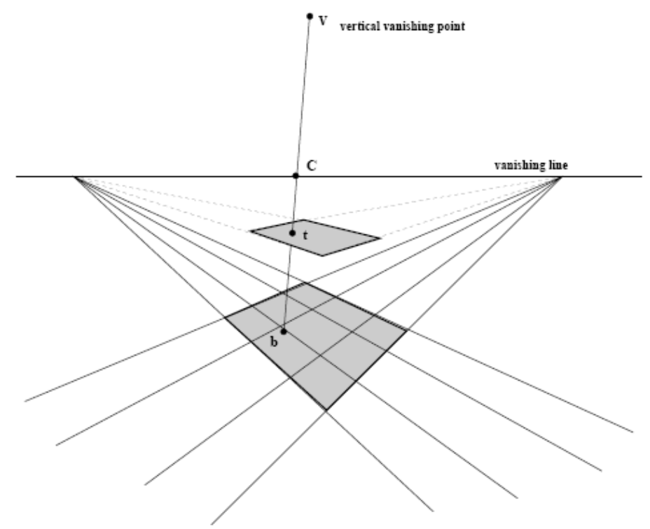
The Horizon
The horizon is the vanishing line for the ground plane
Note that the horizon is a property of the camera

Slide 17
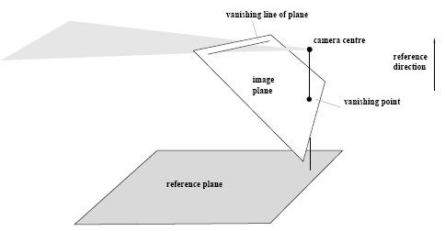
The horizon is defined either as the line joining two vanishing points defined from the reference plane, or
as the intersection of a plane through the projection centre and parallel to the reference plane.
A vertical vanishing point is defined as the intersection of the image plane with a line through the projection centre and perpendicular to the reference plane.

Slide 18
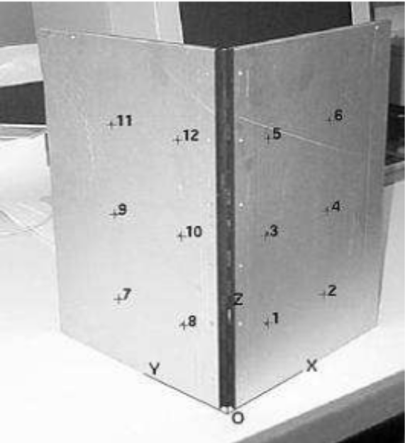
The camera calibration matrix gives you the location of the vanishing point. It maps 3D coordinates in the world to 2D coordinates in the image

Slide 19
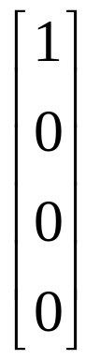
vanishing point of the X axis is the location in the image where a point at infinity on the X axis will appear in the image.
What are the coordinates of a point at infinity on the X axis? Homogeneous coordinates allow us to represent, and do calculations with, points at infinity.
A point at infinity on the X axis is represented by

Slide 20
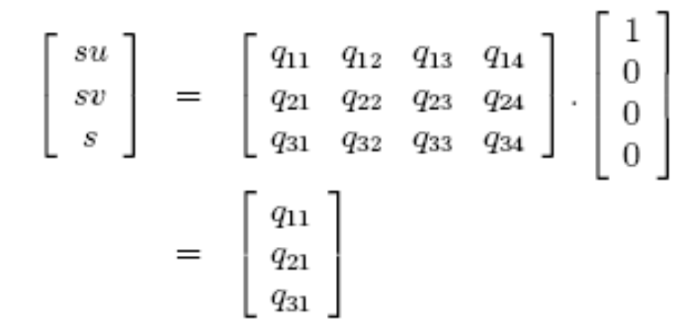
Where will this appear in the image?
Thus, we see that the first, second, and third columns provide the homogeneous image coordinates of the X, Y and Z vanishing points respectively.
The fourth column tells you where the origin is.

