Slide 1
Matlab

Slide 2
Pros and Cons of Matlab
Contains a large collections of mathematical functions and algorithms
Optimized to be relatively quick when performing matrix operations
Interpreted language: can be used interactively, errors are easier to fix
Interpreted language: making it for the most part slower than a compiled language such as C++)
NOT a general purpose programming language (designed for scientific computation and is not suitable for some things such as e.g. parsing text)

Slide 3
Help and basics
The symbol "%" is used in front of a comment.
The current directory is displayed at the top-right corner of MATLAB window. To change the current directory, click the "..." button or use "cd" if you like
Use "dir" to see the list files in current directory
To get help type "help" (will give list of help topics) or "help topic"
If you don't know the exact name of the topic or command you are looking for, type "lookfor keyword" (e.g., "lookfor regression")

Slide 4
When writing a long matlab statement that exceeds a single row use ... to continue statement to next row.
When using the command line, a ";" at the end means matlab will not display the result. If ";" is omitted then matlab will display result.
  >>2+2
ans =
4
Use the up-arrow to recall commands without retyping them (and down arrow to go forward in commands).

Slide 5
.m files
.m files are just text files
Do work in .m file
Paste work into Matlab prompt
Save .m files

Slide 6
The Matlab Prompt
>> denotes where you type commands
Type or paste commands, then hit enter
If entering multiple commands, separate them by ;

Slide 7
Variables
Variables are scalars, vectors, and matrices
Capitalization matters, x not same as X
N = 5 % a scalar
v = [1 0 0] % a row vector
v = [1;2;3] % a column vector
v = v' % transpose a vector
(row to column or column to row)
v = [1:.5:3] % a vector in a specified range:
v = pi*[-4:4]/4 % [start:stepsize:end]
v = [] % empty vector

Slide 8
m = [1 2 3; 4 5 6] % a matrix: 1ST parameter is ROWS
% 2ND parameter is COLS
m = zeros(2,3) % a matrix of zeros
v = ones(1,3) % a matrix of ones
m = eye(3) % identity matrix
v = rand(3,1) % rand matrix (see also randn)
save matrix_data m % save the variable m to a file named matrix_data.mat
clear all % clear all variables currently used by MATLAB
load matrix_data % read data from the saved file
m % display it - it is still there!

Slide 9
v = [1 2 3]; % access a vector element
length(v) % length of a vector
v(3) % vector(number)
m = [1 2 3; 4 5 6]
m(1,3) % access a matrix element
% matrix(rownumber, columnnumber)
m(2,:) % access a matrix row (2nd row)
m(:,1) % access a matrix column (1st row)
size(m) % size of a matrix
size(m,1) % number rows
size(m,2) % number of columns
m1 = zeros(size(m)) % create a new matrix with size of m
who % list of variables
whos % list/size/type of variables

Slide 10
%define a variable x, with value 1
x=1;
%define a variable y, with value 5
y=5;
%define a 1x5 vector V1
V1=[1.1 .99 1.07 .87 .95];
%define a 1x5 vector V2
V2=[.9 1.03 1.03 1.05 .99];
%define a 3x5 matrix M1
M1=[1.01 1.01 1.03 .99 .93
.99 .98 .97 .96 .95
1.21 .77 .89 1.13 1.05];
%Define a 3x5 matrix M2, which uses V1 and V2 as pieces.
M2=[V1; V2; V1];
%Define a 3x5 matrix M3 with all of its entries being zero
M3=zeros(3,5);
%Define a 3x5 matrix M4 with all of its entries being ones
M4=ones(3,5);
%Define a variable z, whose value is the 3rd row, 2nd column of M1
z=M1(3,2);

Slide 11
Basic Operations
Always use brackets [ ] to define matrices
Always use prentices ( ) to call values of matrices
The row is always first, the column is always second, i.e. M1(3,2) is not the same as M1(2,3)
Indices in Matlab are 1-based (not 0-based as in C).
To see which variables exist, use >>whos
To delete variables, use >>clear x y
To find out size use >>size(M1)

Slide 12
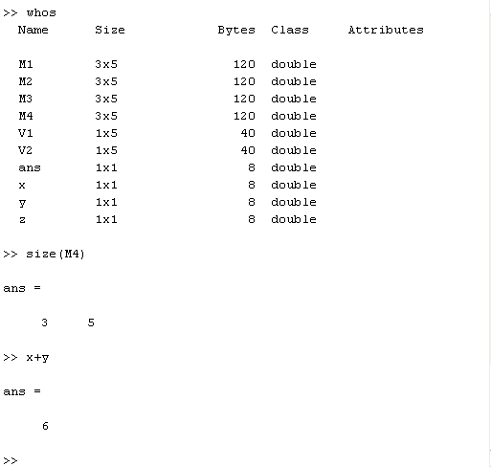

Slide 13
Elementary Algebra
Use +, -, *, / for basic operations
Use ./ and .* for element by element operations on matrices and vectors
Use / and * for matrix multiplication
Use ‘ to transpose a matrix
You can always multiply a matrix by a scalar
You can always overwrite old variables

Slide 14
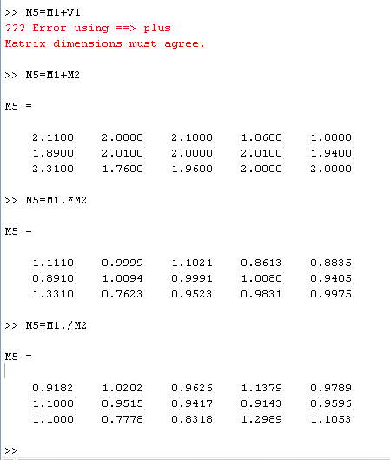

Slide 15
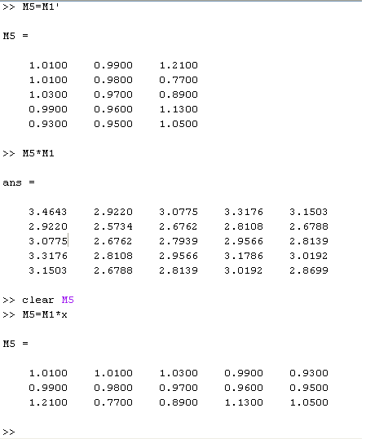

Slide 16
a = [1 2 3 4]; % vector
2 * a % scalar multiplication
a / 4 % scalar division
b = [5 6 7 8]; % vector
a + b % vector addition
a - b % vector subtraction
a .^ 2 % vector squaring (note .)
a .* b % vector multiply (note .)
a ./ b % vector divisiony (note .)
log( [1 2 3 4] ) % arithmetic operation
round( [1.5 2; 2.2 3.1] ) % arithmetic operation

Slide 17
It is convenient to solve matrices equation using Matlab:
To solve the following equations:
  x + 2y = 5
  2x + 6y = 14
  >> a=[1 2; 2 6]
  a = 1 2
  2 6
  >> b=[5; 14]
  b = 5
  14
  >> x=a\b x = 1.0000 2.0000
  Note: (1) A/B = A*INV(B)
  (2) a\b=inv(a)*b

Slide 18
Ranges of numbers
Colon specifies range of numbers
>>V3=[1:5] sets V3 to be the numbers 1 through 5
>>V3=[1:3:13]’ sets V3 to be the numbers 1 through 13, skipping every 3rd, note, it is transposed
>>M5=M1(1:2,1:5) sets M5 to be all the numbers in rows 1-2 and columns 1-5 of M1
>>V3=M1(:,2) sets V3 to be the whole second column of M1

Slide 19
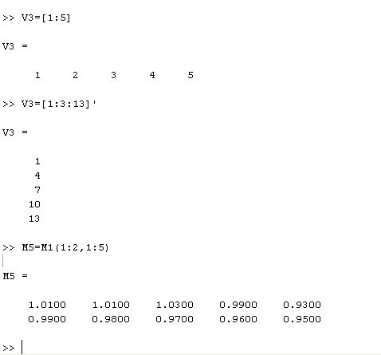

Slide 20
% First, let's create a simple vector with 9 elements called 'a'.
>>a = [1 2 3 4 6 4 3 4 5]
% Now let's add 2 to each element of our vector, 'a', and store the result in a new vector.
>>b = a + 2
% Creating graphs in MATLAB is as easy as one command. Let's plot the result of our vector addition with grid lines.
>>plot(b)
>>grid on

Slide 21
MATLAB can make other graph types as well, with axis labels.
>>bar(b)
>>xlabel('Sample #')
>>ylabel('Pounds')
MATLAB can use symbols in plots as well. Here is an example using *'s to mark the points. MATLAB offers a variety of other symbols and line types.
>>plot(b,'*')
>>axis([0 10 0 10])

Slide 22
Creating a matrix is as easy as making a vector, using semicolons (;) to separate the rows of a matrix.
>>A = [1 2 0; 2 5 -1; 4 10 -1]
We can easily find the transpose of the matrix A.
>>B = A‘
Now let's multiply these two matrices together.
>>C = A * B
Instead of doing a matrix multiply, we can multiply the corresponding elements of two matrices or vectors using the .* operator.
>>C = A .* B

Slide 23
Let's find the inverse of a matrix ...
>>X = inv(A)
... and then illustrate the fact that a matrix times its inverse is the identity matrix.
>>I = inv(A) * A
At any time, we can get a listing of the variables we have stored in memory using the "who" or "whos" command.
>>whos

Slide 24
You can get the value of a particular variable by typing its name.
>>A
You can have more than one statement on a single line by separating each statement with commas or semicolons.
If you don't assign a variable to store the result of an operation, the result is stored in a temporary variable called "ans".
>>sqrt(-1), log(0)
As you can see, MATLAB easily deals with complex and infinite numbers in calculations.

Slide 25
Logic
1 means True, 0 means False
== is used for logic, = to assign values
>>1==1
ans = 1
>>1==2
ans = 0
>>x=5; %assigns value 5 to x
>>x==5; %checks if x is equal to 5, returns either 1 or 0
>>x=(x==5); %checks if x is equal to 5, then assigns True (1) or False (0) to x

Slide 26
Logical Operators
== % equal to
~= % not equal to
> % greater than
>= % greater than or equal to
< % less than
<= % less than or equal to
& % and
| % or

Slide 27
Examples
>>A=[zeros(3,1); ones(3,1); 2*ones(3,1); 3*ones(3,1)];
>>in1=(A>0);
>>A(A>0); % is same as A(in1)
>>in2=(A<1 | A>2);
>>in3=(A>1 & A<3);
>>in4=(A~=2);

Slide 28
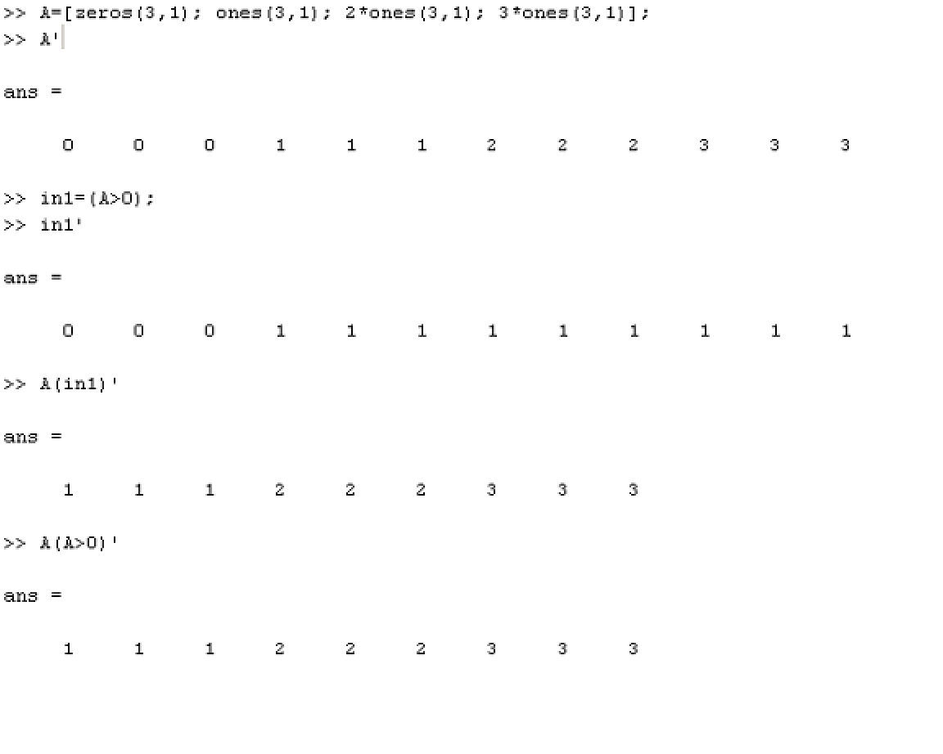

Slide 29
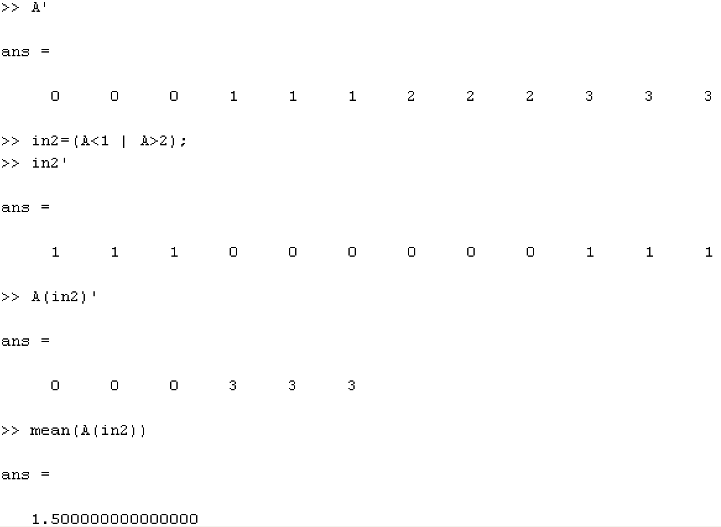

Slide 30
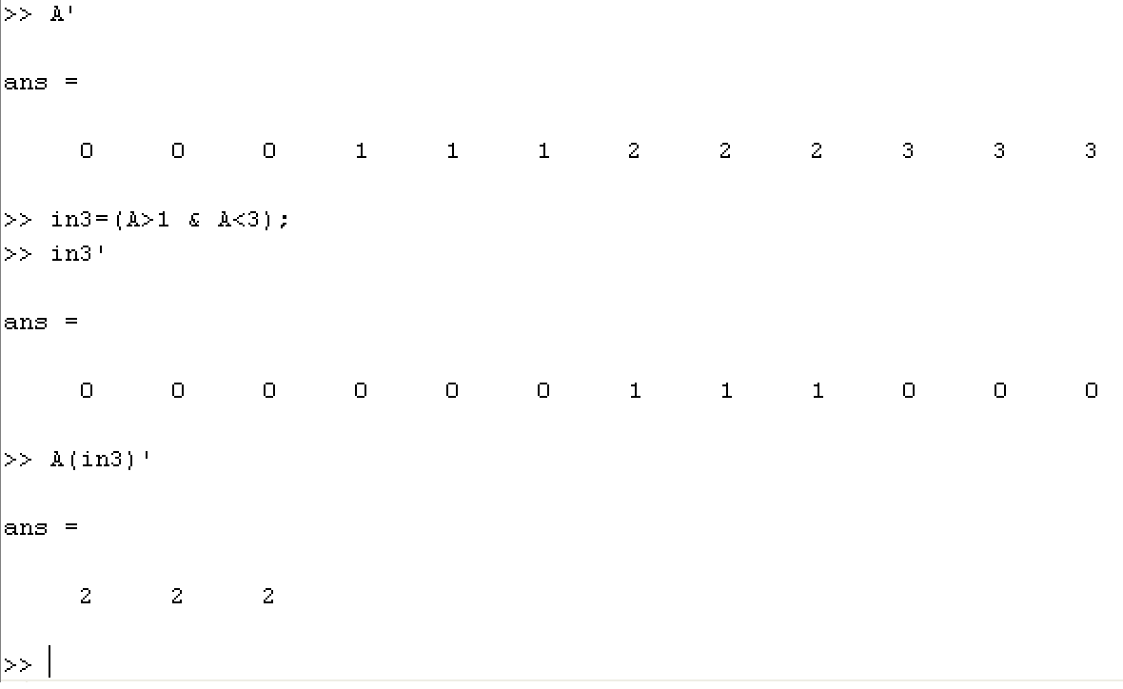

Slide 31
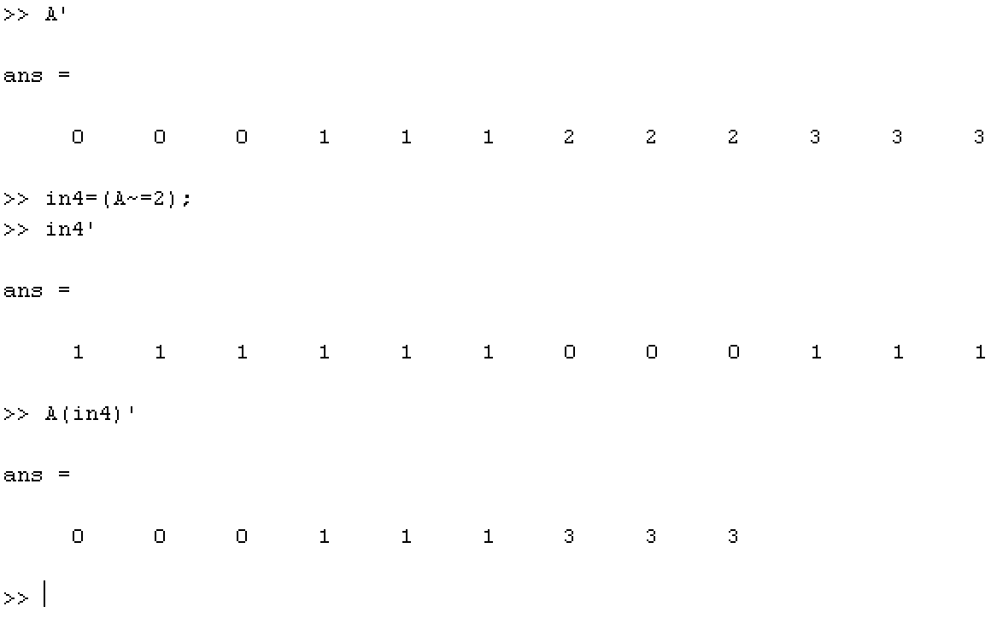

Slide 32
Writing Data
Matlab can write any variable to a text file
>>dlmwrite(‘filename.txt’, X, ’ ’);
DLMWRITE Write ASCII delimited file.
DLMWRITE(FILENAME,M,DLM) writes matrix M into FILENAME using the character DLM as the delimiter. Specify '\t' to produce tab-delimited files.
DLMWRITE(FILENAME, M, DLM, R, C) writes matrix M starting at offset row R, and column C in the file. R and C are zero-based, that is R=C=0 specifies first number in the file.

Slide 33
Functions
All function names are lower case
For vectors, MIN(X) is the smallest element in X.
For matrices, MIN(X) is a row vector containing the minimum element from each column.
  [Y,I] = MIN(X) returns the indices of the minimum values in vector I.
  MIN(X,Y) returns an array the same size as X and Y with the smallest elements taken from X or Y.
See max, mean, std, var, sum, abs, exp, sqrt, round, …etc

Slide 34
a = [1 4 6 3] % vector
sum(a) % sum of vector elements
mean(a) % mean of vector elements
var(a) % variance (sigma^{2})
std(a) % standard deviation (sigma)
max(a) % maximum

Slide 35
a = [1 2 3; 4 5 6] % matrix
mean(a) % mean of each column
max(a) % max of each column
max(max(a)) % to obtain max of matrix
max(a(:)) % another way to obtain max of matrix

Slide 36
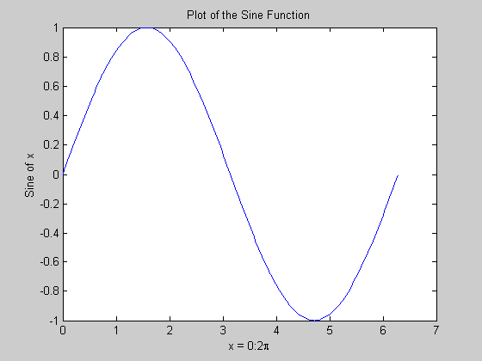
Plots
x = 0:pi/100:2*pi;
y = sin(x);
plot(x,y)
xlabel('x = 0:2\pi')
ylabel('Sine of x')
title('Plot of the Sine Function')

Slide 37
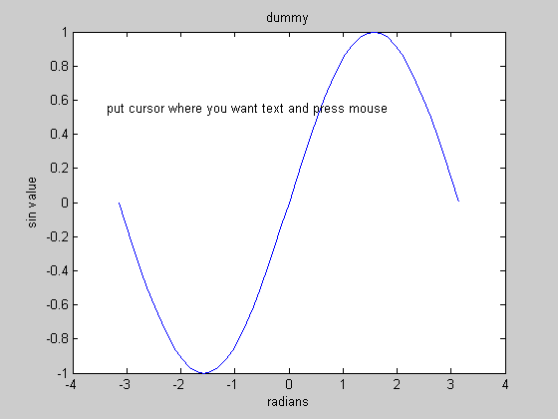
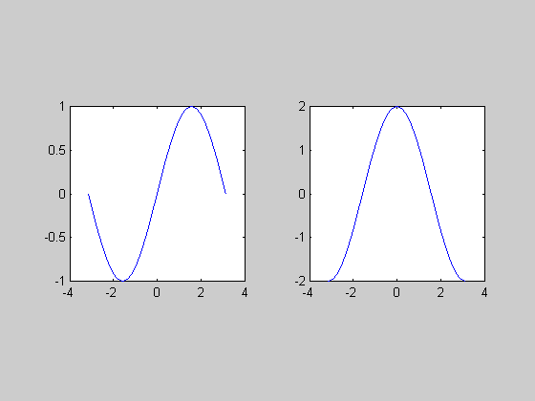
x = pi*[-24:24]/24;
plot( x, sin(x) );
xlabel( 'radians' );
ylabel( 'sin value' );
title( 'dummy' );
gtext( 'put cursor where you want text and press mouse' );
figure % multiple functions in separate graphs
% figure command creates a new figure window
subplot( 1,2,1 ); % creates 1x2 subgraphs, window 1 as current graph
plot( x, sin(x) );
axis square; %makes the current axis box square in size.
subplot( 1,2,2 );
plot( x, 2.*cos(x) );
axis square;

Slide 38
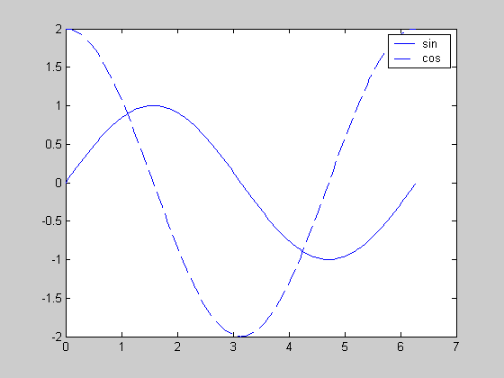
plot( x,sin(x) );
hold on;
plot (x, 2.*cos(x), '--' );
legend( 'sin', 'cos' );
hold off;

Slide 39
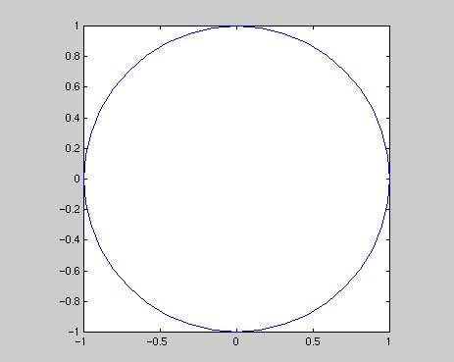
Draw a circle
>> t=0:pi/20:2*pi;
>> plot(sin(t), cos(t))
>> axis square

Slide 40
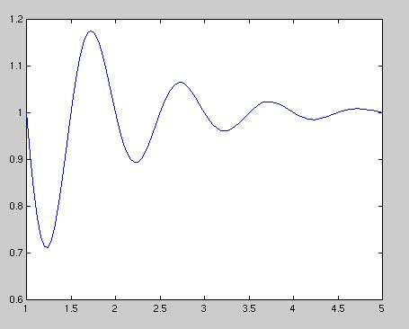
>> x=linspace(1,5);
>> y=1-exp(-x).*sin(2*pi*x);
>> plot(x,y)
%LINSPACE(X1, X2) generates a row vector of 100 linearly equally spaced points between X1 and X2.

Slide 41
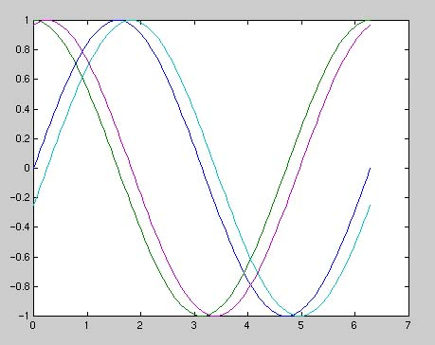
Draw many functions together
>> t=0:pi/50:2*pi;
>> y1=sin(t);
>> y2=cos(t);
>> y3=sin(t-0.25);
>> y4=cos(t-0.25);
>> plot(t,y1,t,y2,t,y3,t,y4)

Slide 42
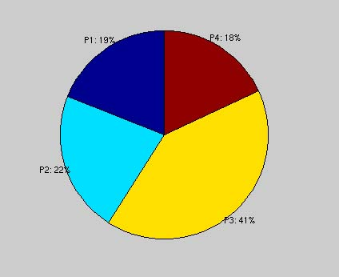
**Presentation Assignment (Explain)
Draw a chart (First Assig!!!)
>> x=[.19 .22 .41 .18];
>> pie(x)
>> explode = zeros(size(x));
>> h = pie(x, explode);
>> textObjs = findobj(h, 'Type', 'text');
>> oldStr = get(textObjs, {'String'});
>> val = get(textObjs, {'Extent'});
>> oldExt = cat(1, val{:});
>> Names = {'P1: '; 'P2: '; 'P3: '; 'P4: '};
>> newStr = strcat(Names, oldStr);
>> set (textObjs, {'String'}, newStr)

Slide 43
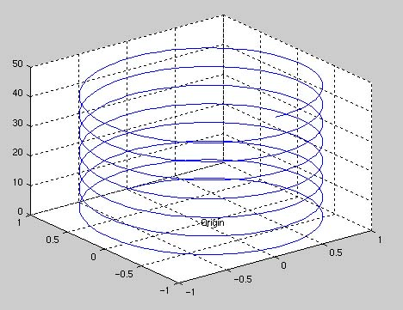
3D Graph
>> t=0:pi/50:15*pi;
>> plot3(sin(t), cos(t), t);
>> text(0,0,0, 'Origin');
>> grid;

Slide 44
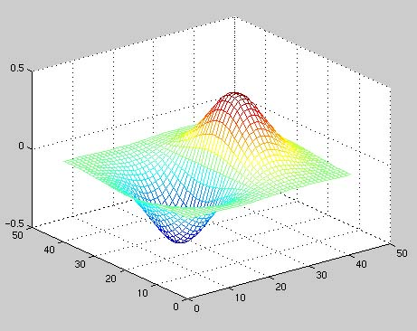
>> [x,y] = meshgrid(-2:.1:2, -2:.1:2);
>> z = x .* exp(-x.^2 - y.^2);
>> mesh(z)

Slide 45
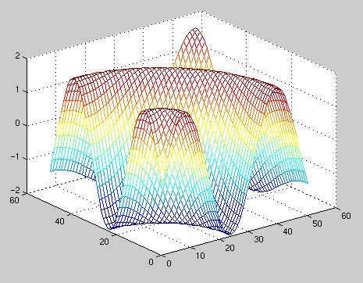
>> g = 0:0.2:10;
>> [x,y] = meshgrid(g);
>> z = 2*sin(sqrt(x.^2 + y.^2));
>> mesh(z);

Slide 46
if statements
if A(1)==0
x=5; y=x;
end
if (logical statement)
(command to be executed);
end

Slide 47
if-else statements
if A(3)==A(4)
x=A(5); y=A(4);
elseif A(3)==0
x=5; y=0;
elseif A(3)==1
x=4; y=5;
else
x=3; y=8;
end
Just like if statement but adds elseif and else

Slide 48
for statements and loops
T=100; s=0; x=0;
for i=1:T
s=s+i;
x=x+i*i;
end
This loop calculates a sum and a sum of squares
Make sure variables are initialized

Slide 49
while
i=0;
while i<10
i=i+1;
disp(i);
end

Slide 50
Alternatives to Loops
Loops are slow, matrix operations are fast
Avoid using loops if you can!
x=0;
for i=1:5
x=x+i*i;
end
A=[1:5]; x=sum(A.*A);

Slide 51
% Example: given a vector v, create a new vector with values equal to v if they are greater than 0, and equal to 0 if they less than or equal to 0.
1: Using FOR LOOPS
  v = [3 5 -2 5 -1 0]
  u = zeros( size(v) ); % initialize
  for i = 1:size(v,2)
  if( v(i) > 0 )
  u(i) = v(i);
  end
  end
2: NO FOR LOOPS
  v = [3 5 -2 5 -1 0]
  u2 = zeros( size(v) ); % initialize
  ind = find( v>0 ) % index into >0 elements
  u2(ind)= v( ind )

Slide 52
Functions
For example, the existence of a file on disk called STAT.M with:
function [mean,stdev] = stat(x)
n = length(x);
mean = sum(x) / n;
stdev = sqrt(sum((x - mean).^2)/n);
Functions do not change the values of the arguments that are passed to them.

Slide 53
A subfunction that is visible to the other functions in the same file is created by defining a new function with the FUNCTION keyword after the body of the preceding function or subfunction.
For example, avg is a subfunction within the file STAT.M:
function [mean,stdev] = stat(x)
%STAT Interesting statistics.
n = length(x);
mean = avg(x,n);
stdev = sqrt(sum((x-avg(x,n)).^2)/n);
%-------------------------
function mean = avg(x,n)
%MEAN subfunction
mean = sum(x)/n;
Subfunctions are not visible outside the file where they are defined.
Normally functions return when the end of the function is reached. A RETURN statement can be used to force an early return.

Slide 54
function can have multiple inputs and outputs
Example 1: a function that packs two matrices A,B into a larger matrice C=[A,B;B,A]
function C=matrice_packing(A,B)
C=[A,B;B,A];
Example 2: calculate both mean and variance of a vector
function [m,v]=mean_and_var(x)
m=mean(x);
v=var(x);

Slide 55
Histograms: hist()
>>X=[2*ones(3,1); 3*ones(5,1); 7*ones(4,1)];
>>subplot(2,1,1);
>>hist(X); %draws histogram of X
>>subplot(2,1,2);
>>hist(X,[0:.25:10]); %draws histogram of X on the interval [0 10] with bins of size .25
>>hist(X,[0:10]); %draws histogram of X on the interval [0 10] with bins of size 1
Default is a histogram with 10 bins, from min(X) to max(X)
hist(X,n) will keep default min and max but make n bins

Slide 56
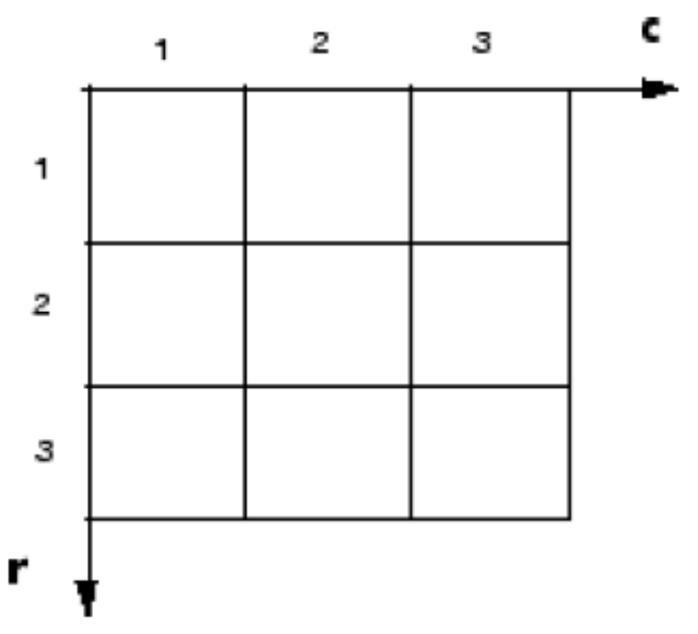
The Pixel Coordinate System

Slide 57
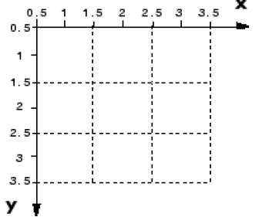
The Spatial Coordinate System
At times, however, it is useful to think of a pixel as a square patch. From this perspective, a location such as (5.3,2.2) is meaningful, and is distinct from (5,2).
In this spatial coordinate system, locations in an image are positions on a plane, and they are described in terms of x and y (not r and c as in the pixel coordinate system).

Slide 58
Using a Non-Default Spatial Coordinate System
For example, you could specify that the upper left corner of an image is the point (19.0,7.5), rather than (0.5,0.5).
For example, if A is a 100 row by 200 column image, the default XData is [1 200], and the default YData is [1 100].
so the actual coordinate range spanned is slightly larger; for instance, if XData is [1 200], the x-axis range spanned by the image is [0.5 200.5].

Slide 59
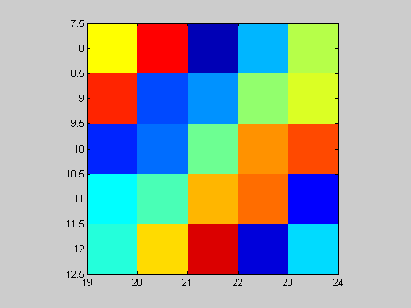
These commands display an image using nondefault XData and YData.
  A = magic(5);
  x = [19.5 23.5];
  y = [8.0 12.0];
  image(A,'XData',x,'YData',y)
  axis image
  colormap(jet(25))

Slide 60
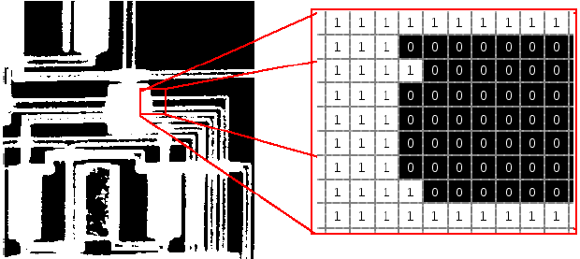
Binary Images

Slide 61
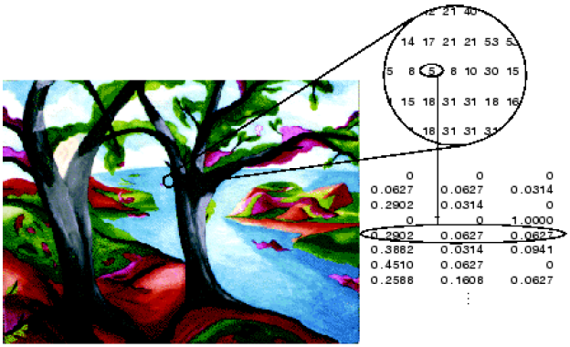
Indexed Images
The colormap matrix is an m-by-3 array of class double containing floating-point values in the range [0,1].
  Each row of map specifies the red, green, and blue components of a single color.

Slide 62
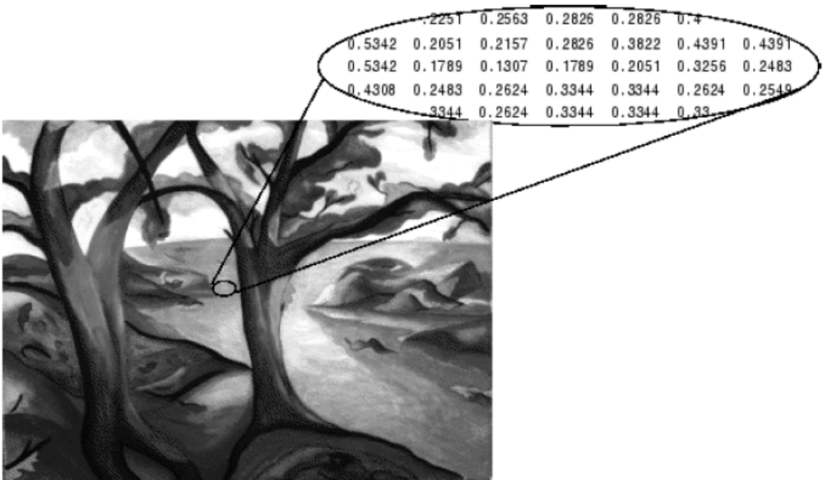
Grayscale Images
For a matrix of class single or double, using the default grayscale colormap, the intensity 0 represents black and the intensity 1 represents white.

Slide 63
Truecolor Images (RGB)
A truecolor image is an image in which each pixel is specified by three values
  one each for the red, blue, and green components of the pixel’s color.
In a truecolor array of class single or double, each color component is a value between 0 and 1. A pixel whose color components are (0,0,0) is displayed as black, and a pixel whose color components are (1,1,1) is displayed as white.
For example, the red, green, and blue color components of the pixel (10,5) are stored in RGB(10,5,1), RGB(10,5,2), and RGB(10,5,3), respectively.
For example, the red, green, and blue color components of the pixel (10,5) are stored in RGB(10,5,1), RGB(10,5,2), and
RGB(10,5,3), respectively.

Slide 64
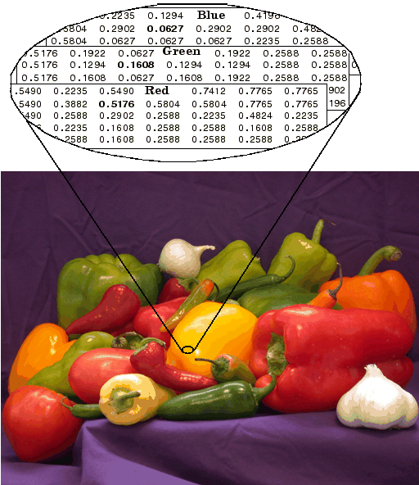

Slide 65
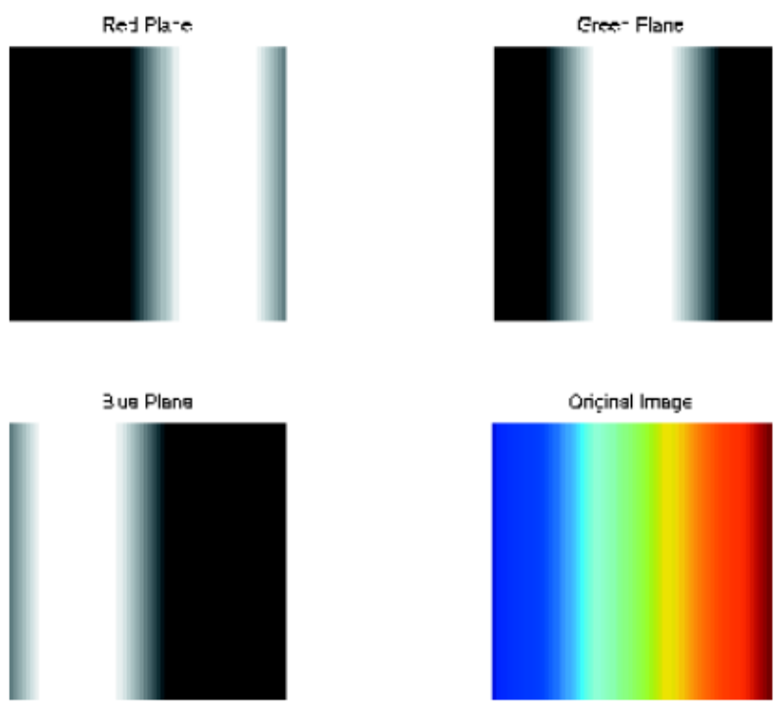
RGB=reshape(ones(64,1)*reshape(jet(64),1,192),[64,64,3]);
R=RGB(:,:,1);
G=RGB(:,:,2);
B=RGB(:,:,3);
imshow(R)
figure, imshow(G)
figure, imshow(B)
figure, imshow(RGB)

Slide 66
**Presentation Assignment
Use Examples!
jet
gray
hsv
colormap
reshape
squeeze
shiftdim
cat

Slide 67
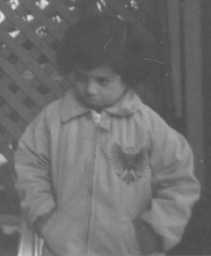
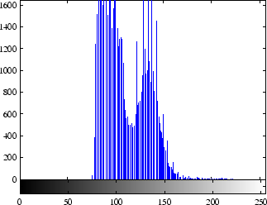
Read and Display an Image
  I = imread('pout.tif');
  imshow(I);
Check How the Image Appears in the Workspace
  Whos
Improve Image Contrast
  figure, imhist(I)
    Notice how the intensity range is rather narrow. It does not cover the potential range of [0, 255].

Slide 68
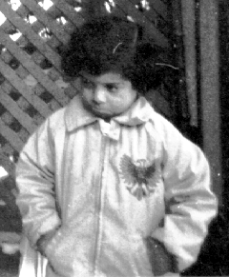
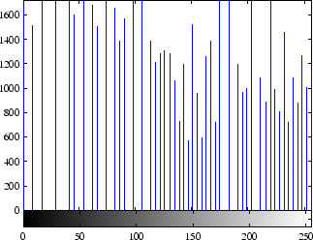
histeq function to spread the intensity values over the full range of the image, a process called histogram equalization.
    I2 = histeq(I); figure, imshow(I2)
    figure, imhist(I2)
Write the Image to a Disk File
  imwrite (I2, 'pout2.png');
Check the Contents of the Newly Written File
  imfinfo('pout2.png')
    ans = Filename: 'pout2.png'
    FileModDate: '29-Dec-2005 09:34:39'
    FileSize: 36938
    Format: 'png'
    FormatVersion: []
    Width: 240
    Height: 291
    BitDepth: 8
    ColorType: 'grayscale'
    FormatSignature: [137 80 78 71 13 10 26 10]
    Colormap: []
    Histogram: []
    …….

Slide 69
[X,map] = imread('trees.tif');
isbw - Return true for binary image.
isgray - Return true for intensity image.
isind - Return true for indexed image.
isrgb - Return true for RGB image.
imwrite(X,map,'clown.bmp')
When using imwrite with some graphics formats, you can specify additional format-specific parameters:
  imwrite(I,'clown.png','BitDepth',4);
  imwrite(A, 'myfile.jpg', 'Quality', 100);
To verify the bit depth of test.tif, call imfinfo and check the BitDepth field.
  info = imfinfo('test.tif');
  info.BitDepth
  ans =1

Slide 70
m = rand(64,64);
imagesc(m)
  %display an image
  %IMAGESC(...) is the same as IMAGE(...)
  %except the data is scaled to use the full colormap.
colormap gray;
axis image
%sets the aspect ratio so that equal tick mark increments %on the x-,y- and z-axis are equal in size.
%This makes SPHERE(25) look like a sphere, instead of %an ellipsoid.
axis off;

Slide 71
n = zeros(64); % generate a square image
n(17:48,17:48)=1;
imshow(n,[ ]);
IMSHOW(I,[LOW HIGH]) displays I as a grayscale intensity image, specifying the data range for I.
  The value LOW (and any value less than LOW) displays as black,
  the HIGH (and any value greater than HIGH) displays as white, and values in between display as intermediate shades of gray.
  IMSHOW uses the default number of gray levels. If you use an empty matrix ([]) for [LOW HIGH], IMSHOW uses [min(I(:)) max(I(:))]; the minimum value in I displays as black, and the maximum value displays as white.

Slide 72
**Presentation Assignment
image();
imagesc();
imshow();
Imread
Isbw
Isgray
Isind
isrgb

Slide 73
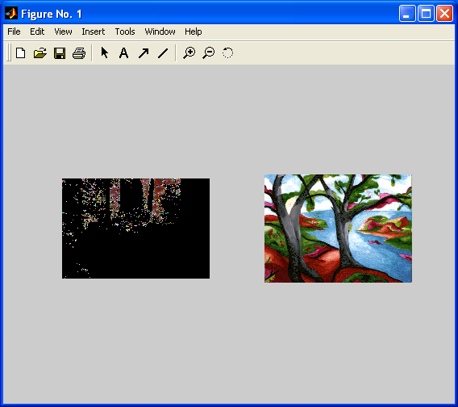
[X1,map1]=imread('forest.tif');
[X2,map2]=imread('trees.tif');
subplot(1,2,1), imshow(X1,map1)
subplot(1,2,2), imshow(X2,map2)
In the figure, note how the first image displayed, X1, appears dark after the second image is displayed.

Slide 74
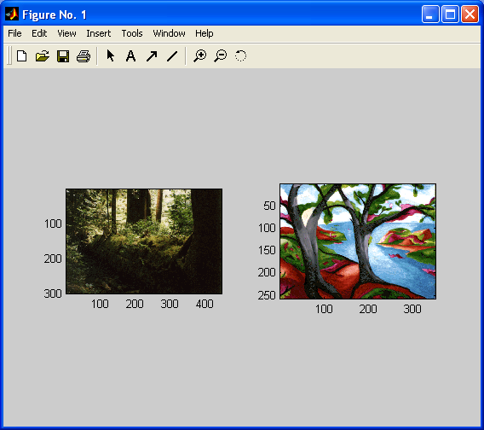
[X1,map1]=imread('forest.tif');
[X2,map2]=imread('trees.tif');
subplot(1,2,1), subimage(X1,map1)
subplot(1,2,2), subimage(X2,map2)
You can use SUBIMAGE in conjunction with SUBPLOT to create figures with multiple images, even if the images have different colormaps.
  SUBIMAGE works by converting images to truecolor for display purposes, thus avoiding colormap conflicts.

Slide 75
Image Class Conversions
RGB2 = im2uint8(RGB1);
  this command converts a double-precision RGB image with data in the range [0,1] to a uint8 RGB image with data in the range [0,255].

Slide 76
**Presentation Assignment
Use Examples!
gray2ind
grayslice
im2bw
ind2gray
ind2rgb
mat2gray
rgb2gray
Rgb2ind
rgb2ntsc
ntsc2rgb

Slide 77
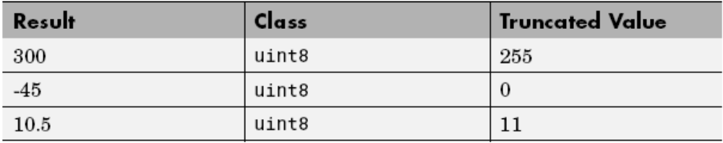
Image Arithmetic Functions
Arithmetic functions accept any numeric data type, including uint8, uint16, and double, and return the result image in the same format.

Slide 78
For example, to calculate the average of two images:
I = imread('rice.tif');
I2 = imread('cameraman.tif');
K = imdivide(imadd(I,I2), 2); % not recommended
When used with uint8 or uint16 data, each arithmetic function rounds and saturates its result before passing it on to the next operation. This can significantly reduce the precision of the calculation.
A better way to perform this calculation is to use the imlincomb function. imlincomb performs all the arithmetic operations in the linear combination in double precision and only rounds and saturates the final result.
IMLINCOMB Compute linear combination of images.
  Z = IMLINCOMB(K1,A1,K2,A2, ..., Kn,An) computes K1*A1 + K2*A2 + ... + Kn*An. A1, A2, ..., An are real, nonsparse, numeric arrays with the same class and size, and K1, K2, ..., Kn are real double scalars. Z has the same size and class as A1.

Slide 79
**Presentation Assignment
Use Examples!
imabsdiff - Compute absolute difference of two images.
imadd - Add two images, or add constant to image.
imcomplement - Complement image.
imdivide - Divide two images, or divide image by constant.
imlincomb - Compute linear combination of images.
immultiply - Multiply two images, or multiply image by constant.
imsubtract - Subtract two images, or subtract constant from image.
-------------------
I = imread(‘??');
IArray = repmat(I, [ 1 1 1 4 ]);
montage(IArray);

Slide 80
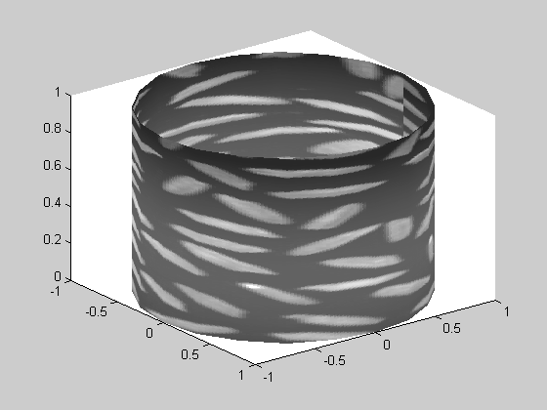
**Presentation Assignment
Use Examples!
text, gtext, input, ginput
colorbar
Iptgetpref
Iptsetpref
--------
figure('Renderer','zbuffer')
[x,y,z] = cylinder;
I = imread('rice.png');
warp(x,y,z,I);

Slide 81
**Presentation Assignment
Alpha Blending Streamed Image Pairs
  This demo captures streaming images from an image acquisition device, performs on-line image processing on each frame and displays the processed frames.
Step 1: Capture A Background Image
Step 2: Process Logged Data

Slide 82
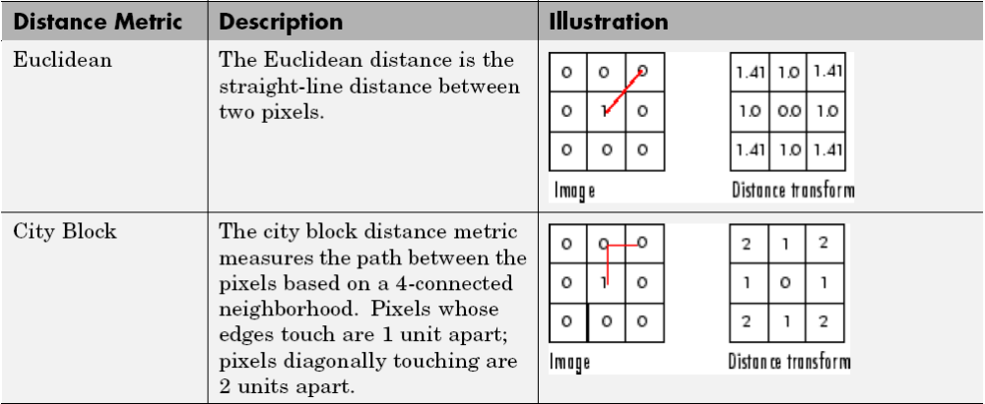
Distance Transform
The distance transform provides a metric or measure of the separation of points in the image.
The bwdist function calculates the distance between each pixel that is set to off (0) and the nearest nonzero pixel for binary images.

Slide 83
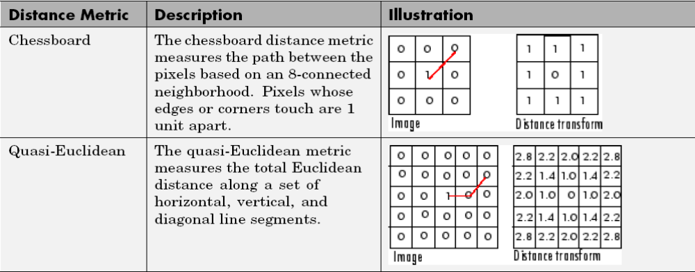

Slide 84
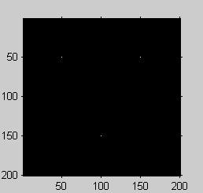
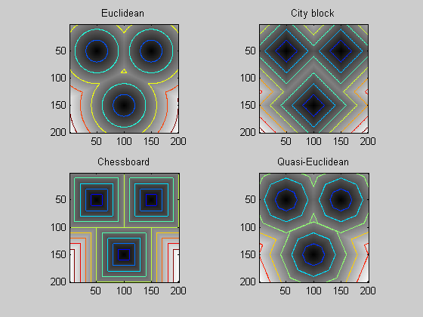
bw = zeros(200,200); bw(50,50) = 1; bw(50,150) = 1;
bw(150,100) = 1;
D1 = bwdist(bw,'euclidean');
D2 = bwdist(bw,'cityblock');
D3 = bwdist(bw,'chessboard');
D4 = bwdist(bw,'quasi-euclidean');
figure
subplot(2,2,1), subimage(mat2gray(D1)), title('Euclidean')
hold on, imcontour(D1)
subplot(2,2,2), subimage(mat2gray(D2)), title('City block')
hold on, imcontour(D2)
subplot(2,2,3), subimage(mat2gray(D3)), title('Chessboard')
hold on, imcontour(D3)
subplot(2,2,4), subimage(mat2gray(D4)), title('Quasi-Euclidean')
hold on, imcontour(D4)

Slide 85
**Presentation Assignment
Use Examples!
bwdist

