Slide 1
edge
Prepared By : Asmaa Ebrahim
Department : CS
Under Supervision of : Dr. Khaled Hussien

Slide 2
edge
Find edges in grayscale image.
edge takes an grayscale image I as its input, and returns a binary image BW of the same size as I, with 1's where the function finds edges in I and 0's elsewhere.

Slide 3
edge supports six different edge-finding methods:
Sobel Method.
Prewitt Method.
Roberts Method.
Laplacian of Gaussian Method.
Zero-Cross Method.
Canny Method

Slide 4
Syntax

Slide 5
1. Sobel Method
BW = edge(I,'sobel')
BW = edge(I,'sobel',thresh)
BW = edge(I,'sobel',thresh,direction)
[BW,thresh] = edge(I,'sobel',...)

Slide 6
BW = edge(I,'sobel') specifies the Sobel method.
BW = edge(I,'sobel',thresh) specifies the sensitivity threshold for the Sobel method.
BW = edge(I,'sobel',thresh,direction) specifies the direction of detection for the Sobel method.
BW = edge(I,'sobel',...,options) provides an optional string input.
[BW,thresh] = edge(I,'sobel',...) returns the threshold value.

Slide 7
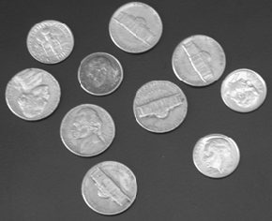
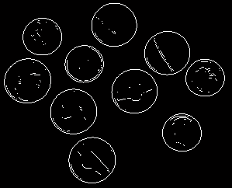
example
I= imread('coins.png');
figure, imshow(I)
BW = edge(I,'sobel');
figure, imshow(BW)
I
BW

Slide 8
2. Prewitt Method
BW = edge(I,'prewitt')
BW = edge(I,'prewitt',thresh)
BW = edge(I,'prewitt',thresh,direction)
[BW,thresh] = edge(I,'prewitt',...)

Slide 9
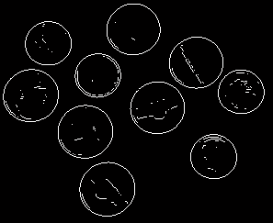
example
I= imread('coins.png');
figure, imshow(I)
BW = edge(I, ‘Prewitt');
figure, imshow(BW)
I
BW

Slide 10
3. Roberts Method
BW = edge(I,'roberts')
BW = edge(I,'roberts',thresh)
[BW,thresh] = edge(I,'roberts',...)

Slide 11

example
I= imread('coins.png');
figure, imshow(I)
BW = edge(I, 'roberts ');
figure, imshow(BW)
I
BW

Slide 12
4. Laplacian of Gaussian Method
BW = edge(I,'log')
BW = edge(I,'log',thresh)
BW = edge(I,'log',thresh,sigma)
[BW,threshold] = edge(I,'log',...)
BW = edge(I,'log',thresh,sigma) specifies the Laplacian of Gaussian method, using sigma as the standard deviation of the LoG filter.

Slide 13

example
I= imread('coins.png');
figure, imshow(I)
BW = edge(I, 'log ');
figure, imshow(BW)
I
BW

Slide 14
5. Zero-Cross Method
BW = edge(I,'zerocross',thresh,h)
[BW,thresh] = edge(I,'zerocross',...)

Slide 15
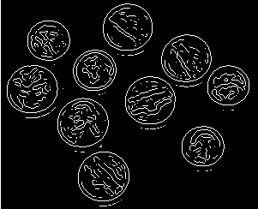
example
I= imread('coins.png');
figure, imshow(I)
BW = edge(I, 'zerocross ');
figure, imshow(BW)
I
BW

Slide 16
6. Canny Method
BW = edge(I,'canny')
BW = edge(I,'canny',thresh)
BW = edge(I,'canny',thresh,sigma)
[BW,threshold] = edge(I,'canny',...)

Slide 17
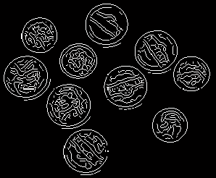
example
I= imread('coins.png');
figure, imshow(I)
BW = edge(I,'canny');
figure, imshow(BW)
I
BW

Slide 18
Reference:
MATLAB Help .

