Slide 1
Segmentation

Slide 2
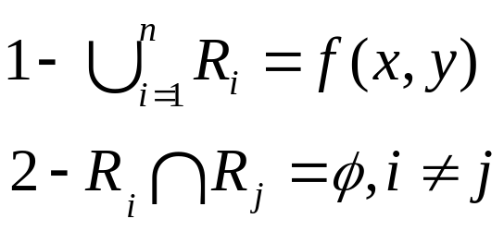
Definition of Segmentation
A segmentation of an image f(x, y) is a partition of f(x, y) into sub images R1, R2, …, Rn such that the following constraints are satisfied:
Each subimage satisfies a predicate or set of predicates Some examples are:
  All pixels in any subimage Ri must have the same grey level
  All pixels in any subimage Ri must not differ by more than X grey levels
  All pixels in any subimage Ri must not differ by more than X from the mean grey level of the region
  The standard deviation of gray levels in any subimage Ri must be small

Slide 3
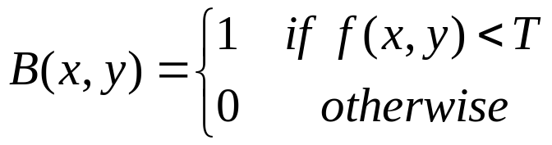
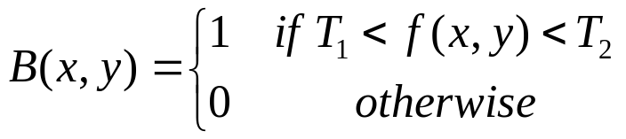
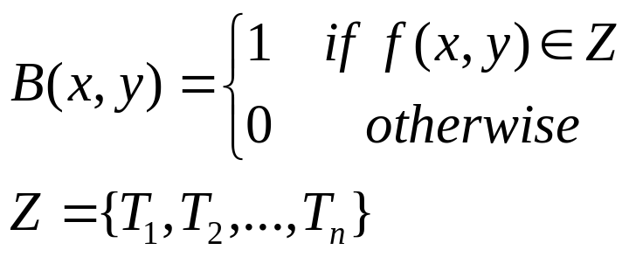
Simple Segmentation
In the simple cases where f(x, y) contains one object the grey level image can be converted into a corresponding binary image B(x, y).
In this binary image the object pixels will be 1’s and the background pixels will be 0’s. To determine a binary image we need to use some threshold(s) as follows:

Slide 4
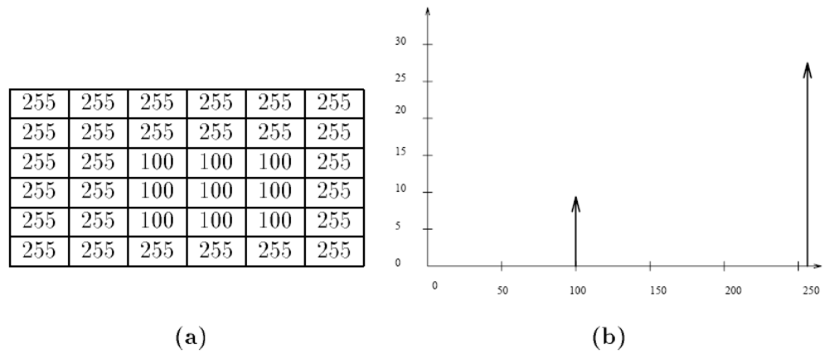
Thresholds and Histograms
(a) Simple synthetic image with one object
(b) Histogram of image shown in (a)

Slide 5
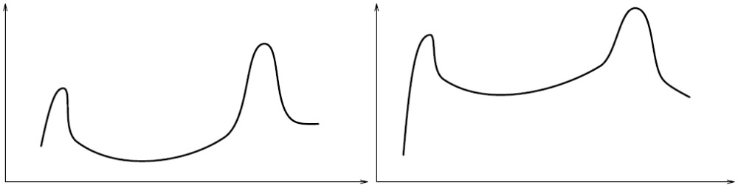
Real images rarely contain step edges The gray levels at the edges changes gradually from background to foreground This results in peaks and valleys in the histogram

Slide 6
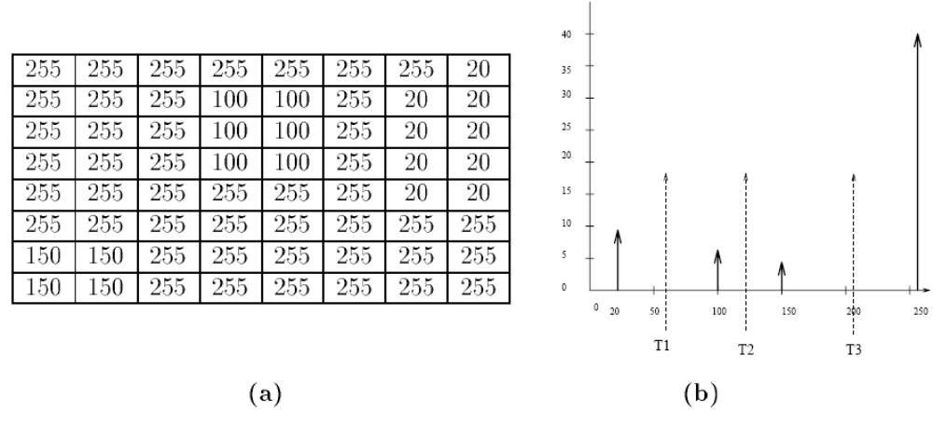
(a) Image consisting of three objects
(b) Histogram of image shown in (a)

Slide 7
Connected Component Algorithms
One important thing to note about the histogram is that it can only distinguish between classes of objects. It does not contain any spatial information
Therefore a half black and half white image chess board image with alternate black and white blocks of equal number and image of random black and white dots of equal distribution have the same histogram
A connected components labeling of a binary image B is a labeled image LB in which the value of each pixel is the label of its connected components

Slide 8
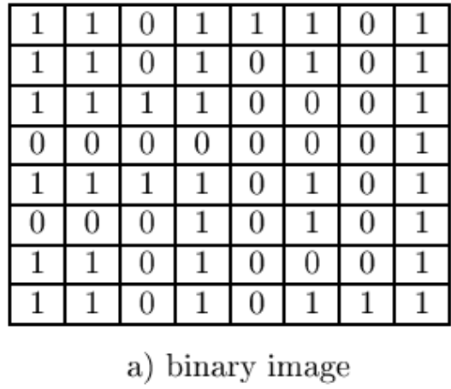
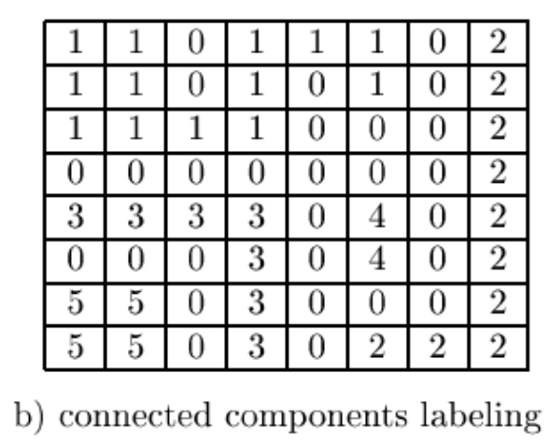
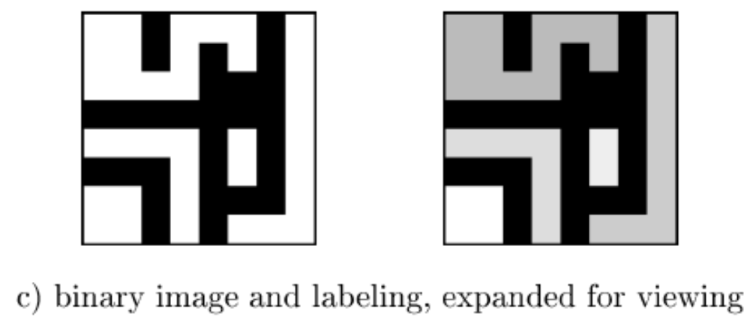
A binary image with five connected components of the value 1

Slide 9
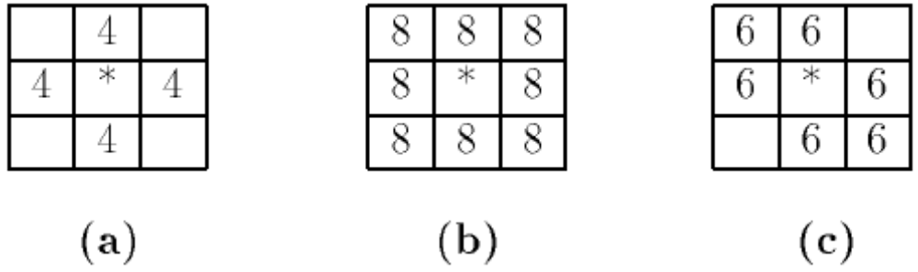
Pixel connectedness
(a) 4-connected
(b) 8-connected
(c) 6-connected

Slide 10
Recursive Connected Component Algorithm
Negate the binary image, so that all the 1-pixels become -1's.
Scan the binary image left to right top to bottom
If there is an unlabeled pixel with a value of ‘-1’ assign a new label to it
Recursively check the neighbors of the pixel in step 3 and assign the same label if they are unlabeled with a value of ‘1’
Stop when all the pixels of value ‘-1’ have been labeled
This algorithm when run on a small computer with a limited stack may easily run into stack overflow which would have to be taken care of by the programmer.
  For a 512x512 image with a quarter million pixels the recursive algorithm may have several thousand recursive calls

Slide 11
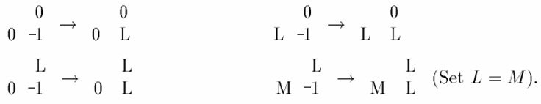
Sequential Connected Component Algorithm
negate the binary image, so that all the 1-pixels become -1's. We can accomplish this with a function that inputs the binary image B and outputs the negated image LB, which will become the labeled image.
Scan the binary image left to right top to bottom
If an unlabeled pixel has a value of ‘-1’ assign a new label to it according to the following rules
Determine equivalence classes of labels
In the second pass assign the same label to all elements in an equivalence class

Slide 12
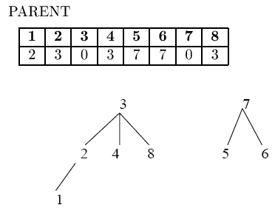
Union-Find Structure
The purpose of the union-find data structure is to store a collection of disjoint sets and to efficiently implement the operations of
  UNION (merging two sets into one) and
  FIND (determining which set a particular element is in).

Slide 13
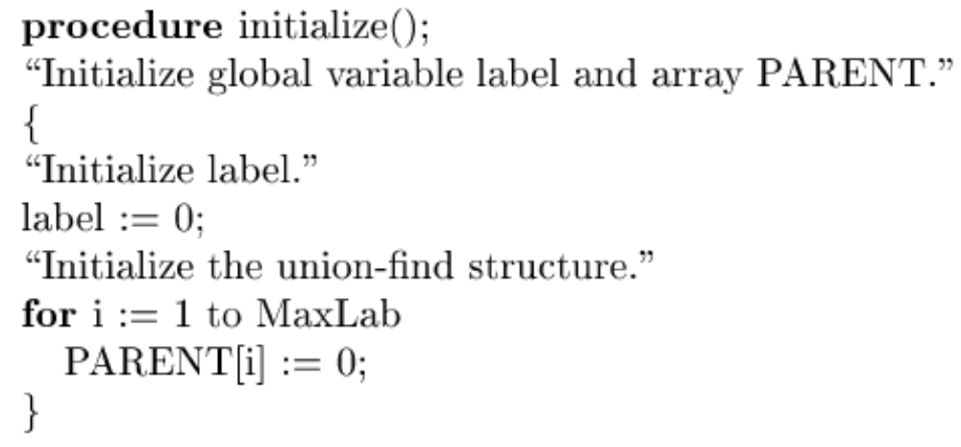
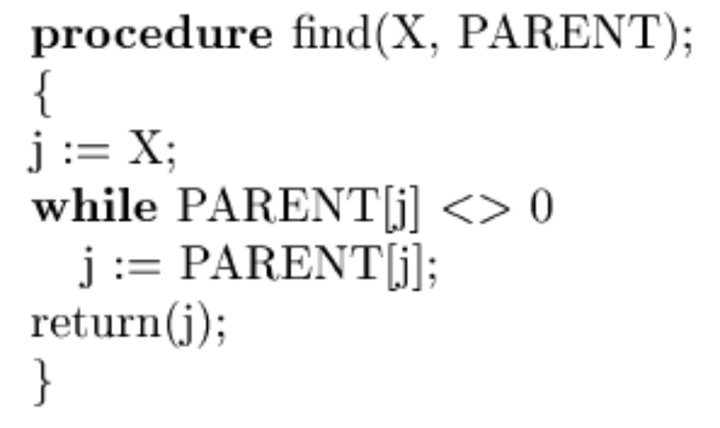
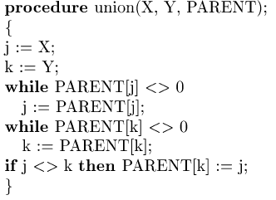
1
2
3

Slide 14
bwlabel
BW = logical([1 1 1 0 0 0 0 0
1 1 1 0 1 1 0 0
1 1 1 0 1 1 0 0
1 1 1 0 0 0 1 0
1 1 1 0 0 0 1 0
1 1 1 0 0 0 1 0
1 1 1 0 0 1 1 0
1 1 1 0 0 0 0 0]);
L = bwlabel(BW,4);
[r,c] = find(L == 2);

Slide 15
L =
1 1 1 0 0 0 0 0
1 1 1 0 2 2 0 0
1 1 1 0 2 2 0 0
1 1 1 0 0 0 3 0
1 1 1 0 0 0 3 0
1 1 1 0 0 0 3 0
1 1 1 0 0 3 3 0
1 1 1 0 0 0 0 0
r =[2 3 2 3]
c =[5 5 6 6]

Slide 16
bweuler
BWEULER Compute the Euler number of binary image.
EUL = BWEULER(BW,N) returns the Euler number for the binary image BW.
EUL is a scalar whose value is the number of objects in the image minus the total number of holes in those objects.
  N can have a value of either 4 or 8, where 4 specifies 4-connected objects and 8 specifies 8-connected objects; if the argument is omitted, it defaults to 8.

Slide 17

BW = imread('circles.png');
imshow(BW)
bweuler(BW)
ans = -2

Slide 18
Compute the area in the objects of a 256-by-256 binary image.
BW = imread('circles.png');
imshow(BW);
bwarea(BW)
ans =
1.4187e+004

Slide 19
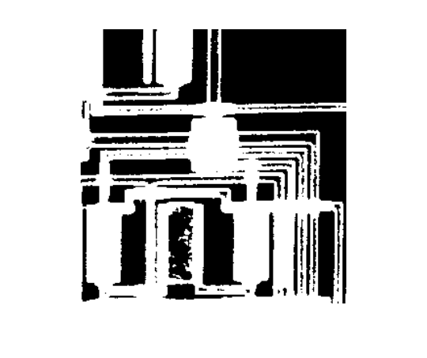

This example uses bwarea to determine the percentage area increase in circbw.tif that results from a dilation operation.
BW = imread('circbw.tif');
SE = ones(5);
BW2 = imdilate(BW,SE);
increase = (bwarea(BW2) - bwarea(BW))/bwarea(BW);
increase =
0.3456

Slide 20
**Presentation Assignment
Use Examples!
bwlabel
bweuler
bwselect
bwarea
bwboundaries
label2rgb

Slide 21
Steps in segmentation using histogram
Compute the histogram of a given image
Smooth the histogram by averaging to remove small peaks
Identify candidate peaks and valleys in the histogram
Detect good peaks by applying peakiness test
Segment the image using thresholds at the valleys
Apply connected component algorithm

Slide 22
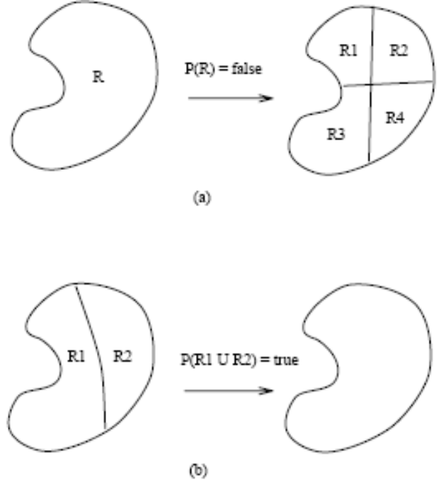
Split and Merge Algorithm
Split region R into four adjacent regions quadrants if Predicate(R) = false
Merge any two adjacent regions R1 and R2 if
  Predicate (R1 U R2) = true
Stop when no further merging and splitting are possible

Slide 23
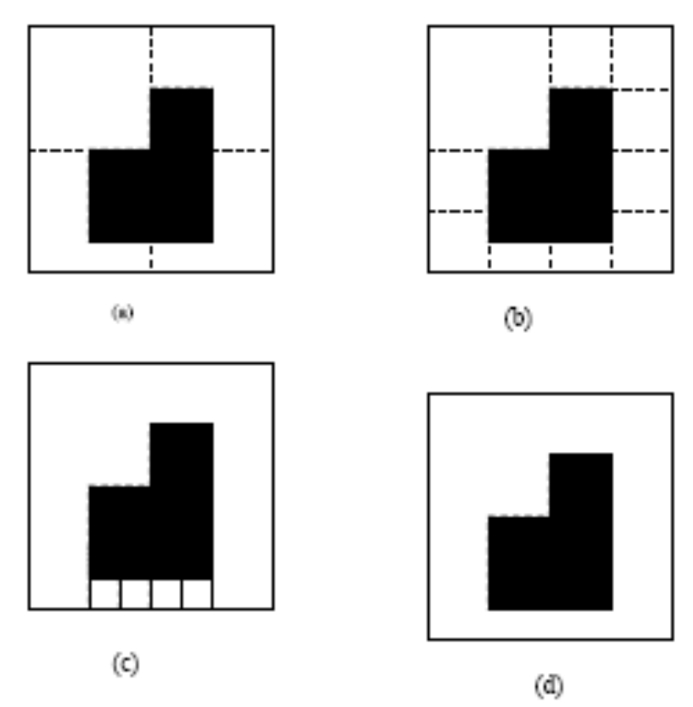
Split and Merge Algorithm (Cont.)

Slide 24
Color Segmentation
Dr. Say that we until this slide we use color segmentation,
that are ffected by Contrast, brightness, …….

Slide 25
Segmentation using optical flow
There is demo using cars in matlab demos
& doctor has been discussed it

Slide 26
Geometrical Properties of Regions
Once the scene is segmented into regions we can determine the geometrical properties of regions which can be used in the object recognition
We will assume that the region is represented by an m x n binary image B(x, y)

Slide 27
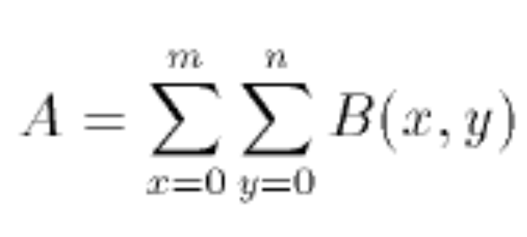
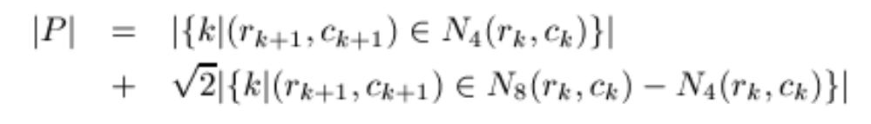
Area (A): Area or size of the regions is a total number of pixels occupied by the region
Perimeter: The perimeter of a region is sum of its border pixels.
To compute length |P| of perimeter P, the pixels in P must be ordered in a sequence p = < (r0,c0),(r1,c1),...,(rK-1,cK-1)>, each pair of successive pixels in the sequence being neighbors, including the first and last pixels.
Then the perimeter length |P| is defined by
  where k+1 is computed modulo K ( the length of the pixel sequence).
Thus two vertically or horizontally adjacent pixels in the perimeter cause value 1 to be added to the total, while two diagonally adjacent pixels cause about 1.4 to be added

Slide 28
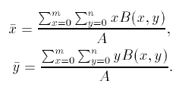

Centroid (not an integer number generally): The centriod is like the center of an arbitrary shaped region and it can be used to represent the location of a region, Centroid is given by:

Slide 29
bw = imread('text.png');
L = bwlabel(bw); % Connected Component
s = regionprops(L, 'centroid');
centroids = cat(1, s.Centroid);
imshow(bw)
hold on
plot(centroids(:,1), centroids(:,2), 'b*')
hold off

Slide 30
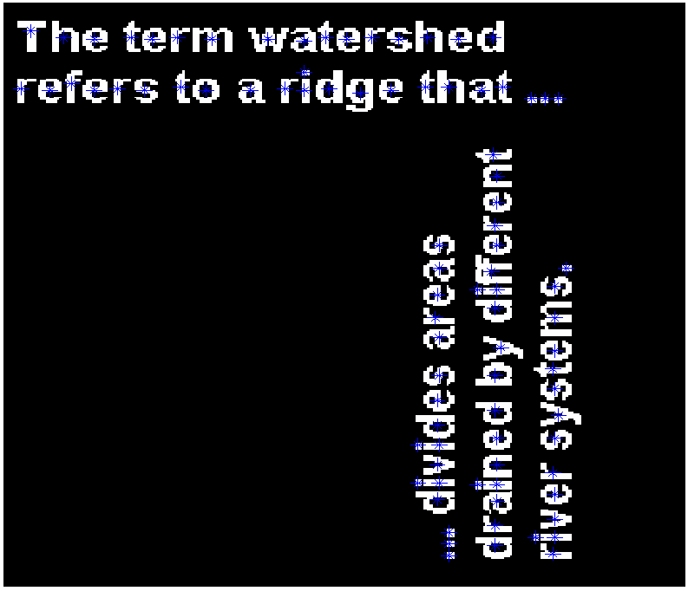

Slide 31

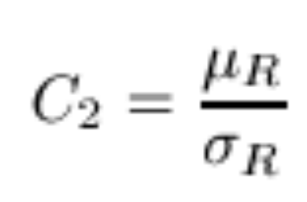

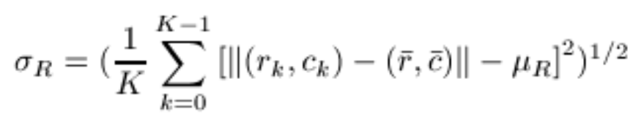
Circularity (C1) (not accurate)
Circularity (C2):
where µR and σR are the mean and standard deviation of the distance from the centroid of the shape to the shape boundary and can be computed according to the following formulas:

Slide 32

Compactness (C)
  where A is the area of a region and P is the perimeter of the region
  The most compact region is a circle with compactness equal to 1
    The area of a circle of radius R is pi*R^2, and
    the perimeter is 2*pi*R
  The compactness of a square shape is pi/4

Slide 33
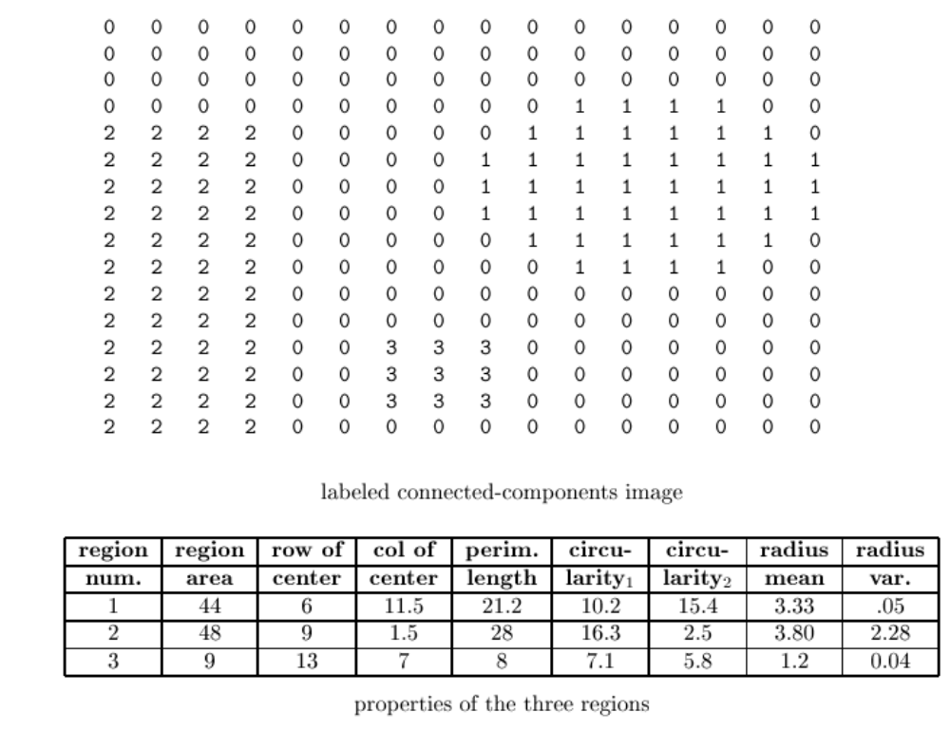

Slide 34
function W = Classify(ImageFile)
Author : Ahmed Samieh Abd El-Wahab
AL-AZHAR UNIVERSITY
% Shapes Classifier
% Step 1: Read image
% Step 2: Convert image from rgb to gray
% Step 3: Threshold the image
% Step 4: Invert the Binary Image
% Step 5: Find the boundaries Concentrate
% Step 6: Determine Shapes properties
% Step 7: Classify Shapes according to properties
% Square = 3
% Rectangular = 2
% Circle = 1
% UNKNOWN = 0

Slide 35
function W = Classify(ImageFile)
% Step 1: Read image Read in
RGB = imread(ImageFile);
figure,
imshow(RGB),
title('Original Image');
% Step 2: Convert image from rgb to gray
GRAY = rgb2gray(RGB);
figure,
imshow(GRAY),
title('Gray Image');
% Step 3: Threshold the image Convert the image to black and white in order
% to prepare for boundary tracing using bwboundaries.
threshold = graythresh(GRAY);
BW = im2bw(GRAY, threshold);
figure,
imshow(BW),
title('Binary Image');

Slide 36
% Step 5: Find the boundaries Concentrate only on the exterior boundaries.
% Option 'noholes' will accelerate the processing by preventing
% bwboundaries from searching for inner contours.
[B,L] = bwboundaries(BW, 'noholes');
% why do you calculate B?
% Step 6: Determine objects properties
STATS = regionprops(L, 'all'); % we need 'BoundingBox' and 'Extent‘
%you also need the centroid
% why do you calculate all properties?
%'Extent‘ = (Area of the region)/(area of the bounding box)

Slide 37
% Step 7: Classify Shapes according to properties
% Square = 3 = (1 + 2) = (width = Height, Extent = 1)
% Rectangular = 2 = (0 + 2) = (only Extent = 1)
% Circle = 1 = (1 + 0) = (width = Height , Extent < 1)
% UNKNOWN = 0
figure,
imshow(RGB),
title('Results');
hold on
for i = 1 : length(STATS)
W(i) = uint8(abs(STATS(i).BoundingBox(3)-STATS(i).BoundingBox(4)) < 0.1);
%BoundingBox(3)=width, BoundingBox(3)=Height
W(i) = W(i) + 2 * uint8((STATS(i).Extent - 1) == 0 );
centroid = STATS(i).Centroid;
switch W(i)
case 1
plot(centroid(1),centroid(2),'wO');
case 2
plot(centroid(1),centroid(2),'wX');
case 3
plot(centroid(1),centroid(2),'wS');
end
end
return

Slide 38
