Slide 1
Simulink

Slide 2
Simulink
Simulink is a software package that enables you to model, simulate, and analyze systems whose outputs change over time.
Such systems are often referred to as dynamic systems.
Simulink can be used to explore the behavior of a wide range of real-world dynamic systems, including electrical circuits, shock absorbers, braking systems, and many other electrical, mechanical, and thermodynamic systems.

Slide 3

Model Example
The model integrates a sine wave and displays the result along with the sine wave. The block diagram of the model looks like this.

Slide 4
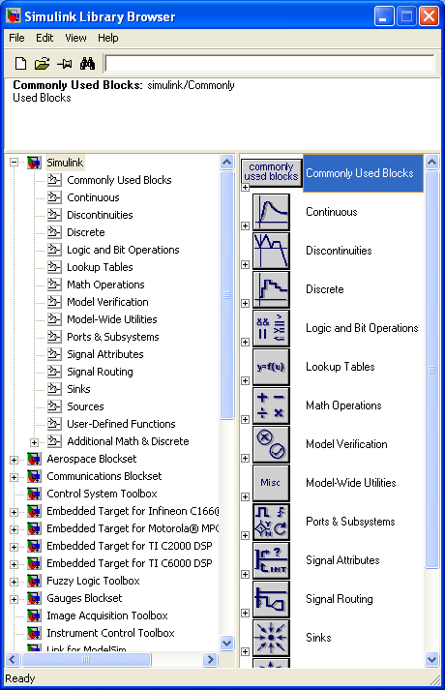
Creating an Empty Model
>> simulink
To create a new model, click the New Model button on the Library Browser's toolbar.

Slide 5


Adding Blocks
To create this model, you need to copy blocks into the model from the following Simulink block libraries:
  Sources library (the Sine Wave block)
  Sinks library (the Scope block)
  Continuous library (the Integrator block)
  Signal Routing library (the Mux block)

Slide 6

Connecting the Blocks

Slide 7
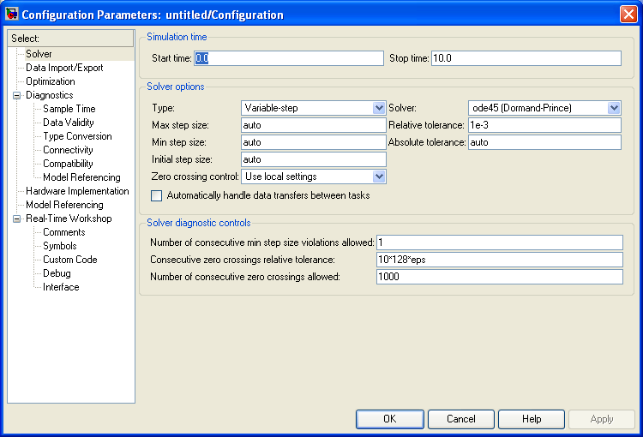
Configuring the Model

Slide 8
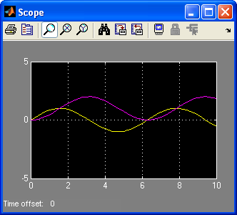
Running the Model
Double-click the Scope block to open its display window.
Choose Start from the Simulation menu and watch the simulation output on the Scope.

Slide 9
The simulation stops
  when it reaches the stop time specified in the Configuration Parameters dialog box or
  when you choose Stop from the Simulation menu or
  click the Stop button on the model window's toolbar

Slide 10
Examples
Importing and Exporting Files
  Working with AVI Files
    Importing and Viewing AVI Files
    Exporting to AVI Files
  Working with Multimedia Files
    Importing and Viewing Multimedia Files
    Exporting to Multimedia Files
    Working with Audio

Slide 11

Importing and Viewing AVI Files
Click-and-drag two blocks into your model:
  Read AVI File (Video and Image Processing Blockset / Sources)
    Read ONLY uncompressed video frames from AVI file
  Video Viewer (Video and Image Processing Blockset / Sinks)
    Display input RGB or intensity video stream or image.
Connect the blocks so your model looks similar to the figure above.

Slide 12
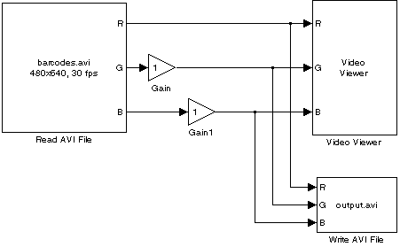
Exporting to AVI Files
Click-and-drag four blocks into your model:
  Read AVI File (Video and Image Processing Blockset / Sources)
  Video Viewer (Video and Image Processing Blockset / Sinks)
  Write AVI File ( Video and Image Processing Blockset / Sinks )
  Gain (Simulink / Math Operations)
Gain blocks. Set the block parameters as follows:
  Main pane, set Gain = 0.3 for green and 1.5 for blue
  Signal data types pane, Output data type mode = Same as input
Use the Write AVI File block to export the video to an AVI file. Set the File name parameter to my_test_file.avi.

Slide 13

Importing and Viewing Multimedia Files
Click-and-drag two blocks into your model:
  From Multimedia File ( Video and Image Processing Blockset / Sources)
    Read video frames and/or audio samples from compressed multimedia file
  To Video Display (Video and Image Processing Blockset / Sinks)
    Sends live video data to a video output device/monitor/camera connected to the system.
    Also allows the video signal to be monitored on the screen.
    Only for use on Windows platforms.

Slide 14
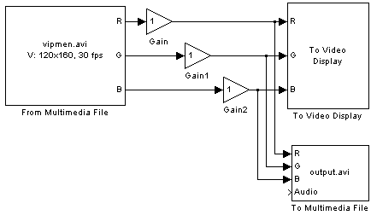
Exporting to Multimedia Files
Click-and-drag four blocks into your model:
  From Multimedia File ( Video and Image Processing Blockset / Sources)
  To Video Display (Video and Image Processing Blockset / Sinks)
  Gain (Simulink / Math Operations)
  To Multimedia File (Video and Image Processing Blockset / Sinks)
    Writes video frames* and/or audio samples to a multimedia file.
    Audio and video compressors are also available to compress audio and/or video streams in the output file.
    If the specified output file exists, it will be overwritten.
    Only for use on Windows platforms.
Gain blocks. Set the block parameters as follows:
  Main pane, set Gain = 1.2 for red, green, and blue
  Signal data types pane, Output data type mode = Same as input
Use the To Multimedia File block to export the video to a multimedia file. Set the block parameters as follows:
  Output file name = my_output.avi
  Write = Video only
  video compressor =?

Slide 15
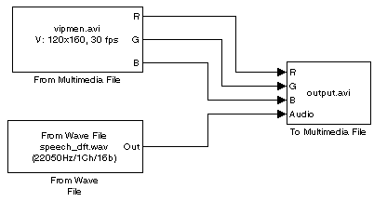
Working with Audio
Click-and-drag three blocks into your model:
  From Multimedia File ( Video and Image Processing Blockset / Sources)
  From Wave File (Signal Processing Blockset / Platform Specific I/O)
  To Multimedia File (Video and Image Processing Blockset / Sinks)

Slide 16
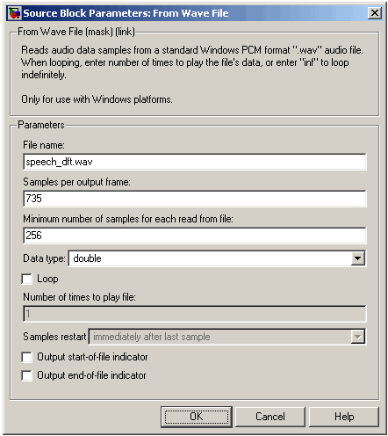
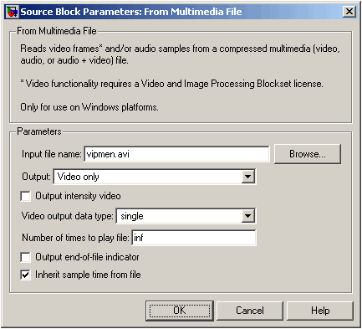
The frame period of the audio signal must match the frame period of the video signals

Slide 17
Note that the From Multimedia File block inherits its sample time from vipmen.avi.
Because this file's frame rate is 30 frames per second (fps) and the frame period is defined as 1/frame rate, the frame period of this block is 0.0333 seconds per frame.
For the audio file, to calculate the output frame size, divide the frequency of the audio signal (22050 samples per second) by the frame rate (30 frames per second) to get 735 samples per frame. Set the Samples per output frame parameter to 735.

Slide 18
Working with MPlay
Viewing Videos from the MATLAB Workspace: Use MPlay to view videos in the MATLAB workspace.
Viewing Video Files: Use MPlay to view videos stored in AVI files.
Viewing Video Signals in Simulink: Use MPlay to view video signals in Simulink models.

Slide 19
Viewing Videos from the MATLAB Workspace
d = aviread('vipmen.avi');
  read an entire video into memory
>>mplay
Connect the MPlay GUI to the variable in the MATLAB workspace by clicking on the MPlay GUI.
  In the Import from Workspace dialog box, select d from the list of workspace variables. Then click Import.
  The first frame of the video appears in the MPlay window.

Slide 20
Viewing Video Files
>>mplay
On the MPlay GUI, click
navigate to $matlabroot\toolbox\vipblks\vipdemos\vipmen.avi.

Slide 21
Viewing Video Signals in Simulink
>>vipmplaytut
>>mplay
Run the model.
Select the signal line you want to view. For example, select the bus signal coming out of the Rotate block.
On the MPlay GUI, click

Slide 22
Conversions
Intensity to Binary Conversion: Learn how to convert an intensity image to a binary image.
Color Space Conversion: Learn how to convert color information between color spaces and to intensity values.
Chroma Resampling: Use the Chroma Resampling block to down sample the chroma components of an image.

Slide 23
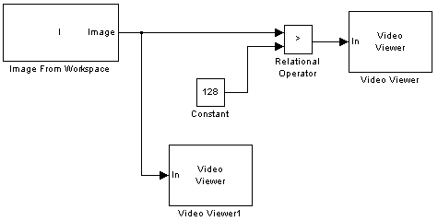
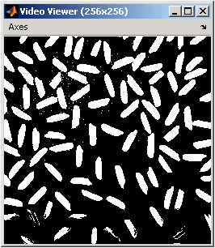
Converting Between Intensity and Binary Images Using Relational Operators
>> I= imread('rice.png');
Create a new Simulink model, and add the following blocks to it.
  Image From Workspace (Video and Image Processing Blockset / Sources)
    Value = I
    Output port labels = Image
  Video Viewer (Video and Image Processing Blockset / Sinks)
    Set the Input image type parameter to Intensity.
  Relational Operator (Simulink / Logic and Bit Operations)
    Set the Relational Operator parameter to >
  Constant (Simulink / Sources)
    Since the pixel values range from 0 to 255, set the Constant value parameter to 128.

Slide 24
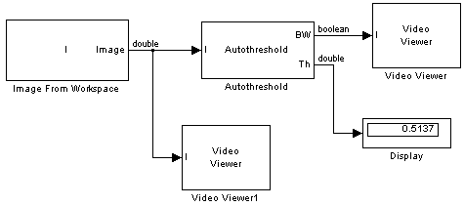
Converting Between Intensity and Binary Images Using the Autothreshold Block
Use the Autothreshold block when lighting conditions vary and the threshold needs to change for each video frame.
From the Video and Image Processing Blockset library, and then from the Conversions library, click-and-drag an Autothreshold block into your model.
  Select the Output threshold check box.
From the Signal Processing Blockset library, and then from the Signal Processing Sinks library, click-and-drag a Display block into the model.
  Connect it to the Th port.
Double-click the Image From Workspace block. On the Data Types pane, set the Output data type parameter to double.

Slide 25

Converting Color Information from R'G'B' to Intensity
>>I= imread('greens.jpg');
Create a new Simulink model, and add the following blocks to it.
  Image From Workspace (Video and Image Processing Blockset / Sources)
    Main pane, Value = I
    Output port labels = R'|G'|B'
  Color Space Conversion (Video and Image Processing Blockset / Conversions)
    Set the Conversion parameter to R'G'B' to intensity.
  Video Viewer (Video and Image Processing Blockset / Sinks)
    Set the Input image type to Intensity.

Slide 26
COLOUR SPACES
A monochrome image requires just one number to indicate the brightness or luminance of each spatial sample.
Color images, on the other hand, require at least three numbers per pixel position to represent color accurately.
  RGB
  YCbCr

Slide 27
YCbCr
The human visual system (HVS) is less sensitive to color than to luminance (brightness).
In the RGB color space the three colors are equally important and so are usually all stored at the same resolution
But it is possible to represent a color image more efficiently by separating the luminance from the color information and representing luma with a higher resolution than color.

Slide 28
The YCbCr color space and its variations (sometimes referred to as YUV) is a popular way of efficiently representing color images. Y is the luminance (luma) component and can be calculated as a weighted average of R, G and B:
  Y = kr R + kgG + kbB
    where k are weighting factors.
The color information can be represented as color difference (chrominance or chroma) components, where each chrominance component is the difference between R, G or B and the luminance Y:
    Cb = B − Y
    Cr = R − Y
    Cg = G − Y
This representation has little obvious merit since we now have four components instead of the three in RGB.
However, Cb + Cr + Cg is a constant and so only two of the three chroma components need to be stored or transmitted since the third component can always be calculated from the other two.
YCbCr has an important advantage over RGB, that is the Cr and Cb components may be represented with a lower resolution than Y.

Slide 29
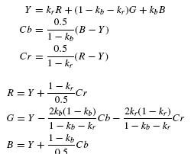
An RGB image may be converted to YCbCr after capture in order to reduce storage and/or transmission requirements.
  Note that there is no need to specify a separate factor kg (because kb + kr + kg = 1)
Before displaying the image, it is usually necessary to convert back to RGB.

Slide 30
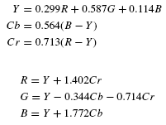
ITU-R recommendation BT.601 defines kb = 0.114 and kr = 0.299. Substituting into the above equations gives the following widely-used conversion equations:

Slide 31
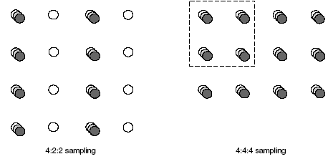
YCbCr Sampling Formats
4:4:4 sampling means that the three components (Y, Cb and Cr) have the same resolution and hence a sample of each component exists at every pixel position.
  The numbers indicate the relative sampling rate of each component in the horizontal direction, i.e. for every four luminance samples there are four Cb and four Cr samples.
In 4:2:2 sampling, the numbers 4:2:2 mean that for every four luminance samples in the horizontal direction there are two Cb and two Cr samples.
  4:2:2 video is used for high-quality color reproduction.

Slide 32
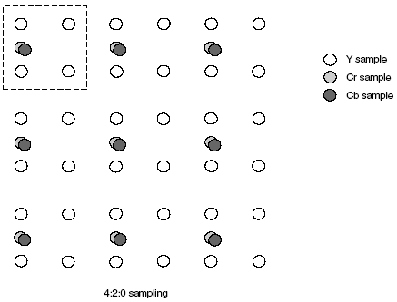
The term ‘4:2:0’ is rather confusing because the numbers do not actually have a logical interpretation.
4:2:0 sampling is widely used for consumer applications such as video conferencing, digital television and digital versatile disk (DVD) storage.

Slide 33
4:2:0 sampling is sometimes described as ‘12 bits per pixel’.
  The reason for this can be seen by examining a group of four pixels.
    Using 4:4:4 sampling, a total of 12 samples are required, four each of Y, Cb and Cr, requiring a total of 12 × 8 = 96 bits, an average of 96/4 = 24 bits per pixel.
  Using 4:2:0 sampling, only six samples are required, four Y and one each of Cb, Cr, requiring a total of 6 × 8 = 48 bits, an average of 48/4 = 12 bits per pixel.

Slide 34
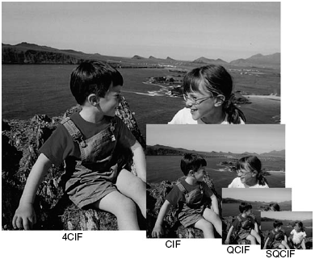
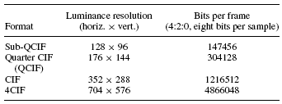
4CIF (Common Intermediate Format) is appropriate for standard-definition television and DVD-video.
CIF and QCIF are popular for videoconferencing applications.
QCIF or SQCIF are appropriate for mobile multimedia applications where the display resolution and the bitrate are limited.

Slide 35
Chroma Resampling
In this example, the Chroma Resampling block is used to downsample the Cb and Cr components of an image.
>>I= imread('autumn.tif'); I is a 206-by-345-by-3 array of 8-bit unsigned integer values.
Create a new Simulink model, and add the following blocks to it.
  Image From Workspace(Video and Image Processing Blockset / Sources)
    Set the Value parameter to I.
  2-D Pad (Video and Image Processing Blockset / Utilities)
    the 2-D Pad block to change the dimensions of the I array from 206-by-345-by-3 to 206-by-346-by-3.
    You are changing these dimensions because the Chroma Resampling block requires that the dimensions of the input be divisible by 2.
    Method = Symmetric; Pad rows at = Right; Pad size along rows = 1; Pad columns at = No padding
  Color Space Conversion (Video and Image Processing Blockset / Conversions)

Slide 36

  Chroma Resampling (Video and Image Processing Blockset / Conversions)
  Video Viewer (Video and Image Processing Blockset / Sinks)
  Bus Creator (Simulink / Signal Routing)
    combine the R, G, and B, signals into one signal so you can process it with one 2-D Pad block.
    Set the Number of inputs parameter to 3.
  Bus Selector (Simulink / Signal Routing)
    You must set the block parameters of this block after you connect a signal to its input port
    In the Signals in the bus pane, select signal3. Click Select to move signal3 to the Selected signals pane. Click OK.
  Configure Simulink to display signal dimensions next to each signal line. From the Format menu, point to Port/Signal Displays, and select Signal Dimensions.

Slide 37
Geometric Transformation
Rotating an Image: Use the Rotate block to continuously rotate an image.
Resizing an Image: Use the Resize block to reduce the size of an image.
Cropping an Image: Use the Selector block to trim an image down to a region of interest

Slide 38
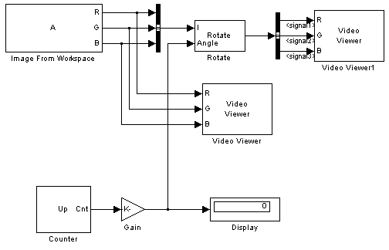
Rotating an Image
>>A = checker_board;
Create a new Simulink model, and add the following blocks to it.
Image From Workspace( Video and Image Processing Blockset / Sources)
  set the Value parameter to A.
Rotate (Video and Image Processing Blockset / Geometric Transformations)
  Rotation angle source = Input port; Sine value computation method = Trigonometric function
  Setting the Output size parameter to Expanded to fit rotated input image
Video Viewer (Video and Image Processing Blockset / Sinks)
Bus Creator (Simulink / Signal Routing)
  Set the Number of inputs parameter to 3.
Bus Selector (Simulink / Signal Routing)
Gain (Simulink / Math Operations)
  Use the Gain block to convert the output of the Counter block from degrees to radians. Set the Gain parameter to pi/180.
Counter (Signal Processing Blockset / Signal Management / Switches and Counters)
  Count event = Free running;
  Counter size = 16 bits;
  Output = Count;
  Clear the Reset input check box;
  Sample time = 1/30
Display (Signal Processing Blockset / Signal Processing Sinks)

Slide 39
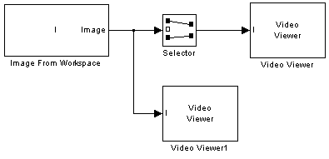
Cropping an Image
>>I = imread('coins.png');
Create a new Simulink model, and add the following blocks to it.
  Image From Workspace
    Main pane, Value = I
    Main pane, Output port labels = Image
  Video Viewer
    Set the Input image type parameter to Intensity
  Selector (Simulink / Signal Routing)
    Input type = Matrix; Rows = 140; Columns = 200
    Select the Use index as starting value check box.
    Output port dimensions = [70 70]
    The Selector block starts at row 140 and column 200 of the image and outputs the next 70 rows and columns of the image.

Slide 40
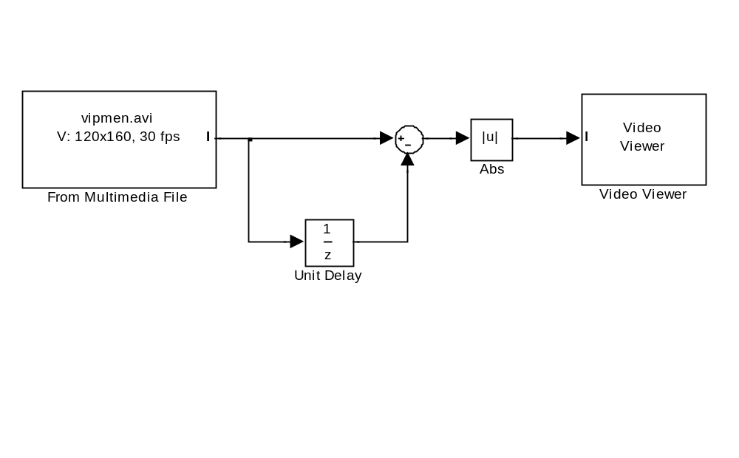
Get Residual Frame

Slide 41
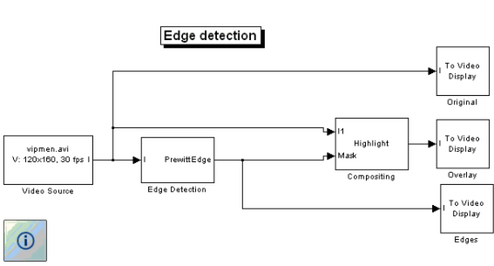
Edge Detection
This demo uses the Video and Image Processing Blockset to find the edges of objects in a video stream using the Prewitt method.
When you run the model, you can double-click the Edge Detection block and adjust the Threshold parameter while the simulation is running.
  The higher you make the threshold, the smaller the amount of edges the demo finds in the video.
This model also illustrates how to use the Compositing block to overlay the edges on the original video frames.

Slide 42
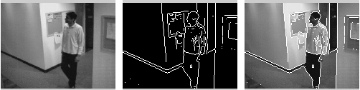

Slide 43
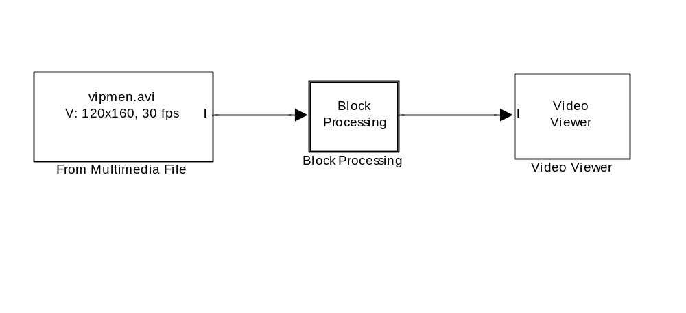


Slide 44
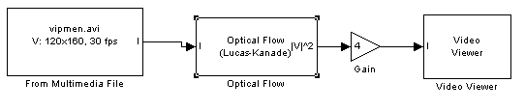
Optical Flow

Slide 45
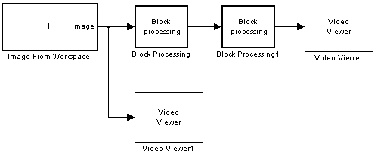
Compressing an Image
I= imread('cameraman.tif');
Output data type = double

Slide 46

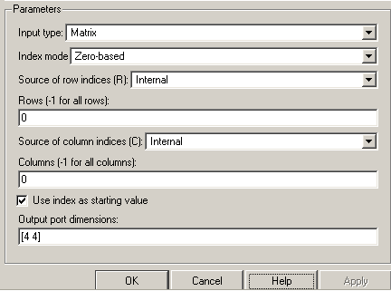
Selector (Simulink / Signal Routing)

Slide 47

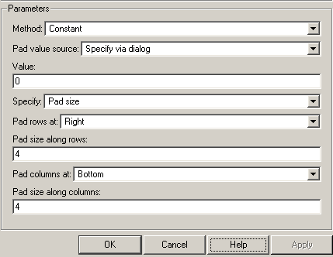
Block Processing1
Use the Block Processing1 block to set the size of the submatrices that the block passes to the subsystem. Set the Block size parameter to {[4 4]}.

Slide 48
Simulink\Sinks\To Workspace
The “To Workspace” block writes its input to the workspace. The block writes its output to an array or structure that has the name specified by the block's Variable name parameter. The Save format parameter determines the output format.
Array
  The way samples are stored in the array depends on whether the input signal is a scalar or vector or a matrix.
  If the input is a scalar or a vector, each input sample is output as a row of the array. For example, suppose that the name of the output array is simout. Then, simout(1,:) corresponds to the first sample, simout(2,:) corresponds to the second sample, etc.
  If the input signal is a matrix, the third dimension of the workspace array corresponds to the values of the input signal at specified sampling point. For example, suppose again that simout is the name of the resulting workspace array. Then, simout(:,:,1) is the value of the input signal at the first sample point; simout(:,:,2) is the value of the input signal at the second sample point; etc.

Slide 49
Simulink\User-Defined Functions\MATLAB Fcn
Pass the input values to a MATLAB function for evaluation.
The function must return a single value having the dimensions specified by 'Output dimensions' and 'Collapse 2-D results to 1-D'.
Examples: u*0.5, sin(u), foo(u(1), u(2))
This block is slower than the Fcn block because it calls the MATLAB parser during each integration step.

Slide 50
Simulink\Math operations\Math Function
The Math Function block performs numerous common mathematical functions. You can select one of the following functions from the Function parameter list:
  exp
  log
  10^u
  log10
  magnitude^2
  square
  sqrt
  pow
  conj
  …
  …

Slide 51
Creating Subsystems
As your model increases in size and complexity, you can simplify it by grouping blocks into subsystems. Using subsystems has these advantages:
  It helps reduce the number of blocks displayed in your model window.
  It allows you to keep functionally related blocks together.
  It enables you to establish a hierarchical block diagram, where a Subsystem block is on one layer and the blocks that make up the subsystem are on another.
You can create a subsystem in two ways:
  Add a Subsystem block to your model, then open that block and add the blocks it contains to the subsystem window.
  Add the blocks that make up the subsystem, then group those blocks into a subsystem.

Slide 52
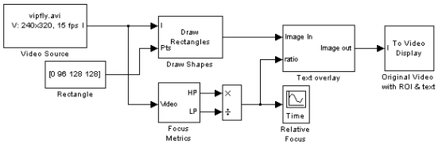
Video Focus Assessment

Slide 53

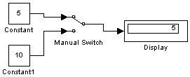
Manual Switch
Output toggles between two inputs by double-clicking on the block.

Slide 54
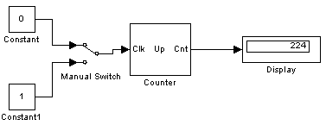
Signal Processing Blockset/Signal Management/Switches and Counters
Non-zero sample: Triggers a count at each sample time when the Clk input is not zero
Free-Running Operation: disables the Clk port. The block increments or decrements the counter at a constant interval, Ts, specified by the Sample time parameter

Slide 55
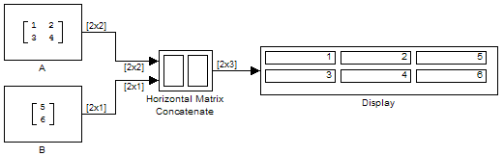
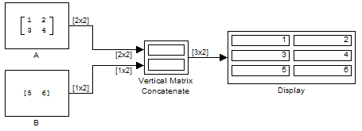
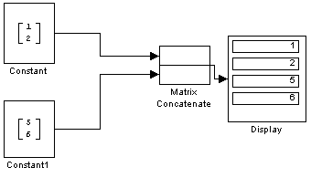
Simulink\Math Operations\Concatenate
Vector

Slide 56
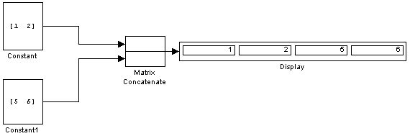
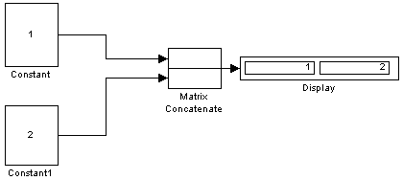
Vector

Slide 57
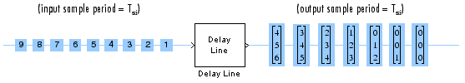
Signal Processing Blockset\Signal Management\Buffers\Delay Line

Slide 58
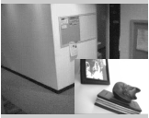
**Presentation Assignment
Picture in Picture (Explain)

Slide 59
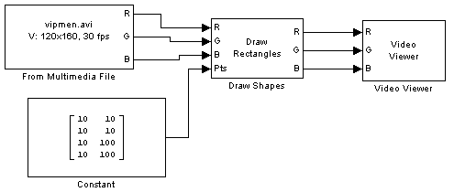

Slide 60
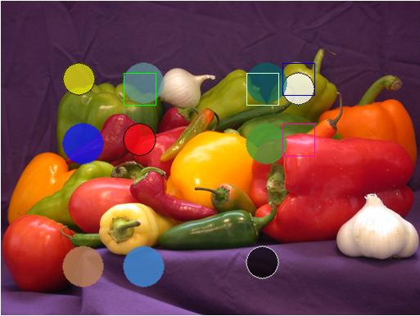
**Presentation Assignment
Bouncing Balls (Explain)

Slide 61


Signal Processing Blockset\Math Functions\Matrices and Linear Algebra\Matrix Operations
Overwrite submatrix or subdiagonal of input

Slide 62
**Presentation Assignment
Visual Effects (Explain)

Slide 63
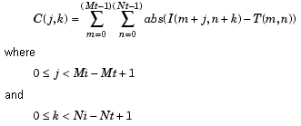
Video and Image Processing Blockset\Analysis & Enhancement\SAD
Perform two-dimensional sum of absolute differences (SAD)
The SAD block finds the similarity between two input images by performing the sum of absolute differences.
  The greater the similarity between the two matrices, the smaller the SAD values that result. Assume that input matrix I has dimensions (Mi, Ni) and the input matrix Template has dimensions (Mt, Nt).
  The equation for the two-dimensional discrete SAD is

Slide 64
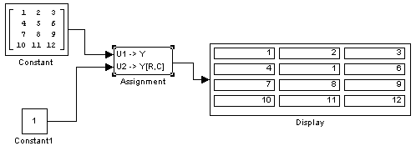
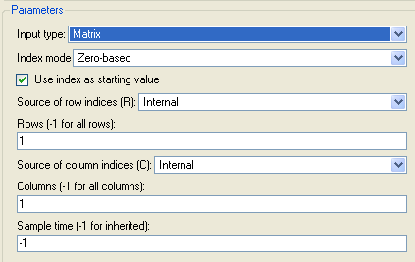
Simulink\Math Operations\Assignment

Slide 65
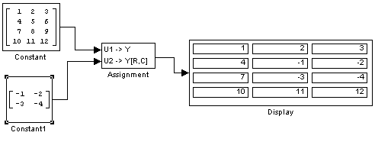

Slide 66
Simulink\Signal Attributes\Signal Specification
You can use the Signal Specification block to ensure that the actual attributes of a signal meet desired attributes.
  For example, suppose that you and a colleague are working on different parts of the same model and you use Signal Specification blocks to connect your part of the model with your colleague's.
  Now, if your colleague changes the attributes of a signal without informing you, the attributes entering the corresponding Signal Specification block do not match and Simulink reports an appropriate error.

Slide 67
**Presentation Assignment
Panorama Creation (Explain)

Slide 68
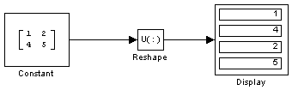
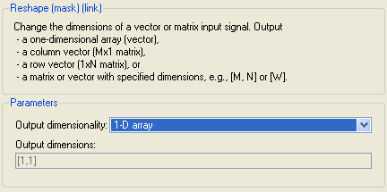
Simulink\Math Operations\Reshape

