Slide 1
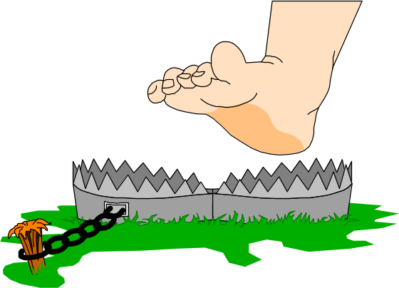
Network programming
Introduction

Slide 2
Introduction-1
The network is everywhere. At the office, machines are wired together into local area networks, and the local networks are interconnected via the Internet. At home, personal computers are intermittently connected to the Internet or, increasingly, via "always-on" cable and DSL modems. New wireless technologies, such as Bluetooth, promise to vastly expand the network realm, embracing everything from cell phones to kitchen appliances.
Such an environment creates tremendous opportunities for innovation. Whole new classes of applications are now predicated on the availability of high-bandwidth, always-on connectivity. Interactive games allow players from around the globe to compete on virtual playing fields and the instant messaging protocols let them broadcast news of their triumphs to their friends. New peer-to-peer systems, such as Napster and Gnutella, allow people to directly exchange MP3 audio files and other types of digital content.

Slide 3
Introduction-2
The ubiquity of the network allows for more earthbound applications as well. With the right knowledge, you can write a robot that will fetch and summarize prices from competitors' Web sites; a script to page you when a certain stock drops below a specified level; a program to generate daily management reports and send them off via e-mail; a server that centralizes some number-crunching task on a single high-powered machine, or alternatively distributes that task among the multiple nodes of a computer cluster.
Whether you are searching for the best price on a futon or for life in a distant galaxy, you'll need to understand how network applications work in order to take full advantage of these opportunities. You'll need a working understanding of the TCP/IP protocol—the common denominator for all Internet-based communications and the most common protocol in use in local area networks as well. You'll need to know how to connect to a remote program, to exchange data with that program, and what to do when something goes wrong. To work with existing applications, such as Web servers, you'll have to understand how the application-level protocols are built on top of TCP/IP, and how to deal with common data exchange formats such as XML and MIME

Slide 4
Introduction-3
Networks (and network programming) have come a long way over the past 20 years. In the early days of network computing (the ’80s), network programming was left to the advanced programmer, who typically built applications using the C programming language in (mostly) Unix environments.
Now, networks are everywhere, from large corporations to small home users. With so many computers connected together via networks, network-aware applications are an accepted necessity. Existing applications must incorporate network features to stay competitive in the marketplace, and adding network communication to applications is essential. To take advantage of opportunities presented by the Internet, businesses are continuously seeking new and innovative ways and means for offering their services via the Internet.
This created a huge demand for software designers with skills to create new Internet-enabled applications or migrate existing/legacy applications on the Internet platform.

Slide 5


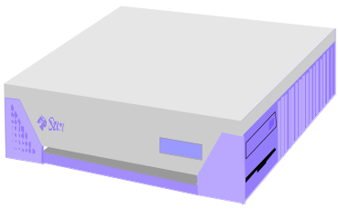
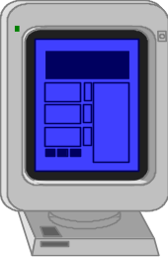

Introduction-4
PC client
Internet Server
Local Area Network
PDA

Slide 6
Introduction-5
Today’s network management and security requirements make it essential to communicate with network devices and track workstations on the network.
Network programs are used for everything from children’s games to advanced corporate database systems.
Trying to quickly write clean network code can be difficult when you are working within the structure of the C socket APIs (especially in WinSock), and running Java applications is often a painful experience due to slow processing speeds and poor Windows support.
Network programming has always been a key feature of the Microsoft Windows operating system. Unfortunately, you’ve had to know advanced C or C++ programming concepts to utilize the network programming features in Windows programs.
Now, though, the .NET Framework languages simplify the task of adding network features to your applications. The .NET libraries provide many network classes that can integrate network programming.

Slide 7
Basic concepts of network programming-1
A computer network is collections of communication endpoints capable of exchanging messages.”
An “endpoint” is specified by an IP address and a port number. In this course, we won’t discuss communication protocols at a lower level than that.
To set up a communication channel between two computers, we will need a pair of endpoints, and a communication protocol (some way of interpreting the data, and a way of establishing the connection between the two endpoints, and a way of ending the “conversation” politely).
One such communication protocol is called TCP (Transport Control Protocol). We leave it to your networking course to supply details about TCP and TCP/IP, but .NET makes it possible to write network programs without knowing anything about TCP.

Slide 8
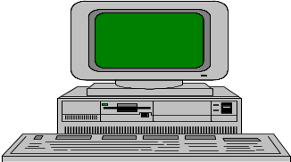
Server
Output/write stream
Client
Input/read stream

Slide 9

Basic concepts of network programming-2
To summarize: to create a usable communications channel we need two endpoints and a protocol, or otherwise described, we need:
  A local IP address
  A local port number
  A remote IP address
  A remote port number
  A transport protocol

Slide 10
Basic concepts of network programming-3
A data structure that encapsulates these five things is called a “socket”.
  The concept of “socket” is independent of .NET and even independent of Windows—every modern operating system has a way to construct sockets.
  Sockets are provided for Windows in the Winsock library, and for Unix in the Berkeley sockets library. The Winsock library functions are wrapped in the .NET Socket class.
  The Socket class also provides a Connect method. That in turn calls on ancient code in the Winsock library to establish a connection between the local endpoint and the remote endpoint. That, of course, is only going to work if the remote endpoint is “listening”, i.e. is ready to receive a connection request and do its part to establish the connection.
  Once we have successfully established a connection to a remote endpoint, we can use the Socket class method Receive to receive data.

Slide 11
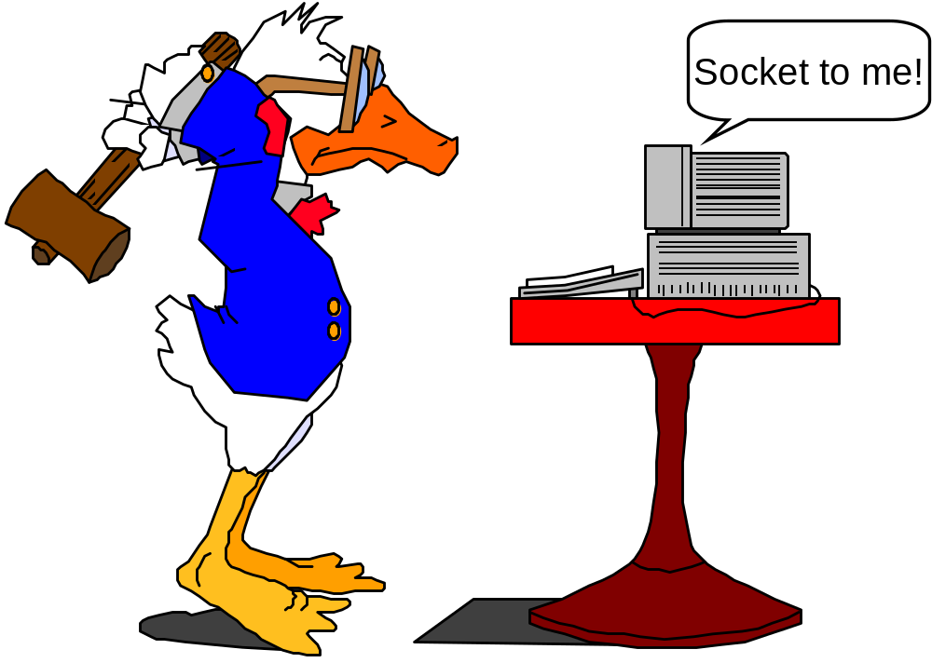
Basic concepts of network programming-4

Slide 12
What can a network program do? -1
A network program is any application that uses a computer network to transfer information to and from other applications. Examples range from Web browser such as Internet Explorer, or the program you use to receive your email, to the software that controls spacecraft at NASA.
All of these pieces of software share the ability to communicate with other computers, and in so doing, become more useful to the end-user. In the case of a browser, every Web site you visit is actually files stored on a computer somewhere else on the Internet. With your email program, you are communicating with a computer at your Internet service provider (ISP) or company email exchange, which is holding your email for you.

Slide 13
What can a network program do? -2
This course is largely concerned with creating network programs, not Web sites. Although the capabilities of Web sites and network programs are quickly converging, it is important to understand the arguments for and against each system.
A service accessed via a Web site is instantly accessible to users across many different platforms, and the whole networking architecture is ready-built for you; however, there is a point at which features are simply unfeasible to implement using Web sites and at which you have to turn to network applications.
Users generally trust network applications; therefore, these programs have much greater control over the computers on which they are running than a Web site has over the computers viewing it. This makes it possible for a network application to manage files on the local computer, whereas a Web site, for all practical purposes, cannot do this.

Slide 14
What can a network program do? -3
More importantly, from a networking perspective, an application has much greater control over how it can communicate with other computers on the Internet.
To give a simple example, a Web site cannot make the computer that is viewing it open a persistent network connection to another computer (except the computer from which the Web site was served). This applies even when the Web site contains embedded content such as a Java applet or Flash movie. There is one exception to this rule, when executable content (such as an ActiveX control) is included in a page. In this case, the page is capable of everything a network program could do, but most browsers and antivirus software will warn against or deny such executable content. Therefore, this scenario is commonly accepted as being unfeasible because of public distrust.

Slide 15
Why network programming in .NET?
One of the first technical decisions to be made whenever a new project is undertaken is what language to use. .NET is a capable platform on which to develop almost any solution, and it offers substantial support for network programming. In fact, .NET has more intrinsic support for networking than any other platform developed by Microsoft.
The C # language has solved many of my network programming problems by allowing me to quickly prototype and deploys network applications using C# classes. Combining the C# Forms library to write the graphical code with the C# Socket library to write the networking code makes creating professional network applications simple. With C# network classes, what used to take a day to write often only takes an hour or less.
This course assumes that you have already decided to develop with .NET, and languages outside the .NET platform will not be discussed in any great detail, except for comparative purposes.
This is not to say that .NET is the be-all and end-all of network-programming applications. If your application runs over a UNIX-only infrastructure communicating via Java remote method invocation (RMI), then .NET is not the way to go. In most circumstances, however, you will find that .NET is more than capable of handling whatever you throw at it.

Slide 16
The goal of the course
This course is for people who want to write programs that communicate with each other using an application program interface (API) known as sockets as that model has become synonymous with network programming.
The goal of this course is to offer guidance on network programming for those developing new network-aware applications and for people who simply want to understand how the networking components of their system function.
All the examples in this course are actual, runnable code tested on Windows systems. However, many non-Windows systems support the sockets API and the examples are largely operating system-independent, as are the general concepts we present.
Virtually every operating system (OS) provides numerous network-aware applications such as Web browsers, email clients, and file-sharing servers. We discuss the usual partitioning of these applications into client and server and write our own small examples of these many times throughout the course.

Slide 17
Course Objectives
A basic understanding of networks using TCP/IP. TCP/IP is a hardware independent protocol. Why is that a good thing?
An understanding of the design considerations in building network applications. It is relatively easy to connect computers using system calls. The hard part is to create effective applications. For example, how do you deal with disconnects, multiple clients, the stream orientation of sockets.

Slide 18
What Will You Learn?
This course is for people who want to write programs that communicate with each other using an application program interface (API) known as sockets. Some readers may be very familiar with sockets already, as that model has become synonymous with network programming. Others may need an introduction to sockets from the ground up. The goal of this book is to offer guidance on network programming for beginners as well as professionals, for those developing new network-aware applications as well as those maintaining existing code, and for people who simply want to understand how the networking components of their system function.
The course is organized into four main parts: Basics, Using the Network, Advanced Concepts.

Slide 19
What Will You Learn?- Part I
Part I, Basics, contains five chapters dedicated to introducing basic concepts:
  Chapter 1 provides an overview of the .NET Framework, and introduces the System.Net namespace.
  Chapter 2 looks at the common I/O architecture of the .NET Framework, which includes streams, readers, and writers. Many of the classes covered here provide a common interface by using streams for performing I/O on files and network resources.
  Chapter 3 covers serialization, which is a powerful mechanism for transferring arbitrary data on a stream. This chapter discusses the different serialization methods and the classes used to access this functionality.
  Chapter 4 is dedicated to threading and the asynchronous I/O pattern. These two concepts are vital for writing scalable, robust network applications with the .NET Framework.
  Chapter 5 is devoted to universal resource identifiers (URIs). We define URIs, discuss how they are used, and introduce the Uri class for parsing and manipulating them.

Slide 20
What Will You Learn?- Part II
Part II, Network Programming Basics, contains five chapters which are intended for programmers just starting out in network programming and looking for some background information about how network programming works and the pieces that are required for network programming.
  Chapter 6, “IP Programming Basics,” This chapter examines the parts of IP communications necessary to your understanding of network communications, along with the inner workings of the two most popular protocols that use IP: TCP and UDP. This section demonstrates a few of the ways that you can use to determine IP configuration information both manually and within your C# programs using WMI.
  Chapter 7, “C# Socket Programming”, socket-level programming is the foundation of all network programming. This chapter should provide enough information to assist you in implementing any TCP- or UDP-based protocol, proprietary or otherwise. Also, this chapter introduces the Domain Name System (DNS) and the .NET Framework class for accessing DNS.

Slide 21
What Will You Learn?- Part II
  Chapter 8, "Multithreaded network applications", this chapter, covers the various concepts and techniques associated with programming multithreaded applications.
  Chapter 9, IP Multicasting applications, this chapter introduces the ideas IP broadcasting, which sends information to all devices on a subnet at the same time, and IP multicasting, which sends information to multiple devices on the network at the same time. Implementing either or both of these IP communication techniques will decrease the amount of network bandwidth used by an application, because you use a single packet to send the same information to a collection of devices.

Slide 22
What Will You Learn?- Part III
Part III, Basic network applications (Application Layer Programming Examples), covers the established Internet technologies. These include the main activities that we all carry out in our daily lives, everything from browsing the Web, sending e-mail, and maybe uploading files with FTP. Knowing how to implement these basic networking operations from .NET is a must for any serious developer.
  Chapter 10, “HTTP,” presents the C# web classes and how you can use them to create web-enabled C# applications. Also, .NET web services , and how you can use them to host your application methods on an IIS server, are discussed.
  Chapter 11, “SNMP,” describes how to write network management applications using C#. SNMP allows you to communicate with many devices on the network to retrieve network statistics. This chapter shows specific examples of reading a vendor MIB sheet and creating a C# application to extract the MIB data from the network device.
  Chapter 12, “SMTP,” describes the C# e-mail classes and shows examples of using them to send mail using SMTP to remote mail servers. Also, an example of using other mail protocols (such as POP3) is shown.
  Chapter 13 , Securing a Network: Firewalls, Proxy Servers, and Routers
  Chapter 14, Ping, DNS, and WHOIS: Monitoring your Network

