Slide 1

Network programming
Introduction to the Microsoft .NET Framework

Slide 2
Why the .NET Framework?
The .NET Framework was designed with one key goal in mind: to increase the productivity of software developers. This goal is accomplished through a number of features that are built into the framework. Understanding these features will help you maximize your development efforts when using the .NET Framework:
  Inherent Benefits of Building on Top of the CLR
  Extensive Use of Patterns
  Broad Windows Platform Support
  Class-Based Model
  Layered Architecture

Slide 3
NET Framework Classes

Slide 4
NET Framework Classes
Classes in the .NET Framework are divided into logical groups called namespaces. Most classes in the .NET Framework exist under a top-level namespace known as System.
The root System namespace contains the basic data types in the framework. System also contains a broad array of second-level namespaces that represent the core functionality in the framework, such as eventing, infrastructure, interfaces, attributes, and exceptions.
There are two general groups of classes in the .NET Framework:
  general-purpose base class libraries, such as Web , Windows forms, Threading, IO, Management, Net, Security,….
  application model–specific classes.

Slide 5
Application Model–Specific Classes
Think of an application model as a set of classes that define a manner in which an application operates. They define the general structure of the application. The following sections provide a brief look at the application models in the .NET Framework
  ASP.NET, contained in the System.Web namespace, is designed to make it easy for developers to build real-world Web applications.
  Windows Services Windows Services are available through the System.ServiceProcess namespace. The System.ServiceProcess classes enable you to create long-running executable applications that run in their own session commonly known as a service.Windows Services are extremely useful for performing routine operations.
  Windows Forms Windows Forms, contained in the System.Windows.Forms namespace, is a broad set of classes that enable rapid development of rich client applications.
  Console The console is accessible through the System.Console class, which is the most basic application model in the .NET Framework. Although the model is quite simple, the console is still an extremely powerful application environment.

Slide 6
Common .NET Framework–Based Network Application Elements
Three base class namespaces focus explicitly on enabling you to develop rich networking scenarios:
System.Net, System.Runtime.Remoting, and System.Web.Services. A number of other classes and patterns in the .NET Framework are often useful when it comes to developing applications that interact with the network. The elements that will be covered:
Input/Output Through Streams
  Applications interacting with the network, or with any other resource for that matter, usually need to accomplish one or more of the following:
    Read input data for the purpose of further processing
    Write output data for the purpose of further processing by some external entity or by the same application at a later time
  The pattern in the .NET Framework for reading and writing data is known as the Stream pattern. The Stream pattern is an incredibly powerful element in the framework because once you learn it, you’ll know how to make your application interact with nearly any type of resource available to the system on which it’s running.

Slide 7
Common .NET Framework–Based Network Application Elements
Threading and Asynchronous APIs:
  Have you ever used an application that seemed to freeze or hang as it requested information over the network? If so, you know that this can be a very frustrating experience. The .NET Framework supports two key concepts that, when used properly, help to eliminate the frustration caused by an unresponsive application that’s waiting on the network. These concepts are threading and the asynchronous API pattern.
  The threading support in the framework makes it easy to perform expensive network operations on a thread other than the main thread of execution, which leaves the main thread free to respond to user input in the case of client applications. For server applications, threading can be fine-tuned to maximize hardware utilization and improve the experience of the client interacting with the server.

Slide 8
Common .NET Framework–Based Network Application Elements
  The .NET Framework also includes a model for calling methods asynchronously. This option gives you many of the same benefits as threading in that you can make a method call on the main thread of execution and quickly return even if the call is one that would block for a long time if called synchronously. The trick comes in the fact that when you make that asynchronous call, a callback method is supplied.
  The framework then processes the call on another thread and calls your callback once the work is done.
  The big difference between the asynchronous pattern and using the threading support directly is that the framework and the underlying CLR thread pool will take care of threading semantics for you in the asynchronous case. All the classes that support asynchronous execution calls follow this common pattern, so if you learn the pattern for one class, you will have learned it for the whole framework.

Slide 9
Common .NET Framework–Based Network Application Elements
Serialization
  Serialization is the process by which objects are converted from instance format to a serial or stream format that can be sent across the network. Deserialization is the process of converting that same serialized object back into an instance.
  Serialization can occur through different formats. For example, binary and SOAP are two formats supported by the .NET Framework. Serialization can also involve different transports. For example, using the .NET Framework, a serialized object can be sent from one machine to another over TCP or over HTTP. Both the format and the transport used can have a significant impact on the ability of one node to interoperate with another. Serialization is a key part of building network applications because it forms the basis by which objects are moved from one application instance to another.

Slide 10
Common .NET Framework–Based Network Application Elements
System.Uri
  Many applications that use the network do so because they want to access resources. To facilitate the naming of resources, the International Engineering Task Force (IETF) created a standard called the URI. URIs are a critical part of network application development because they enable developers to create names for resources that are globally unique. They also enable applications to decouple a resource on the network from the protocol that is used to retrieve that resource. URIs in the .NET Framework are represented by the System.Uri class.
System.Net
  System.Net contains the core networking classes that make up the base transport layer for the .NET Framework. The System.Net namespace includes classes for working with sockets, TCP, UDP, and higher level protocols such as HTTP and File Transfer Protocol (FTP). Chapter 6 introduces the elements of the System.Net namespace and shows how they can be used to build compelling network applications..

Slide 11
Common .NET Framework–Based Network Application Elements
System.Net
  System.Net contains the core networking classes that make up the base transport layer for the .NET Framework. The System.Net namespace includes classes for working with sockets, TCP, UDP, and higher level protocols such as HTTP and File Transfer Protocol (FTP). Chapter 6 introduces the elements of the System.Net namespace and shows how they can be used to build compelling network applications.
System.Web.Services
  The System.Web.Services namespace contains classes for creating and consuming Web services. Web services are a set of APIs that enable developers to expose a set of functionality to Web users over the SOAP protocol. Using Web services, you can build applications that interact and interoperate with other nodes on the network and scale to Internet proportions.
System.Runtime.Remoting
  System.Runtime.Remoting contains a framework for creating and executing objects in a distributed manner. It has an extensible architecture that lets you plug in just about any element of the stack, from the transport used to manipulate the object to the payload serialization format with which it is represented.

Slide 12
Common .NET Framework–Based Network Application Elements
Security
  Security is critical in a networked world. When designing a networked application, developers must constantly be aware of security because most network programs are made interesting by the data or users that are interacting with them. If either of those elements is compromised, the application becomes less useful at best and highly dangerous at worst. The .NET Framework and the underlying CLR were designed from the ground up with network security in mind.
Performance
  Network applications often include requirements for high performance. Interactive client applications must remain snappy as the user interacts with resources over the network. Server-side content applications need to perform well to serve the maximum number of clients possible in a timely fashion. Network performance can be a complex and challenging space. The .NET Framework does quite a bit to simplify the process of writing high-performance network applications; however, a few key factors should be considered when writing a network application with the .NET Framework to ensure that you get the most out of your client, server, peer, and the network that they use to interact.

Slide 13
Streams, Readers, and Writers
This chapter lays the foundation for virtually every networking example contained in this course. Without a working knowledge of how .NET handles I/O, it may prove difficult to adapt the code examples in this book to your own needs.
Traditionally, IO deals with transfer of data to/from secondary storage, most notably disks. IO also covers the transmission of data to/from networks.
I/O applies to network data transfers, as well as saving and loading to your computer’s hard disk Later chapters will describe how to perform network transfers; however, this chapter will be concerned with the underlying I/O operations that are common to both types of transfers.
This includes of course file and directory classes. At the abstract level, the Stream class is the most important class in the IO landscape. Therefore we choose to start the IO story with an exploration of streams, and an understanding of the Stream class in C#. This includes several Stream subclasses and several client classes of Stream. The clients we have in mind are the so-called reader and writer classes.

Slide 14


Streams-1
The Microsoft Windows .NET Framework offers a unified way to access operating system resources such as files, memory, and network resources through the stream I/O pattern. Streams provide a common way to perform I/O operations regardless of the operating system resource.
A stream is an abstract concept. A stream is a connection between a program and a storage/network. Essentially, we can read data from the stream into a program, or we can write data from a program to stream.

Slide 15
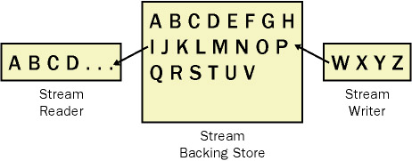
Streams-2
In general, streams allow you to read and write data sequentially to a container (which we call a backing store) as if the data is a continuous sequence of bytes where the first byte that’s written becomes the first byte to be read, and so on. The container is called a backing store because it will typically hold or store the data that’s written to the stream.

Slide 16
Streams-3
Stream and stream processing includes the following:
  Reading or writing of files
  Reading to or writing from primary memory (RAM)
  Connection to the Internet
  Socket connection between two programs
The most important stream in the context of this course is the network-Stream , but another important stream is fileStream , which is used extensively throughout this course to demonstrate file transfers over networks.

Slide 17
Stream Types
There are two types of streams available: base and composable. Base streams are streams that work directly with a backing store such as a file. Composable streams, on the other hand, are streams that operate on top of other streams. Composable streams by their nature have constructors that accept a stream as a parameter, whereas base streams do not.
Therefore, a composable stream relies on the base stream you provide as input. For example, you can have a stream that handles encryption and decryption of data. If you want to write encrypted data to a file, you can write to a composable encryption stream that must call a base stream that’s capable of writing the data from the encryption stream to a file. You can layer as many composable streams as you want on top of one another until you reach a base stream.

Slide 18
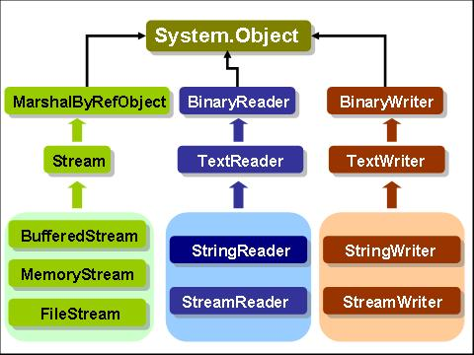
Stream Types

Slide 19
Stream Class
The Stream class of C# is an abstract class. It belongs to the System.IO namespace, together with a lot other IO related types. The abstract Stream class provides a generic view on different kinds of sources and destinations, and it isolates client classes from the operating system details of these.
The Stream class supports both synchronous and asynchronous IO operations. Client classes that invoke a synchronous operation wait until the operation is completed before they can initiate other operations or actions. Use of a synchronous operation is not a problem if the operation is fast. Many IO operations on secondary storage are, however, very slow seen relative to the speed of the operations on primary storage. Therefore it may be attractive to initiate an IO operation, do something else, and consult the result of the IO operation at a later point in time. In order to provide for this, the Stream class supports the asynchronous IO operations BeginRead and BeginWrite.

Slide 20
Stream Class
The Stream class provides simple common methods to read and write data directly to a store, such as base streams, or to another stream, such as composable streams.
The Stream class provides a template for the derived classes that actually communicate with hardware devices such as files. Fundamentally streams support three functions: reading data, writing data, and seeking to a location in the data stream. The Stream class offers Read(), Write() and Seek() abstract methods that must be implemented by derived types. Because reading, writing, and seeking are all optional abilities of Stream-derived classes, the Stream class also defines read-only Boolean properties that indicate the abilities of the particular instance called CanRead, CanWrite and CanSeek.

Slide 21
Basic Operations/ properties
Once you have successfully created a stream, you can begin performing I/O operations. Table 2-1 describes the main operations that are generally available in all stream classes to handle I/O. Depending on the stream at hand, it will not be possible to implement all operations for various technical reasons. If a stream does not handle a particular method, generally it will throw a NotSupportedException from the System namespace.
The stream class has properties to determine what you can do to the stream (is it readable, writeable; does it support random access?), and information about the size of the stream and the current seek position in the stream. Stream has methods to read and write single bytes and arrays of bytes; if you chose to read or write arrays of bytes, this can be done synchronously or asynchronously. Table 2-2 describes the available properties.

Slide 22
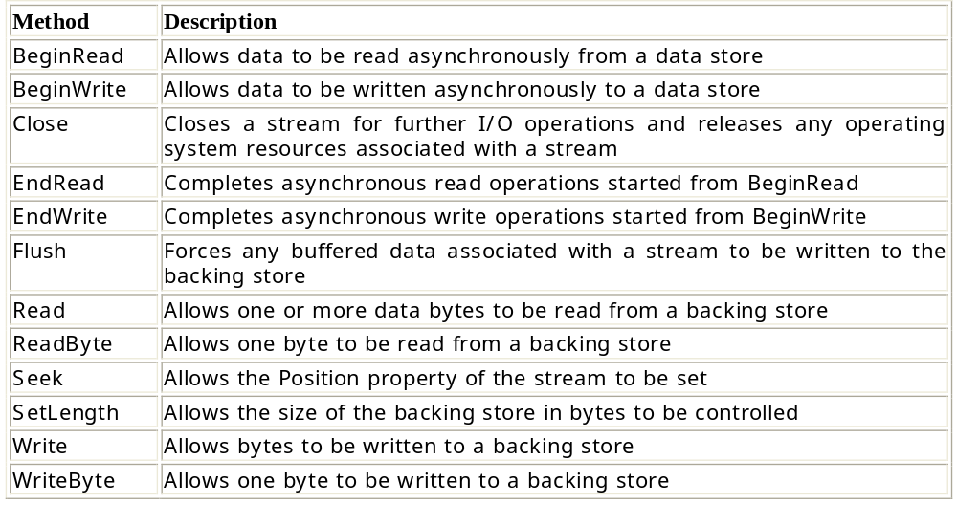
Operations

Slide 23
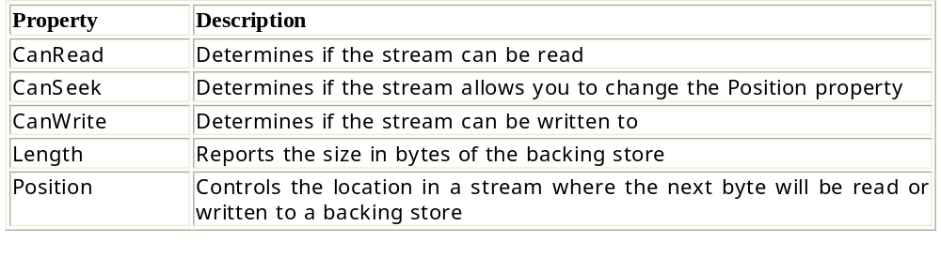
properties

Slide 24
Subclasses of class Stream
The abstract class Stream is used through a number of non-abstract subclasses. Below we list the most important of these. Like the class Stream, many of the subclasses of Stream belong to the System.IO namespace.
  System.IO.FileStream: Provides a stream backed by a file from the operating system.
  System.IO.BufferedStream: Encapsulates buffering around another stream.
  System.IO.MemoryStream: Provides a stream backed by RAM memory.
  System.Net.Sockets.NetworkStream: Encapsulates a socket connection as a stream.
  System.IO.Compression.GzipStream: Provides stream access to compressed data.

Slide 25
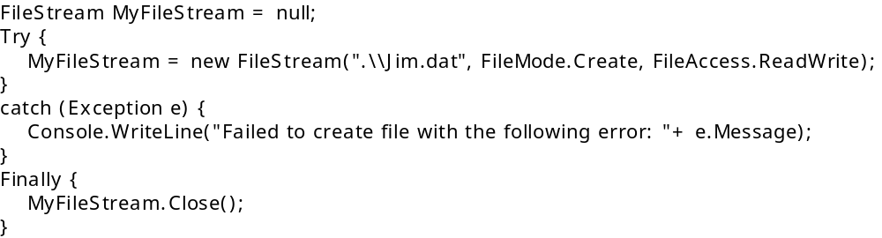
File Stream
One of the most practical uses for streams is reading and writing data to files.
The .NET Framework provides the FileStream class that is specifically designed to work with file I/O. Working with files involves creating a file or opening an existing file, reading and writing data to the file, and eventually closing the file from read and write operations.
Creating or Opening a File:
  Before performing file processing, you must create a new file or open an existing file. To do so, you must supply file location information to the FileStream constructor method.

Slide 26
1
In the above code , I create a FileStream object and assign a reference to a variable with a line of code that looks like this:
Once I have a reference to an object I can do things such as access methods or other members on the object.
It’s important to note that many other prototypes for the FileStream constructor enable more control for gaining access to a file. Two main parameters featured in each prototype control file creation: FileMode and FileAccess.
The other enumeration, FileAccess, determines if your application can read or write to the file. The members of the FileAccess enumerator are shown in Table(2-4).
In multi-user environment, when an operation must be performed on a file, you may have to specify how a file can be shared. This is done through the FileShare enumerator. The values of the FileShare enumerator are shown in Table (2-5).

Slide 27
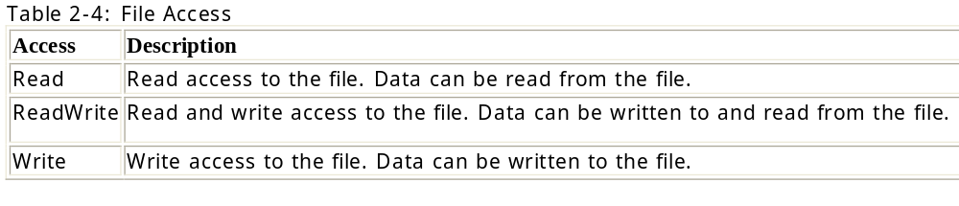
2

Slide 28
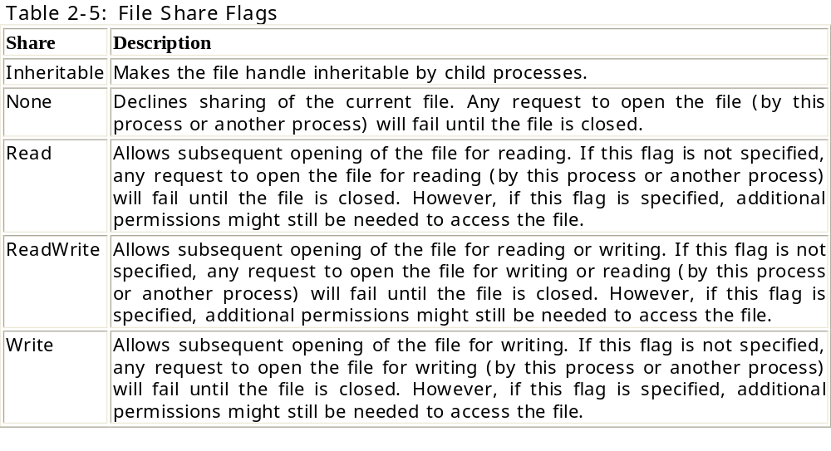
3

Slide 29
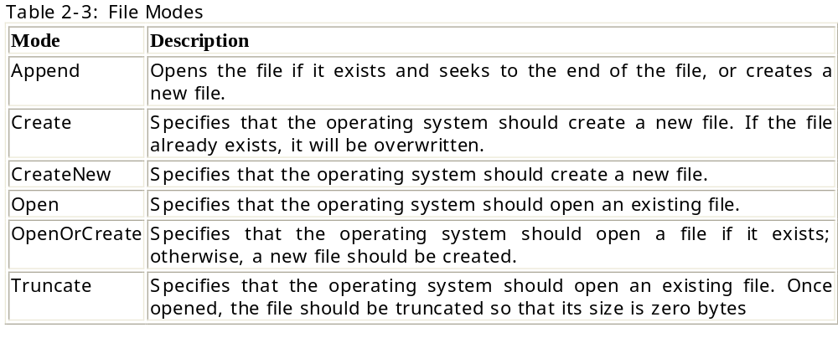
4

Slide 30
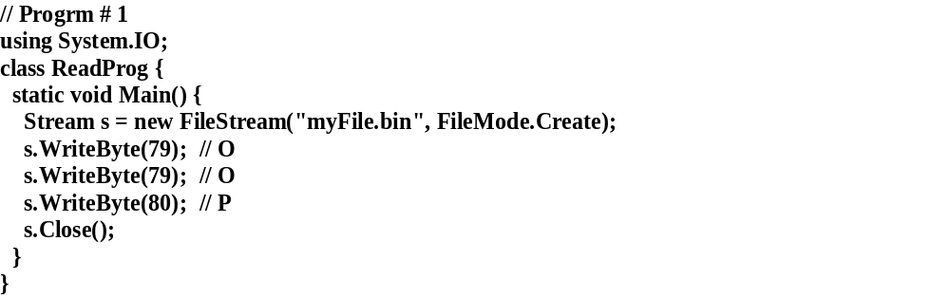
5
Example 1:
  Let us show a couple of very simple programs that write to and read from filestreams. The following program writes bytes corresponding to the three characters 'O', 'O', and 'P' to the file myFile.bin.

Slide 31
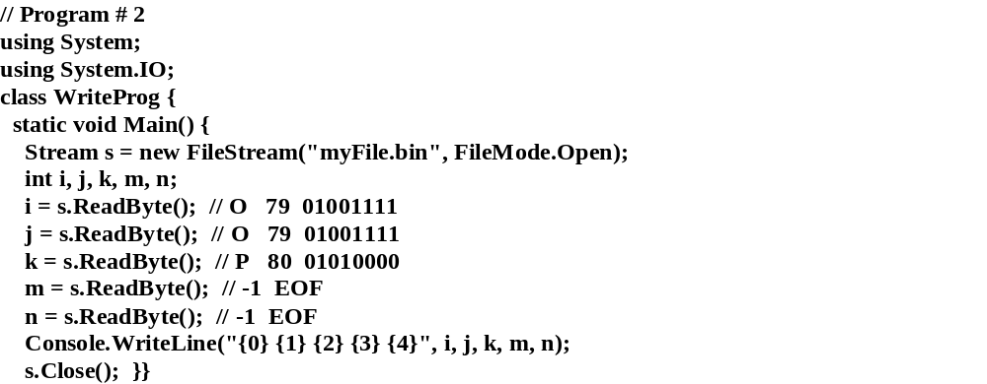
6
  After having executed program 1 the file myFile.bin exists. Program 2 reads it. We create a FileStream object in Open mode, and we read the individual bytes with use of the ReadByte method. If we read beyond the end of the file the ReadByte in that case returns -1, which is not a value in type byte (which supports the range 0..255). Therefore the return type of ReadByte is int (and not byte).

Slide 32
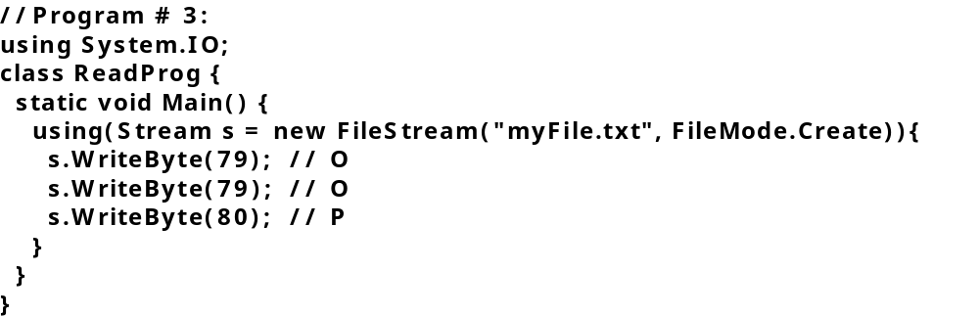
7
Example 2: The using control structure
  The simple file reading and writing examples in Program # 2 show that file opening (in terms of creating the FileStream object) and file closing (in terms of sending a Close message to the stream) always appear in pairs. This inspires a new control structure, which ensures that the file is closed when we are done with it

Slide 33
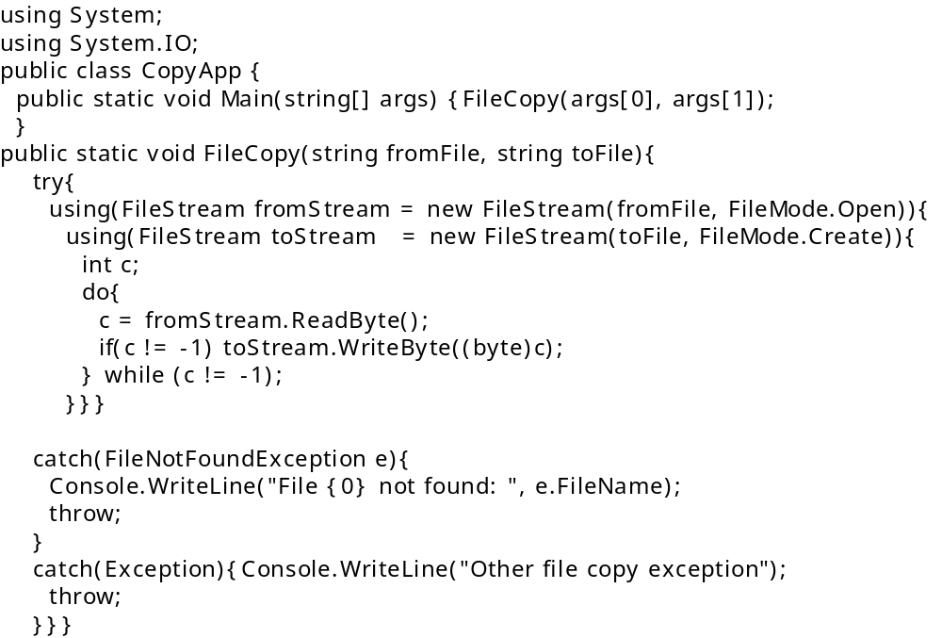
8
Example 1: We will show yet another simple example of FileStreams, namely a static method that copies one file to another.

Slide 34
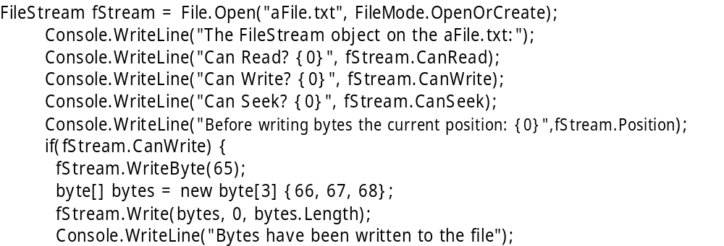
9
Example: Write and Writebyte

Slide 35
10
Example 4-use the Seek() method :
The FileStream class provides the Seek() method which changes the position of the stream in a relative way to one of three values:
  in relation to the beginning of the stream (using the enumeration SeekOrigin.Begin value)
  in relation to the current position of the stream (SeekOrigin.Current)
  in relation to the end of the stream (SeekOrigin.End).

Slide 36
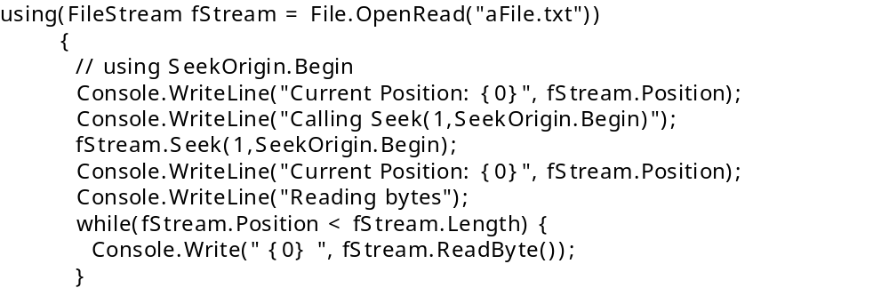
11
As you know, our file contains the bytes 65 66 67 68. The first Seek method (Seek(1, SeekOrigin.Begin) moves the position of the stream by one relative to the beginning of the stream, causing the reading operation to read only the three remaining bytes. Note that we set the position of the stream using the FileStream.Position to zero before using the next Seek() method.

Slide 37
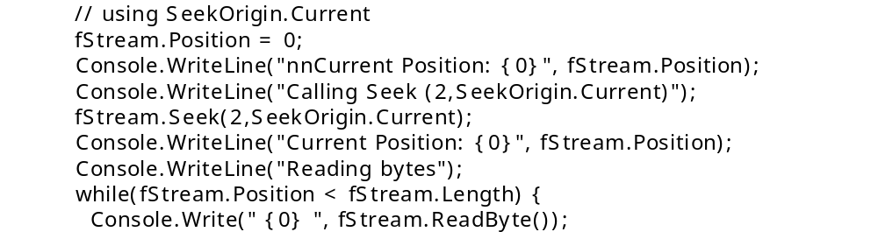
12
The second Seek() method moves the position by two relative to SeekOrigin.Current (currently equal to the first byte because we just assigned 0 to the Position property). This means that the read operation will begin at the third byte.

Slide 38
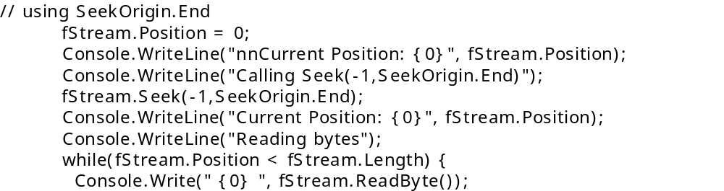
13
The last Seek() method moves the position in the stream to -1 of the end of the stream (SeekOrigin.End), which means that it is reading only the last byte in the stream.

Slide 39
Encoding and Decoding
Every string and text file is encoded using one of many different encoding standards. Most of the time, the .NET Framework handles the encoding for you automatically. However, there are times when you might need to manually control encoding and decoding, such as when:
  Interoperating with legacy or UNIX systems
  Reading or writing text files in other languages
  Creating HTML pages
  Manually generating e-mail messages

Slide 40
Understanding Encoding
Although it was not the first encoding type, American Standard Code for Information Interchange (ASCII) is still the foundation for existing encoding types.
To enable computers to be used in non-English-speaking locations, computer manufacturers made use of the remaining values—128 through 255—in an 8-bit byte. Over time, different locations assigned unique characters to values greater than 127. Because different locations might have different characters assigned to a single value, transferring documents between different languages created problems.
To help reduce these problems, American National Standards Institute (ANSI) defined standardized code pages that had standard ASCII values for 0 through 127, and language-specific values for 128 through 255.
A code page is a list of selected character codes (characters represented as code points) in a certain order. Code pages are usually defined to support specific languages or groups of languages that share common writing systems. Windows code pages contain 256 code points and are zero-based.

Slide 41
1
For example, an e-mail might include one of the following headers:
Content-Type: text/plain; charset=ISO-8859-1
Content-Type: text/plain; charset="Windows-1251"
“ISO-8859-1” corresponds to code page 28591, “Western European (ISO)”. If it had specified “ISO-8859-7”, it could have contained characters from the “Greek (ISO)” code page, number 28597. Similarly, HTML Web pages typically include a meta tag such as one of the following:
<meta http-equiv="Content-Type" content="text/html; charset=iso-8859-1">
<meta http-equiv="Content-Type" content="text/html; charset=utf-8">

Slide 42
2
More and more, ASCII and ISO 8859 encoding types are being replaced by Unicode. Unicode is a massive code page with tens of thousands of characters that support most languages and scripts, including Latin, Greek, Cyrillic, Hebrew, Arabic, Chinese, and Japanese (and many other scripts).
Unicode itself does not specify an encoding type; however, there are several standards for encoding Unicode.
The .NET Framework uses Unicode UTF-16 (Unicode Transformation Format, 16-bit encoding form) to represent characters.
In some cases, the .NET Framework uses UTF-8 internally. The System.Text namespace provides classes that allow you to encode an

Slide 43
3
System.Text encoding support includes the following encodings:
  Unicode UTF-32 encoding represents Unicode characters as sequences of 32-bit integers. You can use the UTF32Encoding class to convert characters to and from UTF-32 encoding.
  Unicode UTF-16 encoding represents Unicode characters as sequences of 16-bit integers. You can use the UnicodeEncoding class to convert characters to and from UTF-16 encoding.
  Unicode UTF-8 uses 8-bit, 16-bit, 24-bit, and up to 48-bit encoding. Values 0 through 127 use 8-bit encoding and exactly match ASCII values, providing some degree of interoperability. Values from 128 through 2047 use 16-bit encoding and provide support for Latin, Greek, Cyrillic, Hebrew, and Arabic alphabets. Values 2048 through 65535 use 24-bit encoding for Chinese, Japanese, Korean, and other languages that require large numbers of values. You can use the UTF8Encoding class to convert characters to and from UTF-8 encoding.
  ASCII encoding encodes the Latin alphabet as single 7-bit ASCII characters. Because this encoding only supports character values from U+0000 through U+007F, in most cases it is inadequate for internationalized applications. You can use the ASCIIEncoding class to convert characters to and from ASCII encoding.
  The System.Text.Encoding class provides support for a wide range of ANSI/ISO encodings.

Slide 44

4
Using the Encoding Class
  You can use the System.Text.Encoding.GetEncoding method to return an encoding object for a specified encoding. You can use the Encoding.GetBytes method to convert a Unicode string to its byte representation in a specified encoding.

Slide 45
5-Write to file
To specify the encoding type when writing a file, use an overloaded Stream constructor that accepts an Encoding object. For example, the following code sample creates several files with different encoding types:
StreamWriter swUtf7 = new StreamWriter("utf7.txt", false, Encoding.UTF7);
swUtf7.WriteLine("Hello, World!");
swUtf7.Close();
StreamWriter swUtf8 = new StreamWriter("utf8.txt", false, Encoding.UTF8);
swUtf8.WriteLine("Hello, World!");
swUtf8.Close();
StreamWriter swUtf16 = new StreamWriter("utf16.txt", false, Encoding.Unicode);
swUtf16.WriteLine("Hello, World!");
swUtf16.Close();
StreamWriter swUtf32 = new StreamWriter("utf32.txt", false, Encoding.UTF32);
swUtf32.WriteLine("Hello, World!");
swUtf32.Close();

Slide 46
6
Typically, you do not need to specify an encoding type when reading a file. The .NET Framework automatically decodes most common encoding types. However, you can specify an encoding type using an overloaded Stream constructor, as the following sample shows:
string fn = "file.txt";
StreamWriter sw = new StreamWriter(fn, false, Encoding.UTF7);
sw.WriteLine("Hello, World!");
sw.Close();
StreamReader sr = new StreamReader(fn, Encoding.UTF7);
Console.WriteLine(sr.ReadToEnd());
sr.Close();

Slide 47
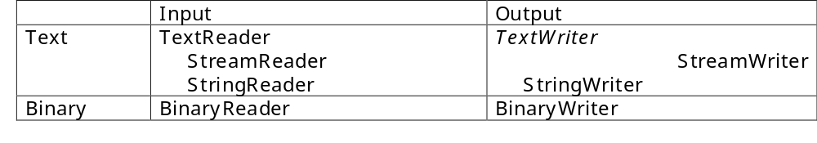
Readers and Writers in C#
In most practical cases one or more of reader and writer classes are used for IO purposes instead of a Stream subclass. Table 36 provides an overview of the reader and writer classes. In the horizontal dimension we have input (readers) and output (writers). In the vertical dimension we distinguish between binary (bits structured as bytes) and text (char/string) IO.

Slide 48
Readers and Writers
Stream readers and writers provide a convenient way to read and write text and binary data types to streams.
You might have noticed in our discussions so far that stream Read and Write methods perform I/O using byte-type data arrays.
Using byte-type arrays to read and write data makes stream classes inconvenient, especially when you’re writing text because your application has to spend a great deal of time converting data types to byte arrays.
There are two reader classes—StreamReader and BinaryReader—and two writer classes— StreamWriter and BinaryWriter—that make handling I/O on streams a snap.

Slide 49
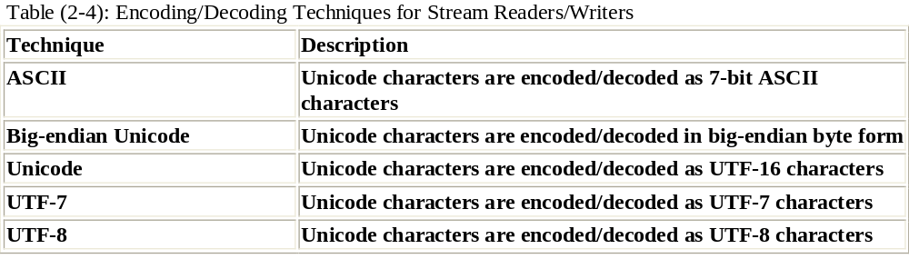
StreamReader and StreamWriter -1
The best way to read and write character-based data to a stream is by using the StreamReader and StreamWriter classes. Both classes are based on the abstract classes TextReader and TextWriter that enable you to read and write a sequence of characters.

Slide 50
2
The most useful methods in the StreamWriter class are Write and WriteLine, which come from the TextWriter class. The only difference between the two methods is that WriteLine places a carriage return followed by a line feed at the end of the text and Write does not. Both methods have many prototypes and allow you to read and write many numerical data types and strings as text to a stream.

Slide 51
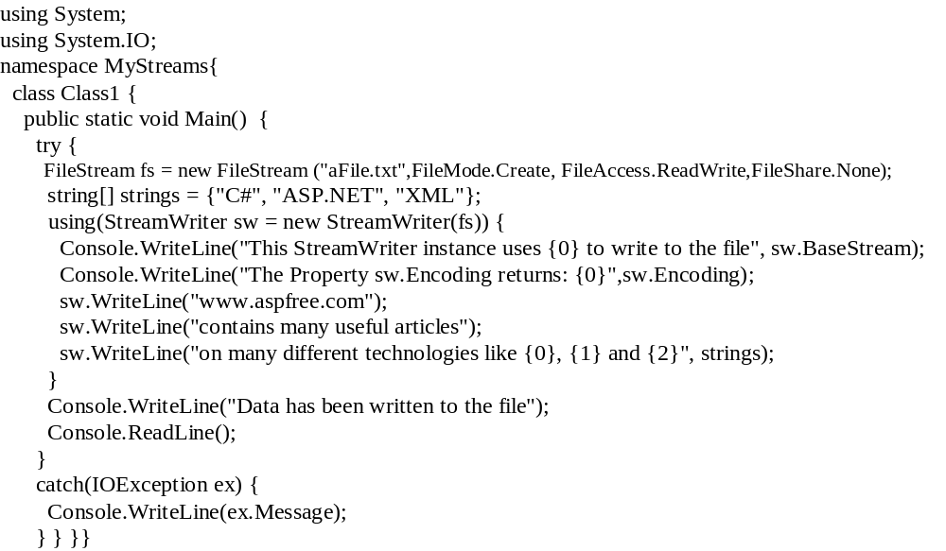
Example 1: using the StreamWriter object

Slide 52
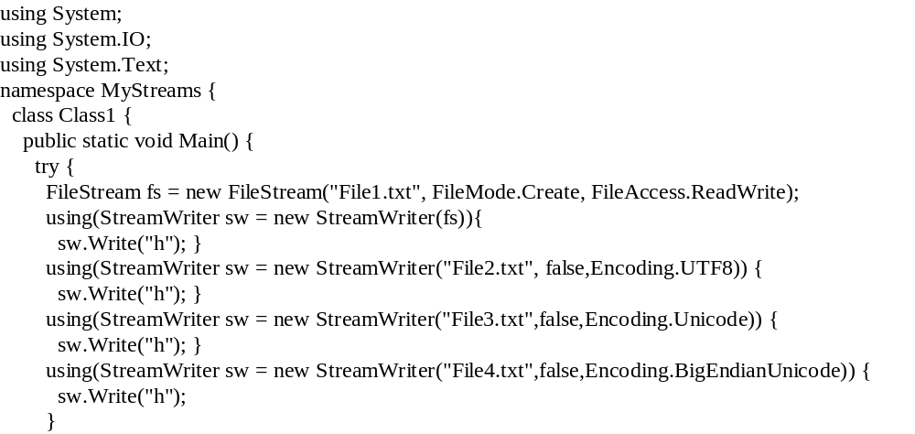
Example 2: Using StreamReader to read from the file

Slide 53
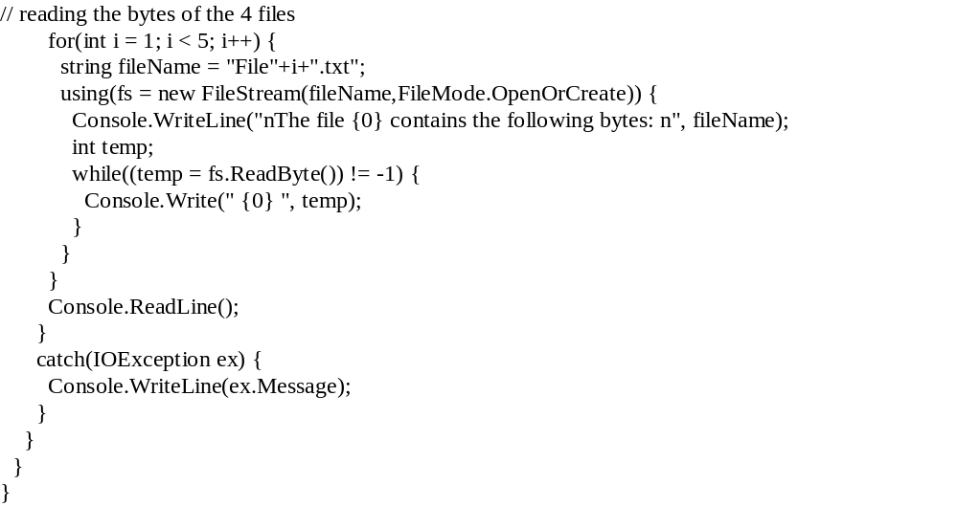
2

Slide 54
BinaryWriter and BinaryReader classes
.NET allows you to write or read binary data with any stream by using the BinaryWriter and BinaryReader classes. When writing data with the BinaryWriter, you use the BinaryWriter.Write method. This method is overloaded to support all the common C# .NET data types, including strings, chars, integers, floating point numbers, decimals, and so on. The information will then be encoded as a series of bytes and written to the file. You can configure the encoding used for strings by using an overloaded constructor that accepts a System.Text.Encoding object.
You must be particularly fastidious with data types when using binary files. This is because when you retrieve the information, you must use one of the strongly typed Read methods from the BinaryReader. For example, to retrieve decimal data, you use ReadDecimal. To read a string, you use ReadString. (The BinaryWriter always records the length of a string when it writes it to a binary file to prevent any possibility of error.)

Slide 55
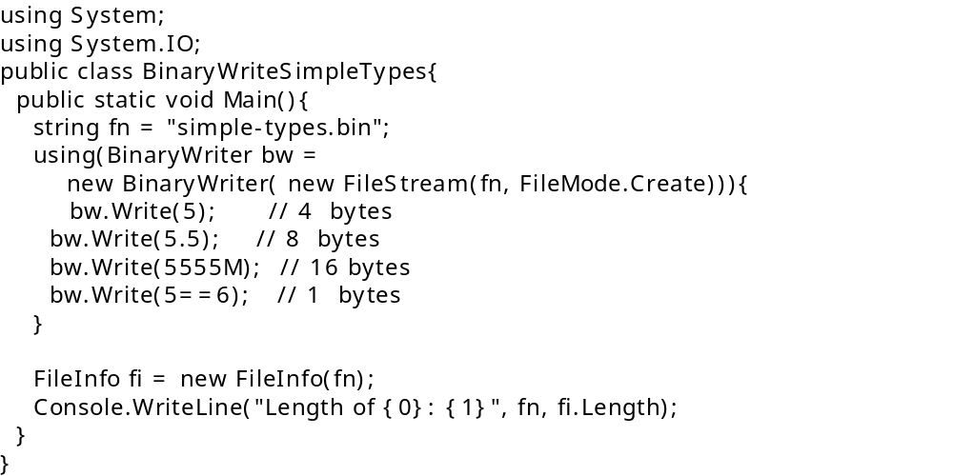
Example - Bwriter

Slide 56
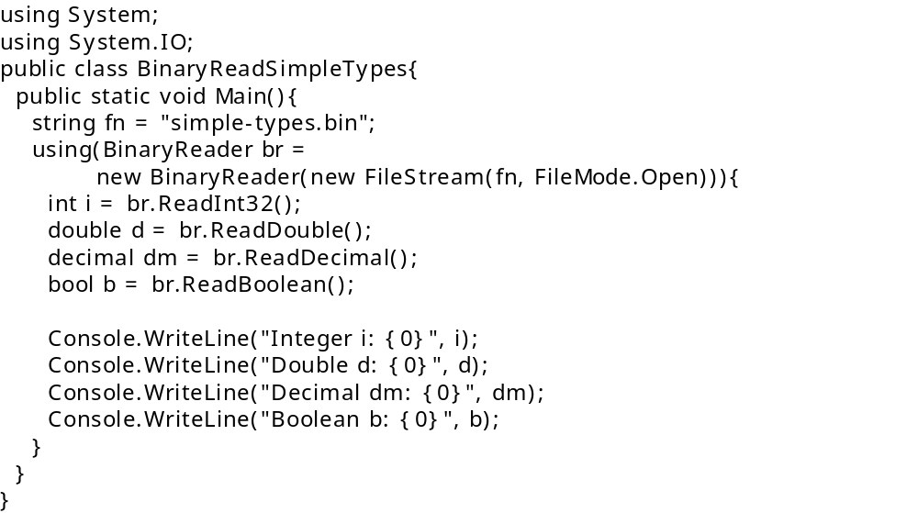
Example-BReader
The class BinaryReader is the natural counterpart to BinaryWriter. Both of them deal with input from and output to binary data (in contrast to text in some given encoding). The following program reads the binary file produced by the above Program.

Slide 57
Example -Binaryreader
The following code example creates a FileStream around the existing MyFile.txt in order to buffer MyFile.txt. (Note that FileStreams are buffered by default.) Next, a BinaryReader is created to read bytes from the FileStream, which is passed to the BinaryReader as its constructor argument. ReadByte reads until PeekChar finds no more bytes.
using System;
using System.IO;
public class ReadBuf {
private const string FILE_NAME = "MyFile.txt";
public static void Main(String[] args) {
if (!File.Exists(FILE_NAME)) {
Console.WriteLine("{0} does not exist.", FILE_NAME);
return; }
FileStream f = new FileStream(FILE_NAME, FileMode.Open,
FileAccess.Read, FileShare.Read);
// Create an instance of BinaryReader that can read bytes from the FileStream.
BinaryReader sr = new BinaryReader(f);
// While not at the end of the file, read lines from the file.
while (sr.PeekChar()>-1) {
byte input = sr.ReadByte();
Console.WriteLine (input);}
sr.Close();
}}

Slide 58
Memory and Buffered Streams
The classes MemoryStream and BufferedStream are both derived from the abstract Stream class, just as FileStream is. Therefore, MemoryStream and BufferedStream share many of the same characteristics and functionality.
Both are designed for streaming data into and out of memory rather than persistent storage. Both can be associated with a stream of another kind.such as a file.if required, and thus both can be used to act as a buffer between memory and persistent storage.
The MemoryStream class offers methods such as WriteTo, which will write to another stream. Similarly, a BufferedStream object is normally associated with another stream on construction, and when you close the BufferedStream, its contents are flushed to the associated stream.

Slide 59
Memory Stream
The MemoryStream class allows you to create a memory stream with a memory buffer as a backing store of a fixed size or of a dynamic size.
The MemoryStream constructor features several prototypes that allow you to pass in a fixed byte-type array buffer that the stream internally uses as a backing store to read and write data. Otherwise, you can specify a size in bytes where the stream will dynamically allocate and manage a buffer for you.
The MemoryStream class provides the basic functionality to create in-memory streams. Table 26 and Table 27 show the most important MemoryStream properties and methods, respectively.

Slide 60
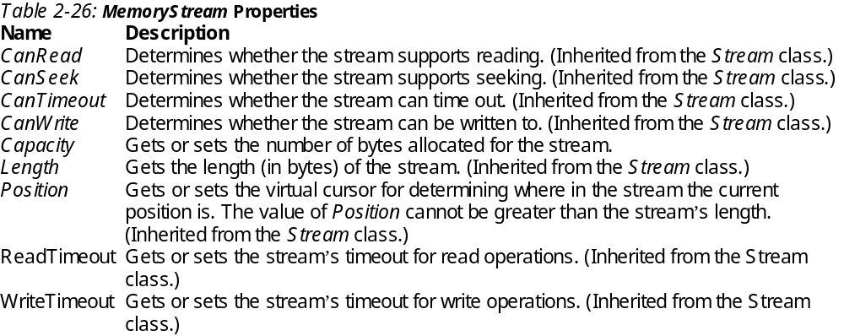
1

Slide 61
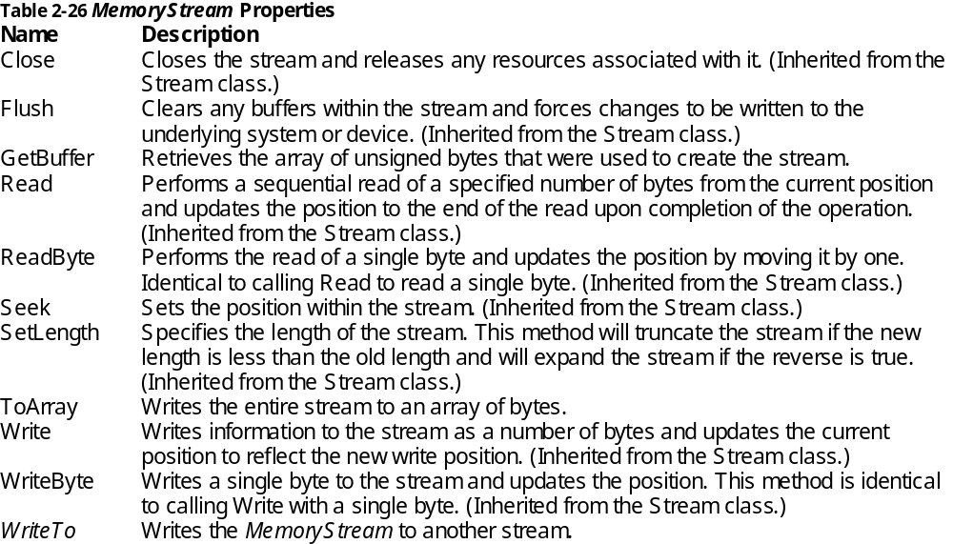
2

Slide 62
3
The MemoryStream class creates streams that have memory as a backing store instead of a disk or a network connection. MemoryStream encapsulates data stored as an unsigned byte array that is initialized upon creation of a MemoryStream object, or the array can be created as empty. The encapsulated data is directly accessible in memory. Memory streams can reduce the need for temporary buffers and files in an application.
The current position of a stream is the position at which the next read or write operation could take place. The current position can be retrieved or set through the Seek method. When a new instance of MemoryStream is created, the current position is set to zero.
Memory streams created with an unsigned byte array provide a non-resizable stream view of the data, and can only be written to. When using a byte array, you can neither append to nor shrink the stream, although you might be able to modify the existing contents depending on the parameters passed into the constructor. Empty memory streams are resizable, and can be written to and read from.
If a MemoryStream object is added to a ResX file or a .resources file, call the GetStream method at runtime to retrieve it.
If a MemoryStream object is serialized to a resource file it will actually be serialized as an UnmanagedMemoryStream. This behavior provides better performance, as well as the ability to get a pointer to the data directly, without having to go through Stream methods.

Slide 63
How to Use a MemoryStream
The MemoryStream class has the job of helping you create streams in memory. Creating a memory stream is as simple as creating a new instance of the MemoryStream class:
MemoryStream memStrm = new MemoryStream();
You can use the StreamWriter exactly as you used the FileStream class earlier to write data to your new MemoryStream:
StreamWriter writer = new StreamWriter(memStrm);
writer.WriteLine("Hello");
writer.WriteLine("Goodbye");
The designers of the MemoryStream class understand that storing the stream in memory is usually a temporary situation. So the class supports writing the stream directly to another stream or copying the data to other storage.
writer.Flush();
// Create a file stream
FileStream theFile = File.Create(@"c:\inmemory.txt");
// Write the entire Memory stream to the file
memStrm.WriteTo(theFile);
// Clean up
writer.Close();
theFile.Close();
memStrm.Close();

Slide 64
4-Example
using System;
using System.IO;
using System.Text;
class MemStream {
static void Main() {
int count;
byte[] byteArray;
char[] charArray;
UnicodeEncoding uniEncoding = new UnicodeEncoding();
// Create the data to write to the stream.
byte[] firstString = uniEncoding.GetBytes(
"Invalid file path characters are: ");
byte[] secondString = uniEncoding.GetBytes(
Path.InvalidPathChars);
using(MemoryStream memStream = new MemoryStream(100)) {
// Write the first string to the stream.
memStream.Write(firstString, 0 , firstString.Length);
// Write the second string to the stream, byte by byte.
count = 0;
while(count < secondString.Length) {
memStream.WriteByte(secondString[count++]);
}

Slide 65
5
// Write the stream properties to the console.
Console.WriteLine("Capacity = {0}, Length = {1}, Position = {2}\n",
memStream.Capacity.ToString(),
memStream.Length.ToString(),
memStream.Position.ToString());
// Set the position to the beginning of the stream.
memStream.Seek(0, SeekOrigin.Begin);
// Read the first 20 bytes from the stream.
byteArray = new byte[memStream.Length];
count = memStream.Read(byteArray, 0, 20);
// Read the remaining bytes, byte by byte.
while(count < memStream.Length){
byteArray[count++] =
Convert.ToByte(memStream.ReadByte());
}
// Decode the byte array into a char array and write it to the console.
charArray = new char[uniEncoding.GetCharCount( byteArray, 0, count)];
uniEncoding. GetDecoder().GetChars(byteArray, 0, count, charArray, 0);
Console.WriteLine(charArray);
}
}
}

Slide 66
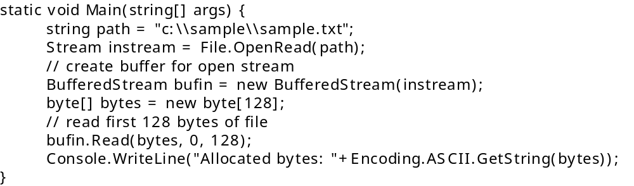
BufferedStream
Using of streams to do file IO is straightforward but slow with low performance (as was mentioned above). For that reason BufferedStream class exists and is more efficient. It can be used by any stream class. For file operations it’s possible to use FileStream, where buffering operations are already included.

Slide 67
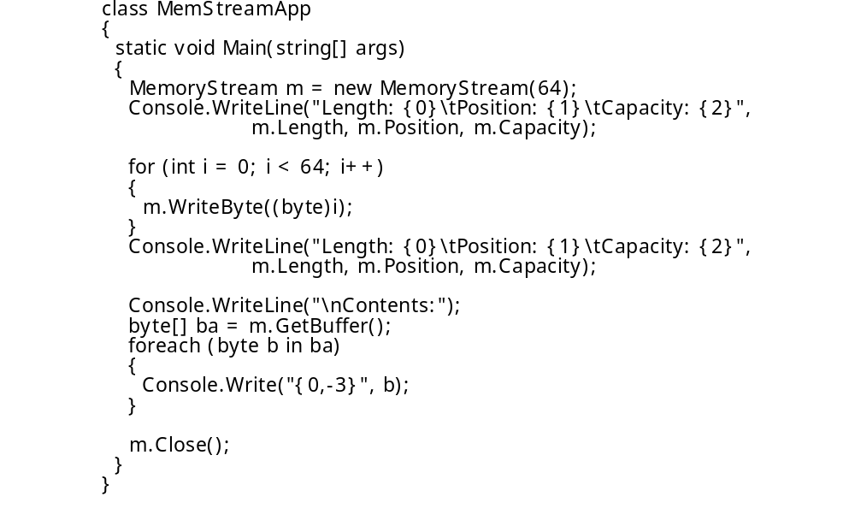
Example – Memory and Buffered streams -1
In this example, we first create a MemoryStream object with an initial capacity of 64 bytes and print some arbitrary property values. Then we write out 64 bytes and report the same properties. We then use MemoryStream.GetBuffer to get a byte array of the entire contents of the stream and print the values, before finally closing the stream:

Slide 68
Here's the output -2
Length: 0 Position: 0 Capacity: 64
Length: 64 Position: 64 Capacity: 64
Contents:
0 1 2 3 4 5 6 7 8 9 10 11 12 13 14 15 16 17 18 19
20 21 22 23 24 25 26 27 28 29 30 31 32 33 34 35 36 37 38 39
40 41 42 43 44 45 46 47 48 49 50 51 52 53 54 55 56 57 58 59
60 61 62 63
Finally, let.s associate this MemoryStream with a FileStream before closing it:
FileStream fs = new FileStream("Goo.txt", FileMode.Create, FileAccess.Write);
m.WriteTo(fs);
m.Close();

Slide 69
3
Now let.s do the same thing with a BufferedStream object.
Although generally similar, there are some subtle differences between MemoryStream and BufferedStream.
  First, we can construct a BufferedStream only by initializing it to some other existing Stream.in this example, a file.
  The buffer in a BufferedStream is managed differently than that in the MemoryStream: if we don.t specify an initial size when we construct the object, it defaults to 4096 bytes.
  Also, if we've written some data to the BufferedStream and want to read it back, we must use the Read method because there is no GetBuffer method. Using the Read method means making sure the internal stream pointer is positioned correctly in this case, at the beginning of the stream before attempting the read.

Slide 70
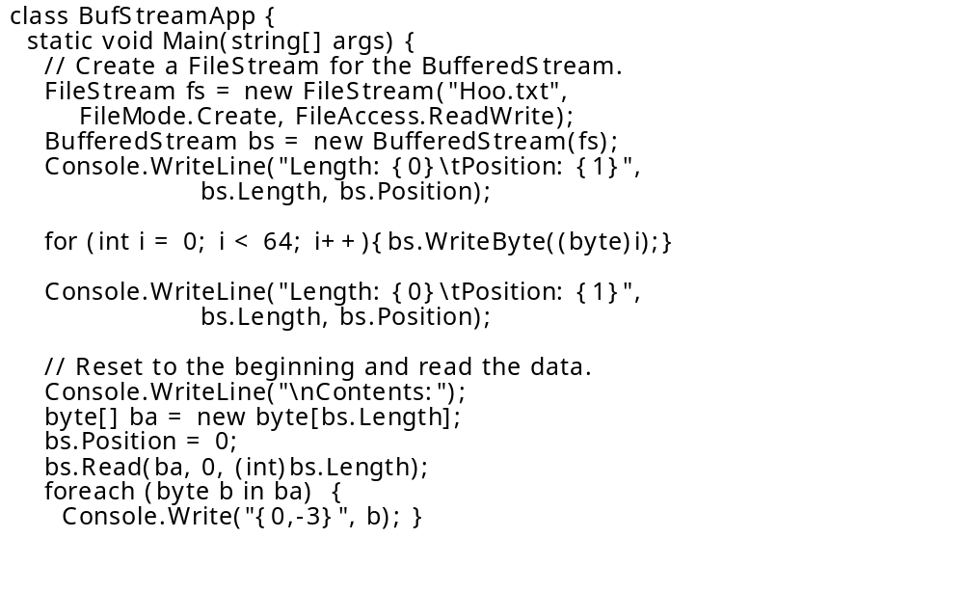
4

Slide 71
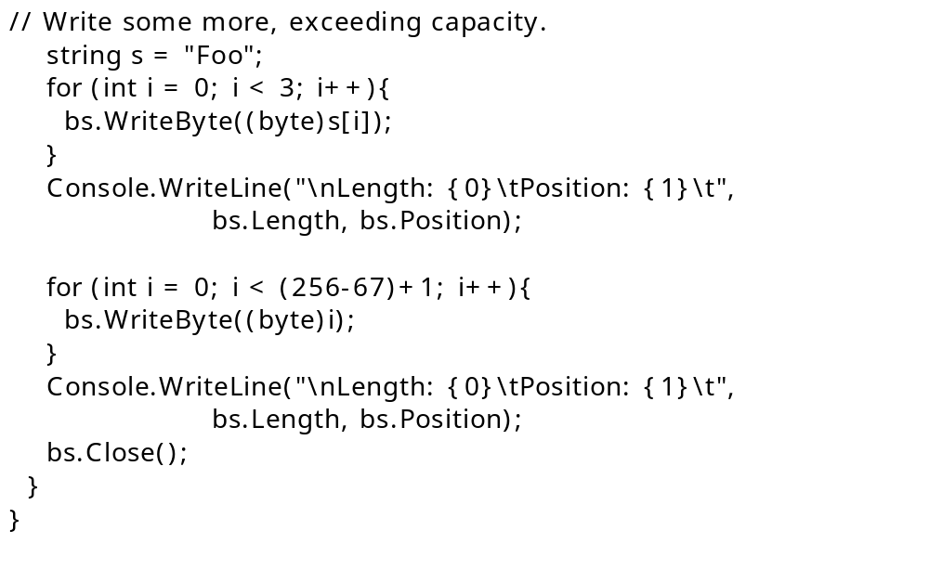
5

Slide 72
6
The console output is listed here:
Length: 0 Position: 0
Length: 64 Position: 64
Contents:
0 1 2 3 4 5 6 7 8 9 10 11 12 13 14 15 16 17 18 19
20 21 22 23 24 25 26 27 28 29 30 31 32 33 34 35 36 37 38 39
40 41 42 43 44 45 46 47 48 49 50 51 52 53 54 55 56 57 58 59
60 61 62 63
Length: 67 Position: 67
Note that the Hoo.txt file will have the same contents as those in the MemoryStream example. We didn’t have to explicitly write from the BufferedStream to the FileStream as we did for MemoryStream because the BufferedStream must be associated with another stream in the first place.
All writes to the BufferedStream will be buffered for writing to the associated stream, and merely closing the BufferedStream object is enough to flush any pending writes to the file.

Slide 73
Image to Memorystream
MemoryStream ms = new MemoryStream();
pictureBox1.Image.Save(ms, System.Drawing.Imaging.ImageFormat.Jpeg);
byte[] arrImage = ms.GetBuffer();
ms.Close();

Slide 74
Bytearray->Fs->Bytearray
public bool SaveDocument( Byte[] docbinaryarray, string docname){
string strdocPath;
strdocPath = "C:\\DocumentDirectory\\" + docname;
FileStream objfilestream =new FileStream(strdocPath,FileMode.Create,FileAccess.ReadWrite);
objfilestream.Write(docbinaryarray,0,docbinaryarray.Length);
objfilestream.Close();
return true;
}
public Byte[] GetDocument(string DocumentName){
string strdocPath;
strdocPath = "C:\\DocumentDirectory\\" + DocumentName;
FileStream objfilestream = new FileStream(strdocPath,FileMode.Open,FileAccess.Read);
int len = (int)objfilestream.Length;
Byte[] documentcontents = new Byte[len];
objfilestream.Read(documentcontents,0,len);
objfilestream.Close();
return documentcontents;
}

Slide 75
stream2stream
public class StreamUtil{
private StreamUtil() { }
private const int BUFFER_SIZE = 1024;
public static void CopyStream ( Stream From, Stream To){
byte[] buffer = new byte[BUFFER_SIZE];
int got;
while ( ( got = From.Read ( buffer, 0, BUFFER_SIZE ) ) > 0)
To.Write ( buffer, 0, got );
}
}

Slide 76
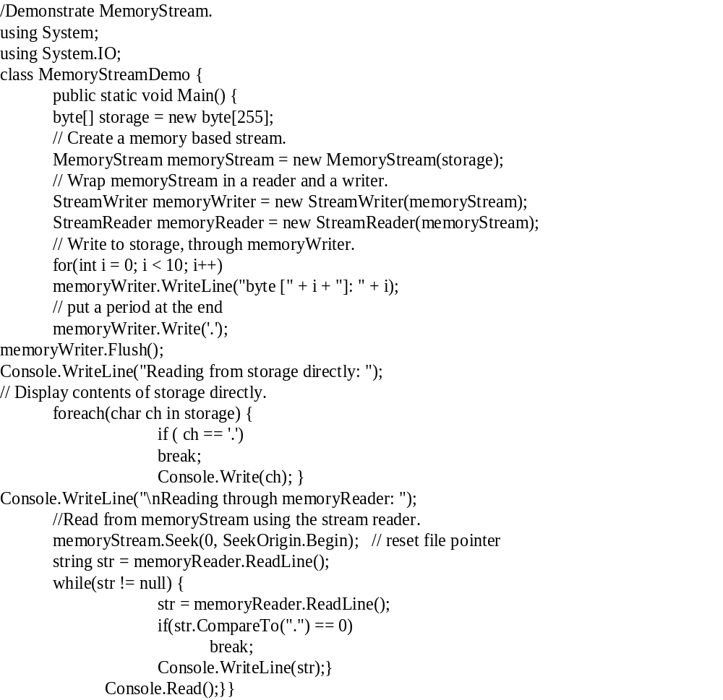
Example

Slide 77
Output
Reading from storage directly:
byte [0]: 0
byte [1]: 1
byte [2]: 2
byte [3]: 3
byte [4]: 4
byte [5]: 5
byte [6]: 6
byte [7]: 7
byte [8]: 8
byte [9]: 9
Reading through memoryReader:
byte [1]: 1
byte [2]: 2
byte [3]: 3
byte [4]: 4
byte [5]: 5
byte [6]: 6
byte [7]: 7
byte [8]: 8
byte [9]: 9
In the program, an array of bytes called storage is created. This array is then used as the underlying storage for a MemoryStream called memoryStream. From memoryStream are created a StreamReader called memoryReader and a StreamWriter called memoryWriter. Using memoryWriter, output is written to the memory-based stream. Notice that after the output has been written, flush() is called on memoryWriter. This is necessary to ensure that the contents of memoryWriter’s buffer are actually written to the underlying array. Next the contents of the underlying byte array are displayed manually, using a foreach loop. Then, using Seek(), the file pointer is reset to the start of the stream, and the memory stream is read using memoryReader.

Slide 78
Convert Image to string
Image can be transferred into stream and byte array, and if you want to convert to string, it is possible. But when you convert it back to html page, it'll has some issue. Anyway, convert image to string is possible:
Image im = Image.FromFile(@"D:\microsoft.jpg");
MemoryStream ms = new MemoryStream();
im.Save(ms, System.Drawing.Imaging.ImageFormat.Jpeg);
byte[] Barray = ms.ToArray();
string str = string.Empty;
foreach (byte b in oImage){str += b.ToString();}

Slide 79
convert image to a base64 string
A better way is to convert it to a base64 string. That would also allow you to restore it back. The following example includes two methods that convert an image to a string and back to the image from a string:
public string ImageToString(string path){
if (path == null)
throw new ArgumentNullException("path");
Image im = Image.FromFile(path);
MemoryStream ms = new MemoryStream();
im.Save(ms, im.RawFormat);
byte[] array = ms.ToArray();
return Convert.ToBase64String(array);}
public Image StringToImage(string imageString) {
if (imageString == null)
throw new ArgumentNullException("imageString");
byte[] array = Convert.FromBase64String(imageString);
Image image = Image.FromStream(new MemoryStream(array));
return image;}
The usage would look like this:
// convert the image to a string.
string imageAsString = ImageToString(@"C:\Users\Chris\Pictures\untitled.png");
// or convert it back to an image.
Image image = StringToImage(imageAsString);

Slide 80
Example
There are many occasions which require web developers to provide downloadable content to end-users in the form of text files, Excel files, etc. This is pretty straight forward if the files already exist and are physically located somewhere the user can access via the browser.
However, this requirement becomes a little more complicated if the data that comprises the file is dynamically generated based on user input. An example of this is an application that allows a user to select the number of widgets their company produced between DateA and DateB and then have that data immediately downloaded as a text file. In this situation the text file has to be created on the fly and sent to the browser.
Meeting the requirement is pretty straightforward. The following example shows you how to query a SQL Server database, buffer the output to a MemoryStream, and then have that data transferred to the browser as a Tab-Delimited text file.

Slide 81
1
The first step in this example is to query the data out of the database and put it into a MemoryStream. The following function give shows how this can be done.
private MemoryStream GetData() {
//Create the return memorystream object that will hold the buffered data.
MemoryStream ReturnStream = new MemoryStream();
//Put together the connection string
string cn = "Persist Security Info=False;Integrated Security=false;User ID=sa;Pwd=foo;database=northwind;server=foo;Connect Timeout=30";
try{
//Get the sql string
string SqlString = "select * from dbo.Orders";
//Create a new command object
SqlCommand sc = new SqlCommand();
//Set the connection
sc.Connection = new SqlConnection(cn);
//Open the connection
sc.Connection.Open();
//Set the command type
sc.CommandType = CommandType.Text;
//Set the SQL String
sc.CommandText = SqlString;
//Execute the SQL Statement/Procedure
SqlDataReader RS = sc.ExecuteReader();

Slide 82
2
//Create a streamwriter to write to the memory stream
StreamWriter sw = new StreamWriter(ReturnStream);
if (RS.Read()) {
//Create a header for the file from the names of the columns that we are retrieving
string tempstring = "";
for (int counter = 0; counter < RS.FieldCount;counter++) {
tempstring += RS.IsDBNull(counter)?"":RS.GetName(counter) + "\t"; }
//Write the row of data to the Memory Stream.
sw.WriteLine(tempstring);
//Loop through the data row and write the contents to the memory stream.
while (RS.Read()){
//Put each columns' data value into a string separated by a tab.
tempstring = "";
for (int counter = 0; counter < RS.FieldCount;counter++) {
tempstring += RS.IsDBNull(counter)?"":RS.GetValue(counter).ToString() + "\t";
}
//Write the row of data to the Memory Stream.
sw.WriteLine(tempstring);}}
//Clean up the stream writer
sw.Flush();
sw.Close();
//Clean up the data reader
RS.Close();
//Clean up the command object
sc.Connection.Close();
sc.Dispose();}
catch (Exception Ex){
throw Ex;
}
//Return the memory Stream
return ReturnStream;}

Slide 83
3
The previous function solves the requirement of dynamically retrieving data from a database and buffering the data. Now the only thing left to do is to take the buffered data and send it on its way to the client as a text file. The following snippet shows how this is done.
private void Page_Load(object sender, System.EventArgs e) {
//Create and populate a memorystream with the contents of the database table
System.IO.MemoryStream mstream = GetData();
//Convert the memorystream to an array of bytes.
byte[] byteArray = mstream.ToArray();
//Clean up the memory stream
mstream.Flush();
mstream.Close();
// Clear all content output from the buffer stream
Response.Clear();
// Add a HTTP header to the output stream that specifies the default filename
// for the browser's download dialog
Response.AddHeader("Content-Disposition", "attachment; filename=foo.xls");
// Add a HTTP header to the output stream that contains the
// content length File Size). This lets the browser know how much data is being transfered
Response.AddHeader("Content-Length", byteArray.Length.ToString());
// Set the HTTP MIME type of the output stream
Response.ContentType = "application/octet-stream";
// Write the data out to the client.
Response.BinaryWrite(byteArray);
}

Slide 84
Reading and Writing Compressed Files
The two compression stream classes in the System.IO.Compression namespace that you'll look at here, DeflateStream and GZipStream, work in very similar ways. In both cases, you initialize them with an existing stream, which in the case of files will be a FileStream object. After this you can use them with StreamReader and StreamWriter just like any other stream. All you need to specify on top of that is whether the stream will be used for compression (saving files) or decompression (loading files) so that the class knows what to do with the data that passes through it. This is best illustrated with the following example.

Slide 85
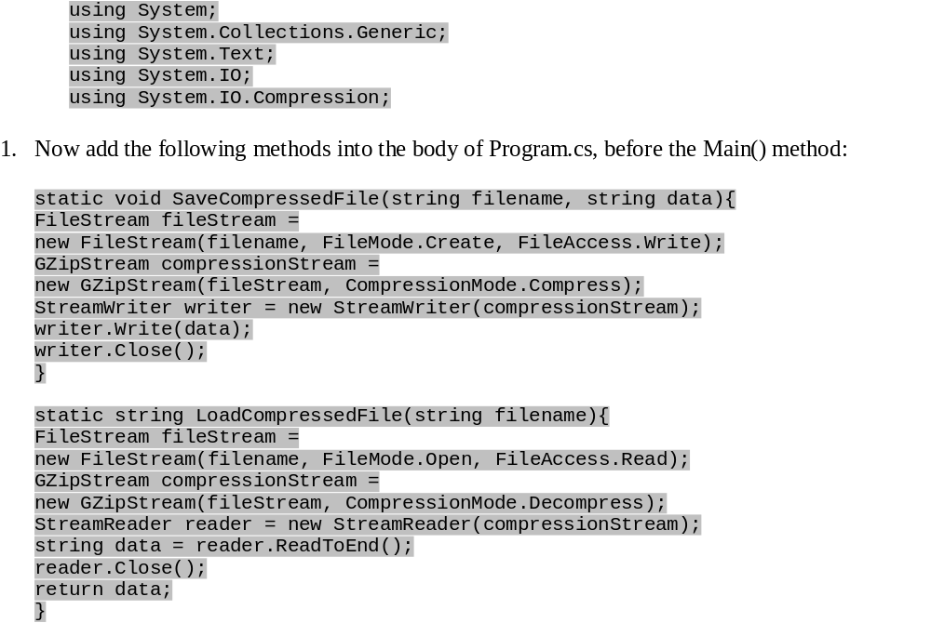

Slide 86
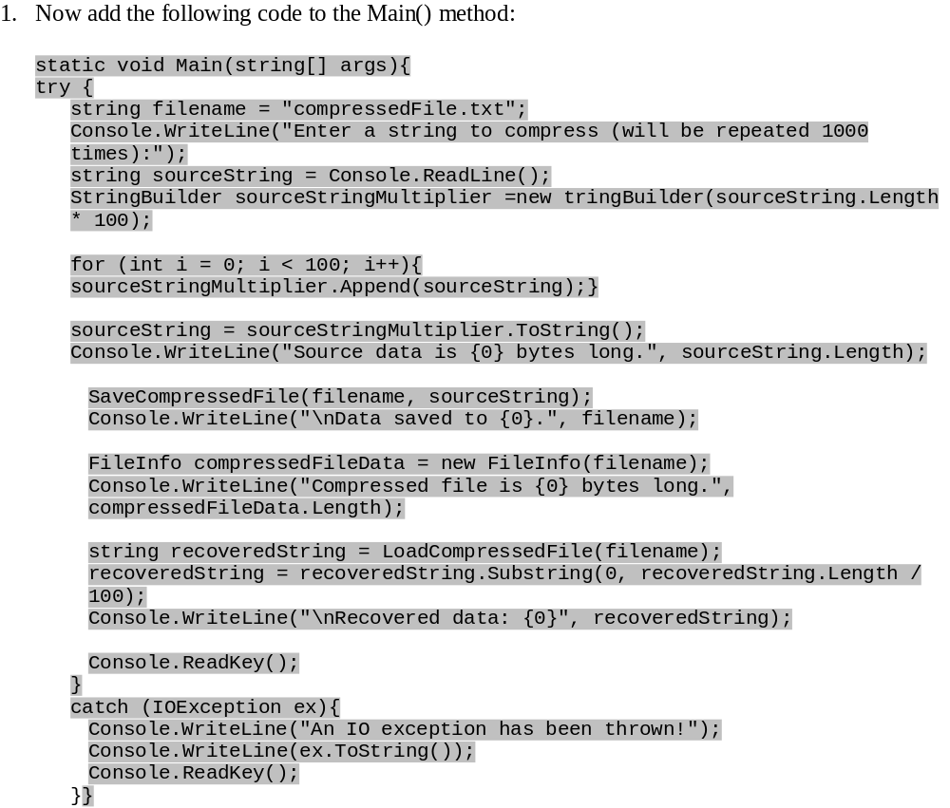

Slide 87
A Look at C# Directory and DirectoryInfo Classes
The Directory and the DirectoryInfo classes are used to represent a folder in the file system. But there are critical differences between the two. The Directory class has only static methods, and it is used when you need to perform just one operation on a folder. Since you don't have to create an object to represent the directory to perform one operation, all of the methods of the Directory class are static, so you perform the operation without creating an instance of that class.
If you need to perform a lot of operations on a folder, it's better to create an object that represents the specific folder. The class DirectoryInfo is used to create an object to represent a folder. It's effective if you are going to perform many operations on the folder because, once the object is created, it has all the necessary information about the folder such as its creation time, last access time and attributes. All the members of the DirectoryInfo class are instance members, unlike the Directory class which contains only static members.

Slide 88
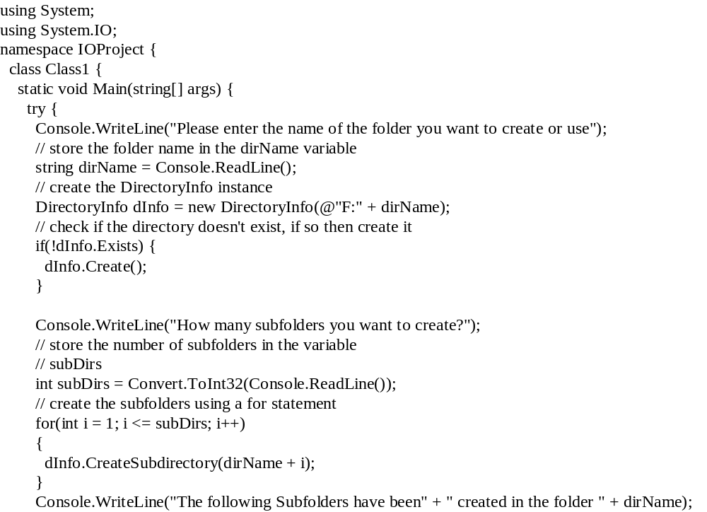
1

Slide 89
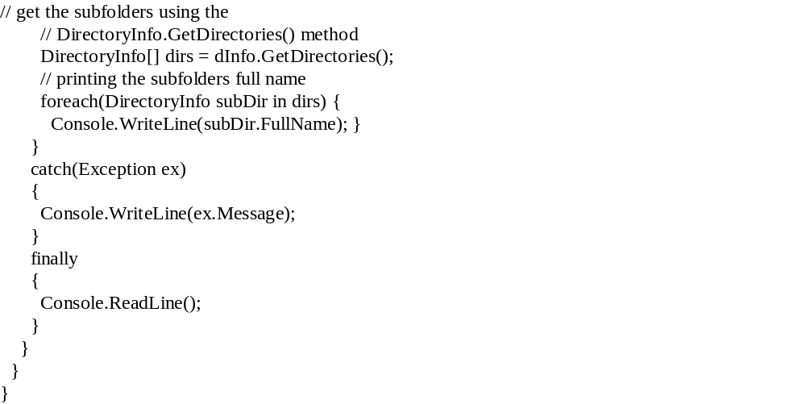
2

Slide 90
3

Slide 91
Write a complete C# window forms application, backupFile, that can be used to make a backup file of a specific file. Use an open file dialog to get a filename.
Solve the above example using memorystream class.
Write an application that can be used to read a compressed file and display it a picture Box.
You need to write data to a sequential text file using ASCII, Unicode, or UTF-8 encoding.
Write a complete C# console application, countZero that display the number of Zeros in a file. You’re apllication accepts the name of the file on the command line.For example:
C:\> countZero asd.txt
Write windows form application that open a file (using file dialog) and write it in a new file after reversing its contents.
Create a File Searcher Application.
  Create an application that will search a drive for a particular file.
  Add code to view the file by using the FileStream class to show the file in a text window.
  Finally, add a feature to compress a file when it is found.

Slide 92
Reading and Writing Compressed Files
Often when dealing with files you will find that quite a lot of space is used up on your hard disk. You've probably come across utilities that enable you to compress and decompress files, which comes in handy when you want to move them around or e-mail them to your friends. The System.IO.Compression namespace contains classes that enable you to compress files from your code, either using the GZIP or Deflate algorithm — both of which are publicly available and free for anyone to use.
The two compression stream classes in the System.IO.Compression namespace that you'll look at here, DeflateStream and GZipStream, work in very similar ways. In both cases, you initialize them with an existing stream, which in the case of files will be a FileStream object. After this you can use them with StreamReader and StreamWriter just like any other stream. All you need to specify on top of that is whether the stream will be used for compression (saving files) or decompression (loading files) so that the class knows what to do with the data that passes through it.

Slide 93
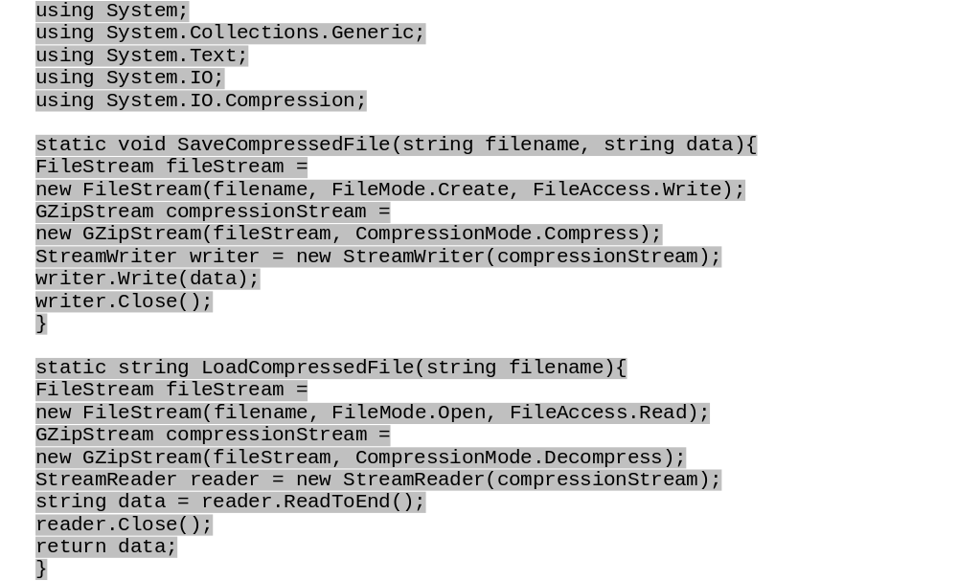
Example

Slide 94
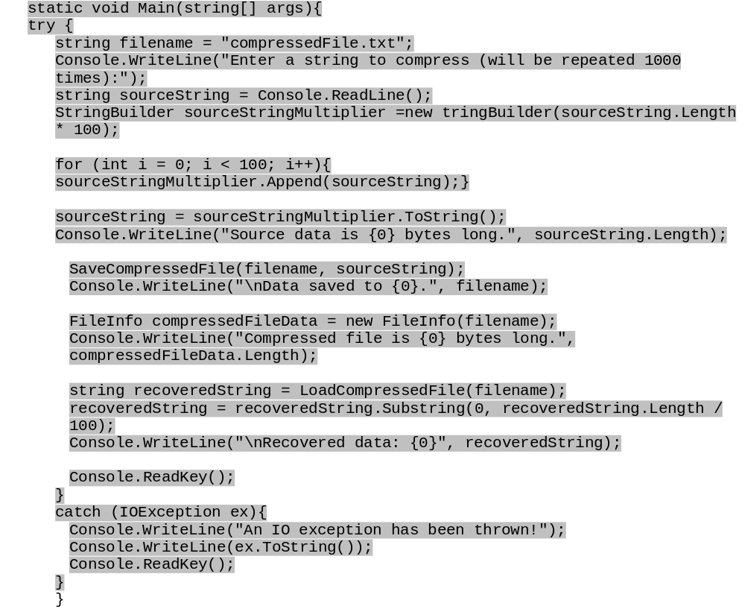
2

