Slide 1

Network programming
Serialization

Slide 2
Introduction
Many applications need to store or transfer data stored in objects. To make these tasks as simple as possible, the .NET Framework includes several serialization techniques. These techniques convert objects into binary, Simple Object Access Protocol (SOAP), or XML documents that can be easily stored, transferred, and retrieved. This chapter discusses how to implement serialization using the tools built into the .NET Framework and how to implement serialization to meet custom requirements.
When you create an object in a .NET Framework application, you probably never think about how the data is stored in memory. You shouldn’t have to—the .NET Framework takes care of that for you. However, if you want to store the contents of an object to a file, send an object to another process, or transmit it across the network, you do have to think about how the object is represented because you will need to convert it to a different format. This conversion is called serialization.

Slide 3
What Is Serialization?
Serialization is an extremely important concept. At its core, it refers to the idea of taking some data and then representing that as a serial stream of bits. Often times, programmatically, serialized data is therefore represented by standard Byte[] arrays. Serialized data also must have the capability to be deserialized.
What is the significance of serialization?
  Data that is serialized is easy to represent, transport, and store. We've just seen that serialized data is naturally represented by Byte[] arrays.
  Byte[] arrays, accordingly, are very easy to manipulate programmatically.
  Transmitting a Byte[] array over network is straightforward; indeed, a send() call on a standard socket requires a Byte[] array as a parameter.
  Additionally, serialized data can then be stored. It is intuitive that storing a Byte[] array onto some type of disk storage is straightforward, since fundamentally these devices deal with sequences of bytes.

Slide 4
1
How is serialization useful, then? In C#, like with many object oriented programming languages, serialization is often used to translate programmatic Objects (of any type) to Byte[] arrays (also known as byte streams). These byte streams can then be stored or transmitted as required.
Later, the information can be retrieved serially (across the network, or from a hard drive, for example), and then deserialized accordingly.
In this manner, we could create, say, an ArrayList object and fill it with Arbitrary data, write it to the disk, and restore the object later for use. This sort of scenario lies at the core of information storage (in particular, databases).

Slide 5
2
Serialization, as implemented in the System.Runtime.Serialization namespace, is the process of serializing and deserializing objects so that they can be stored or transferred and then later re-created. Serializing is the process of converting an object into a linear sequence of bytes that can be stored or transferred. Deserializing is the process of converting a previously serialized sequence of bytes into an object.
Basically, if you want to store an object (or multiple objects) in a file for later retrieval, you store the output of serialization. The next time you want to read the objects, you call the deserialization methods, and your object is re-created exactly as it had been previously. Similarly, if you want to send an object to an application running on another computer, you establish a network connection, serialize the object to the stream, and then deserialize the object on the remote application.

Slide 6
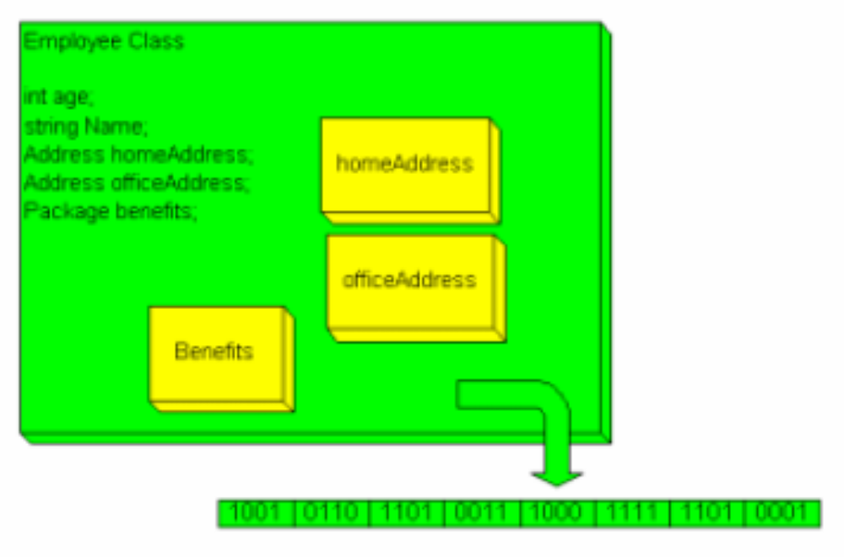
3
When an object is saved to disk or sent over the Internet it must be serialized—that is written out as a stream of bytes, one after the other. When you serialize an object, instruct each member field to serialize itself. Intrinsic types (such as integer, double, etc.) know how to serialize themselves.

Slide 7
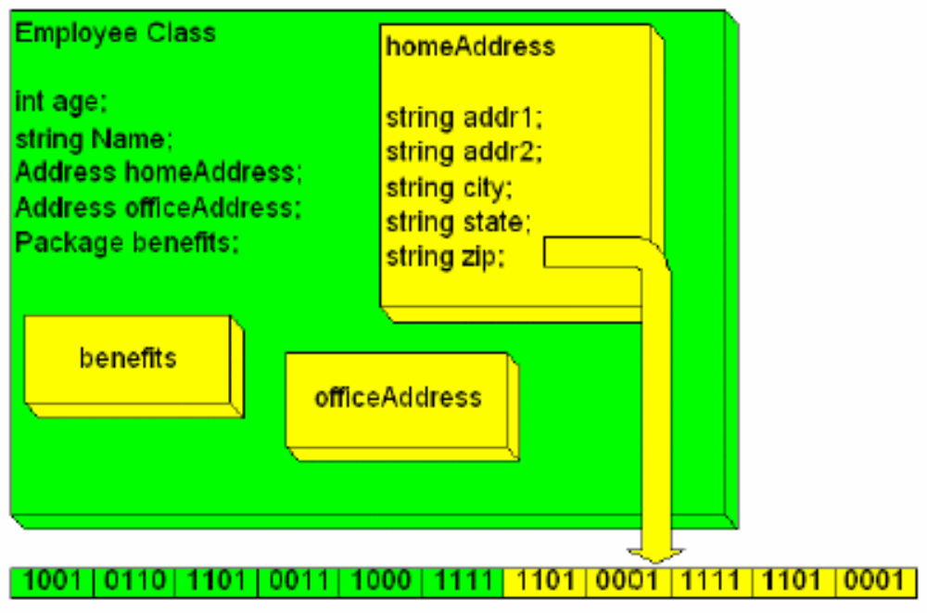
4
Member fields that are not primitive types must stream themselves, as illustrated in Figure 2. This works because all user-defined types are either composed of primitive types or of other user-defined types. Each user-defined type delegates responsibility for streaming to all its fields; ultimately every user-defined type reduces to primitive types, and primitive types know how to stream themselves.

Slide 8
How to Serialize an Object
By default user-defined types are not serializable; you must explicitly mark them using an attribute. To mark your class serializable use the following attribute:
[serializable]
Although the framework knows how to save an object marked with the Serializable attribute, you still have to specify the format in which the object is saved (i.e., store the data as binary, XML, or some custom format), and the storage medium.
A formatter is used to determine the format of the serialization. The .NET Framework provide two formatters: SOAP and Binary. You’ll typically use the SOAP formatter for serializing across the Web, and the Binary formatter for serializing to disk. You are also free to write your own formatter, but this is a nontrivial task.

Slide 9
6
To specify the format in which an object is saved, you use an instance of an object that supports the IFormatter interface. The Framework ships with two such classes, System.Runtime:
Serialization.Formatters.Binary.BinaryFormatter
System.Runtime. Serialization.Formatters.Soap.SoapFormatter
The BinaryFormatter uses a binary, compact format for serializing and deserializing on platforms that support the Common Language Runtime. The SoapFormatter uses the industry-standard SOAP protocol. Since it is an XML-, and therefore text-based protocol, it can be used to communicate with a non-CLR-based platform. The binary format is faster when serializing and deserializing data.
You can, of course, implement your own formatter classes. You might do this if you had to talk to a system with its own legacy byte format.

Slide 10
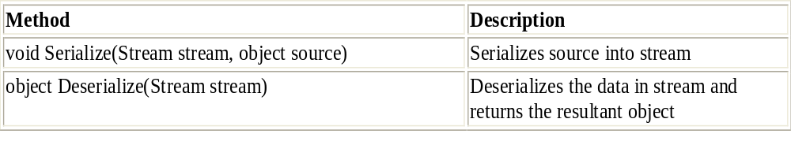
8
Sometimes the serialization provided by the Framework is not satisfactory. You can provide custom serialization for a class by implementing the ISerializable interface and adding a constructor to the class. The ISerializable interface has one member: GetObjectData. This method is used when data is serialized.
To inform the framework that a class can be serialized, mark the class with the System.Serializable attribute. Any field or property that should not be serialized can be marked with the System.NonSerialized attribute. For example, fields that represent calculated values need not be serialized. All you have to do is mark the class with the attribute; you need write no other code to save the class's fields. Only instance fields are saved; the static fields of a class are never saved.
The IFormatter interface provides the methods shown in the following table:

Slide 11
7
At a high level, the steps for serializing an object are as follows:
  Create a stream object to hold the serialized output.
  Create a BinaryFormatter object (located in System.Runtime.Serialization.Formatters.Binary).
  Call the BinaryFormatter.Serialize method to serialize the object, and output the result to the stream.
At the development level, serialization can be implemented with very little code. The following console application—which requires the System.IO, System.Runtime.Serialization, and System.Runtime.Serialization.Formatters. Binary namespaces—demonstrates this:
string data = "This must be stored in a file.";
// Create file to save the data to
FileStream fs = new FileStream("SerializedString.Data", FileMode.Create);
// Create a BinaryFormatter object to perform the serialization
BinaryFormatter bf = new BinaryFormatter();
// Use the BinaryFormatter object to serialize the data to the file
bf.Serialize(fs, data);
// Close the file
fs.Close();

Slide 12
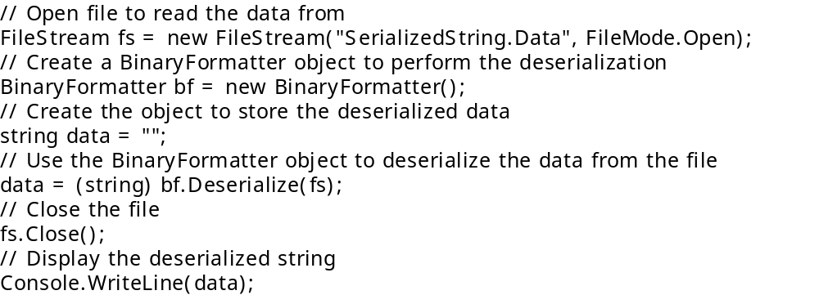
8-How to Deserialize an Object
Deserializing an object allows you to create a new object based on stored data. Essentially, deserializing restores a saved object. At a high level, the steps for deserializing an object are as follows:
  Create a stream object to read the serialized output.
  Create a BinaryFormatter object.
  Create a new object to store the deserialized data.
  Call the BinaryFormatter.Deserialize method to deserialize the object, and cast it to the correct type.

Slide 13
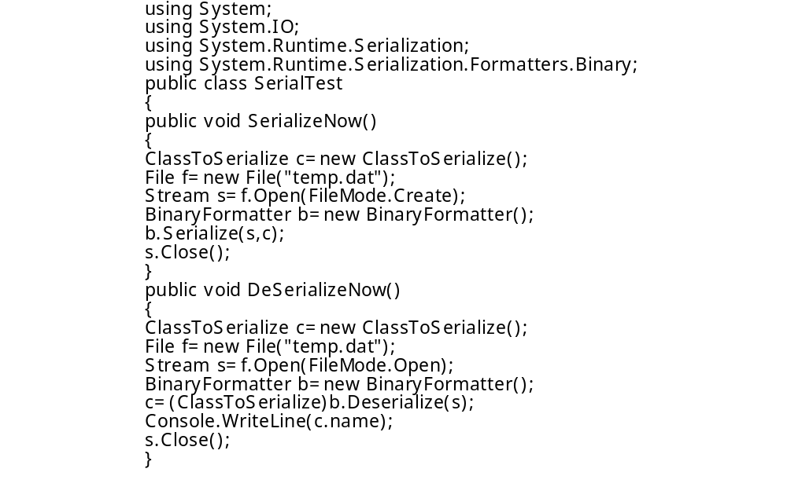
9

Slide 14
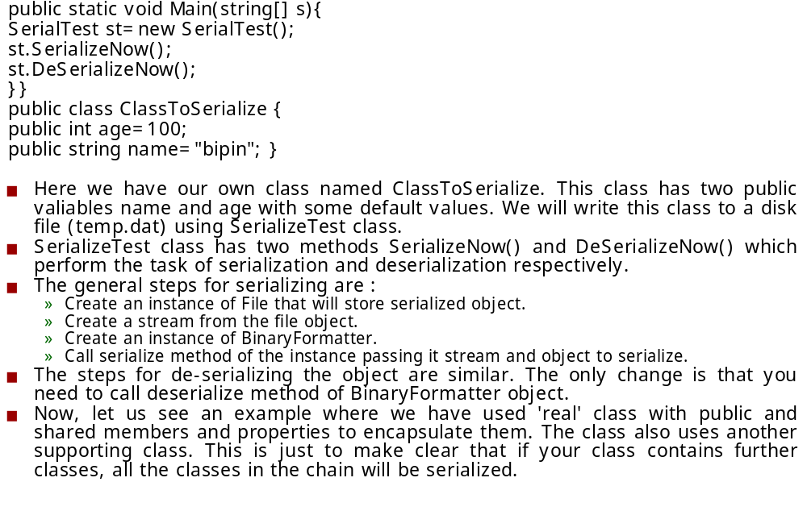
10

Slide 15
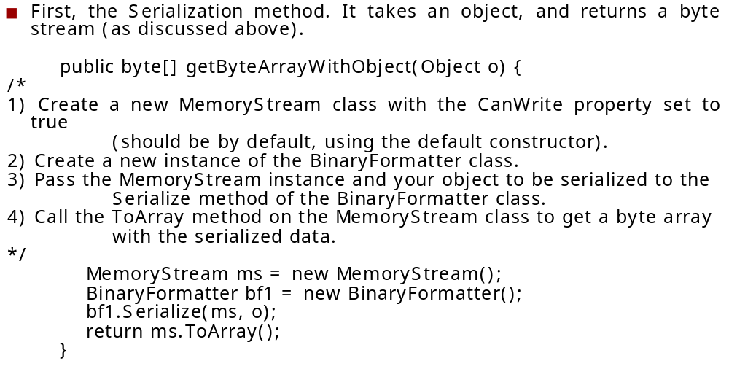
Example

Slide 16
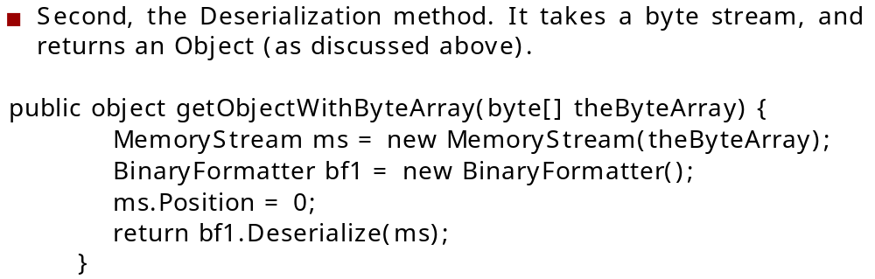
12

Slide 17
Example
So, at the beginning you have a class which you want to serialize. For example it looks like this:
public class MyExampleClass {
public string name;
public int age;
public readonly DateTime dateOfBirth;
public double[] score;
public MyExampleClass(string name, int age, DateTime dateOfBirth){
this.name = name;
this.age = age;
this.dateOfBirth = dateOfBirth;
this.score = new double[0];
}
}

Slide 18
14
Now, you want to save object of this class on a disk. At first add some namespaces:
using System.IO; //Stream class
using System.Runtime.Serialization.Formatters.Binary;
Add [Serializable] attribute to your class:
[Serializable]
public class MyExampleClass
and then add methods for save and load in MyExampleClass:

Slide 19
15
public void SaveToFile(string filename){
using (Stream stream = File.Open(filename, FileMode.Create)){
BinaryFormatter formatter = new BinaryFormatter();
formatter.Serialize(stream, this);
}
}
public static MyExampleClass LoadFromFile(string filename){
using (Stream stream = File.Open(filename, FileMode.Open)){
BinaryFormatter formatter = new BinaryFormatter();
return (MyExampleClass)formatter.Deserialize(stream);
}
}

Slide 20
16
Here is an example how to use these methods:
//create new object
MyExampleClass myObject = new MyExampleClass("John", 30, new DateTime(1967, 1, 1));
myObject.score = new double[] { 5.5, 5.6, 6.1 };
myObject.SaveToFile("store");
myObject = null; //discard object
//load saved object
myObject = MyExampleClass.LoadFromFile("store");
Console.WriteLine(myObject.name);

Slide 21
17
That is all. It is very simple to use.
Note: Instead of BinaryFormatter you can use SoapFormatter.
The code is the same, only replace BinaryFormatter by SoapFormatter and use System.Runtime.Serialization.Formatters.Soap namespace. For this namesapce you have to add reference to System.Runtime.Serialization.Formatters.Soap.dll assembly in your project.
The difference is in the saved file. With SoapFormatter you get a file that is human readable. For our example, the saved file contains:

Slide 22
18
<a1:MyExampleClass id=\"ref-1\">
<name id=\"ref-3\">John</name>
<age>30</age>
<dateOfBirth>
1967-01-01T00:00:00.0000000+01:00
</dateOfBirth>
<score href=\"#ref-4\"/>
</a1:MyExampleClass>
<SOAP-ENC:Array id=\"ref-4\" SOAP-ENC:arrayType=\"xsd:double[4]\">
<item>5.5</item>
<item>5.6</item>
<item>6.1</item>
</SOAP-ENC:Array>

Slide 23
Ali Sufyan
Ali Sufyan is an IT strategist for ACME Corporation. He needs a way to store the state of his objects to disk. The company uses C# to code its internal system applications. The application contains a class called PayRoll, which consists of the members like this:
MEMBER NAME
TYPE
uName
Property
uId Property
eName Property
eSal Property
CalcHRA() Method
CalcPF() Method
Deductions Property
NetSal Property
Sufyan wants to save the state of his object at any point in his program. You will help him mark the class as Serializable and persist the properties of the class to disk using the binary formatter.

Slide 24
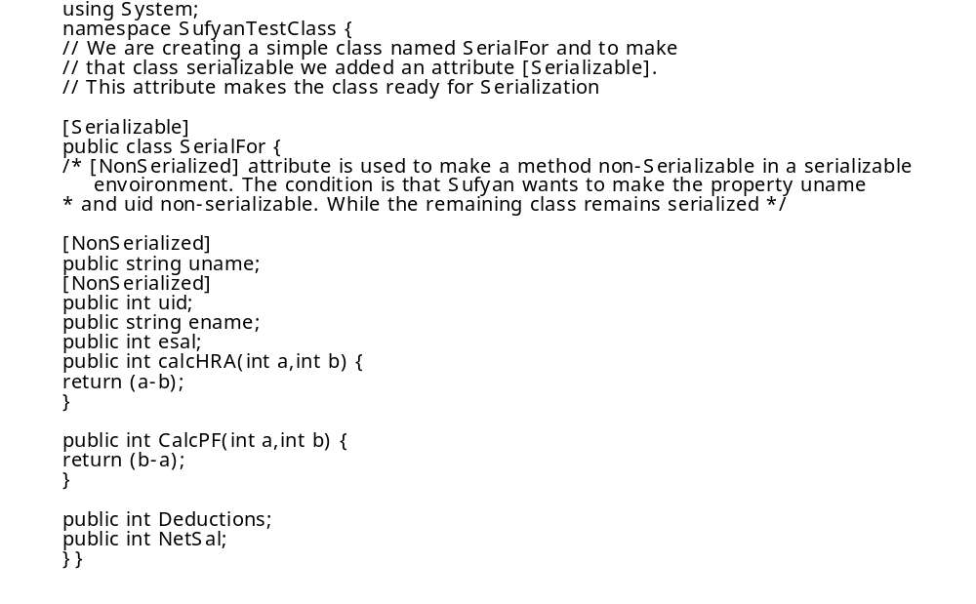
1

Slide 25
2
Build the project as a class library. To make your project a class library, you go to solution explorer, right-click the Project, select Properties and change the OutPut Type to class library. When you build the project a .dll file is created in the debug folder of your projects directory.
Now, open another project in which you will serialize this class. Add a reference to the DLL created by the previous code. You then can create the class with the following code:
using System;
using System.Runtime.Serialization.Formatters.Binary;
using System.IO;
namespace SerialsufyanTestClass{
class Class1 {
[STAThread]
static void Main(string[] args){
SufyanTestClass.SerialFor obj= new
SufyanTestClass.SerialFor();
obj.Deductions=90;
obj.NetSal=1000;
Stream a= File.OpenWrite("C:\\abc.bin");
BinaryFormatter bf=new BinaryFormatter();
bf.Serialize(a,obj);
a.Close();
}}}

Slide 26
3
This listing will create a file named abc.bin. on the C: drive. We are serializing the whole class to the file as well as adding value to deductions and NetSal to the file. We will use this in the next example.
The above code serializes the class. Now, you will deserialize the same class:
using System;
using System.Runtime.Serialization.Formatters.Binary;
using System.IO;
namespace SerialsufyanTestClass{
class Class1{
[STAThread]
static void Main(string[] args){
FileStream file=new FileStream( "C:\\abc.bin",FileMode.Open);
BinaryFormatter bf=new BinaryFormatter();
SufyanTestClassForSerialization.SerialFor obj =bf.Deserialize(file) as
SufyanTestClassForSerialization.SerialFor;
Console.WriteLine(obj.Deductions);
Console.WriteLine(obj.NetSal);
Console.WriteLine(obj.calcHRA());
Console.ReadLine();
}}}

Slide 27
Using SOAP TO Serialize and Deserialize

Slide 28
Using SOAP TO Serialize and Deserialize
Using a SOAP protocol to serialize and deserialize your code is more or less the same as above. A little change will be required. You have to add a reference to System.Runtime.Serialization.Formatters.Soap in your Application.
The following is a repeat the above serialize and deserialize code. However, this time it uses SOAP. The main benefit of SOAP Serialization is portability. You can share the serialization information with any other application on any platform.
using System;
using System.Runtime.Serialization.Formatters.Soap;
usingSystem.IO;
namespace SerialsufyanTestClass{
class Class1{
[STAThread]
static void Main(string[] args){
SufyanTestClass.SerialFor obj=newSufyanTestClass.SerialFor();
obj.Deductions=90;
obj.NetSal=1000;
Stream a=File.OpenWrite("C:\\abc.ex");
SoapFormatter bf=new SoapFormatter();
bf.Serialize(a,obj);
a.Close();
}
}
}

Slide 29
2
Deserializing Using SOAP
using System;
using System.Runtime.Serialization.Formatters.Soap;
using System.IO;
namespace {
classClass1
{static void Main(string[] args){
FileStream file=new FileStream( "C:\\abc.ex", FileMode.Open);
SoapFormatter bf=new SoapFormatter();
SufyanTestClassForSerialization.SerialFor obj =
bf.Deserialize(file) as
SufyanTestClassForSerialization.SerialFor;
Console.WriteLine(obj.Deductions);
Console.WriteLine(obj.NetSal);
Console.WriteLine(obj.calcHRA());
Console.ReadLine();
}
}

