Slide 1

Network programming
Multithreading

Slide 2
Introduction
Multithreading is what enables complex applications to appear to be performing numerous tasks at the same time. They may respond to user events, while at the same time accessing network resources, or the file system. Such concurrent applications are written in different ways depending on the platform and the operating system, giving varying control over this process.
One of the strengths of the Microsoft Windows operating system is that it allows many programs (processes) to run concurrently and allows each process to perform many tasks concurrently (using multiple threads). When you run an executable application, a new process is created. The process isolates your application from other programs running on the computer. The process provides the application with its own virtual memory and its own copies of any libraries it needs to run, allowing your application to execute as if it were the only application running on the machine.
Along with the process, an initial thread is created that runs your Main method. In single-threaded applications, this one thread steps through your code and sequentially performs each instruction.
If an operation takes time to complete, such as reading a file from the Internet or doing a complex calculation, the application will be unresponsive (will block) until the operation is finished, at which point the thread will continue with the next operation in your program.

Slide 3
Introduction
To avoid blocking, the main thread can create additional threads and specify which code each should start running. As a result, many threads may be running in your application’s process, each running (potentially) different code and performing different operations seemingly simultaneously.
In reality, unless you have multiple processors (or a single multicore processor) in your computer, the threads are not really running simultaneously. Instead, the operating system coordinates and schedules the execution of all threads across all processes; each thread is given a tiny portion (or time slice) of the processor’s time, which gives the impression they are executing at the same time.
The difficulty of having multiple threads executing within your application arises when those threads need to access shared data and resources. If multiple threads are changing an object’s state or writing to a file at the same time, your data will quickly become corrupt. To avoid problems, you must synchronize the threads to make sure they each get a chance to access the resource, but only one at a time.

Slide 4
Introduction
Synchronization is also important when waiting for a number of threads to reach a certain point of execution before proceeding with a different task and for controlling the number of threads that are at any given time actively performing a task—perhaps processing requests from client applications.
The .NET Framework's managed coding environment has made available a full and powerful threading model that allows you to control exactly what runs in a thread, when the thread exits, and how much data it should have access to. However, just as the Common Language Runtime has taken responsibility for memory management out of the hands of programmers, it has also taken much of the responsibility for managing and cleaning up threads. So, in .NET we have a happy medium between the power of C++ and the simplicity of Visual Basic. That said, multithreaded applications introduce a whole range of programming problems that single-threaded programs never encounter.

Slide 5
Definitions-Multitasking
As you probably know, the term multitasking refers to an operating system's ability to run more than one application at a time. For instance, while this chapter is being written, Microsoft Outlook is open as well as two Microsoft Word windows, with the system tray showing further applications running in the background. When clicking back and forth between applications, it would appear that all of them are executing at the same time. The word "application" is a little vague here, though; what we really are referring to are processes.
In earlier versions of Windows - such as Windows 3.x - and in some other operating systems, a program is allowed to execute until it cooperates by releasing its use of the processor to the other applications that are running. Because it is up to the application to cooperate with all other running programs, this type of multitasking is called cooperative multitasking. The downside to this type of multitasking is that if one program does not release execution, the other applications will be locked up. What is actually happening is that the running application hangs and the other applications are waiting in line.

Slide 6
Multitasking
Thankfully, we shouldn't encounter this problem with current versions of Windows (2000 and XP) as the method of multitasking used is very different. An application is now allowed to execute for a short period before it is involuntarily interrupted by the operating system and another application is allowed to execute. This interrupted style of multitasking is called pre-emptive multitasking. Pre-emption is simply defined as interrupting an application to allow another application to execute. It's important to note that an application may not have finished its task, but the operating system is going to allow another application to have its time on the processor.
While pre-emption solves the problem of the processor becoming locked, it does have its own share of problems as well. As you know, some applications may share resources such as database connections and files. What happens if two applications are accessing the same resource at the same time? One program may change the data, then be interrupted, allowing another program to again change the data. Now two applications have changed the same data. Both applications assumed that they had exclusive access to the data

Slide 7
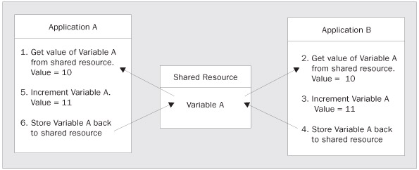
Multitasking
In Step 1, Application A obtains an integer value from a data store and places it in memory. That integer variable is set to 10. Application A is then pre-empted and forced to wait on Application B. Step 2 begins and Application B then obtains that same integer value of 10. In Step 3, Application B increments the value to 11. The variable is then stored to memory by Application B in Step 4. In Step 5, Application A increments this value as well. However, because they both obtained a reference to this value at 10, this value will still be 11 after Application A completes its increment routine. The desired result was for the value to be set to 12.
Both applications had no idea that another application was accessing this resource, and now the value they were both attempting to increment has an incorrect value. What would happen if this were a reference counter or a ticket agency booking plane tickets?

Slide 8
Processes
When an application is launched, memory and any other resource for that application are allocated. The physical separation of this memory and resources is called a process. Of course, the application may launch more than one process. It's important to note that the words "application" and "process" are not synonymous. The memory allocated to the process is isolated from that of other processes and only that process is allowed to access it.
In Windows, you can see the currently running processes by accessing the Windows Task Manager. Right-clicking in an empty space in the taskbar and selecting Task Manager will load it up, and it will contain three tabs: Applications, Processes, and Performance. The Processes tab shows the name of the process, the process ID (PID), CPU usage, the processor time used by the process so far, and the amount of memory it is using. Applications and the processes appear on separate tabs, for a good reason. Applications may have one or more processes involved. Each process has its own separation of data, execution code, and system resources.

Slide 9
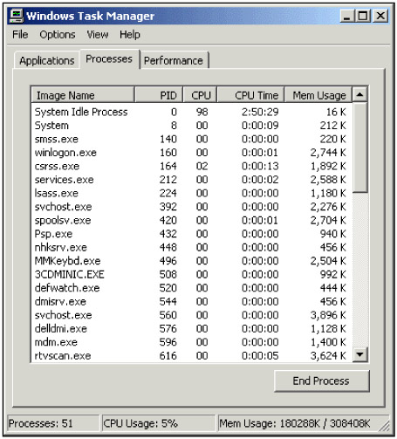
Processes

Slide 10
Threads
You will also notice that the Task Manager has summary information about process CPU utilization. This is because the process also has an execution sequence that is used by the computer's processor. This execution sequence is known as a thread. This thread is defined by the registers in use on the CPU, the stack used by the thread, and a container that keeps track of the thread's current state. The container mentioned in the last sentence is known as Thread Local Storage.

Slide 11
Single-Threaded Processes
As noted above, each process has at least one of these sequential execution orders, or threads. Creating a process includes starting the process running at a point in the instructions. This initial thread is known as the primary or main thread. The thread's actual execution sequence is determined by what you code in your application's methods. For instance, in a simple .NET Windows Forms application, the primary thread is started in the static Main () method placed in your project. It begins with a call to Application.Run().
Now that we have an idea of what a process is and that it has at least one thread, let's look at a visual model of this relationship in the following figure.
Looking at the diagram above, you'll notice that the thread is in the same isolation as the data. This is to demonstrate that the data you declare in this process can be accessed by the thread. The thread executes on the processor and uses the data within the process, as required. This all seems simple; we have a physically separated process that is isolated so no other process can modify the data. As far as this process is concerned, it is the only process running on the system. We don't need to know the details of other processes and their associated threads to make our process work.

Slide 12
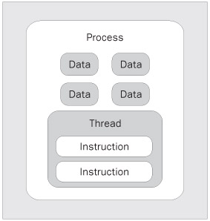
Single-Threaded Processes
To be more precise, the thread is really a pointer into the instruction stream portion of a process. The thread does not actually contain the instructions, but rather it indicates the current and future possible paths through the instructions determined by data and branching decisions.

Slide 13
Time Slices
When we discussed multitasking, we stated that the operating system grants each application a period to execute before interrupting that application and allowing another one to execute. This is not entirely accurate. The processor actually grants time to the process. The period that the process can execute is known as a time slice or a quantum. The period of this time slice is unknown to the programmer and unpredictable to anything besides the operating system. Programmers should not consider this time slice as a constant in their applications. Each operating system and each processor may have a different time allocated.
Nevertheless, we did mention a potential problem with concurrency earlier, and we should consider how that would come into play if each process were physically isolated. We mentioned that a process has to have at least one thread of execution - at least one. Our process may have more than one task that it needs to be doing at any one point in time. For instance, it may need to access a SQL Server database over a network, while also drawing the user interface.

Slide 14
Multithreaded Processes
We can split up our process to share the time slice allotted to it. This happens by spawning additional threads of execution within the process. You may spawn an additional thread in order to do some background work, such as accessing a network or querying a database. Because these secondary threads are usually created to do some work, they are commonly known as worker threads. These threads share the process's memory space that is isolated from all the other processes on the system. The concept of spawning new threads within the same process is known as free threading.
The concept of free threading gives a significant advantage over the apartment-threading model - the threading model used in Visual Basic 6.0. With apartment threading, each process was granted its own copy of the global data needed to execute. Each thread spawned was spawned within its own process, so that threads could not share data in the process's memory.

Slide 15
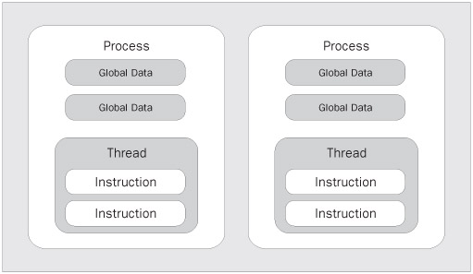
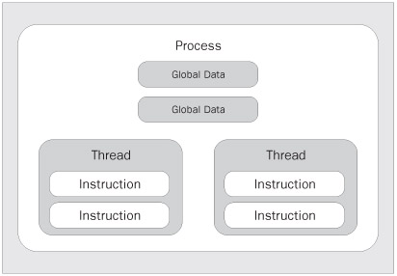
Apartment-threading concept
Apartment-threading: As you can see, each time you want to do some background work, it happens in its own process. This is therefore called running out-of-process.
Free-threading

Slide 16
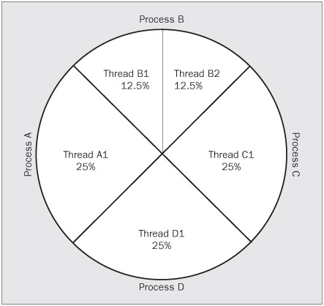
In the free-threading we can get the CPU to execute an additional thread using the same process's data. This is a significant advantage over single threaded apartments. We get the benefits of an additional thread as well as the ability to share the same data. It is very important to note, however, that only one thread is executing on the processor at a time. Each thread within that process is then granted a portion of that execution time to do its work.

Slide 17
For the sake of this course, the examples and diagrams assume a single processor. However, there is an even greater benefit to multi-threading your applications if the computer has more than one processor. The operating system now has two places to send execution of the thread. In a bank, this would be similar to opening up another line with another teller. The operating system is responsible for determining which threads are executed on which processor.
However, the .NET platform does provide the ability to control which CPU a process uses if the programmer so chooses. This is made possible with the ProcessorAffinity property of the Process class in the System.
The scheduling of these threads is vastly more complicated than demonstrated in the last diagram, but for our purposes, this model is sufficient for now. Since each thread is taking its turn to execute, we might be reminded of that frustrating wait in line at the bank teller. However, remember that these threads are interrupted after a brief period. At that point, another thread, perhaps one in the same process, or perhaps a thread in another process, is granted execution.

Slide 18
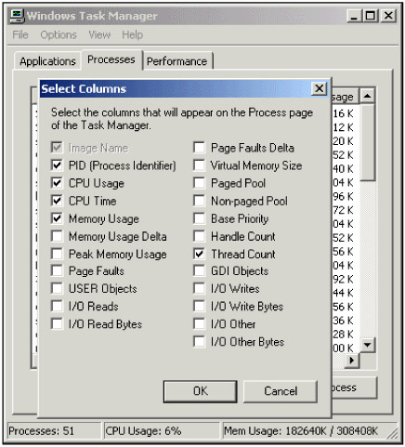
Launch the Task Manager and return to the Processes tab. Once open, go to the View | Select Columns menu. You will see a list of columns that you can display in the Task Manager. We are only concerned with one additional column at this point - the Thread Count option. Select this checkbox. You should see something like this:

Slide 19
How Interrupts and Thread Local Storage Work
When one thread runs out of time in its allocated time slice, it doesn't just stop and wait its turn again. Each processor can only handle one task at a time, so the current thread has to get out of the way. However, before it jumps out of line again, it has to store the state information that will allow its execution to start again from the point it left earlier. If you remember, this is a function of Thread Local Storage (TLS). The TLS for this thread, as you may remember, contains the registers, stack pointers, scheduling information, address spaces in memory, and information about other resources in use. One of the registers stored in the TLS is a program counter that tells the thread which instruction to execute next.
Remember that we said that processes don't necessarily need to know about other processes on the same computer. If that were the case, how would the thread know that it's supposed to give way to anther process? This scheduling decision nightmare is handled by the operating system for the most part. Windows itself (which after all is just another program running on the processor) has a main thread, known as the system thread, which is responsible for the scheduling of all other threads.

Slide 20
Windows knows when it needs to make a decision about thread scheduling by using interrupts.
An interrupt is a mechanism that causes the normally sequential execution of CPU instructions to branch elsewhere in the computer memory without the knowledge of the execution program. Windows determines how long a thread has to execute and places an instruction in the current thread's execution sequence. This period can differ from system to system and even from thread to thread on the same system. Since this interrupt is obviously placed in the instruction set, it is known as a software interrupt.This should not be confused with hardware interrupts, which occur outside the specific instructions being executed.
Once the interrupt is placed, Windows then allows the thread to execute. When the thread comes to the interrupt, Windows uses a special function known as an interrupt handler to store the thread's state in the TLS. The current program counter for that thread, which was stored before the interrupt was received, is then stored in that TLS. As you may remember, this program counter is simply the address of the currently executing instruction. Once the thread's execution has timed out, it is moved to the end of the thread queue for its given priority to wait its turn again.

Slide 21
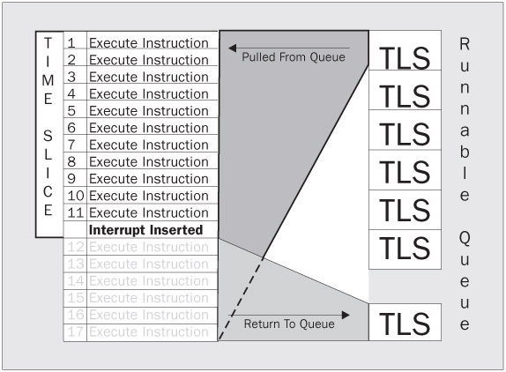

Slide 22
Thread Sleep and Clock Interrupts
When a thread voluntarily takes itself out of the execution queue for a period, it is said to sleep. When a thread is put to sleep, it is again packed up into TLS, but this time, the TLS is not placed at the end of the running queue; it is placed on a separate sleep queue. In order for threads on a sleep queue to run again, they are marked to do so with a different kind of interrupt called a clock interrupt. When a thread is put into the sleep queue, a clock interrupt is scheduled for the time when this thread should be awakened. When a clock interrupt occurs that matches the time for a thread on the sleep queue, it is moved back to the runnable queue where it will again be scheduled for execution.

Slide 23
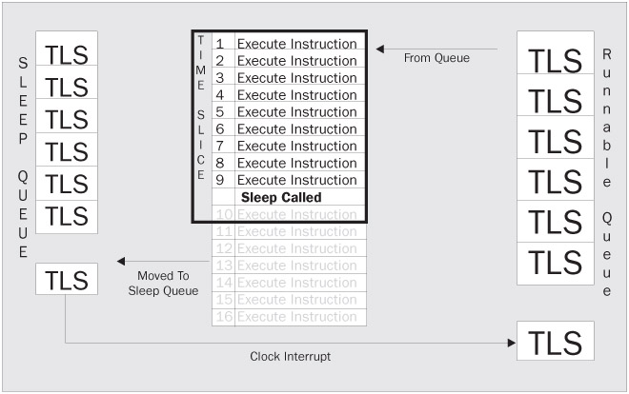

Slide 24
Thread Abort
We've seen a thread interrupted, and we've seen a thread sleep. However, like all other good things in life, threads must end. Threads can be stopped explicitly as a request during the execution of another thread. When a thread is ended in this way, it is called an abort. Threads also stop when they come to the end of their execution sequence. In any case, when a thread is ended, the TLS for that thread is de-allocated. The data in the process used by that thread does not go away, however, unless the process also ends. This is important because the process may have more than one thread accessing that data. Threads cannot be aborted from within themselves; a thread abort must be called from another thread.

Slide 25
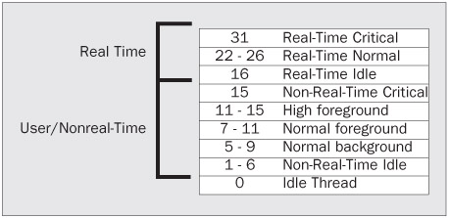
Thread Priorities
We've seen how a thread can be interrupted so that another thread can execute. We have also seen how a thread may yield its execution time by either yielding that execution once, or by putting itself to sleep. We have also seen how a thread can end. The last thing we need to cover for the basic concept of threading is how threads prioritize themselves.
Some threads just need to have a higher priority. Just as eating and sleeping are high priorities because they allow us to function, system tasks may have higher priorities because the computer needs them to function. Windows prioritizes threads on a scale of 0 to 31, with larger numbers meaning higher priorities.
A priority of 0 can only be set by the system and means the thread is idle. Priorities between 1 and 15 can be set by users of a Windows system. If a priority needs to be set higher than 15, it must be done by the administrator.
Threads running in a priority between 16 and 31 are considered to be running real-time. When we refer to the term real-time, we mean that the priority is so high that they pre-empt threads in lower priorities. This pre-emption has the effect of making their execution more immediate. The types of items that might need to run in real-time mode are processes like device drivers, file systems, and input devices. Imagine what would happen if your keyboard and mouse input were not high priorities to the system! The default priority for user-level threads is 8.

Slide 26
System.AppDomain
We established that they are a physical isolation of the memory and resources needed to maintain themselves.
We later mentioned that a process has at least one thread.
When Microsoft designed the .NET Framework, it added one more layer of isolation called an application domain or AppDomain. This application domain is not a physical isolation as a process is; it is a further logical isolation within the process. Since more than one application domain can exist within a single process, we receive some major advantages.
In general, it is impossible for standard processes to access each other's data without using a proxy. Using a proxy incurs major overheads and coding can be complex. However, with the introduction of the application domain concept, we can now launch several applications within the same process. The same isolation provided by a process is also available with the application domain. Threads can execute across application domains without the overhead associated with inter-process communication. Another benefit of these additional in-process boundaries is that they provide type checking of the data they contain.

Slide 27
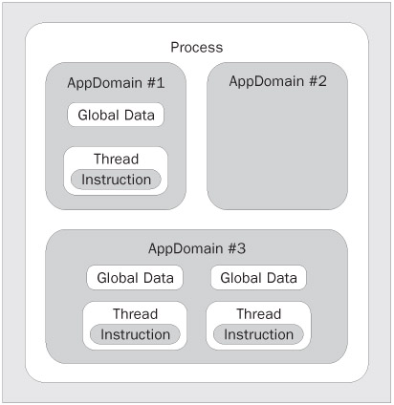
System.AppDomain
Microsoft encapsulated all of the functionality for these application domains into a class called System.AppDomain. Microsoft .NET assemblies have a very tight relationship with these application domains. Any time that an assembly is loaded in an application, it is loaded into an AppDomain. Unless otherwise specified, the assembly is loaded into the calling code's AppDomain. Application domains also have a direct relationship with threads; they can hold one or many threads, just like a process. However, the difference is that an application domain may be created within the process and without a new thread.

Slide 28
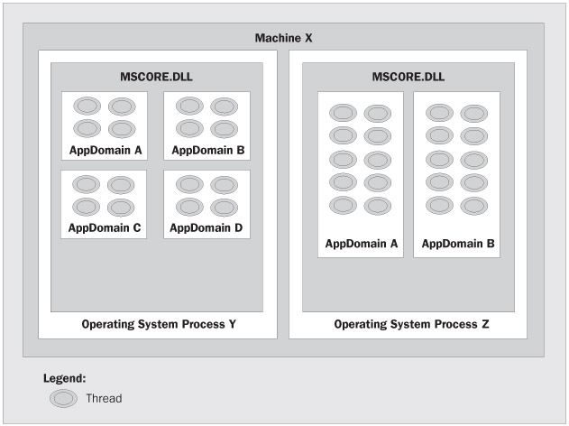
System.AppDomain
Each application contains one or more AppDomains. Each AppDomain can create and execute multiple threads. In the shown Fig., in Machine X there are two OS processes Y and Z running. The OS process Y has four running AppDomains: A, B, C, and D. The OS process Z has two AppDomains: A and B.

Slide 29
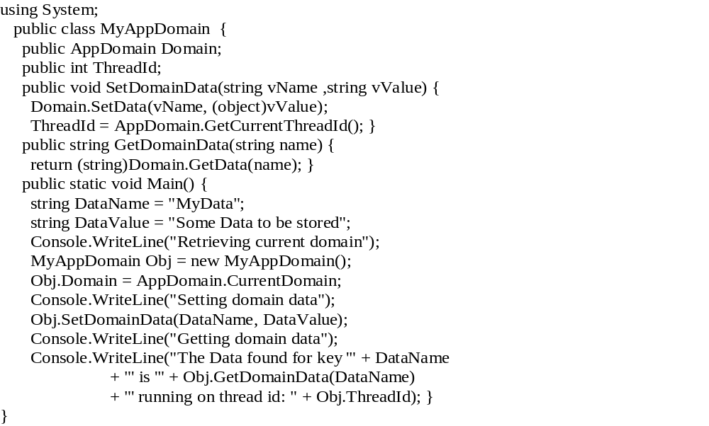
Setting AppDomain Data
In the example below, we will be using the AppDomain to set data, retrieve data, and identify the thread that the AppDomain is executing.

Slide 30
Your output should look something like this:
  Retrieving current domain
  Setting domain data
  Getting domain data
  The Data found for key 'MyData' is 'Some Data to be stored' running on thread id: 1372
The SetDomainData method takes parameters for the name of the data to be set, and the value. You'll notice that the SetData () method has done something a little different when it passes the parameters in. In the last part of this method, you will notice that we can obtain the currently executing ThreadId with a simple call to the GetCurrentThreadId property of our AppDomain object .
The GetDomainData method is very basic as well. We use the GetData () method of the AppDomain class to obtain data based on a key value. In this case, we are just passing the parameter from our GetDomainData() method to the GetData () method. We return the result of that method to the calling method.

Slide 31
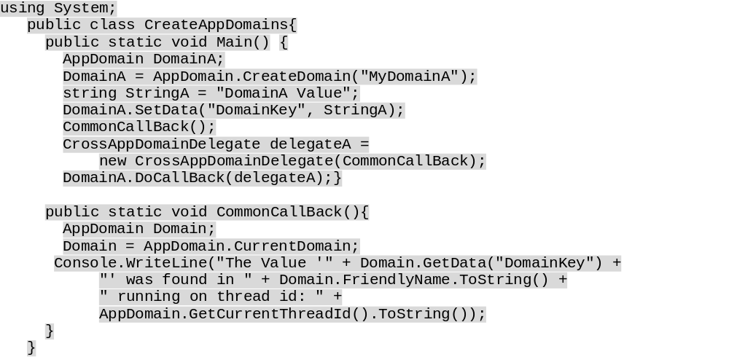
Executing Code within a Specified AppDomain

Slide 32
Executing Code within…
The output of this compiled class should look similar to this:
The Value " was found in create_appdomains.exe running on thread id: 1372
The Value 'DomainA Value' was found in MyDomainA running on thread id: 1372
You'll notice in this example we have created two application domains. To do this, we call the CreateDomain() static method of the AppDomain class. The parameter that the constructor takes is a friendly name for the AppDomain instance that we are creating. We will see that we can access the friendly name later by way of a read-only property. Here is the code that creates the AppDomain instance:
AppDomain DomainA;
DomainA = AppDomain.CreateDomain("MyDomainA");
Next we call the SetData () method that we saw in the previous example. What we need to explain next is how we get code to execute in a given AppDomain. We do this with the DoCallBack() method of the AppDomain class. This method takes a CrossAppDomainDelegate as its parameter. In this case, we have created an instance of a CrossAppDomainDelegate passing the name of the method we wish to execute into the constructor:
CommonCallBack();
CrossAppDomainDelegate delegateA =
new CrossAppDomainDelegate(CommonCallBack);
DomainA.DoCallBack(delegateA);
You'll notice that we call CommonCallBack() first. This is to execute our CommonCallBack () method within the context of the main AppDomain. You'll also notice from the output that the FriendlyName property of the main AppDomain is the executable's name.

Slide 33
System.Threading namespace
The .NET Framework provides a Thread class in the System.Threading namespace that allows you to create and manage threads in your application.
The classes available in the System.Threading namespace are listed in the following table.

Slide 34
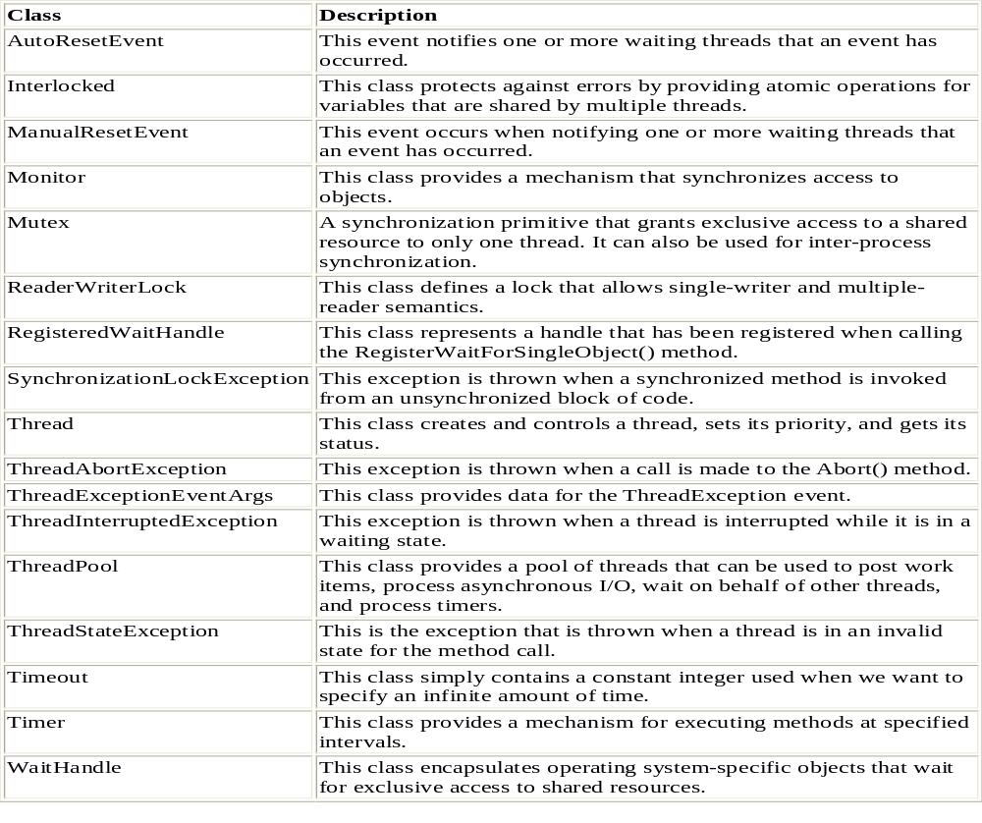
The classes available in the System.Threading namespace

Slide 35
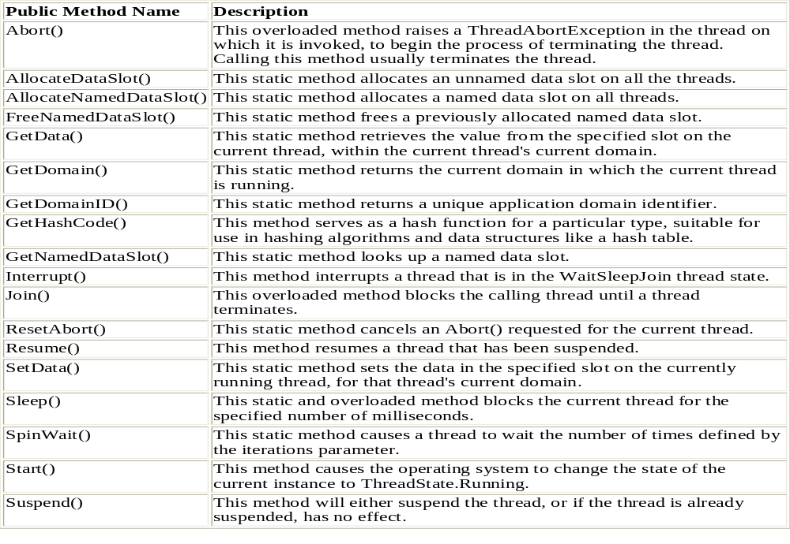
Thread Class
Let's start by looking at a table of this class's public methods.

Slide 36
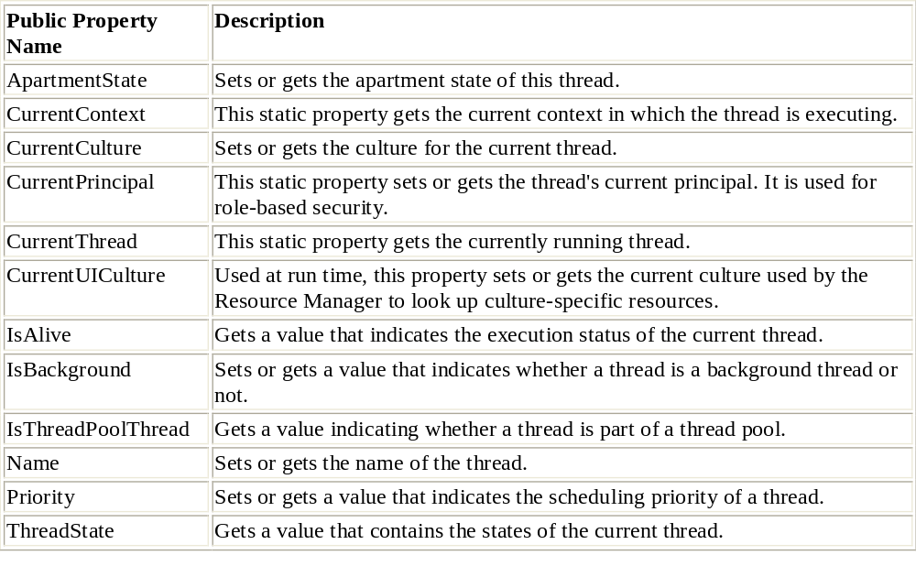
Thread Class
Now let's look at another table, this time containing its public properties.

Slide 37
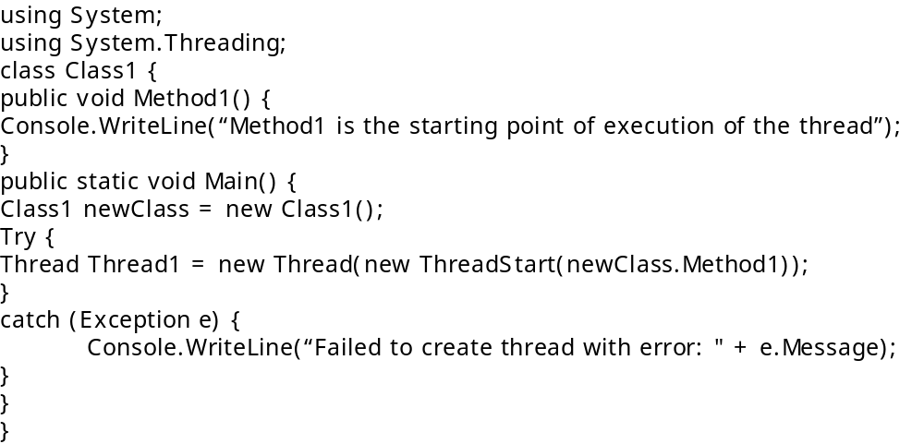
Creating a Thread
Creating a thread is simple. All you have to do is create a thread object using the System.Threading.Thread class and pass a delegate method to the Thread constructor that will be called when the thread starts running. A delegate method can be any method that does not take a parameter and does not return a value.

Slide 38
Creating a Thread
Here, an instance of the Thread class, Thread1, is created. Creating a thread requires that you identify a delegate method to the Thread class constructor. A special class named ThreadStart allows you to define a delegate method to a thread. In the above example, the ThreadStart() delegate specifies the name of the method, Method1, with which the execution of Thread1 starts. Method1 is a public void function defined in Class1.
However, creating an instance of the Thread class does not make the thread functional.To start the thread, you need to call the Start() method.
Once you’ve successfully created a thread, you can begin controlling how the thread operates within your program. When the thread is created, nothing actually happens from your application’s point of view; therefore, you’re required to call the thread’s Start method to get the thread running. Calling Start actually tells the operating system to begin scheduling your thread for processing.

Slide 39
Creating a Thread
Try
{
Thread1.Start();
}
catch (Exception e) {
Console.WriteLine(“The thread failed to start with error:"+ e.Message);
}
If you try to start the thread twice, a ThreadStateException will be raised, indicating that the thread can’t be started twice. Also, when the thread delegate method completes, you can’t restart the thread; if you try to, an exception will be raised. Your application is allowed to run only a finite number of threads at the same time. If you try to start a thread while too many threads are running, Start will throw an OutOfMemoryException.

Slide 40
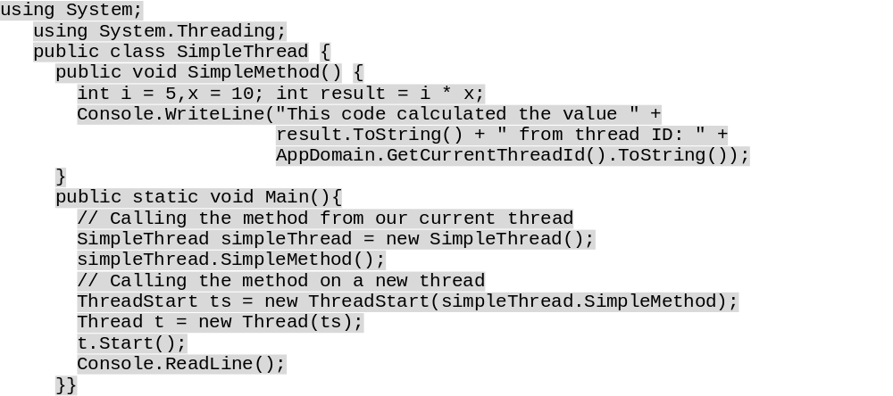
Example-1
Your output should look something like this:
This code calculated the value 50 from thread id: 1400
This code calculated the value 50 from thread id: 1040

Slide 41
Example-1
Our program's entry point is the Main() method. The first thing we do inside this method is execute our SimpleMethod() method. This calls the method on the same thread as that on which the Main() method is running.
The next part is important: we get our first look at creating a thread. Before we can create a thread in C#, we must first create a ThreadStart delegate instance. A delegate is really an object-oriented type-safe function pointer. Since we are going to tell a thread what function to execute, we are essentially passing a function pointer to the thread's constructor. This is demonstrated in our application as follows:
ThreadStart ts = new ThreadStart(simpleThread.SimpleMethod);

Slide 42
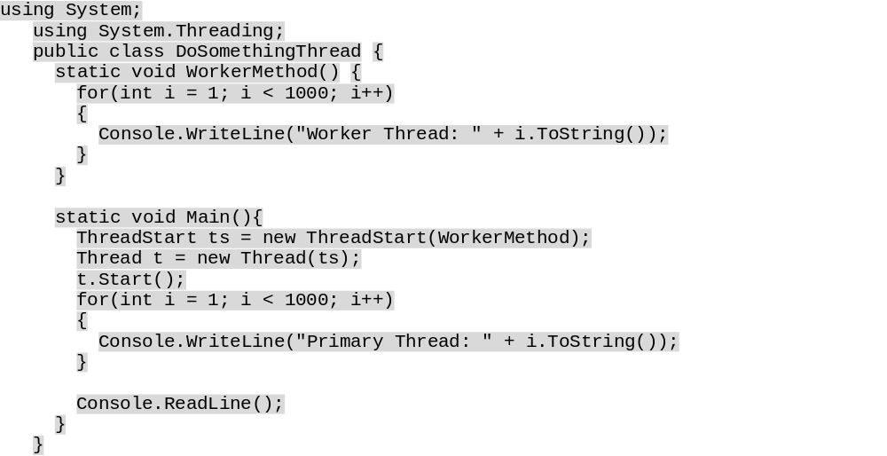
Example -2
Your output may be somewhat different every time. The thread execution will be switched at different points in the loop every time.
Primary Thread: 1
Primary Thread: 2
...
Worker Thread: 743
Worker Thread: 745
...
Primary Thread: 1000

Slide 43
Example -3
Let's examine a quick example in a real-world scenario. Suppose that you want to perform some background routine when a user launches an application. Depending on who is launching the application, you want to perform different routines. For instance, let's say that when an administrator logs into an application, you want to run a background process that will gather report data and format it. That background process will alert the administrator when the report is available. You probably wouldn't want to perform the same reporting function for an ordinary user as you would for an administrator. This is where the object-oriented nature of ThreadStart is useful.

Slide 44
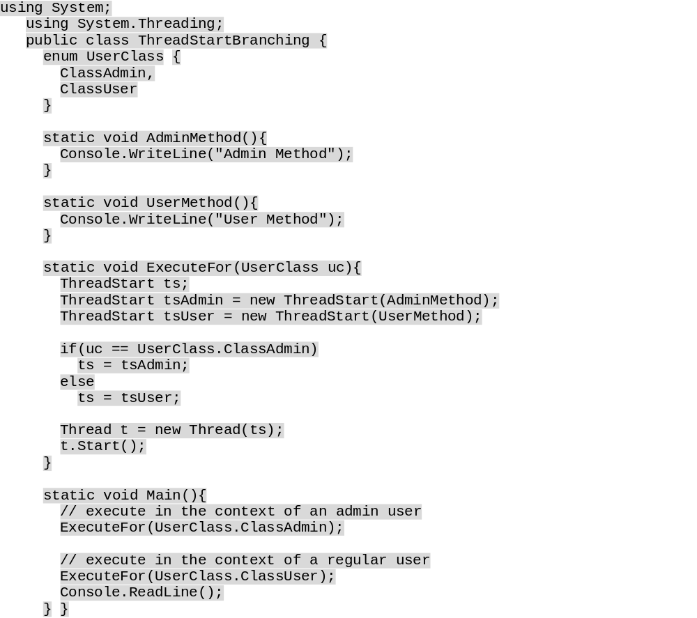
Example-3
The output from the code is quite simple:
Admin Method
User Method

Slide 45
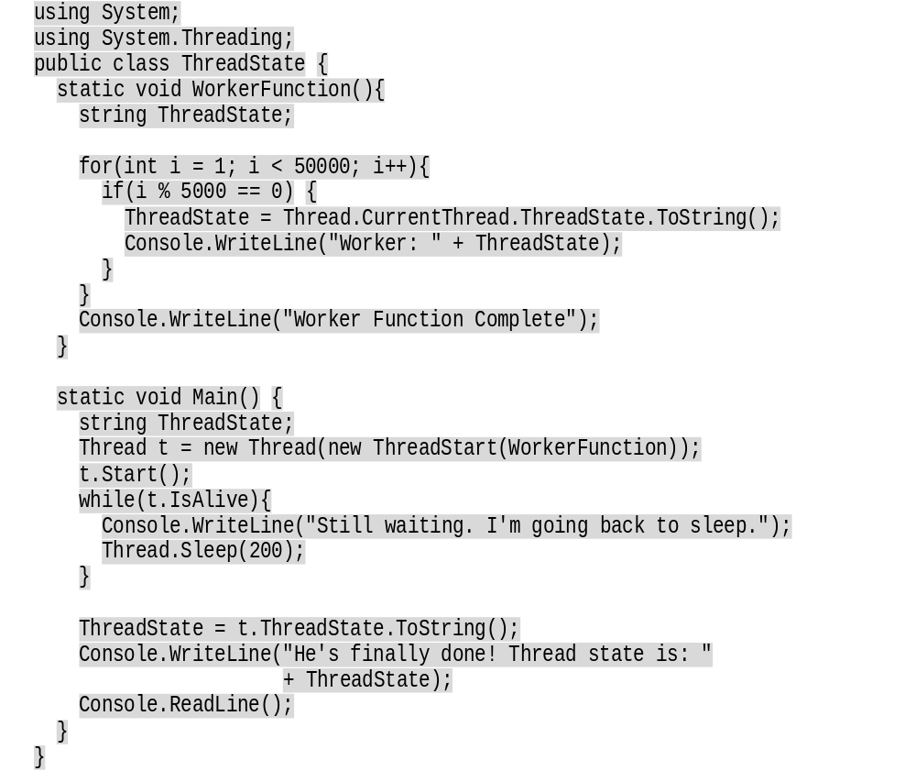
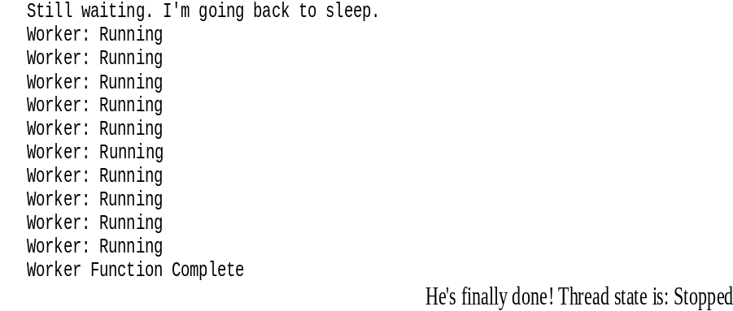
The Sleep() method and the IsAlive property

Slide 46
The Sleep() method and the IsAlive property
There are some important things to note. The first is that we tell one thread to sleep for a specified period so that we yield execution to our other threads. We do that with the Thread object's Sleep() method - passing in the length of time in milliseconds that we want to the thread to sleep. In addition, we can test our threads to see if they have finished executing by using the IsAlive property. Lastly, we can use the ThreadState property of our thread instances to determine their exact thread state.

Slide 47
Thread Priorities
The thread priority determines the relative priority of the threads against each other. The ThreadPriority enumeration defines the possible values for setting a thread's priority. The available values are:
  Highest
  AboveNormal
  Normal
  BelowNormal
  Lowest
When a thread is created by the runtime and it has not been assigned any priority then it will initially have the Normal priority. However, this can be changed using the ThreadPriority enumeration. Before seeing an example for the thread priority, let's see what a thread priority looks like.

Slide 48
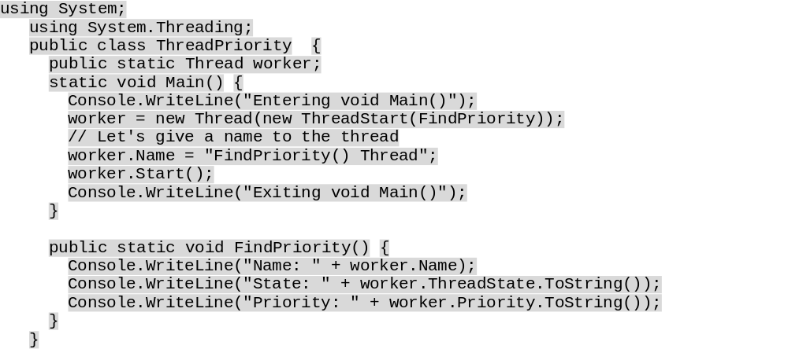
Example
Entering the void Main()
Exiting the void Main()
Name: FindPriority() Thread
State: Running
Priority: Normal

Slide 49
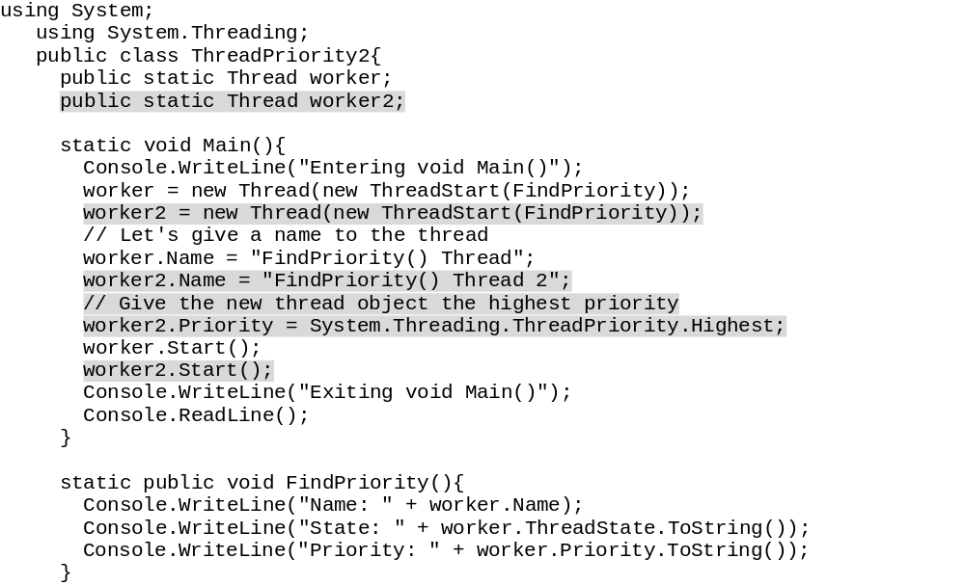
Exampe-2 (adding another thread)
Entering void Main()
Name: FindPriority() Thread2
State: Running
Priority: Highest
Exiting void Main()
Name: FindPriority() Thread
State: Running
Priority: Normal

Slide 50
Timers and Callbacks
As threads run out of sequence from the rest of the application code, we cannot be certain that actions affecting a particular shared resource that occur in one thread will be completed before code in another thread wants to access that same shared resource. There are various methods of dealing with these issues, but here we will cover one simple way; the use of timers. Using a timer, we can specify that a method is executed at a specific regular interval, and this method could check that the required actions have been completed before continuing. This is a very simple model, but can apply to a variety of situations.
Timers are made up of two objects, a TimerCallback and a Timer. The TimerCallback delegate defines the method to be called at a specified interval, whereas the Timer is the timer itself.
The TimerCallback associates a specific method with the timer. The Timer's constructor (which is overloaded) requires four arguments. The first is the TimerCallback specified earlier. The second is an object that can be used to transmit state across to the method specified. The last two arguments are the period after which to start periodic method calls, and the interval between subsequent TimerCallback method calls. They can be entered as integers or longs representing numbers of milliseconds, but as you will see below, an alternative is to use the System.TimeSpan object with which you can specify the intervals in ticks, milliseconds, seconds, minutes, hours, or days.

Slide 51
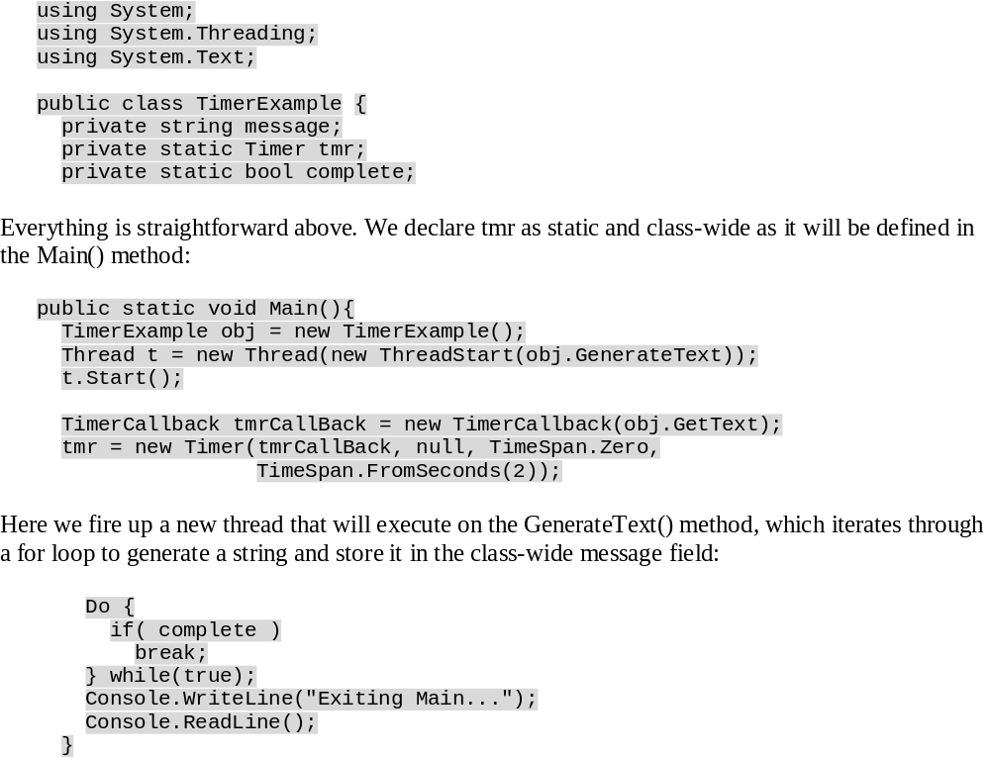
Example

Slide 52
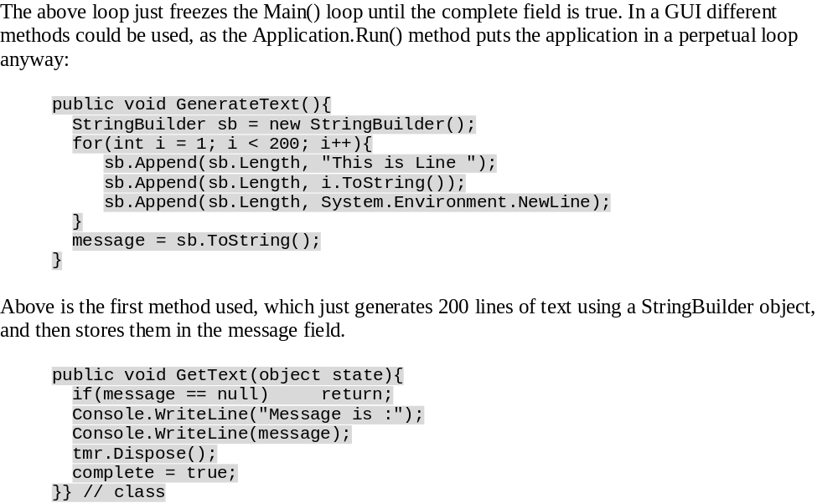
Cont.
Message is : This is Line 1 This is Line 2 ... This is Line 199 This is Line 200 Exiting Main...
Message is :
This is Line 1
This is Line 2
...
This is Line 199
This is Line 200
Exiting Main...

Slide 53
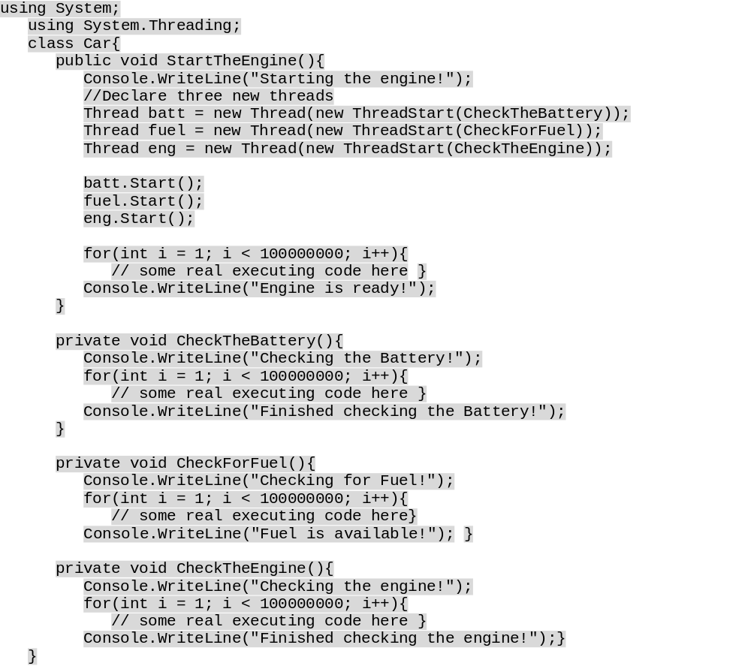
Spinning Threads with Threads
We've seen in code how to spawn a thread from the void Main(). In a similar way, we can also spawn multiple threads within a thread. For example, let's say we have a Car class that has a public method called StartTheEngine(). The StartTheEngine() method calls another three private methods called CheckTheBattery(), CheckForFuel(), and CheckTheEngine(). Since each of these tasks, checking the battery, fuel, and engine, can happen simultaneously, we can run each of these methods in a different thread.

Slide 54
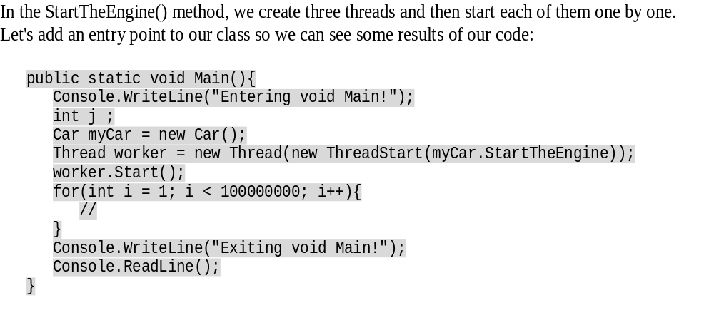
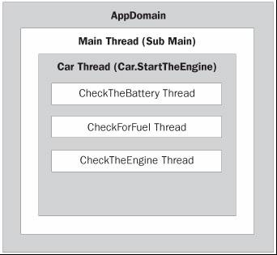
Cont.
Entering void Main!
Exiting void Main!
Starting the engine!
Checking the Battery!
Checking for Fuel!
Checking the engine!
Finished checking the Battery!
Fuel is available!
Finished checking the engine! Engine is ready!

Slide 55
Cont.

Slide 56
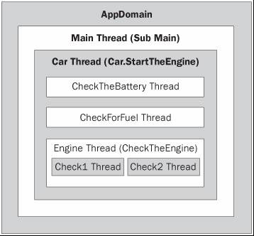
Cont.
We can split the Car class into separate classes and we could build two more methods in a new Engine class called check1() and check2(). Then the Engine class will execute the check1() and check2() methods in its own thread as shown below.

Slide 57
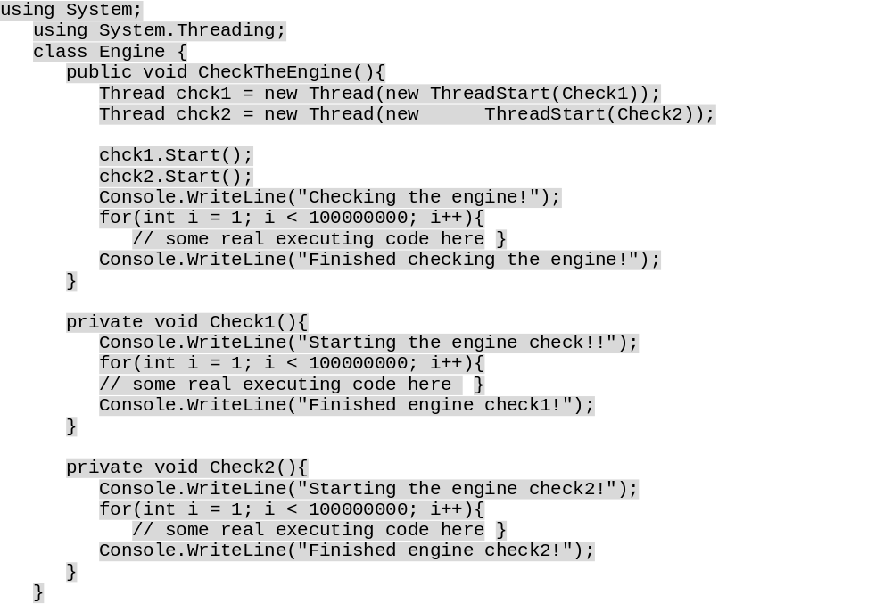
Cont.
Entering void Main!
Exiting void Main!
Starting the engine!
Checking the Battery!
Checking for Fuel!
Checking the engine!
Starting the engine check!!
Starting the engine check2!
Finished checking the Battery!
Fuel is available!
Engine is ready!
Finished engine check1!
Finished checking the engine!
Finished engine check2!

Slide 58
Lifecycle of Threads

Slide 59
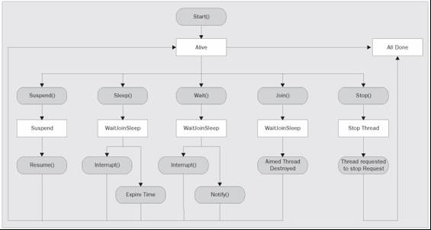

Slide 60
Putting a Thread to Sleep
When we create a new thread we have to call the Start() method of the Thread object to schedule that thread. At this time, the CLR will allocate a time slice to the address of the method passed to the constructor of the Thread object. Once the thread is in the Running state, it can go back to either the Sleep or Abort states when the OS is processing the other threads. We can use the Sleep() method of the Thread class to put a thread to sleep. The Sleep() method is really useful if you are waiting for a resource and you want to retry for it.
The overloaded Sleep() method is available in two flavors. The first overload takes an integer as the parameter that will suspended the thread for number of milliseconds specified. For example, if you pass 100 to the parameter the thread will be suspended for 100 milliseconds. This will place the thread into the WaitSleepJoin state.

Slide 61
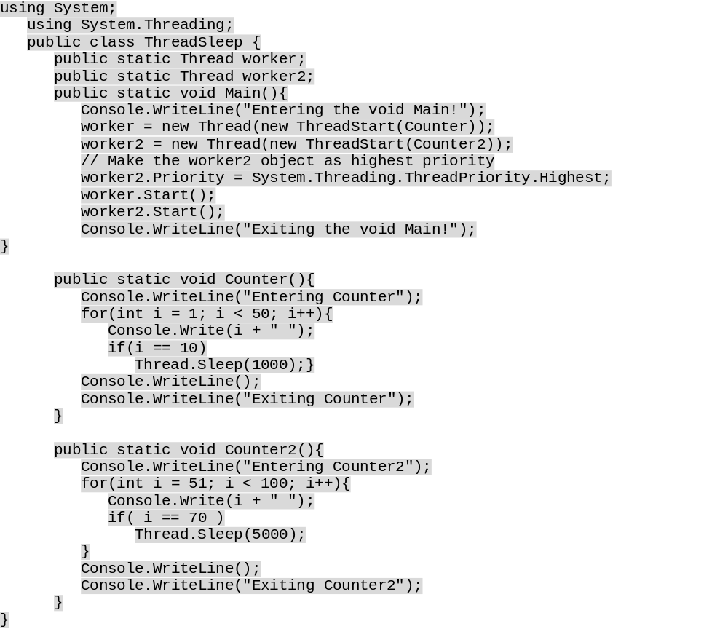
Example

Slide 62
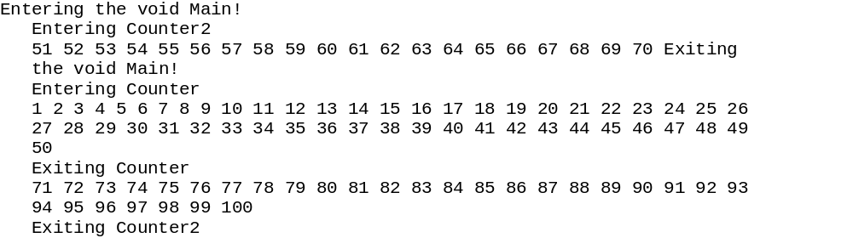
Example-cont
The Counter() method counts numbers from 1 to 50 and when it reaches 10 it sleeps for 1000 milliseconds. The Counter2() method counts from 51 to 100 and when it reaches 70 it sleeps for 5000 milliseconds. Here is how the output might look:

Slide 63
Interrupting a Thread
When a thread is put to sleep, the thread goes to the WaitSleepJoin state. If the thread is in the sleeping state the only way to wake the thread, before its timeout expires, is using the Interrupt() method. The Interrupt() method will place the thread back in the scheduling queue.
In the following example, the first thread (sleeper) is put to sleep when the counter reaches 10, 20, and 30. The second thread (worker) checks if the first thread is asleep. If so, it interrupts the first thread and places it back in the scheduler. The Interrupt() method is the best way to bring the sleeping thread back to life and you can use this functionality if the waiting for the resource is over and you want the thread to become alive.

Slide 64

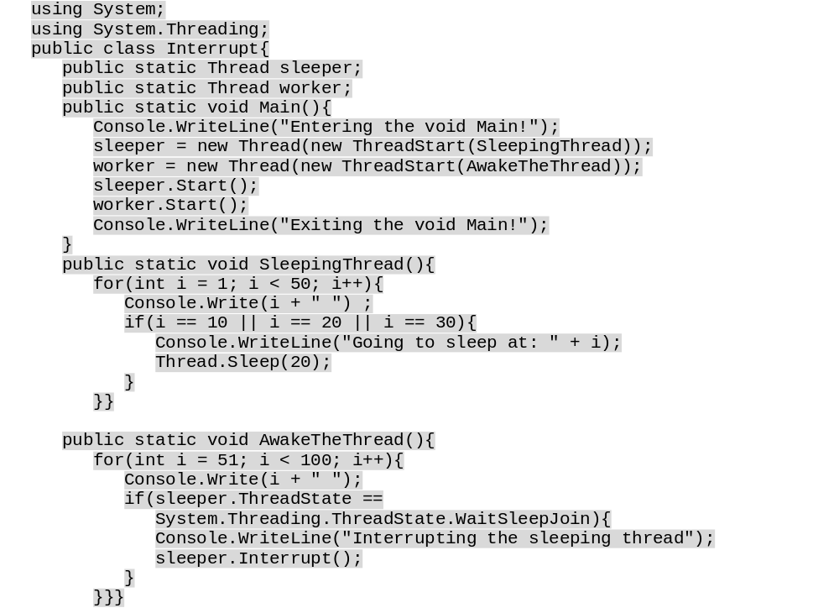
Example

Slide 65
Pausing and Resuming Threads
The Suspend() and Resume() methods of the Thread class can be used to suspend and resume the thread. The Suspend() method will suspend the current thread indefinitely until another thread wakes it up. When we call the Suspend() method, the thread will be place in the SuspendRequested or Suspended state.
Let's see an example for this. We'll create a new C# application that generates prime numbers in a new thread. This application will also have options to pause and resume the prime number generation thread. To make this happen let's create a new C# WinForms project called PrimeNumbers and build a UI like this in Form1.
We have a ListBox and three command buttons in the UI. The ListBox is used to display the prime numbers and three command buttons are used to start, pause, and resume the thread. Initially we've disabled the pause and the resume buttons, since they can't be used until the thread is started.

Slide 66
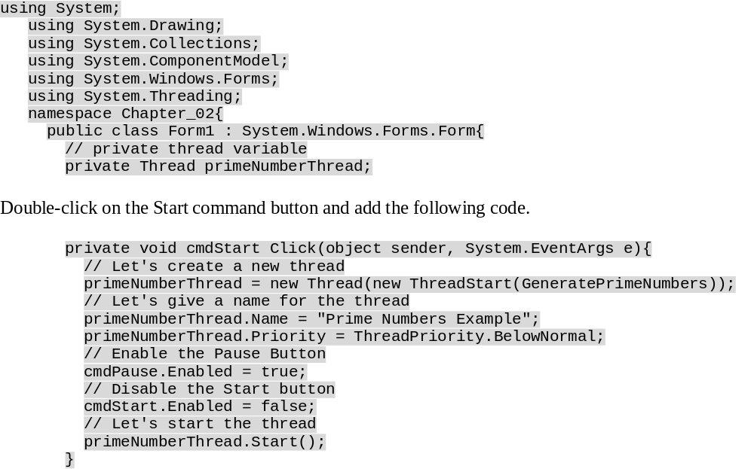
Example
All the Start button does is create a new Thread object with the ThreadStart delegate of the GeneratePrimeNumbers() method and assign the name Prime Number Example to the thread. Then it enables the Pause button and disables the Start button. Then it starts the prime number generating thread using the Start method of the Thread class.

Slide 67
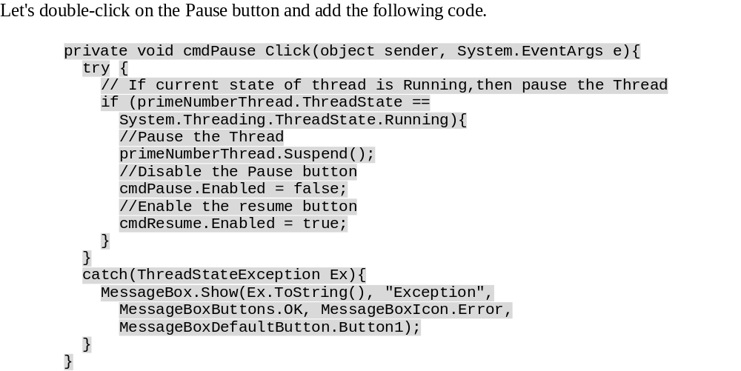
Example-Cont.
The Pause button checks if the thread is in the Running state. If it is in the Running state, it pauses the thread by calling the Suspend method of the Thread object. Then it enables the Resume button and disables the Pause button. Since the Suspend method can raise the ThreadStateException exception, we're wrapping the code with in a try...catch block.

Slide 68
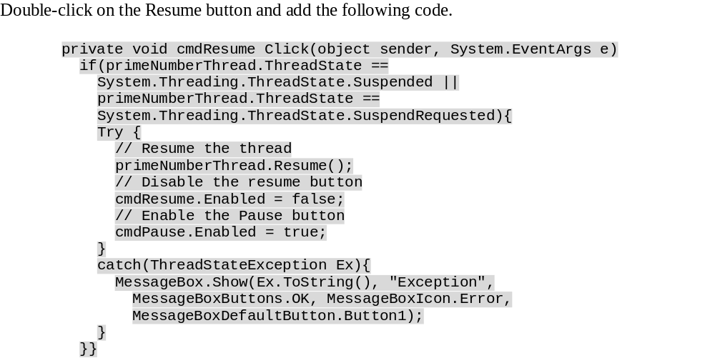
Example-Cont.
The Resume button checks if the state of the thread is Suspended or SuspendRequested before resuming the thread. If the state of the thread is either Suspended or SuspendRequested then it resumes the thread and disables the Resume button and enables the Pause button.

Slide 69
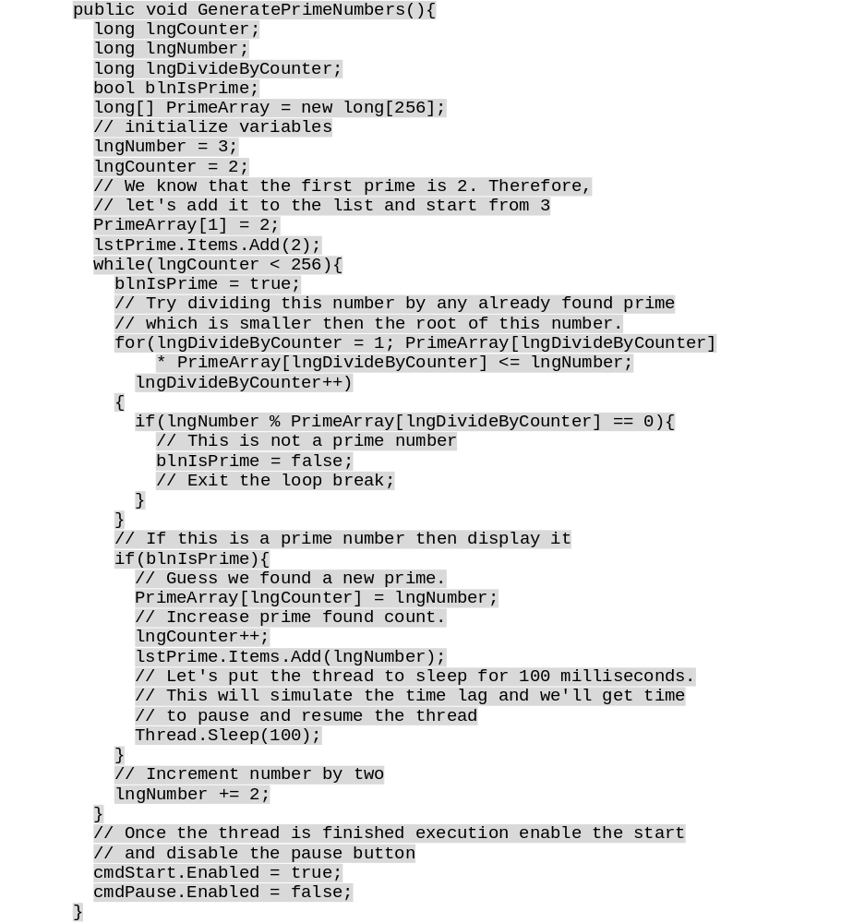
GeneratePrimeNumbers

Slide 70
Problem and Solution-1
Well, everything looks good now and the code is apparently working fine. But there is a huge flaw in our code. When the GeneratePrimeNumbers() method finds a prime number it adds the prime number back to the listbox control. It may not look like a problem for you if this code is running in a synchronized execution manner where both the prime number generation code and the user interface are running on the same thread. But in our example, the UI is running in a different thread from the GeneratePrimeNumbers() method. Therefore, when we go between threads to write data this could cause some unexpected behaviors in our application.

Slide 71
2
The best way to address this problem is using delegates. We can declare a delegate and we can use the delegate to inform the UI thread to update the listbox control itself. In this way, we're not crossing the threading boundaries and the application stability is not compromised.
Let's see how we can implement this operation. Let's add one more public delegate called UpdateData:
public delegate void UpdateData(string returnVal);
Let's modify the GeneratePrimeNumbers() method a little bit to call the delegate from it. We've added a new string array with the initial value as 2, since the first prime number is 2. Then we've declared a new object of the type UpdateData as a delegate and we've passed the address of the UpdateUI method. Then we've used the this. Invoke method with the delegate object and the string array to inform the user interface to update itself. We've done the same when we found a prime number

Slide 72
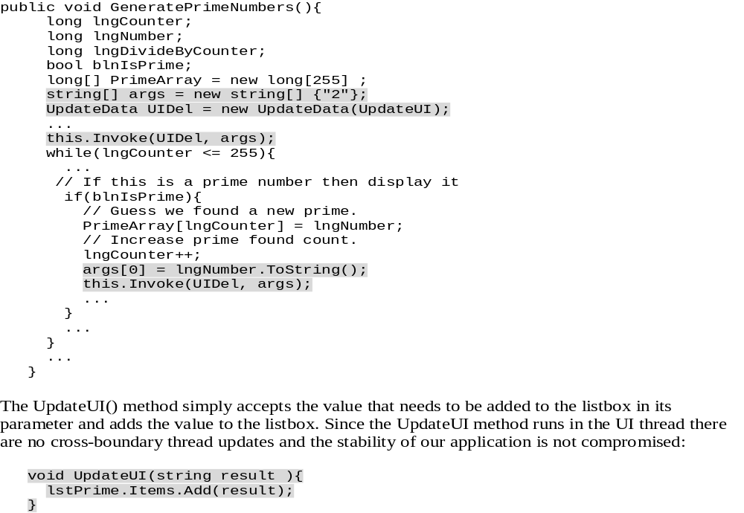
3

Slide 73
4

Slide 74
Destroying Threads
The Abort() method can be used to destroy the current thread. The Abort() method would be very useful, if you want to terminate the thread for whatever reason, such as the thread is taking too much time to execute or the user has changed their mind by selecting cancel. You might want this behavior in a search process that takes a long time. A search may continue running but the user may have seen the results they wish to see and discontinue the thread that is carrying on the search routine.
When Abort() is called against a thread, the ThreadAbortException exception will be raised. If it isn't caught in any code in the thread, then the thread will terminate. Think twice before writing generic exception handling code inside methods that will be accessed in a multithreaded context, since a catch (Exception e) will also catch ThreadAbortExceptions - from which you probably don't want to recover. As we'll see, ThreadAbortException isn't so easily stopped, and your program flow may not continue as you expect it to .
We're going to create a new project called Destroying and we'll copy the code from the previous prime number generation code into the new Form1.cs class. Let's add one more Stop button to the UI like this

Slide 75
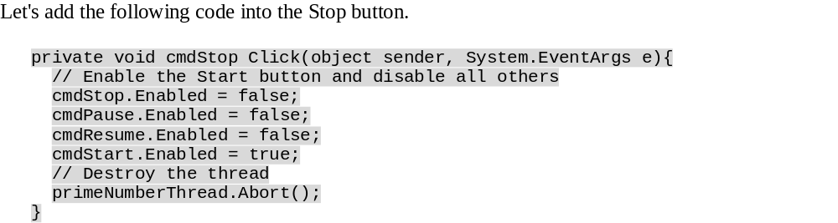
Example
This example is very similar to the previous example. The only difference is that we're using the Abort() method to destroy the thread when the user clicks on the Stop button. Then we're enabling the Start button and disabling all other buttons. You might also note that the ThreadAbortException is a special exception. Like all other exceptions it can be caught. However, once the catch block has completed, the exception will automatically be raised again. When the exception is raised, the runtime executes all the finally blocks before killing the thread.

Slide 76
Joining Threads
The Join() method blocks a given thread until the currently running thread is terminated. When we call the Join() method against a given thread instance, the thread will be placed in the WaitSleepJoin state. This method is very useful, if one thread is dependent upon another thread. By simply joining two threads we are saying that the thread that is running when the Join() method is called will enter the WaitSleepJoin state and not return to the Running state until the thread upon which the Join() method was called completes its tasks.
In the following simple example, the aim is to output numbers to the console sequentially, starting at 1 and finishing at 500. The First() method will output the first 250 numbers and the Second() method will produce those from 251 to 500. Without the FirstThread.Join() line in the Second() method, execution would switch back and forth between the two methods and our output would be scrambled (try commenting out the line and running the example again). By calling the FirstThread.Join() method within the Second() method, the execution of the Second() method is paused until the execution of whatever is in FirstThread (the First() method) has completed.

Slide 77
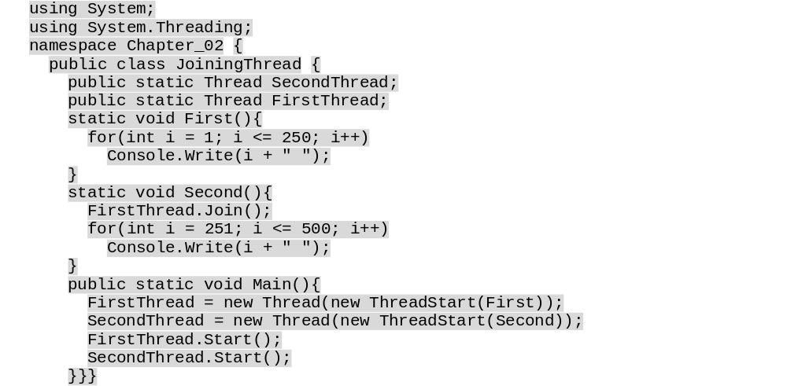
Example

