Slide 1
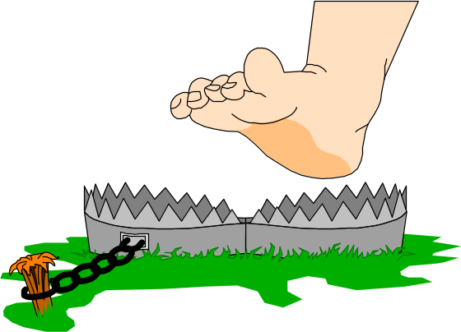
Network programming
The Concept of Thread Pooling

Slide 2
Example
Animation provides an interesting application for threads. We will use a thread to show a ball moving across the screen. This thread computes the new position of the ball, asks the system to repaint the screen showing the ball in the new position, and sleeps for a fraction of a second so we can see the ball moving at human speed.
Suppose we want to write an application to move a ball across the screen. We can add a button, and whenever the user presses the button we can change the position of the ball, asking the system to repaint the screen.
The following code shows the Move_Click method that handles the button press:
protected void Move_Click(object sender, EventArgs e) {
x += 9;
y += 9;
Invalidate();
}
protected void Move_Click(object sender, EventArgs e) {
for (int i = 0; i < 10; i++) {
x += 9;
y += 9;
Invalidate();
}
}

Slide 3
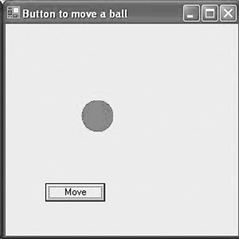
2

Slide 4
3-Form1.cs
using System;
using System.Collections.Generic;
using System.ComponentModel;
using System.Data;
using System.Drawing;
using System.Text;
using System.Windows.Forms;
namespace WindowsApplication1{
public partial class Form1 : Form {
private int x = 50, y = 50;
public Form1() {
InitializeComponent();
}
private void button1_Click(object sender, EventArgs e){
x += 9;
y += 9;
Invalidate();
}
protected override void OnPaint(PaintEventArgs e){
Graphics g = e.Graphics;
Brush red = new SolidBrush(Color.Red);
g.FillEllipse(red, x, y, 40, 40);
base.OnPaint(e);
}
}
}

Slide 5
3
Each time we press the button, the system executes the above code. The call to Invalidate asks to paint the screen which, because x and y have increased, will show the ball in its new position. When the event-handling thread releases control, the system paints the screen. We can press the button several times, each time moving the ball farther.

Slide 6
4
An application needs its own thread of control to do animation. By using a separate thread, other system functions can proceed in parallel, sharing the processor, so the animation will not monopolize the system's resources. The following method, Run,will serve as the ThreadStart delegate that the thread will execute when it gets its turn:
public void Run() {
int dx = 9, dy = 9;
for(int i = 0; i < 10; i++) {
x += dx;
y += dy;
Invalidate();
Thread.Sleep(300);
}
}

Slide 7
5
The following code moves the ball ten times when the user presses the button. Each time the user presses the button, we return the ball to its start position and repeat the ten moves.
namespace WindowsApplication1{
public partial class Form1 : Form {
private int x = 50, y = 50;
public Form1() {
InitializeComponent();
}
private void button1_Click(object sender, EventArgs e){
x = 50; y = 50;
Thread t = new Thread(new ThreadStart(Run));
t.Start();
}
protected override void OnPaint(PaintEventArgs e){
Graphics g = e.Graphics;
Brush red = new SolidBrush(Color.Red);
g.FillEllipse(red, x, y, 40, 40);
base.OnPaint(e);
}
public void Run(){
int dx = 9, dy = 9;
for (int i = 0; i < 10; i++){
x += dx;
y += dy;
Invalidate();
Thread.Sleep(300);}
} }}

Slide 8
6
Because the animation occurs in a thread and does not interfere with other processing, we can modify the above code to keep it going indefinitely. To move the ball continuously, we use a nonterminating loop in the Run method, moving the ball ten times down and to the right, followed by ten moves up and to the left. While the ball moves, notice that we can edit text in another window or run another program. The animation shares the processor rather than monopolizing it.
The following cdoe, uses a thread to move the ball back and forth until the user aborts it by pressing a button. We must terminate the thread before closing the window. We also add buttons to suspend and resume the thread to allow us to stop and start the ball.

Slide 9
7
namespace WindowsApplication1{
public partial class Form1 : Form {
private int x,y;
private Thread t;
public Form1() {
InitializeComponent();
x = 50; y = 50;
t = new Thread(new ThreadStart(Run));
t.Start();
}
private void button1_Click(object sender, EventArgs e){
t.Suspend();}
private void button2_Click(object sender, EventArgs e){
t.Resume();}
private void button3_Click(object sender, EventArgs e){
t.Abort();}
protected override void OnPaint(PaintEventArgs e){
Graphics g = e.Graphics;
Brush red = new SolidBrush(Color.Red);
g.FillEllipse(red, x, y, 40, 40);
base.OnPaint(e);
}

Slide 10
8
public void Run(){
int dx = 9, dy = 9;
while (true){
for (int i = 0; i < 10; i++){
x += dx;y += dy;
Invalidate();
Thread.Sleep(100);}
dx = -dx; dy = -dy;}
}
}
}

Slide 11
9
We used a thread to animate a ball; we can use the same technique to do fancier animations, for example, to draw a sequence of figures that would change the appearance of each frame of the animation. To make a modest start in this direction, we animate a circular face with circles for eyes, a line for a nose, and an arc for a mouth. We use three different frames and continually draw one after the other, sleeping for 300 milliseconds between each repainting of the next frame.

Slide 12
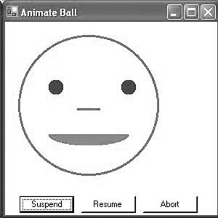
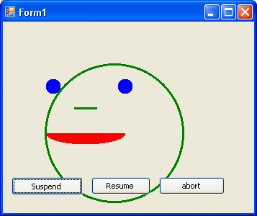
10

Slide 13
11
namespace WindowsApplication1{
public partial class Form1 : Form {
private int x = 10, y = 10;
private int width = 200, height = 200;
private int leftEyeX = 50, leftEyeY = 70;
private int lwidth = 30, lheight = 30;
private int rightEyeX = 150, rightEyeY = 70;
private int rwidth = 30, rheight = 30;
private int leftNoseX = 90, leftNoseY = 120;
private int rightNoseX = 140, rightNoseY = 120;
private int mouthX = 50, mouthY = 130;
private int mouthWidth = 120, mouthHeight = 40;
private Thread t;
public Form1() {
InitializeComponent();
x = 50; y = 50;
t = new Thread(new ThreadStart(Run));
t.Start();
}
private void button1_Click(object sender, EventArgs e){
t.Suspend();}
private void button2_Click(object sender, EventArgs e){
t.Resume();}
private void button3_Click(object sender, EventArgs e){
t.Abort();}

Slide 14
12
protected override void OnPaint( PaintEventArgs e ) {
Graphics g = e.Graphics;
Pen green = new Pen(Color.Green, 3);
Brush red = new SolidBrush(Color.Red);
g.DrawEllipse(green, x, y, width, height);
g.FillEllipse(Brushes.Blue, leftEyeX, leftEyeY, lwidth, lheight);
g.FillEllipse (Brushes.Blue, rightEyeX, rightEyeY, rwidth, rheight);
g.DrawLine (green, leftNoseX, leftNoseY,rightNoseX, rightNoseY);
g.FillPie(Brushes.Red, mouthX, mouthY, mouthWidth,mouthHeight, 0, 180);
base.OnPaint(e); }

Slide 15
13
public void Run() {
int dx = 9, dy = 9;
while (true){
for (int i = 0; i < 3; i++){
x += dx;
y += dy;
width -= dx;
height -= dy;
leftEyeX += dx;
leftEyeY += dy;
lwidth -= dx;
lheight -= dy;
rightEyeX += dx;
rightEyeY += dy;
rwidth -= dx;
rheight -= dy;
leftNoseX += dx;
rightNoseX -= dx;
mouthX += dx;
mouthY += dy;
mouthWidth -= dx;
mouthHeight -= dy;
Invalidate();
Thread.Sleep(300);
}
dx = -dx; dy = -dy;
}
}
}
}

Slide 16
What is Thread Pooling?
Applications that use many short-lived threads or maintain large numbers of concurrent threads can suffer performance degradation because of the overhead associated with the creation, operation, and destruction of threads. In addition, it's common in multithreaded systems for threads to sit idle a large portion of the time while they wait for the appropriate conditions to trigger their execution. Use of a thread pool provides a common solution to improve the scalability, efficiency, and performance of multithreaded systems.
Thread pooling is the process of creating a collection of threads during the initialization of a multithreaded application, and then reusing those threads for new tasks as and when required, instead of creating new threads. The number of threads for the process is usually fixed depending on the amount of memory available, and the needs of the application. However, it might be possible to increase the number of available threads. Each thread in the pool is given a task and, once that task has completed, the thread returns to the pool and waits for the next assignment.

Slide 17
The Need for Thread Pooling
Thread pooling is essential in multithreaded applications for the following reasons:
  Thread pooling improves the response time of an application as threads are already available in the thread pool waiting for their next assignment and do not need to be created from scratch.
  Thread pooling saves the CLR from the overhead of creating an entirely new thread for every short-lived task and reclaiming its resources once it dies.
  Thread pooling optimizes the thread time slices according to the current process running in the system.
  Thread pooling enables us to start several tasks without having to set the properties for each thread
  Thread pooling enables us to pass state information as an object to the procedure arguments of the task that is being executed
  Thread pooling can be employed to fix the maximum number of threads for processing a particular request

Slide 18
The Concept of Thread Pooling
One of the major problems affecting the responsiveness of a multithreaded application is the time involved in creating threads for each task.
For example, a web server is a multithreaded application that can service several client requests simultaneously. Let's suppose that ten clients are accessing the web server at the same time:
  If the server operates a one thread per client policy, it will create ten new threads to service these clients, which entails the overhead of first creating those threads and then of managing them throughout their lifetime. It's also possible that the machine will run out of resources at some point.
  Alternatively, if the server uses a pool of threads to satisfy those requests, then it will save the time involved in the creating of those threads each time a request from a client comes in. It can manage the number of threads created, and can reject client requests if it is too busy to handle them. This is exactly the concept behind thread pooling.
The .NET CLR maintains a pool of threads for servicing requests. If our application requests a new thread from the pool, the CLR will try to fetch it from the pool. If the pool is empty, it will create a new thread and give it to us. When our code using the thread terminates, the thread is reclaimed by .NET and returned to the pool. The number of threads in the thread pool is limited by the amount of memory available.
To recap then, the factors affecting the threading design of a multithreaded application are:
  The responsiveness of the application
  The allocation of thread management resources
  Resource sharing
  Thread synchronization

Slide 19
Caveats to Thread Pooling
There are some situations where we should avoid its use. The following list indicates the drawbacks and situations where we should avoid using thread pooling:
  The CLR assigns the threads from the thread pool to the tasks and releases them to the pool once the task is completed. There is no direct way to cancel a task once it has been added to the queue.
  Thread pooling is an effective solution for situations where tasks are short lived, as in the case of a web server satisfying the client requests for a particular file. A thread pool should not be used for extensive or long tasks.
  Thread pooling is a technique to employ threads in a cost-efficient manner, where cost efficiency is defined in terms of quantity and startup overhead. Care should be exercised to determine the utilization of threads in the pool. The size of the thread pool should be fixed accordingly.
  All the threads in the thread pool are in multithreaded apartments. If we want to place our threads in single-thread apartments then a thread pool is not the way to go.
  If we need to identify the thread and perform various operations, such as starting it, suspending it, and aborting it, then thread pooling is not the way of doing it.
  Also, it is not possible to set priorities for tasks employing thread pooling.
  There can be only one thread pool associated with any given Application Domain.
  If the task assigned to a thread in the thread pool becomes locked, then the thread is never released back to the pool for reuse. These kinds of situations can be avoided by employing effective programmatic skills.

Slide 20
Exploring the ThreadPool Class
In this section, we will be exploring the various aspects of the ThreadPool class and will see how they can be employed to create thread pools in our .NET applications. The ThreadPool class provides a pool of threads that can be used to do the following things:
  Process work items
  Process asynchronous I/O calls
  Process timers
  Wait on behalf of other threads
The .NET Framework provides a simple thread-pool implementation accessible through the static members of the ThreadPool class. The QueueUserWorkItem method allows you to execute a method using a thread-pool thread by placing a work item on a queue. The work item is represented by a WaitCallback delegate instance that references the method you want to execute. As a thread from the thread pool becomes available, it takes the next work item from the queue and executes it. The thread carries out the work assigned to it, and when it's finished, instead of terminating, the thread returns to the thread pool and takes the next work item from the work queue.

Slide 21
The list of methods of the ThreadPool class and their functionality
Method Name | Functionality
BindHandle | This method binds the OS handle to the thread pool
GetAvailableThreads | This method indicates the number of work items that can be added to the work items queue
GetMaxThreads | This method indicates the number of requests that the thread pool can queue simultaneously
QueueUserWorkItem | This method queues a work item to the thread pool
RegisterWaitForSingleObject | This method registers a delegate, which waits for a WaitHandle
UnsafeQueueUserWorkItem | This is the unsafe version of the QueueUserWorkItem() method
UnsafeRegisterWaitForSingleObject | This is the unsafe version of the RegisterWaitForSingleObject() method

Slide 22
22
The following example demonstrates the use of the ThreadPool class to execute a method named DisplayMessage. The example passes DisplayMessage to the thread pool twice, first with no arguments, and then with a MessageInfo object, which allows you to control which message the new thread will display.
using System;
using System.Threading;
// A class used to pass data to the DisplayMessage method when it is
// executed using the thread pool.
public class MessageInfo {
private int iterations;
private string message;
// A constructor that takes configuration settings for the thread.
public MessageInfo(int iterations, string message) {
this.iterations = iterations;
this.message = message;
}
// Properties to retrieve configuration settings.
public int Iterations { get { return iterations; } }
public string Message { get { return message; } }
}

Slide 23
23
public class ThreadPoolExample {
// Displays a message to the console.
public static void DisplayMessage(object state) {
// Cast the state argument to a MessageInfo object.
MessageInfo config = state as MessageInfo;
// If the config argument is null, no arguments were passed to
// the ThreadPool.QueueUserWorkItem method, use default values.
if (config == null) {
// Display a fixed message to the console 3 times.
for (int count = 0; count < 3; count++) {
Console.WriteLine("A thread pool example.");
// Sleep for the purpose of demonstration. Avoid sleeping
// on thread-pool threads in real applications.
Thread.Sleep(1000);
}
} else {
// Display the specified message the specified number of times.
for (int count = 0; count < config.Iterations; count++) {
Console.WriteLine(config.Message);
// Sleep for the purpose of demonstration. Avoid sleeping
// on thread-pool threads in real applications.
Thread.Sleep(1000);
}
}
}

Slide 24
24
public static void Main() {
// Create a delegate instance to enable us to pass the
// DisplayMessage method to the thread pool for execution.
WaitCallback workMethod =
new WaitCallback(ThreadPoolExample.DisplayMessage);
// Execute DisplayMessage using the thread pool and no arguments.
ThreadPool.QueueUserWorkItem(workMethod);
// Execute DisplayMessage using the thread pool and providing a
// MessageInfo object to pass to the DisplayMessage method.
MessageInfo info =
new MessageInfo(5, "A thread pool example with arguments.");
ThreadPool.QueueUserWorkItem(workMethod, info);
// Wait to continue.
Console.WriteLine("Main method complete. Press Enter.");
Console.ReadLine();
}
}

Slide 25
IP Programming Basics
The Internet Protocol (IP) is at the core of network programming. IP is the vehicle that transports data between systems, whether within a local area network (LAN) environment or a wide area network (WAN) environment. Though there are other network protocols available to the Windows network programmer, IP provides the most robust technique for sending data between network devices, especially if they are located across the Internet.
Programming using IP is often a complicated process. There are many factors to consider concerning how data is sent on the network: the number of client and server devices, the type of network, network congestion, and error conditions on the network. Because all these elements affect the transportation of your data from one device to another, understanding their impact is crucial to your success in network programming. Often what you think is happening in your programs is not happening on the network.

Slide 26
Introduction
This part describes a method of watching IP traffic on the network to help you debug your network programs.
This part also examines the parts of IP communications necessary to your understanding of network communications, along with the inner workings of the two most popular protocols that use IP:
  the Transmission Control Protocol (TCP) and the User Datagram Protocol (UDP).
Finally, one of the most confusing network issues is IP network addressing.
This part finishes up with a helpful look at Microsoft Windows systems’ handling of IP addresses, and how you can programmatically determine the IP address configuration of the system on which your program is running.

Slide 27
Watching Network Traffic
One of the biggest difficulties for network programmers is not being able to see exactly what is happening on the network. Often you think you have created the perfect client/server application, spending hours working out the mechanics of sending and receiving application data among machines, only to find out that somewhere along the network your data is not getting through.
A network analyzer can be the network programmer’s best friend in finding out what is happening “on the wire.” Programming errors can often be detected by watching application data pass from one device to another.
This part shows how to install a simple public-domain network analyzer on your Windows workstation or server to help you debug network programming problems. This analyzer is the WinPcap driver and its associated tools.

Slide 28
Installing the WinPcap Programs
The NetGroup at the Politecnico di Torino developed the WinPcap driver to allow Windows systems to capture network packets. The NetGroup has released a complete set of network monitoring tools to the public domain that use the WinPcap driver and operate on all Windows systems. These tools allow the network programmer to “look under the hood” of the network and see what is happening. The network tools available are WinDump, a command-line packet capture tool; and Analyzer, a Windows-based packet capture tool.
The WinPcap driver is the core of the package. It allows most types of network cards on a Windows workstation or server to be placed in promiscuous mode. In promiscuous mode, the network card can receive all traffic on the network, no matter where the packet is destined. (Ordinarily, the network card driver only accepts packets destined for the individual device address, or for a broadcast address.) The WinDump and Analyzer programs can display the network data as readable Ethernet and IP packets, allowing you to watch your application data as it passes between devices on the network.
The WinPcap driver and network tools can be downloaded from the NetGroup home page at http://netgroup-serv.polito.it/netgroup/tools.html. Each package tool has its own separate home page that is referenced from the main tool’s web page. Each package must be downloaded and installed separately.

Slide 29
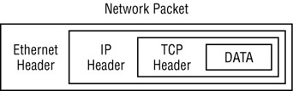
Analyzing Network Packets
The ability to watch an IP session and decode its meaning is a crucial skill for a network programmer. To fully understand the concepts behind network programming, you must first understand the IP protocol and how it moves data among network devices. Getting familiar with this information could save you countless hours of troubleshooting network programs that aren’t behaving the way you think they should.
The network packets that you capture contain several layers of information to help the data get transported between the two network devices. Each layer of information contains bytes arranged in a predetermined order, specifying parameters specific for the protocol layer. Most packets that you will use in IP network programming will contain three separate protocol layers of information, along with the actual data being transmitted between network devices. The following figure illustrates the protocol hierarchy used for IP packets, as discussed in the sections that follow.

Slide 30
Ethernet - A Real Data-Link Layer
It will be useful to discuss a real data-link layer.
Ethernet (really IEEE 802.3) is widely used.
Supported by a variety of physical layer implementations.
Multi-access (shared medium).
Every Ethernet interface has a unique 48 bit address (a.k.a. hardware address).
Example: C0:B3:44:17:21:17
The broadcast address is all 1’s.
Addresses are assigned to vendors by a central authority.
CSMA/CD(Carrier Sense Multiple Access with Collision Detection):
  Carrier Sense: can tell when another host is transmitting
  Multiple Access: many hosts on 1 wire
  Collision Detection: can tell when another host transmits at the same time.

Slide 31
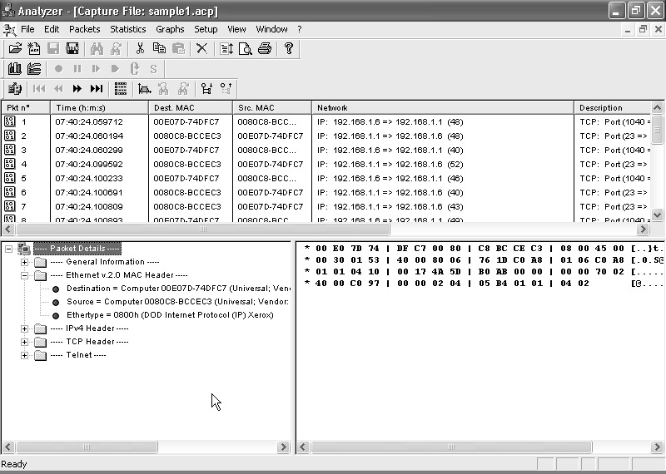
The Ethernet Layer
The first layer of the network packet shown in the Analyzer capture is called the Ethernet header. You may see three types of Ethernet protocol packets on your network: Ethernet 802.2, Ethernet 802.3, and Ethernet version 2.
The Ethernet 802.2 and 802.3 protocols are IEEE standard protocols defined for Ethernet layer traffic. Ethernet version 2 is a legacy protocol that is not a standard protocol per se, but it is the most common protocol used on Ethernet networks.

Slide 32
The Ethernet version 2 header shows the Media Access Card (MAC) addresses that are used to identify individual devices on the Ethernet network, along with an Ethernet protocol number that identifies the next layer protocol contained in the Ethernet packet. Each Ethernet packet conforms to a predetermined layout:
  A 6-byte destination Ethernet (or MAC) address
  A 6-byte source Ethernet (or MAC) address
  A 2-byte next-layer protocol identifier
  A data payload of 46 to 1500 bytes
  A 4-byte checksum
The data payload must contain a minimum of 46 bytes to ensure that the Ethernet packet is at least 64 bytes long. (This helps prevent collisions, because sending shorter packets could cause a collision on the network after the packet has been sent, and the sending device would never know.) If the data is not 46 bytes long, padding characters are added. The checksum value supplies a rudimentary error checking mechanism for the data on the network. If the packet becomes corrupt in transit, the checksum will not compute properly, and the packet is marked as bad.

Slide 33
Ethernet Address
The Ethernet addresses of devices are assigned by the network card vendor and should not be changed (even though in some instances software allows you to override that address). Each device on an Ethernet network must have a unique MAC address. The MAC address consists of two parts:
  A 3-byte vendor identifier, or Organizationally Unique Identifier (OUI)
  A 3-byte device serial number unique to the vendor
The resulting 6-byte network address uniquely identifies the network card on the network, no matter how large the network is. The Internet Assigned Numbers Authority (IANA) assigns vendors MAC addresses to ensure there is no duplication. The assigned numbers are published in Internet Request For Comments (RFC) documents (the most recent Assigned Numbers RFC is RFC 1700).

Slide 34
After the 3-byte vendor portion, a 3-byte unique serial number is added to produce the unique 6-byte address. You may see Ethernet addresses referenced in several ways; here are some of the traditional formats:
  As a single value: 0020AFCCEC3
  Using colons: 00:20:AF:BC:CE:C3
  Using hyphens: 00-20-AF-BC-CE-C3
  Using a single hyphen: 0020AF-BCCEC3 (as used by the Analyzer program)
In addition to individual device addresses, the Ethernet addressing scheme allows for broadcast and multicast addresses. In the broadcast address, all of the destination address bits are set to 1 (FFFFFFFFFFFF in hexadecimal). Every device on the Ethernet should accept packets addressed to the Ethernet broadcast address. This address is useful for protocols that must send a query packet to all devices on the network; ARP, for example, when a workstation is looking for a device that has a particular IP address.
Ethernet multicast addresses are a special form of Ethernet address; only a subset of the network devices will accept the packet. The Ethernet software on the network device must be configured to accept the particular type of multicast address.

Slide 35
Ethernet Protocol Type
The other important part of the Ethernet header is the Protocol Type field. The difference between the Ethernet version 2 packet and the Ethernet 802.2 and 802.3 packets occurs in the Protocol Type field. The 802.2 and 802.3 packets both contain a 2-byte value in the same location of the packet, and they both use the value to indicate the total size of the Ethernet packet. The Ethernet version 2 protocol uses those same 2 bytes to define the protocol type used in the next level packet that is contained within the Ethernet packet. This allows network applications to quickly identify the next layer protocol in the packet data.
Similar to the Ethernet vendor addresses are the IANA-assigned values for various protocols that can be identified within the Ethernet protocol type field. For IP=088, ARP=0806.

Slide 36
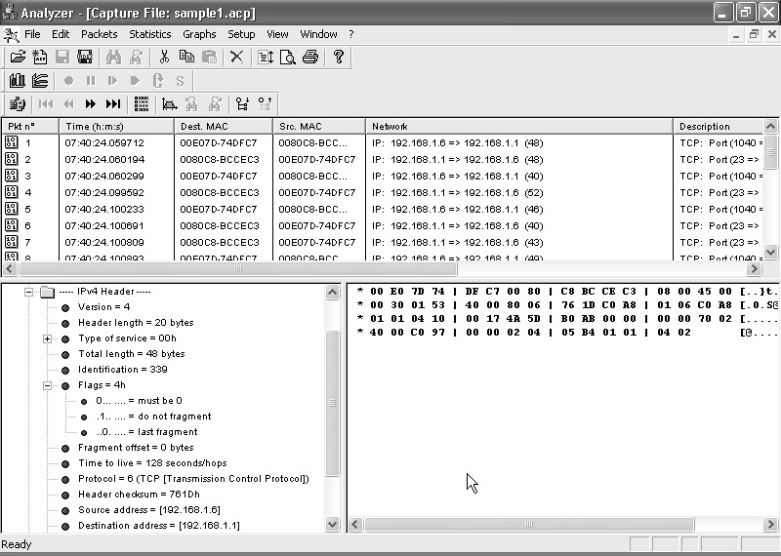
The IP Layer
The next protocol layer in the Analyzer capture packet is the IP packet. As you can see, the IP protocol defines several additional fields of to the Ethernet protocol information.

Slide 37
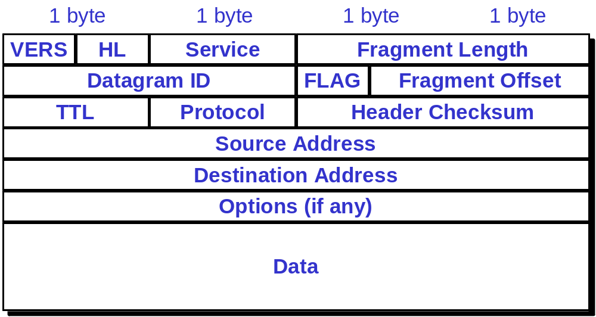
IP Datagram

Slide 38
IP Datagram
Field Bits Description
Version 4 IP header version format (current version is 4)
Header Length 4 The length of the header part of the IP packet, in octets
Type of Service 8 The Quality of Service (QoS) type desired for the packet
Total Length 16 The length of the total IP packet, in octets
Identification 16 An ID value that uniquely identifies the individual IP packet
Flags 3 Indicate whether the IP packet can be fragmented, or if there are more fragments
Fragment offset 13 Location of the fragment in the IP packet
Time to Live (TTL) 8 The maximum time the packet is allowed to remain in the network (in seconds)
Protocol 8 The protocol type of the next level data
Header Checksum 16 A checksum of the IP header data
Source Address 32 The IP address of the sending device
Destination Address 32 The IP address of the receiving device
Options variable Optional fields that further define the IP packet characteristics

Slide 39

IP Addresses
IP addresses are not the same as the underlying data-link (MAC) addresses.
Why ?
Rensselaer

Slide 40
Address Fields
While Ethernet addresses are good for uniquely identifying devices on a LAN, they do not help at all for identifying remote devices. It is impossible to look at an Ethernet address and determine what network it is on. To help uniquely identify the devices on separate networks, the IP addressing scheme uses particular bits of the 32-bit address to identify address features. The IP address is divided into three parts:
  A preset number of high bits used to identify the packet address scheme used
  A predetermined network address
  A device address on the network
From 1 to 4 high bits identify how the network and device addresses are determined within the total 32 bits of the IP address. The network address identifies the unique network where the device is located. Every network should have a unique IP network address assigned to it. IP routers can use the network address information to decide the routing of individual IP packets to the proper remote network, even when they are located across the Internet. The device address uniquely identifies the device within the network address. No two devices with the same network address can have the same device address.

Slide 41
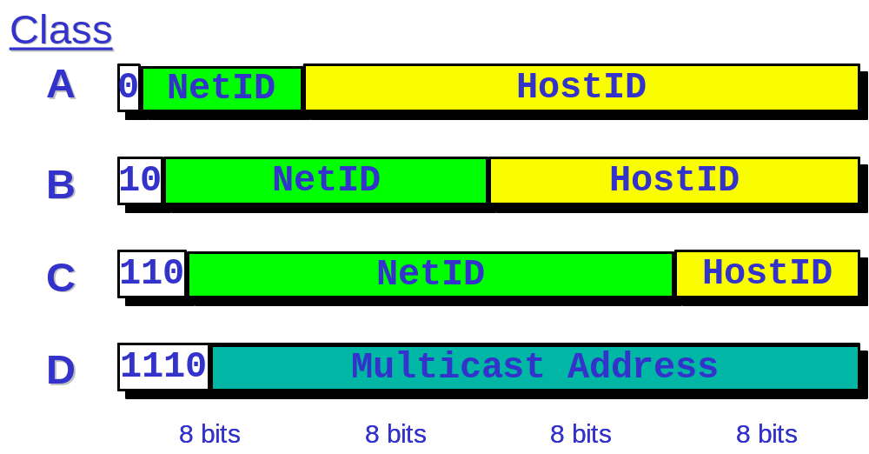
The four formats of IP Addresses

Slide 42
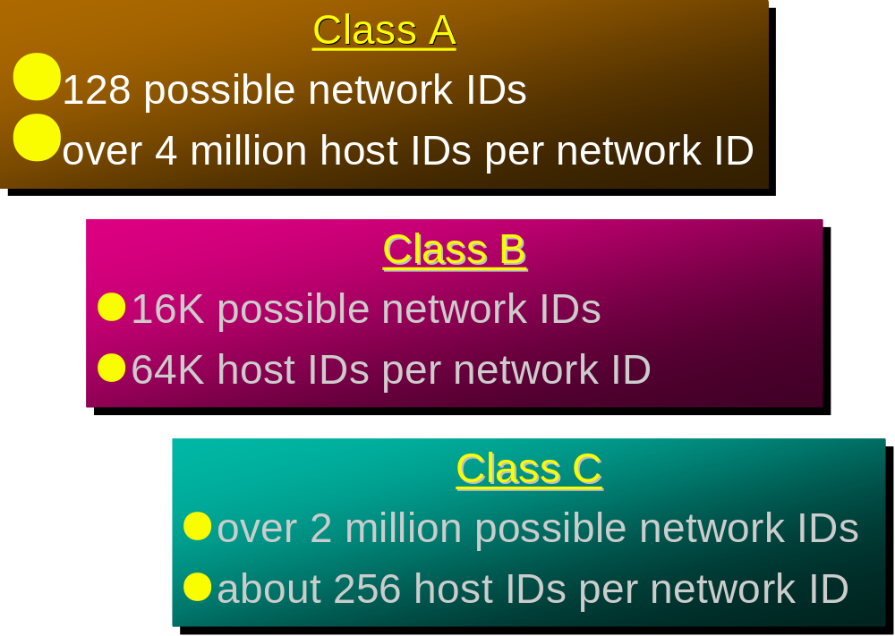

Slide 43
Fragmentation Flags
One of the many complexities of IP packets is their size. The maximum size of an IP packet can be 65,536 bytes. This is a huge amount of data for an individual packet. In fact, most lower-level transports (such as Ethernet) cannot support carrying a large IP packet in one piece (remember, the Ethernet data section can only be 1,500 bytes long). To compensate for this, IP packets employ fragmentation to divide the IP packet into smaller parts for transport to the destination. When the pieces arrive at the destination, the receiving software must have a way to recognize the fragmented packet and reassemble the pieces back into a single IP packet.
Fragmentation is accomplished using three fields of the IP packet, the fragmentation flags, the fragment offset, and the identification fields. The fragmentation flags consist of three 1-bit flags:
  A reserved flag, which must be zero
  A Don’t Fragment flag, which indicates that the IP packet may not be fragmented
  A More Fragment flag, which indicates that this packet is an IP fragment and more fragments are on the way
The IP Identification field uniquely identifies each IP packet. All the fragments of any packet will have the same identification number. This tells the receiving software which packets need to be joined together to create the original IP packet. The fragment offset field indicates the location for the fragment in the original packet.

Slide 44
Each fragment (packet) has the same structure as the IP datagram.
IP specifies that datagram reassembly is done only at the destination (not on a hop-by-hop basis).
If any of the fragments are lost - the entire datagram is discarded (and an ICMP message is sent to the sender).

Slide 45
Type of Service Field
The Type of Service field identifies a Quality of Service (QoS) type for the IP packet, to mark an individual IP packet (or a stream of IP packets) as having a particular priority. In the past this field was not used much. However, recently there has been a push for using this field to prioritize real-time data such as video and audio streams. This will help routers and other network devices to give real-time data packets a higher priority of service to reduce the delay in their transmission. In most network traffic, the Type of Service field will be set to all zeros, indicating normal, routine data. However, with the increased use of IP for transporting real-time data, you may encounter applications that use the Type of Service field to prioritize packets.
The Type of Service (ToS) field contains 8 bits of information, divided into the following subfields:
  3 bits used as a precedence field
  1 bit used to denote normal or low delay
  1 bit used for normal or high throughput
  1 bit used for normal or high reliability
  2 bits reserved for future use

Slide 46
Protocol Field
The Protocol field is used to identify the next layer protocol contained in the IP packet. The IANA has defined 135 values for this field that can be used in IP packets, but in practice on a typical network you will see just a few.
Value (Decimal) Description
1 Internet Control Message (ICMP)
2 Internet Group Message (IGP)
6 Transmission Control (TCP)
8 Exterior Gateway (EGP)
9 Interior Gateway (Cisco IGP)
17 User Datagram (UDP)
88 Cisco EIGRP

Slide 47
Mapping IP Addresses to Hardware Addresses
IP Addresses are not recognized by hardware.
If we know the IP address of a host, how do we find out the hardware address ?
The process of finding the hardware address of a host given the IP address is called :Address Resolution
The process of finding out the IP address of a host given a hardware address is called:Reverse Address Resolution
Reverse address resolution is needed by diskless workstations when booting (which used to be quite common).

Slide 48

ARP
Arp Arp!
The Address Resolution Protocol is used by a sending host when it knows the IP address of the destination but needs the Ethernet (or whatever) address.
ARP is a broadcast protocol - every host on the network receives the request.
Each host checks the request against it’s IP address - the right one responds.
ARP does not need to be done every time an IP datagram is sent - hosts remember the hardware addresses of each other.
Part of the ARP protocol specifies that the receiving host should also remember the IP and hardware addresses of the sending host.

Slide 49
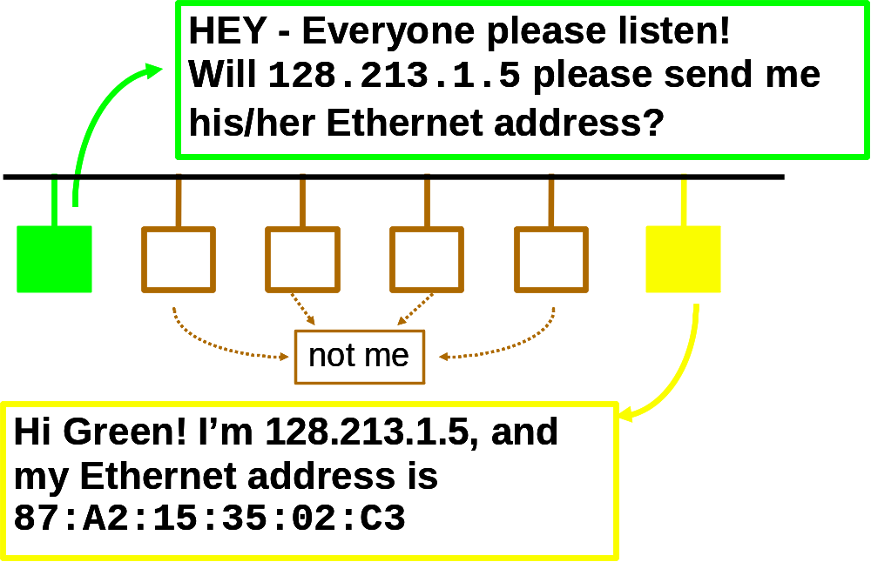
ARP conversation

Slide 50
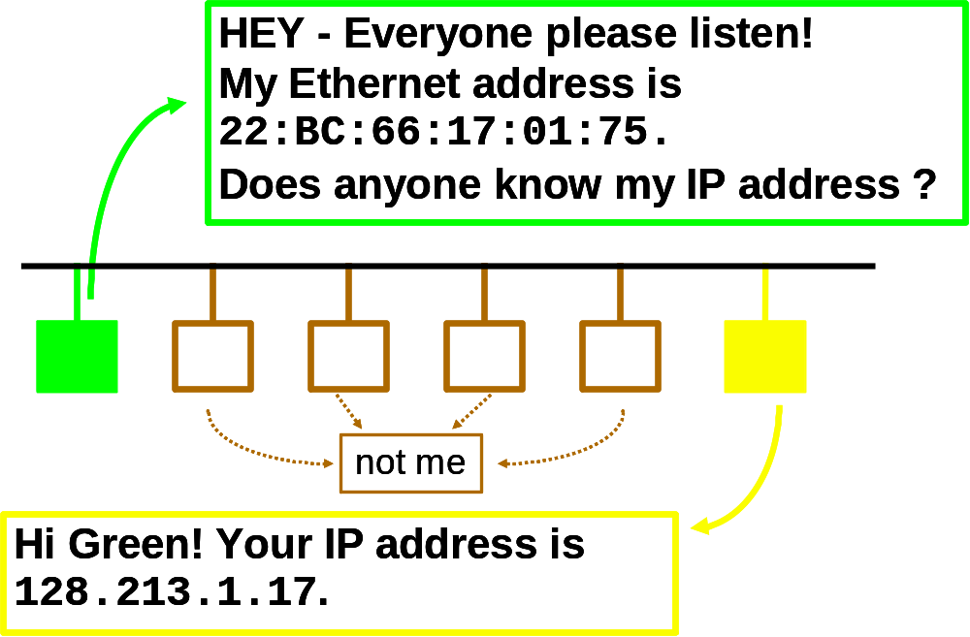
RARP conversation

Slide 51
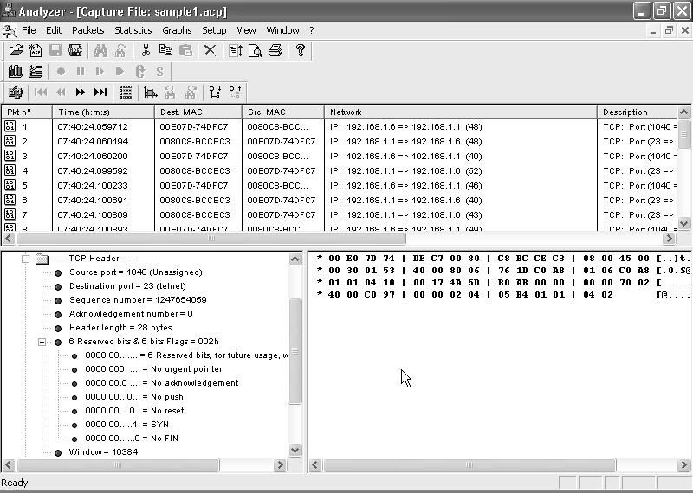
The TCP Layer
The Transmission Control Protocol (TCP) adds connection information to the data packet. This allows programs to create an end-to-end connection between two network devices, providing a consistent path for data to travel. TCP guarantees the data will reliably be delivered to the destination device or that the sender will receive indication that a network error occurred.
Because of this feature, TCP is called a connection-oriented protocol. Each TCP connection, or session, includes a certain amount of packet overhead related to establishing the connection between the two devices. Once the connection is established, data can be sent between the devices without the application having to check for lost or out-of-place data.
For a network programmer, it is a good idea to have a basic understanding of how TCP works, and especially how it moves data between devices on the network.

Slide 52
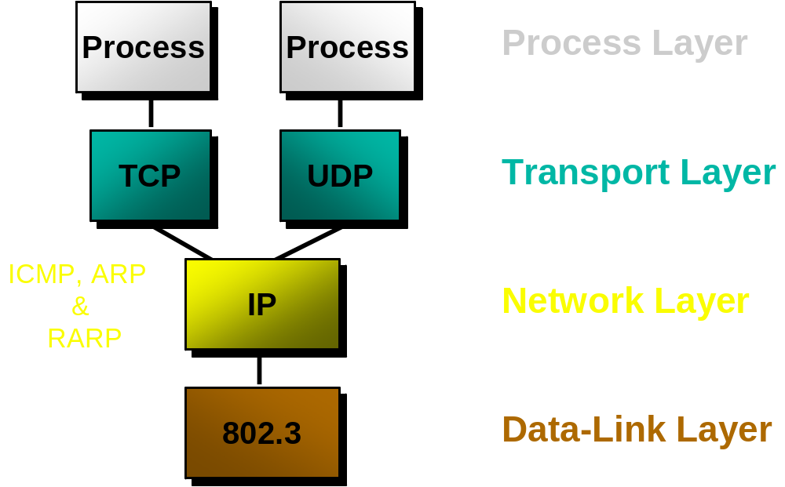
Transport Layer & TCP/IP
Q: We know that IP is the network layer - so TCP must be the transport layer, right ?
A: No… well, almost.
TCP is only part of the TCP/IP transport layer - the other part is UDP (User Datagram Protocol).

Slide 53
Each of the many fields in the TCP Header is associated with a particular function in the TCP session. The functions worth looking at are as follows:
  The tracking of multiple connections between devices (source and destination ports)
  The tracking of packet order and requests for retransmission of lost packets (sequence and acknowledgement numbers)
  The opening and closing of connection streams between devices for data transmission (TCP flags)

Slide 54
TCP:Transmission Control Protocol
TCP is an alternative transport layer protocol supported by TCP/IP.
TCP provides:
  Connection-oriented
  Reliable
  Full-duplex
  Byte-Stream
Connection oriented means that a virtual connection is established before any user data is transferred.
  If the connection cannot be established - the user program is notified (finds out).
  If the connection is ever interrupted - the user program(s) is finds out there is a problem.

Slide 55
TCP
Reliable( Reliable does not mean that things don't go wrong, it means that we find out when things go wrong):
  Reliable means that every transmission of data is acknowledged by the receiver.
  If the sender does not receive acknowledgement within a specified amount of time, the sender retransmits the data.
Byte Stream
  Stream means that the connection is treated as a stream of bytes.
  The user application does not need to package data in individual datagrams (as with UDP).
Buffering
  TCP is responsible for buffering data and determining when it is time to send a datagram.
  It is possible for an application to tell TCP to send the data it has buffered without waiting for a buffer to fill up.
Full Duplex
  TCP provides transfer in both directions (over a single virtual connection).
  To the application program these appear as 2 unrelated data streams, although TCP can piggyback control and data communication by providing control information (such as an ACK) along with user data.

Slide 56
TCP Application Ports
The first two entries in the expanded TCP Header in the Analyzer capture window are the source and destination ports. TCP uses ports to identify individual TCP connections on a network device. The port value identifies a TCP endpoint on the device to be used for a particular application. To communicate with an application on a remote device, you must know two pieces of information:
  The remote device’s IP address
  The TCP port assigned to the remote application
For a TCP connection to be established, the remote device must accept incoming packets on the assigned port. Because there could be many applications running on a device that uses TCP, the device must allocate specific port numbers to specific applications. This tells the client which port to use for a particular application and tells the host which application an incoming packet should be forwarded to.

Slide 57
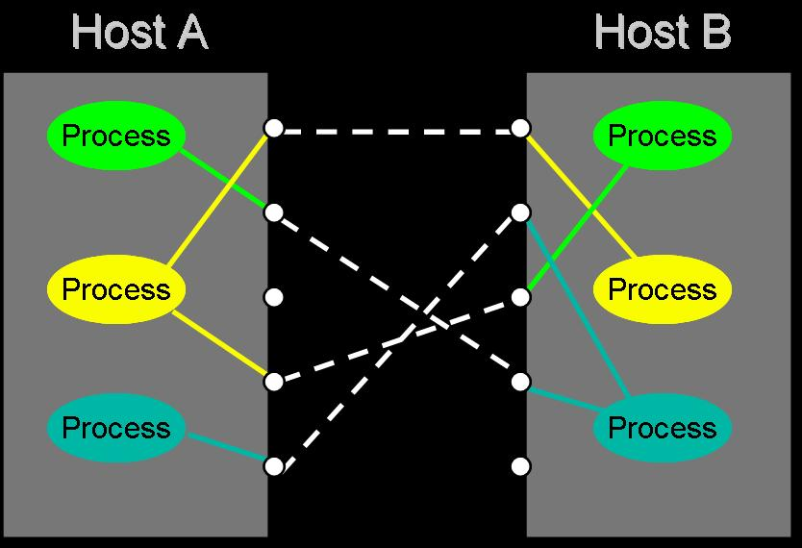
Ports

Slide 58
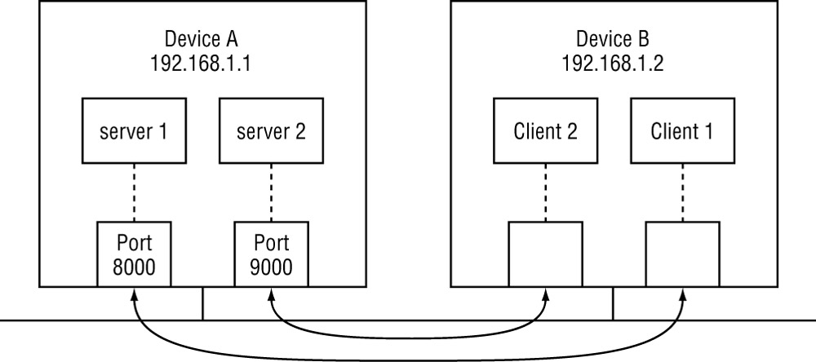
Ports
Network device A is running two server applications, waiting for incoming packets from remote devices. One application is assigned TCP port 8000 on the device, and the other is assigned port 9000. Network device B is a client that wants to connect to the applications on the server. For a device to send a packet to a remote device, it too must obtain a free TCP port from the operating system, which remains open for the duration of the session. The client TCP port number is usually not important and can be assigned to any available port on the device. The client forwards the packet from an available port on Device B to the application TCP ports on Device A.

Slide 59
Ports
The combination of an IP address and a port number defines an IP endpoint. A TCP session is defined as the combination of a local IP endpoint and a remote IP endpoint. Only one session can have both these properties the same. A single network application can use the same local IP endpoint, but each remote connection must have either a separate IP address or remote port number.
Ports that are numbered from 0 to 1023 are called well-known ports because they are assigned to specific, common applications. If you are creating a new application, avoid assigning it to one of these ports to avoid confusion. In fact, if an application is already using a port, the system will not allow you to use that port. Ports numbered from 1024 to 65,535 are open for use by any application; even in this wide range, it is still possible to run into two applications that chose to use the same port. For this reason, many custom-made applications give users the choice of defining their own port number to use.
For the network programmer, TCP ports are crucial elements. All server applications must use a valid (and available) port on the network device. It is up to you to decide how to use the TCP port assignment for your application. As mentioned, it is always a good idea to give your customer the option of changing the TCP port number of your application. Just remember that if the server port number changes, the client application must know about this change, or it will never find the server application.

Slide 60
Ensuring Packet Reliability
After the ports, the next fields in the TCP header are the sequence and acknowledgement numbers. These values allow TCP to track packets and ensure they are received in the proper order from the network. If any packets are missing, the TCP system can request a retransmission of the missing packets and reassemble the data stream before passing it off to the application.
Each packet sent has a unique sequence number for the TCP session. A random number is chosen for the first packet sent in the session. Each subsequent packet sent by the device increases the sequence number by the number of TCP data bytes in the preceding packet. This ensures that each packet is uniquely identified within the TCP data stream.
The receiving device uses the acknowledgement field to acknowledge the last sequence number received from the remote device. The receiving device can receive multiple packets before sending an acknowledgement. The returned acknowledgement number should be the highest consecutive sequence number of data received. This technique is called a sliding window. Packets received out of order can be held in a buffer and placed in the right order when the other packets are successfully received, rather than being retransmitted. If a packet it dropped, the receiver will see the missing sequence number and send a lower acknowledgement number to request the missing packet. Without the sliding window each packet would have to be individually acknowledged, resulting in an increase of network traffic and delay.
When troubleshooting TCP problems, the sequence and acknowledgement numbers are often the most difficult part to debug. Often it is best to create a list of packet sequence numbers for each packet from each individual device. By comparing the TCP sequence numbers of each packet, you can determine if packets are being frequently retransmitted (repeated or overlapping sequence numbers in a TCP session). This could mean a network problem somewhere along the line.

Slide 61
After the header length field, the TCP Header shows a Flags field. The flags are used to control the TCP connection between the two devices.
There are a bunch of control flags:
  URG: urgent data included.
  ACK: this segment is (among other things) an acknowledgement.
  RST: error - abort the session.
  SYN: synchronize Sequence Numbers (setup)
  FIN: polite connection termination.

Slide 62
TCP Connection Creation
Programming details later - for now we are concerned with the actual communication.
A server accepts a connection.
  Must be looking for new connections!
A client requests a connection.
  Must know where the server is!
A client starts by sending a SYN segment with the following information:
  Client’s ISN (generated pseudo-randomly)
  Maximum Receive Window for client.
  Optionally (but usually) MSS (largest datagram accepted).
  No payload! (Only TCP headers)
When a waiting server sees a new connection request, the server sends back a SYN segment with:
  Server’s ISN (generated pseudo-randomly)
  Request Number is Client ISN+1
  Maximum Receive Window for server.
  Optionally (but usually) MSS
  No payload! (Only TCP headers
When the Server’s SYN is received, the client sends back an ACK with:
  Request Number is Server’s ISN+1

Slide 63
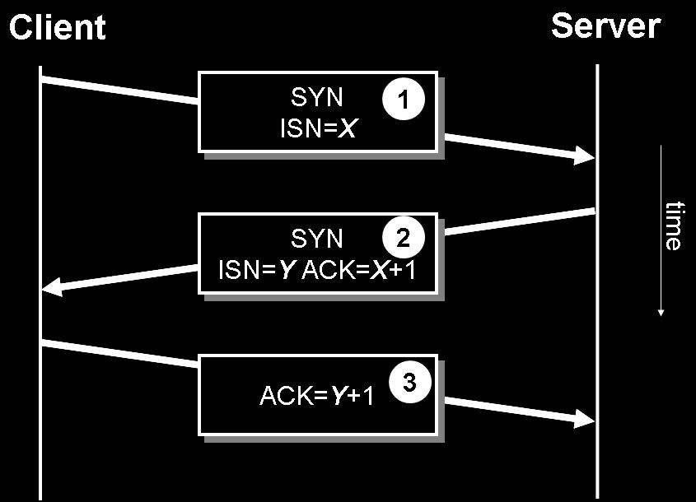
1

Slide 64
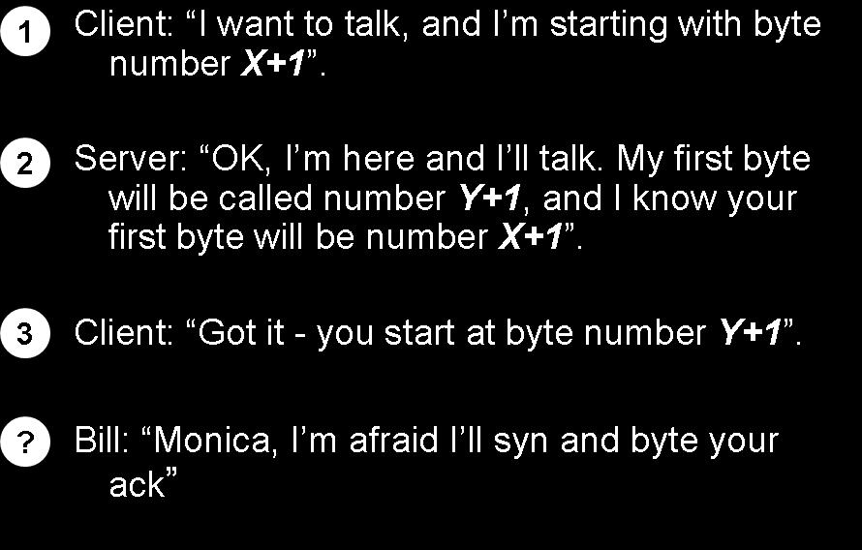
2

Slide 65
Once the connection is established, data can be sent.
Each data segment includes a sequence number identifying the first byte in the segment.
Each segment (data or empty) includes a request number indicating what data has been received.
Keep in mind that TCP is (usually) part of the Operating System. It takes care of all these details asynchronously.
The TCP layer doesn’t know when the application will ask for any received data.
TCP buffers incoming data so it’s ready when we ask for it.
Both the client and server allocate buffers to hold incoming and outgoing data
  The TCP layer does this.
Both the client and server announce with every ACK how much buffer space remains (the Window field in a TCP segment).

Slide 66
The application gives the TCP layer some data to send.
The data is put in a send buffer, where it stays until the data is ACK’d.
  it has to stay, as it might need to be sent again!
The TCP layer won’t accept data from the application unless (or until) there is buffer space.
The TCP layer can send a RST segment that terminates a connection if something is wrong.
Usually the application tells TCP to terminate the connection politely with a FIN segment.
Either end of the connection can initiate termination.
A FIN is sent, which means the application is done sending data.
The FIN is ACK’d.
The other end must now send a FIN.
That FIN must be ACK’d.

Slide 67
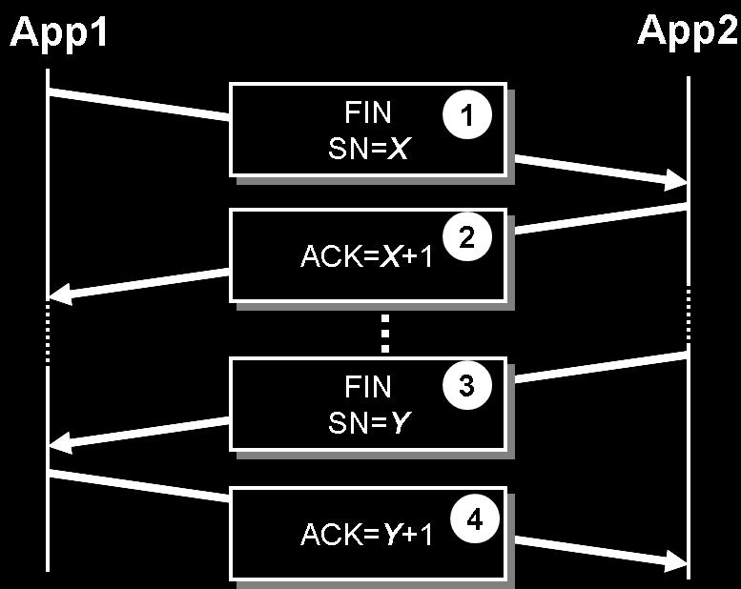

Slide 68
TCP TIME_WAIT
Once a TCP connection has been terminated (the last ACK sent) there is some unfinished business:
  What if the ACK is lost? The last FIN will be resent and it must be ACK’d.
  What if there are lost or duplicated segments that finally reach the destination after a long delay?
TCP hangs out for a while to handle these situations.

Slide 69
TCP uses connection states to determine the status of a connection between devices. A specific handshaking protocol is used to establish these connections and to monitor the status of the connection during the session. The TCP session has three phases:
  Opening handshake
  Session communication
  Closing handshake
Each phase requires the flag bits to be set in a certain order. The opening handshake is often called the three-way handshake and requires three steps to establish the connection:
The originating host sends a SYN flag to indicate the start of a session.
The receiving host sends a both a SYN flag and an ACK flag in the same packet to indicate it accepts the start of the session.
The originating host sends an ACK flag to indicate the session is open and ready for packets.
After the session is established, you will see the ACK flag set on packets, indicating that the device is acknowledging the receipt of a packet with a particular sequence number. To close the session, another handshake is done using the FIN packets:
The host initiating the close sends a FIN flag.
The initiating host sends an ACK flag to officially close the session.

Slide 70
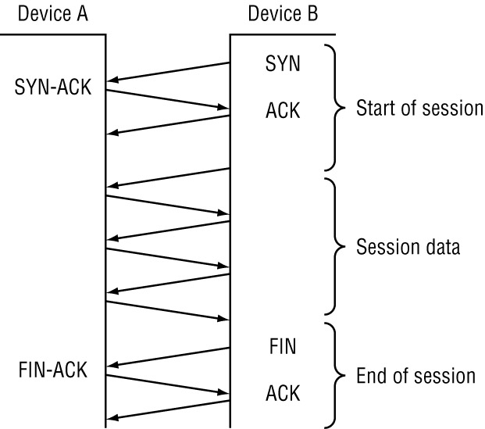

Slide 71
The phases of the TCP session are associated with connection state names. Each connection state indicates the session’s current position in the handshaking sequence. The connection states apply equally to clients as well as servers. Both devices in the TCP session follow the same TCP states. Table 2.11 lists the TCP connection states and describes their associated flags.
TCP Connection States
State Description
CLOSED The session is not active.
LISTEN The device is waiting for incoming data on a specific port.
SYN-SENT The device sent a SYN flag to start a session and is waiting for the remote device to acknowledge and return a SYN flag.
SYN-RECEIVED The device received a SYN flag, returned both a SYN flag and an ACK flag to complete the start of session, and is waiting for an ACK flag.
ESTABLISHED Both devices completed the opening handshake and can pass data packets between each other.
FIN-WAIT-1 The device sent a FIN flag to end the session.
FIN-WAIT-2 The device received a FIN flag and returns FIN and ACK flags.
LAST-ACK The device has sent a FIN flag in response to receiving a FIN flag and is waiting for the final ACK flag from the remote device.
TIME-WAIT After the LAST-ACK state a device will wait a preset amount of time before officially closing the session port to ensure the remote device does not send additional data.

Slide 72
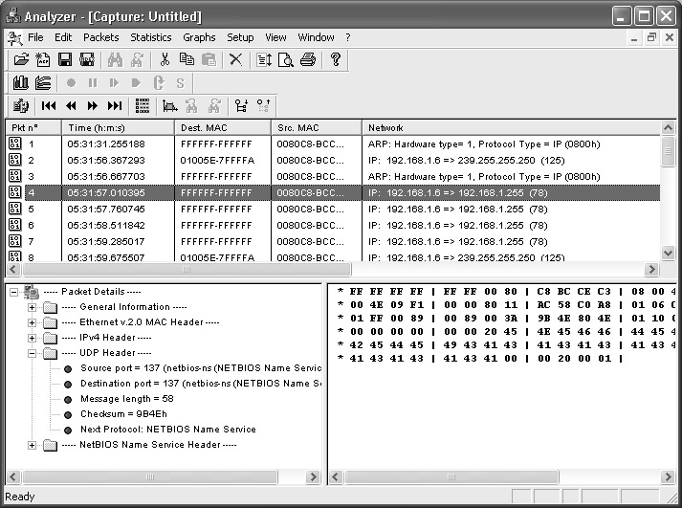
The UDP Layer
The User Datagram Protocol (UDP) is another popular high-level protocol used in IP communications. After studying TCP, UDP will seem like a snap. Unlike TCP, UDP provides a connectionless path between network devices to transmit data, and thus does not need all of the overhead of session establishment flags and connection states. Each UDP “session” is nothing more than a single packet transmitted in one direction.

Slide 73
UDP
The term datagram is also used to describe the unit of transfer of UDP!
  Datagram Delivery
  Connectionless
  Unreliable
  Minimal
Source Port
Destination Port
Length
Checksum
Data

Slide 74
UDP
The UDP header fields are pretty straightforward:
  Source Port
  Destination Port
  Message Length
  Checksum
  Next Level Protocol
Like TCP, UDP tracks individual connections using port numbers and assigns port numbers from 0 to 1023 to reserved application ports. Ports 1024 to 65536 are available for you to use in your applications.
TCP vs. UDP:
Q: Which protocol is better ?
A: It depends on the application.
  TCP provides a connection-oriented, reliable, byte stream service (lots of overhead).
  UDP offers minimal datagram delivery service (as little overhead as possible).

Slide 75
TCP/IP Summary
IP: network layer protocol
  unreliable datagram delivery between hosts.
UDP: transport layer protocol
  unreliable datagram delivery between processes.
TCP: transport layer protocol
  reliable, byte-stream delivery between processes.

Slide 76
TCP-IP/BYE-BYE
TCP-IP/BYE-BYE is a lecture protocol used to signal the class that we have just finished our discussion of the TCP/IP.
The appropriate response to an TCP-IP/BYE-BYE request is immediate applause, although simply opening your eyes is enough (known as a WAKEUP response).

Slide 78
Finding IP Address Information
One of the biggest challenges of network programming is dealing with network configurations of individual workstations and servers. When sending data across the network, you often need to determine the IP network information for the system running your program. The Windows OS family offers many ways to determine IP configuration information, both manually and from within a program.
This section demonstrates a few of the ways that you can use to determine IP configuration information both manually and within your C# programs.

Slide 79
Using ipconfig
The ipconfig program displays IP network information for each active network interface on the system. The default form of ipconfig displays basic information for each network device:
C:\>ipconfig
Windows NT IP Configuration
Ethernet adapter El90x1:
IP Address. . . . . . . . . : 192.168.1.6
Subnet Mask . . . . . . . . : 255.255.255.0
Default Gateway . . . . . . : 192.168.1.1
PPP adapter NdisWan5:
IP Address. . . . . . . . . : 0.0.0.0
Subnet Mask . . . . . . . . : 0.0.0.0
Default Gateway . . . . . . :
C:\>
Here, the ipconfig program found two network interfaces configured on the workstation. The first interface is an Ethernet card configured for a LAN with a static IP address assigned to the workstation. The second device is a PPP connection configured to use a modem in the workstation. Because the PPP connection obtains its IP information dynamically when the PPP session starts, the values set by default in the workstation are zeroed. When the PPP connection is enabled, the assigned IP information is displayed.
To obtain more detailed information about a device, use the /all switch for the ipconfig command, as shown here:
C:\>ipconfig /all

Slide 80
To obtain more detailed information about a device, use the /all switch for the ipconfig command, as shown here:
C:\>ipconfig /all
Windows NT IP Configuration
Host Name . . . . . . . . . : shadrach.blum.lan
DNS Servers . . . . . . . . : 192.168.1.1
192.168.1.2
192.168.1.3
Node Type . . . . . . . . . : Broadcast
NetBIOS Scope ID. . . . . . :
IP Routing Enabled. . . . . : No
WINS Proxy Enabled. . . . . : No
NetBIOS Resolution Uses DNS : No
Ethernet adapter El90x1:
Description . . . . . . . . : 3Com EtherLink PCI
Physical Address. . . . . . : 00-50-DA-10-78-67
DHCP Enabled. . . . . . . . : No
IP Address. . . . . . . . . : 192.168.1.6
Subnet Mask . . . . . . . . : 255.255.255.0
Default Gateway . . . . . . : 192.168.1.1
PPP adapter NdisWan5:
Description . . . . . . . . : NdisWan Adapter
Physical Address. . . . . . : 00-00-00-00-00-00
DHCP Enabled. . . . . . . . : No
IP Address. . . . . . . . . : 0.0.0.0
Subnet Mask . . . . . . . . : 0.0.0.0
Default Gateway . . . . . . :
C:\>

Slide 81
Using the Windows Registry
What is it:
  A central hierarchical database to store information necessary to configure the system for one or more users, applications and hardware devices.
  Replaces AUTOEXEC.BAT, CONFIG.SYS and INI files
  First introduced in Windows 3.1 for storing OLE Settings (pre 1995).
تعتبر الريجستري أحد أهم ركائز نظام التشغيل (الويندوز)، لكونها تمثل قاعدة البيانات database التي يستخدمها الويندوز لخزن المعلومات التي تخص إعدادات وأماكن وجود البرامج ومكونات الويندوز على القرص الصلب. معظم البرامج أثناء تنصيبها تكتب إلى الريجستري معلومات عن إعداداتها وأرقام إصداراتها وأمكن تواجدها وغيرها على القرص الصلب. قد يختلف مسار المعلومات المدونة في الريجستري من ريجستري إلى أخرى بإختلاف نسخ الويندوز، وكذلك لكل ويندوز وجهاز ريجستري خاصة بهما.

Slide 82
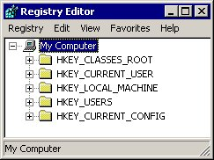
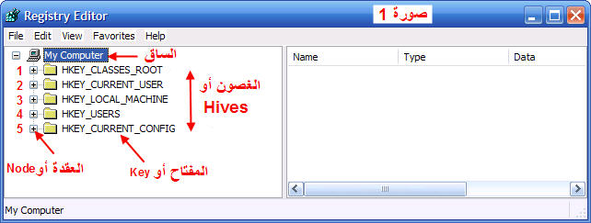
There are five root keys:
  HKEY_CLASSES_ROOT
  HKEY_CURRENT_USER
  HKEY_LOCAL_MACHINE
  HKEY_USERS
  HKEY_CURRENT_CONFIG

Slide 83
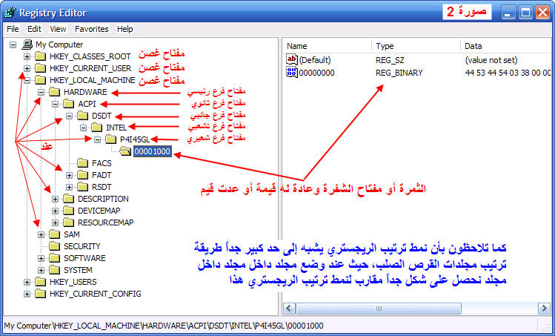

Slide 84
Registry Architecture
The registry is made up of "Keys". Each key is like the branch of a tree. Each key has one parent key, and zero or more child keys. Each key can contain zero or more "Values", each of which contains a single piece of data.

Slide 85
To make navigating the registry a bit easier, you can think of the registry's construction like your hard drives:
Hard drive <-> Registry
Folders <-> Keys
Files <-> Values
The registry contains 6 main keys:
  HKEY_CLASSES_ROOT ---- Contains information on file types, including which programs are used to open a particular file type.
  HKEY_CURRENT_USER ---- Contains user-specific settings that are built from information in the HKEY_USERS key during the logon process.
  HKEY_LOCAL_MACHINE ---- Contains computer specific information including installed hardware and software. This is the one users tend to spend the most time in.
  HKEY_USERS ---- Contains information (generic and user-specific) about all the users who log on to the computer. The generic settings are available to all users who log on to the computer. The information is made up of default settings for programs, desktop configurations, and so on. This key contains subkeys for each user that logs on to the computer.
  HKEY_CURRENT_CONFIG ---- Contains information about the computer's hardware configuration .
  HKEY_DYN_DATA ---- Contains real-time performance statistics on the computer's hardware.

Slide 86
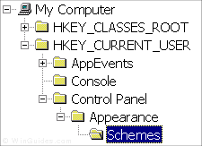
Each main branch (denoted by a folder icon in the Registry Editor, see right) is called a Hive, and Hives contains Keys. Each key can contain other keys (sometimes referred to as sub-keys), as well as Values. The values contain the actual information stored in the Registry. There are three types of values; String, Binary, and DWORD - the use of these depends upon the context.

Slide 87
Each registry value is stored as one of five main data types:
  REG_BINARY - This type stores the value as raw binary data. Most hardware component information is stored as binary data, and can be displayed in an editor in hexadecimal format.
  REG_DWORD - This type represents the data by a four byte number and is commonly used for boolean values, such as "0" is disabled and "1" is enabled. Additionally many parameters for device driver and services are this type, and can be displayed in REGEDT32 in binary, hexadecimal and decimal format, or in REGEDIT in hexadecimal and decimal format.
  REG_EXPAND_SZ - This type is an expandable data string that is string containing a variable to be replaced when called by an application. For example, for the following value, the string "%SystemRoot%" will replaced by the actual location of the directory containing the Windows NT system files. (This type is only available using an advanced registry editor such as REGEDT32)
  REG_MULTI_SZ - This type is a multiple string used to represent values that contain lists or multiple values, each entry is separated by a NULL character. (This type is only available using an advanced registry editor such as REGEDT32)
  REG_SZ - This type is a standard string, used to represent human readable text values.

Slide 89
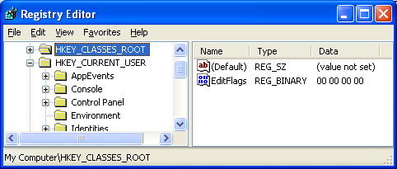
Subkeys
Root keys (sometimes called predefined keys), contain subkeys. Subkeys look like folders in Regedit
HKCU has these top-level subkeys: AppEvents, Console, Control Panel, Environment, …
A root key and its subkeys form a path

Slide 90
Values
Every Subkeys contains at least one value
The default value (often undefined)
Values have name, data type, and data

Slide 91
Regedt32
Windows 2000 included two registry editors: Regedit.exe and Regedt32.exe. Regedt32 is gone, and now that command just launches Regerdit.

Slide 92
Using C# to Search the Registry
Once you have determined where to find the network information in the Registry of your target system, you can create C# code to search for it and display the information to the user (or use it in your program). In this section, we’ll examine a C# program to query the system Registry for IP information.
The .NET Framework provides a set of classes that help you query and manipulate Registry entries. The .NET Registry classes are contained in two separate namespaces:
  Microsoft.Win32.Registry The Microsoft.Win32.Registry namespace contains all the base classes needed to access the base Registry key names: Current_User, Local_Machine, Classes_Root, Current_Config, Dyn_Data, and Users. You must use one of the base Registry key names to build your specific Registry subkey.
  Microsoft.Win32.RegistryKey The Microsoft.Win32.RegistryKey namespace contains the classes and methods necessary to query and modify Registry keys and data. The OpenSubKey() method allows you to open a subkey of a known key and access any data values contained in the subkey. Once you have the appropriate subkey, you can use the GetValue() method to get the data values assigned to the subkey.

Slide 93
Example-1
Add Registry Data: Following text is a actual registry information. Copy and paste this content in a text file and save as with extention .reg. and double click on the file.
/*Windows Registry Editor Version 5.00
[HKEY_CURRENT_USER\Software\TAW\BSE]
"DSN"="TAWReports"
"User"="TAW1"
"Password"="taw1.1"
"Server"="dbserver"
"IP"=""
*/
Read the Registry Data:
Create two RegistryKey variables.
Create object od sealed class as shown below with first parameter as HKEY (main root key name) and second as "" for local machine.
Create sub key from where one would like to read information.
Use Getvalue method of RegistryKey class for reading data for a particular node key information. Here DSN,Server,Password are nodes.

Slide 94
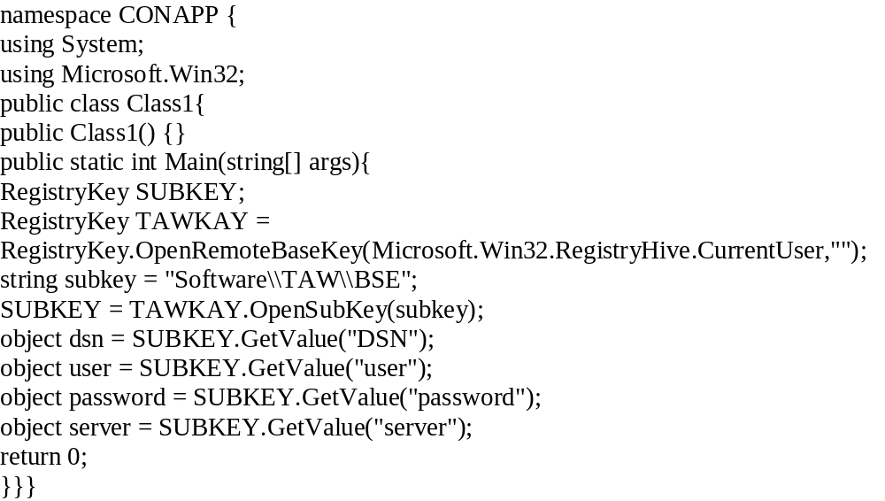
Example-2

Slide 95
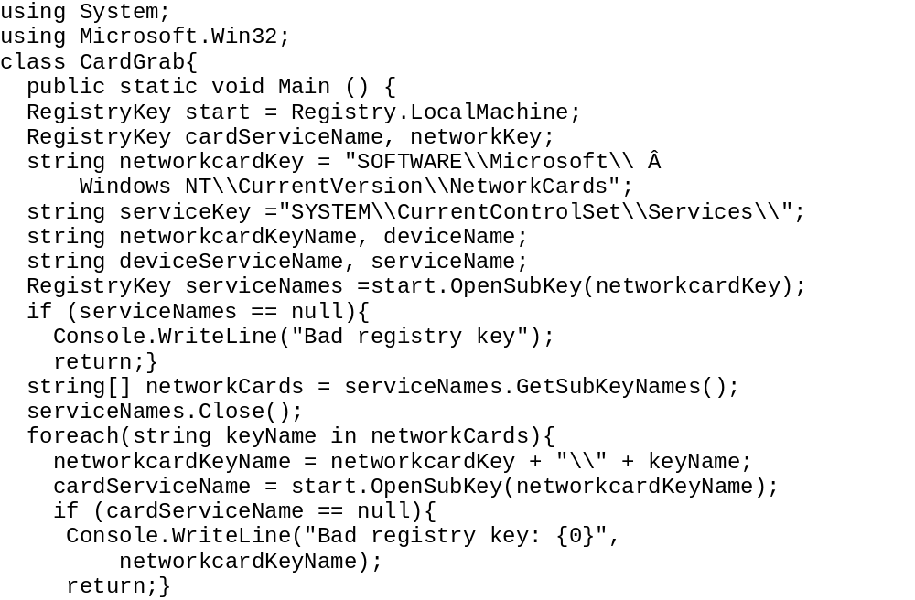
Example2-1

Slide 96
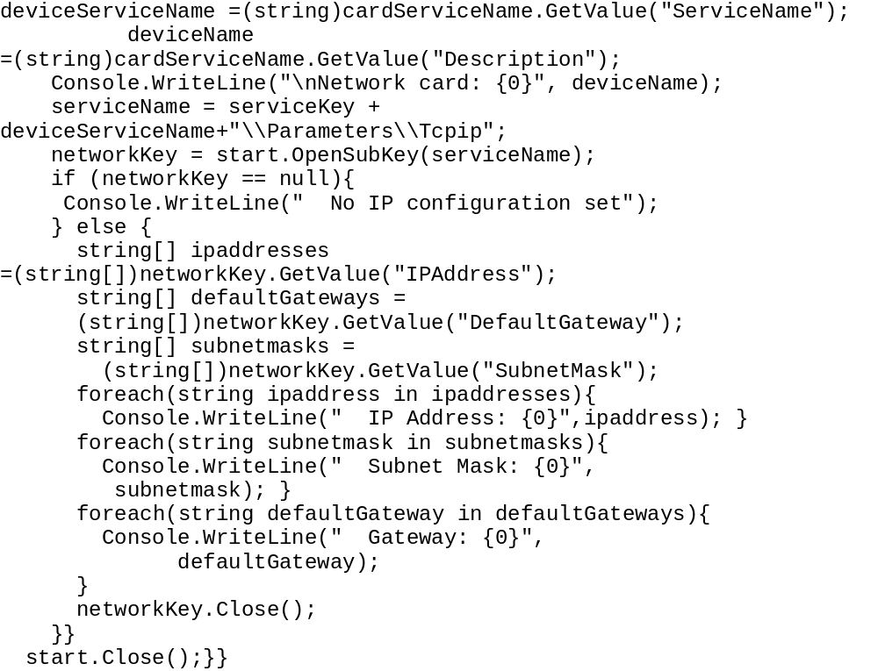
Example2-2

Slide 97
Example2-3
A sample output of the CardGrab program should look like this:
C:\>CardGrab
Network card: D-Link DE660 PCMCIA LAN adapter
IP Address: 192.168.1.6
Subnet Mask: 255.255.255.0
Gateway: 192.168.1.1
C:\>

Slide 98
Using WMI
In addition to the Registry, there’s another source available to you for obtaining IP network information from Windows systems.
The Windows Management Instrumentation (WMI) is the Microsoft implementation of Web-Based Enterprise Management (WBEM), which is a standard for accessing system information in a network environment, developed by the Distributed Management Task Force, Inc. (DMTF).
Since Windows 2000, Microsoft has included in the OS a database that contains information regarding system hardware and software, as well as current hardware status.
The C# language can query the database to determine the status of managed hardware and software components, including network devices.
WMI unifies two other standards as Common Management Information Protocol (CMIP) and Simple Network Management Protocol (SNMP).
DMTF defines many other standards related to management like Web Based Enterprise Management (WBEM) instead of other companies (BMC Software, Cisco Systems Inc., Compaq, Intel and Microsoft) which passed this specification to DMTF.

Slide 99
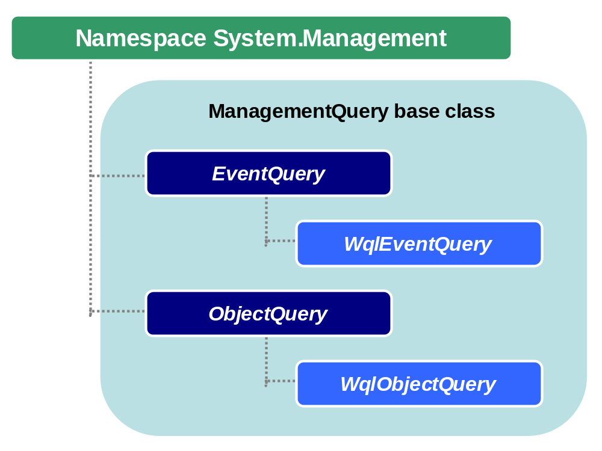

Slide 100
CIM Schema
CIM specification consists of two parts: CIM schema and language for working with this schema and data.
CIM schema is organized as a structure of classes with their methods, properties and qualifiers and this structure defines how classes are organized and rules for them.
Schema is devided into logical and physical domains, logical domains are:
  Application domains – this domain is suitable for applications, to set their installation properties, upgrade specifics, working rules etc.
  Device domains
  Network domains – it is related to protocols, network settings and access etc.
  System domains – this is related to computer settings, environment, processes, services etc.

Slide 101
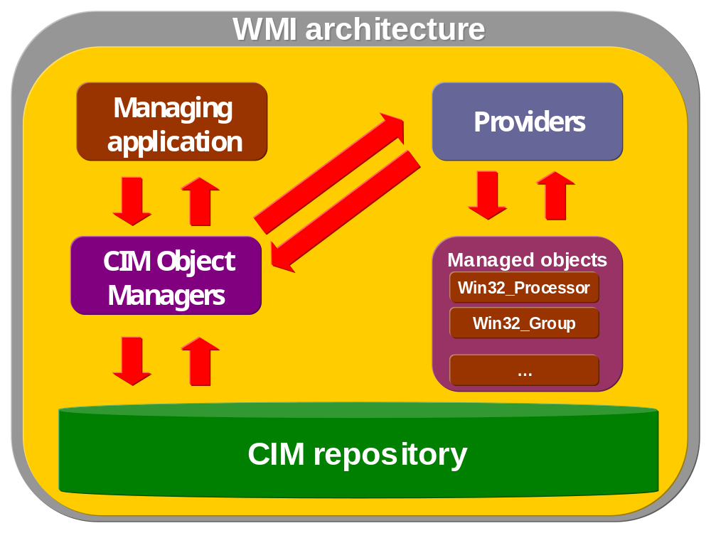
WMI Architecture

Slide 102
WMI tools
Microsoft provides WMI tools that can be used to test or manage WMI classes and environment. There are four tools available:
  WMI Object Browser
  WMI CIM Studio
  WMI Event Registration Tool
  WMI Even Viewer
Those tools are written using HTML and ActiveX and they provide management environment for WMI for local (“\root\CIMV2”) or remote computers (“\\remotesrv\root\default”) and their usage is easy and intuitive.

Slide 103
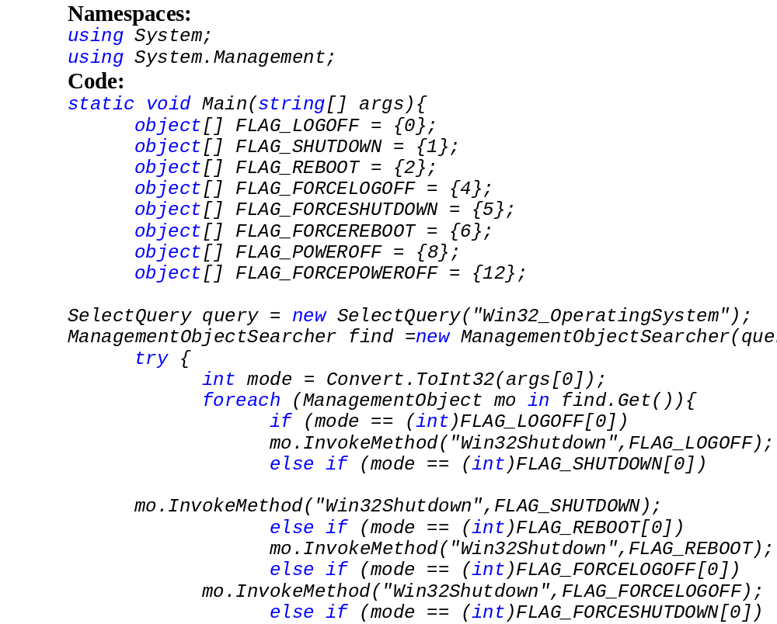
Logoff, shutdown, reboot computer

Slide 104
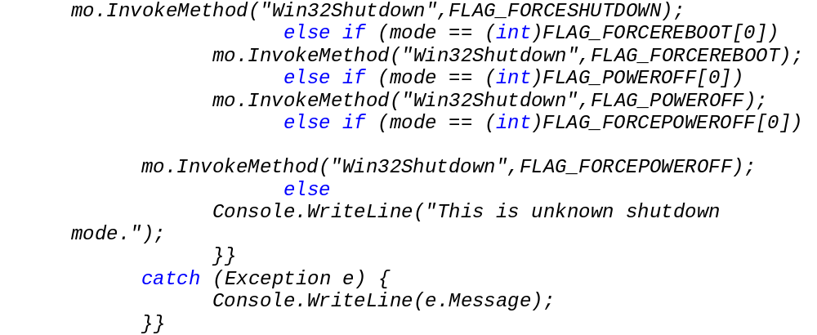

Slide 105
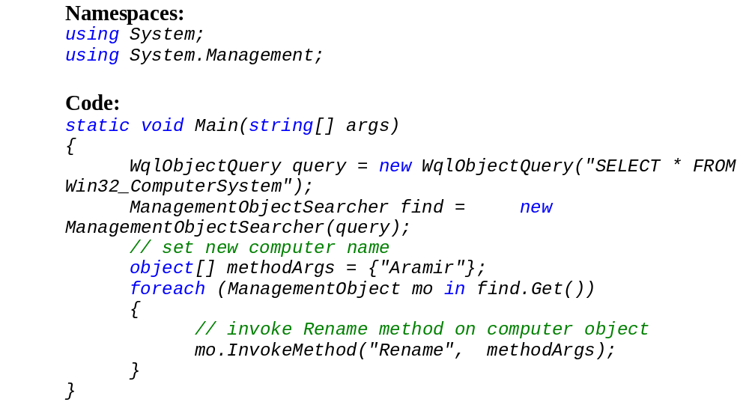
Rename computer name

Slide 106
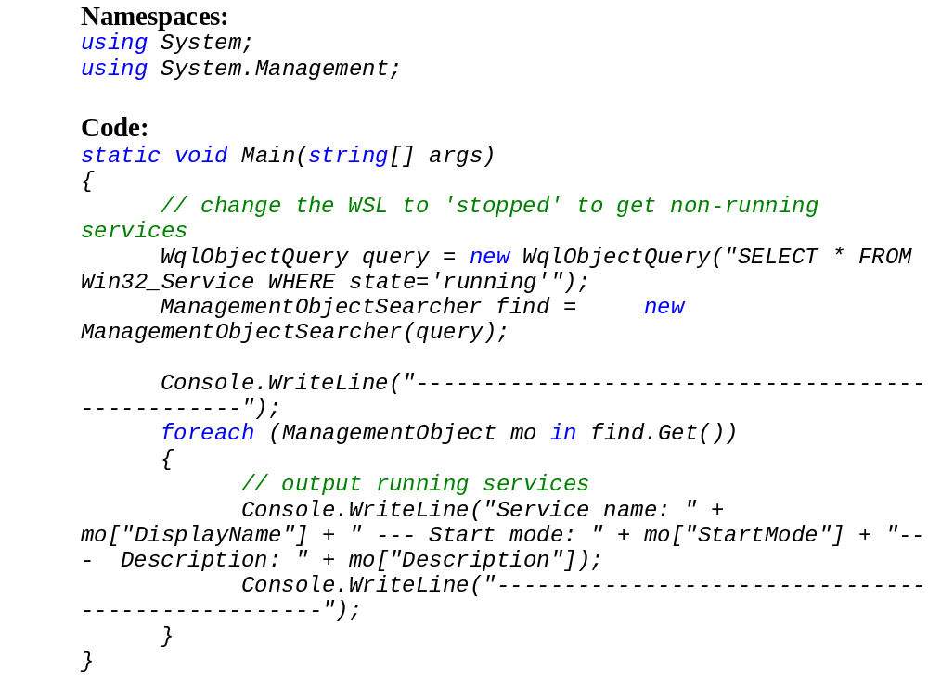
Get list of running/stopped services

Slide 107
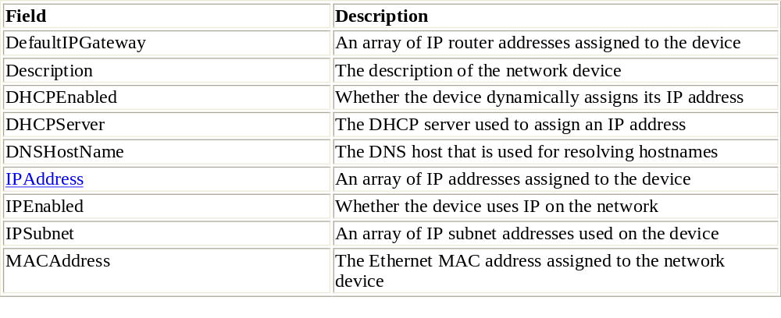
IP Info in WMI
The WMI Win32 NetworkAdapterConfiguration table within WMI contains information related to the network devices installed on the system. The result of the table query is a collection of information for each network interface. Each network interface represents one record in the returned collection. The IP information for the network interface appears as separate fields within the record.
A wide variety of network data values are contained in the WMI database. Table 2.14 describes some useful IP data fields contained in the Win32 NetworkAdapterConfiguration table.

Slide 108
Applications can access the WMI database using standard SQL syntax queries. The queries must specify a table to query, along with the fields to return. A sample SQL query would look like this:
SELECT IPAddress, IPSubnet from Win32_NetworkAdapterConfiguration
This SQL statement returns the IP address and subnet mask for each network interface configured on the system. Again, remember that any one interface can have multiple IP addresses, so this information is returned in the form of a multivalue array.
Now that you know where the WMI network information is stored, let’s look at an example of using C# to extract the information.
Using C# to Query WMI:
  The .NET System.Management namespace contains classes used for querying the WMI databases. You can create a C# program to query WMI for each network interface installed on the system and then display the IP information returned. The steps to use to query the WMI database from a C# program are as follows:
  Create a ManagementObjectSearcher object that contains a SQL Select statement for the database table.
  Create a ManagementObjectCollection object to obtain the result set from executing the SQL query.
  In a foreach loop, assign a new ManagementObject for each object in the Management-ObjectCollection.
  Assign the desired data fields to regular type variables.

Slide 109
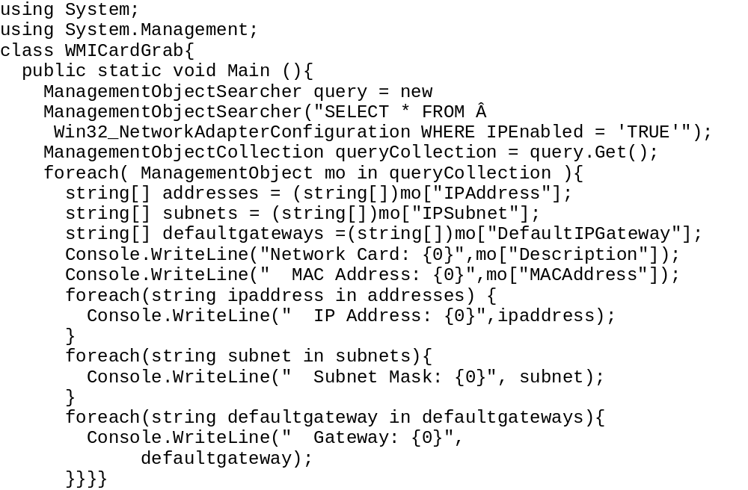

Slide 110
Using DNS
The last way to determine system IP information is to utilize the C# DNS (Domain Name System) classes. Chapter 4, “DNS and C#” contains a substantial discussion of how to use the DNS to obtain Internet hostnames and IP addresses. You can exploit this system to obtain the local IP address(es) of the system your program is running on.
The C# System.Net namespace contains the Dns class, which comprises several methods that allow you to obtain DNS information about hosts. The GetHostName() method retrieves the hostname of the local system. The GetHostByName() method attempts to find the IP address of a hostname. You can combine these two functions to find the IP address of the local system. The following code shows the DNSName.cs program, which demonstrates using these functions to find the local IP address(es) of the system.

Slide 111
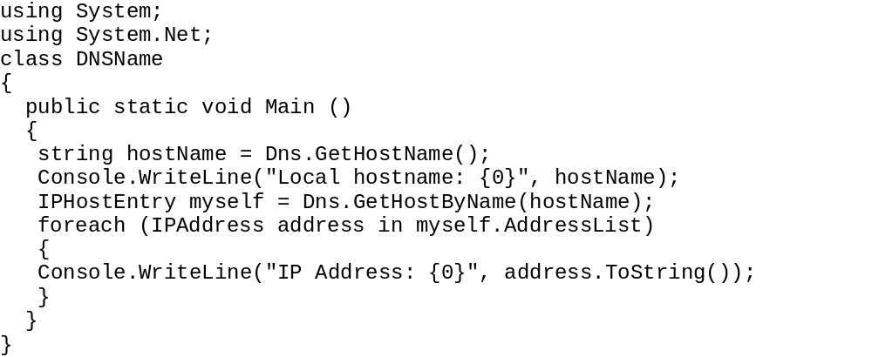
Again, similar to the Registry and WMI programs, you must take into account the possibility of the local system having more than one IP address assigned to it. The AddressList property of the IPHostEntry class is an array of type IPAddress. You can use the foreach function to extract each of the IP addresses in the array. The output of this program is very simple:
C:\>DNSName
Local hostname: abednego
IP Address: 192.168.1.6
C:\>
This is a very common method to use to get the local system IP address for determining the local IP address to use for creating server network connections. You will see this code used many times in later chapters.

