Slide 1

Network programming
C# Network Programming Classes

Slide 2

Socket to me!

Slide 3
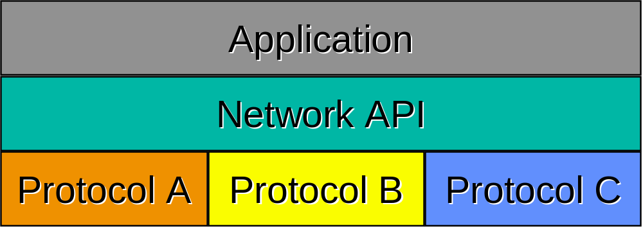
Network Application Programming Interface (API)
The services provided by the operating system that provide the interface between application and protocol software.
Generic Programming Interface.
Support for message oriented and connection oriented communication.
Work with existing I/O services (when this makes sense).
Operating System independence.

Slide 4
Generic Programming Interface
Support multiple communication protocol suites (families).
Address (endpoint) representation independence.
Provide special services for Client and Server?
TCP/IP does not include an API definition.
There are a variety of APIs for use with TCP/IP:
  Sockets
  TLI, XTI
  Winsock
  MacTCP

Slide 5
Functions needed
Specify local and remote communication endpoints
Initiate a connection
Wait for incoming connection
Send and receive data
Terminate a connection gracefully
Error handling

Slide 6





Creating a network app
application
transport
network
data link
physical
write programs that
  run on (different) end systems
  communicate over network
  e.g., web server software communicates with browser software
No need to write software for network-core devices
  Network-core devices do not run user applications
  applications on end systems allows for rapid app development, propagation
application
transport
network
data link
physical
application
transport
network
data link
physical

Slide 7
A Primer on Socket Programming
The Unix operating system revolutionized many features in the programming world. Among these is the file descriptor. A file descriptor provides a programming interface to a file object. Because nearly every object contained in a Unix system is defined as a file, the file descriptor can be used to send and receive data that has many objects across the Unix system. This makes life much simpler for Unix programmers. The same type of programming model works no matter what type of device (or file) you are trying to access.
Starting in the 4.2BSD Unix release, network access was also defined using file descriptors. A network file descriptor is called a socket. Unix (and Windows) network programs both utilize sockets for all network communication. This section describes the features of socket network programming in general so that you will be better prepared to understand the concepts behind C# network programming. Following this is the “Socket Programming in Windows” section, which describes the Windows Winsock implementation of sockets. Winsock is the base on which the C# Socket class implementation is built.

Slide 8
Sockets
In socket-based network programming, you do not directly access the network interface device to send and receive packets. Instead, an intermediary file descriptor is created to handle the programming interface to the network. The Unix operating system handles the details of determining which network interface device will be used to send out the data and how.
The special file descriptors used to reference network connections are called sockets. The socket defines the following:
  A specific communication domain, such as a network connection or a Unix Interprocess Communication (IPC) pipe
  A specific communication type, such as stream or datagram
  A specific protocol, such as TCP or UDP
  After the socket is created, it must be bound to either a specific network address and port on the system, or to a remote network address and port. Once the socket is bound, it can be used to send and receive data from the network. Figure 3.1 shows what this process looks like.

Slide 9
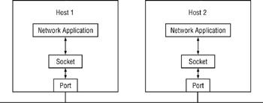
Socket
A socket is an abstract representation of a communication endpoint.
Sockets work with Unix I/O services just like files, pipes & FIFOs.
Sockets (obviously) have special needs:
  establishing a connection
  specifying communication endpoint addresses

Slide 10
Sockets
process sends/receives messages to/from its socket
socket analogous to door
  sending process shoves message out door
  sending process relies on transport infrastructure on other side of door which brings message to socket at receiving process
host or
server
host or
server
controlled by
app developer
process
process
socket
socket
TCP with
buffers,
variables
TCP with
buffers,
variables
Internet
controlled
by OS
API: (1) choice of transport protocol; (2) ability to fix a few parameters

Slide 11
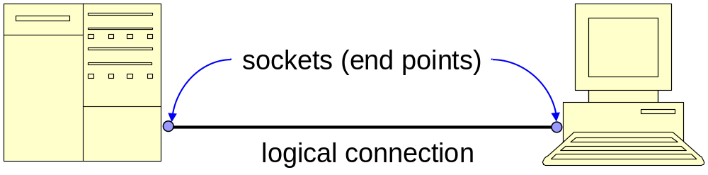
Socket Programming
Sockets
  Ends points of two-way communications, i.e., logical connections between hosts
  Can be used to send and receive data
  Supported by most languages and platforms
  Server vs. client sockets
Server sockets
  Wait for requests to come in over the network
  Implemented by java.net.ServerSocket class
Client sockets
  Used to send and receive data
  Can be thought of as a pair of input and output streams
  Implemented by java.net.Socket class

Slide 12
Client/sever model
Client asks (request) – server provides (response)
Typically: single server - multiple clients
The server does not need to know anything about the client
  even that it exists
The client should always know something about the server
  at least where it is located
1. Client sends request
Client
process
Server
process
Resource
4. Client
handles
response
3. Server sends response
2. Server
handles
request
Note: clients and servers are processes running on hosts
(can be the same or different hosts).
Notes:
Both Can run on the same machine

Slide 13

Sockets as means for inter-process communication (IPC)
application layer
application layer
Client Process
Internet
Server Process
Socket
Socket
OS network
stack
OS network
stack
transport layer (TCP/UDP)
transport layer (TCP/UDP)
Internet
network layer (IP)
network layer (IP)
link layer (e.g. ethernet)
link layer (e.g. ethernet)
Internet
physical layer
physical layer
The interface that the OS provides to its networking subsystem

Slide 14
Internet Connections (TCP/IP)
Address the machine on the network
  By IP address
Address the process
  By the “port”-number
The pair of IP-address + port – makes up a “socket-address”
Client socket address
128.2.194.242:3479
Server socket address
208.216.181.15:80
Client
Server
(port 80)
Connection socket pair
(128.2.194.242:3479, 208.216.181.15:80)
Client host address
128.2.194.242
Server host address
208.216.181.15
Note: 3479 is an
ephemeral port allocated
by the kernel
Note: 80 is a well-known port
associated with Web servers

Slide 15
Clients
Examples of client programs
  Web browsers, ftp, telnet, ssh
How does a client find the server?
  The IP address in the server socket address identifies the host
  The (well-known) port in the server socket address identifies the service, and thus implicitly identifies the server process that performs that service.
  Examples of well known ports
    Port 7: Echo server
    Port 23: Telnet server
    Port 25: Mail server
    Port 80: Web server

Slide 16
Using Ports to Identify Services
Server host 128.2.194.242
Client host
Service request for
128.2.194.242:80
(i.e., the Web server)
Web server
(port 80)
Client
Kernel
Echo server
(port 7)
Service request for
128.2.194.242:7
(i.e., the echo server)
Web server
(port 80)
Client
Kernel
Echo server
(port 7)

Slide 17
Servers
Servers are long-running processes (daemons).
  Created at boot-time (typically) by the init process (process 1)
  Run continuously until the machine is turned off.
Each server waits for requests to arrive on a well-known port associated with a particular service.
  Port 7: echo server
  Port 23: telnet server
  Port 25: mail server
  Port 80: HTTP server
Other applications should choose between 1024 and 65535

Slide 18
Sockets
What is a socket?
  To the kernel, a socket is an endpoint of communication.
  To an application, a socket is a file descriptor that lets the application read/write from/to the network.
    Remember: All Unix I/O devices, including networks, are modeled as files.
Clients and servers communicate with each by reading from and writing to socket descriptors.
The main distinction between regular file I/O and socket I/O is how the application “opens” the socket descriptors.

Slide 19
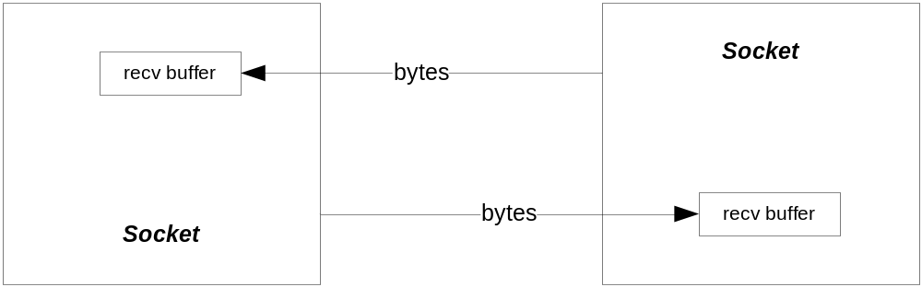
Socket Logical Structure

Slide 20
How do Sockets Function?
There are several modes of operation available for sockets:
  A very common mode is to establish a socket listener that listens on some port, say 4040, for connection requests.
  When a socket client, from another process or a remote computer, requests a connection on port 4040, the listener spawns a new thread that starts up a socket server on a new port, say 5051.
  From that time on the socket client and socket server communicate on port 5051. Either one can send data, in the form of a group of bytes, to the other.
  Meanwhile the listener goes back to listening for connection requests on port 4040.

Slide 21
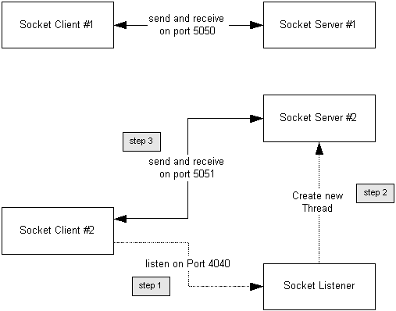
Socket Client, Server, and Listener

Slide 22
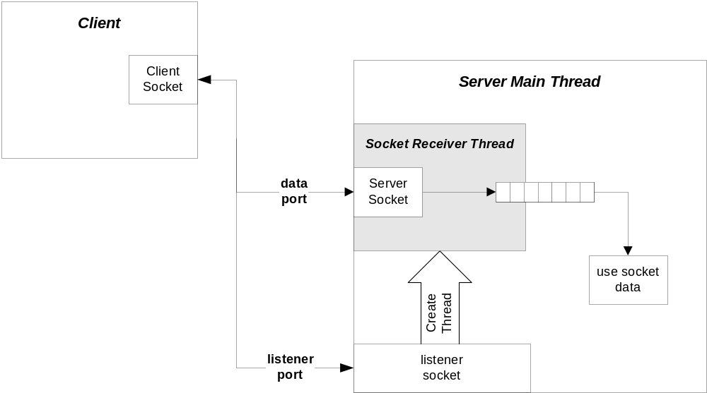
Client/Server Configuration

Slide 23
Socket Data Transfer
The receiving socket, either client or server, has a buffer that stores bytes of data until the receiver thread reads them.
  If the receiver buffer is full, the sender thread will block on a send call until the receiver reads some of the data out of the buffer.
    For this reason, it is a good idea to assign a thread in the receiver to empty the buffer and enqueue the data for a worker thread to digest.
  If the receiver buffer becomes full during a send, the send request will return having sent less than the requested number of bytes.
  If the receiving buffer is empty, a read request will block.
  If the receiving buffer has data, but less than the number of bytes requested by a read, the call will return with the bytes available.

Slide 24
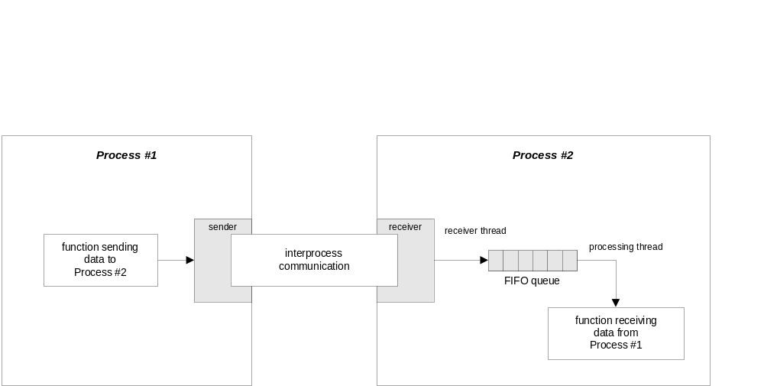
Non-Blocking Communication

Slide 25
Creating a Socket
int socket(int family,int type,int proto);
family specifies the protocol family (PF_INET for TCP/IP).
type specifies the type of service (SOCK_STREAM=Uses connection-oriented communication packets, SOCK_DGRAM=Uses connectionless communication packets).
protocol specifies the specific protocol (usually 0, which means the default). The specific protocol value used to create the socket depends on which type value you choose. Most socket types (such as SOCK_STREAM and SOCK_DGRAM) can be safely used only with their default protocols (TCP for SOCK_STREAM, and UDP for SOCK_DGRAM). To specify the default protocol, you can specify a zero value in the protocol parameter instead of the normal protocol value.

Slide 26
Specifying an Endpoint Address
Remember that the sockets API is generic.
There must be a generic way to specify endpoint addresses.
TCP/IP requires an IP address and a port number for each endpoint address.
Other protocol suites (families) may use other schemes.

Slide 27
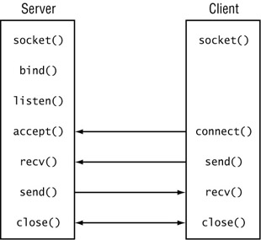
Using Connection-Oriented Sockets
The world of IP connectivity revolves around two types of communication: connectionoriented and connectionless. In a connection-oriented socket (one that uses the SOCK_STREAM type) the TCP protocol is used to establish a session (connection) between two IP address endpoints. There is a fair amount of overhead involved with establishing the connection, but once it is established, data can be reliably transferred between the devices. To create a connection-oriented socket, separate sequences of functions must be used for server programs and for client programs .

Slide 28
The Server Functions -1
For the server program, the created socket must be bound to a local IP address and port number that will be used for the TCP communication. The Unix bind() function is used to accomplish this:
int bind(int socket, sockaddr *addr, int length);
In bind(), the socket parameter references the return value from the socket() function. The addr parameter references a sockaddr address/port pair to define the local network connection. Because the server usually accepts connections on its own IP address, this is the IP address of the local device, along with the assigned TCP port for the application. If the IP address of the local system is unknown, the INADDR_ANY value can be used to allow the socket to bind to any local address on the system.
After the socket is bound to an address and port, the server program must be ready to accept connections from remote clients. This is a two-step process: first, the program looks for an incoming connection, next it sends and receives data.
The program must first use the listen() function to "listen" to the network for an incoming connection. Next it must use the accept() function to accept connection attempts from clients. The format of the listen() function is as follows:
int listen(int socket, int backlog);
As you’d expect, the socket parameter refers to the socket descriptor created with the socket() function. The backlog parameter refers to the number of pending connections waiting to be processed that the system can accept. For example, suppose this value is set to 2. If two separate clients attempt to connect to the port, the system will accept one of the connections for processing and hold the other connection until the first one is done. If a third connection attempt arrives, the system refuses it because the backlog value has already been met.

Slide 29
The Server Functions-2
After the listen() function, the accept() function must be called to wait for incoming connections. The format of the accept() function is as follows:
int accept(int socket, sockaddr *from, int *fromlen);
By now, you’re familiar with the socket parameter. The from and fromlen parameters point to a sockaddr address structure and its length. The remote address information from the client is stored in this structure in case it’s needed.
Once the connection has been accepted, the server can send and receive data from the client using the send() and recv() function calls:
int send(int socket, const void *message, int length,
int flags)
int recv(int socket, void *message, int length, int flags)
Here, the socket parameter again references the open socket for the connection. The message parameter references either the buffer of data to send, or an empty buffer to receive data into. The length parameter indicates the size of the buffer, and the flags parameter indicates if any special flags are necessary (such as for tagging the data as urgent in the TCP packet).

Slide 30
The Client Functions
In a connection-oriented socket, the client must bind to the specific host address and port for the application. For client programs, the connect() function is used instead of the listen() function:
int connect(int socket, sockaddr *addr, int addrlen);
As in server functions, the socket parameter references the created socket() function value. The addr parameter points to a created sockaddr structure containing the remote IP address and TCP port number.
Once the connect() function succeeds, the client is connected to the server and can use the standard send() and recv() functions to transmit data back and forth with the server.
Closing the Connection
When the client and server are finished sending data, two commands should be used to properly terminate the connection:
shutdown(int socket, int how)
close(int socket)
It is possible to use the close() function alone (and often you will see programs that use only this function to close the connection). However, the kinder, more gentler way is to use shutdown()first, and then close(). The shutdown() function uses the how parameter to allow the programmer to determine how gracefully the connection will close. The options available are as follows:
0 No more packets can be received.
1 No more packets can be sent.
2 No more packets can be sent or received.
By selecting values 0 or 1, you can disable the socket from receiving or sending more data, yet allow the socket to either finish sending pending data, or finish receiving pending data. After the connection has a chance to flush out any pending data, the close() function is called to terminate the connection without any data loss.

Slide 31
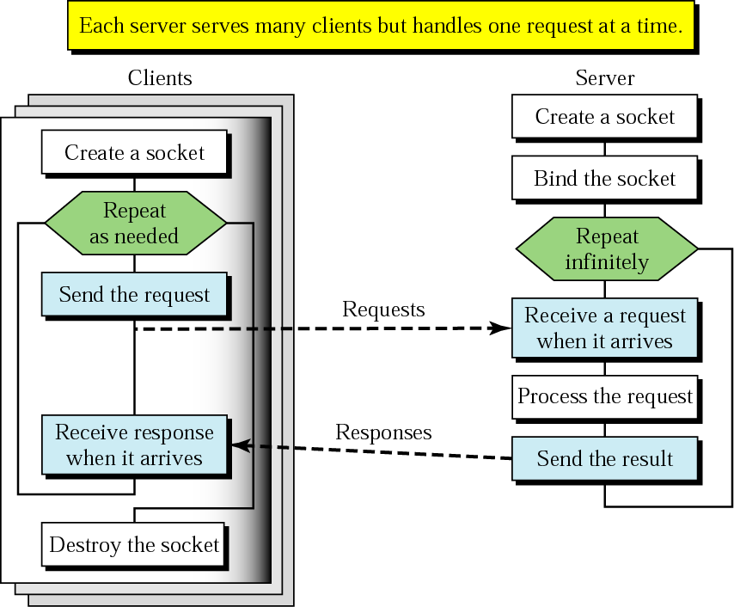
Client+server: connectionless
CREATE
BIND
SEND
RECEIVE
SEND
CLOSE

Slide 32
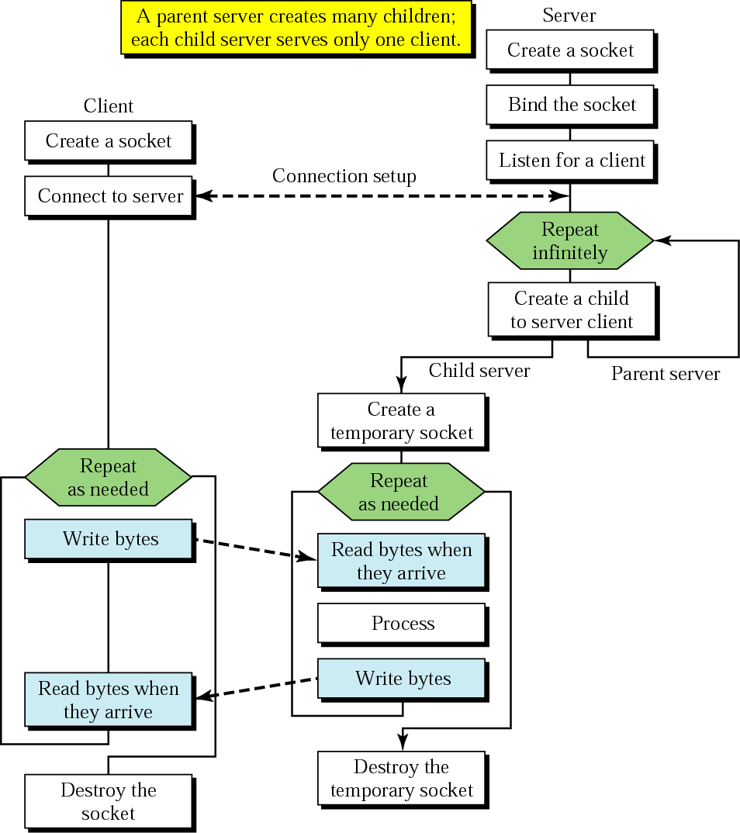
Client+server: connection-oriented
BIND
SOCKET
LISTEN
CONNECT
TCP three-way handshake
ACCEPT
SEND
RECEIVE
SEND
RECEIVE
CLOSE
Concurrent server

Slide 33
Byte ordering routines
How to interpret bits on the wire:
Network is big-endian, host may be big- or little-endian

Slide 34
C# Socket Programming

Slide 35
C# Socket Programming
The .NET Framework network classes were created to provide easy interfaces to the native Winsock network API for programmers using the .NET programming languages. Now that you have seen how the Winsock API handles network programming, you’re ready to examine C#’s way of handling sockets.
System.Net is the namespace in the Microsoft Windows .NET Framework that contains the core classes intended for building applications that communicate over a network. The types of functionality found in System.Net range from access to a raw socket to the ability to upload to and download from resources on the Internet. In addition to providing a language-independent, object-oriented way to access network resources, System.Net serves as the communication infrastructure for higher-level, distributed application programming models such as XML-based Web services and .NET Remoting.

Slide 36
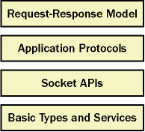
Layers of System.Net
The System.Net classes can be divided into four layers:
Basic network types and services Fundamental types that are used for working with Internet Protocol (IP) addresses or non-IP network addresses such as Internetwork Packet Exchange (IPX). This layer also includes classes for performing Domain Name System (DNS) resolution.
Socket-level APIs A set of managed classes for performing network communication over a socket, such as sending and receiving data between two hosts.
Application protocols Classes intended to be used both on the client and on the middle tier. These classes are for protocols layered on top of the socket APIs, such as the Hypertext Transfer Protocol (HTTP) and the File Transfer Protocol (FTP).
Protocol-independent request-response model These classes provide a pattern that is used by request-response protocols for resolving Uniform Resource Identifiers (URIs) without requiring the developer to write protocol-specific code.

Slide 37
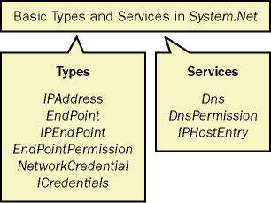
Basic Network Types and Services
The following figure contains the classes that make up the basic types and services included in System.Net. In the subsequent sections, we’ll look briefly at each of the basic types and services that are made accessible through System.Net.

Slide 38
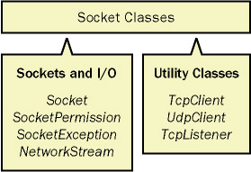
Using the Socket-Level Classes
The socket-level classes in System.Net enable fine-grained control over the way data is read from and written to the network. These classes include access to sockets, a stream pattern for network I/O, and some helper classes that simplify a number of the most common tasks that are desirable when working with this level of the network.

Slide 39
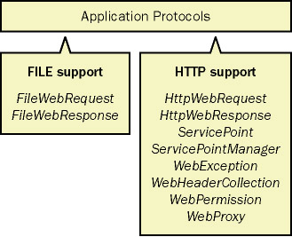
Application Protocols
The application protocols level contains classes designed for resolving specific protocols. Resources that can be resolved using these protocols are most often represented by a URI. In version 1.1 of the .NET Framework, the supported schemes include HTTP, HTTPS, and FILE. In an upcoming release of the .NET Framework, this layer will be enhanced to include FTP protocol support as well.

Slide 40
Request-Response Model
The request-response model in System.Net is defined by the WebRequest and WebResponse classes. These abstract base classes provide an implementation pattern that’s used by protocol-specific implementations such as the FILE and HTTP handlers. This common pattern for request-response enables developers to resolve resources containing different URI schemes in a consistent and protocol-independent manner. For example, this common model enables a developer to write the same code to download a resource on an FTP server as that needed to download a resource on an HTTP server. This model is extensible, so third-party implementers can plug in their own protocol handlers as well. There are also a number of helper classes that work with this model and apply to the various supported protocols.

Slide 41
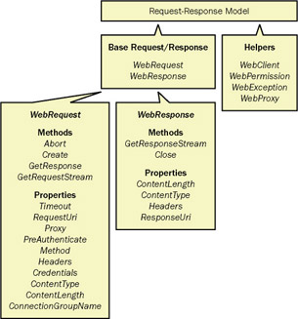
Request-Response Model

Slide 42
IP Addressing and DNS

Slide 43
Overview-1
When a computer or a device is connected to an IP network, it must obtain at least one or more IP addresses either dynamically or statically for it to communicate over an IP network. Static IPs are configured manually by the administrator of the machine or device, and dynamic IPs are automatically assigned to a computer over a network using one of the following methods: Dynamic Host Configuration Protocol (DHCP) or Router Advertisement (RA).
DHCP is commonly used on IPv4 networks, while RA is typically found on IPv6 networks.
The IP addresses are represented in numerical form, which makes it difficult for users to remember a computer or device identification on an IP network. To make addressing more flexible, IP networks typically have a Domain Name System (DNS) available, which allows you to identify machines or devices by a more meaningful, friendly name instead of the difficult-to-remember numerical identification.

Slide 44
Overview-2
In this Part, we’ll describe how computers identify and address one another using the IPv4 and IPv6 protocols. Understanding IP addressing is essential for working with the Microsoft Windows .NET Framework networking classes, which allow you to communicate over IP networks. These classes will be discussed in the next two chapters. The .NET Framework networking classes also support addressing non-IP address-based communications using Internetwork Packet Exchange (IPX), AppleTalk, Infrared, and so on. However, the focus of this book is only the IP-based classes. Once IP addressing is explained, we’ll explain name resolution techniques using DNS through the .NET Framework that can simplify the complexities of IP addressing

Slide 45
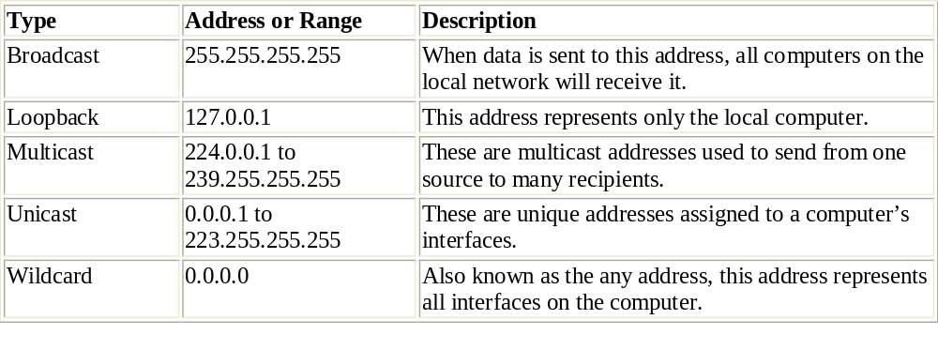
2
On IP networks, computers and devices identify one another using numerical IP addresses. As mentioned earlier in this chapter, two versions of IP are in use today: IPv4 and IPv6.
There are three types of IPv4 addresses: unicast, multicast, and broadcast. There are also two other special address types—loopback and wildcard.

Slide 46
IP Addresses in C#
One of the biggest advantages you will notice in the .NET network library is the way IP address/port pairs are handled. It is a fairly straightforward process that represents a welcome improvement over the old, confusing Unix way. .NET defines two classes in the System.Net namespace to handle various types of IP address information:
  IPAddress
  IPEndPoint

Slide 47
IPAddress
An IPAddress object is used to represent a single IP address. This value can then be used in the various socket methods to represent the IP address. The default constructor for IPAddress is as follows:
public IPAddress(long address)
The default constructor takes a long value and converts it to an IPAddress value. In practice, this default is almost never used. (How many times do you happen to have the long value of an IP address handy?) Instead, several methods in the IPAddress class can be used to create and manipulate IP addresses.

Slide 48
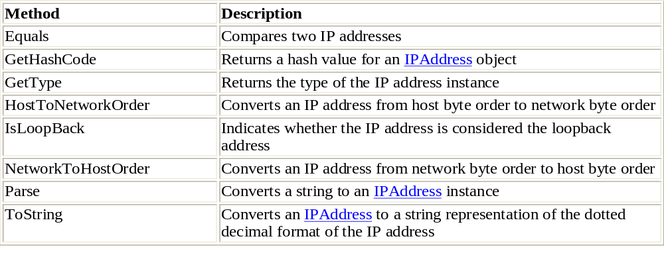
IPAddress Methods
The IPAddress class also provides four read-only fields that represent special IP addresses for use in programs:
Any Used to represent any IP address available on the local system
Broadcast Used to represent the IP broadcast address for the local network
Loopback Used to represent the loopback address of the system
None Used to represent no network interface on the system

Slide 49
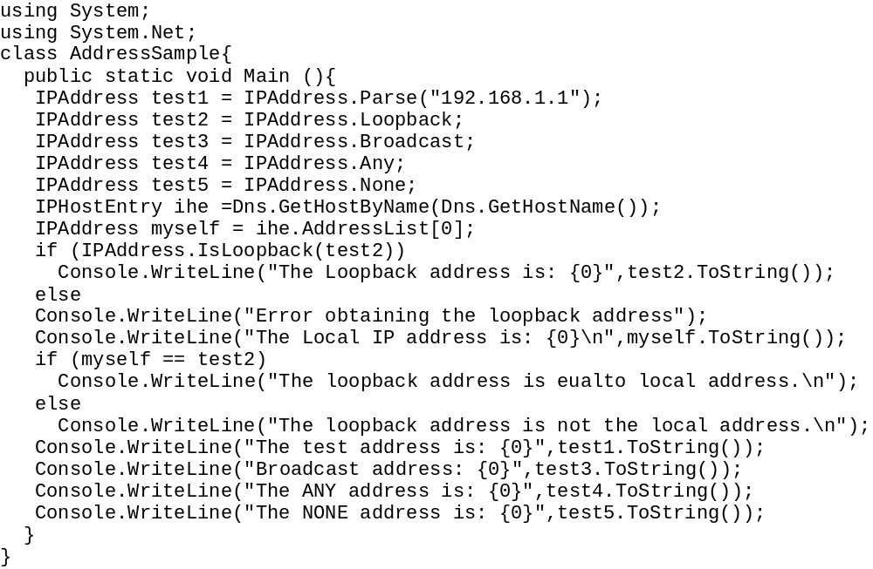
Example-1

Slide 50
2
C:\>AddressSample
The Loopback address is: 127.0.0.1
The Local IP address is: 192.168.1.
The loopback address is not the local address.
The test address is: 192.168.1.1
Broadcast address: 255.255.255.255
The ANY address is: 0.0.0.0
The NONE address is: 255.255.255.255
C:\>
What’s interesting about this output is the resulting values of the Any and None addresses. These values might look backward to what you would expect:
the Any IPAddress object points to the 0.0.0.0 address, which you might think represents nothing. However, this address is most often used when a system has multiple network interfaces and you do not want to bind a socket to any particular interface.
The None IPAddress object points to the 255.255.255.255 address, which is often used when a system wants to create a dummy socket and not bind it to any interfaces.

Slide 51
IPEndPoint
The .NET Framework uses the IPEndPoint object to represent a specific IP address/port combination. An IPEndPoint object is used when binding sockets to local addresses, or when connecting sockets to remote addresses.
Two constructors are used to create IPEndPoint instances:
  IPEndPoint(long address, int port)
  IPEndPoint(IPAddress address, int port)
Both constructors use two parameters: an IP address value, represented as either a long value or an IPAddress object; and the integer port number. As you can probably guess, the most common constructor used is the IPAddress form.

Slide 52
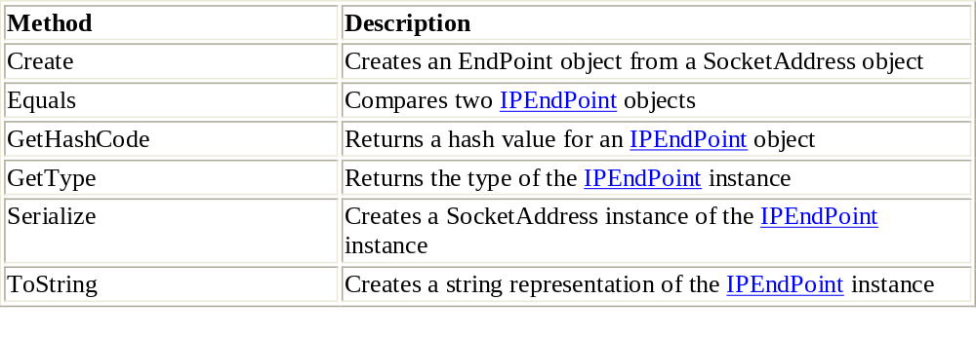
IPEndPoint Methods
The SocketAddress class is a special class within the System.Net namespace. It represents a serialized version of an IPEndPoint object. This class can be used to store an IPEndPoint instance, which can then be re-created using the IPEndPoint.Create() method. The format of the SocketAddress class is as follows:
  1 byte represents the AddressFamily of the object.
  1 byte represents the size of the object.
  2 bytes represent the port number of the object.
  The remaining bytes represent the IP address of the object.

Slide 53
2
In addition to the methods, the IPEndPoint class also contains three properties that can be set or obtained from an instance:
  Address Gets or sets the IP address property
  AddressFamily Gets the IP address family
  Port Gets or sets the TCP or UDP port number
Each of these properties can be used with an IPEndPoint instance to obtain information about individual parts of the IPEndPoint object. The Address and Port properties can also be used to set the individual values within an existing IPEndPoint object.
There are also two fields that can be used with the IPEndPoint object to obtain the available port ranges from a system:
  MaxPort The maximum value that can be assigned to a port number
  MinPort The minimum value that can be assigned to a port number

Slide 54
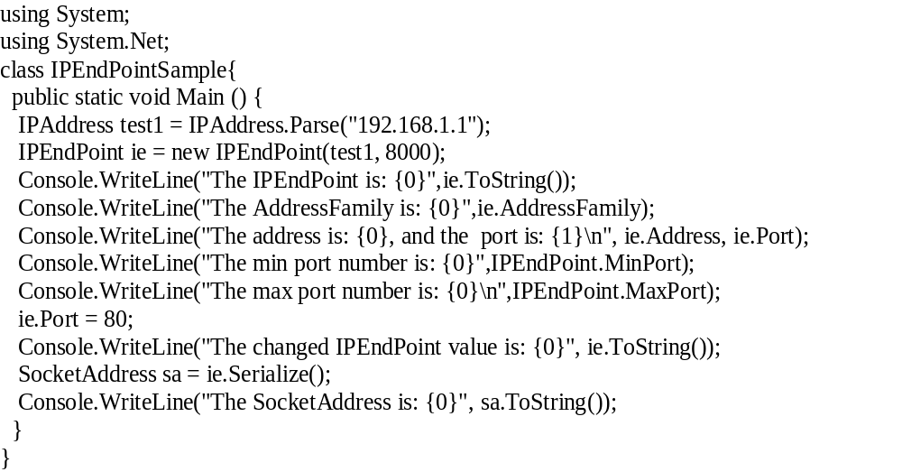
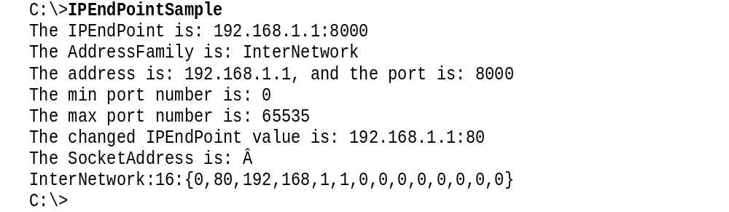
Example

Slide 55
IPAddress.HostToNetworkOrder
using System;
using System.Net;
using System.Text;
class MainClass {
public static void Main(){
short test1 = 45;
int test2 = 314159;
long test3 = -123456789033452;
byte[] data = new byte[1024];
string output;
short test1b = IPAddress.HostToNetworkOrder(test1);
data = BitConverter.GetBytes(test1b);
output = BitConverter.ToString(data);
Console.WriteLine("test1 = {0}, nbo = {1}", test1b, output);
int test2b = IPAddress.HostToNetworkOrder(test2);
data = BitConverter.GetBytes(test2b);
output = BitConverter.ToString(data);
Console.WriteLine("test2 = {0}, nbo = {1}", test2b, output);
long test3b = IPAddress.HostToNetworkOrder(test3);
data = BitConverter.GetBytes(test3b);
output = BitConverter.ToString(data);
Console.WriteLine("test3 = {0}, nbo = {1}", test3b, output);
}
}

Slide 56
The Domain Name System (DNS)-1
The primary use of DNS is to manage Internet names across the World Wide Web. To enable users or clients to use names instead of 32-bit IP addresses, the TCP/IP model designers developed DNS to translate names into IP addresses.
DNS uses TCP and UDP port number 53. TCP port 53 is also used for DNS zone transfers. UDP 53 is used for DNS lookups and browsing.
In a large IP environment, network users need a way to connect to hosts without having to remember 32-bit IP addresses that is where DNS comes into play.
DNS provides a service that allows users to use a host's name in place of an IP address to connect to the host.
When DNS services are running, the host's name is used to request its IP address from a DNS server.
A DNS server is a host that is running the DNS service, and it is configured to do the translation for the user transparently. In other words, the user never sees the DNS request and host name-to-IP address translation. The client simply connects to a host name, and the DNS server does the translation. For example, the website www.cisco.com is translated to the IP address 198.133.219.25.

Slide 57
2
To simplify the unwieldy state of computer naming, the Domain Name System (DNS) was created. It allows the master host database to be split up and distributed among multiple systems on the Internet. DNS uses a hierarchical database approach, creating levels of information that can be split and stored on various systems throughout the Internet.
In addition to splitting up the database, DNS also provides a means for clients to query the database in real time. All a client needs to know is the location of one DNS server (and maybe a backup or two) in the database hierarchy. If the client queries a DNS server with a hostname not stored on the DNS server’s local database, the server can query another DNS server that does have the information and forward it to the client.
To implement the DNS concept, a new database and protocol were created to pass DNS information among clients and servers and to enable DNS servers to update one another.

Slide 58
3
DNS services
  hostname to IP address translation
  host aliasing
    Canonical, alias names
  mail server aliasing
  load distribution
    replicated Web servers: set of IP addresses for one canonical name
Why not centralize DNS?
  single point of failure
  traffic volume
  distant centralized database
  maintenance
  doesn’t scale!

Slide 59

DNS: Root name servers
contacted by local name server that can not resolve name
root name server:
  contacts authoritative name server if name mapping not known
  gets mapping
  returns mapping to local name server
a Verisign, Dulles, VA
c Cogent, Herndon, VA (also LA)
d U Maryland College Park, MD
g US DoD Vienna, VA
h ARL Aberdeen, MD
j Verisign, ( 21 locations)
k RIPE London (also 16 other locations)
i Autonomica, Stockholm (plus 28 other locations)
e NASA Mt View, CA
f Internet Software C. Palo Alto, CA (and 36 other locations)
m WIDE Tokyo (also Seoul, Paris, SF)
13 root name servers worldwide
b USC-ISI Marina del Rey, CA
l ICANN Los Angeles, CA

Slide 60
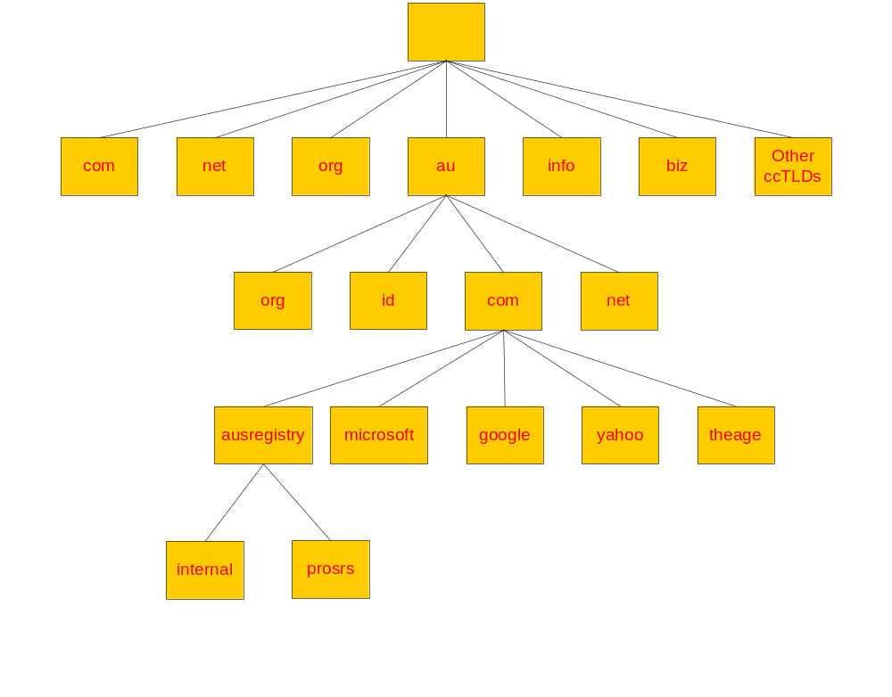

4
“root” zone
TLDs & ccTLDs
2lds
3lds
4lds

Slide 61
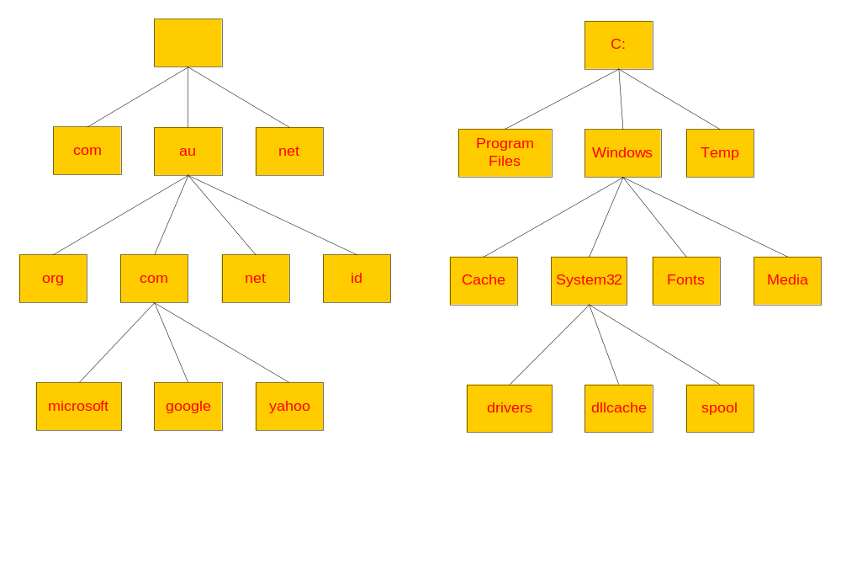
5
DNS vs File System

Slide 62
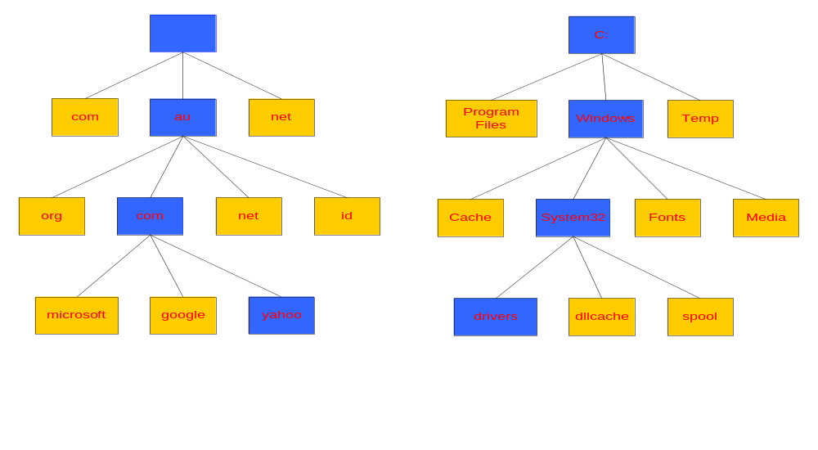
6
Naming a Domain Naming a Directory
Start Here
Start Here
C:\windows\system32\drivers\
yahoo.com.au.
A “.” is used as separator
A “\” is used as separator

Slide 63
7
“root” zone
TLDs & ccTLDs
2lds
“zone cuts” or delegation points
3lds
4lds

Slide 64
TLD /Authoritative Servers/ Local Name Server
Top-level domain (TLD) servers:
  responsible for com, org, net, edu, etc, and all top-level country domains uk, fr, ca, jp.
  Network Solutions maintains servers for com TLD
  Educause for edu TLD
Authoritative DNS servers:
  organization’s DNS servers, providing authoritative hostname to IP mappings for organization’s servers (e.g., Web, mail).
  can be maintained by organization or service provider
Local Name Server:
  does not strictly belong to hierarchy
  each ISP (residential ISP, company, university) has one.
    also called “default name server”
  when host makes DNS query, query is sent to its local DNS server
    acts as proxy, forwards query into hierarchy

Slide 65
What is a domain?
A domain is a sub tree of a larger tree identified by a domain name
Contains resource records and sub-domains
Some resource records point to authoritative server for sub-domains / zones
eg. the root contains pointers to .au
google.com.au is a domain

Slide 66
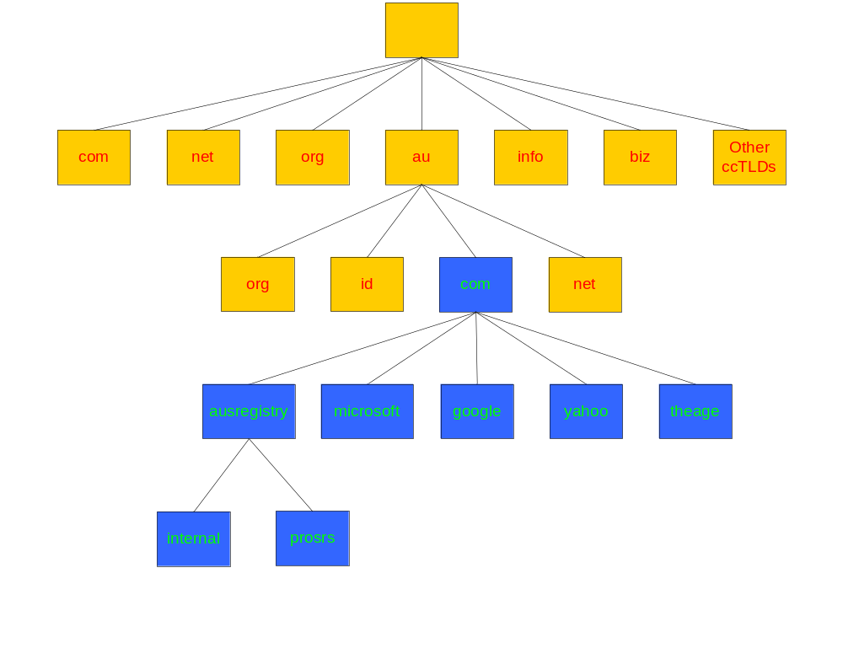
8
Domain com.au
The ausregistry.com.au sub-domain of com.au

Slide 67
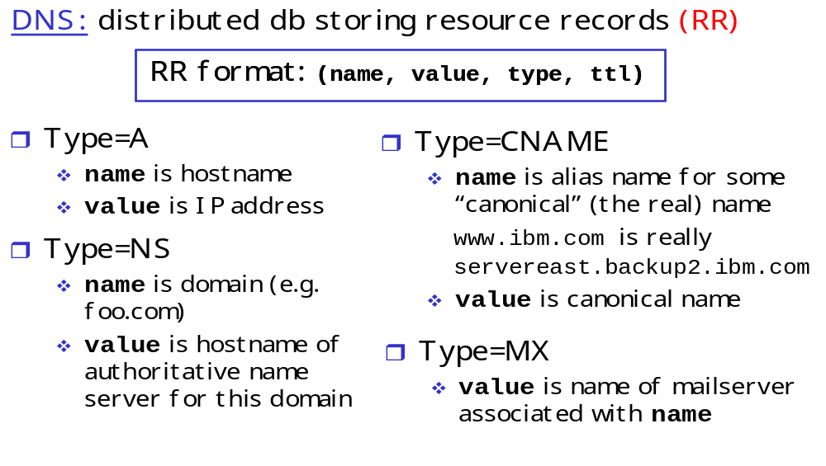
What is a resource record?
A domain contains resource records
Resource records are analogous to files
Classified into types
Some of the important types are SOA, NS, A, CNAME and MX
Normally defines in “zone files”

Slide 68
Example
“A” Record :
www A 203.18.56.31
In the ausregistry.com.au domain, defines the host uniquely identifiable as “www.ausregistry.com.au” to be reachable at the IPv4 Address 203.18.56.31
“CNAME” Record :
search CNAME www.google.com.
In the ausregistry.com.au domain, defines the name uniquely identifiable as “search.ausregistry.com.au” to be and alias to “www.google.com”
“MX” Record :
ausregistry.com.au MX 10 mail
In the ausregistry.com.au domain, defines the host mail to be the priority 10 mail server for the “ausregistry.com.au” domain
“NS” Record :
internal NS ns1.hosting.com.au.
In the ausregistry.com.au domain, defines the host “ns1.hosting.com.au” to be a name sever for the “internal.ausregistry.com.au” sub-domain

Slide 69
What is a Delegation?
Delegation refers to the act of putting NS records in a domain name “delegating” control of a sub-domain to another entity
This entity then has the ability to control the resource records in this sub-domain and delegate further children domains to other entities.
Eg. IANA delegating control of a country code domain to the country.
The Zone:
Its records are held in a database (“zonefile”) and served from an authoritative name server
Zone refers to all the resource records in a domain but not its sub domains, the com.au zone contains delegations records for ausregistry.com.au, but not the resource records for ausregistry.com.au, however all of these records are part of the com.au domain

Slide 70
What is a Name Sever?
Server responsible for answering DNS queries
  Exists at all levels of hierarchy
  Authoritative name servers hold part of the DNS database
  One name server can serve more then one zone
  Many name servers “should” serve the same zone
  Some name servers are authoritative for certain zones
Iterative vs Recursive Name Servers
  Serve two very different functions
  Shouldn’t mix the two
  Generally the DNS your computer points to is recursive
  Zones are hosted in iterative name servers
  Iterative servers can only answer information they know or have cached
  Recursive know how to ask others for information

Slide 71
Who runs what?
ICANN/IANA have been granted the power by the US department of commerce to run the root zone.
Root ‘zone’ is split into all the ISO ccTLD and some other TLD’s eg. .com, .net, .info
Domain name Registries are appointed to operate the “major” zones.
Each country elects a delegate whom controls their ccTLD eg in Australia the delegate is auDA.
Modify TLD and ccTLD resource records on behalf of registrants through a system of registrars eg. MelbourneIT.

Slide 72
So what does all this mean to you?
Domain names make large networks such as the internet human friendly
IPv4 address difficult to remember and offer no hint as to whom they belong to.
Problem gets worse when you consider IPv6
Allow intelligent systems (eg Mail (SMTP)) to preform tasks automatically

Slide 73
DNS name resolution example
You type http://www.google.com into your web browser and hit enter.
What happens now?

Slide 74
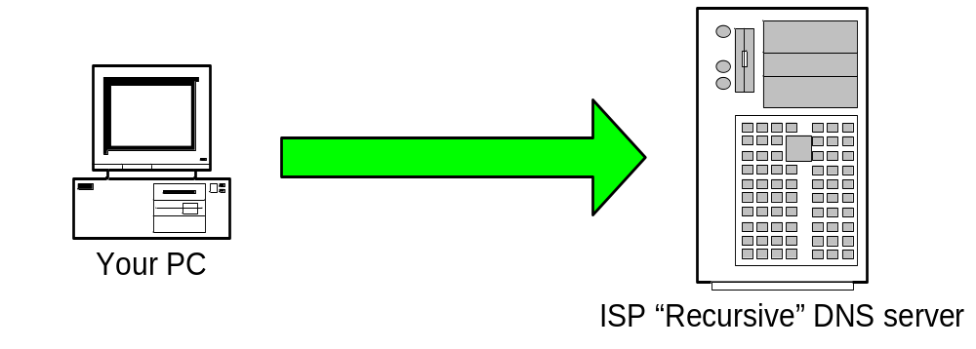
1
Step 1: Your PC sends a resolution request to its configured DNS Server, typically at your ISP.
Tell me the Address of “www.google.com”

Slide 75
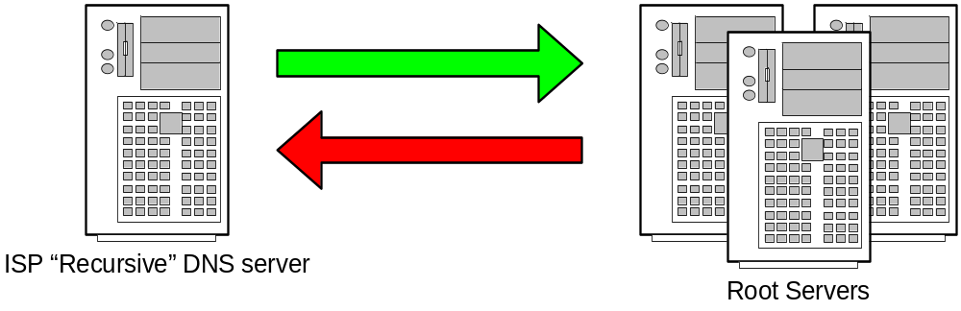
2
Step 2: Your ISPs recursive name server starts by asking one of the root servers predefined in its “hints” file.
Tell me the Address of “www.google.com”
I don’t know the address but I know who’s authoritative for the ”com” domain ask them

Slide 76
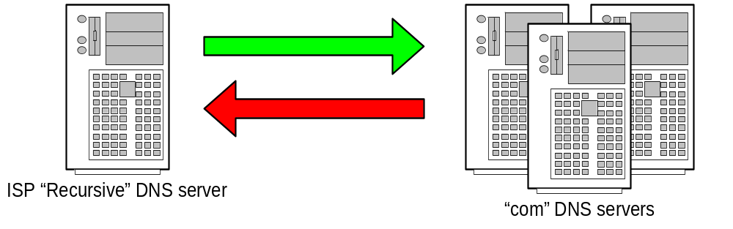
3
Step 3: Your ISPs recursive name server then asks one of the “com” name servers as directed.
Tell me the Address of “www.google.com”
I don’t know the address but I know who’s authoritative for the ”google.com” domain ask them

Slide 77
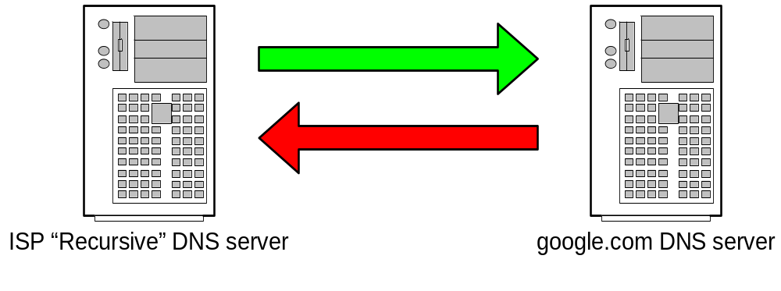
4
Step 4: Your ISPs recursive name server then asks one of the “google.com” name servers as directed.
Tell me the Address of “www.google.com”
The Address of www.google.com is 216.239.53.99

Slide 78
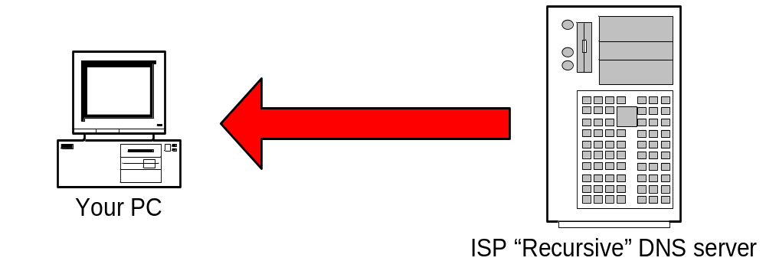
5
Step 5: ISP DNS server then send the answer back to your PC. The DNS server will “remember” the answer for a period of time.
The Address of www.google.com is 216.239.53.99

Slide 79
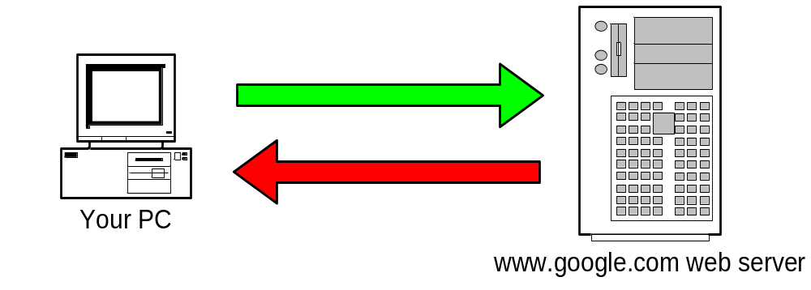
6
Step 6: Your PC can then make the actual HTTP request to the web server.
Send me the www.google.com.au web page
Here it is!

Slide 80
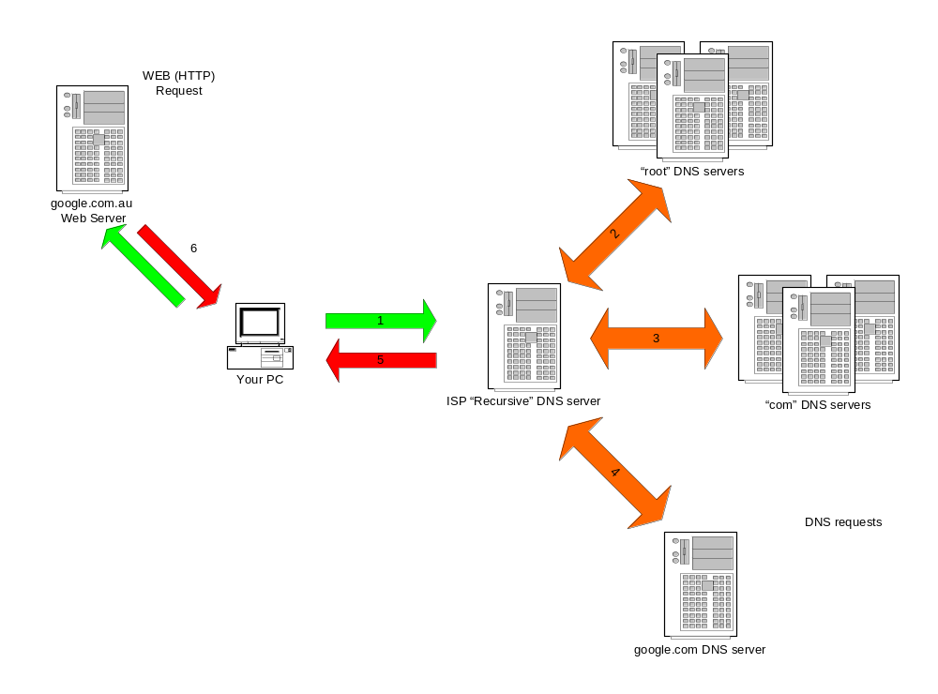
Summary
The actual web request
DNS

Slide 81
Sending an Email
DNS is not just used in HTTP protocol (web pages)
DNS is involved in almost every protocol in use on the internet
Next example is how DNS facilitates the transfer of electronic mail.

Slide 82
DNS name resolution example
root DNS server
Host at cis.poly.edu wants IP address for gaia.cs.umass.edu
2
3
iterated query:
contacted server replies with name of server to contact
“I don’t know this name, but ask this server”
TLD DNS server
4
5
local DNS server
dns.poly.edu
7
6
1
8
authoritative DNS server
dns.cs.umass.edu
requesting host
cis.poly.edu
gaia.cs.umass.edu

Slide 83
DNS name resolution example
root DNS server
recursive query:
puts burden of name resolution on contacted name server
heavy load?
2
3
7
6
TLD DNS server
local DNS server
dns.poly.edu
5
4
1
8
authoritative DNS server
dns.cs.umass.edu
requesting host
cis.poly.edu
gaia.cs.umass.edu

Slide 84

1
Step 1: Your PC sends the e-mail to its configured outbound mail server. A DNS request similar to the previous example is required to find the address of the mail server.
Please send this message to “someone@example.com”

Slide 85
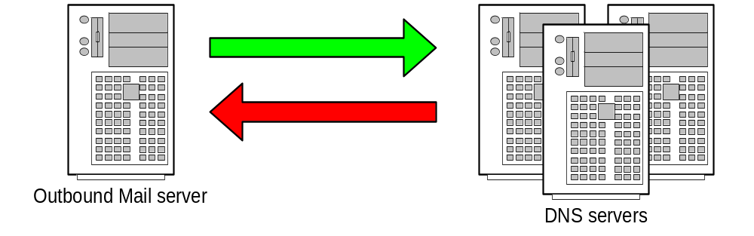
2
Step 2: Your mail server follows the same intensive process to find the authoritative servers for “example.com”.
Tell me the name servers for “example.com”
Here are the name servers for “example.com”

Slide 86
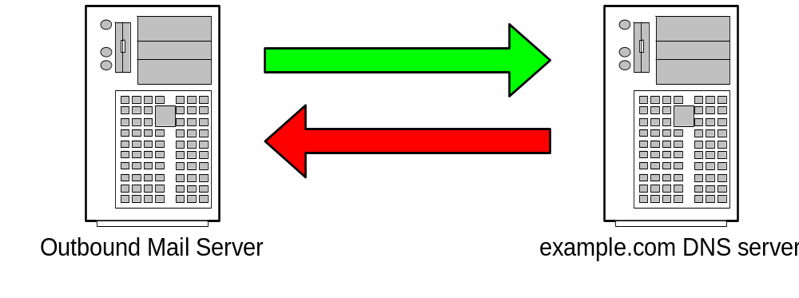
3
Step 3: Ask the “example.com” name server for the list of “Mail eXchangers (MX) for that domain.
Tell me the MX’s for “example.com”
The MXs are mx10.example.com and mx20.backmail.com

Slide 87

4
Step 4: Select a Mail server and deliver the mail.
Here is some mail for the “example.com” domain
Mail accepted for delivery

Slide 88

DNS protocol, messages
DNS protocol : query and reply messages, both with same message format
msg header:
identification: 16 bit # for query, reply to query uses same #
flags:
  query or reply
  recursion desired
  recursion available
  reply is authoritative

Slide 89
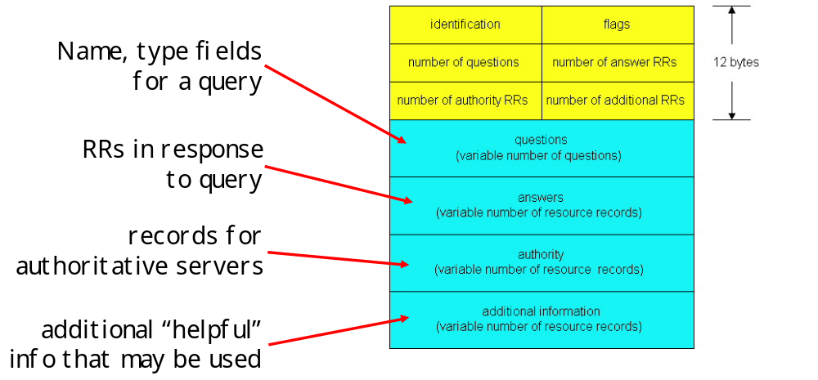
1

Slide 90
Windows DNS Client Information
All Microsoft Windows platforms support the DNS protocol in one way or another. Each of the workstation platforms allows you to configure remote DNS servers for resolving hostnames in applications. In addition, on the Windows 2000 server platform you can also create a DNS server database to support the DNS for a domain.
For your C# DNS programs to work, the DNS settings must be set properly on the Windows platform. This section describes how to configure the DNS client components on Windows systems and how to obtain the system DNS client information from a C# program.

Slide 91
DNS Configuration
All Windows systems have the capability to resolve hostnames. There are two techniques for resolving hostnames to IP addresses:
  Accessing a local file of hostnames
  Querying a remote DNS server
Using the hosts File:
The simplest way to resolve a limited number of hostnames is to maintain a local hostnames file on the system. For remote hostnames that you frequently access, this is the most efficient arrangement for Windows because it allows more immediate access than going out to a remote DNS server. However, this is obviously not the preferred method to use for resolving lots of hostnames, as is the case during Internet surfing.
The hostnames file is named hosts, and its location depends on which version of Windows you are using:
  For Windows 95, 98, Me, and XP, hosts is located in the C:\WINDOWS\SYSTEM32\DRIVERS\ETC directory.
  For Windows NT, and 2000, hosts is located in the C:\WINNT\SYSTEM32\DRIVERS\ETC directory.

Slide 92
DNS Configuration
The hosts file is in text format, with each line representing a record for each host. The host IP address is listed first, followed by one or more spaces and then the hostname; for example:
  127.0.0.1 localhost
  192.168.1.1 shadrach.blum.lan
  192.168.1.2 meshach.blum.lan
  192.168.1.6 abednego.blum.lan
Notice the first entry in the hosts file. The 127.0.0.1 address represents the special loopback address and always points to the localhost hostname. The localhost hostname is itself special because it represents the internal network address of the system. Applications often use this address to direct IP packets to the same system—that’s one way to communicate between programs running on the same system.
After the localhost definition, each remote host that you access frequently should be listed on its own line. Let’s say you run a local in-house network using a fictitious domain name (as shown in the previous example); you can still use the hostnames in the network programs if you enter them in the hosts file on each system.
It’s easy to see that this method will work fine for a limited number of hosts, but if you’re trying to access lots of hosts, the hosts file will become pretty unwieldy. The obvious solution is to use the DNS system to resolve hostnames.

Slide 93
Using a Remote DNS Server
When you need to resolve standard Internet hostnames, the easiest way is to find a DNS server to query. Most (if not all) ISPs provide one or more DNS server addresses for customers to use for DNS queries. Often you won’t need to do anything at all to configure the DNS servers into your system. If your ISP dynamically assigns an IP address to your system, it most likely also assigns the DNS servers dynamically as well.
On the other hand, if your DNS servers are not assigned dynamically, it may be up to you to make sure they are configured. The DNS server entries are stored in the Internet Protocol Properties section of the system’s network properties. You’ll take a slightly different route to get to these properties based on the Windows platform you’re working on. On a Windows 2000 or XP workstation, click Control Panel, and double-click the Network Connections entry. A list of all available network interfaces will be shown. Right-click the network interface for which you want to configure the DNS server, and select the Properties option.

Slide 94
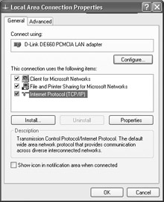
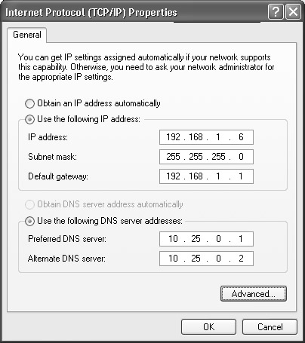
DNS Server Configurations and Windows

Slide 95
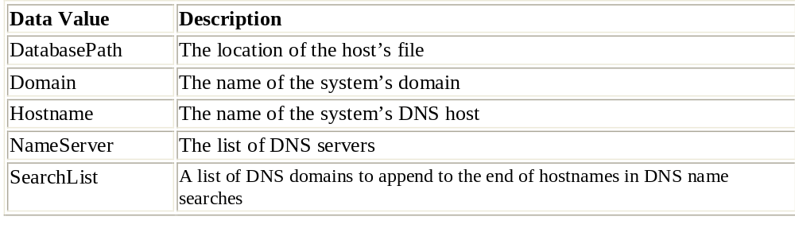
Using C# to Investigate the DNS Configuration
When your C# application is running on a customer’s system, you have no guarantee that there are any DNS servers configured. You can find out what (if any) DNS servers are configured by using the .NET Registry class methods to examine the DNS Registry values.
Fortunately, all Windows platforms store the DNS server information in the same place:
HKLM\SYSTEM\CurrentControlSet\Services\Tcpip\Parameters This key stores all the DNS parameters from the Internet Protocol Properties window as separate data values.

Slide 96
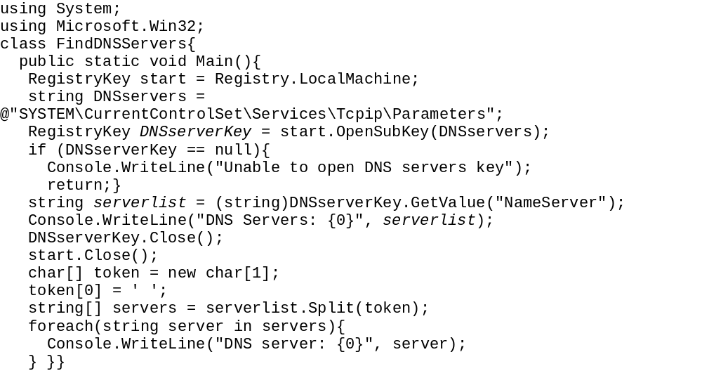
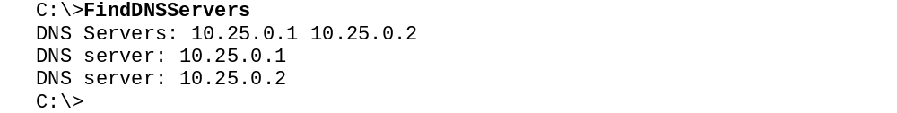
Example

Slide 97
Resolving Hostnames with nslookup
Once the DNS server configuration is set, you can test the DNS functionality by manually using the command-line nslookup program to query the servers for DNS information. The nslookup program comes standard on all Windows platforms. This section shows how to use nslookup to obtain DNS information for domains and hosts.
The default nslookup format described in the preceding sections provides good, simple information regarding the hostname requested. If you would like to see other DNS record types, you must use options for nslookup. The nslookup options can be specified on the command line, but it is often easier to use nslookup in interactive mode.
To enter interactive mode, simply type nslookup at the command prompt without any parameters. The default DNS server used will be displayed, along with an nslookup prompt:
C:\>nslookup
Default Server: dns.ispnet.net
Address: 10.25.0.1
>
At the nslookup prompt, you can enter in a variety of special commands to modify the behavior of the nslookup query:

Slide 98
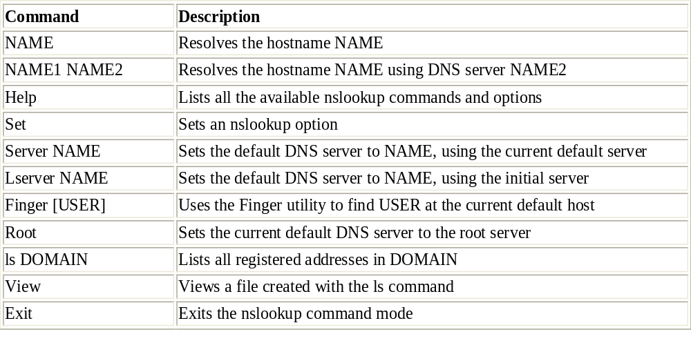

Slide 99
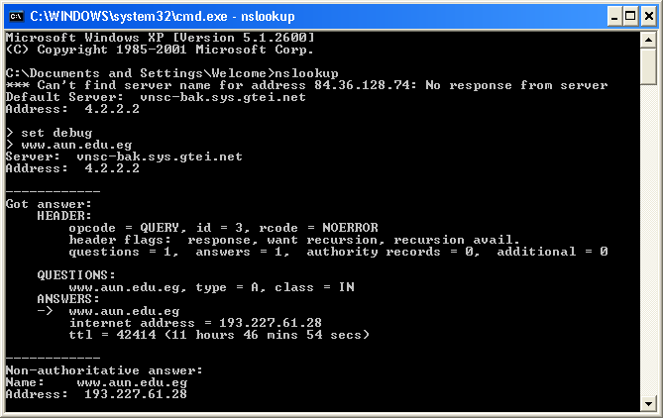
Example

Slide 100
DNS Classes in C#
The System.Net namespace contains the Dns class, which provides all the necessary DNS functions for C# programs. This section describes the Dns class methods and shows how they can be used in C# programs to utilize the DNS capabilities of the system.
Synchronous Methods:
There are four synchronous methods defined in the Dns class:
  GetHostName()
  GetHostByName()
  GetHostByAddress()
  Resolve()
GetHostName()
The GetHostName() method is used to determine the hostname of the local system the program is running on. This information is frequently needed for network programs, so you’ll see this method used a lot. The format is simple: there are no parameters to enter, and the result is a string object:
string hostname = Dns.GetHostName();
The information retrieved by GetHostName()hostname should be the same name that appears in the Registry Hostname data value, along with the Domain data value, to create the complete fully-qualified domain name (FQDN) of the system. The FQDN includes the local hostname, along with the full domain name information

Slide 101
2
GetHostByName()
The GetHostByName() method performs a DNS query for a specified hostname using the default DNS server configured on the system. The format of the method is as follows:
IPHostEntry GetHostByName(string hostname)
The IPHostEntry that is returned by GetHostByName() is itself an interesting object. It associates a DNS hostname with an array of alias names and IP addresses. It contains three properties:
  AddressList: An array of IPAddress objects, one for each assigned IP address
  Aliases: An array of string objects, one for each alias
  HostName: A string object for the hostname
  The AddressList and Aliases objects must be separated into their individual array elements in order to retrieve the information stored. This is often done using the foreach function in C#.

Slide 102
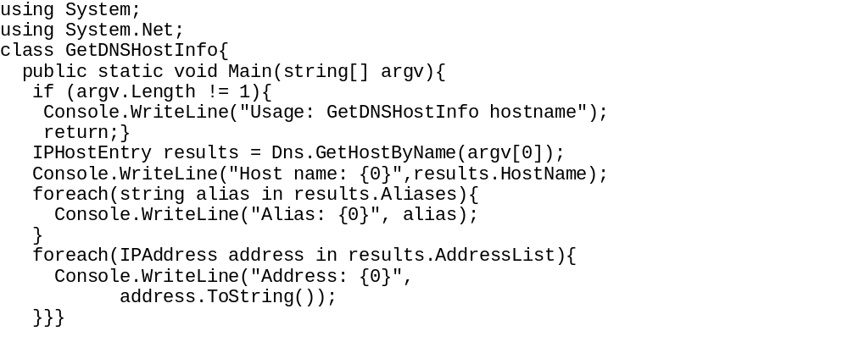
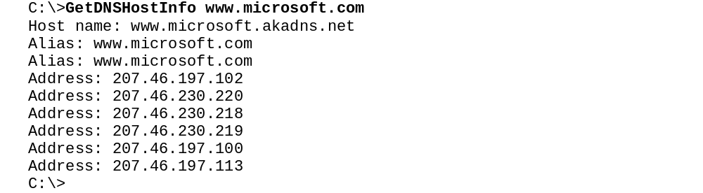
Example

Slide 103
GetHostByAddress()
When you do need to find the hostname for a known IP address, use the GetHostByAddress() method. There are two formats for this method:
  IPHostEntry GetHostByAddress(IPAddress address)
  IPHostEntry GetHostByAddress(string address)
The first format is used when you have the IP address as an IPAddress object. The second format is used if you want to use the string representation of the dotted quad format of the IP address (such as 207.46.197.100).

Slide 104
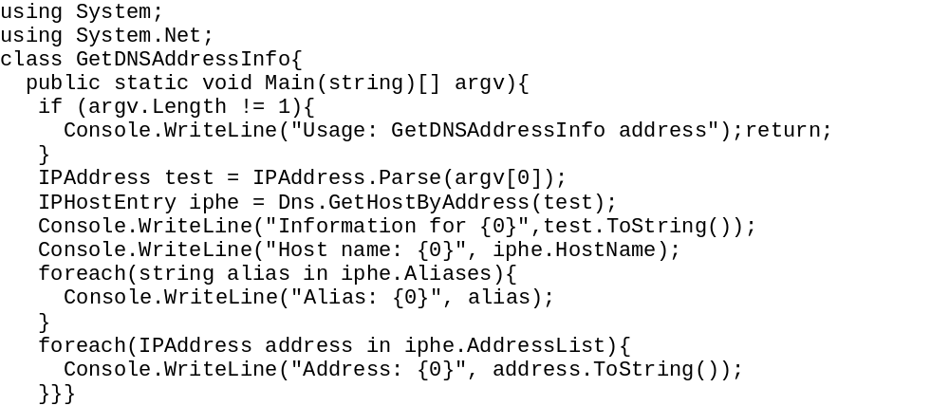
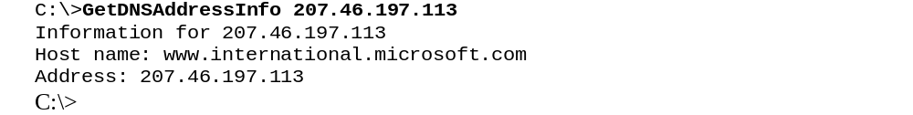
Example

Slide 105
Resolve()
As you saw in the preceding sections, the main disadvantage with the GetHostByName() and GetHostByAddress() methods is that they are specific to one or the other types of address information. If you feed an IP address into the GetHostByName() method, it returns only the address. Even worse, if you try to feed a string hostname to the GetHostByAddress() method, it will produce an Exception (because it uses the IPAddress.Parse() method on the supplied string IP address).
Suppose you are creating a program where customers are entering the address of a remote host—you might not know which form the customers will use. Instead of worrying about trying to figure out whether the input is numeric or text so that you can use the proper GetHostBy method, the Dns class offers a simple solution: the Resolve() method. Resolve() accepts an address in either hostname or IP address format and returns the DNS information in an IPHostEntry object.

Slide 106
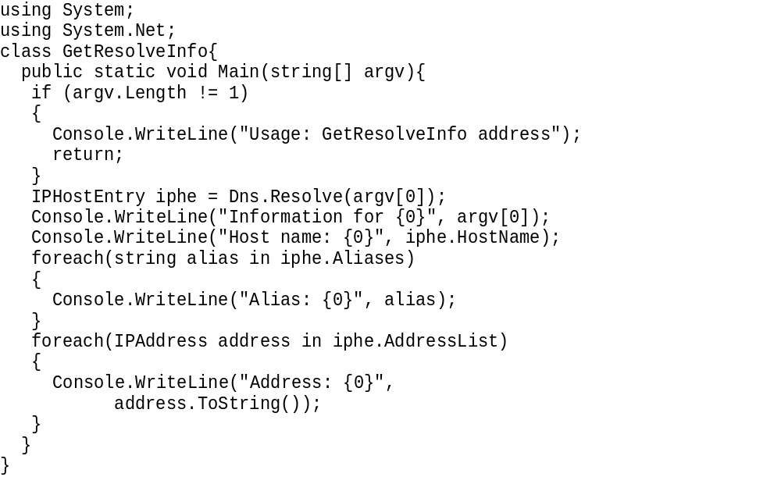
Example

Slide 107
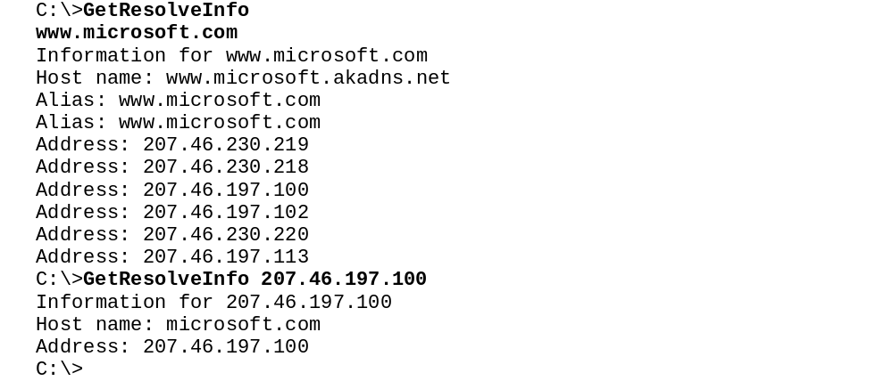
1

Slide 108
Asynchronous Methods
The regular Dns methods might cause a problem for your C# program because they use blocking mode to communicate with the remote DNS server. If you ran the example programs offered earlier in this section on the DNS classes, you may have noticed that it often takes a few seconds for the DNS information to be returned from the remote DNS server. This may not seem like much of a problem, but it can cause serious difficulties in Windows programs that allow the user to do other things at the same time. While the program is waiting for the DNS server response, the user is prevented from clicking any buttons or entering any information in TextBox fields. For some applications, this can mean unacceptable performance.
One of the techniques is to use the asynchronous socket methods (described in more detail in Chapter 8, “Asynchronous Socket Programming). These methods allow you to start a network function and specify a delegate to call when the network function completes. Meanwhile, the rest of the program can go happily on its way doing other things. When the network function is completed, it signals the program to run the delegate method.
The Dns class provides the following asynchronous methods to allow your programs to perform asynchronous DNS function calls:
  BeginGetHostByName()
  BeginResolve()
  EndGetHostByName()
  EndResolve()
Each of the asynchronous methods parallels the equivalent synchronous method. At this time there is no asynchronous GetHostByAddress() call.

Slide 109
The methods are called in pairs. The Beginxxx method is called from the program and points to a delegate method, which contains the Endxxx method. For example, BeginResolve() uses the following format:
public static IAsyncResult BeginResolve(string hostname,
AsyncCallback requestCallback, object stateObject)
The method uses three parameters:
A string representation, hostname, of a hostname or IP address
An AsyncCallback object, requestCallback, which defines the delegate
A generic object, stateObject, which defines the method state
The AsyncCallback object is created to point to the delegate method used when the DNS results are returned. To do this, you must first create the AsyncCallback object, then assign the delegate method to it:
private AsyncCallback OnResolved;
OnResolved = new AsyncCallback(Resolved);
Object state = new Object();
.
.
Dns.BeginResolve(addr, OnResolved, state);
.
}
private void Resolved(IasyncResult ar)
{
IPHostEntry iphe = Dns.EndResolve(ar);
}

Slide 110
The OnResolved AsyncCallback object points to the delegate method Resolved, which will contain the EndResolve() method to complete the DNS call. The state object allows you to pass information to the delegate method. The EndResolve() method has this format:
public static IPHostEntry EndResolve(IasyncResult ar) The IAsyncResult object ar is what refers the EndResolve() method to the original BeginResolve() method. The result of the EndResolve() method is the standard IPHostEntry object, which can then be broken down to extract the returned information, similar to the standard Resolve() method discussed earlier.

Slide 111
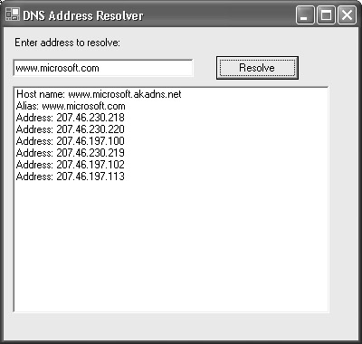
Example

Slide 112

1

Slide 113

2

Slide 114
3
After the constructor, two methods are defined. The ButtonResolveOnClick() method is registered as a delegate for the button using the Click property:
checkit.Click += new EventHandler(ButtonResolveOnClick);
Notice that the EventHandler object is added to the existing list of event handlers for the control. The EventHandler object references the delegate to call when the button Click event is detected.
When the Button object is clicked, the ButtonResolveOnClick() delegate is performed. It reads the value entered into the TextBox object and calls the BeginResolve() method using the value of the object, the AsyncCallback object created earlier, and an empty state object:
Dns.BeginResolve(addr, OnResolved, state);
The OnResolved parameter is defined as an AsyncCallback object, and defines the Resolved() method in the program class:
private AsyncCallback OnResolved = null;
OnResolved = new AsyncCallback(Resolved);
The Resolved() method calls the EndResolve() Dns class method, which completes the BeginResolve/EndResolve pair. It must use the IasyncResult object parameter as the parameter value:
private void Resolved(IAsyncResult ar)
{
string buffer;
IPHostEntry iphe = Dns.EndResolve(ar);

