Slide 1
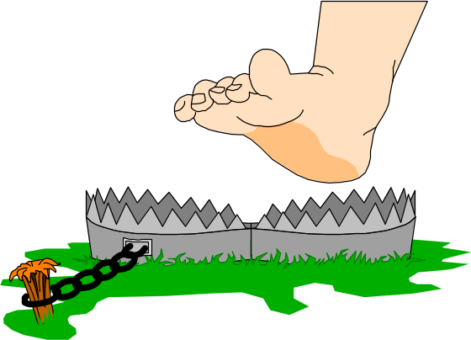
Network programming
C# Network Programming Classes-2

Slide 2
Using C# Sockets
The System.Net.Sockets namespace contains the classes that provide the actual .NET interface to the low-level Winsock APIs. This section gives a brief overview of the C# Socket class.
The core of the System.Net.Sockets namespace is the Socket class. It provides the C# managed code implementation of the Winsock API. The Socket class constructor is as follows:
Socket(AddressFamily af, SocketType st,ProtocolType pt)
As you can see, the basic format of the Socket constructor mimics the original Unix socket() function. It uses three parameters to define the type of socket to create:
  An AddressFamily to define the network type
  A SocketType to define the type of data connection
  A ProtocolType to define a specific network protocol

Slide 3
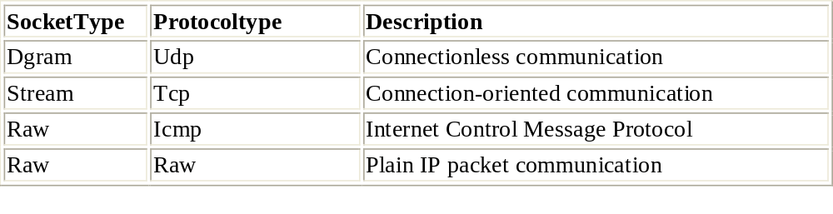
Each of these parameters is represented by a separate enumeration within the System.Net.Sockets namespace. Each enumeration contains the values that can be used. For normal IP communications on networks, the AddressFamily.InterNetwork value should always be used for the AddressFamily. With the InterNetwork AddressFamily, the SocketType parameter must match a particular ProtocolType parameter. You are not allowed to mix and match SocketTypes and ProtocolTypes.

Slide 4
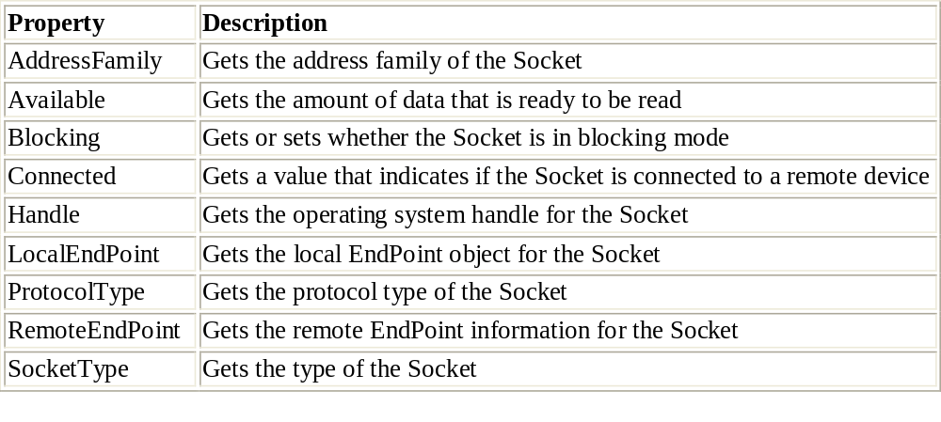
Socket Properties
Several properties of the Socket class can be used to retrieve information from a created Socket object:

Slide 5
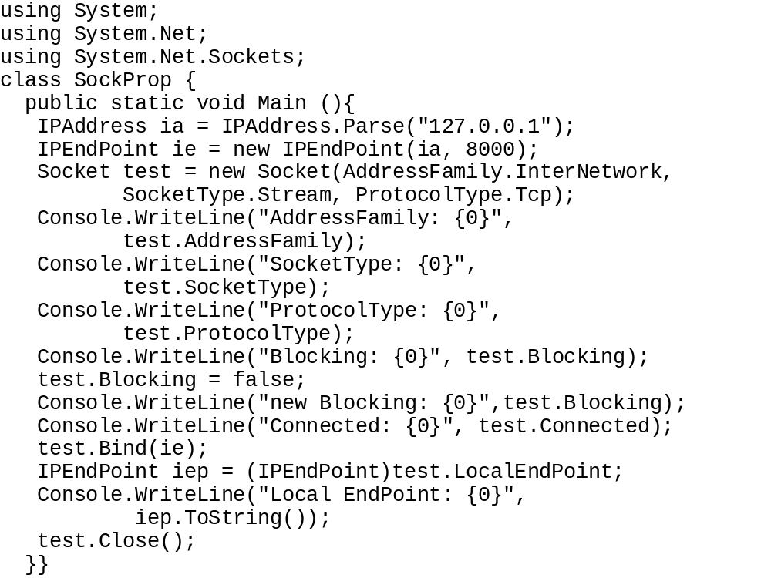
The SockProp.cs sample socket properties program
The following code is a simple program that demonstrates the Socket properties. Because the LocalEndPoint property needs a bound Socket object, I used the Bind() method to bind the socket to the loopback address of the system (127.0.0.1).

Slide 6
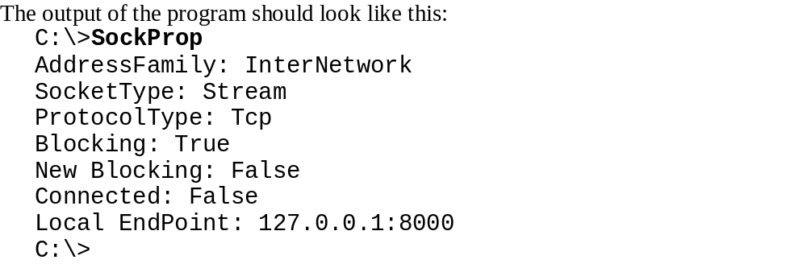

Slide 7
Socket Options
Like Unix sockets, .NET sockets allow you to set protocol options for the created Socket object. However, because C# is an object-oriented language, there is a twist.
Instead of being a stand-alone function, the call is a method. Like its Unix counterpart, SetSocketOption() configures the socket parameters that you want to tweak to customize the communication parameters. The SetSocketOption() method is overloaded, using three different formats:
SetSocketOption(SocketOptionLevel sl,
SocketOptionName sn, byte[] value)
SetSocketOption(SocketOptionLevel sl,
SocketOptionName sn,int value)
SetSocketOption(SocketOptionLevel sl,
SocketOptionName sn, object value)
The parameters used are similar to the Unix setsockopt() function. The sl defines the type of socket option to set. Table 3.9 lists the available SocketOptionLevels.

Slide 8
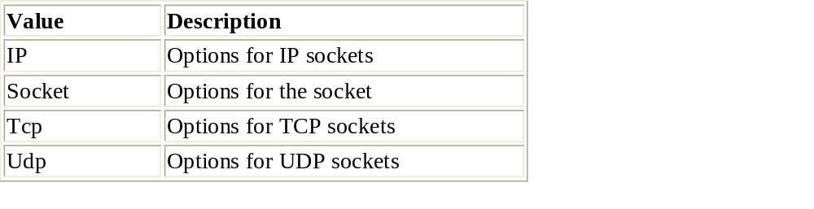
SocketOptionLevel Values
The parameters used are similar to the Unix setsockopt() function. The sl defines the type of socket option to set. The following table lists the available SocketOptionLevels.

Slide 9
The sn defines the specific socket option that will be set within the SocketOptionLevel. The following table lists the available SocketOptionNames.

Slide 10
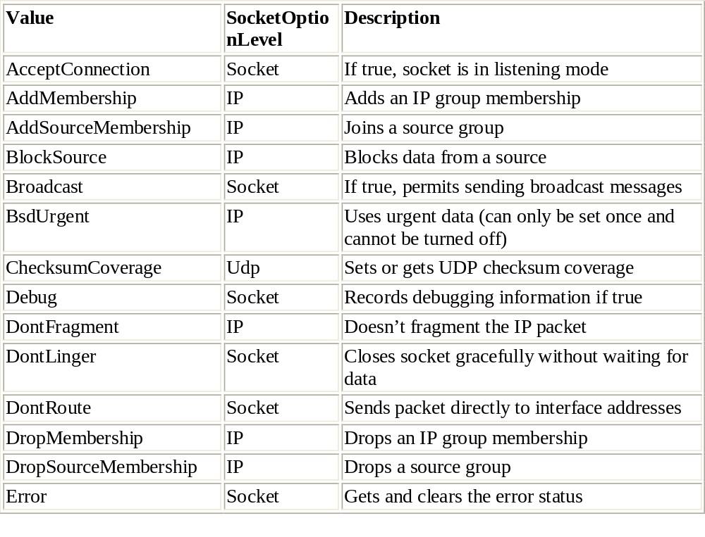
1

Slide 11
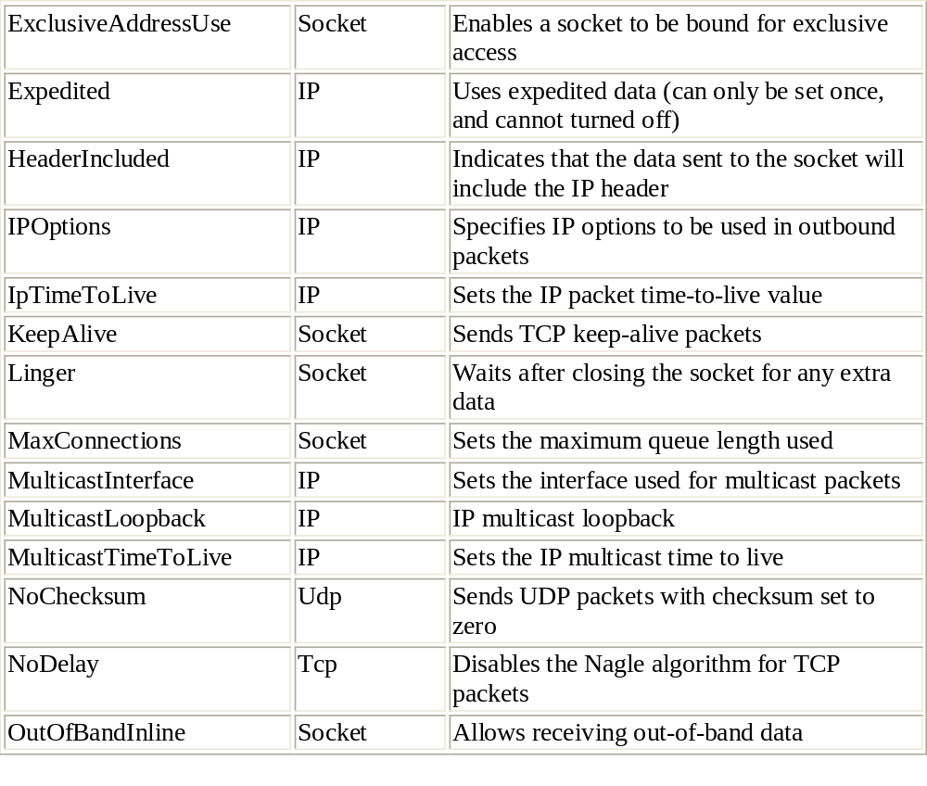
2

Slide 12
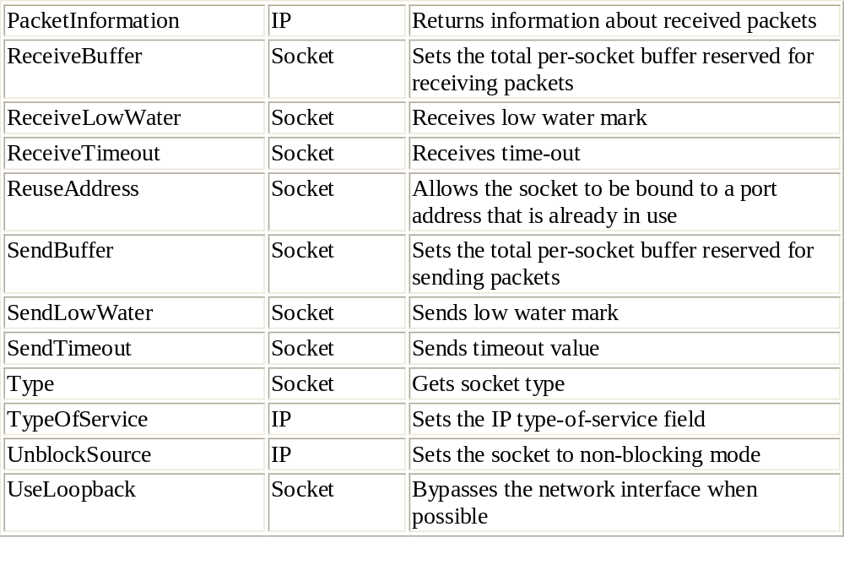
3

Slide 13
Connection-Oriented Sockets-The Server Functions:
Once again, the .NET Framework concepts are similar to Unix network programming. In the .NET Framework, you can create connection-oriented communications with remote hosts across a network. Because C# is an object-oriented language, all the Unix socket functions are implemented as methods of the Socket class. By referring to the method from the Socket instance, you can perform network operations using the indicated socket.
Similar to the Unix server, once a server socket is created, it must be bound to a local network address on the system. The Bind() method is used to perform this function:
Bind(EndPoint address)
The address parameter must point to a valid IPEndPoint instance, which includes a local IP address and a port number. After the socket is bound to a local address, you use the Listen() method to wait for incoming connection attempts from clients:
Listen(int backlog)
The backlog parameter defines the number of connections that the system will queue, waiting for your program to service. Any attempts by clients beyond that number of waiting connections will be refused. You should remember that specifying a large number here might have performance consequences for your server. Each pending connection attempt uses buffer space in the TCP buffer area. This means less buffer space available for sent and received packets.
After the Listen() method is performed, the server is ready to accept any incoming connections. This is done with the Accept() method. The Accept() method returns a new socket descriptor, which is then used for all communication calls for the connection.

Slide 14
Here’s a sample of C# server code that sets up the necessary socket pieces:
IPHostEntry local = Dns.GetHostByName(Dns.GetHostName());
IPEndPoint iep = new IPEndPoint(local.AddressList[0], 8000);
Socket newserver = new Socket(AddressFamily.InterNetwork,
SocketType.Stream, ProtocolType.Tcp);
newserver.Bind(iep);
newserver.Listen(5);
Socket newclient = newserver.Accept();
This program will block at the Accept() statement, waiting for a client connection. Once a client connects to the server, the newclient Socket object will contain the new connection information and should be used for all communication with the remote client. The newserver Socket object will still be bound to the original IPEndPoint object and can be used to accept more connections with another Accept() method. If no more Accept() methods are called, the server will not respond to any more client connection attempts.
After the client connection has been accepted, the client and server can begin transferring data. The Receive() and Send() methods are used to perform this function. Both of these methods are overloaded with four forms of the method. Table 3.11 shows the available methods to use for each.

Slide 15
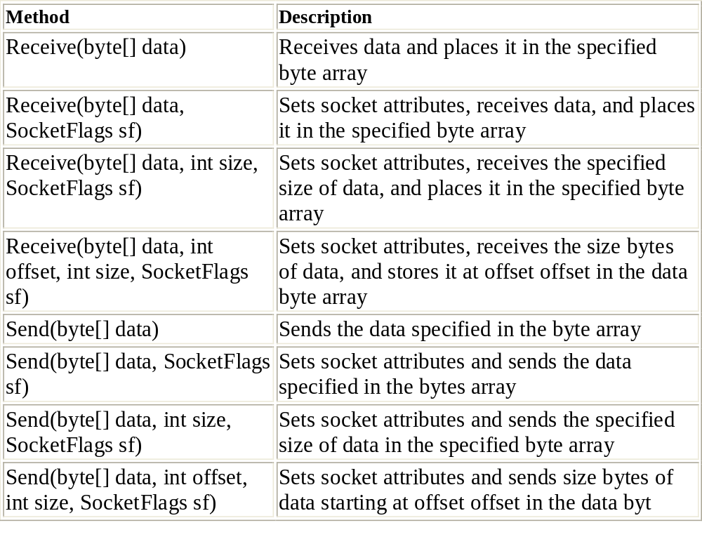
The Receive() and Send() Methods

Slide 16
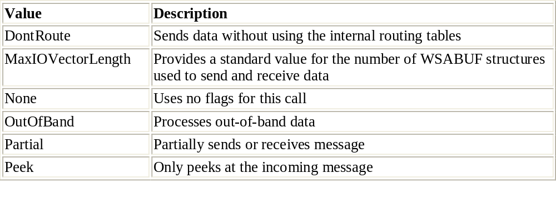
SocketFlag Values
The simple form of the Send() and Receive() methods sends a single byte array of data, or receives data and places it into the specified byte array. If you want to specify any special SocketFlags, you can add them into the method call as well.

Slide 17
The Client Functions
The client device must also bind an address to the created Socket object, but it uses the Connect() method rather than Bind(). As with Bind(),Connect()requires an IPEndPoint object for the remote device to which the client needs to connect:
IPAddress host = IPAddress.Parse("192.168.1.1");
IPEndPoint hostep = new IPEndPoint(host, 8000);
Socket sock = new Socket(AddressFamily.InterNetwork,
SocketType.Stream, ProtocolType.Tcp);
sock.Connect(hostep);
The Connect() method will block until the connection has been established. If the connection cannot be established, it will produce an exception (see the section "Socket Exceptions" later in this chapter).
Once the connection has been established, the client can use the Send() and Receive() methods of the Socket classsimilar to the way the server uses them. When communication is done, the Socket instance must be closed. Like the Unix socket, the Socket class usesboth a shutdown() method to gracefully stop a session, and a close() method to actually close the session. The shutdown() method uses one parameter to determine how the socket will shutdown.

Slide 18
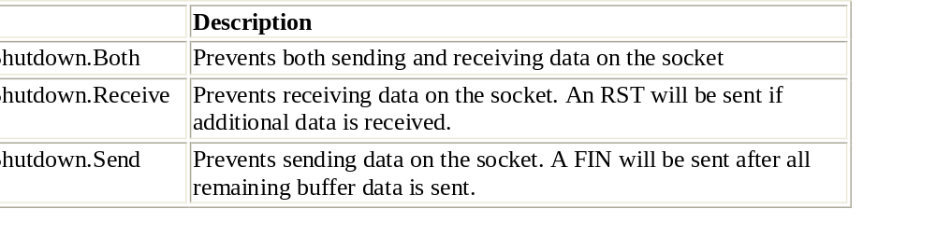
Socket.Shutdown() Values

Slide 19
Using Connectionless Sockets
.NET uses the same functionality for connectionless sockets as that employed by the Unix model. When you create a socket with the SocketType.Dgram socket type, the UDP protocol is used to transmit packets across the network. Similar to the Unix model, you must set up the Bind() method for the server to bind the socket to a particular port. Also similar to the Unix model, the server and client do not need to use the Listen() or Connect() methods.
Because there is no connection for communication, the standard Receive() and Send() methods will not work. Instead, you must use the special ReceiveFrom() and SendTo() methods. The formats for these methods comprise the same base parameters as the Receive() and Send() methods. In addition, there is an extra parameter that is a reference to an EndPoint object. This parameter defines where the data is going (for SendTo) or where it is coming from (for ReceiveFrom). For example, the simplest format of the methods would be as follows:
ReceiveFrom(byte[], ref EndPoint)
SendTo(byte[], ref EndPoint)
For UDP communications, the EndPoint object will point to an IPEndPoint object. If you are new to C#, you may not have seen the ref keyword before. The ref keyword indicates that the method will access the EndPoint object by reference in memory, and not by its value. This is a popular technique in C and C++ programming, but it is not seen very often in C# programs.

Slide 20
Non-blocking Programming
The .NET Socket class I/O methods use blocking by default, just like the Unix network programming model. When a program reaches a network function that blocks, such as Receive(), the program waits there until the function completes, such as when data is received from the socket. Three C# techniques are available to avoid using blocking network calls: non-blocking sockets, multiplexed sockets, and asynchronous sockets.
Non-blocking Sockets:
  As mentioned earlier, C# Socket objects contain properties that can be queried for their values. However, one of the properties, Blocking, can also be set. You can set the Blocking property of a socket to false, putting the socket into non-blocking mode.
  When the socket is in non-blocking mode, it will not wait for an I/O method to complete. Rather, it will check the method; if it can’t be completed, the method will fail and the program will go on. For example, with Blocking set to false, the Receive() method will not wait for data to appear on the socket. Instead, the method will return a value of 0, indicating that no data was available on the socket.

Slide 21
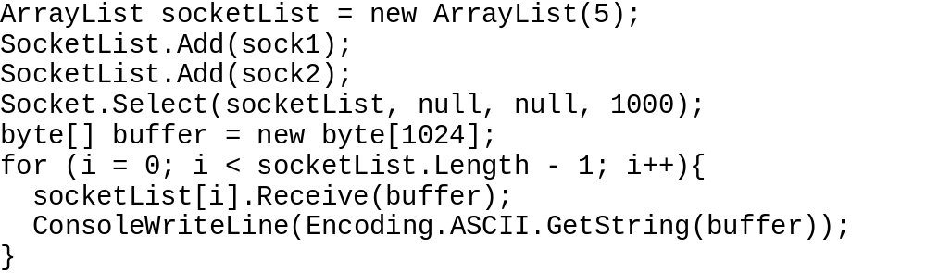
Mutiplexed Sockets:
Just as in Unix, the Socket class provides the Select() method. This method is used to multiplex multiple Socket instances to watch for the ones that are ready to be read or written to. In C#, however, the Select() method is used somewhat differently. Here is the format of the Select() method:
Select(IList read, IList write, IList error, int microseconds)
  The read, write, and error parameters are IList objects, which are arrays that contain created sockets to monitor. The microseconds parameter defines the amount of time (in microseconds) the Select() method will wait for the events to happen.The following is a small code fragment showing how the Select() method can be used:

Slide 22
Asynchronous Socket Programming
  It is no surprise that the .NET Framework uses the asynchronous socket model introduced by the Windows Winsock API. This method allows you to use a separate method when a socket is ready to receive or send data. Instead of using a Receive() method to wait for data from a client, you can use the BeginReceive() method, which will register a delegate to be called when data is available on the socket. Within the delegate method, you must use the EndReceive() method to stop the asynchronous read and retrieve the data from the socket.

Slide 23
C# Socket Exceptions
One feature of socket programming included in .NET Framework that is used neither by Unix nor the Winsock API is socket exceptions. So far, all of the examples and code fragments shown in this chapter assumed one important thing: that all socket calls will succeed. This is a dangerous assumption to make in today’s networking world.
C# uses the try-catch mechanism to catch errors and exceptions as the program is running. You should always plan thoroughly for these exceptions and carefully determine what actions should be taken when an exception occurs.
All of the Socket class methods use the SocketException exception. Any socket programming you do should always check for SocketException exceptions and then attempt to recover from the error, or at least warn the user of the problem.
The following Listing shows a simple socket client program that uses exception programming to determine if any errors occur during the normal network session. By using try-catch blocks around individual network calls, you can single out where problems occur in your program and give your customers better information so they can take the appropriate actions to fix the problem.

Slide 24
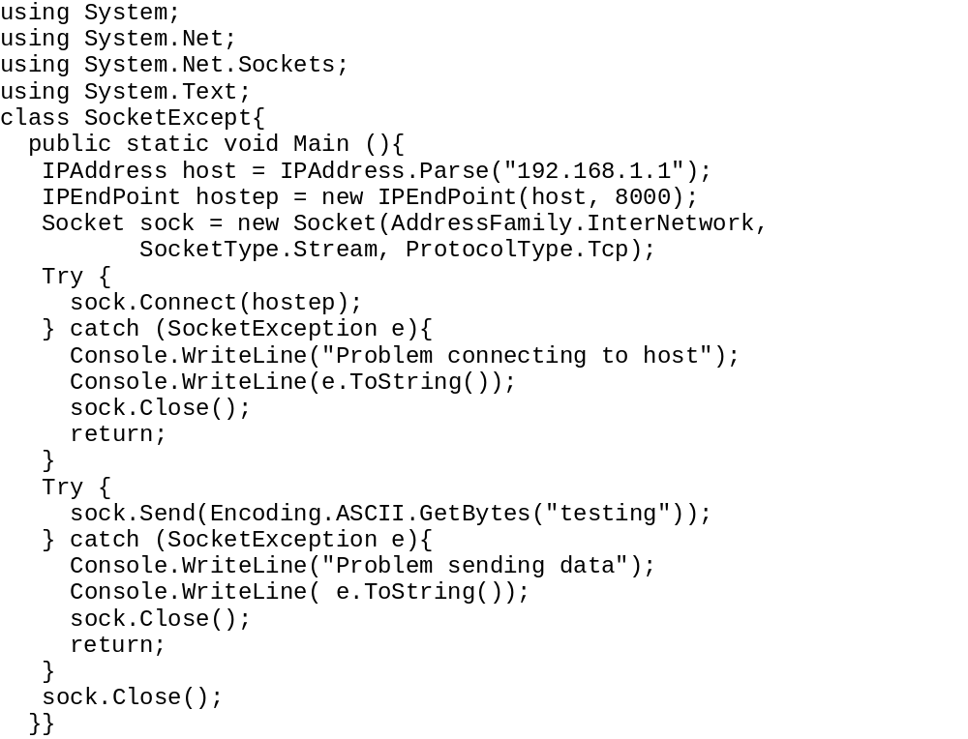

Slide 25
A Simple TCP Server
As discussed before, you have four tasks to perform before a server can transfer data with a client connection:
  Create a socket
  Bind the socket to a local IPEndPoint
  Place the socket in listen mode
  Accept an incoming connection on the socket
Creating the Server:
The first step to constructing a TCP server is to create an instance of a Socket object. The other three functions necessary for successful server operations are then accomplished by using methods of the Socket object. The following C# code snippet includes these steps:
IPEndPoint ipep = new IPEndPoint(IPAddress.Any, 9050);
Socket newsock = Socket(AddressFamily.InterNetwork,
SocketType.Stream, ProtocolType.Tcp);
newsock.Bind(ipep);
newsock.Listen(10);
Socket client = newsock.Accept();
The Socket object created by the Accept() method can now be used to transmit data in either direction between the server and the remote client.

Slide 26
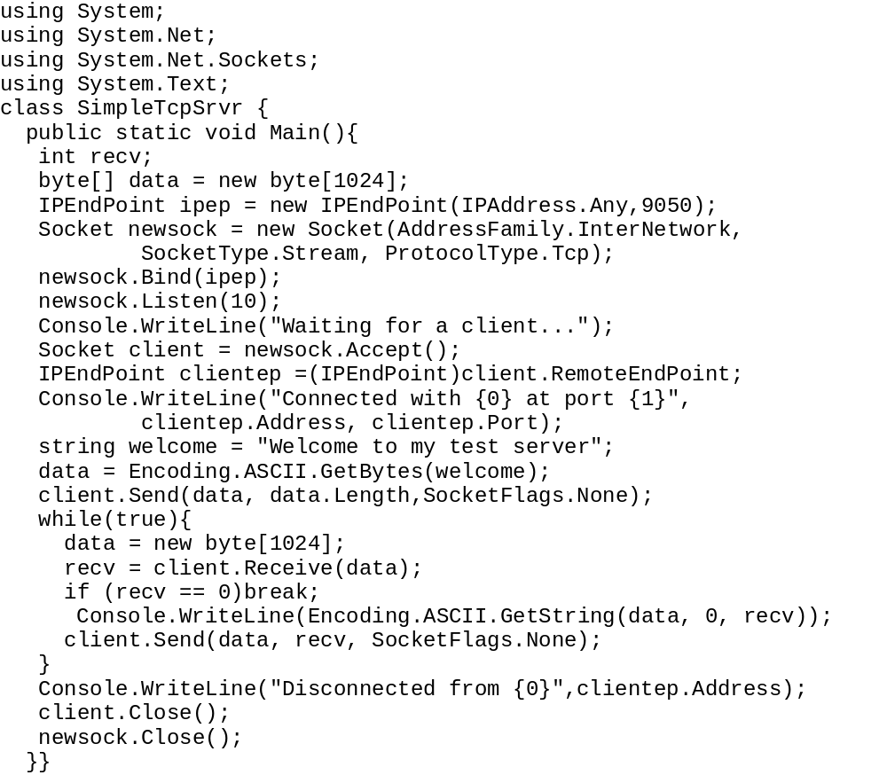

Slide 27
A Word about the Receive() Method
You may have noticed in above Listing that the first line in the while loop resets the data variable to a new byte array. This is a crucial detail that is forgotten by many less-experienced network programmers. As the Receive() method places data in the data buffer, the size of the data buffer is set. If the data buffer is not reset to its original value, the next Receive() call using the buffer will only be able to place as much data as the previous call.
The Receive() method normally returns the amount of data received from the remote client. If no data is received, the Receive() method blocks, waiting for data to appear. You may be wondering how Receive() can possibly return a value of zero. It’s simple: when the TCP structure has detected that the remote client has initiated a close session (by sending a TCP FIN packet), the Receive() method is allowed to return a zero value.
This allows you to check the Receive() return value for a zero value. If it is zero, the program must attempt to gracefully close the newly created client socket by using the Close() method along with the optional Shutdown() method. After the client Socket object is closed, no further communication can take place. Remember however, that the original main Socket object is still active and can still be used to accept more incoming connections until it is closed as well. If you do not want any additional connections at all, the original Socket object must also be closed.

Slide 28
Testing the Server
You can easily test the server code using the Microsoft Telnet program that comes standard on all Windows platforms. To start the sample TCP server, open a command prompt window and type SimpleTcpSrvr. The server will display the opening greeting and wait for an incoming client:
C:\>SimpleTcpSrvr
Waiting for a client...
Once the server is running, open another command prompt window (either on the same system or another system on the network) and start the Telnet program. Connect to the address of the server and the 9050 port used:
C:\>telnet 127.0.0.1 9050
The connection should start, and the server welcome screen should appear.
At this point, the server is waiting for a message from the client. Using the Telnet program, a strange thing happens. If you try to type a message, each individual character is sent to the server and immediately echoed back. If you try to type in a phrase, each character is sent individually and returned by the server individually. This behavior is caused by the way the Telnet application transmits data to the remote server: it automatically sends each typed character to the remote server. It does not wait for a carriage return or line feed character to transmit data.

Slide 29
A Simple TCP Client
Now that you have a working TCP server, you can create a simple TCP client program to interact with it. As described in Chapter 3, there are only two steps required to connect a client program to a TCP server:
  Create a socket
  Connect the socket to the remote server address
As it was for the server program, the first step of creating the client program is to create a Socket object. The Socket object is used by the Socket Connect() method to connect the socket to a remote host:
IPEndPoint ipep = new IPEndPoint(Ipaddress.Parse("192.168.1.6"), 9050);
Socket server = new Socket(AddressFamily.InterNetwork,
SocketType.Stream, ProtocolType.Tcp);
server.Connect(ipep);
This example attempts to connect the socket to the server located at address 192.168.1.6. Of course, you can also use hostnames along with the Dns.Resolve() method. You may have noticed that I didn’t use any fancy Exception programming for the server program. We will not have the same walk in the park for the client program. One huge challenge with the client’s Connect() method is that if the remote server is unavailable, it will create an Exception. This can result in an ugly error message for customers. It is always a good idea to use a try-catch block to catch SocketExceptions when using the Connect() method so you can provide your own user-friendly message for your customers.
Once the remote server TCP program accepts the connection request, the client program is ready to transmit data with the server using the standard Send() and Receive() methods.

Slide 30
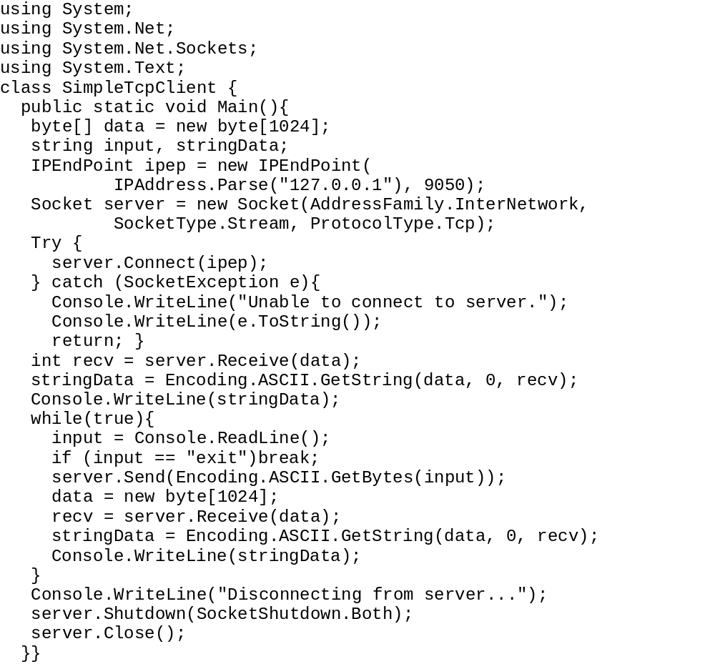
The SimpleTcpClient.cs program

Slide 31
Testing the Client
The first thing to test is the Exception code used for the situation where the server is unavailable. This is an easy thing to do: just don’t start the server program and do run the SimpleTcpClient program. This should produce the warning message you created in the Exception code:
C:\>SimpleTcpClient
Unable to connect to server.
System.Net.Sockets.SocketException: Unknown error (0x274d)
at System.Net.Sockets.Socket.Connect(EndPoint remoteEP)
at SimpleTcpClient.Main()
C:\>
Now that the error test is out of the way, it is time to try connecting to the server. First, start the SimpleTcpSrvr program on the designated server machine. Once it has indicated it is waiting for clients, start the SimpleTcpClient program either in a separate command prompt window on the same machine, or on another machine on the network. When the client establishes the TCP connection, it should display the greeting banner from the server. At this point, it is ready to accept data from the console, so you can start entering data.

Slide 32
Problems with TCP Messages
One of the biggest pitfalls for novice network programmers is using message-oriented communications with TCP connections. The most important point to remember about using TCP for network communications is that TCP does not respect message boundaries. This section demonstrates this behavior using a badly written TCP program and some ways to fix it.
The typical novice network programmer, having just read about the wonderful benefits of TCP programming, proceeds to create a client/server application that passes messages back and forth between two devices on the network using TCP sockets. However, not realizing the inherent disregard of message boundaries suffered by stream protocols such as TCP, the programmer writes a series of Send() methods on the client, along with a corresponding series of Receive() methods on the server.

Slide 33
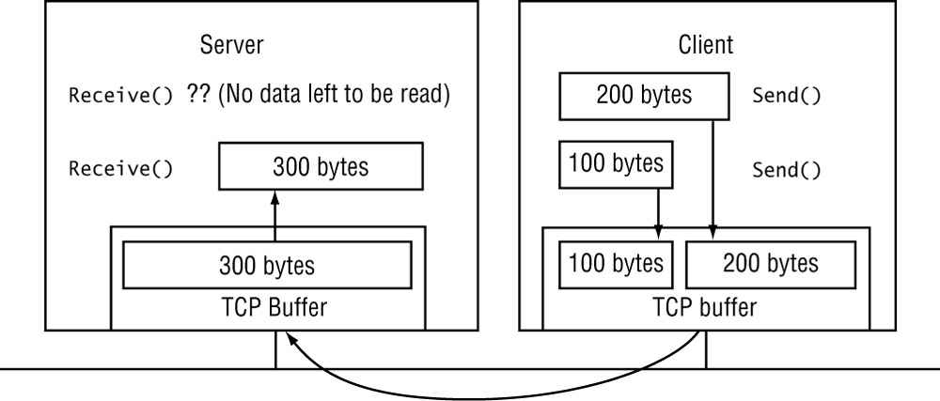
The critical drawback to using this way to communicate is that you are not guaranteed that the data from each individual Send() method will be read by each individual Receive() method.

Slide 34
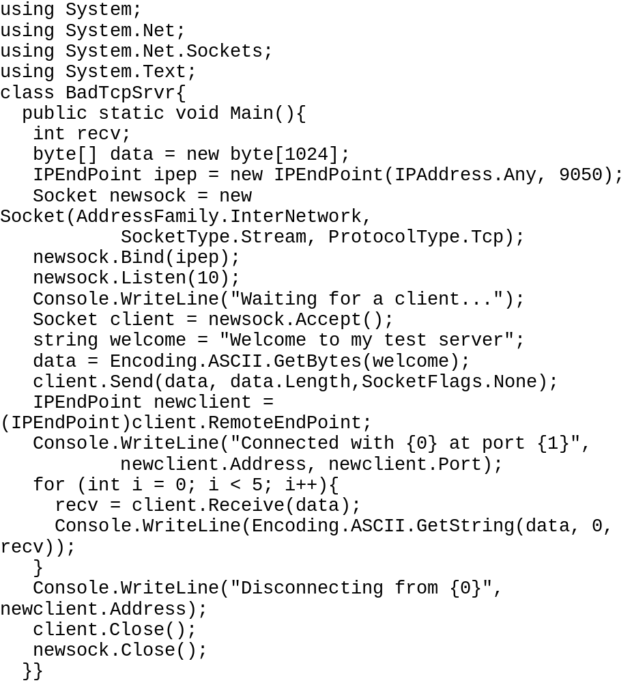
The BadTcpSrvr.cs program

Slide 35
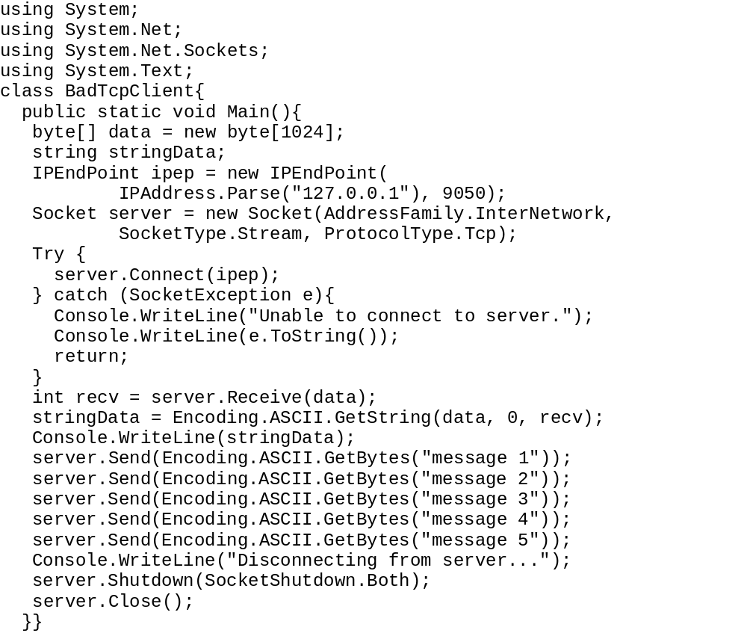
The BadTcpClient.cs program

Slide 36
Try running these programs multiple times from various clients and servers on the network. The results you will see are unpredictable. It is possible that each Receive() call on the server will read a single message sent by the Send() call on the client, which is what might be expected. But this behavior is not guaranteed. I tried it a few times, with different results. It appears that when the client and server are on the same system, the expected result usually occurs. However, when using the client on a system other than the server’s (as you would assume in a normal network program environment), some very interesting things happen.
Here are two representative results from the server output:
C:\>BadTcpSrvr
Waiting for a client...
Connected with 192.168.1.6 at port 2345
message 1message 2
message 3message 4
message 5
Disconnecting from 192.168.1.6
C:\>BadTcpSrvr
Waiting for a client...
Connected with 192.168.1.6 at port 1065
message 1
message 2message 3message
4message 5
Disconnecting from 192.168.1.6
C:\>

Slide 37
In the first try, the first server Receive() call picks up the complete messages from the first two client Send() calls. Then, the second server Receive() call gets the next two client Send() calls. Finally, the third server Receive() call grabs the data from the last client Send() call. Once the client disconnects, the remaining server Receive() calls return with no data, and the server properly closes the connection.
The second try is even more interesting. The first server Receive() call picks up a complete message from the first client Send() call—so far, so good. Then, the second server Receive() picks up the next two client Send() calls, plus part of the fourth client Send() call. This is a classic example of a message being split between Receive() calls. Finally, the third server Receive() call gets the rest of the data from the fourth client Send() call, plus the data from the last Send() call. What a mess!
There are two lessons that can be learned from this example:
  Never test your network programs only on a local client and server and expect those programs to work the same way on a network.
  Never assume that TCP will send message data in the same way you are employing in your program.

Slide 38
Solving the TCP Message Problem
To solve the unprotected boundary problems of our bad server and bad client programs, you must devise some technique to distinguish between separate messages on the remote system. There are three common ways to distinguish messages sent via TCP:
  Always send fixed-sized messages
  Send the message size with each message
  Use a marker system to separate messages
Each of these techniques offers a way for the remote system to separate out individual messages as they are received across the network. These techniques also have their own set of pros and cons. This section takes you through these techniques and their idiosyncrasies when they’re employed in C# network programs.

Slide 39
Using Fixed-Sized Messages
The easiest but most costly way to solve the TCP message problem is to create a protocol that always transmits messages of a fixed size. By setting all messages to the same size, the receiving TCP program can know without doubt when an entire message has been received from the remote device.
Another advantage to using fixed-size messages is that when multiple messages are received, they can be clearly separated based on the number of bytes in the message. This way, messages received together can be separated with some accuracy. The following sections describe how to implement fixed-size messages for the Send() and Receive() methods.

Slide 40
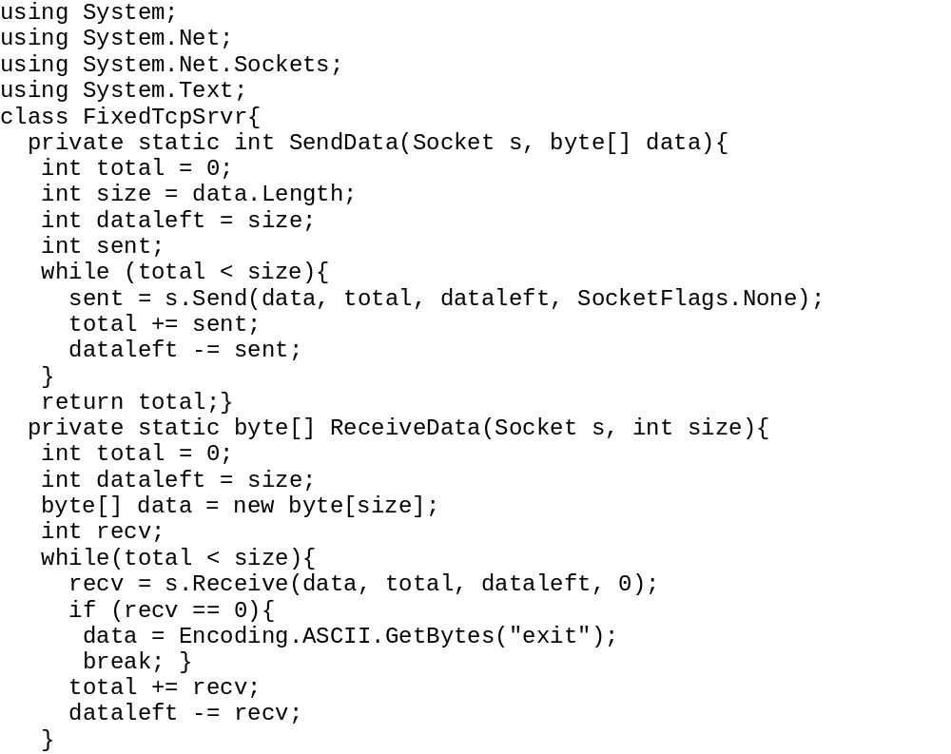
1

Slide 41
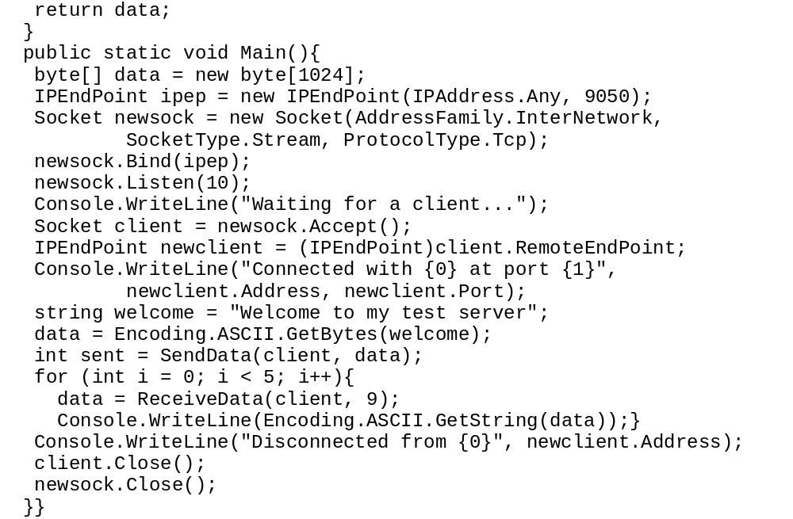
2

Slide 42
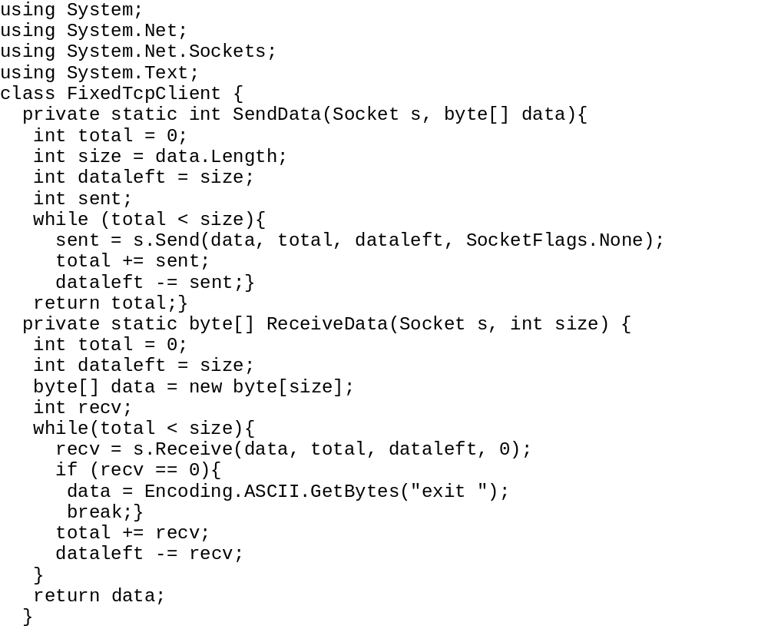
The FixedTcpClient.cs program

Slide 43
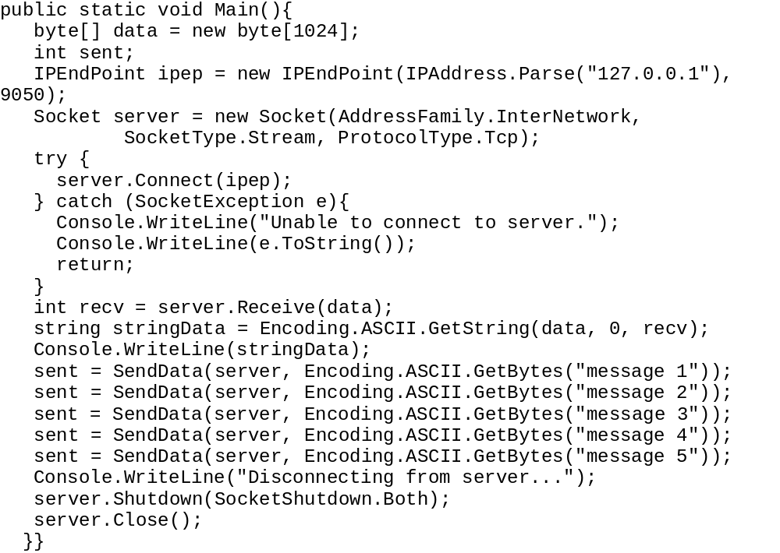
1

Slide 44
Sending Variable-Length Messages
The SendVarData() method is a modified version of the SendData() method presented earlier. In SendVarData(), you find the size of the outbound message and add it to the beginning of the message as a 4-byte integer value. By using a set 4-byte value, any size message (up to 65KB) can be accommodated using the same coding scheme. The new method should look like this:
private static int SendVarData(Socket s, byte[] data) {
int total = 0; int size = data.Length;
int dataleft = size; int sent;
byte[] datasize = new byte[4];
datasize = BitConverter.GetBytes(size);
sent = s.Send(datasize);
while (total < size)
{
sent = s.Send(data, total, dataleft, SocketFlags.None);
total += sent;
dataleft -= sent;
}
return total;}
The SendVarData() method first converts the integer value of the data size to 4 bytes in a byte array, using the BitConverter class available in the System namespace. The GetBytes() method converts the 32-bit integer value to the 4-byte array. The array is then sent to the remote system. After sending the message size, the method then attempts to send the message itself using the standard technique of looping until it knows that all of the bytes have been sent.

Slide 45
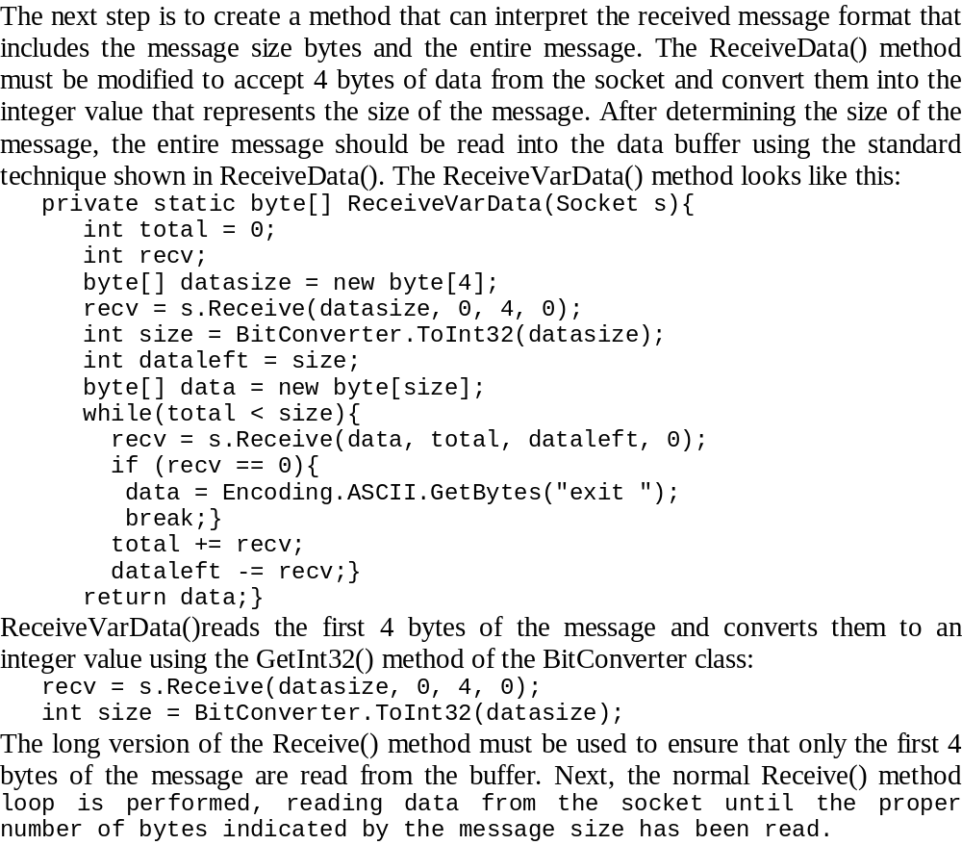
Receiving Variable-Length Messages

Slide 46
Using Message Markers
Still another way to improve control when sending TCP messages is a message marker system. This system separates each message by a predetermined character (or characters) to specify the end of the message. As messages are received from the socket, the data is checked character-by-character for the occurrence of the marker character(s). When a marker is detected, the preceding data is known to contain a complete message and is passed to the application as a message. The data following the marker is tagged as the start of a new message.
One of the drawbacks to using message markers is that each character received in the data stream must be checked to determine if it is the marker. For large messages, this could greatly slow down performance of the system. Also, it means that some character must be designated as a marker, and that character has to be restricted from the normal data (or things get really complicated).
Instead of creating your own message marker system, The C# language provides some classes that can be used to simplify the process. The next section describes how to use the System.IO namespace stream classes to easily read and write text messages in a TCP connection.

Slide 47
Using C# Streams with TCP
C# uses streams to help programmers move data in large chunks. The System.Net.Sockets namespace contains the NetworkStream class, which provides a stream interface to sockets.
There are several constructors that can be used to create a NetworkStream object. The easiest (and most popular) way to create the NetworkStream object is to simply use the Socket object:
Socket newsock = new Socket(AddressFamily.InterNetwork, SocketType.Stream, ProtocolType.Tcp);
NetworkStream ns = new NetworkStream(newsock);
This creates a new NetworkStream object that can then be referenced instead of the Socket object.
After the NetworkStream object has been created, there are several properties and methods for augmenting the functionality of the Socket object.

Slide 48
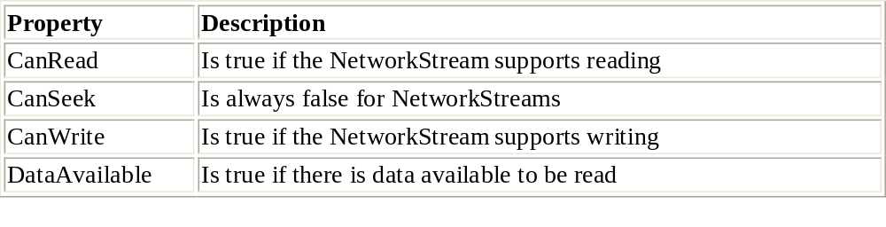
NetworkStream Class Properties

Slide 49
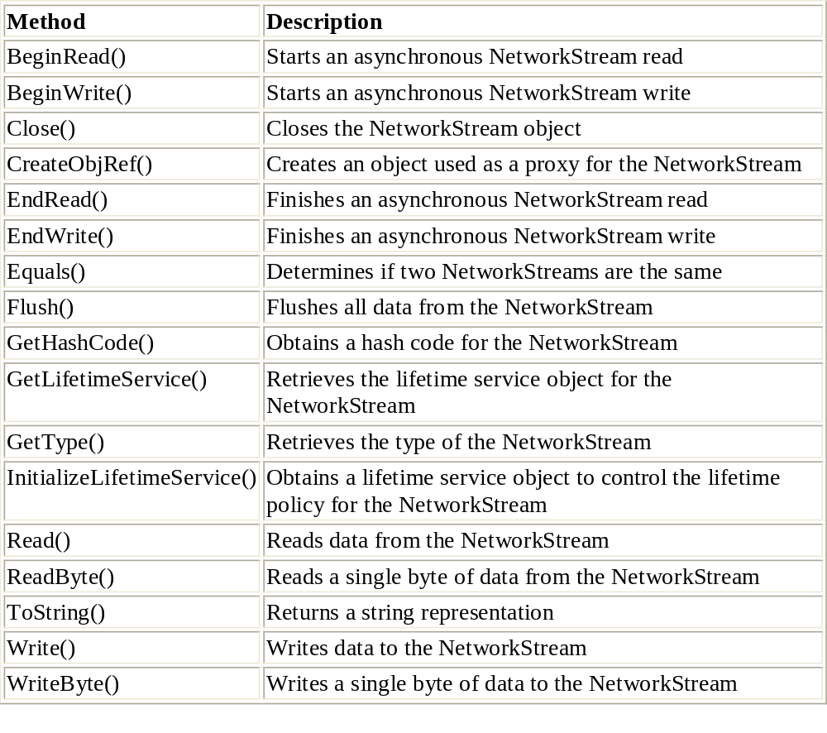
NetworkStream Class Methods

Slide 50
Use the Read() method to read blocks of data from the NetworkStream. Its format is as follows, where buffer is a byte array buffer to hold the read data, offset is the buffer location at which to start placing the data, and size is the number of bytes to be read.
int Read(byte[] buffer, int offset, int size)
The Read() method returns an integer value representing the number of bytes actually read from the NetworkStream and placed in the buffer.
Similarly, the Write() method format is as follows, where buffer is the buffer from which to get the data to send, offset is the buffer location at which to start getting data, and size is the number of bytes to send:
void Write(byte[] buffer, int offset, int size)

Slide 51
The NetworkStreamTcpClient.cs progam
using System;
using System.Net;
using System.Net.Sockets;
using System.Text;
class NetworkStreamTcpClient {
public static void Main() {
byte[] data = new byte[1024];
string input, stringData;
int recv;
IPEndPoint ipep = new IPEndPoint(
IPAddress.Parse("127.0.0.1"), 9050);
Socket server = new Socket(AddressFamily.InterNetwork,SocketType.Stream, ProtocolType.Tcp);
try { server.Connect(ipep); }
catch (SocketException e){
Console.WriteLine("Unable to connect to server.");
Console.WriteLine(e.ToString());
return; }
NetworkStream ns = new NetworkStream(server);
if (ns.CanRead) {
recv = ns.Read(data, 0, data.Length);
stringData = Encoding.ASCII.GetString(data, 0, recv);
Console.WriteLine(stringData);
}
else {
Console.WriteLine("Error: Can't read from this socket");
ns.Close();
server.Close();
return; }

Slide 52
cont
while(true){
input = Console.ReadLine();
if (input == "exit")
break;
if (ns.CanWrite)
{
ns.Write(Encoding.ASCII.GetBytes(input), 0, input.Length);
ns.Flush();
}
recv = ns.Read(data, 0, data.Length);
stringData = Encoding.ASCII.GetString(data, 0, recv);
Console.WriteLine(stringData);
}
Console.WriteLine("Disconnecting from server...");
ns.Close();
server.Shutdown(SocketShutdown.Both);
server.Close();
}
}

Slide 53
This program creates a NetworkStream object from the Socket object:
NetworkStream ns = new NetworkStream(server);
Once the NetworkStream object has been created, the Socket object is never again referenced until it is closed at the end of the program. All communication with the remote server is done through the NetworkStream object:
recv = ns.Read(data, 0, data.Length);
ns.Write(Encoding.ASCII.GetBytes(input), 0, input.Length);
ns.Flush();
The Flush() method is used after every Write() method to ensure that the data placed in the NetworkStream will immediately be sent to the remote system rather than waiting in the TCP buffer area for more data before being sent.
Since the NetworkStreamTcpClient program sends and receives the same data packets, you can test it with the original SimpleTcpSrvr program presented before. It should behave the same way as the SimpleTcpClient program, sending a message to the server and receiving the echoed message back.
Although the NetworkStream object has some additional functionality over the Socket object, it is still limited in how it sends and receives data from the socket. The same unprotected message boundary problems exist, as when using the plain Socket object to send and receive messages. The next section describes two classes that can help you have more control of the data on the socket.

Slide 54
The StreamReader and StreamWriter Classes
The System.IO namespace contains the StreamReader and StreamWriter classes that control the reading and writing of text messages on a stream. Both of these classes can be deployed with a NetworkStream object to help define markers for TCP messages.
The StreamReader class has lots of constructor formats for many applications. The simplest format to use with NetworkStreams is as follows:
public StreamReader(Stream stream)
The stream variable can reference any type of Stream object, including a NetworkStream object. You have a generous selection of properties and methods available for use with the StreamReader object after it is created.

Slide 55
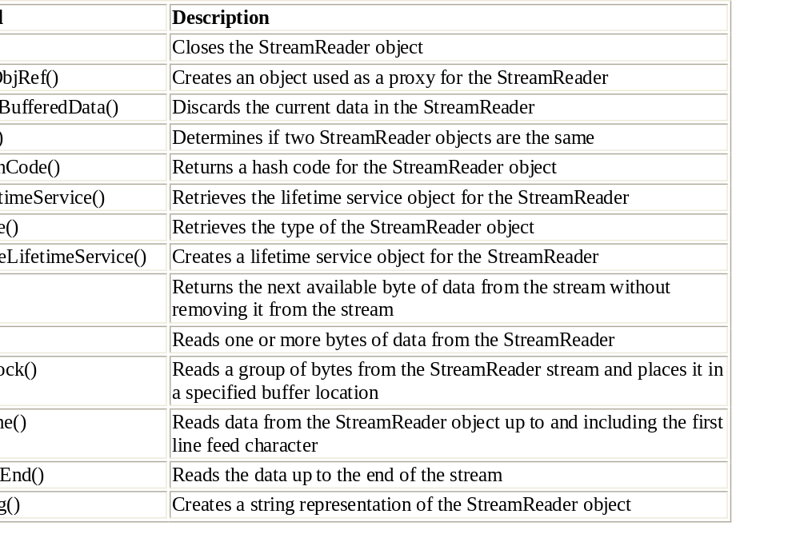
StreamReader Class Methods

Slide 56
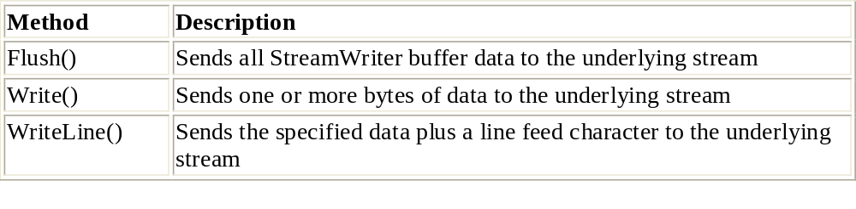
Similar to StreamReader, the StreamWriter object can be created from a NetworkStream object:
public StreamWriter(Stream stream)
StreamWriter, too, has several associated properties and methods. And, as expected, most of the common methods of the StreamReader class are also found in the StreamWriter class.
The programs presented in the next slides show you how to use the StreamReader and StreamWriter classes to modify the TCP server and client programs presented earlier to use text messages.

Slide 57
The StreamTcpSrvr.cs program -1
The StreamTcpSrvr program uses the StreamWriter WriteLine() method to send text messages terminated with a line feed. As is true for the NetworkStream object, it is best to use the Flush() method after each WriteLine() call to ensure that all of the data is sent from the TCP buffer.
You may have noticed one major difference between this program and the original SimpleTcpSrvr program: the way StreamTcpSrvr knows when the remote connection is disconnected. Because the ReadLine() method works on the stream and not the socket, it cannot return a 0 when the remote connection has disconnected. Instead, if the underlying socket disappears, the ReadLine() method will produce an Exception. It is up to you to catch the Exception produced when the socket has been disconnected:
try
{
data = sr.ReadLine();
} catch (IOException)
{
break;
}

Slide 58
The StreamTcpSrvr.cs program-2
using System;
using System.IO;
using System.Net;
using System.Net.Sockets;
using System.Text;
class StreamTcpSrvr {
public static void Main(){
string data;
IPEndPoint ipep = new IPEndPoint(IPAddress.Any, 9050);
Socket newsock = new Socket(AddressFamily.InterNetwork,
SocketType.Stream, ProtocolType.Tcp);
newsock.Bind(ipep); newsock.Listen(10);
Console.WriteLine("Waiting for a client...");
Socket client = newsock.Accept();
IPEndPoint newclient = (IPEndPoint)client.RemoteEndPoint;
Console.WriteLine("Connected with {0} at port {1}",
newclient.Address, newclient.Port);
NetworkStream ns = new NetworkStream(client);
StreamReader sr = new StreamReader(ns);
StreamWriter sw = new StreamWriter(ns);
string welcome = "Welcome to my test server";
sw.WriteLine(welcome);
sw.Flush();

Slide 59
The StreamTcpSrvr.cs program-3
while(true){
try {
data = sr.ReadLine();
} catch (IOException){
break;}
Console.WriteLine(data);
sw.WriteLine(data);
sw.Flush();}
Console.WriteLine("Disconnected from {0}", newclient.Address);
sw.Close();sr.Close();ns.Close();
}}

Slide 60
Stream Client-1
Now that you have a server that accepts messages delimited by a line feed, you need a client that can send messages in that format.
This version of the client program performs the same functions as the SimpleTcpClient program, but it sends messages terminated with a line feed. There is one important difference for you to observe. If you try using the StreamTcpClient program with the original
SimpleTcpSrvr program, it won’t work. That’s because the greeting banner produced by the SimpleTcpSrvr program does not include a line feed at the end of the text. Without the line feed, the ReadLine() method in the client program does not complete, and blocks the program execution, waiting for the line feed to appear. Remember this behavior whenever you use the ReadLine() stream method.
Warning Another point to remember when using the ReadLine() method is to ensure that the data itself does not contain a line feed character. This will create a false marker for the ReadLine() method and affect the way the data is read.

Slide 61
Stream Client-2
using System;
using System.IO;
using System.Net;
using System.Net.Sockets;
using System.Text;
class StreamTcpClient {
public static void Main() {
string data;
string input;
IPEndPoint ipep = new IPEndPoint(
IPAddress.Parse("127.0.0.1"), 9050);
Socket server = new Socket(AddressFamily.InterNetwork,
SocketType.Stream, ProtocolType.Tcp);
try
{
server.Connect(ipep);
} catch (SocketException e)
{
Console.WriteLine("Unable to connect to server.");
Console.WriteLine(e.ToString());
return;}
NetworkStream ns = new NetworkStream(server);
StreamReader sr = new StreamReader(ns);
StreamWriter sw = new StreamWriter(ns);

Slide 62
Stream Client-3
data = sr.ReadLine();
Console.WriteLine(data);
while(true)
{
input = Console.ReadLine();
if (input == "exit")
break;
sw.WriteLine(input);
sw.Flush();
data = sr.ReadLine();
Console.WriteLine(data);
}
Console.WriteLine("Disconnecting from server...");
sr.Close();
sw.Close();
ns.Close();
server.Shutdown(SocketShutdown.Both);
server.Close();
}
}

Slide 63
C# Socket Helper Classes-1
The .NET Framework supports the normal socket interface for advanced network programmers, but it also provides a simplified interface for easier network programming. The simplified socket helper classes help network programmers create socket programs with simpler statements and less coding—two important benefits for any programmer.
Here are the three helper classes used for socket programming:
  TcpClient
  TcpListener
  UdpClient
Each one is designed to support a specific socket programming function and to simplify the interfaces required to program for that function.
Obviously, the TcpClient and TcpListener classes are used for creating TCP client and server programs; the UdpClient class is used for creating UDP programs.

Slide 64
2
The TcpClient class, located in the System.Net.Sockets namespace, was designed to facilitate the writing of TCP client applications by bypassing the need to use the Socket class TCP functions.
The methods of the TcpClient class are used to create client network programs that follow the connection-oriented network model. The TcpClient methods mirror those in normal socket programming, but many of the steps are compacted to simplify the programming task.
For starters, there are three ways to create a TcpClient object and connect it to a remote host, and each technique makes creating a socket easier than using the manual Socket class methods.

Slide 65
The TcpClient Class Constructors-1
TcpClient() The first constructor format creates a new TcpClient object, binding a socket to the local system address and a random TCP port. After the default TcpClient object is created, it must be connected to a remote device using the Connect() method. Here is the format for this constructor:
TcpClient newcon = new TcpClient(); newcon.Connect("www.ispnet.net", 8000);
TcpClient(IPEndPoint localEP) The second constructor allows you to specify a specific local IP address to use, as well as a specific TCP port number. This is most often used when the device has more than one network card, and you want to specifically send packets out a particular card. Again, after the TcpClient object is created, it must be connected to a remote device using the Connect() method. Here’s the format:
IPAddress ia = Dns.GetHostByName(Dns.GetHostName()).AddressList[0];
IPEndPoint iep = new IPEndPoint(ia, 10232);
TcpClient newclient2 = new TcpClient(iep);
newclient2.Connect("www.isp.net", 8000);

Slide 66
The TcpClient Class Constructors-2
TcpClient(String host, int port) The third constructor format is the most frequently used. It allows you to specify the remote device within the constructor, and no Connect() method is needed. The remote device can be specified by its address and numeric TCP port value. The address can be either a string hostname, or a string IP address. The TcpClient constructor will automatically resolve the string hostname into the proper IP address. The format is as follows:
TcpClient newcon = new TcpClient("www.isp.net", 8000);
Once the TcpClient object has been created, several properties and methods are available with which to manipulate the object and transfer data back and forth with the remote device.

Slide 67
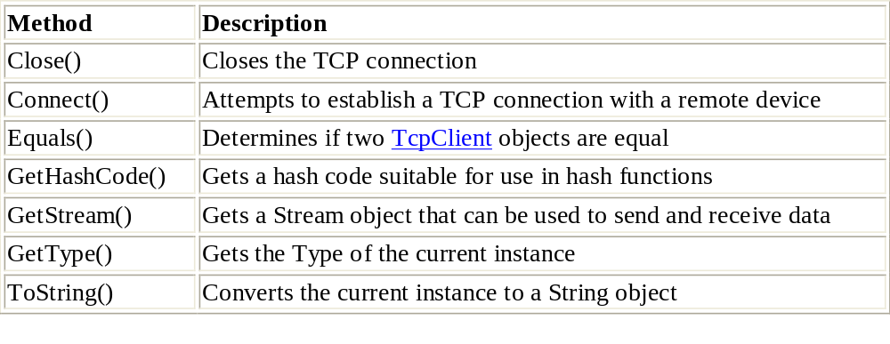
The TcpClient Class Methods
The TcpClient class contains a helpful collection of properties and methods to assist your efforts in writing TCP client applications.

Slide 68
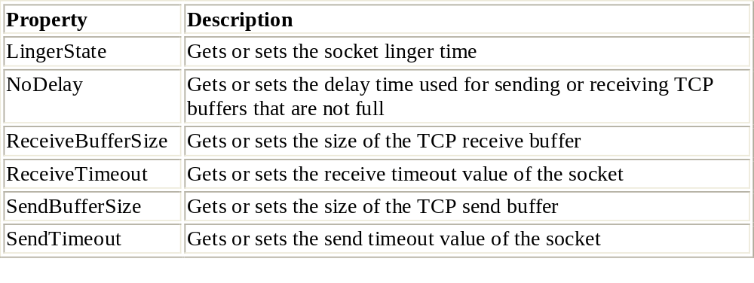
TcpClient Object Properties
In addition to the TcpClient class methods, there are several properties that can be used with the TcpClient object.

Slide 69
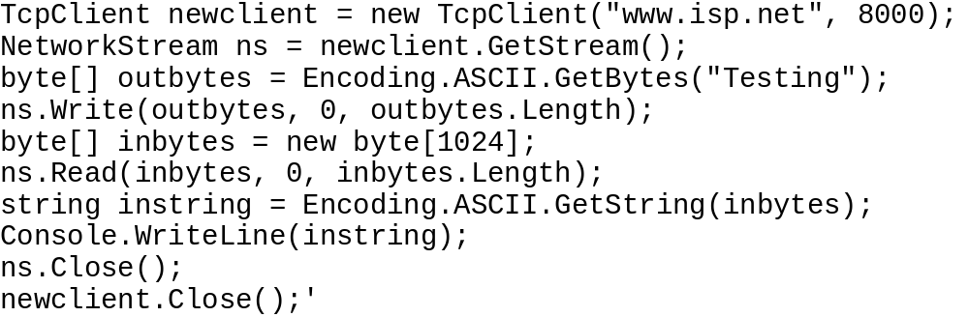
Once a TcpClient instance is created, you will probably want to send and receive data with it. The GetStream() method is used to create a NetworkStream object that allows you to send and receive bytes on the socket. Once you have a NetworkStream instance for the socket, it is a snap to use the standard stream Read() and Write() methods to move data into and out of the socket. This code fragment demonstrates assigning a NetworkStream object to the TcpClient instance and writing data to and reading it from the socket:

Slide 70
TcpClientSample.cs program
Because the version of the TcpClient constructor used in this example automatically tries to connect to the specified remote server, it is a good idea to place it within a try-catch block in case the remote server is unavailable. As is true for the Socket method Connect() method, if the remote server is unavailable, a SocketException will be generated.
After the NetworkStream object is created, you use the normal Read() and Write() methods to move the data:
while(true) {
input = Console.ReadLine();
if (input == "exit")
break;
ns.Write(Encoding.ASCII.GetBytes(input), 0, input.Length);
ns.Flush();
data = new byte[1024];
recv = ns.Read(data, 0, data.Length);
stringData = Encoding.ASCII.GetString(data, 0, recv);
Console.WriteLine(stringData);
}

Slide 71
TcpClientSample.cs program
The Read() method requires three parameters:
  The data-byte array in which to place the received data
  The offset location in the buffer at which you want to start placing the data
  The length of the data buffer
  Like the Socket method Receive(), the object’s Read() method will read as much data as it can fit into its buffer. If the supplied buffer is too small, the leftover data stays in the stream for the next Read() method call.
The Write() method, too, requires three parameters:
  The data-byte array to send to the stream
  The offset location in the buffer from which you want to start sending data
  The length of the data to send
  Note It is important to remember that TCP does not preserve message boundaries. This fact also applies to the TcpClient class. By now you’ll recognize that this method should be handled the same way as the Receive() method in the TCP Socket class, creating a loop to ensure that all of the required data is read from the stream.

Slide 72
TcpClientSample.cs program
using System;
using System.Net;
using System.Net.Sockets;
using System.Text;
class TcpClientSample {
public static void Main(){
byte[] data = new byte[1024];
string input, stringData;
TcpClient server;
Try {
server = new TcpClient("127.0.0.1", 9050);
} catch (SocketException){
Console.WriteLine("Unable to connect to server");
return;
}
NetworkStream ns = server.GetStream();
int recv = ns.Read(data, 0, data.Length);
stringData = Encoding.ASCII.GetString(data, 0, recv);
Console.WriteLine(stringData);
while(true){
input = Console.ReadLine();
if (input == "exit")
break;
ns.Write(Encoding.ASCII.GetBytes(input), 0, input.Length);
ns.Flush();
data = new byte[1024];
recv = ns.Read(data, 0, data.Length);
stringData = Encoding.ASCII.GetString(data, 0, recv);
Console.WriteLine(stringData);}
Console.WriteLine("Disconnecting from server...");
ns.Close();server.Close();}}

Slide 73
The TcpListener Class
Like TcpClient, the TcpListener class (also located in the System.Net.Sockets namespace) provides a simplified way to create TCP server applications.
Just as the TcpClient class simplifies client socket programs, the TcpListener class simplifies server programs; their class constructors are similar as well. Here are the three constructor formats:
TcpListener(int port) binds to a specific local port number
TcpListener(IPEndPoint ie) binds to a specific local EndPoint
TcpListener(IPAddress addr, int port) binds to a specific local IPAddress and port number
These three formats allow you to control how the underlying socket is created for the TcpListener object. Once the object is created, you can begin listening for new connection attempts using the Start() method.

Slide 74
1
Unlike TcpClient, the TcpListener class constructor requires at least one parameter: the port number on which to listen for new connections. If the server machine has multiple network cards and you want to listen on a specific one, you can use an IPEndPoint object to specify the IP address of the desired card, along with the desired TCP port number to listen on. The constructor described last in the list just above allows you to specify the desired IP address using an IPAddress object, with the port number as a separate parameter.

Slide 75
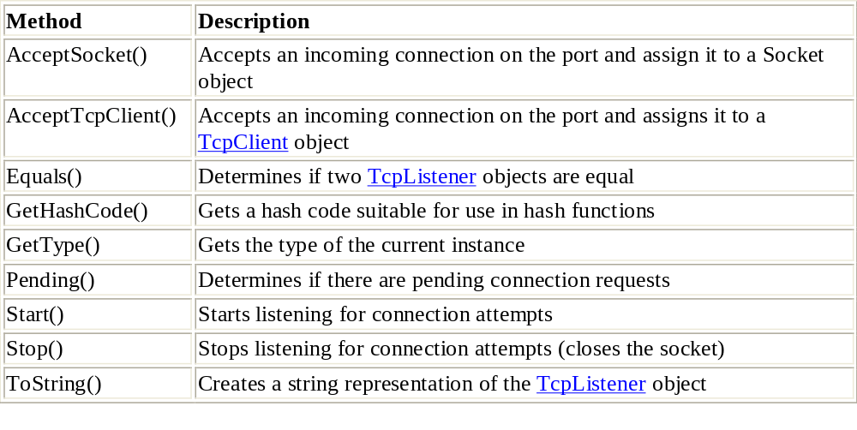
The TcpListener Class Methods
The TcpListener class methods are used to perform the necessary functions on the created TcpListener object.

Slide 76
1
The procedure to create a TcpListener object and listen for incoming connections goes like this:
TcpListener server = new TcpListener(IPAddress.Parse("127.0.0.1"), 9050);
server.Start();
TcpClient newclient = server.AcceptTcpClient();
The Start() method is similar to the combination of Bind() and Listen() used in the Socket class. Start() binds the socket to the endpoint defined in the TcpListener constructor and places the TCP port in listen mode, ready to accept new connections. The AcceptTcpClient() method is comparable to the Accept() socket method, accepting incoming connection attempts and assigning them to a TcpClient object.
After the TcpClient object is created, all communication with the remote device is performed with the new TcpClient object rather than the original TcpListener object. The TcpListener object can thus be used to accept other connections and pass them to other TcpClient objects. To close the TcpListener object, you must use the Stop() method:
server.Stop();

Slide 77
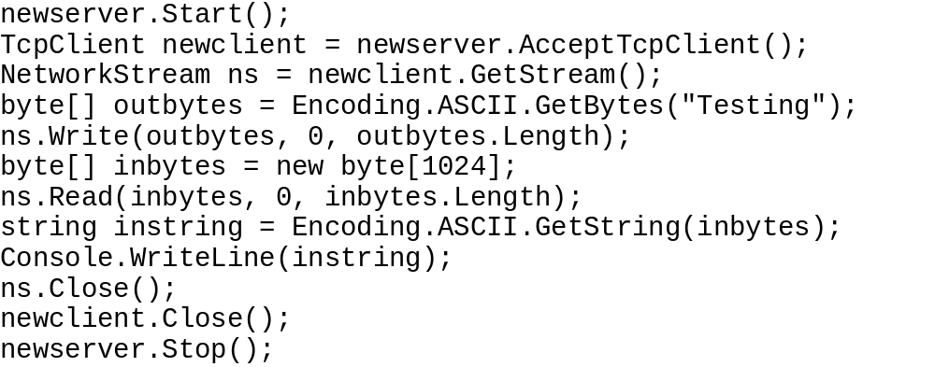
2
Once the new TcpClient object is created for the connection, you can employ the standard TcpClient methods to begin communicating with the client. A sample code fragment would look like this:
This program will block at the AcceptTcpClient() method, waiting for a new client connection. Once connected, the GetStream() method is used to create a NetworkStream object for reading and writing data to the connected socket.
Remember to close the NetworkStream as well as the TcpClient object when they are finished. You must use the Stop() method to close the TcpListener.

Slide 78
A Simple Server Program
The TcpListenerSample program first creates a TcpListener object, using a UDP port of 9050, and the Start() method places the new object in a listening mode. Then the AcceptTcpClient() method waits for an incoming TCP connection and requests and assigns it to a TcpClient object:
TcpListener newsock = new TcpListener(9050);
newsock.Start();
TcpClient client = newsock.AcceptTcpClient();
NetworkStream ns = client.GetStream();
With the TcpClient object established, a NetworkStream object is assigned to it to communicate with the remote client. All communication is done using the NetworkStream object’s Read() and Write() methods. Remember to place all data into a byte array for the Write() method. Likewise, all received data from the Read() method must also be assigned to a byte array.

Slide 79
A Simple Server Program
using System;
using System.Net;
using System.Net.Sockets;
using System.Text;
class TcpListenerSample {
public static void Main() {
int recv;
byte[] data = new byte[1024];
TcpListener newsock = new TcpListener(9050);
newsock.Start();
Console.WriteLine("Waiting for a client...");
TcpClient client = newsock.AcceptTcpClient();
NetworkStream ns = client.GetStream();
string welcome = "Welcome to my test server";
data = Encoding.ASCII.GetBytes(welcome);
ns.Write(data, 0, data.Length);
while(true) {
data = new byte[1024];
recv = ns.Read(data, 0, data.Length);
if (recv == 0)
break;
Console.WriteLine(Encoding.ASCII.GetString(data, 0, recv));
ns.Write(data, 0, recv);
}
ns.Close();
client.Close();
newsock.Stop();
}}

Slide 80
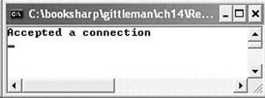
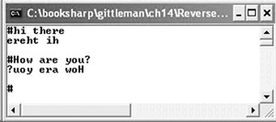
Example
If we write our own server we can use our own protocol for communicating with a client.
Write a complete application (server and client) using the C# Sockets Helper Classes. In this simple application the server reverses the text that the client sends to it.

Slide 81
code
// Listens on port 5678. When a client connects, the server reverses whatever the client sends, and sends it back.
using System;
using System.IO;
using System.Text;
using System.Net.Sockets;
public class ReverseServer {
public static void Main() {
TcpListener server = new TcpListener(5678); // Note 1
server.Start(); // Note 2
TcpClient client = server.AcceptTcpClient(); // Note 3
Console.WriteLine("Accepted a connection");
try{
NetworkStream stream = client.GetStream();
while(true) {
byte[] receive = new byte[80]; // Note 4
int count = stream.Read(receive, 0, 80);
if (count == 0)
break; // Note 5
String s = Encoding.ASCII.GetString(receive);
char[] unused = {(char)s[count]};
int size = s.TrimEnd(unused).Length;
char[] c = new char[size]; // Note 6
for (int i = 0; i < size; i++)
c[i] = s[size-1-i]; // Note 7
byte[] send = Encoding.ASCII.GetBytes(c); // Note 8
stream.Write(send, 0, send.Length);
}
}catch(Exception e) { // Note 9
Console.WriteLine(e);
}finally { //Note 10
client.Close();server.Stop(); //Note 11}}}

Slide 82
Notes
TcpListener server = new TcpListener(5678);
  The TcpListener class builds on the Socket to provide TCP services at a higher level of abstraction. We create a server to listen for connections on port 5678.
server.Start();
  Start initializes the underlying socket. It listens for network requests.
TcpClient client = server.AcceptTcpClient();
  The AcceptTcpClient method blocks any further progress in the program until a client connects; it then returns the TcpClient.
byte[] receive = new byte[80];
  We read one line to reverse, so we make the array size 80.
if (count == 0) break;
  If we do not read any bytes from the client, we break and terminate the server. Normally a server would remain in a loop and return to the AcceptTcpClient statement to wait for another client to connect.

Slide 83
Notes
char[] c = new char[size];
  We cannot change a String object, so we create an array of characters to hold the reverse of the line the client inputs.
for (int i = 0; i < size; i++) c[i] = s[size-1-i];
  We reverse the String by copying it from its end, starting at the beginning of the char array.
byte[] send = Encoding.ASCII.GetBytes(c);
  We convert the char array containing the reversed characters to bytes to send to the client.
}catch(Exception e) {
  We handle any exceptions that may be thrown. We just display a message in this example.
}finally {
  The system will execute the code in the finally clause whether or not an exception occurs. Had the Close statement been at the end of the try block an exception might have caused it to be skipped. By putting it here we will be sure to close the file in any case.
server.Stop();
  The Stop method closes the listener.

Slide 84
ReverseClient.cs
We can run the server on the same machine as the client or on a different machine. The server does not terminate until we abort it, so we should run it in the background in its own thread, and we can do other things while it is waiting for clients to connect.
The client connects using the address of the host, which we pass as a program argument. The name localhost denotes the local machine, so the client connects to the server on the same machine with the command:
ReverseClient localhost
Using two machines, we would have started the server on one machine and let the client connect to it using the server's name or its IP address. We usually refer to machines by their names, as, for example, www.cecs.csulb.edu, but underlying each name is a 4-byte IP (Internet Protocol) address, as, for example 134.139.67.68. (The local machine, named localhost, has the IP address 127.0.0.1.)
If we start ReverseServer on machine 134.139.67.68, we would connect to the server from another machine using the command
ReverseClient 134.139.67.68.
The client creates a TcpClient using the port 5678, on which the server is listening. The client enters a loop, printing a prompt, getting a line from the user, sending it to the server, getting the reversed line from the server, displaying it on the screen, and exiting when the user signals the end of input by entering an empty line. Example 14.6 shows the client program that connects to a server that reverses its input.

Slide 85
code
/* Connect to a server that reverses whatever the user inputs. Specifies the host of the
* server on the command line. */
using System;
using System.Text;
using System.IO;
using System.Net.Sockets;
public class ReverseClient {
public static void Main(String[] args) {
TcpClient client = new TcpClient(args[0], 5678); // Note 1
NetworkStream stream = client.GetStream();
try{
while(true) {
Console.Write("#");
String s = Console.ReadLine(); // Note 2
if (s == "")
break; // Note 3
byte[] send = Encoding.ASCII.GetBytes(s);
stream.Write(send, 0, send.Length); // Note 4
byte[] bytes = new byte[80];
stream.Read(bytes, 0, 80);
String data = Encoding.ASCII.GetString(bytes);
Console.WriteLine(data); // Note 5
}
}catch(Exception e) {
Console.WriteLine(e);
}finally {stream.Close();}}}

Slide 86
notes
TcpClient client = new TcpClient(args[0], 5678);
  The client creates a socket connection to the server on port 5678, the port on which the server is listening.
String s = Console.ReadLine();
  We display a prompt and read a line from the keyboard.
if (s == "") break;
  If the user enters an empty line we break the loop, which will terminate the client.
stream.Write(send, 0, send.Length);
  We convert the input string to a byte array which we send to the server.
Console.WriteLine(data);
  We read a byte array from the server, convert it to a String, and display it on the screen. It will be the reverse of the string we sent.

Slide 87
Example
Write an application that can be used to download a page form a web server. TryTcp localhost 80 /12/default.aspx
/* Uses a TcpClient to handle HTTP explicitly.*/
using System;
using System.Text;
using System.IO;
using System.Net.Sockets;
public class TryTcp {
public static void Main(String [] args) {
TcpClient client =
new TcpClient(args[0], int.Parse(args[1])); // Note 1
NetworkStream stream = client.GetStream(); // Note 2
byte[] send = Encoding.ASCII.GetBytes
("GET " + args[2] + " HTTP/1.0 \r\n\r\n"); // Note 3
stream.Write(send, 0, send.Length); // Note 4
byte[] bytes = new byte[client.ReceiveBufferSize]; // Note 5
int count = stream.Read
(bytes, 0, (int)client.ReceiveBufferSize); // Note 6
String data = Encoding.ASCII.GetString(bytes); // Note 7
char[] unused = {(char)data[count]}; // Note 8
Console.WriteLine(data.TrimEnd(unused)); // Note 9
stream.Close();
client.Close();
}}

Slide 88
Output
TryTcp localhost 80 /12/default.aspx
HTTP/1.1 200 OK
Date: Sat, 03 Aug 2002 21:37:39 GMT
Server: Apache/1.3.9 (Unix) PHP/4.0.6 mod_perl/1.21
Last-Modified: Sat, 03 Aug 2002 12:40:05 GMT
ETag: "10f16c-375-3d4bcf25"
Accept-Ranges: bytes
Content-Length: 885
Connection: close
Content-Type: text/plain
Contents of default.aspx

Slide 89
Notes
new TcpClient(args[0], int.Parse(args[1]));
  The first argument to the constructor is the name of the host to which we want to connect. The second argument is the port on which the server is running.
NetworkStream stream = client.GetStream();
  The GetStream method returns a NetworkStream used to send and receive data.
byte[] send = Encoding.ASCII.GetBytes
("GET " + args[2] + " HTTP/1.0 \r\n\r\n");
  The Encoding class in the System.Text namespace represents character encodings. The ASCII property provides encoding for the ASCII (7-bit) character set. The GetBytes method encodes the specified String in a byte array. The String we use represents an HTTP request followed by a blank line. There are no request headers. The special character sequence "\r\n" signals a carriage return and a newline command. The first such sequence gets to the line after the request and the second provides the blank line.
stream.Write(send, 0, send.Length);
  The first argument is the array containing the bytes to send to the server. The second argument is the starting index in the array. The third is the number of bytes to send.
byte[] bytes = new byte[client.ReceiveBufferSize];
  We need to create a byte array to hold the data we read from the server. We use ReceiveBufferSize, the number of bytes we expect to store in the buffer at each read operation.

Slide 90
notes
int count = stream.Read
(bytes, 0, (int)client.ReceiveBufferSize);
  We read from the server into the bytes array. The second argument is the array index at which to start, and the third argument is the number of bytes to read. The return value represents the number of bytes read.
String data = Encoding.ASCII.GetString(bytes);
  The GetString method converts the bytes to a character String according to the ASCII encoding.
char[] unused = {(char)data[count]};
  Because we convert a whole block of data, there may be extra characters at the end that are not part of our requested resource. We use the character just beyond those at indices 0 through count -1, representing the data we read from the server. We make a char array to use when removing extraneous characters from the end of the string.
Console.WriteLine(data.TrimEnd(unused));
  The TrimEnd method returns a String with any characters in the char array passed to it removed from the end of the data String.

Slide 91
Browsers and Web Servers
A browser is an HTTP client, which may use other protocols, and a web server is an HTTP server. In this section we write a very simple browser and a very simple web server, leaving to the exercises many improvements to make them more functional. We conclude with a threaded web server, which can handle multiple clients connected simultaneously.
An HTTP client sends a request to the server followed by request headers and a blank line. It then reads the status line, response headers, and the requested file from the server. A browser typically can handle several types of files, the most important being HTML files that define web pages. The browser has to interpret the HTML tags to guide it in displaying the page. With so many file types to handle, and such intricate processing necessary for web pages, a useful browser is not a small or simple undertaking. Our very simple browser handles only plain text files.

Slide 92
// Connects to a web server to download a text file. Exercises suggest extensions to handle other file types.
using System;
using System.Text;
using System.IO;
using System.Net.Sockets;
public class VerySimpleBrowser {
public static void Main(String [] args) {
TcpClient client =
new TcpClient(args[0], int.Parse(args[1])); // Note 1
NetworkStream stream = client.GetStream();
byte[] send = Encoding.ASCII.GetBytes
("GET " + args[2] + " HTTP/1.0 \r\n");// Note 2
stream.Write(send, 0, send.Length);
send = Encoding.ASCII.GetBytes
("Host: " + args[0] + ':' + args[1] + "\r\n\r\n");// Note 3
stream.Write(send, 0, send.Length);
int size = (int)client.ReceiveBufferSize;
byte[] bytes = new byte[size];
StreamReader reader = new StreamReader(stream); // Note 4
while(reader.ReadLine() != ""); // Note 5
String s;
try{
while((s = reader.ReadLine()) != null) // Note 6
Console.WriteLine(s);
}catch(IOException e) {
}finally {
reader.Close();stream.Close();client.Close();}}}

Slide 93
Notes
new TcpClient(args[0], int.Parse(args[1]));
  The standard HTTP port is 80, but some servers use 8080. We run our simple web server on port 11111. The user should pass the server port number as the second program argument.
byte[] send = Encoding.ASCII.GetBytes
("GET " + args[2] + " HTTP/1.0 \r\n");
  We use the path to the resource, /~artg/TryURL.cs in Figure 14.8, sending the host address and port in a separate Host header. Alternatively, we could have sent the GET command
  GET www.cecs.csulb.edu:80/~artg/TryURL.cs HTTP/1.0
send = Encoding.ASCII.GetBytes
("Host: " + args[0] + ':' + args[1] + "\r\n\r\n");
  We append "\r\n\r\n" to the last header. The first "\r\n" ends the current line, and the second ends a blank line, which signals the end of the request headers.
StreamReader reader = new StreamReader(stream);
  We create a StreamReader from the NetworkStream so we can read the headers line by line.
while(reader.ReadLine() != "");
  We read and ignore the status line and headers sent by the server, looking for the blank line that signals the end of the headers and the start of the file we requested. We leave it to the exercises to improve the browser to make use of this information.
while((s = reader.ReadLine()) != null)
Console.WriteLine(s);
  This loop reads the file we requested from the server, displaying it in the command window. Extending this very simple browser to display HTML would use graphics extensively.

Slide 94
A Very Simple Web Server
An HTTP server reads the request from the client, any headers, and in some cases additional data. It sends a status line followed by headers and the requested resource, if any. Web servers often transmit data from the client to other programs for processing before returning results to the client. Our very simple web server responds only to GET requests and serves only text files. We leave it to the exercises to add features to make this server more functional.
To start VerySimpleWebServer we use the command :
start VerySimpleWebServer 11111
  which, on Windows systems, starts the server in a new window

Slide 95
code
/* Serves a text file to an HTTP client submitting a GET request. Exercises suggest extensions to make the server more functional. */
using System;
using System.IO;
using System.Text;
using System.Net.Sockets;
public class VerySimpleWebServer {
public static void Main(String[] args) {
TcpListener server = new TcpListener(int.Parse(args[0]));
server.Start();
TcpClient client = server.AcceptTcpClient();
NetworkStream stream = client.GetStream();
StreamReader reader = new StreamReader(stream);
String s = reader.ReadLine(); // Note 1
String[] strings = s.Split(); // Note 2
StreamWriter writer;
if (strings[0] != "GET") { // Note 3
writer = new StreamWriter(stream);
writer.WriteLine
("HTTP/1.0 501 Not Implemented");
writer.WriteLine();
} else {

Slide 96
code
String filename = strings[1]; // Note 4
while(reader.ReadLine() != ""); // Note 5
writer = new StreamWriter(stream); // Note 6
writer.WriteLine("HTTP/1.0 200 OK"); // Note 7
writer.WriteLine("Content-type: text/plain");
writer.WriteLine(); // Note 8
StreamReader file = new StreamReader(filename);
String z = file.ReadToEnd(); // Note 9
writer.WriteLine(z);
writer.Flush();
writer.Close();
file.Close();
}
client.Close();
stream.Close();
reader.Close();
writer.Close();
server.Stop();
}
}

Slide 97
notes
String s = reader.ReadLine();
  We read the first line from the client to find the method and the path to the resource.
String[] strings = s.Split();
  Blanks separate each item of the request. We use the Split method to get the method and identifier parts of the request.
if (strings[0] != "GET") {
  If the request method is anything other than GET, the server sends a status line with a code of 501 to indicate that the method is not implemented.
String filename = strings[1];
  The file name comes after GET, separated by a blank, in the request from the client.
while(reader.ReadLine() != "");
  We read and ignore the request headers from the client, stopping when we reach the blank line that terminates them.
writer = new StreamWriter(stream);
  We create a StreamWriter from the NetworkStream so we can write lines to the client.
writer.WriteLine("HTTP/1.0 200 OK");
  Having created the file to send, the server sends a status line with code 200, meaning OK, and follows with one header describing the content type to help the client to display it.
writer.WriteLine();
  We write the blank line to terminate the response headers.
String z = file.ReadToEnd();
  We read the entire file requested and write it to the client.

Slide 98
The UdpClient Class
The UdpClient class was created to help make UDP network programs simpler for network programmers. This section describes the UdpClient class and its methods and walks you through creating a simple UDP server and client program using the helper class.
For applications that require a connectionless socket, the UdpClient class provides a simple interface to UDP sockets. You may be wondering why there is not a listener version of the UDP helper class. The answer is simple: you don’t need one. Remember, UDP is a connectionless protocol, so there is no such thing as a client or server; there are only UDP sockets either waiting for or sending data. You do not need to bind the UDP socket to a specific address and wait for incoming data.
The UdpClient constructors work like their comparable TcpClient constructors. You can either let the system choose a UDP port for the application, or you can select a specific port in the constructor. If your UDP application must accept data on a specific port, you must define that port in the UdpClient constructor.
Once the UdpClient object is created, you can manipulate the underlying socket and move data using the various methods available.

Slide 99
The UdpClient class has four formats of constructors:
  UdpClient() This format creates a new UdpClient instance not bound to any specific address or port.
  UdpClient(int port) This constructor binds the new UdpClient object to a specific UDP port number.
  UdpClient(IPEndPoint iep) This constructor binds the new UdpClient object to a specific local IP address and port number.
  UdpClient(string host, int port) This format binds the new UdpClient object to any local IP address and port and associates it with a specific remote IP address and port.
The UdpClient constructors work like their comparable TcpClient constructors. You can either let the system choose a UDP port for the application, or you can select a specific port in the constructor. If your UDP application must accept data on a specific port, you must define that port in the UdpClient constructor.
Once the UdpClient object is created, you can manipulate the underlying socket and move data using the various methods available.

Slide 100
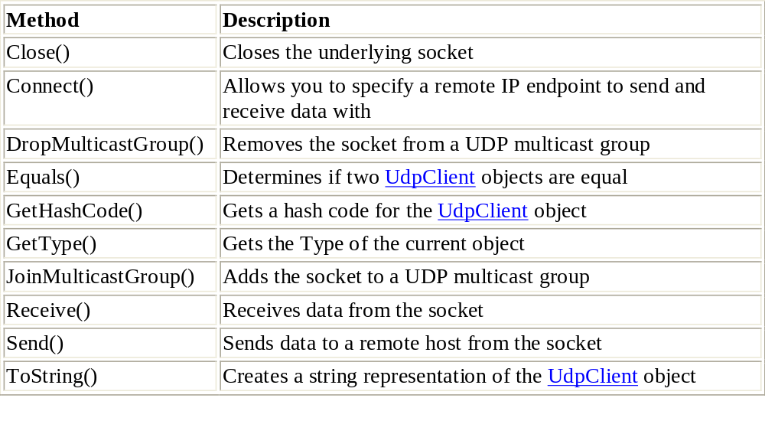
The UdpClient Class Methods
The methods of the UdpClient class provide various functionality for controlling and moving data into and out of the UDP socket.

Slide 101
Writing a Multithreaded Port Scanner in C#
In the 1980's, the hacker's (to be technically correct, I should say "cracker's") favorite tool for scanning a computer network for vulnerable entry points was a tool known as a "war dialer". This piece of software dialed a range of phone numbers, checking to see which ones were answered by a modem. The hacker would then use this information to try and break into the network.
However, with the advent of the Internet and TCP/IP, the primary means of breaking into a network has evolved into finding out which TCP/IP ports are open on a network's server, thus generally indicating what type of software is running on it (such as web servers/FTP servers etc). Known vulnerabilities for this software are tested on the machine, according to which ports are open. Depending on the vulnerability, the attacker can be allowed to read any file on the server, create a buffer overflow (effectively shutting down that service on the machine), be allowed full administrative access, or any variation thereof.
However, before any vulnerability can be exploited, it is essential that the attacker know which ports are open on the server. A port scanner is a piece of software that, given the address of a server, will return which ports are open on the server and which are closed. System administrators today often use port scanners to check their own servers, so that they can see their servers from an attacker's point of view, and lock them down accordingly, namely by closing unneeded ports and continually applying patches to the software running on the open ports.

Slide 102
How does a port scanner work?
This article will cover the simplest method of port scanning, which is commonly known as the connect() method, due to the syntax for opening a TCP/IP connection in C++. Cracking is sometimes compared to breaking into a house, and in line with this metaphor, port scanning is checking which doors (and windows) are open.
The connect() method is the most direct method of approach, and for the purposes of the house-breaking metaphor, is analogous to going up to each door of the house, turning the handle and pushing to see if the door will open. Basically it involves attempting to initiate a full TCP socket connection with all the ports that the scanner has been told to check.
If a "couldn't connect" exception is not raised, then it knows that the port it is checking is open, but if an exception is raised, then it knows that the port is not open. Again I stress that this isn't the only, or necessarily the best way, to perform a port scan, but it is certainly the simplest, and for our purpose of demonstrating multithreaded programming in .NET, certainly quite adequate.

Slide 103
Foundations for the port scanner
To begin with, we'll create a skeleton for our port scanner that implements the bare minimum to scan a range of ports on a specified machine. The program will run as a console application, although it would be a trivial affair to port it to a WinForms application because of the continuity of the .NET programming model.
Firstly, our application must accept three arguments from the command line: machine to scan (either IP address, or domain name); port to start scans from; and port to end scans on. If anything other than three arguments are given, a usage message must be displayed informing the user of the expected arguments.
Secondly, the port number arguments must be converted to integers.
Finally, a loop must then be made, going from the starting port to the end port, with each iteration attempting a connection to the port and writing the result to the console. The code would look something like this:

Slide 104
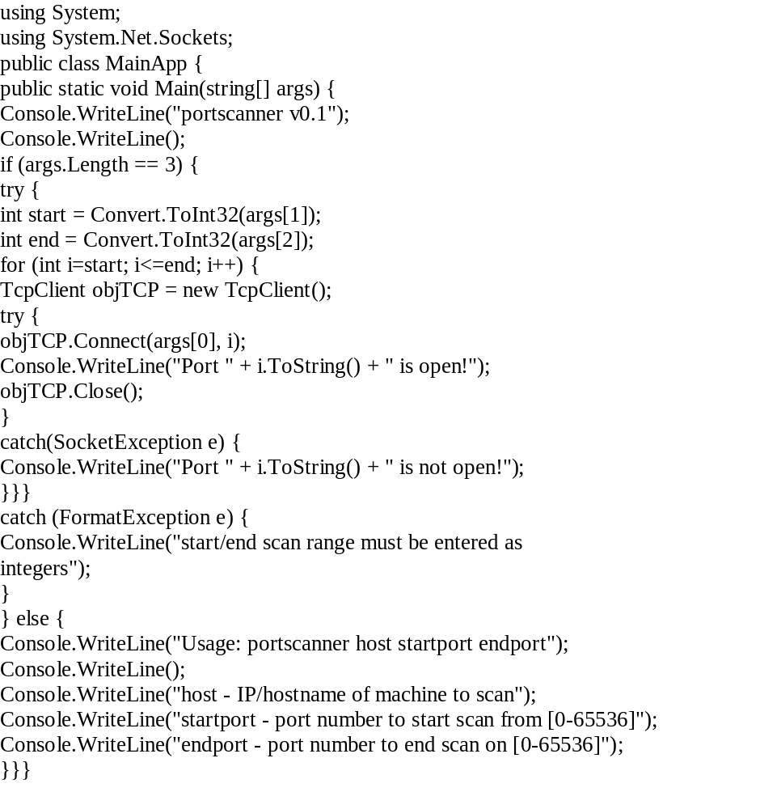

Slide 105
There is a static entry point "Main" for the application that includes an array of strings where the arguments from the command line can be passed. The length of the arguments array is checked to ensure that three arguments are passed, otherwise a usage message is displayed. If the program proceeds past this check, the program attempts to convert the two port arguments to integers. If non-integer values are entered in the command line, a FormatException exception will be raised, and caught by the structured error handling in place, which will then inform the user that they must enter the port scan range as integer values. This is all standard C# code for a skeleton console application that accepts arguments.
The following lines are where the port scanning actually takes place. There is a "for" loop iterating from the indicated starting port to the end port, inclusive. For each iteration of the loop, a TcpClient object is created, and then there is an attempt to open a TCP connection to the host address argument on the port that the loop's counter variable contains. If the connect method fails (because a connection could not be established, and therefore it can be assumed that the port is not open), a SocketException exception is raised. If this happens, then the error handling code of the try..catch block informs the user that the port could not be opened. However, if a connection was established, then the port must have been open. Since we're not actually going to send or receive any data to or from the port, as we only want to know if it opens, we close it immediately, and thereafter inform the user that we were able to successfully open that port.

Slide 106
Testing
To test out the code for yourself, save the above code as portscanner.cs and compile it using the C# command-line compiler, csc.exe . No switches are required. Run the newly formed executable using the following line:
C:\>portscanner 127.0.0.1 20 25
Depending on what machine you're running it on, the results will look similar to the following. If you have a default IIS installation, then FTP (port 21) and SMTP (port 25) should both be running.
C:\>portscanner 127.0.0.1 20 25
portscanner v0.1
Port 20 is not open!
Port 21 is open!
Port 22 is not open!
Port 23 is not open!
Port 24 is not open!
Port 25 is open!
C:\>

Slide 107
As you can see, the program checks the ports in a linear fashion. It checks port 20, outputs the result, then moves onto checking port 21, outputs the result, and so forth. The problem with this approach is that it's incredibly slow. The reason for this is that it has to wait for the current check to complete before it can attempt the next connect.
Even when testing the port scanner on your local machine, it takes about three quarters of a second per port to check ports that don't open. When scanning a remote machine, the lag can be much greater, depending on connection speed. Imagine scanning a remote machine for ports 1 to 200 when each check has a delay of 2 seconds? That's more the 6 minutes! Considering that it would be advisable to check from ports 1 to 1024 (the port range generally used by system services), the scan would take a ludicrously long amount of time to complete.

Slide 108
Enter Multithreading
The kind of problem created by the linear port scanning approach is one that multithreading is particularly adept at solving. The area in which multithreaded programming makes a lot of sense is in scenarios where there are many operations that have to take place, not in any particular order, that involve a lot of waiting and aren't extremely resource-hungry (i.e. they don't use up 100% of the CPU when they're executing).
In the case of our port scanner, most of the time in the port-checking operation is spent waiting for the port to reply. Windows allows multiple ports to be opened at the same time (otherwise you wouldn't be able to browse the web and check your email at the same time), so we'll try to get close to a scenario where connections to all the ports in the specified range are attempted, then wait until all the ports have responded (either with a SocketException , or with an actual connection).
In the current application, the System.Threading.ThreadPool class is used. This class provides functionality specifically for the scenario where threads will be created that spend most of their time waiting. The class manages all the aspects of creating threads for you, and uses the machine running the program's specifications as a basis for how many threads it will allow to run simultaneously, so as to avoid starving the CPU and RAM by creating too many threads at once.

Slide 109
When using threads, the method that is called to be executed by the thread is usually contained in a class other than the one calling the thread, as it can be useful for keeping count of threads in existence, amongst other reasons. Therefore, we will separate our actually scanning from the main application. Here is a method in its own class that will attempt a connection to the specified to port and write to the console if it managed to successfully open the port.
public class PortScan {
public string Addr;
public void Scan(object portArg) {
int port = (int)portArg;
TcpClient objTCP = new TcpClient();
try {
objTCP.Connect(Addr, port);
Console.WriteLine("Port " + port.ToString() + " is open!");
objTCP.Close();
}
catch(SocketException e) {
}
}
};

Slide 110
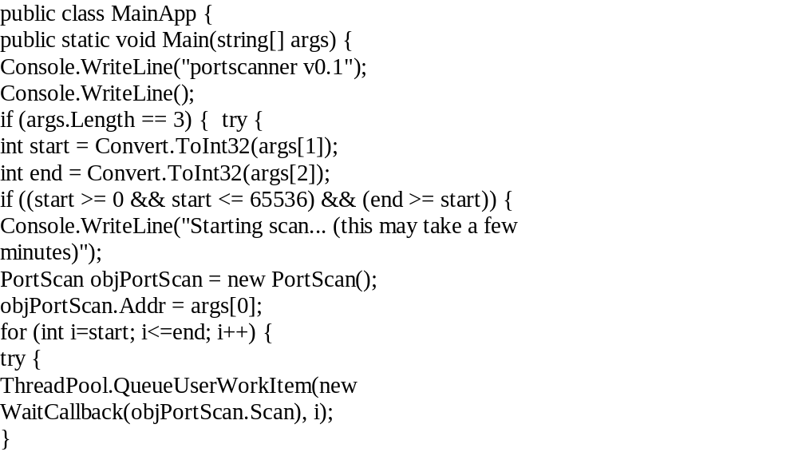
1

Slide 111
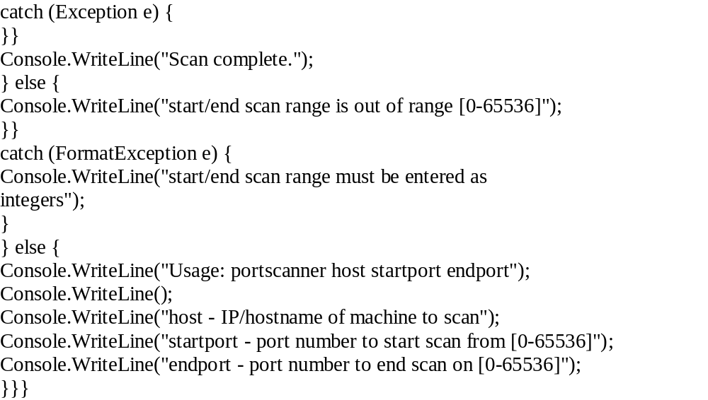
2

Slide 112
3
This code is fine, except for one minor detail, which is that it doesn't wait until all the threads have finished executing. In other words, if you compiled and ran it in its present form, no ports would be checked, as the program would have exited before any of the threads had a chance to execute, seemingly immediately after outputting "Starting scan.".
Waiting until all the threads have completed is a task with two main aspects to it. Firstly, we need to keep track of how many ports we've finished scanning, and secondly, we need to make the program wait until the number of ports we've finished scanning is the same as the total number it was supposed to scan. Microsoft again comes to the rescue here, with the ManualResetEvent class that provides just the functionality we need for the latter. The ManualResetEvent class has two methods pertinent to our problem, Set() and WaitOne() . The Set() method will be called by our program when all the ports have been checked, and the WaitOne() method will force the program to wait for a specified time period for the Set() method to be called.

Slide 113
4
With the waiting part of the problem solved, we just need to keep count of the number of ports we've scanned. This may sound trivial, but again, it's not quite as simple as it seems because we're dealing with multiple threads, which means unpredictable results because a method may be called by two threads at exactly the same time. Again, Microsoft provides a perfect solution to the problem in the Interlocked class's static ' Increment ' method. Its definition is as follows:
public static int Increment(
ref int location
);
Basically it accepts an integer variable by reference and increments it by 1, but it does it in such a way that prevents multithreaded applications from scenarios where the variable may be incremented twice if incremented normally (i.e. int++;), without using the Interlocked class.
With both these problems solved, here is the final source code listing for the program:

Slide 114
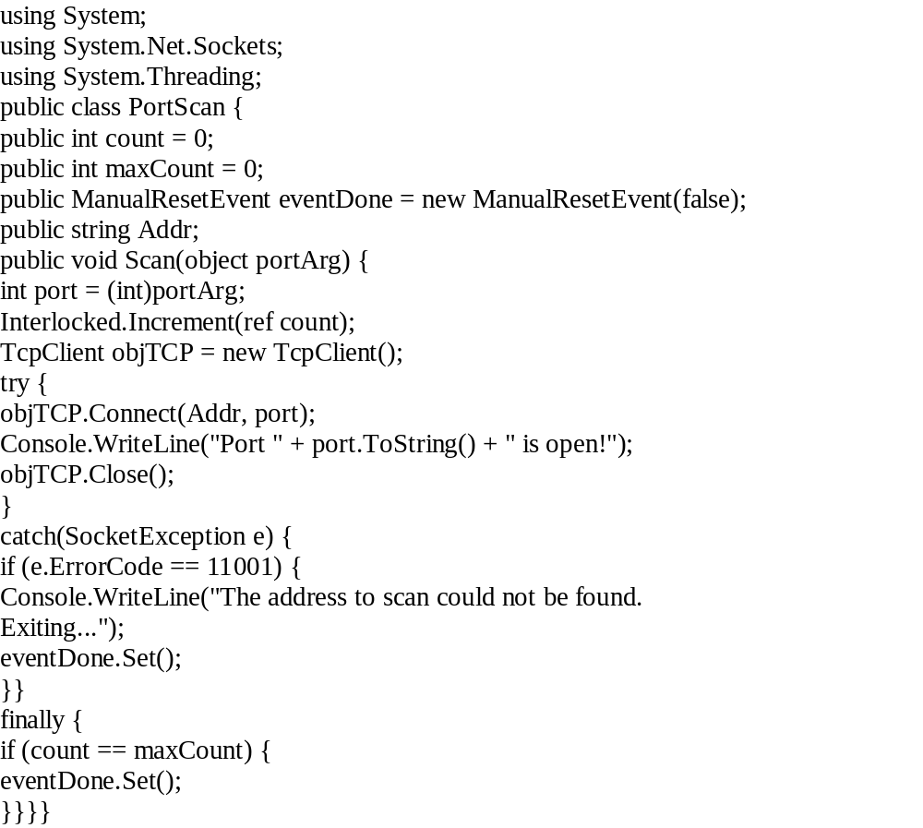
5

Slide 115
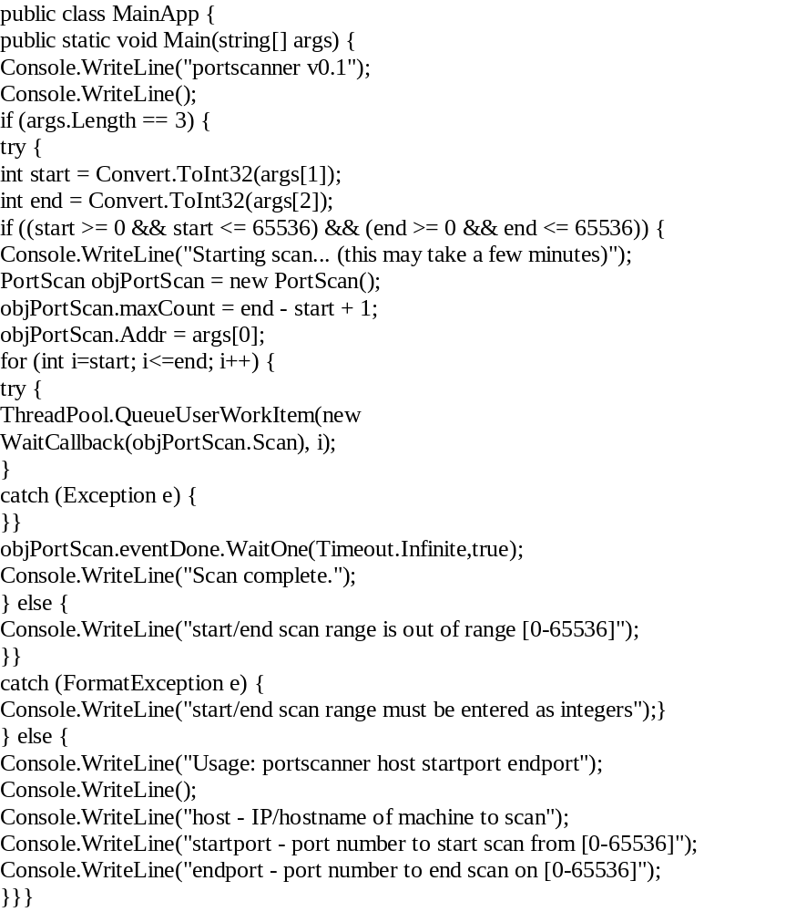
6

Slide 116
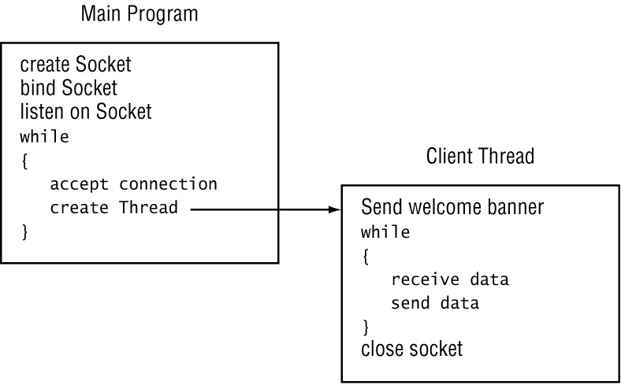
Creating a Threaded Server
The key to creating a threaded server is to map out its handling of each client individually and then extrapolate to hundreds (or thousands) of clients.

Slide 117
The key to the threaded server is to create the main server Socket object in the main program. As each client connects to the server, the main program creates a separate Thread object to handle the connection.
Because the Socket Accept() method creates a new Socket object for the connection, the new object is passed to the delegate method and used for all communication with the client from the new thread.
The original Socket object is then free to accept more client connections.
After you have determined how the new server program will create threads to handle new clients, it’s easy to program the model with C#.
The following Listing is a sample threaded TCP server that can be used to communicate with multiple clients.

Slide 118
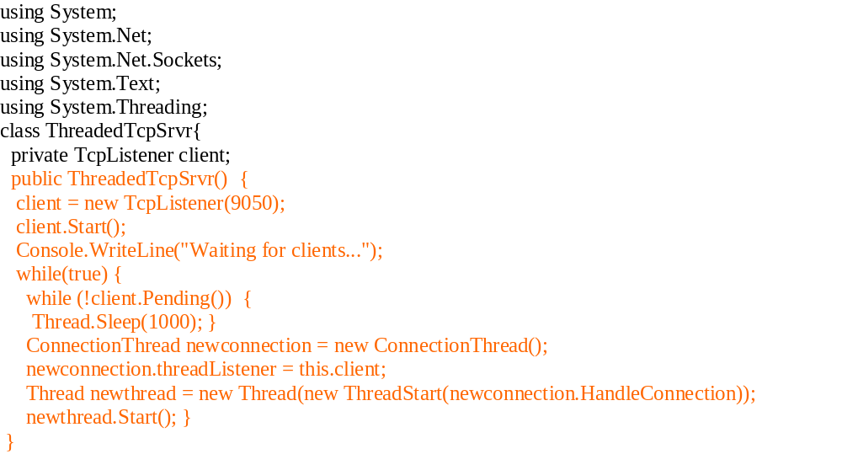
1

Slide 119
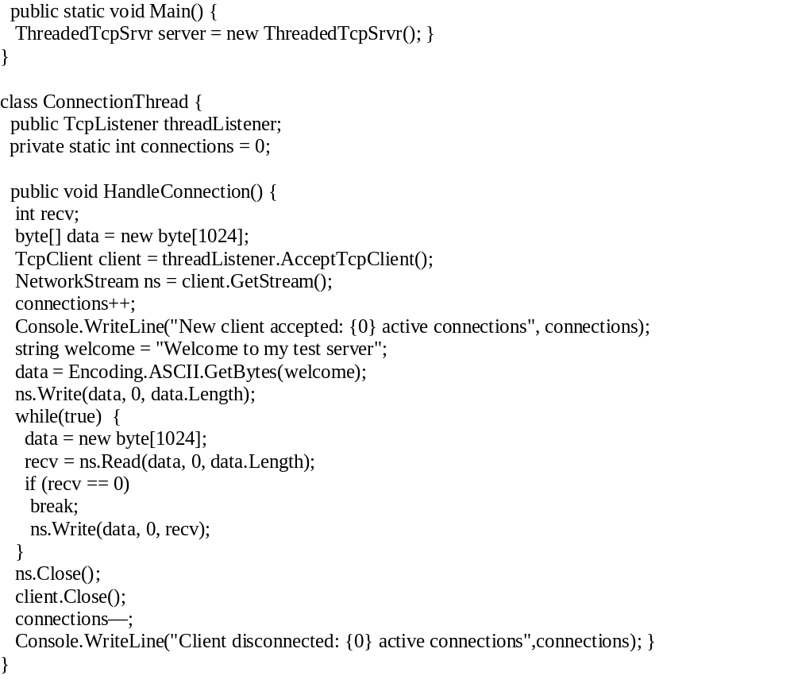
2

Slide 120
3
ThreadedTcpSrvr.cs starts off much like the other TCP server programs presented so far. It uses the TcpListener class to listen for incoming TCP connections on a standard port (9050), and it uses the Start() method to begin waiting for new clients. The difference with this example is in how it accepts new clients:
while(true){
while (!client.Pending()){
Thread.Sleep(1000);
}
ConnectionThread newconnection = new ConnectionThread();
newconnection.threadListener = this.client;
Thread newthread = new Thread(new
ThreadStart(newconnection.HandleConnection));
newthread.Start();
}
The server’s main program goes into an infinite loop, checking once every second to see if a client has connected and, if it has, creating a new thread to accept the connection. A separate class handles the actual communication with the client. The TcpListener object for the class is set to the original TcpListener object from the client connection.
This technique will create as many threads as there are clients wanting to connect to the server.

Slide 121
Testing the Server
After starting the ThreadedTcpSrvr program, you can run as many client programs as you like to connect to the server.
As the server accepts the connection from each client, it creates a separate socket and passes it to a new thread. Each thread is self-contained and performs the standard server functions without having to pass the connection back to the main program.
Each client program can operate completely independently. You can send messages from clients at will, receiving the correct message back for each client. Also, each client can terminate the connection without affecting the other clients.
Watching the Threads:
You can watch the threads created for each client by using the ListThreads program while the server is running. If you redirect the output of the ListThreads program to a file, you can use the Notepad program to search for the ThreadedTcpSrvr process and see the threads in action.
When no clients are connected to the ThreadedTcpSrvr program, it uses three threads. When two clients are connected, it has five threads. As expected, an additional thread is created in the ThreadedTcpSrvr process as each client connects. When each client disconnects, the thread is terminated.

Slide 122
Information for All Processes
The .NET library contains classes for allowing your C# programs to access the process information on the system. You can use this information to determine the status of your program as it is running, or you can get information about other programs running on the system at the same time as your program.
The System.Diagnostics namespace includes the Process class, which is used within a C# program to retrieve and set information for individual processes running on the system. The Process class can start, stop, control, and monitor processes, all from within your program.
As stated earlier, you can use Task Manager to manually display process information for all processes running on the system. The GetProcesses() method does the same task in your C# program.
The following listing, the ListProcs.cs program, lists all the processes running on the system, along with some useful information for each process.

Slide 123
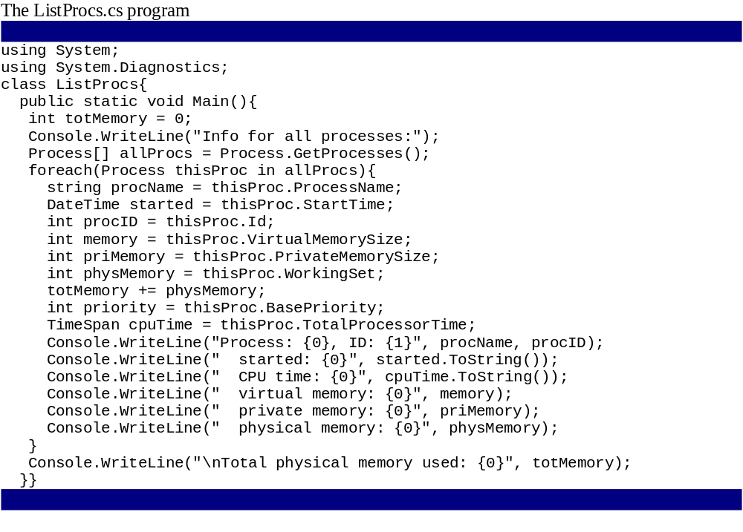

Slide 124
After the GetProcesses() method places the process information in an array of Process objects, you can use the handy foreach function to iterate through the array, assigning each Process array item to a single Process object and extracting the pertinent information. Depending on what is running on your system, the resulting output could be quite lengthy. Here’s a partial output from my system:
C:\>ListProcs
Info for all processes:
Process: winword, ID: 318
started: 7/18/02 7:38:58 PM
CPU time: 00:00:11.3363008
virtual memory: 59056128
private memory: 4009984
physical memory: 9977856
Process: drvmgr, ID: 94
started: 7/18/02 6:48:49 PM
CPU time: 00:00:00.0701008
virtual memory: 25489408
private memory: 1691648
physical memory: 204800
Process: CMD, ID: 307
started: 7/18/02 7:46:13 PM
CPU time: 00:00:00.2303312
virtual memory: 18448384
private memory: 471040
physical memory: 1810432
Process: spoolss, ID: 82
------------------------------------

Slide 125
Seeing Threads in All Processes
The .NET ProcessThread class in the System.Diagnostics namespace allows you to access the threads within a process from your C# program. Similar to the Process class, the ProcessThread class contains many properties and methods used to obtain information regarding the threads in a process.
You can now put the ProcList and GetThreads programs together, getting a listing of all threads for all processes. The following listing, the ListThreads.cs program, displays thread information for all the threads running on the system.

Slide 126
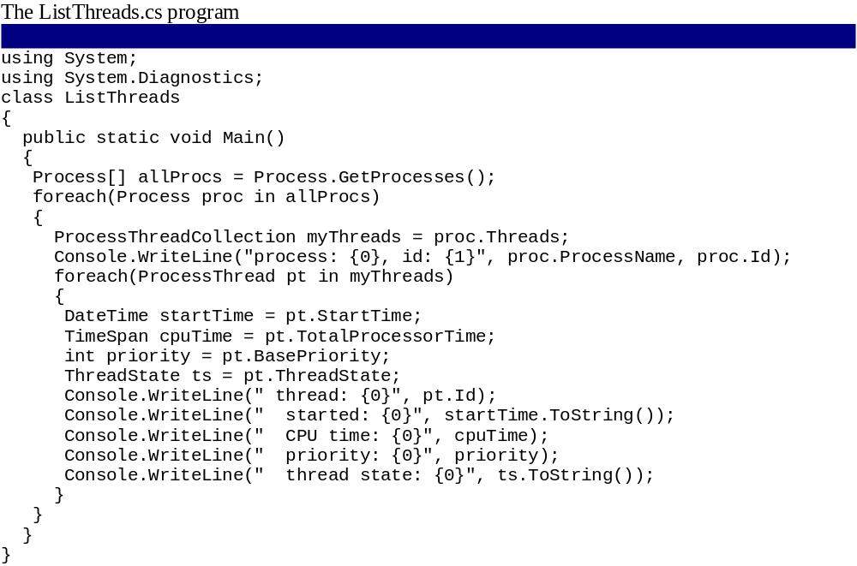
1

Slide 127
2
The ListThreads program uses the GetProcesses() method to obtain an array of all the running processes on the system. Then, each process is taken individually, and the Threads() method creates a ProcessThreadCollection object. From there, each individual thread in the process is extracted into a ProcessThread object. After the ProcessThread object is created, you can extract any thread property that you require.
Depending on how busy your particular system is, the output from the ListThreads program can be pretty large. A small sample of an output looks like this:
C:\>ListThreads
process: ListThreads, id: 318
thread: 327
started: 7/18/02 11:42:22 AM
CPU time: 00:00:00.7711088
priority: 8
thread state: Running
thread: 371
started: 7/18/02 11:42:22 AM
CPU time: 00:00:00
priority: 8
thread state: Wait
thread: 377

Slide 128
Create a Multithreaded TCP Server
Problem:
  You want to create a TCP server that can simultaneously handle multiple TCP clients.
Solution:
  Use the AcceptTcpClient method of the TcpListener class. Every time a new client connects, start a new thread to handle the request and call TcpListener.AcceptTcpClient again.
Discussion:
  A single TCP endpoint (IP address and port) can serve multiple connections. In fact, the operating system takes care of most of the work for you. All you need to do is create a worker object on the server that will handle each connection on a separate thread.

Slide 129
1
Once a TCP connection is established, the two computers can send any type of data by writing it to the NetworkStream. However, it's a good idea to begin designing a networked application by defining the application-level protocol that clients and servers will use to communicate. This protocol includes constants that represent the allowable commands, ensuring that your application code doesn't include hard-coded communication strings.
namespace SharedComponent {
public class ServerMessages {
public const string AcknowledgeOK = "OK";
public const string AcknowledgeCancel = "Cancel";
public const string Disconnect = "Bye";
}
public class ClientMessages {
public const string RequestConnect = "Hello";
public const string Disconnect = "Bye";
}
}

Slide 130
Basic server (single client)
In this example, the defined vocabulary is basic. You would add more constants depending on the type of application. For example, in a file transfer application, you might include a client message for requesting a file. The server might then respond with an acknowledgment and return file details such as the file size. These constants should be compiled into a separate class library assembly, which must be referenced by both the client and server.
The following code is a template for a basic TCP server. It listens on a fixed port, accepts the first incoming connection, and then waits for the client to request a disconnect. At this point, the server could call the TcpListener.AcceptTcpClient method again to wait for the next client, but instead, it simply shuts down.

Slide 131
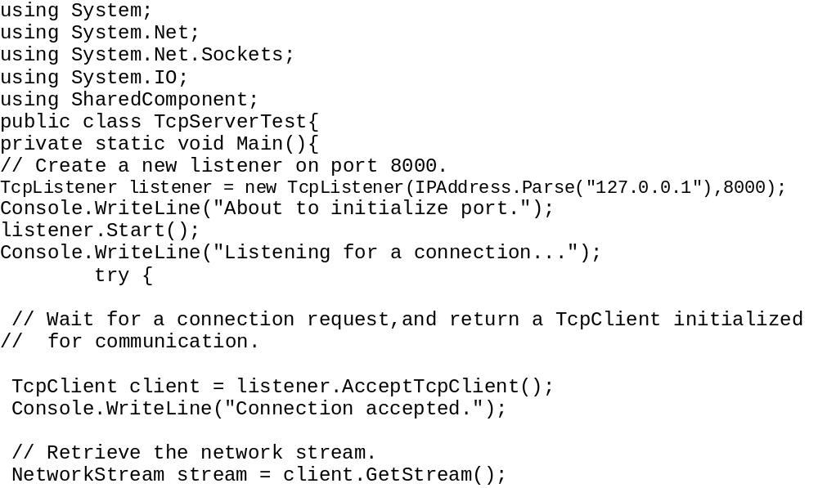
1

Slide 132
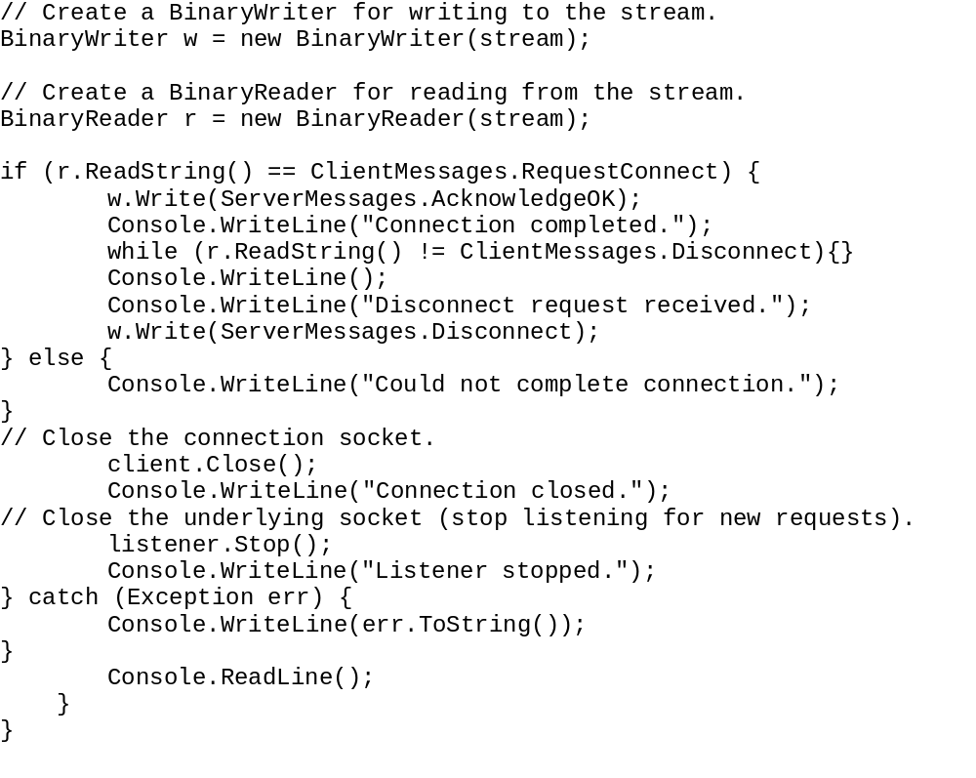
2

Slide 133
TCP client
The following code is a template for a basic TCP client. It contacts the server at the specified IP address and port. In this example, the loopback address (127.0.0.1) is used, which always points to the current computer. Keep in mind that a TCP connection requires two ports: one at the server end and one at the client end. However, only the server port needs to be specified. The client port can be chosen dynamically at run time from the available ports, which is what the TcpClient class will do by default.

Slide 134
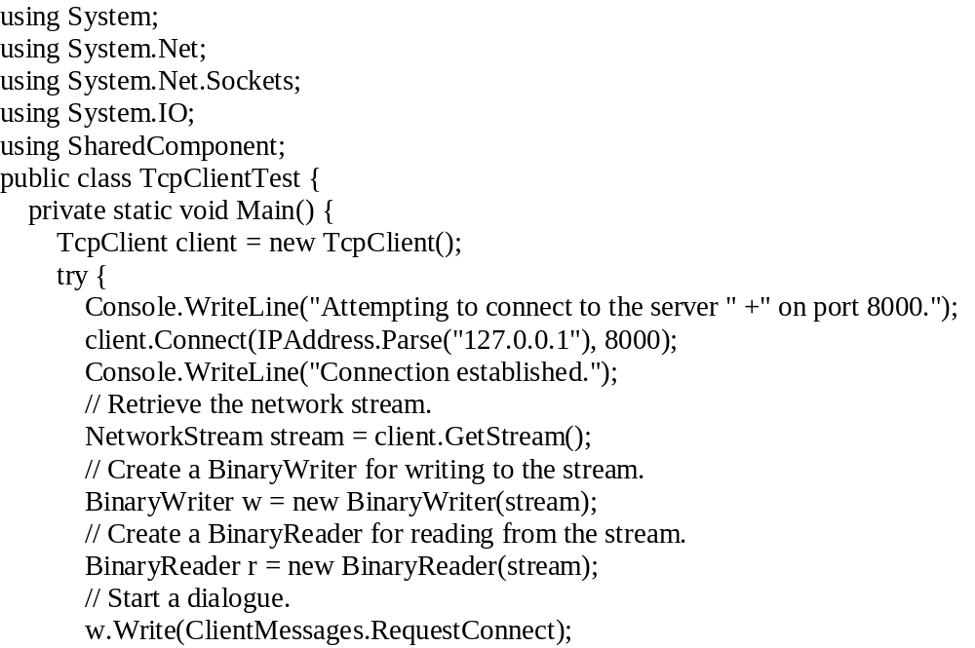
1

Slide 135
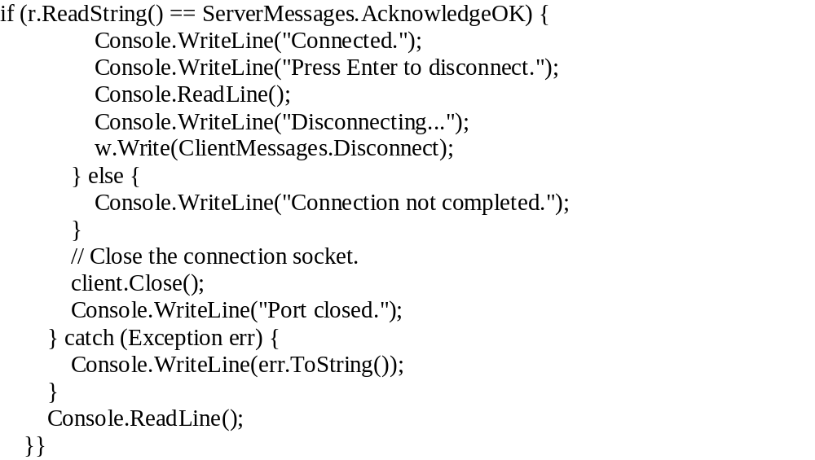
2

Slide 136
connection transcript
Here's a sample connection transcript on the server side:
About to initialize port.
Listening for a connection...
Connection accepted.
Connection completed.
Disconnect request received.
Connection closed.
Listener stopped.
And here's a sample connection transcript on the client side:
Attempting to connect to the server on port 8000.
Connection established.
Connected.
Press Enter to disconnect.
Disconnecting...
Port closed.

Slide 137
Multithreaded TCP Server
For example, consider the basic TCP client and server classes shown in the above slides. You can easily convert the server into a multithreaded server that supports multiple simultaneous connections.
First create a class that will interact with an individual client, as shown in the following code:

Slide 138

1

Slide 139

2

Slide 140
3
Next modify the server code so that it loops continuously, creating new ClientHandler instances as required and launching them on new threads. Here's the revised code:

Slide 141

4

Slide 142
5
The following code shows the server-side transcript of a session with two clients:
  Server: About to initialize port.
  Server: Listening for a connection...
  Server: Connection accepted.
  Client 1: Connection completed.
  Server: Connection accepted.
  Client 2: Connection completed.
  Client 2: Disconnect request received.
  Client 2: Client connection closed.
  Client 1: Disconnect request received.
  Client 1: Client connection closed.
You might want to add additional code to the network server so that it tracks the current worker objects in a collection. Doing so would allow the server to abort these tasks if it needs to shut down and enforce a maximum number of simultaneous clients.

Slide 143
Using Threads for Sending and Receiving Data
In addition to supporting multiple clients, threads can also be used in network programs when there is no clear protocol model to use.
In the sample programs thus far in the course, a consistent model was defined so that both the client and server knew when to expect data to be received and when they should send data. This is not always the case in network programs, however.
An example is the common chat program, which allows two people to communicate via a message-board system, where text entered on one system is displayed on the remote system, and vice-versa. The problem is that either person can decide to send a message at any time during the connection—this would cause havoc on a network protocol model.
Fortunately, threads can come to the rescue. A secondary thread can be created apart from the main program and used to block on a Receive() method, so any incoming data at any time is displayed on the message board.
This concept is diagrammed in the following Figure. The chat participant that chooses to be the chat server places the program in a listen mode, waiting to accept a new chat client. When the client connects, the server creates a separate thread to wait for any incoming data.
Likewise, when the chat client connects to the server, it too creates a separate thread to wait for incoming data from the server. Because the secondary thread is always listening for incoming data, the primary thread has to worry only about when the local person wants to send a message to the remote host.

Slide 144

The concept of the Chat

Slide 145

Interface

Slide 146

Now that the application has been diagrammed, you’ll find it fairly simple to understand and follow the C# program in the following Listing, the TcpChat.cs program, which demonstrates a simple network chat program.

Slide 147


Slide 148


Slide 149


Slide 150
Because the TcpChat program must be used as both the client and server, it must be multifunctional. The main program creates the Windows Form, which includes the following objects:
A Listen button for placing the program in listen mode
A Connect button for connecting to a remote chat partner
A Send button for sending messages entered into a TextBox item to the remote partner
A ListBox object for displaying status information and messages received from the remote partner
If the customer clicks the Listen button, a socket is created and listens for an incoming connection using the BeginAccept() method:
void ButtonListenOnClick(object obj, EventArgs ea)
{
results.Items.Add("Listening for a client...");
Socket newsock = new Socket(AddressFamily.InterNetwork, SocketType.Stream,
ProtocolType.Tcp);
IPEndPoint iep = new IPEndPoint(IPAddress.Any, 9050);
newsock.Bind(iep);
newsock.Listen(5);
newsock.BeginAccept(new AsyncCallback(AcceptConn), newsock);
}

Slide 151
When the other chat program connects, the AcceptConn() method creates a separate socket for the client, passing it off to the secondary thread.
If the customer clicks the Connect button, a socket is created and attempts to connect to the remote host, using the BeginConnect() method. After the remote host accepts the connection, the socket is passed off to the secondary thread. The sole purpose of the secondary thread is to wait for incoming data, and post it to the list box:
void ReceiveData(){
int recv;
string stringData;
while (true){
recv = client.Receive(data);
stringData = Encoding.ASCII.GetString(data, 0, recv);
if (stringData == "bye")
break;
results.Items.Add(stringData);}
stringData = "bye";
byte[] message = Encoding.ASCII.GetBytes(stringData);
client.Send(message);
client.Close();
results.Items.Add("Connection stopped");
return;}

Slide 152
If the received data consists of the string "bye", the program replies to the string with the same message and then closes the socket. Both chat programs thus realize the conversation is over and properly close the TCP connection.
Because the secondary thread is separate from the main program thread, it can use standard blocking network methods such as Receive(); the secondary thread won’t impede the operation of the Windows Form.
Meanwhile, back on the main program, when the customer clicks the Send button, the text entered into the text box is sent to the remote chat host.

Slide 153
The UdpClient Class
The UdpClient class was created to help make UDP network programs simpler for network programmers. This section describes the UdpClient class and its methods and walks you through creating a simple UDP server and client program using the helper class.
For applications that require a connectionless socket, the UdpClient class provides a simple interface to UDP sockets. You may be wondering why there is not a listener version of the UDP helper class. The answer is simple: you don’t need one. Remember, UDP is a connectionless protocol, so there is no such thing as a client or server; there are only UDP sockets either waiting for or sending data. You do not need to bind the UDP socket to a specific address and wait for incoming data.
The UdpClient constructors work like their comparable TcpClient constructors. You can either let the system choose a UDP port for the application, or you can select a specific port in the constructor. If your UDP application must accept data on a specific port, you must define that port in the UdpClient constructor.
Once the UdpClient object is created, you can manipulate the underlying socket and move data using the various methods available.

Slide 154
The UdpClient class has four formats of constructors:
  UdpClient() This format creates a new UdpClient instance not bound to any specific address or port.
  UdpClient(int port) This constructor binds the new UdpClient object to a specific UDP port number.
  UdpClient(IPEndPoint iep) This constructor binds the new UdpClient object to a specific local IP address and port number.
  UdpClient(string host, int port) This format binds the new UdpClient object to any local IP address and port and associates it with a specific remote IP address and port.
The UdpClient constructors work like their comparable TcpClient constructors. You can either let the system choose a UDP port for the application, or you can select a specific port in the constructor. If your UDP application must accept data on a specific port, you must define that port in the UdpClient constructor.
Once the UdpClient object is created, you can manipulate the underlying socket and move data using the various methods available.

Slide 155
The UdpClient Class Methods
The methods of the UdpClient class provide various functionality for controlling and moving data into and out of the UDP socket.

Slide 156
The UDP Server
Although UDP applications aren’t really servers or clients by strict definition, I will call this next application a UDP server for the sake of simplicity. It creates a Socket object and binds it to a set IPEndPoint object so it can wait for incoming packets:
IPEndPoint ipep = new IPEndPoint(IPAddress.Any,9050);
Socket newsock = Socket(AddressFamily.InterNetwork,
SocketType.Dgram, ProtocolType.Udp);
newsock.Bind(ipep);
For connectionless communications, you must specify the Dgram SocketType, along with the Udp ProtocolType. Remember, if your application does not need to receive UDP data on a specific UDP port, you do not have to bind the socket to a specific IPEndPoint. However, if you do need to listen to specific port, such as for servers, you must use the Bind() method.
The following sample, the SimpleUdpSrvr.cs program, demonstrates the basic components of a simple UDP server by binding a dedicated socket on the server for other UDP clients to connect to.

Slide 157
The SimpleUdpSrvr.cs program
using System;
using System.Net;
using System.Net.Sockets;
using System.Text;
class SimpleUdpSrvr {
public static void Main() {
int recv;
byte[] data = new byte[1024];
IPEndPoint ipep = new IPEndPoint(IPAddress.Any, 9050);
Socket newsock = new Socket(AddressFamily.InterNetwork,
SocketType.Dgram, ProtocolType.Udp);
newsock.Bind(ipep);
Console.WriteLine("Waiting for a client...");
IPEndPoint sender = new IPEndPoint(IPAddress.Any, 0);
EndPoint Remote = (EndPoint)(sender);
recv = newsock.ReceiveFrom(data, ref Remote);
Console.WriteLine("Message received from {0}:", Remote.ToString());
Console.WriteLine(Encoding.ASCII.GetString(data, 0, recv));
string welcome = "Welcome to my test server";
data = Encoding.ASCII.GetBytes(welcome);
newsock.SendTo(data, data.Length, SocketFlags.None, Remote);
while(true) {data = new byte[1024];
recv = newsock.ReceiveFrom(data, ref Remote);
Console.WriteLine(Encoding.ASCII.GetString(data, 0, recv));
newsock.SendTo(data, recv, SocketFlags.None, Remote);}}}

Slide 158
As mentioned, for the UDP server program to accept incoming UDP messages, it must be bound to a specific UDP port on the local system. This is accomplished by creating an IPEndPoint object using the appropriate local IP address (or as shown here, the IPAddress.Any address to use any network interface on the system), and the appropriate UDP port:
IPEndPoint ipep = new IPEndPoint(IPAddress.Any, 9050);
Socket newsock = new Socket(AddressFamily.InterNetwork,
SocketType.Dgram, ProtocolType.Udp);
newsock.Bind(ipep);
The sample UDP server illustrated in the example will accept any incoming UDP packet on port 9050 from the network.
There is not an established connection between hosts, so UDP is not picky about where the packet comes from (unlike TCP). However, because of this feature of UDP, when communicating with multiple UDP clients you must be careful to check the transmission point of the received packets.

Slide 159
When creating your sample UDP server, be careful that you don’t choose a UDP port that is already in use by another application on your machine. You can monitor the arrangement of applications that are listening on particular UDP ports by using the netstat command at a command prompt. Here’s an example of the results:
C:\>netstat -a
Active Connections
Proto Local Address Foreign Address State
TCP abednego:epmap 0.0.0.0:0 LISTENING
TCP abednego:microsoft-ds 0.0.0.0:0 LISTENING
TCP abednego:1025 0.0.0.0:0 LISTENING
TCP abednego:1034 0.0.0.0:0 LISTENING
TCP abednego:5000 0.0.0.0:0 LISTENING
TCP abednego:12174 0.0.0.0:0 LISTENING
TCP abednego:38292 0.0.0.0:0 LISTENIN

Slide 160
A UDP Client
The UDP client program is similar to its partner server program.
Because the client does not need to wait on a specific UDP port for incoming data, it does not use the Bind() method. Instead, it employs a random UDP port assigned by the system when the data is sent, and it uses the same port to receive return messages. If you are in a production environment, you might want to specify a set UDP port for the client as well, so that both the server and client programs use the same port numbers.
Warning Be careful if you are using the UDP server and client programs on the same machine. You cannot Bind() the same UDP port number for both programs, or an error will occur. Only one application can bind to a specific port number at a time. Either select a different port number, or let the system choose a random port for the client.
The following Listing shows the SimpleUdpCLient.cs program that demonstrates the fundamentals of a UDP setup.

Slide 161
The SimpleUdpClient.cs program
using System;
using System.Net;
using System.Net.Sockets;
using System.Text;
class SimpleUdpClient
{
public static void Main()
{
byte[] data = new byte[1024];
string input, stringData;
IPEndPoint ipep = new IPEndPoint(
IPAddress.Parse("127.0.0.1"), 9050);
Socket server = new Socket(AddressFamily.InterNetwork,
SocketType.Dgram, ProtocolType.Udp);
string welcome = "Hello, are you there?";
data = Encoding.ASCII.GetBytes(welcome);
server.SendTo(data, data.Length, SocketFlags.None, ipep);
IPEndPoint sender = new IPEndPoint(IPAddress.Any, 0);
EndPoint Remote = (EndPoint)sender;
data = new byte[1024];
int recv = server.ReceiveFrom(data, ref Remote);
Console.WriteLine("Message received from {0}:", Remote.ToString());
Console.WriteLine(Encoding.ASCII.GetString(data, 0, recv));

Slide 162
while(true)
{
input = Console.ReadLine();
if (input == "exit")
break;
server.SendTo(Encoding.ASCII.GetBytes(input), Remote);
data = new byte[1024];
recv = server.ReceiveFrom(data, ref Remote);
stringData = Encoding.ASCII.GetString(data, 0, recv);
Console.WriteLine(stringData);
}
Console.WriteLine("Stopping client");
server.Close();
}
}
The client program sends a quick message to the server machine to introduce itself, then waits for the welcome banner message to be sent back. Because it does not need to accept UDP messages on a specific port number, the client does not bind the Socket object. It will receive the return UDP message on the same port from which it sent the original message.
The SimpleUdpClient program reads the console input and waits for the phrase exit to appear before leaving the while loop. Once the loop is exited, the socket is closed.

Slide 163
Start the SimpleUdpSrvr program on the assigned server machine you will use for your testing. When the server program starts, it displays a short message:
C:\>SimpleUdpSrvr
Waiting for a client...
Nothing too fancy here. After the server is started, you can run the SimpleUdpClient program in either a separate command-prompt window on the same machine, or on another machine on the network. (If you use a remote machine, remember to change the 127.0.0.1 IP address to the address of the server machine.)
SimpleUdpClient immediately sends a message to the server, which in turn should send its welcome banner back. On the client, it looks like this:
C:\>SimpleUdpClient
Message received from 127.0.0.1:9050:
Welcome to my test server
Notice that the EndPoint object of the remote server indicates that it is indeed sending data out from the same UDP port to which it was bound, 9050.
On the server side, you should see the connection message sent by the client:
C:\>SimpleUdpSrvr
Waiting for a client...
Message received from 127.0.0.1:1340:
Hello, are you there?

Slide 164
A Simple UdpClient Server Program-using helper classes
using System;
using System.Net;
using System.Net.Sockets;
using System.Text;
class UdpSrvrSample {
public static void Main(){
byte[] data = new byte[1024];
IPEndPoint ipep = new IPEndPoint(IPAddress.Any, 9050);
UdpClient newsock = new UdpClient(ipep);
Console.WriteLine("Waiting for a client...");
IPEndPoint sender = new IPEndPoint(IPAddress.Any, 0);
data = newsock.Receive(ref sender);
Console.WriteLine("Message received from {0}:", sender.ToString());
Console.WriteLine(Encoding.ASCII.GetString(data, 0, data.Length));
string welcome = "Welcome to my test server";
data = Encoding.ASCII.GetBytes(welcome);
newsock.Send(data, data.Length, sender);
while(true) {
data = newsock.Receive(ref sender);
Console.WriteLine(Encoding.ASCII.GetString(data, 0, data.Length));
newsock.Send(data, data.Length, sender);
}
}}

Slide 165
A Simple UdpClient Client Program
using System;
using System.Net;
using System.Net.Sockets;
using System.Text;
class UdpClientSample {
public static void Main(){
byte[] data = new byte[1024]; string input, stringData;
UdpClient server = new UdpClient("127.0.0.1", 9050);
IPEndPoint sender = new IPEndPoint(IPAddress.Any, 0);
string welcome = "Hello, are you there?";
data = Encoding.ASCII.GetBytes(welcome);
server.Send(data, data.Length);
data = server.Receive(ref sender);
Console.WriteLine("Message received from {0}:", sender.ToString());
stringData = Encoding.ASCII.GetString(data, 0, data.Length);
Console.WriteLine(stringData);
while(true) {
input = Console.ReadLine();
if (input == "exit") break;
server.Send(Encoding.ASCII.GetBytes(input), input.Length);
data = server.Receive(ref sender);
stringData = Encoding.ASCII.GetString(data, 0, data.Length);
Console.WriteLine(stringData); }
Console.WriteLine("Stopping client");
server.Close();
}}

Slide 166
Moving Data across the Network
So far in this chapter you have seen how to move text messages efficiently from one device to another device across the network using the Socket helper classes. Certainly, for many applications this is all that is necessary; for many other applications, however, more advanced functionality is required to handle classes of data other than text such as binary data and groups of more than one type of data.
This section shows techniques for moving different types of binary data across the network. When programming to communicate with various systems, it is important that you understand how binary data is stored on a device and how it is transmitted across the network. This section also covers how to move complex datatypes, such as data elements in classes, among devices on the network.

Slide 167
Moving Binary Data
Whether you use TCP or UDP, sending binary data between two devices on a network is a complex topic. There are many possibilities for errors, and you must take them all into account.
Sending Binary Datatypes
  int test = 1990;
  byte[] data = BitConverter.GetBytes(test);
  newsock.Send(data, data.Length);
This simple code snippet shows the conversion of a standard 4-byte integer value into a 4-byte byte array, which is then used in a Write() or Send() method call to forward the value to a remote device.
Once the received byte array is converted to a binary datatype, you can use it in the program as any other value of that datatype, as shown here:
  double total = 0.0;
  byte[] data = newsock.Receive(ref sender);
  double test = BitConverter.ToDouble(data, 0);
  total += test;

Slide 168
The BinaryUdpSrvr.cs program
using System;
using System.Net;
using System.Net.Sockets;
using System.Text;
class BinaryUdpSrvr
{
public static void Main()
{
byte[] data = new byte[1024];
IPEndPoint ipep = new IPEndPoint(IPAddress.Any, 9050);
UdpClient newsock = new UdpClient(ipep);
Console.WriteLine("Waiting for a client...");
IPEndPoint sender = new IPEndPoint(IPAddress.Any, 0);
data = newsock.Receive(ref sender);
Console.WriteLine("Message received from {0}:", sender.ToString());
Console.WriteLine(Encoding.ASCII.GetString(data, 0, data.Length));
string welcome = "Welcome to my test server";
data = Encoding.ASCII.GetBytes(welcome);
newsock.Send(data, data.Length, sender);
byte[] data1 = newsock.Receive(ref sender);

Slide 169
int test1 = BitConverter.ToInt32(data1, 0);
Console.WriteLine("test1 = {0}", test1);
byte[] data2 = newsock.Receive(ref sender);
double test2 = BitConverter.ToDouble(data2, 0);
Console.WriteLine("test2 = {0}", test2);
byte[] data3 = newsock.Receive(ref sender);
int test3 = BitConverter.ToInt32(data3, 0);
Console.WriteLine("test3 = {0}", test3);
byte[] data4 = newsock.Receive(ref sender);
bool test4 = BitConverter.ToBoolean(data4, 0);
Console.WriteLine("test4 = {0}", test4.ToString());
byte[] data5 = newsock.Receive(ref sender);
string test5 = Encoding.ASCII.GetString(data5);
Console.WriteLine("test5 = {0}", test5);
newsock.Close();
}
}

Slide 170
The BinaryUdpSrvr program uses the Receive() method to wait for a remote client to send a greeting message, then returns its welcome banner to the client.
Next, it expects to receive five test messages in a row from the remote client. Each message contains a different type of data. The order in which the messages appear is critical, because each message is decoded back into the appropriate datatype based on its position in the receipt order. Of course, with UDP, there’s no guarantee that the packets will arrive at all, so this is not a good real-world example. You must be careful when using this technique with UDP messages.
One important thing to note about this program is that the BitConverter class contains methods to convert raw binary data into binary datatypes, but not into a text datatype. The BitConverter method ToString()does exist, but its role is different from what you probably expect. Rather than converting the raw binary data into a printable string, it converts the raw data into a string representation of the binary data in hexadecimal. For example, this code snippet:
string data = "this is a test";
string test = BitConverter.ToString(Encoding.ASCII.GetBytes(data));
Console.WriteLine("data = '{0}'", data);
Console.WriteLine("test = '{0}'", test);
produces these results:
C:\>test
data = 'this is a test'
test = '74-68-69-73-20-69-73-20-61-20-74-65-73-74'
C:\>

Slide 171
The BinaryUdpClient.cs program
using System;
using System.Net;
using System.Net.Sockets;
using System.Text;
class BinaryUdpClient
{
public static void Main()
{
byte[] data = new byte[1024];
string stringData;
UdpClient server = new UdpClient("127.0.0.1", 9050);
IPEndPoint sender = new IPEndPoint(IPAddress.Any, 0);
string welcome = "Hello, are you there?";
data = Encoding.ASCII.GetBytes(welcome);
server.Send(data, data.Length);
data = new byte[1024];
data = server.Receive(ref sender);
Console.WriteLine("Message received from {0}:", sender.ToString());
stringData = Encoding.ASCII.GetString(data, 0, data.Length);
Console.WriteLine(stringData);

Slide 172
int test1 = 45;
double test2 = 3.14159;
int test3 = -1234567890;
bool test4 = false;
string test5 = "This is a test.";
byte[] data1 = BitConverter.GetBytes(test1);
server.Send(data1, data1.Length);
byte[] data2 = BitConverter.GetBytes(test2);
server.Send(data2, data2.Length);
byte[] data3 = BitConverter.GetBytes(test3);
server.Send(data3, data3.Length);
byte[] data4 = BitConverter.GetBytes(test4);
server.Send(data4, data4.Length);
byte[] data5 = Encoding.ASCII.GetBytes(test5);
server.Send(data5, data5.Length);
Console.WriteLine("Stopping client");
server.Close();
}
}

Slide 173
BinaryUdpClient uses the Send() method to send a greeting banner to the server (specified by an address in the UdpClient constructor) and waits for the welcome banner to be returned. Once the welcome banner is received, the program sends a series of five messages, each containing data in a different datatype.
The output from the BinaryUdpSrvr program should look like this:
C:\>BinaryUdpSrvr
Waiting for a client...
Message received from 127.0.0.1:1252:
Hello, are you there?
test1 = 45
test2 = 3.14159
test3 = -1234567890
test4 = False
test5 = This is a test.
C:\>

