Slide 1
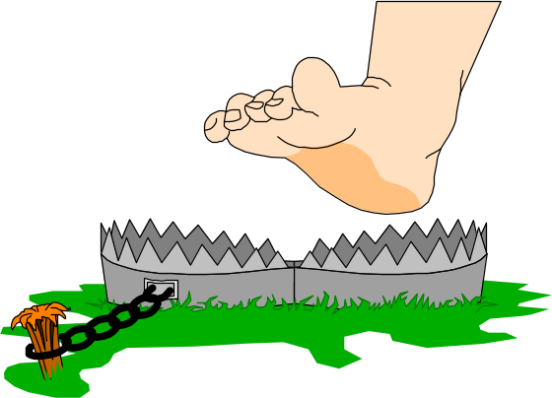
Network programming
C# Network Programming Asynchronous Sockets

Slide 2
Windows Event Programming
So far, all but one of the network programming examples have used the console mode in .NET. Windows console-mode programming uses a traditional structured programming model.
In structured programming, program flow is controlled within the program itself. Each method within the class is called in turn by the functions as they occur in the program execution. The customer does not have options for changing the program execution other than what is allowed by the program. By contrast, Windows programming uses an event programming model.
Windows event programming bases program flow on events. As events occur within the program, specific methods are called and performed based on the events, as illustrated in Figure 1. This does not work well with blocking network functions, however. When an application presents a graphical interface to a customer, it will wait for events from the customer to determine what functions to perform.
Event programming assumes that while other functions are processing (such as network access), the customer will still have control over the graphical interface. This allows the customer to perform other functions while waiting for a network response, or even abort network connections if necessary. However, if the blocking network functions were used, program execution would wait while the function was performed, and the customer would have control over neither the interface nor the program.

Slide 3
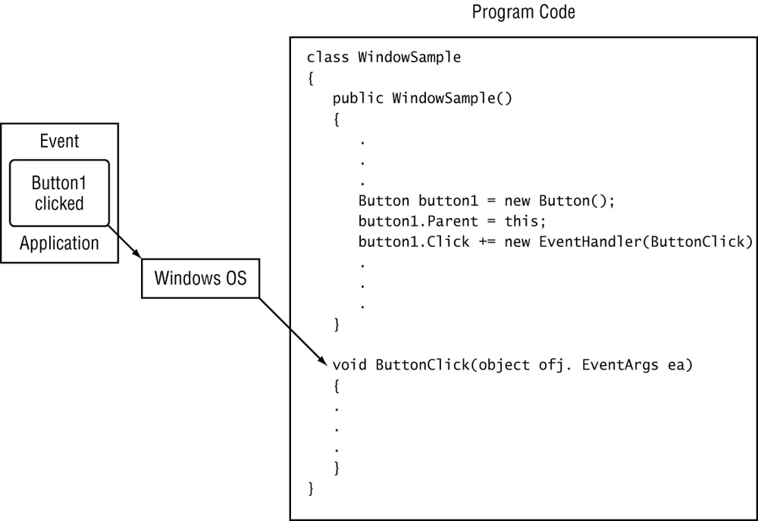
The Windows event programming model

Slide 4
Using Events and Delegates
The .NET programming environment is closely tied to the Windows environment, so it is not surprising that .NET fully supports the event programming model. In .NET event programming, the two key constructs are the events and delegates.
An event is a message sent by an object that represents an action that has taken place. The message identifies the action and gives any useful data related to the action. Events can be anything from the customer clicking a button (where the message represents the button name), to a packet being received on a socket (where the message represents the socket that received the data). The event sender does not necessarily know what object will handle the event message once it is sent through the Windows system. It is up to the event receiver to register with the Windows system and inform it of what types of events the receiver wants to receive.

Slide 5
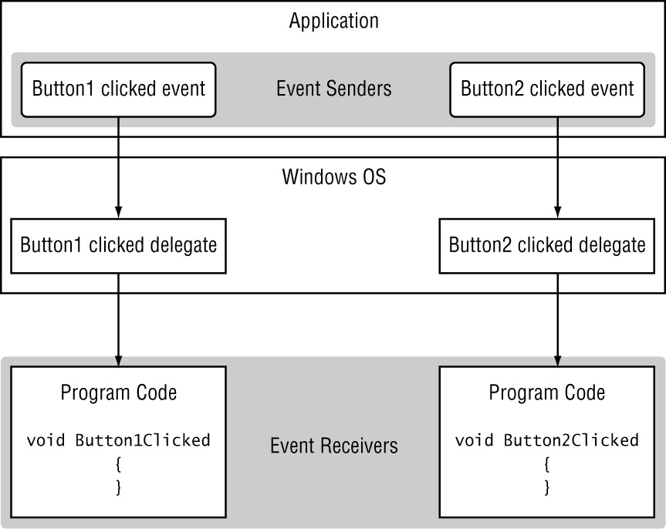
Windows event senders and receivers

Slide 6
Windows event senders and receivers
The event receiver is identified within the Windows system by a pointer class called a delegate. The delegate is a class that holds a reference to a method that can handle the received event. When Windows receives an event, it checks to see if any delegates are registered to handle it. If any delegates are registered to handle the event, the event message is passed to the methods defined by the delegates. After the methods complete, the Windows system processes the next event that occurs, until an event signals the end of the program.

Slide 7
The AsyncCallback Class
Just as events can trigger delegates, .NET also provides a way for methods to trigger delegates. The .NET AsyncCallback class allows methods to start an asynchronous function and supply a delegate method to call when the asynchronous function completes.
This process is different from standard event programming in that the event is not generated from a Windows object, but rather from another method in the program. This method itself registers an AsyncCallback delegate to call when the method completes its function. As soon as this occurs and the method indicates its completion to the Windows OS, an event is triggered to transfer the program control to the method defined in the registered AsyncCallback delegate.
The Socket class utilizes the method defined in the AsyncCallback to allow network functions to operate asynchronously in background processing. It signals the OS when the network functions have completed and passes program control to the AsyncCallback method to finish the network function. In a Windows programming environment, these methods often help avoid the occurrence of an application lock-up while waiting for network functions to complete.

Slide 8
Using Asynchronous Sockets
The Socket object contains methods that utilize the AsyncCallback class to call completion methods when the network functions are finished. This allows the application to continue processing other events while waiting for network operations to complete their work.
  The Socket asynchronous methods split common network programming functions into two pieces:
  A Begin method that starts the network function and registers the AsyncCallback method
  An End method that completes the function when the AsyncCallback method is called.

Slide 9
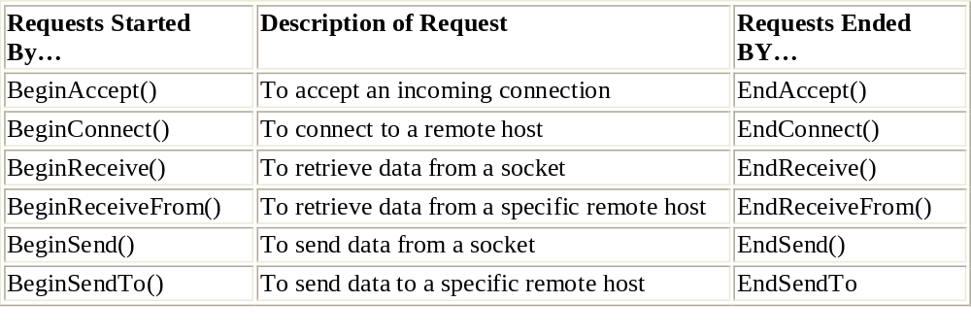

Slide 10
Establishing the Connection
The method used to establish a connection with a remote host depends on whether the program is acting as a server (waiting for clients to connect to it) or a client (attempting to connect to a remote server). For servers, the BeginAccept() method should be used; for clients, the BeginConnect() method is used.
The BeginAccept() and EndAccept() Methods:
To accept an incoming connection attempt from a remote client, you must use the BeginAccept() method. Its format is as follows:
IAsyncResult BeginAccept(AsyncCallback callback, object state)
The BeginAccept() method takes two parameters: the name of the AsyncCallback method used to complete the function, and a generic state object that can pass information between the asynchronous methods. This is how the BeginAccept() method is typically used:
Socket sock = new Socket(AddressFamily.InterNetwork, SocketType.Stream,ProtocolType.Tcp);
IPEndPoint iep = new IPEndPoint(IPAddress.Any, 9050);
sock.Bind(iep);
sock.Listen(5);
sock.BeginAccept(new AsyncCallback(CallAccept), sock);

Slide 11
After the BeginAccept() method is finished, the AsyncCallback method defined will be called when a connection attempt occurs. The AsyncCallback method must include the EndAccept() method to finish the socket accept. Here is the format of the EndAccept() method:
Socket EndAccept(IAsyncResult iar);
The IAsyncResult object parameter passes the IAsyncResult value from the associated BeginAccept() method to the EndAccept() method—this is how the BeginAccept() and EndAccept() pairs are matched.
Similar to the synchronous Accept() method, the EndAccept() method returns a Socket object that is used for the new connection with the client. All further communication with the remote client should be done using this Socket object. A sample section from an EndAccept() AsyncCallback method would look like this:
private static void CallAccept(IAsyncResult iar){
Socket server = (Socket)iar.AsyncState;
Socket client = server.EndAccept(iar);
.
.
.
}

Slide 12
The BeginConnect() and EndConnect() Methods
For a client application to connect to a remote server using asynchronous methods, you must use the BeginConnect() method. Its format is as follows:
IAsyncResult BeginConnect(EndPoint ep, AsyncCallback callback, Object state)
The first parameter passed to the BeginConnect() method is the EndPoint value of the remote host to connect to. Like the BeginAccept() method, the BeginConnect() method specifies the AsyncCallback method name of the delegate method to call when the connection is ready for completion. The last parameter is a state object that can be passed to the EndConnect() method to transfer necessary data.Here is an example of BeginConnect() code:
Socket newsock = new Socket(AddressFamily.InterNetwork, SocketType.Stream, ProtocolType.Tcp);
IPEndPoint iep = new IPEndPoint(IPAddress.Parse("127.0.0.1"), 9050);
newsock.BeginConnect(iep, new AsyncCallback(Connected), newsock);

Slide 13
This code snippet creates a Socket object newsock and an IPEndPoint object iep for the remote host. The BeginConnect() method references the AsyncCallback method (Connected) and passes the original Socket object newsock to the AsyncCallback method.
When the connection is completed, the AsyncCallback method that was declared is called. The AsyncCallback method uses the EndConnect() method to complete the connection.
When the connection is completed, the AsyncCallback method that was declared is called. The AsyncCallback method uses the EndConnect() method to complete the connection.The format of the EndConnect() method is as follows:
EndConnect(IAsyncResult iar)
Here again, the IAsyncResult object specified pass the object value from the BeginConnect() method. It will be instantiated with the IAsyncResult object returned by the BeginConnect() method. A sample method to use this would look like the following:

Slide 14
public static void Connected(IAsyncResult iar)
{
Socket sock = (Socket)iar.AsyncState;
try
{
sock.EndConnect(iar);
} catch (SocketException)
{
Console.WriteLine("Unable to connect to host");
}
}
The first statement in the AsyncCallback method retrieves the original socket used for the BeginConnect() method call, using the AsyncState property of the IAsyncResult object passed to the AsyncCallback method.
After the original socket is recreated, the EndConnect() method is called, using the IAsyncResult object to point it back to the original BeginConnect() method. Because it is possible that the remote host will not be available, it is good practice to place the EndConnect() method in a try-catch block. If the EndConnect() method is unsuccessful, it will throw a SocketException error.

Slide 15
Sending and Receiving Data
After a connection is established, you will most likely want to send and receive data with the remote host. Asynchronous methods can also be used to do this.
The BeginSend() and EndSend() Methods:
The BeginSend() method sends data to a connected socket. The format of this method is as follows:
IAsyncResult BeginSend(byte[] buffer, int offset, int size,
SocketFlags sockflag, AsyncCallback callback, object state)
As you can see, there are plenty of parameters to use with the BeginSend() method. You may notice that most of them are similar to the synchronous Send() method. Walking through them, the first one is the byte array that contains the data you want sent. The offset parameter points to the location within the buffer parameter from which to start sending data, and the size parameter specifies how many bytes from the buffer parameter to send.
Next, the sockflag parameter specifies any special socket flags that you want set for the communication. Finally, the AsyncCallback callback and state objects are specified, defining the method to call when the BeginSend() method succeeds and a state object to send information to the EndSend() method.

Slide 16
sample BeginSend() method would look like this:
sock.BeginSend(data, 0, data.Length, SocketFlags.None,
new AsyncCallback(SendData), sock);
This example sends the entire data buffer and calls the SendData() method when the socket is ready to send the data. The sock Socket object is passed to the AsynCallback() method.
The EndSend() method completes the sending of the data. The format for this method is as follows, where the IAsyncResult parameter defines an empty object that references the result of the BeginSend() method call:
int EndSend(IAsyncResult iar)
The EndSend() method returns the number of bytes successfully sent from the socket. Here’s an example of the EndSend() AsyncCallback method:
private static void SendData(IAsyncResult iar)
{
Socket server = (Socket)iar.AsyncState;
int sent = server.EndSend(iar);
}
The original sock socket is re-created using the AsyncState property of the IAsyncResult object passed to the AsyncCallback method. Again, this relates to the state object specified in the BeginSend() method.

Slide 17
The BeginSendTo() and EndSendTo() Methods
The BeginSendTo() method is used with connectionless sockets to start an asynchronous data transmission to a remote host. The format of the BeginSendTo() method is as follows:
IAsyncResult BeginSendTo(byte[] buffer, int offset, int size,
SocketFlags sockflag, EndPoint ep, AsyncCallback callback, object state)
As you can see, for the most part the BeginSendTo() method format is similar to the SendTo() method format, with the asynchronous features of the BeginSend() method added. The BeginSendTo() method allows you to specify the EndPoint object of the remote host to which to send the message. Sample sBeginSendTo() code would look like this:
IPEndPoint iep = new IPEndPoint(IPAddress.Parse("192.168.1.6"), 9050);
sock.BeginSendTo(data, 0, data.Length, SocketFlags.None, iep,
new AsynCallback(SendDataTo), sock);
Again, the only difference between this call and the BeginSend() call is the IPEndPoint of the remote host added to the parameters.The EndSendTo() method uses the standard format of End methods:
int EndSendTo(IAsyncResult iar)
As always, the IAsyncResult parameter accepts the IAsyncResult value returned by the BeginSendTo() method. The EndSendTo() method returns the number of bytes sent out from the socket.

Slide 18
The BeginReceive() and EndReceive() Methods
The BeginReceive() method accepts data from a remote host on a socket. The format for this method is as follows:
IAsyncResult BeginReceive(byte[] buffer, int offset, int size,
SocketFlags sockflag, AsyncCallback callback, object state)
The first parameter is a byte array that accepts the incoming data. The offset and size parameters are used to specify where in the buffer to start placing the data, and how large the buffer is. The sockflags parameter sets any needed socket flags for the communication. The callback and state parameters allows you to pass information to the EndReceive() method.
Here’s a sample BeginReceive() method call:
sock.BeginReceive(data, 0, data.Length, SocketFlags.None,
new AsyncCallback(ReceivedData), sock);

Slide 19
The BeginReceive() method passes the original socket to the EndReceive() method so that it can re-create the socket for the AsyncCallback method. The AsyncCallback method used for the EndReceive() method would look like this:
void ReceivedData(IAsyncResult iar)
{
Socket remote = (Socket)iar.AsyncState;
int recv = remote.EndReceive(iar);
string receivedData = Encoding.ASCII.GetString(data, 0, recv);
Console.WriteLine(stringData);
}
You see the same AsyncCallback behavior again: the first statement recreates the original socket from the IAsyncResult object. The second statement uses the socket to finish the socket receive, via the EndReceive() method call. Incoming data is placed in the data buffer specified in the corresponding BeginReceive() method call. To access the data buffer from the AsyncCallback method, you must ensure that it is accessible from both methods (such as using a global variable or data class).

Slide 20
The BeginReceiveFrom() and EndReceiveFrom() Methods
The BeginReceiveFrom() method accepts data from any remote host on a connectionless socket. Here is the format:
IAsyncResult BeginReceiveFrom(byte[] buffer, int offset, int size,
SocketFlags sockflag, ref EndPoint ep, AsyncCallback callback, object state)
Notice that the BeginReceiveFrom() method is similar to the BeginReceive() method, except that it specifies a reference to an EndPoint object. The EndPoint object defines the remote host IP address and port number that sent the data. A sample BeginReceiveFrom() method would look like this:
sock.BeginReceive(data, 0, data.Length, SocketFlags.None, ref iep, new AsyncCallback(ReceiveData), sock);
The corresponding EndReceiveFrom() method is placed in the appropriate AsyncCallback method:
void ReceiveData(IasyncResult iar) {
Socket remote = (Socket)iar.AsyncState;
int recv = remote.EndReceiveFrom(iar);
string stringData = Encoding.ASCII.GetString(data, 0, recv);
Console.WriteLine(stringData);
}
The EndReceiveFrom() method returns the number of bytes read from the socket and places the received data in the data buffer defined in the BeginReceiveFrom() method. Again, if you need to access this data within the AsyncCallback method, you should ensure that the data buffer is accessible from both methods.

Slide 21
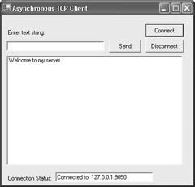
Sample Programs Using Asynchronous Sockets-The Client Program

Slide 22
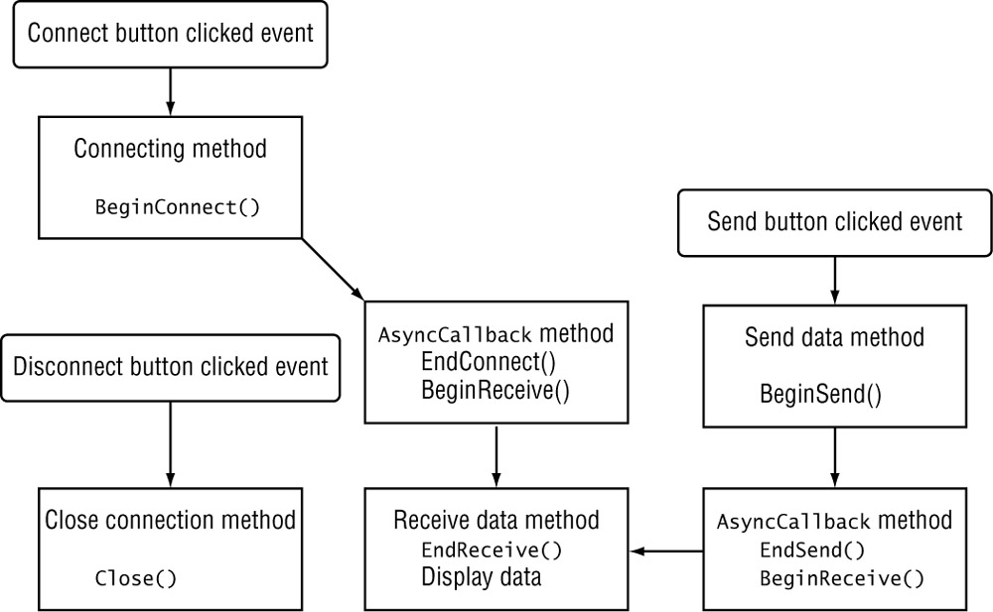
The following diagram shows each of the required methods and how they interact with the Windows event code. The following paragraphs describe the steps accomplished by the sample client program: connecting, receiving, sending, and disconnecting.

Slide 23
Connecting
As seen in the figure, when the customer clicks the Connect button, the method used to start the connection is performed. In the program code, this is the ButtonConnectOnClick() method:
void ButtonConnectOnClick(object obj, EventArgs ea)
{
conStatus.Text = "Connecting...";
Socket newsock = new Socket(AddressFamily.InterNetwork, SocketType.Stream,ProtocolType.Tcp);
IPEndPoint iep = new IPEndPoint(IPAddress.Parse("127.0.0.1"), 9050);
newsock.BeginConnect(iep, new AsyncCallback(Connected), newsock);
}
The ButtonConnectOnClick() method creates a new Socket object for the communication. Then it starts the BeginConnect() method with the address information of the remote host, the name of the associated AsyncCallback method, and the newly created Socket object. When this method finishes processing, Windows waits for the BeginConnect() method to trigger its event, which indicates that a connection is established with the remote host. When this occurs, program control is passed to the Connected() method:

Slide 24
void Connected(IAsyncResult iar) {
client = (Socket)iar.AsyncState;
try {
client.EndConnect(iar);
conStatus.Text = "Connected to: " + client.RemoteEndPoint.ToString();
client.BeginReceive(data, 0, size, SocketFlags.None,
new AsyncCallback(ReceiveData), client); }
catch (SocketException) {
conStatus.Text = "Error connecting"; }}
The first thing that must be done in the Connected() method is to retrieve the original Socket object used for the connection. The AsyncState property of the IAsyncResult class returns the object passed to the AsyncCallback method, which in the case of the BeginConnect() method was the newly created Socket object.
After the Socket object is recreated, the EndConnect() method can be performed. Because it is possible that the EndConnect() method could fail (for instance, if the remote host is unavailable), it is a good idea to place it in a try-catch block. Should EndConnect() fail, you can notify the customer through the conStatus TextBox object.
In this program protocol, the first thing the server does after the connection is established is to send a welcome banner. To accommodate this, the AsyncTcpClient program must be prepared to accept an incoming message immediately after establishing the connection. This is done by using a BeginReceive() method call at the end of the Connected() method.

Slide 25
Receiving Data
After a new connection, and after every sent message, a ReceiveData() method is performed. The BeginReceive() method declares the ReceiveData() method, the AsyncCallback method that’s used when the data is received:
void ReceiveData(IAsyncResult iar)
{
Socket remote = (Socket)iar.AsyncState;
int recv = remote.EndReceive(iar);
string stringData = Encoding.ASCII.GetString(data, 0, recv);
results.Items.Add(stringData);
}
Again, the first statement recreates the communication socket. After the original socket is recreated, the EndReceive() method is used, referencing the original IAsyncResult object, which pairs it with the original BeginReceive() method call. When the message is received from the remote host, it is placed in the data buffer referenced in the BeginReceive() method call. Because the data variable was defined as a global variable, it is used within this method to place the message in the results ListBox.

Slide 26
Sending Data
After entering a message in the TextBox object to send to the remote host, the customer clicks the Send button, and the SendData() method is performed. The EventHandler for the button points to the ButtonSendOnClick() method:
void ButtonSendOnClick(object obj, EventArgs ea) {
byte[] message = Encoding.ASCII.GetBytes(newText.Text);
newText.Clear();
client.BeginSend(message, 0, message.Length, SocketFlags.None,
new AsyncCallback(SendData), client);
}
The message is extracted from the TextBox object, converted to a byte array, and sent out the socket. Because the ButtonSendOnClick() method does not have the original Socket object passed to it, it needs to use a class member to reference the connected socket. The BeginSend() method is used on the connected socket. It specifies the message and the AsyncCallback method to call when the BeginSend() function is ready to complete, along with an object to pass to the EndSend() method. In this case, it is the connected socket.

Slide 27
The AsyncCallback method, SendData(), is triggered when the socket indicates it is ready to send the message:
void SendData(IAsyncResult iar)
{
Socket remote = (Socket)iar.AsyncState;
int sent = remote.EndSend(iar);
remote.BeginReceive(data, 0, size, SocketFlags.None,
new AsyncCallback(ReceiveData), remote);
}
Once again, you see the familiar behavior: the original connected socket is recreated using the AsyncState of the state object passed from the BeginSend() method. When the original socket is recreated, the EndSend() method completes the data transmission. The IAsyncResult object pairs the EndSend()to the original BeginSend() and EndSend()returns the number of bytes that were actually sent out from the socket.
In this application, after a message is sent, the server is expected to echo it back. Knowing this, the BeginReceive() method is called to start the receiving process. BeginReceive()again calls the same ReadData() method, just as it did to receive the original connection’s welcome banner.

Slide 28
Disconnecting
Now that you have the wonders of event programming at your disposal, you can finally create a button to control the disconnect from the remote host (rather than having to define a control word to stop the client). Here’s how that works:
void ButtonDisconOnClick(object obj, EventArgs ea){
client.Close();
conStatus.Text = "Disconnected";
}
By issuing the Close() method for the client socket, the connection is disconnected. To establish a new connection, the customer can click the Connect button.

Slide 29
using System;
using System.Drawing;
using System.Net;
using System.Net.Sockets;
using System.Text;
using System.Windows.Forms;
class AsyncTcpClient Form: {
private TextBox newText;
private TextBox conStatus;
private ListBox results;
private Socket client;
private byte[] data = new byte[1024];
private int size = 1024;
public AsyncTcpClient() {
Text = "Asynchronous TCP Client";
Size = new Size(400, 380);
Label label1 = new Label();
label1.Parent = this;
label1.Text = "Enter text string:";
label1.AutoSize = true;
label1.Location = new Point(10, 30);
newText = new TextBox();
newText.Parent = this;
newText.Size = new Size(200, 2 * Font.Height);
newText.Location = new Point(10, 55);
results = new ListBox();
results.Parent = this;

Slide 30
results.Location = new Point(10, 85);
results.Size = new Size(360, 18 * Font.Height);
Label label2 = new Label();
label2.Parent = this;
label2.Text = "Connection Status:";
label2.AutoSize = true;
label2.Location = new Point(10, 330);
conStatus = new TextBox();
conStatus.Parent = this;
conStatus.Text = "Disconnected";
conStatus.Size = new Size(200, 2 * Font.Height);
conStatus.Location = new Point(110, 325);
Button sendit = new Button();
sendit.Parent = this;
sendit.Text = "Send";
sendit.Location = new Point(220,52);
sendit.Size = new Size(5 * Font.Height, 2 * Font.Height);
sendit.Click += new EventHandler(ButtonSendOnClick);
Button connect = new Button();
connect.Parent = this;
connect.Text = "Connect";
connect.Location = new Point(295, 20);
connect.Size = new Size(6 * Font.Height, 2 * Font.Height);
connect.Click += new EventHandler(ButtonConnectOnClick);
Button discon = new Button();
discon.Parent = this;
discon.Text = "Disconnect";
discon.Location = new Point(295,52);
discon.Size = new Size(6 * Font.Height, 2 * Font.Height);
discon.Click += new EventHandler(ButtonDisconOnClick);
}

Slide 31
void ButtonConnectOnClick(object obj, EventArgs ea) {
conStatus.Text = "Connecting...";
Socket newsock = new Socket(AddressFamily.InterNetwork,
SocketType.Stream, ProtocolType.Tcp);
IPEndPoint iep = new IPEndPoint(IPAddress.Parse("127.0.0.1"), 9050);
newsock.BeginConnect(iep, new AsyncCallback(Connected), newsock);
}
void ButtonSendOnClick(object obj, EventArgs ea) {
byte[] message = Encoding.ASCII.GetBytes(newText.Text);
newText.Clear();
client.BeginSend(message, 0, message.Length, SocketFlags.None,
new AsyncCallback(SendData), client);
}
void ButtonDisconOnClick(object obj, EventArgs ea) {
client.Close();
conStatus.Text = "Disconnected";
}
void Connected(IAsyncResult iar) {
client = (Socket)iar.AsyncState;
try
{
client.EndConnect(iar);
conStatus.Text = "Connected to: " + client.RemoteEndPoint.ToString();
client.BeginReceive(data, 0, size, SocketFlags.None,
new AsyncCallback(ReceiveData), client);
} catch (SocketException)
{
conStatus.Text = "Error connecting";} }

Slide 32
void ReceiveData(IAsyncResult iar)
{
Socket remote = (Socket)iar.AsyncState;
int recv = remote.EndReceive(iar);
string stringData = Encoding.ASCII.GetString(data, 0, recv);
results.Items.Add(stringData);
}
void SendData(IAsyncResult iar)
{
Socket remote = (Socket)iar.AsyncState;
int sent = remote.EndSend(iar);
remote.BeginReceive(data, 0, size, SocketFlags.None,
new AsyncCallback(ReceiveData), remote);
}
public static void Main()
{
Application.Run(new AsyncTcpClient());
}
}

Slide 33
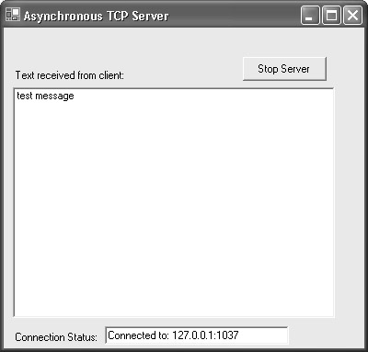
The Server Program

Slide 34
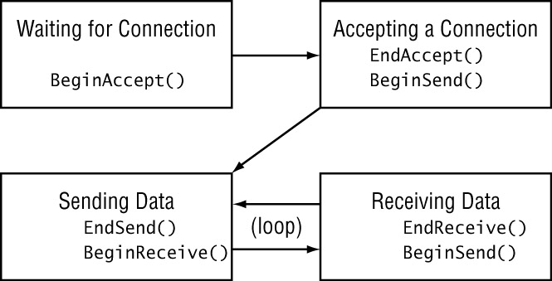
The Server Program Flow

Slide 35
Waiting for New Client Connections
Because you know that the server must immediately listen for incoming connections, the required network programming code is added to the class constructor after the Forms objects have been created:
server = new Socket(AddressFamily.InterNetwork, SocketType.Stream,
ProtocolType.Tcp);
IPEndPoint iep = new IPEndPoint(IPAddress.Any, 9050);
server.Bind(iep);
server.Listen(5);
server.BeginAccept(new AsyncCallback(AcceptConn), server);
By now, you should recognize this as standard server socket code: creating a new Socket object, binding it to a local IPEndPoint object, and listening for new connection attempts.
The BeginAccept() method specifies the AsyncCallback method to use when a connection is received, and the object to pass to the AsyncCallback method.
When a connection attempt is detected, the AsyncCallback method registered with the BeginAccept() method is performed:
void AcceptConn(IAsyncResult iar) {
Socket oldserver = (Socket)iar.AsyncState;
Socket client = oldserver.EndAccept(iar);
conStatus.Text = "Connected to: " + client.RemoteEndPoint.ToString();
string stringData = "Welcome to my server";
byte[] message1 = Encoding.ASCII.GetBytes(stringData);
client.BeginSend(message1, 0, message1.Length, SocketFlags.None,
new AsyncCallback(SendData), client);}

Slide 36
The AsyncCallback method recreates the original Socket object using the AsyncState property of the IAsyncResult object. When the EndAccept() method is called, it uses the IAsyncResult object to pair it up with the calling BeginAccept() method. The EndAccept() method returns a new Socket object to be used for all communication with the remote client.
As reflected in the program flow diagram, the next step for the server is to send a welcome banner to the client. This requires the BeginSend() method, which registers an AsyncCallback method to complete the send operation when the socket is ready to send out data.
Warning Note that the Socket object passed to the AsyncCallback method is the newly created client socket, not the original server socket. This is the socket that is connected to the remote client, and it should be used for all communications with that client.

Slide 37
Sending Data
The EndSend() method is found in the AsyncCallback method registered in the BeginSend() method:
void SendData(IAsyncResult iar)
{
Socket client = (Socket)iar.AsyncState;
int sent = client.EndSend(iar);
client.BeginReceive(data, 0, size, SocketFlags.None,
new AsyncCallback(ReceiveData), client);
}
This sample program uses the standard EndSend() format. A good-quality production program would also compare this value with the original byte count of the sent message and perform the BeginSend() method again if some of the message were not properly sent.
The server program flow model specifies that after the welcome banner is sent, the server should wait for an incoming message from the client. This is accomplished with the BeginReceive() method, which specifies a data buffer in which to place the received data, along with the AsyncCallback method to call when the data is received.

Slide 38
Receiving Data
The EndReceive() method is placed in the AsyncCallback method for the BeginReceive() method:
void ReceiveData(IAsyncResult iar)
{
Socket client = (Socket)iar.AsyncState;
int recv = client.EndReceive(iar);
if (recv == 0)
{
client.Close();
conStatus.Text = "Waiting for client...";
server.BeginAccept(new AsyncCallback(AcceptConn), server);
return;
}
string receivedData = Encoding.ASCII.GetString(data, 0, recv);
results.Items.Add(receivedData);
byte[] message2 = Encoding.ASCII.GetBytes(receivedData);
client.BeginSend(message2, 0, message2.Length, SocketFlags.None, new AsyncCallback(SendData), client);
}

Slide 39
The ReceiveData() method is a little lengthier than the others because it has to accommodate two scenarios in the program flow. First, as always, the client socket is recreated using the standard AsyncState property. Next, the EndReceive() method is called using the IAsyncResult object to pair it up with the appropriate BeginReceive() method. EndReceive()returns the number of bytes received from the socket. As stated earlier, a real-time production program would check the number of bytes received against an expected message size.
If the received message size is zero bytes, it is assumed that the remote client has disconnected the TCP session. In that case, the client socket is closed, and the server can start listening for a new client connection by using the BeginAccept() method and starting the whole program flow all over again.
If a message has been received from the remote client, it must be displayed in the ListBox object and echoed back to the client. This is done by using the BeginSend() method again. Because the program flow now duplicates the original flow from sending the welcome banner, the original SendData() method is used for this AsyncCallback method as well.

Slide 40
1
using System;
using System.Drawing;
using System.Net;
using System.Net.Sockets;
using System.Text;
using System.Windows.Forms;
class AsyncTcpSrvr Form:{
private TextBox conStatus;
private ListBox results;
private byte[] data = new byte[1024];
private int size = 1024;
private Socket server;
public AsyncTcpSrvr() {
Text = "Asynchronous TCP Server";
Size = new Size(400, 380);
results = new ListBox();
results.Parent = this;
results.Location = new Point(10, 65);
results.Size = new Size(350, 20 * Font.Height);
Label label1 = new Label();
label1.Parent = this;
label1.Text = "Text received from client:";
label1.AutoSize = true;
label1.Location = new Point(10, 45);
Label label2 = new Label();
label2.Parent = this;

Slide 41
2
label2.Text = "Connection Status:";
label2.AutoSize = true;
label2.Location = new Point(10, 330);
conStatus = new TextBox();
conStatus.Parent = this;
conStatus.Text = "Waiting for client...";
conStatus.Size = new Size(200, 2 * Font.Height);
conStatus.Location = new Point(110, 325);
Button stopServer = new Button();
stopServer.Parent = this;
stopServer.Text = "Stop Server";
stopServer.Location = new Point(260,32);
stopServer.Size = new Size(7 * Font.Height, 2 * Font.Height);
stopServer.Click += new EventHandler(ButtonStopOnClick);
server = new Socket(AddressFamily.InterNetwork,
SocketType.Stream, ProtocolType.Tcp);
IPEndPoint iep = new IPEndPoint(IPAddress.Any, 9050);
server.Bind(iep);
server.Listen(5);
server.BeginAccept(new AsyncCallback(AcceptConn), server);
}
void ButtonStopOnClick(object obj, EventArgs ea)
{
Close();
}

Slide 42
3
void AcceptConn(IAsyncResult iar) {
Socket oldserver = (Socket)iar.AsyncState;
Socket client = oldserver.EndAccept(iar);
conStatus.Text = "Connected to: " + client.RemoteEndPoint.ToString();
string stringData = "Welcome to my server";
byte[] message1 = Encoding.ASCII.GetBytes(stringData);
client.BeginSend(message1, 0, message1.Length, SocketFlags.None,
new AsyncCallback(SendData), client);
}
void SendData(IAsyncResult iar){
Socket client = (Socket)iar.AsyncState;
int sent = client.EndSend(iar);
client.BeginReceive(data, 0, size, SocketFlags.None,
new AsyncCallback(ReceiveData), client);
}
void ReceiveData(IAsyncResult iar){
Socket client = (Socket)iar.AsyncState;
int recv = client.EndReceive(iar);
if (recv == 0){
client.Close();
conStatus.Text = "Waiting for client...";
server.BeginAccept(new AsyncCallback(AcceptConn), server);
return;
}
string receivedData = Encoding.ASCII.GetString(data, 0, recv);
results.Items.Add(receivedData);
byte[] message2 = Encoding.ASCII.GetBytes(receivedData);
client.BeginSend(message2, 0, message2.Length, SocketFlags.None,
new AsyncCallback(SendData), client);
}
public static void Main(){
Application.Run(new AsyncTcpSrvr());
}
}

Slide 43
Using Non-blocking Socket Methods
Asynchronous sockets have been created specifically for the Windows environment. Traditional Unix network programming does not use asynchronous sockets. Instead, programs contain non-blocking socket methods that check a socket without actually committing to a blocking function. This allows the program to continue executing even if the network operation would normally block the program. If the socket is determined to be ready for the network function, the blocking function is performed.
The .NET Sockets library includes non-blocking socket methods found in the Unix socket library. This allows network programmers to easily port Unix network programs to the Windows environment.
This section describes the Poll() and Select() methods that are used to determine whether a network function would block and to help network applications avoid getting stuck on a blocking network function.

Slide 44
The Poll() Method
Often, when you’re attempting to perform a blocking network function such as a Receive() command, you need to have the capability of checking the socket before committing to the command.
The Socket method Poll() gives you just that. It checks a Socket object to see whether a network method call would block or be successfully completed. If the poll indicates that the method would execute without blocking, you’re home free. Otherwise, you can perform some other functions and check again at a later time. The format of the Poll() method is simple:
bool Poll(int microseconds, SelectMode mode);
It returns a simple boolean value: true if the action would complete, or false if the action would block. The int parameter allows you to set the amount of time (in microseconds) the Poll() method will wait and watch the socket for the indicated events. Use the SelectMode parameter to specify what type of action to watch for. The SelectMode class enumerates three possible events for the Poll() method to monitor:
SelectRead The SelectRead value for SelectMode will cause the Poll()to return a true value under the following conditions:
  If an Accept() method call would succeed
  If data is available on the socket
  If the connection has been closed
  SelectWrite The SelectWrite value for SelectMode will cause the Poll()to return a true value under the following conditions:
  If a Connect() method call has succeeded
  If data can be sent on the socket
  SelectError The SelectError value for SelectMode will cause the Poll() method to return a true value under the following conditions:
  If a Connect() method call has failed
  If out-of-band data is available and the Socket OutOfBandInline property has not been set.

Slide 45
A Sample Poll() Program
using System;
using System.Net;
using System.Net.Sockets;
using System.Text;
class TcpPollSrvr
{
public static void Main()
{
int recv;
byte[] data = new byte[1024];
IPEndPoint ipep = new IPEndPoint(IPAddress.Any,
9050);
Socket newsock = new
Socket(AddressFamily.InterNetwork,
SocketType.Stream, ProtocolType.Tcp);
newsock.Bind(ipep);
newsock.Listen(10);
Console.WriteLine("Waiting for a client...");
bool result;
int i = 0;

Slide 46
while(true){
i++;
Console.WriteLine("polling for accept#{0}...", i);
result = newsock.Poll(1000000, SelectMode.SelectRead);
if (result){
break;
}}
Socket client = newsock.Accept();
IPEndPoint newclient =(IPEndPoint)client.RemoteEndPoint;
Console.WriteLine("Connected with {0} at port {1}",
newclient.Address, newclient.Port);
After the server socket is created, it is bound to a local IPEndPoint object and placed in listen mode using the standard Bind() and Listen() Socket methods. In a normal blocking program, the next step would be to use the Accept() method to wait for an incoming connection attempt from a client. This would cause the program to wait at that point and prevent it from doing any other work until an incoming connection is received.
Instead, in this example, the non-blocking Poll() method polls the socket to determine if an incoming connection is available.

Slide 47
string welcome = "Welcome to my test server";
data = Encoding.ASCII.GetBytes(welcome);
client.Send(data, data.Length,SocketFlags.None);
i = 0;
while(true){
Console.WriteLine("polling for receive #{0}...", i);
i++;
result = client.Poll(3000000, SelectMode.SelectRead);
if(result){
data = new byte[1024];
i = 0;
recv = client.Receive(data);
if (recv == 0)
break;
Console.WriteLine(
Encoding.ASCII.GetString(data, 0, recv));
client.Send(data, recv, 0);
}
}
Console.WriteLine("Disconnected from {0}",
newclient.Address);
client.Close();
newsock.Close();
}}

Slide 48
The Select() Method
The Poll() method works well for watching a single socket for activity but can get extremely complex if you are trying to monitor multiple sockets. For that situation you can use the Select() method.
The Select() method of the Socket class polls one or more sockets for blocking functions. As sockets become available for reading or writing, the Select() method can determine which ones are ready to use and which ones would block if used.
Because the Select() method is declared as a static method, it cannot be used on an instance of a Socket object. Instead, you must use it from a generic Socket declaration: Here’s the format:
Socket.Select(IList checkRead, IList checkWrite, IList checkError, int microseconds)
The three IList objects represent three categories to monitor for socket activity:
  checkRead monitors the specified sockets for the ability to read data from the socket.
  checkWrite monitors the specified sockets for the ability to write data to the socket.
checkError monitors the specified sockets for error conditions.
The IList object represents a collection of objects that can be individually accessed by an index value. When the Select() method exits, each IList object will be modified to only contain Socket objects that meet the criteria of the position (read, write, or error).
The microseconds parameter determines how long the Select() method will monitor the sockets before returning to the program (similar to the Poll() method).

Slide 49
For example, the following code snippet creates three separate sockets and monitors them for new connections:
IPEndPoint iep1 = new IPEndPoint(IPAddress.Any, 9050);
Socket sock = new Socket(AddressFamily.InterNetwork, SocketType.Stream, ProtocolType.Tcp);
sock.Bind(iep1);
sock.Listen(5);
Socket newsock1 = sock.Accept();
Socket newsock2 = sock.Accept();
Socket newsock3 = sock.Accept();
ArrayList socketList = new ArrayList(3);
socketList.Add(newsock1);
socketList.Add(newsock2);
socketList.Add(newsock3);
Socket.Select(sockList, null, null, 10000000);
for(int I = 0; I < sockList.Count; i++)
{
client = (Socket)sockList[i];
data = new byte[1024];
recv = client.Receive(data);
}

Slide 50
The Select() Server Program
The SelectTcpSrvr.cs program uses the Select() method to monitor two separate clients at the same time. It creates a single socket, places it in listen mode, and then waits for two clients to connect to the socket. Each client generates its own separate socket, which is placed in an ArrayList. The ArrayList of sockets is then monitored using the Select() method for incoming data. When data is detected on a socket, it is echoed back to the same client.
using System;
using System.Collections;
using System.Net;
using System.Net.Sockets;
using System.Text;
class SelectTcpSrvr {
public static void Main(){
ArrayList sockList = new ArrayList(2);
ArrayList copyList = new ArrayList(2);
Socket main = new Socket(AddressFamily.InterNetwork,
SocketType.Stream, ProtocolType.Tcp);
IPEndPoint iep = new IPEndPoint(IPAddress.Any, 9050);
byte[] data = new byte[1024];
string stringData;
int recv;
main.Bind(iep);
main.Listen(2);

Slide 51
Console.WriteLine("Waiting for 2 clients...");
Socket client1 = main.Accept();
IPEndPoint iep1 = (IPEndPoint)client1.RemoteEndPoint;
client1.Send(Encoding.ASCII.GetBytes("Welcome to my server"));
Console.WriteLine("Connected to {0}", iep1.ToString());
sockList.Add(client1);
Console.WriteLine("Waiting for 1 more client...");
Socket client2 = main.Accept();
IPEndPoint iep2 = (IPEndPoint)client2.RemoteEndPoint;
client2.Send(Encoding.ASCII.GetBytes("Welcome to my server"));
Console.WriteLine("Connected to {0}", iep2.ToString());
sockList.Add(client2);
main.Close();
while(true)
{
copyList = new ArrayList(sockList);
Console.WriteLine("Monitoring {0} sockets...", copyList.Count);
Socket.Select(copyList, null, null, 10000000);

Slide 52
foreach(Socket client in copyList)
{
data = new byte[1024];
recv = client.Receive(data);
stringData = Encoding.ASCII.GetString(data, 0, recv);
Console.WriteLine("Received: {0}", stringData);
if (recv == 0)
{
iep = (IPEndPoint)client.RemoteEndPoint;
Console.WriteLine("Client {0} disconnected.", iep.ToString());
client.Close();
sockList.Remove(client);
if (sockList.Count == 0)
{
Console.WriteLine("Last client disconnected, bye");
return;
}
}
else
client.Send(data, recv, SocketFlags.None);
}
}
}
}

Slide 53
The Select() Client Program
The SelectTcpClient.cs program is a simple client program that connects to the specified server and waits for the customer to enter a text message on the console. The message is sent to the SelectTcpSrvr program, which echoes it back to the client. The message is displayed on the console, and the program waits for another message to be entered. The SelectTcpClient program itself does not need to use the Select() method because it only connects with one server.

Slide 54
using System;
using System.Collections;
using System.Net;
using System.Net.Sockets;
using System.Text;
class SelectTcpClient {
public static void Main() {
Socket sock = new Socket(AddressFamily.InterNetwork,
SocketType.Stream, ProtocolType.Tcp);
IPEndPoint iep = new IPEndPoint(IPAddress.Parse("127.0.0.1"), 9050);
byte[] data = new byte[1024];
string stringData;
int recv;
sock.Connect(iep);
Console.WriteLine("Connected to server");
recv = sock.Receive(data);
stringData = Encoding.ASCII.GetString(data, 0, recv);
Console.WriteLine("Received: {0}", stringData);
while(true) {
stringData = Console.ReadLine();
if (stringData == "exit")
break;
data = Encoding.ASCII.GetBytes(stringData);
sock.Send(data, data.Length, SocketFlags.None);
data = new byte[1024];
recv = sock.Receive(data);
stringData = Encoding.ASCII.GetString(data, 0, recv);
Console.WriteLine("Received: {0}", stringData);
}
sock.Close();
}}

