Slide 1

Network programming
C# Network Programming IP Multicasting

Slide 2
Introduction
All of the programming examples in the preceding chapters have one thing in common (other than being written in C#): they were designed to send messages to one remote device at a time. When there were multiple clients involved, each message was sent to each client separately.
This chapter changes that pattern by introducing the ideas IP broadcasting, which sends information to all devices on a subnet at the same time, and IP multicasting, which sends information to multiple devices on the network at the same time.
Implementing either or both of these IP communication techniques will decrease the amount of network bandwidth used by an application, because you use a single packet to send the same information to a collection of devices.

Slide 3
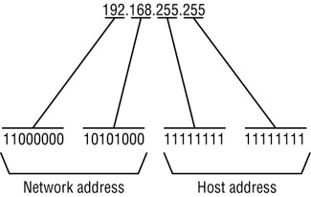
What Is Broadcasting?
IP broadcasting is used by network devices to send a single packet of information that can be accessible by every device on the network. Because TCP communication requires that two devices have a dedicated connection, it is not possible to send broadcast messages in a strictly TCP environment. Instead, UDP packets must be used because that protocol has the capability of sending messages without a specific connection being defined.
Local versus Global Broadcasts
  Broadcast messages contain a special destination IP address. The IP address format allows for two types of broadcast message addresses: local broadcasts and global broadcasts.
  Network programmers use the local broadcast address to send a broadcast message destined for all devices on a particular subnet. The idea is to localize a broadcast message so that other networks are not affected by the broadcast.

Slide 4
Implementing Broadcasting with C#
Sending Broadcast Packets:
  By default, sockets are not allowed to send broadcast messages. You can test this by running the simple program shown :
The BadBroadcast.cs program
using System;
using System.Net;
using System.Net.Sockets;
using System.Text;
class BadBroadcast
{
public static void Main()
{
Socket sock = new Socket(AddressFamily.InterNetwork, SocketType.Dgram,ProtocolType.Udp);
IPEndPoint iep = new IPEndPoint(IPAddress.Broadcast, 9050);
byte[] data = Encoding.ASCII.GetBytes("This is a test message");
sock.SendTo(data, iep);
sock.Close();
}
}
When you try to run this program, you will get an Exception message

Slide 5
For a C# application to send broadcast packets, the broadcast socket option must be set on the created socket using the SetSocketOption() method of the Socket class. Here is a code snippet for using the SetSocketOption() method in this way:
Socket sock = new Socket(AddressFamily.InterNetwork,
SocketType.Dgram, ProtocolType.Udp);
sock.SetSocketOption(SocketOptionLevel.Socket, SocketOptionName.Broadcast, 1);
Note that the SocketType must be set to Dgram for broadcast messages. The SocketOptionName.Broadcast option is a Socket level option, so the SocketOptionLevel parameter must be set to Socket.
Because the SetSocketOption() method does not allow boolean values for the data parameter, you must set the value parameter to any non-zero value to represent the true boolean value. Zero represents the false boolean value.
After the socket option is set, you specify a broadcast address and port to use for the broadcast and use the SendTo() method to send a message on that address:
IPEndPoint iep = new IPEndPoint(IPAddress.Broadcast, 9050);
byte[] data = Encoding.Ascii.GetBytes("test message");
sock.SendTo(data, iep);

Slide 6
The Broadcst.cs program
using System;
using System.Net;
using System.Net.Sockets;
using System.Text;
class Broadcst{
public static void Main(){
Socket sock = new Socket(AddressFamily.InterNetwork, SocketType.Dgram,ProtocolType.Udp);
IPEndPoint iep1 = new IPEndPoint(IPAddress.Broadcast, 9050);
IPEndPoint iep2 = new IPEndPoint(IPAddress.Parse("192.168.1.255"), 9050);
string hostname = Dns.GetHostName();
byte[] data = Encoding.ASCII.GetBytes(hostname);
sock.SetSocketOption(SocketOptionLevel.Socket,
SocketOptionName.Broadcast, 1);
sock.SendTo(data, iep1);
sock.SendTo(data, iep2);
sock.Close();
}}
The Broadcst program creates two separate IPEndPoint objects, one using the IPAddress.Broadcast address and one using a local broadcast address 192.168.1.255. Next, the local hostname of the device is determined using the standard Dns GetHostName() method, and it is sent out in two separate broadcast messages.

Slide 7
Receiving Broadcast Packets
By default, no special options are required for a socket to receive a broadcast message. If a socket is listening on a specified UDP port, it will accept any message destined for either a broadcast address or the local IP address of the device. The RecvBroadcst.cs program in the following Listing demonstrates this by creating a socket to listen for packets on UDP port 9050, the same port from which the Broadcst program is sending broadcast messages.
The RecvBroadcst program is a simple UDP program that creates a socket and binds it to all network interfaces on the device, using port 9050, the same port that the Broadcst program uses to send its broadcast messages. After binding the socket to the UDP port, the program attempts to receive two messages sent to the port and displays the message and the sending host address information.
You can start the RecvBroadcst program in a command prompt window, and then run the Broadcst program from either another command prompt window on the same device, or from another device on the same subnet. A sample output from the RecvBroadcst program is as follows:
C:\>RecvBroadcst
received: abednego from: 192.168.1.6:1042
received: abednego from: 192.168.1.6:1042
C:\>
As expected, the RecvBroadcst program received both forms of the broadcast message that were sent by the Broadcst program.

Slide 8
using System;
using System.Net;
using System.Net.Sockets;
using System.Text;
class RecvBroadcst {
public static void Main(){
Socket sock = new Socket(AddressFamily.InterNetwork,
SocketType.Dgram, ProtocolType.Udp);
IPEndPoint iep = new IPEndPoint(IPAddress.Any, 9050);
sock.Bind(iep);
EndPoint ep = (EndPoint)iep;
Console.WriteLine("Ready to receive…");
byte[] data = new byte[1024];
int recv = sock.ReceiveFrom(data, ref ep);
string stringData = Encoding.ASCII.GetString(data, 0, recv);
Console.WriteLine("received: {0} from: {1}", stringData, ep.ToString());
data = new byte[1024];
recv = sock.ReceiveFrom(data, ref ep);
stringData = Encoding.ASCII.GetString(data, 0, recv);
Console.WriteLine("received: {0} from: {1}", stringData, ep.ToString());
sock.Close();
}}

Slide 9
Using Broadcast Packets to Advertise a Server
One of the most common uses for broadcast packets is to advertise the presence of a server on the network. By repeatedly sending out a broadcast packet containing information regarding the server at a predetermined time interval, you make it possible for clients to easily detect the presence of the server on the local subnet. This technique is used for many types of applications, from Windows application servers to network printers.
This section shows you a simple way to add broadcast advertising to the TcpChat program . This version allows clients to know when another chat program is running on the same subnet.
The Advertising Loop:
  The easiest way to add advertising to a network application is to create a background thread that repeatedly broadcasts the server information at a set time interval. The trick is to repeat the broadcast often enough that new clients can quickly find the broadcasting server, but not so often that the local network gets flooded with broadcast packets. Often a one-minute interval is chosen as a compromise.
  The advertising thread should be self-contained, creating its own socket and sending the broadcast packet at the predetermined interval. It should be created as a background thread and assigned a lower priority than the main program thread. This ensures that the advertising thread does not take away from the main program’s processing time and affect the program’s overall response.

Slide 10
The Advertise.cs program in the following Listing creates a background thread that sends out a broadcast packet every minute with the hostname of the device running the application.
using System;
using System.Net;
using System.Net.Sockets;
using System.Text;
using System.Threading;
class Advertise
{
public static void Main()
{
Advertise server = new Advertise();
}
public Advertise()
{
Thread advert = new Thread(new ThreadStart(sendPackets));
advert.IsBackground = true;
advert.Start();
Console.Write("Press Enter to stop");
string data = Console.ReadLine();
}

Slide 11
void sendPackets(){
Socket sock = new Socket(AddressFamily.InterNetwork,
SocketType.Dgram, ProtocolType.Udp);
sock.SetSocketOption(SocketOptionLevel.Socket,
SocketOptionName.Broadcast, 1);
IPEndPoint iep = new IPEndPoint(IPAddress.Broadcast, 9050);
string hostname = Dns.GetHostName();
byte[] data = Encoding.ASCII.GetBytes(hostname);
while (true){
sock.SendTo(data, iep);
Thread.Sleep(60000);
}
}
}
The Advertise.cs program creates a new Thread object using the sendPackets() method, which generates a Socket object for the broadcast address and broadcasts the hostname every 60 seconds. The Thread.Sleep() method puts the thread in idle mode between broadcasts. The broadcast thread is placed in background mode by means of the IsBackground property of the Thread class.
Because the main part of the application does nothing but create the background thread, it must wait, or the background thread will be terminated. This is set up using the Console.ReadLine() method to wait for input from the console before terminating the main program.

Slide 12
You can watch the Advertise.cs program by running the RecvBroadcst program, which will show the first two broadcast messages.
The TcpChat program presented before had one major drawback: for it to communicate properly, you had to manually compile the address of the remote host into the program—obviously not a good way to do business in a production application. With broadcast messages at your disposal, you can fix the TcpChat program to be more user-friendly.
There are two pieces that need to be added to the original TcpChat program to accomplish this goal:
  A background thread that broadcasts an identification message on the subnet
  A way to listen for broadcast messages and detect another chat application running on the subnet
As seen in the Advertise.cs program, the first part is easy; you just create a background thread using the Thread class to broadcast a message using a UDP port that’s separate from the one used for the chat communication. The second piece—the listener—is a little trickier to implement.

Slide 13
First, the program must listen for broadcast messages from possible chat clients on the subnet. This can be done by another background thread that listens for broadcasts on the network. As broadcast messages from other chat clients are detected, their information will be listed for the customer’s selection. A problem with creating this list is that each client is sending its information out every minute. You cannot simply add any message detected to the list, or a single chat client will appear multiple times. A production-quality application must keep track of each client added to the list and not duplicate it. For this simple example, you can handle that issue by having the program get only the first advertising chat program it sees and place its information in the ListBox.
The second part of this process is to enable the customer’s selection of the desired client information from the list box (which for this example will be only one entry). Then the customer needs to click the Connect button to chat with the selected client. The hostname and address for the remote client are taken from the information gathered from the broadcast packet, and the chat connection is created.

Slide 14
What Is Multicasting?
Broadcasting is an excellent way to send information to all devices on a subnet, but it does have a drawback: the broadcast packets are restricted to the local subnet. IP multicasting was devised to allow an application to send a single packet to a select subset of devices both on the local subnet and across network boundaries. This feature allows an application to join a multicast group to participate in a wide-area conference.
Just like broadcasting, IP multicasting uses special IP addresses. The IP multicasting scheme uses a particular range of IP addresses to designate different multicast groups. Each multicast group consists of a group of devices listening to the same IP address. As packets are sent out destined for the multicast group address, each device listening to the address receives them.
The IP address range 224.0.0.1 through 239.255.255.255 represents multicast groups. According to Internet Request For Comments (RFC) 3171, the groups are divided as shown in :

Slide 15
Range | Assignment
224.0.0.0–224.0.0.255 | Local network control block
224.0.1.0–224.0.1.255 | Internetwork control block
224.0.2.0–224.0.255.0 | AD-HOC block
224.1.0.0–224.1.255.255 | ST multicast groups
224.2.0.0–224.2.255.255 | SDP/SAP block
224.252.0.0–224.255.255.255 | DIS transient block
225.0.0.0–231.255.255.255 | Reserved
232.0.0.0–232.255.255.255 | Source-specific multicast block
233.0.0.0–233.255.255.255 | GLOP block
234.0.0.0–238.255.255.255 | Reserved
239.0.0.0–239.255.255.255 | Administratively scoped block

Slide 16
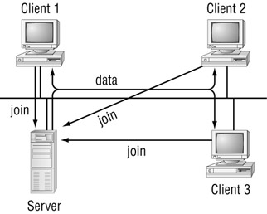
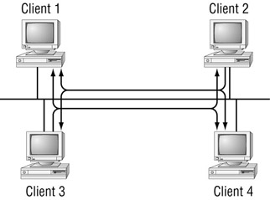
Multicast Techniques
There are two techniques used to control multicast sessions:
  A peer-to-peer technique, in which all clients can send messages to all other clients in the group
  A central server that sends messages to group clients
Peer-to-Peer Technique
Central Server

Slide 18
Sending Multicast Packets through Routers
Although multicast packets can be passed across network boundaries, making this happen requires some effort on the part of the network routers. By default, most routers do not pass multicast packets through to other subnets. If a router passed every received multicast packet to every interface, it would put the network at risk of being flooded with multicast packets. Instead, a system has been developed to allow selective forwarding of multicast packets.
The Internet Group Management Protocol (IGMP) was developed to aid in notifying routers when multicast packets should to be passed to various subnets. When a network device wants to join a multicast group, it sends an IGMP packet to the local router on its subnet. The IGMP packet registers the network device and the multicast group address from which that device must receive messages. This enables the router to know that it must forward any received multicast messages for that group to the subnet of the specified network device.

Slide 19
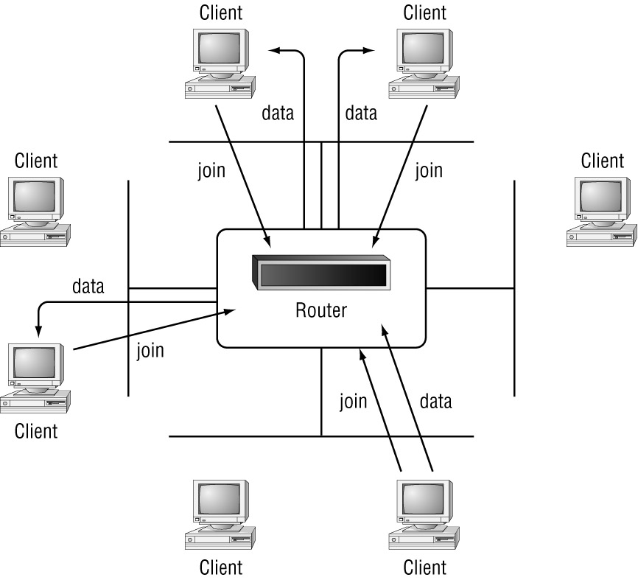

Slide 20
C# Socket Multicasting
The Socket class supports IP multicasting by using the SetSocketOption() method of the socket, but in a different way than with broadcasting. There are two socket options that can be used for multicasting:
  Adding the socket to a multicast group
  Removing the socket from a multicast group
Both of these options are defined by IP-level Socket option names, AddMembership and DropMembership. The value parameter of the SetSocketOption() method is not a normal data value. Instead, it uses the MulticastOption class. The MulticastOption class defines the multicast group that the socket will be added to or removed from. These two constructors are used for the MulticastOption class:
MulticastOption(IPAddress)
MulticastOption(IPAddress,IPAddress)
The firsts constructor format defines the IP multicast address used in the SetSocketOption. The default behavior of this constructor is to allow all interfaces on the system to be affected by the SetSocketOption() method. If you want to limit the action to an individual network interface on the system, the second constructor allows specification of an IPAddress value to represent the interface.
For example, if you wanted to add a socket to the multicast group 224.100.0.1, you would use the following statement:
sock.SetSocketOption(SocketOptionLevel.IP, SocketOptionName.AddMembership,
new MulticastOption(IPAddress.Parse("224.100.0.1"));
This sets the socket to join the multicast group for all interfaces on the system.

Slide 21
Receiving Multicast Packets
using System;
using System.Net;
using System.Net.Sockets;
using System.Text;
class MultiRecv {
public static void Main(){
Socket sock = new Socket(AddressFamily.InterNetwork,
SocketType.Dgram, ProtocolType.Udp);
Console.WriteLine("Ready to receive…");
IPEndPoint iep = new IPEndPoint(IPAddress.Any, 9050);
EndPoint ep = (EndPoint)iep;
sock.Bind(iep);
sock.SetSocketOption(SocketOptionLevel.IP, Â
SocketOptionName.AddMembership, Â
new MulticastOption(IPAddress.Parse("224.100.0.1")));
byte[] data = new byte[1024];
int recv = sock.ReceiveFrom(data, ref ep);
string stringData = Encoding.ASCII.GetString(data, 0, recv);
Console.WriteLine("received: {0} from: {1}", stringData, ep.ToString());
sock.Close();
}
}

Slide 22
The MultiRecv program creates a UDP socket in the normal way, using the standard Socket class methods. After being added to the multicast group, the socket blocks on a ReceiveFrom() method call, waiting for data to arrive.
There are two very important points to remember about using multicast sockets:
First, the SetSocketOption() method call must be made after the Bind() method call for the socket. This enables the multicast group to be set for a specific IPEndPoint address on the socket.
Second, once the socket has been added to a multicast group, the ReceiveFrom() method will accept packets destined for the following:
  The IPEndPoint address and port specified in the Bind() method
  The multicast group IP address specified in the MulticastOption constructor and the port specified in the IPEndPoint object
  Broadcast packets for the specified IPEndPoint port
  Many novice network programmers forget the second item, especially. When a ReceiveFrom() method is performed, you are not guaranteed to receive packets destined just for the multicast group. So be careful of extraneous packets sent from other sources. You will not be able to easily distinguish those packets.

Slide 23
Sending Multicast Packets
Sending multicast packets is easy. Nothing special must be done to send the packets to members in the multicast group; you just specify the multicast group IP address as the destination address of the packet. Listing 10.7 demonstrates this with the MultiSend.cs program.
using System;
using System.Net;
using System.Net.Sockets;
using System.Text;
class MultiSend
{
public static void Main()
{
Socket server = new Socket(AddressFamily.InterNetwork,
SocketType.Dgram, ProtocolType.Udp);
IPEndPoint iep = new IPEndPoint(IPAddress.Parse("224.100.0.1"), 9050);
byte[] data = Encoding.ASCII.GetBytes("This is a test message");
server.SendTo(data, iep);
server.Close();
}
}

Slide 24
Note that nowhere is the SetSocketOption() used on the socket. It is unnecessary if the socket will only send packets to the multicast group on the local subnet. As you will see later, if you want to forward multicast packets to other networks, you will have to use the SetSocketOption(). Also, if the socket needs to receive multicast packets, the SetSocketOption() must be used with the appropriate MulticastOption constructor for the multicast group.
Watching the Programs:
You can test these programs on your system and watch the network traffic using WinDump or Analyzer. In this case, because the MulticastOption constructor did not specify an interface, you can watch the network packets even if both the sender and receiver are running on the same machine.
First, start the MultiRecv program in a command prompt window. Then run the MultiSend program in a second command prompt window. You should see the following text, along with the address of the sending machine, displayed in the MultiRecv console:
C:\>MultiRecv
received: This is a test message from: 192.168.1.6:1294
C:\>

Slide 25
Sample Multicast Application
Multicast applications come in handy when a device needs to send information to multiple remote devices without having to maintain a connection to each device or send out multiple packets (one for each device). This section demonstrates a simple multicast whiteboard/chat system, in which any client that joins the multicast group can forward messages to all devices in the multicast group and can receive messages from all the other devices in the group. This is a common application for multicast communication. By allowing anyone on the network to join the multicast group chat, you create an environment where everyone can post comments to the group and see the posts from everyone else.
The basic format for this program will be the TcpChat program before. Instead of sending packets to an individual device, the chat program sends packets to the 224.100.0.1 multicast IP address. Any clients listening to that multicast group will receive the messages. Similarly, the TcpChat program will be modified to listen to the same multicast group address and display messages received from other chat clients on the network.
The easiest way to modify the existing TcpChat program is to create a new Thread object, which monitors the multicast group address. As messages are received on the address, they are displayed in the list box. The message-sending function can remain the same, with the exception that the multicast group IP address must now be used. Listing 10.13 is the multicast chat program that uses this concept.

Slide 26
E-mail Basics
Almost all Internet e-mail packages use the Unix e-mail model to implement electronic messaging with remote hosts. This model has become the most popular and widely implemented technique of delivering messages both to local customers and to remote host customers.
The Unix e-mail model divides the e-mail functions into three parts:
The Message Transfer Agent (MTA)
The Message Delivery Agent (MDA)
The Message User Agent (MUA)
Each of these parts performs a specific function in the e-mail process of sending, delivering, and displaying messages.
The MTA Process:
The MTA process handles both incoming and outgoing mail messages. This obviously includes two separate functions:
  Determining where and how to deliver outgoing mail
  Determining where to deliver incoming mail
  Each of these functions requires different processing capabilities within the MTA process.

Slide 27
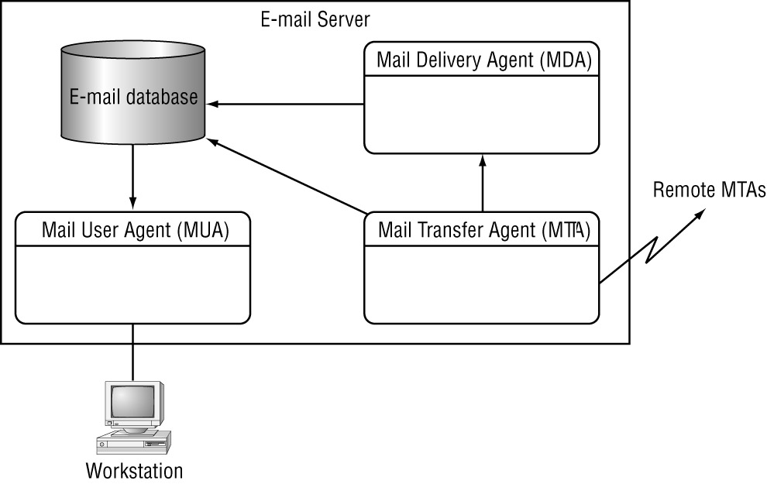

Slide 28
Sending Outgoing Mail:
For each outgoing mail message, the MTA must determine the destination of the recipient addresses. If the destination is the local system, the MTA process can either deliver the message directly to the local mailbox system, or pass the message off to the MDA process for delivery. However, if the destination is a remote domain, the MTA process must perform two functions:
  Determine the responsible mail server for the domain using the MX entry in DNS
  Establish a communication link with the remote mail server and transfer the message
The communication link that is established with the remote mail server almost always uses the Simple Mail Transfer Protocol (SMTP). This standard protocol provides a common communication technique to move messages between various types of systems on the Internet.

Slide 29
Receiving Incoming Mail:
The MTA process is responsible for accepting incoming messages from both local system users and remote host users. Many variables are associated with this seemingly simple function. Destination addresses in the mail message must be examined closely, and a decision must be made as to whether the message can in fact be delivered by the local system.
There are three categories of destination addresses that can be used in a mail message:
  Local system accounts Every mail system, whether Windows, Unix, or even Macintosh, has its own set of configured local user accounts that have access to the system. The MTA must recognize messages destined for the user accounts and forward them either directly to the user’s mailbox, or to a separate MDA process for delivery.
  Local alias accounts Many MTA programs allow for user alias names to be created. The alias name itself cannot store mail messages. Instead, it is used as a pointer to one or more actual system user accounts where the messages are stored. Once the MTA determines that the alias name is valid, it converts the destination address to the actual system user account name and either delivers the message or passes it to an MDA process.
  Remote user accounts Many MTA processes also accept incoming messages destined for user accounts not on the local system. This is the trickiest of the delivery categories. There have been many debates and arguments over how MTA programs handle mail destined for remote user accounts.

Slide 30
This technique is called mail relaying. A mail server accepts a message destined for a remote host user and automatically forwards it to the destination remote host. For many ISPs, this feature is a necessity because dial-up customers do not have the capability to send Internet mail messages directly to remote hosts. Instead, they must send messages to the ISP mail server, which in turn passes them off (relays them) to the remote destination.
Unfortunately, mail relaying can be exploited. Unscrupulous individuals can use relay mail servers to help hide their original host addresses when forwarding mass mail advertisements to remote e-mail users. Whether it’s called Unsolicited Commercial E-mail (UCE), Unsolicited Bulk E-mail (UBE), or just plain old spam, this mail is annoying and must be stopped by the mail administrator.

Slide 31
The MDA Process
The primary function of the MDA process is to deliver mail messages destined for local system user accounts. To do this, the MDA must know the type and location of the individual user mailboxes. Most e-mail systems use some type of database system to track the e-mail messages stored for local users. The MDA process must have access to each user’s mailbox to insert incoming messages.
Many MDA processes also perform advanced techniques in addition to just delivering mail messages:
Automatic mail filtering Possibly the most helpful and popular feature of the MDA process is enabling the filtering of incoming mail messages. For users who get a lot of e-mail messages, this feature can be a lifesaver. Messages can be automatically sorted into separate e-mail folders based on a subject header value, or even just one word contained in the subject header.
Most MDA programs also allow the mail administrator to configure a global filter that can help block spam and well-known virus mail messages. This is done using standard text wildcard expressions. Each expression can be matched against incoming message subject headers, and the messages that match the expression are dropped and not delivered.
Automatic mail replying Many MDA programs allow the customer to configure an auto-reply message for e-mail messages. Some auto-reply messages can be configured to reply to all mail messages received by a user, such as an out-of-office message indicator. Other auto-reply messages can be set up to reply to specific text found in the message subject header, much like the mail filter. When a message matches the text expression, a specific auto-reply message is automatically sent.
Automatic Program Initialization The ability to start system programs based on incoming mail messages is another feature found in MDA programs. Certainly there must be controls in place to prevent misuse, but when used safely this feature is a handy tool. Administrators can use it to start server processes remotely, or to change configuration values from a machine other than the server.

Slide 32
The MUA Process
  The MUA process allows customers who are located remotely from their mail server to access mailboxes. One common misconception about MUA programs is that they send mail messages. The MUA process itself is only responsible for reading mailbox messages; it does not receive or send new messages. The misconception comes from the fact that many MUA programs include a small MTA process that offers the convenience of relaying new messages to the mail server.
  There are two philosophies underlying MUA programs, both dealing with how incoming messages are read and stored.

Slide 33
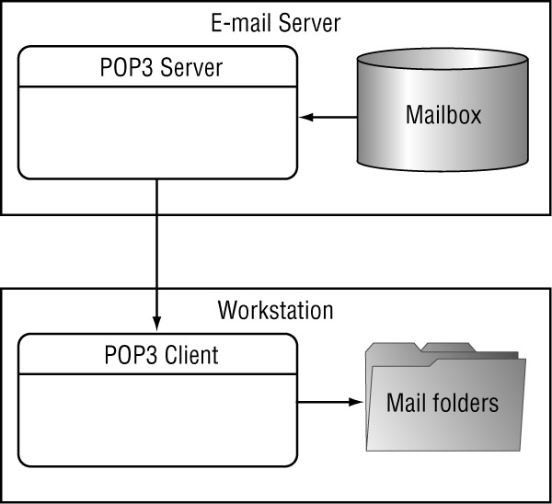
Storing Messages on the Client
Many ISPs prefer to have customers download their messages directly to their workstations. Once the message is downloaded, it is removed from the mail server. This helps the mail administrator maintain the disk space on the server and prevent messages from clogging up the disk system.

Slide 34
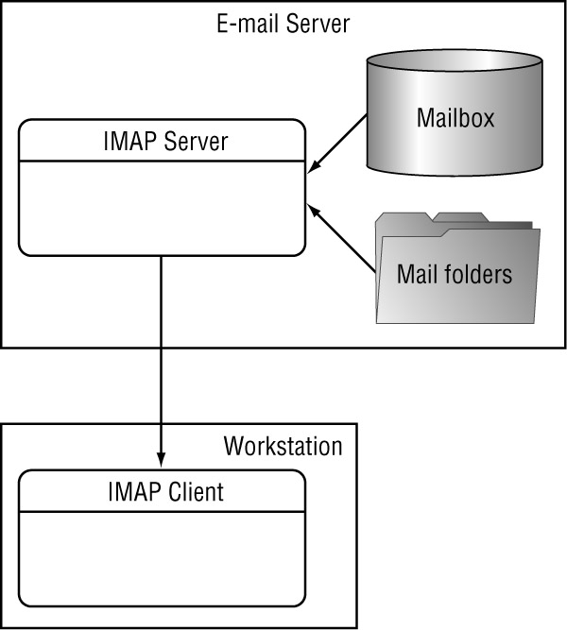
Storing Messages on the Server
As an alternative to the POP3 access method, the Interactive Mail Access Protocol (IMAP, or IMAPrev4 for version 4) was created. IMAP allows the customer to build folders on the mail server and store messages in the folders instead of downloading them to the workstation.

