Slide 1

Security
Computer System Security and Access Controls

Slide 2
Introduction
Computer security covers a lot of territory: locking your server and telecommunications rooms, locking your machine, protecting your login accounts with strong passwords, using file protection and adhering to a regular backup schedule to keep your data from being destroyed, encrypting network communications lines, and using special shields to keep electromagnetic emanations from leaking out of your computer (TEMPEST).
But when people talk about computer security, they usually mean what is called computer system security, which is a fancy way of saying data protection.

Slide 3
What Makes a System Secure?
In the most basic sense, computer system security ensures that your computer does what it's supposed to doeven if its users don't do what they're supposed to do. It protects the information stored in it from being lost, changed either maliciously or accidentally, or read or modified by those not authorized to access it. How does computer system security provide protection? There are four primary methods:
System access controls
  These methods ensure that unauthorized users don't get into the system and encourage (sometimes force) authorized users to be security-consciousfor example, by changing their passwords on a regular basis. The system also protects password data and keeps track of who's doing what in the system, especially if what they're doing is security-related (e.g., logging in, trying to open a file, using special privileges). System access controls are the soul of authentication.
Data access controls
  These methods monitor who can access what data, and for what purpose. Another word for this is authorization, that is, what you can do once you are authenticated. Your system might support discretionary access controls; with these, you determine whether other people can read or change your data. Your system might support mandatory access controls; with these, the system determines access rules based on the security levels of the people, the files, and the other objects in your system. Role-based access controls are a hybrid system; these methods extend individual authorization to group memberships.

Slide 4
2
System and Security Administration
  These methods perform the offline procedures that make or break a secure systemby clearly delineating system administrator responsibilities, by training users appropriately, and by monitoring users to make sure that security policies are observed. This category also involves more global security management; for example, figuring out what security threats face your system and what it will cost to protect against them.
System Design
  These methods take advantage of basic hardware and software security characteristics; for example, using a system architecture that's able to segment memory, thus isolating privileged processes from nonprivileged processes.

Slide 5
Definitions
Identification - a claim about identity
  Who or what I am (global or local)
Authentication - confirming that claims are true
  I am who I say I am
  I have a valid credential
Authorization - granting permission based on a valid claim
  Now that I have been validated, I am allowed to access certain resources or take certain actions
Access control system - a system that authenticates users and gives them access to resources based on their authorizations
  Includes or relies upon an authentication mechanism
  May include the ability to grant course or fine-grained authorizations, revoke or delegate authorizations

Slide 6
Logical Access Controls
Logical access controls provide a technical means of controlling what information users can utilize, the programs they can run, and the modifications they can make.
Logical access controls can help protect:
  operating systems and other system software from unauthorized modification or manipulation (and thereby help ensure the system's integrity and availability);
  the integrity and availability of information by restricting the number of users and processes with access; and
  confidential information from being disclosed to unauthorized individuals.
On many multi-user systems, requirements for using (and prohibitions against the use of) various computer resources vary considerably. Typically, for example, some information must be accessible to all users, some may be needed by several groups or departments, and some should be accessed by only a few individuals. (Users need not be actual human users. They could include, for example, a program or another computer requesting use of a system resource.) While it is obvious that users must have access to the information they need to do their jobs, it may also be required to deny access to non-job-related information. It may also be important to control the kind of access that is afforded (e.g., the ability for the average user to execute, but not change, system programs). These types of access restrictions enforce policy and help ensure that unauthorized actions are not taken.
The term access is often confused with authorization and authentication.

Slide 7
1
Access is the ability to do something with a computer resource. This usually refers to a technical ability (e.g., read, create, modify, or delete a file, execute a program, or use an external connection).
Authorization is the permission to use a computer resource. Permission is granted, directly or indirectly, by the application or system owner. It is the permission to do something with information in a computer, such as read a file.
Authentication is proving (to some reasonable degree) that users are who they claim to be. Typically, identification is performed by entering a name or a user ID, and authentication is performed by entering a password, although many organizations are moving to stronger authentication methods. For example, banks require a magnetic stripe card and a personal identification number to authenticate users at ATMs.

Slide 8
2
Access is the ability to do something with a computer resource (e.g., use, change, or view).
Access control is the means by which the ability is explicitly enabled or restricted in some way (usually through physical and system-based controls).
Computer-based access controls are called logical access controls. Logical access controls can prescribe not only who or what (e.g., in the case of a process) is to have access to a specific system resource but also the type of access that is permitted. These controls may be built into the operating system, may be incorporated into applications programs or major utilities (e.g., database management systems or communications systems), or may be implemented through add-on security packages.
Logical access controls may be implemented internally to the computer system being protected or may be implemented in external devices.
Although the ability to sign onto a computer system (enter a correct userid and password) is often called "accessing the system," this is actually the identification and authentication function. Once a user has entered a system, access controls determine what the user can do, i.e., which data the user can read or modify and what programs the user can execute.

Slide 9
3
Controlling access is normally thought of as applying to human users (e.g., will technical access be provided for user JSMITH to the file "payroll.dat") but access can be provided to other computer systems.
Also, access controls are often incorrectly thought of as only applying to files. However, they also protect other system resources such as the ability to place an outgoing long-distance phone call though a system modem (as well as, perhaps, the information that can be sent over such a call).
Access controls can also apply to specific functions within an application and to specific fields of a file.
When determining what kind of technical access to allow to specific data, programs, devices, and resources, it is important to consider who will have access and what kind of access they will be allowed. It may be desirable for everyone in the organization to have access to some information on the system, such as the data displayed on an organization's daily calendar of non-confidential meetings. The program that formats and displays the calendar, however, might be modifiable by only a very few system administrators, while the operating system controlling that program might be directly accessible by still fewer.

Slide 10
Access Criteria
In deciding whether to permit someone to use a system resource logical access controls examine whether the user is authorized for the type of access requested. (Note that this inquiry is usually distinct from the question of whether the user is authorized to use the system at all, which is usually addressed in an identification and authentication process.)
The system uses various criteria to determine if a request for access will be granted. They are typically used in some combination. Many of the advantages and complexities involved in implementing and managing access control are related to the different kinds of user accesses supported.
Identity
  It is probably fair to say that the majority of access controls are based upon the identity of the user (either human or process), which is usually obtained through identification and authentication (I&A). The identity is usually unique, to support individual accountability, but can be a group identification or can even be anonymous. For example, public information dissemination systems may serve a large group called "researchers" in which the individual researchers are not known.

Slide 11
1
Roles
  Access to information may also be controlled by the job assignment or function (i.e., the role) of the user who is seeking access. Examples of roles include data entry clerk, purchase officer, project leader, programmer, and technical editor. Access rights are grouped by role name, and the use of resources is restricted to individuals authorized to assume the associated role. An individual may be authorized for more than one role, but may be required to act in only a single role at a time. Changing roles may require logging out and then in again, or entering a role‑changing command. Note that use of roles is not the same as shared-use accounts. An individual may be assigned a standard set of rights of a shipping department data entry clerk, for example, but the account would still be tied to that individual's identity to allow for auditing.
  The use of roles can be a very effective way of providing access control. The process of defining roles should be based on a thorough analysis of how an organization operates and should include input from a wide spectrum of users in an organization.

Slide 12
2
Location
  Access to particular system resources may also be based upon physical or logical location. For example, in a prison, all users in areas to which prisoners are physically permitted may be limited to read-only access. Changing or deleting is limited to areas to which prisoners are denied physical access. The same authorized users (e.g., prison guards) would operate under significantly different logical access controls, depending upon their physical location. Similarly, users can be restricted based upon network addresses (e.g., users from sites within a given organization may be permitted greater access than those from outside).
Time
  Time-of-day or day-of-week restrictions are common limitations on access. For example, use of confidential personnel files may be allowed only during normal working hours -- and maybe denied before 8:00 a.m. and after 6:00 p.m. and all day during weekends and holidays.

Slide 13
3
Transaction
  Another approach to access control can be used by organizations handling transactions (e.g., account inquiries). Phone calls may first be answered by a computer that requests that callers key in their account number and perhaps a PIN. Some routine transactions can then be made directly, but more complex ones may require human intervention. In such cases, the computer, which already knows the account number, can grant a clerk, for example, access to a particular account for the duration of the transaction. When completed, the access authorization is terminated. This means that users have no choice in which accounts they have access to, and can reduce the potential for mischief. It also eliminates employee browsing of accounts (e.g., those of celebrities or their neighbors) and can thereby heighten privacy.

Slide 14
4
Service Constraints
  Service constraints refer to those restrictions that depend upon the parameters that may arise during use of the application or that are pre-established by the resource owner/manager. For example, a particular software package may only be licensed by the organization for five users at a time. Access would be denied for a sixth user, even if the user were otherwise authorized to use the application. Another type of service constraint is based upon application content or numerical thresholds. For example, an ATM machine may restrict transfers of money between accounts to certain dollar limits or may limit maximum ATM withdrawals to $500 per day. Access may also be selectively permitted based on the type of service requested. For example, users of computers on a network may be permitted to exchange electronic mail but may not be allowed to log in to each others' computers.

Slide 15
Common Access Modes
In addition to considering criteria for when access should occur, it is also necessary to consider the types of access, or access modes. The concept of access modes is fundamental to access control. Common access modes, which can be used in both operating or application systems, include the following:
  Read access provides users with the capability to view information in a system resource (such as a file, certain records, certain fields, or some combination thereof), but not to alter it, such as delete from, add to, or modify in any way. One must assume that information can be copied and printed if it can be read (although perhaps only manually, such as by using a print screen function and retyping the information into another file).
  Write access allows users to add to, modify, or delete information in system resources (e.g., files, records, programs). Normally user have read access to anything they have write access to.
  Execute privilege allows users to run programs.
  Delete access allows users to erase system resources (e.g., files, records, fields, programs). Note that if users have write access but not delete access, they could overwrite the field or file with gibberish or otherwise inaccurate information and, in effect, delete the information.

Slide 16
1
Other specialized access modes (more often found in applications) include:
  Create access allows users to create new files, records, or fields.
  Search access allows users to list the files in a directory.
Of course, these criteria can be used in conjunction with one another. For example, an organization may give authorized individuals write access to an application at any time from within the office but only read access during normal working hours if they dial-in.
Depending upon the technical mechanisms available to implement logical access control, a wide variety of access permissions and restrictions are possible. No discussion can present all possibilities.

Slide 17
Building blocks of authentication
Factors
  Something you know (or recognize)
  Something you have
  Something you are
Two factors are better than one
  Especially two factors from different categories
What are some examples of each of these factors?
What are some examples of two-factor authentication?

Slide 18
System Access: Logging into Your System
Identification is the way you tell the system who you are. Authentication is the way you prove to the system that you are who you say you are. In just about any multi-user system that involves local area networks, and in most desktop and laptop PCs, you must identify yourself, and the system must authenticate your identity, before you can use the system. There are three classic ways to do so:
What you know
  The most familiar example is a password. The theory is that if you know the secret password for an account, you must be the owner of that account. There is a problem with this theory: you might give your password away or have it stolen from you. If you write it down, someone might read it. If you tell someone, that person might tell someone else. If you have a simple, easy-to-guess password, someone might guess it or systematically crack it.

Slide 19
2
What you have
  Examples are keys, tokens, badges, and smart cards you must use to unlock your terminal or your account. The theory is that if you have the key or equivalent, you must be the owner of it. The problem with this theory is that you might lose the key, it might be stolen from you, or someone might borrow it and duplicate it. Electronic keys, badges, and smart cards can be used as authentication devices and as access devices for buildings and computer rooms. Some of the most sophisticated new security tokens are physical devices that continually calculate new passwords based on time-of-day or according to secure algorithms. These passwords are similarly calculated back to the system for which entrance is sought, and the password from the petitioning party must match the password calculated locally.

Slide 20
3
What you are
  Examples are physiological or behavioral traits, such as your fingerprint, handprint, retina pattern, iris pattern, voice, signature, or keystroke pattern. Biometric systems compare your particular trait against the one stored for you and determine whether you are who you claim to be. Problems sometimes occur with false positives and false negatives; occasionally, a valid user is rejected and an invalid user is accepted. In addition, a big problem with these authentication systems is that, on the whole, people aren't comfortable using them.

Slide 21
Multifactor authentication
Multifactor authentication is a way to cascade the three methods listed previously such that if an attacker gets past one safeguard, they still have to pass another. Passwords are still, far and away, the authentication tool of choice. In a multifactor authentication system, username and password would be augmented with one of the other two systems. In fact, almost every time authentication devices such as tokens and biometric devices are used, they usually supplement, not replace, conventional login IDs and passwords.

Slide 22
Login Processes
In most systems, you identify yourself to the system by entering some kind of unique login identifier or username, followed by a password. The identifier is typically a name, initials, department, or an account number assigned by the system administrator based on your own name and/or group. The password is typically a string of letters and/or numbers known only to you.
The exact method of the username/password authentication process varies depending on the network operating system. Generally, however, it involves one or more of the following:
Encryption
  This method scrambles a password so that it cannot be deciphered by someone who monitors storage or transmissions. The opposite of encryption is clear text, in which password or other information is transmitted unmodified.
Challenge and response
  With this method, the user is asked to authenticate at the beginning of the exchange, and frequently at random intervals thereafter

Slide 23
Password Authentication Protocol
In Password Authentication Protocol (PAP), the user provides a username and password, and these are compared with values stored in a table to see if they match. PAP is essentially the same as the classic Unix login. With PAP, login information is transmitted in the clear, that is, unencrypted, or using clear text.
Challenge Handshake Authentication Protocol (CHAP)
  The Challenge Handshake Authentication Protocol (CHAP) is a type of authentication in which the device doing the authenticating, usually a network server, sends the client program an ID value and a random number, and both the sender and peer share a predefined secret word, phrase or value. The client strings together the random value (or nonce), the ID, and the secret, and calculates a new value from them using what is called a hash function. This new value is sent to the authenticator, which has built the same string and calculated a similar hash. The authenticator compares the result with the value it received from the client. If the values match, the peer is authenticated. To increase security, the authenticator can be set to repeat the challenge-response process periodically throughout the communications session.

Slide 24
1
Mutual authentication
  Mutual authentication can be thought of as two-way authentication. The client authenticates to the server, and then the server authenticates to the client or workstation. This allows the server to verify that the user is at an authorized workstation. If not, access is denied. Mutual authentication can prevent masquerade attacks, in which identity is pretended in order to gain access, or man-in-the-middle attacks, in which an attacker represents itself to the server as a valid client, and to the client as the valid server, taking advantage of the information flow to steal secrets or inject malicious data.
One-time password
  The one-time password (OTP) is a variation of the username/password combination. With OTP, the user creates a password, and the system creates a variation of the password each time a password is required. In this way, the same password is never used twice. With OTP, even if an attacker learns a password by snooping, he won't be able to use it again.
Per-session authentication
  Setting up an authentication method that requires the client to reauthenticate for each exchange of information is burdensome, but it provides a great deal of security. One way to do per-session authentication is to increment a counter with every transmission. Because the password changes constantly, this form of authentication protects against attackers who snoop.

Slide 25
Tokens/ Memory tokens
Objects that a user possesses for the purpose of Identification and Authentication are called tokens. This section divides tokens into two categories: memory tokens and smart tokens.
Memory tokens store, but do not process, information. Special reader/writer devices control the writing and reading of data to and from the tokens. The most common type of memory token is a magnetic striped card, in which a thin stripe of magnetic material is affixed to the surface of a card (e.g., as on the back of credit cards). A common application of memory tokens for authentication to computer systems is the automatic teller machine (ATM) card. This uses a combination of something the user possesses (the card) with something the user knows (the PIN).
Some computer systems authentication technologies are based solely on possession of a token, but they are less common. Token-only systems are more likely to be used in other applications, such as for physical access.

Slide 26
Memory tokens
Benefits of Memory Token Systems.
  Memory tokens when used with PINs provide significantly more security than passwords. In addition, memory cards are inexpensive to produce. For a hacker or other would-be masquerader to pretend to be someone else, the hacker must have both a valid token and the corresponding PIN. This is much more difficult than obtaining a valid password and user ID combination (especially since most user IDs are common knowledge).
  Another benefit of tokens is that they can be used in support of log generation without the need for the employee to key in a user ID for each transaction or other logged event since the token can be scanned repeatedly. If the token is required for physical entry and exit, then people will be forced to remove the token when they leave the computer. This can help maintain authentication.
Problems With Memory Token Systems. Although sophisticated technical attacks are possible against memory token systems, most of the problems associated with them relate to their cost, administration, token loss, user dissatisfaction, and the compromise of PINs.

Slide 27
Memory tokens
  Requires special reader. The need for a special reader increases the cost of using memory tokens. The readers used for memory tokens must include both the physical unit that reads the card and a processor that determines whether the card and/or the PIN entered with the card is valid. If the PIN or token is validated by a processor that is not physically located with the reader, then the authentication data is vulnerable to electronic monitoring (although cryptography can be used to solve this problem).
  Token loss. A lost token may prevent the user from being able to log in until a replacement is provided. This can increase administrative overhead costs. The lost token could be found by someone who wants to break into the system, or could be stolen or forged.
  User Dissatisfaction. In general, users want computers to be easy to use. Many users find it inconvenient to carry and present a token. However, their dissatisfaction may be reduced if they see the need for increased security.

Slide 28
Smart Tokens
A smart token expands the functionality of a memory token by incorporating one or more integrated circuits into the token itself. When used for authentication, a smart token is another example of authentication based on something a user possesses (i.e., the token itself). A smart token typically requires a user also to provide something the user knows (i.e., a PIN or password) in order to "unlock" the smart token for use.
There are many different types of smart tokens. In general, smart tokens can be divided three different ways based on physical characteristics, interface, and protocols used. These three divisions are not mutually exclusive.
  Physical Characteristics. Smart tokens can be divided into two groups: smart cards and other types of tokens. A smart card looks like a credit card, but incorporates an embedded microprocessor. Smart cards are defined by an International Standards Organization (ISO) standard. Smart tokens that are not smart cards can look like calculators, keys, or other small portable objects.

Slide 29
Smart Tokens
  Interface. Smart tokens have either a manual or an electronic interface. Manual or human interface tokens have displays and/or keypads to allow humans to communicate with the card. Smart tokens with electronic interfaces must be read by special reader/writers. Smart cards, described above, have an electronic interface. Smart tokens that look like calculators usually have a manual interface.
  Protocol. There are many possible protocols a smart token can use for authentication. In general, they can be divided into three categories: static password exchange, dynamic password generators, and challenge-response.
  Static tokens work similarly to memory tokens, except that the users authenticate themselves to the token and then the token authenticates the user to the computer.

Slide 30
Smart Tokens
A token that uses a dynamic password generator protocol creates a unique value, for example, an eight-digit number, that changes periodically (e.g., every minute). If the token has a manual interface, the user simply reads the current value and then types it into the computer system for authentication. If the token has an electronic interface, the transfer is done automatically. If the correct value is provided, the log-in is permitted, and the user is granted access to the system.
Tokens that use a challenge-response protocol work by having the computer generate a challenge, such as a random string of numbers. The smart token then generates a response based on the challenge. This is sent back to the computer, which authenticates the user based on the response. The challenge-response protocol is based on cryptography. Challenge-response tokens can use either electronic or manual interfaces.
There are other types of protocols, some more sophisticated and some less so. The three types described above are the most common.

Slide 31
Benefits of Smart Tokens
Smart tokens offer great flexibility and can be used to solve many authentication problems. The benefits of smart tokens vary, depending on the type used. In general, they provide greater security than memory cards. Smart tokens can solve the problem of electronic monitoring even if the authentication is done across an open network by using one-time passwords.
  One-time passwords. Smart tokens that use either dynamic password generation or challenge-response protocols can create one-time passwords. Electronic monitoring is not a problem with one-time passwords because each time the user is authenticated to the computer, a different "password" is used. (A hacker could learn the one-time password through electronic monitoring, but would be of no value.)
  Reduced risk of forgery. Generally, the memory on a smart token is not readable unless the PIN is entered. In addition, the tokens are more complex and, therefore, more difficult to forge.
  Multi-application. Smart tokens with electronic interfaces, such as smart cards, provide a way for users to access many computers using many networks with only one log-in. This is further discussed in the Single Log-in section of this chapter. In addition, a single smart card can be used for multiple functions, such as physical access or as a debit card.

Slide 32
Problems with Smart Tokens
Like memory tokens, most of the problems associated with smart tokens relate to their cost, the administration of the system, and user dissatisfaction. Smart tokens are generally less vulnerable to the compromise of PINs because authentication usually takes place on the card. (It is possible, of course, for someone to watch a PIN being entered and steal that card.) Smart tokens cost more than memory cards because they are more complex, particularly challenge-response calculators.
Electronic reader/writers can take many forms, such as a slot in a PC or a separate external device. Most human interfaces consist of a keypad and display.
  Need reader/writers or human intervention. Smart tokens can use either an electronic or a human interface. An electronic interface requires a reader, which creates additional expense. Human interfaces require more actions from the user. This is especially true for challenge-response tokens with a manual interface, which require the user to type the challenge into the smart token and the response into the computer. This can increase user dissatisfaction.
  Substantial Administration. Smart tokens, like passwords and memory tokens, require strong administration. For tokens that use cryptography, this includes key management.

Slide 33
Biometric Authentication
Based on Something the User Is
Biometric authentication technologies use the unique characteristics (or attributes) of an individual to authenticate that person's identity. These include physiological attributes (such as fingerprints, hand geometry, or retina patterns) or behavioral attributes (such as voice patterns and hand-written signatures). Biometric authentication technologies based upon these attributes have been developed for computer log-in applications.
Biometric authentication generally operates in the following manner:
  Before any authentication attempts, a user is "enrolled" by creating a reference profile (or template) based on the desired physical attribute. The resulting template is associated with the identity of the user and stored for later use.
  When attempting authentication, the user's biometric attribute is measured. The previously stored reference profile of the biometric attribute is compared with the measured profile of the attribute taken from the user. The result of the comparison is then used to either accept or reject the user. Biometric authentication is technically complex and expensive, and user acceptance can be difficult. However, advances continue to be made to make the technology more reliable, less costly, and more user-friendly.

Slide 34
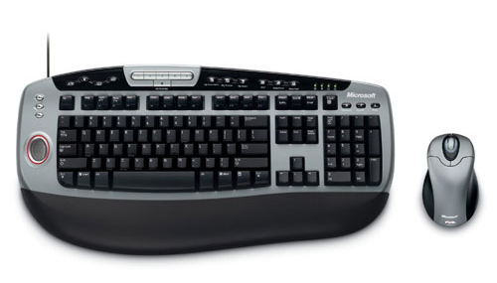
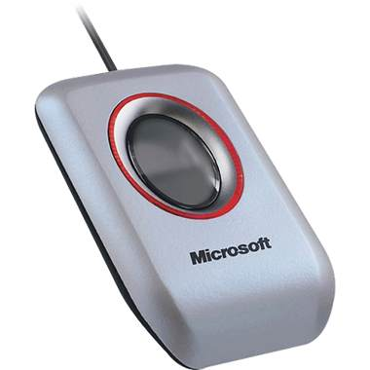
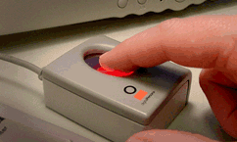
Biometric Authentication
Notes:
In the past few months a number of inexpensive fingerprint readers have become available, marketed to the home user. For example, Microsoft has a series of finger print readers packaged with mice and keyboards that come with software that allow users to use IE and login to web sites with their finger prints.
Right now the available software does not allow these readers to work with arbitrary applications, and users still have to remember passwords if they use multiple computers.

Slide 35
Biometric Authentication
Biometric systems can provide an increased level of security for computer systems, but the technology is still less mature than that of memory tokens or smart tokens. Imperfections in biometric authentication devices arise from technical difficulties in measuring and profiling physical attributes as well as from the somewhat variable nature of physical attributes. These may change, depending on various conditions. For example, a person's speech pattern may change under stressful conditions or when suffering from a sore throat or cold.
Due to their relatively high cost, biometric systems are typically used with other authentication means in environments requiring high security.

Slide 36
Passwords
In spite of all the options, far and away the most common method for authentication is the username/password combination, as is found on any Unix, Linux, or Windows system.
You type the password (which is ordinarily never echoed, or displayed, on the terminal screen, unless it is by a series of asterisks, which may or may not correspond to the number of keystrokes). The system then authenticates your identity by verifying that the entered password is valid for your account. You'll be able to proceed only if the password you enter matches the password stored for you in the system.
Passwords are your first defense against intruders. To protect your system and your data, you must select good passwords, and you must protect them carefully.
This all assumes that you are the only user of your computer. If you share a computer with multiple users, say workers on different shifts, or supervisors who keep accounts on your machine to aid maintenance, any one of the passwords could be the target of the attack.

Slide 37
Typical password advice
Pick a hard to guess password
Don’t use it anywhere else
Change it often
Don’t write it down
So what do you do when every web site you visit asks for a password?
Notes:
Common knowledge that this is advice doesn’t work

Slide 38
Protecting passwords
Access decisions are the heart of system security, and access decisions are based on passwords, so it's vital that your system protect its passwords and other login information.
Most security administrators protect passwords in three important ways: they make passwords hard to guess, they make login controls hard to crack, and they protect the file in which passwords are stored.
Making passwords hard to guess is a matter of user training and occasionally testing to see if the system yields to a common dictionary attack. Such penetration testing can smoke out users who have weak, easily guessed passwords.
Making passwords hard to steal is a matter of hiding the file in which they are stored, and in some cases, performing a one-way encryption called a message digest, or hash which stores the passwords in an encrypted form.

Slide 39
Hints for Protecting Passwords -1
Don't allow any logins without passwords. If you're the system administrator, make sure every account has a password.
Don't keep passwords that may have come with your system. Change all test, vendor, or guest passwordsfor example, root, system, test, demo, and guest before allowing users to log in.
Don't ever let anyone use your password. If you must share it, say because you are at home, and someone at work needs it, change it as soon as possible, or consult a security administrator to create a new one until you can change yours.
Don't write your password downparticularly on your terminal, computer, or anywhere around your desk. If you ever do write your password down, don't identify it as a password. Better yet, add a few leading or trailing characters, and write two or three more potential passwords along with it. Consider writing it backwards.

Slide 40
2
Don't type a password while anyone is watching.
Don't record your password online or send it anywhere via electronic mail. In his book The Cuckoo's Egg, Cliff Stoll reports how his intruder scanned electronic mail messages for references to the word "password."
Don't keep the same password indefinitely. Even if your password hasn't been compromised, change it on a regular basis.
An old saying from the USENET: "A password should be like a toothbrush. Use it every day; change it regularly; and DON'T share it with friends."

Slide 41
Hints for Picking Passwords
Pick passwords that aren't words (English or otherwise) or names (especially your own, that of a fictional character such as Hamlet or Gandolf, or that of a family member, a pet, or a car).
Pick a mix of alphabetic and numeric characters. Never use an all-numeric password(especially your phone number or social security number).
Pick long passwords. If your password is only a few letters long, an attacker can easily try all combinations. Most systems insist that your password be at least 6-8 characters. Some systems support passwords of up to 40 or more characters.
Pick different passwords for the different machines or network nodes you access.
Mixing special characters such as & or $ can help increase the pool of available characters a brute force attacker must cycle through. Be careful about using numbers that resemble letters, or 31337-speak, because the attackers know it well. Check with your system administrator to find which characters are allowed.

Slide 42
Protecting your password in storage
Every system needs to maintain its authentication data. Typically, valid passwords are stored in a password file. This file is accessed only under certain limited circumstanceswhen a new user is registered, when you change your password, or when you log in and need to be authenticated. As a security protection against imposters or compromised passwords, in most cases, administrators cannot access stored passwords. The best they can do is reset a password to a temporary value, such as "letmein" or "password," and require a user to change the temporary password at the next login.
Protection of passwords is extremely critical to system security. Systems commonly use both encryption and access controls to protect password data.

Slide 43
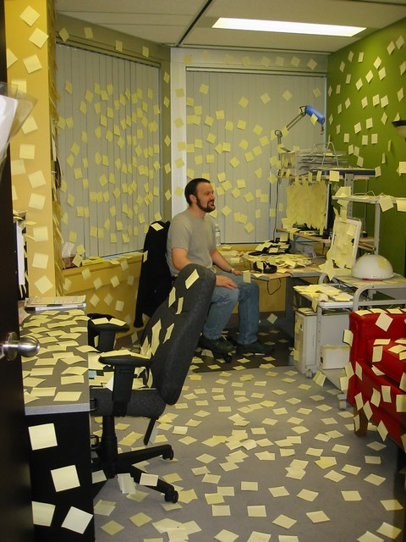
2

Slide 44
3
Encryption
  Most systems encrypt the data stored in the system's password file. Encryption transforms original information into altered information that usually has the appearance of random text. Encryption ensures that even if file security is somehow breached, the intruder won't be able to read the passwords in the file; they'll look like gibberish.
  Most systems perform one-way encryption of passwords. One-way encryption means that the password is not intended to be decryptedthat is, deciphered into its original form. When the system administrator supplies you with your initial password, it's encrypted before it's stored in the password file. The original password is not preserved, not even in memory. Each time you log in and enter your password, the system encrypts the password you enter and compares the encrypted version with the encrypted password stored in the password file to be sure you've entered a valid password. Remember too that the password is never displayed on the terminal screen.

Slide 45
4
Access controls
  Even encrypted passwords can be cracked by a determined foe. Many systems store encrypted password data in files known as shadow password files, which have the most restrictive protection available in the system. In most systems, access is limited to the system administrator, usually by specifying only the administrator's ID in an ACL on the file.

Slide 46
Problems with Passwords
Selection
  Difficult to think of a good password
  Passwords people think of first are easy to guess
Memorability
  Easy to forget passwords that aren’t frequently used
  Difficult to remember “secure” passwords with a mix of upper & lower case letters, numbers, and special characters
Reuse
  Too many passwords to remember
  A previously used password is memorable
Sharing
  Often unintentional through reuse
  Systems aren’t designed to support the way people work together and share information

Slide 47
Password attacks
There are two primary methods of password cracking. The first is to try to guess a password by trying every possible combination of characters, one attempt at a time (a so-called brute force attack). Like everything else, this process has been automated. Crackers now use computers to do the guessing. In theory, the longer the password, the longer it takes to try every combination. For example, with a password containing eight random characters, there are 2.8 trillion combinations. Even a fast computer could take weeks to saw through all possible combinations.
The second method is a dictionary attack. The dictionary attack works because most users don't select random, or even decently secure passwords. Most users typically pick passwords that are laughably easy to guesstheir initials, their childrens' names, their license plates, etc. Studies indicate that a very large percentage of users' passwords can easily be guessed. With the help of online dictionaries of common passwords (English words, names of people, animals, cars, fictional characters, places, and so on), crackers are quite likely to be able to guess a good many of the passwords most people are likely to choose. But if you select a good password an intruder shouldn't be able to guess itwith or without a dictionary.

Slide 48
Authorization
Once you've been authenticated, the system uses your ID (and the security information associated with it) to determine what you're allowed to do in the computer or on the network. The process of determining your bounds is called authorization. For example, if you try to modify a sensitive file, the system checks your authenticated user ID against the list of IDs representing users who are authorized to read and write the data in that file. Only if your ID appears in that list will the system allow you to access the file.

Slide 49
2
One of the important pieces of information that appears in your authentication profile or user list is an indication of what kind of user you are. Most systems support several categories of users, or roles; a typical set includes regular users, a system administrator, and an operator. Highly secure systems may define a security officer as a separate category. Each category of user has specific privileges and responsibilities for example, specific programs the user can run. The system administrator, for example, may effectively be able to do anything in the system, including overriding or circumventing security requirements and creating new, spurious accounts for the use of attackers. (The power of the system administrator is a major issue in secure systems;

Slide 50
3
Systems typically maintain a file containing information about your privileges and characteristics; in some systems, this is called a security profile, an authentication profile, or a user list. Your profile might tell the system what your clearance is (e.g., SECRET), whether you're allowed to change your own password, whether you can log in on weekends, whether you can run backup programs and other privileged programs, and a myriad of other information.
In some cases, your profile is in the same file as the password list; in other cases, the information might be kept in separate files. In any case, it's vital that your system protect this information; any compromise can jeopardize the security of the entire system.

Slide 51
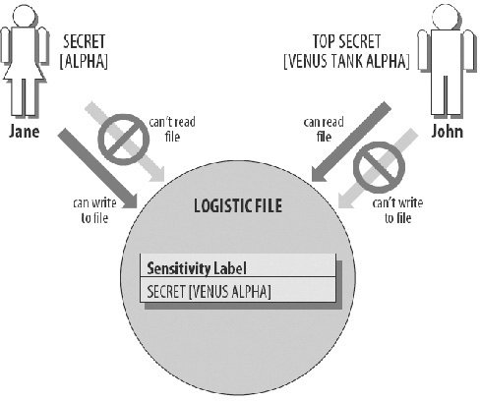
Sensitivity labels
Every subject and object in a system supporting mandatory access controls has a sensitivity label associated with it. A sensitivity label consists of two parts: a classification and a set of categories (sometimes called compartments).

Slide 52
1
The classification is a single, hierarchical level. In the so-called military security model (based on the Department of Defense multilevel security policy), there are four distinct levels:
  TOP SECRET
  SECRET
  CONFIDENTIAL
  UNCLASSIFIED
Each classification is more trusted than the classification beneath it.
The actual definition of classifications is up to a site's system administrator or security officer. If your site is processing government classified information, your labeling setup has to support the military model. But in general, labels represent whatever set of classifications and categories make sense in your own environment. For example, at a commercial site, you might define this corporate hierarchy:
  CORPORATE
  BRANCH
  DEPARTMENTS

Slide 53
2
Or you might define gradations in levels of trust:
  EYES ONLY
  OFFICERS ONLY
  COMPANY PROPRIETARY
  PUBLIC
Or:
  RESTRICTED
  CONFIDENTIAL
  PUBLIC
The categories or compartments are nonhierarchical and represent distinct areas of information in your system. Together, the categories make up a category set or a compartment set. A set may contain an arbitrary number of items.

Slide 54
3
In a military environment, you might have categories such as:
  ANTI-TERRORISM
  TANK
  SUB
  VENUS
  STEALTH
In a commercial environment, your categories might correspond to company departments, product names, ad campaigns, or any other setup you wish to implement:
  ACCOUNTING
  PR
  MARKETING
  SALES
  R&D
The idea is that even someone who has the highest classification isn't automatically cleared to see all information at that level. For example, to see information in the ANTI-TERRORISM category, you must "need to know" that information.

Slide 55
Access Control Lists
Access Control Lists (ACLs) refer to a register of:
  (1) users (including groups, machines, processes) who have been given permission to use a particular system resource, and
  (2) the types of access they have been permitted.
ACLs vary considerably in their capability and flexibility. Some only allow specifications for certain pre-set groups (e.g., owner, group, and world) while more advanced ACLs allow much more flexibility, such as user-defined groups.
Also, more advanced ACLs can be used to explicitly deny access to a particular individual or group. With more advanced ACLs, access can be at the discretion of the policymaker (and implemented by the security administrator) or individual user, depending upon how the controls are technically implemented.
Elementary ACLs. Elementary ACLs (e.g., "permission bits") are a widely available means of providing access control on multiuser systems. In this scheme, a short, predefined list of the access rights to files or other system resources is maintained.

Slide 56
1
Example of Elementary ACL for the file "payroll":
Owner: PAYMANAGER
Access: Read, Write, Execute, Delete
Group: COMPENSATION-OFFICE
Access: Read, Write, Execute, Delete
"World"
Access: None
Elementary ACLs are typically based on the concepts of owner, group, and world. For each of these, a set of access modes (typically chosen from read, write, execute, and delete) is specified by the owner (or custodian) of the resource. The owner is usually its creator, though in some cases, ownership of resources may be automatically assigned to project administrators, regardless of the identity of the creator. File owners often have all privileges for their resources.

Slide 57
2
In addition to the privileges assigned to the owner, each resource is associated with a named group of users. Users who are members of the group can be granted modes of access distinct from nonmembers, who belong to the rest of the "world" that includes all of the system's users.
User groups may be arranged according to departments, projects, or other ways appropriate for the particular organization. For example, groups may be established for members of the Personnel and Accounting departments. The system administrator is normally responsible for technically maintaining and changing the membership of a group, based upon input from the owners/custodians of the particular resources to which the groups may be granted access.

Slide 58
3
Since one would presume that no one would have access without being granted access, why would it be desirable to explicitly deny access? Consider a situation in which a group name has already been established for 50 employees. If it were desired to exclude 5 of the individuals from that group, it would be easier for the access control administrator to simply grant access to that group and take it away from the 5 rather than grant access to 45 people. Or, consider the case of a complex application in which many groups of users are defined. It may be desired, for some reason, to prohibit Ms. X from generating a particular report (perhaps she is under investigation). In a situation in which group names are used (and perhaps modified by others), this explicit denial may be a safety check to restrict Ms. X's access -- in case someone were to redefine a group (with access to the report generation function) to include Ms. X. She would still be denied access.

Slide 59
Introduction to access control for general objects
Objects and subjects accessing them
  General objects in OS that need protection (examples)
      Memory / File or data set on auxiliary storage device
      Pgm executing in memory / Directory of files / Hardware device
      Data structure / OS tables / Instructions, esp. privileged instructions
      Passwords and authentication mechanism / Protection mechanism
  Subjects
    User / Administrator / Programmer / Pgm
    Another object / Anything that seeks to use object
Complementary goals in access control:
  1) Check every access
      Access is not granted forever—can be suspended or revoked
    2) Enforce least privilege
      Give subject access to the smallest number of objects necessary to perform subject’s task
    3) Verify acceptable use
      E.g., verify if requested kind of access is acceptable
        E.g., R is OK, W/X is not

Slide 60
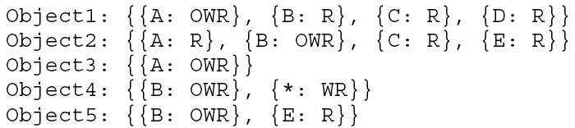
Access control lists (1)
Access control list: A list attached to an object
Specifying ARs for each subject (who accesses this object)
For some subjects specified individually, for others — via being member of a group
Example 1
  Subjects: A, B, C, D, E
  Use of wild card (*) for ‘any’ (any subject other than B can R/W Object 4)

Slide 61
Example 2: Unix approach
  UNIX: 3 classes of users: owner, group, rest
  File ARs for: user (owner) / (owner’s) group / others (default)
  E.g.: drwxr-xr-x 34 jones faculty 1476 Oct 17 08:26 secClas
Field 1: a set of ten permission flags.
Field 2: link count (don't worry about this)
Field 3: owner of the file
Field 4: associated group for the file
Field 5: size in bytes
Field 6-8: date of last modification (format varies, but always 3 fields)
Field 9: name of file (possibly with path, depending on how ls was called)

Slide 62
Example 3: Multics OS approach
  user / group / compartment
    user – ARs for individual subject
    group – ARs for a group of subjects (e.g., for all project members)
    compartment – confines untrusted objects or
    collects related objects (see text)
  Use of wild cards: any user / any group / any comp’t
    Object1: { {Sanjay—Web_Proj—Midwest: X} }
    Object2: { {Sanjay—*—*: RW}, {*—*—*: R} }
    Meaning: Only Sanjay can execute O1 within the ‘Midwest’ compartment when working on the ‘Web’ project.
    Only Sanjay can write O2, but everybody can read it

Slide 63
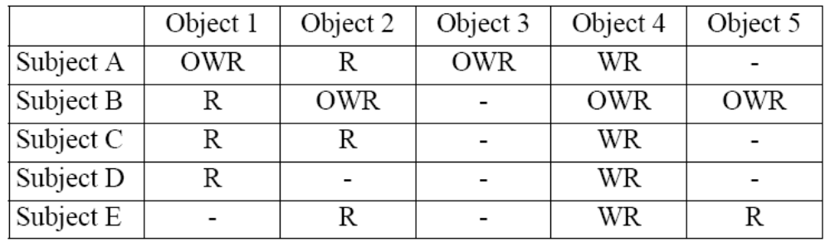
Access control matrices
Previous access control mechanism used lists
  Access list – object’s list of ARs for subjects that can access the object
Access Control Matrix
  A sparse matrix (a table)
    Rows — subjects / columns — objects
      Cell (i, j) — subjects i’s ARs for access to object j

Slide 64
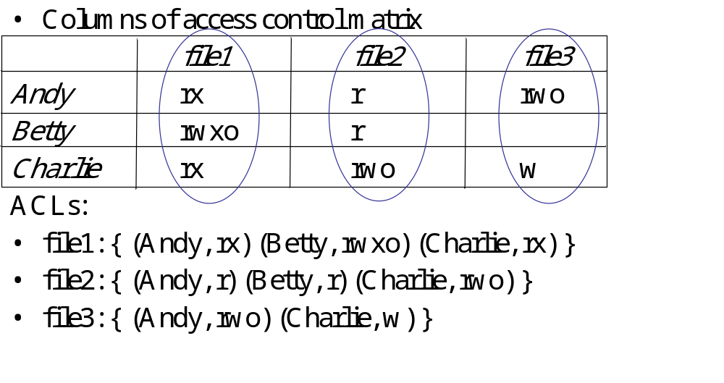

Slide 65
Capabilities for access control
Capability mechanism
  Subjects access objects only via capabilities
Capability — a kind of token/ticket/pass giving to subject certain ARs for an object
  To see (kind of access) a movie (object), a moviegoers (subject) must have a ticket (capability)
Capability to transfer ARs — allows subject to pass copies of its capabilities to other subjects
  S1 can copy its capability to access O1 and transfer it to S2
  If S1 omits ‘transfer’ rights for O1 in capability passed to S2, S2 can’t transfer these rights to any other subject
Capability is limited by its domain (= local name space)
  Not all cap’s passed from caller domain to subroutine domain
  Subr. can have cap’s that its calling pgm doesn’t

Slide 66
2
Capabilities help OS keep track of ARs during execution
  Backed up by more detailed table (e.g. acc. ctrl matrix)
  Capabilities for objects accessed by current process are kept readily available (for speed)
Protecting capabilities
  Capabilities in memory are accessible to OS only
    E.g., stored in protected memory
  Capability are unforgeable - two basic ways:
    1) Only OS holds and writes capabilities
    OS issues to subjects only pointers to capabilities
    2) Capability is encrypted
    Key known only to OS’s access control mechanism
  Problem: Capability revokation can be complicated
    When capability revoked by its issuing subject,
    OS must find & stop corresponding accesses

Slide 67
Windows NT ACLs
Different sets of rights
  Basic: read, write, execute, delete, change permission, take ownership
  Generic: no access, read (read/execute), change (read/write/execute/delete), full control (all), special access (assign any of the basics)
  Directory: no access, read (read/execute files in directory), list, add, add and read, change (create, add, read, execute, write files; delete subdirectories), full control, special access

Slide 68
Accessing Files
User not in file’s ACL nor in any group named in file’s ACL: deny access
ACL entry denies user access: deny access
Take union of rights of all ACL entries giving user access: user has this set of rights over file

Slide 69
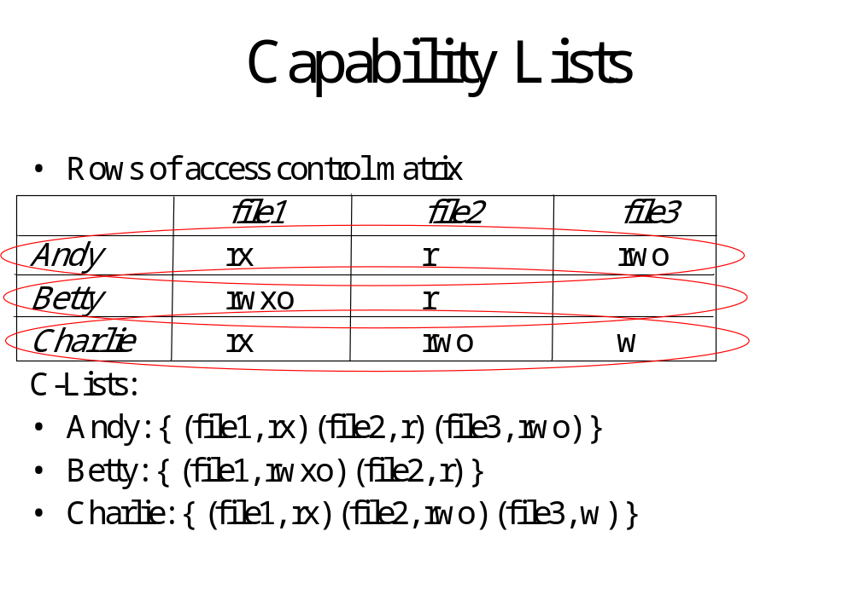

Slide 70
ACLs vs. Capabilities
Both theoretically equivalent; consider 2 questions
  Given a subject, what objects can it access, and how?
  Given an object, what subjects can access it, and how?
  ACLs answer second easily; C-Lists, first
Suggested that the second question, which in the past has been of most interest, is the reason ACL-based systems more common than capability-based systems
  As first question becomes more important (in incident response, for example), this may change

