Slide 1

Security
Firewalls

Slide 2
Networking components (continued)
Host
Host
Host
Application
Application
Application
TCP
TCP
Bridge
TCP
IP
IP
IP
Datalink
Datalink
Datalink
Datalink
Datalink
Physical
Physical
Physical
Physical
Physical
Physical
Physical
Hub
Hub

Slide 3
Networking components
Hosts
  Considered a “node” or “end point” in the network (client/server/printer)
  Processes all levels of the protocol stack
Hubs
  acts as an “extender” - acts at physical layer
  Does not do any processing
Bridges
  attaches two physically identical LANs together, physical layer processing
  forwards only traffic which is destined for “the other side”
Switches
  Works at the data link layer
  Each port on the switch acts like a bridge
Routers
  Processing at the Network layer
  Route packets between networks with potentially different lower level protocol stacks (i.e., different physical and data link layers)
Gateways
  Processes all levels of the protocol stack
  Used to connect networks with different protocol stacks

Slide 4
Networking components (continued)
Gateway
Switch
Application
Application
Datalink
Datalink
Datalink
Datalink
TCP
TCP
Physical
Physical
Physical
Physical
IP
IP
Datalink
Datalink
Host
Physical
Physical
Application
TCP
Router
IP
Datalink
Network
Network
Physical
Datalink
Datalink
Physical
Physical

Slide 5
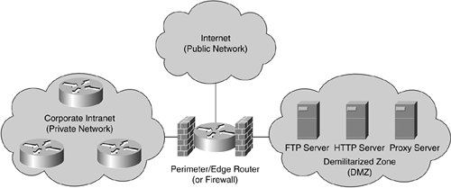
Firewall Basics
A firewall is defined as a gateway or access server (hardware- or software-based) or several gateways or access servers that are designated as buffers between any connected public network and a private network.
A firewall is a device that separates a trusted network from an untrusted network. It may be a router, a PC running specialized software, or a combination of devices.
The following figure displays a network in which firewalls are typically located between the trusted networks and untrusted networks.

Slide 6
Firewalls
firewall
isolates organization’s internal net from larger Internet, allowing some packets to pass, blocking others.
administered
network
public
Internet
firewall
(Modified from Dr. Chang’s slides)

Slide 7
Functions:
Blocking traffic
Permitting traffic
Enabling secure remote connections (VPN)
Logging traffic
Content filtering (blocking): viruses, attacks
Network management purposes (screening the traffic etc.)

Slide 8
Main goals
The main goal of firewalling is :
  to control unnecessary services, traffic
  to hide our internal network topology and services
  to protect against protocol errors (e.g. invalid SMTP commands can be filtered)
  to enable logging
  to control the activity of internal users
  every accessible point is a possible security hole: With firewalling we minimize the accessible points and we are making it more difficult to deploy an attack
  we can make it more difficult to exploit the vulnerability: E.g. with tftp denied it is more difficult to send files to the internet after an attack
  we can separate the network to subnetworks: an intrusion will not compromise our whole system, just a subnetwork/server

Slide 9
Firewalls: Why
prevent denial of service attacks:
  SYN flooding: attacker establishes many bogus TCP connections, no resources left for “real” connections.
prevent illegal modification/access of internal data.
  e.g., attacker replaces CIA’s homepage with something else
allow only authorized access to inside network (set of authenticated users/hosts)
preventing visits to bad outside resources from internal network.
two types of firewalls:
  application-level
  packet-filtering

Slide 10
A firewall is not good for…
Stopping information flow/leakage:
  Data can be leaked out even through DNS applications or e.g. HTTP tunnels. It is very hard to protect against covert channels.
Complete protection against intrusions:
  A single open port can be used to gain privileged access
  An application proxy might not stop attacking through badly formed parameters, etc.
  An industry spy can use the telefax to transport secrets…

Slide 11
Firewall Basics - Types of firewall
Companies such as Cisco and other major vendors have introduced a multitude of firewall products that are capable of monitoring traffic using different techniques. Some of today's firewalls can inspect data packets up to Layer 4 (TCP layer). Others can inspect all layers (including the higher layers) and are referred to as deep packet firewalls. This section defines and explains these firewalls. The three types of inspection methodologies are as follows:
  Packet filter
  Stateful packet filter
  Circuit-level gateway
  Proxy-based

Slide 12
Packet filtering firewalls
Packet filtering firewalls decide whether or not to forward packets based on
  source and destination IP addresses
  protocol field
  source and destination port numbers
  SYN flag settings
Rules dictate whether or not packets should be forwarded
Inspects packets in isolation
Does not keep track of connection state
Susceptible to application layer attacks

Slide 13
Packet Filtering
Should arriving packet be allowed in? Departing packet let out?
internal network connected to Internet via router firewall
router filters packet-by-packet, decides to forward/drop packet based on certain/configurable criteria.

Slide 14
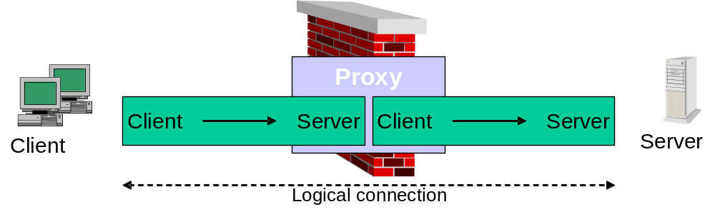
Packet Filtering
Packet filters (basic access-list filters on routers) are now easy to break, hence the introduction of proxy servers that limit attacks to a single device. A proxy server is a server that sits between a client application, such as a web browser, and a real server. It intercepts all requests to the real server to see if it can fulfill the requests itself. If not, it forwards the request to the real server. A proxy requests a connection to the Internet based on requests from internal or hidden resources. Proxy servers are application based, slow, and difficult to manage in large IP networks. The next generation of packet filters is stateless firewalls.

Slide 15
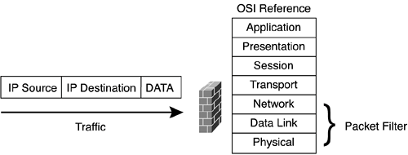
Stateless Firewall
Basically, a stateless firewall permits only the receipt of information packets that are based on the source's address and port from networks that are trusted.

Slide 16
A stateful firewall limits network information from a source to a destination based on the destination IP address, source IP address, source TCP/UDP port, and destination TCP/UDP port. Stateful firewalls can also inspect data content and check for protocol anomalies.
Maintains state information on connections
Tracks open, valid connections without reprocessing rule set
Can implement complex policies
Susceptible to Application Layer attacks
Lacks user authentication control The following figure illustrates the inspection depth of a stateful firewall. Packets are inspected up to Layer 4 of the OSI model, which is the transport layer. Therefore, stateful firewalls are able to inspect protocol anomalies.

Slide 17
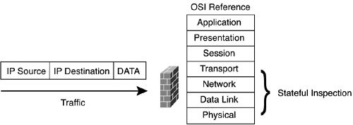
Stateful Firewall

Slide 18
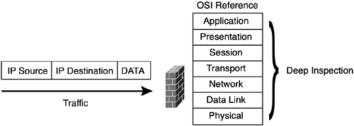
Deep Packet Layer Firewall
With deep packet layer inspection, the firewall inspects network information from a source to a destination based on the destination IP address, source IP address, source TCP/UDP port, and destination TCP/UDP port. It also inspects protocol conformance, checks for application-based attacks, and ensures integrity of the data flow between any TCP/IP devices. The Cisco Intrusion Detection System (IDS), which is discussed in Chapter 10, "Intrusion Detection System Concepts," and NetScreen firewall products support deep packet layer inspection. The Cisco PIX Firewall supports stateless and stateful operation, depending on your product. Please refer to the Cisco website for the specific support for your product

Slide 19
Network Topology
The topology of your network after deploying a firewall will likely include several types of network, such as:
  Internet
    Attached to the untrusted interface of the firewall
  De-Militarized Zone (DMZ)
    The LAN attached to the untrusted interface of the firewall
  Extranet
    If using VPNs, may include remote branch offices or mobile clients
  Service network
    A network protected by the firewall but separate from the internal trusted network, used to offer services over the Internet such as a web server
  Protected network
    The internal trusted network which the firewall will protect
  Enclave network
    An internal network protected from the rest of the internal network to mitigate internal threats to sensitive data

Slide 20




Network Topology (continued)
Service
network
Internet
Screening
router
Selected services
SMTP, FTP, Web, ...
DMZ network
Protected
Network
Security Gateway
Internal
Security
Gateway
Bastion hosts
Enclave network

Slide 21
Hardware Firewalls: PIX and NetScreen
This section covers two of the most common hardware-based firewalls in the marketplace today, namely the CiscoSecure Private Internet Exchange (PIX) Firewall and the NetScreen firewall.

Slide 22
PIX
The PIX is a dedicated hardware-based networking device that is designed to ensure that only traffic that matches a set of criteria is permitted to access resources from networks defined with a secure rating. The PIX Firewall was an acquisition by Cisco Systems in the 1990s. The command-line interface (CLI) is vastly different from Cisco IOS, although recent software developments have made the CLI closer to the traditional Cisco IOS syntax that most readers are familiar with.
The Cisco PIX and Cisco IOS feature sets are designed to further enhance a network's security level. The PIX Firewall prevents unauthorized connections between two or more networks. The latest released versions of Cisco code for the PIX Firewall also perform many advanced security functions such as authentication, authorization, and accounting (AAA) services, access lists, VPN configuration (IPSec), FTP logging, and Cisco IOS-like interface commands. All these features are discussed in the remaining chapters of this book. In addition, the PIX Firewall can support multiple outside or perimeter networks in the demilitarized zones (DMZs).
Typically, the Internet connection is given the lowest level of security, and a PIX ensures that only traffic from internal networks is trusted to send data. By default, no data is permitted at all. Therefore, the biggest problem or issue with a PIX Firewall is misconfiguration, which most crackers use to compromise network functionality.

Slide 23
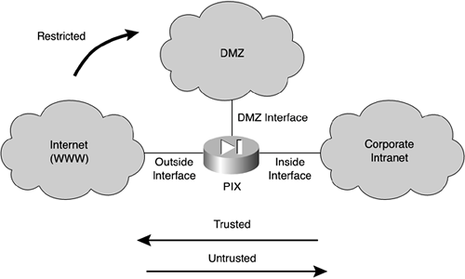
PIX

Slide 24
A PIX Firewall permits a connection-based security policy. For instance, you might allow Telnet sessions to be initiated from within your network but not allow them to be initiated into the network from outside the network.
The PIX Firewall's popularity stems from the fact that it is solely dedicated to security. A router is still required to connect to wide area networks (WANs), such as the Internet, and to perform additional routing tasks and processes (recent versions of PIX OS do support some routing protocols). Some companies also use the PIX Firewalls for internal use to protect sensitive networks such as those of payroll or human resources departments.
As previously mentioned, the Cisco PIX Firewall is a stateful inspection device and bases all its decisions on a Cisco propriety algorithm, namely the Adaptive Security Algorithm (ASA).

Slide 25
ِِASA
The ASA is based on static and dynamic translation slots (or TCP/UDP-IP stateful inspection flow) configured in the PIX. All IP packets incoming on any of the interfaces are checked against the ASA and against connection state information in memory. The ASA follows a certain set of rules, including the following:
  By default, allow any TCP connections that originate from the higher-security network.
  By default, deny any TCP connections that originate from the lower-security network.
  Ensure that if an FTP data connection is initiated to a translation slot, there is already an FTP control connection between that translation slot and the remote host. If not, drop and log the attempt to initiate an FTP data connection. For valid connections, the firewall handles passive and normal FTP transparently without the need to configure your network differently.
  Drop and log attempts to initiate TCP connections to a translation slot from the outside.
  Drop and log source-routed IP packets sent to any translation slot on the PIX Firewall.
  Silently drop ping requests to dynamic translation slots.
  Answer (by the PIX Firewall) ping requests directed to static translation slots

Slide 26
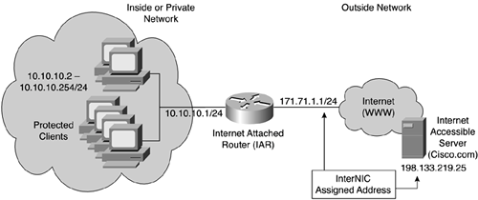
Enhancements for Firewalls
Of the many enhancements to firewalls, this section concentrates on four of the most important feature enhancements present in today's firewalls, namely:
NAT:
  NAT is a router or firewall function whose main objective is to translate the addresses of hosts behind a firewall or router. NAT can also be used to overcome the IP address shortage that users currently experience with IPv4.
  NAT is typically used for internal IP networks that have unregistered (not globally unique) IP addresses. NAT translates these unregistered addresses into the legal addresses of the outside (public) network. This allows unregistered IP address space connectivity to the web and also provides added security.

Slide 27
Proxy Services
  The use of proxy services in the network has multiple goals. Proxy services can be used to hide the real IP address of users. This means that when crackers or intruders try to spoof IP addresses, for example, they have no idea about the hidden addresses and in fact attack a proxy server designed to drop the packets and alert network administrators of the event.
  Proxy servers can also cache information that is frequently used by end users and thus can act as an intermediate device between a web client and a web server. This allows other web clients to access web content much faster by downloading web content from a local device rather than from the web (proxies protect clients and reverse proxies protect servers).
Content filtering
Antivirus software

Slide 28
Content Filters
With content filtering (also known as URL filtering), an organization designs a policy defining which websites are permitted to be accessed by local resources and which are not. Content filters can monitor, manage, and provide restricted access to the Internet. This means that employees do not tie up valuable and expensive WAN connections to the Internet for nonbusiness matters.
Cisco provides a number of content-filtering engines that can perform the following functions:
  Deny access to URLs specified in a list
  Permit access only to URLs specified in a list
  Use an authentication server in conjunction with a URL filtering scheme

Slide 29
Antivirus Software
A computer virus can best be described as a small program or piece of code that penetrates into the operating system, causing an unexpected and usually negative event. Antivirus software applications scan the memory and hard disks of hosts for known viruses. If the application finds a virus (using a reference database with virus definitions), it informs the user. The user can decide what needs to happen next. These types of applications are becoming integrated features of newer software firewalls.

Slide 30
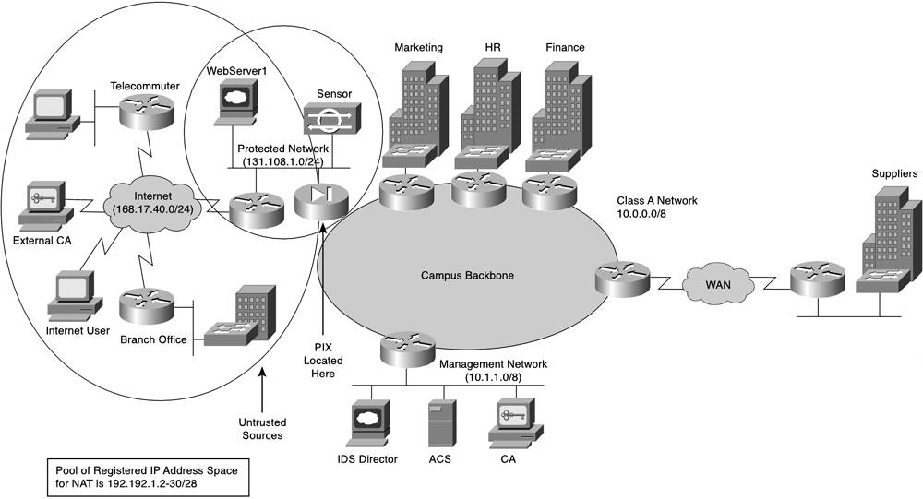
Example

