Slide 1

Security
Cryptography

Slide 2
Crypto Basics
The word cryptography comes from two Greek words meaning "secret writing" and is the art and science of concealing meaning. Cryptanalysis is the breaking of codes. The basic component of cryptography is a cryptosystem.
Cryptography is about scrambling data so that it looks like babble to anyone except those who know the trick to decoding it. Almost anything in the world can be hidden from sight and revealed again.
Cryptography is the art of concealing information.
Cryptography is the art and science of keeping messages secure.
The magician David Copperfield has made his living from hiding enormous things from plain view — like elephants and the Statue of Liberty — and then magically revealing them again.
Any magician will tell you that in order to make things disappear and appear again, you have to have a plan of action — a formula or recipe — to make the magic work.
In cryptography, the magic recipe for hiding data is called an algorithm. An algorithm is a precise set of instructions that tells programs how to scramble and unscramble data.

Slide 3
Why?
Computers and use of the Internet have fostered new interest in cryptography partly due to the new emphasis on personal privacy. Little did I realize that in our efforts to make it easy for computers to share stuff, it would make it easy for other people to see all of our personal stuff, too. Perhaps you’ve discovered for yourself that it is far too easy for unknown persons to read your e-mail, private documents, love letters, financial information, and so on.
The Internet is truly the Global Village . . . a village where everyone can see what you do and hear what you say. The good news is that you can use cryptography to protect yourself from the eavesdroppers and Peeping Toms of the village.
Not only can cryptography scramble your files, but it can also be used to prove who you are (and maybe who you aren’t!).
Cryptography can be used to alert you if the contents of a file have been changed, attest to the identity of the person who sent you a message, keep online communications safe and secure, and, of course, hide important data.
And the best news of all is that not every cryptographic solution is expensive, and you don’t need to be a rocket scientist to incorporate crypto solutions into your network.

Slide 4
Cryptographic Protocols!
Plus throw some math at the problem!
    Messages should get to destination
    Only the recipient should see it
    Only the recipient should get it
    Prof of the sender’s identity
    Message shouldn’t be corrupted in transit
    Message should be sent/received once

Slide 5
Terminology
plaintext, cleartext: an “unhidden message”
encrypt: transform a message to hide its meaning
ciphertext: encrypted message
cipher: cryptographic algorithm
decrypt: recover meaning from encrypted message
cryptography: art/science of keeping message secure
cryptanalysis: art/science of breaking ciphertext
cryptology: study of both cryptography and cryptoanalysis
Key: A complex sequence of alpha-numeric characters, produced by the algorithm, that allows you to scramble and unscramble data.

Slide 6
Encryption and Decryption
plaintext, cleartext
ciphertext
Decryption
Method
Encryption Method
ciphertext
plaintext, cleartext

Slide 7
Definition
A cryptosystem is a 5-tuple (E, D, M, K, C), where:
  P plaintext
  C ciphertext
  E encryption function
  D decryption function
  K a set of keys
Some algorithms use the same key for encryption and decryption :
E_{K}(P) = C
D_{K}(C) = P
Some algorithms use a different encryption key and decryption key :
  E_{K1}(M) = C
  D_{K2}(C) = M

Slide 8
Understanding physical cryptography
In general, physical cryptography refers o any method that does not alter the value using a mathematical process.
Physical cryptography includes several approaches . The most common methods involves transposition or substation of characters or words. Physical cryptography include a method of encryption called stegangraphy, which is the science of hiding information within other information , such as a picture.
A cipher is a method used to encode characters o hide their value. Ciphering is the process of using a cipher to encode a message.

Slide 9
Substitution ciphers-1
Just as it sounds, a substitution cipher substitutes one letter or character for another. As a child you may have gotten a secret decoder ring from an offer on a cereal box or chocolate milk powder. The decoder ring consisted of two dials, both containing all the letters of the alphabet. The trick was to twirl one dial around the other so that the letters of the alphabet did not match up. Then you found the letter you wanted to use on one ring and substituted the letter on the other ring. Carry on letter by letter and then you have a secret message. Although this is technically not a ring shown below, here’s an example of how the substitutions would line up:
A B C D E F G H I J K L M N O P Q R S T U V W X Y Z
S T U V W X Y Z A B C D E F G H I J K L M N O P Q R
Using the graph above, you would locate your letter and then substitute it with the letter directly below it. Therefore, the phrase:
ATTACK AT DAWN AT THE NORTHERN BRIDGE
would become:
SLLSUC SL VSOF SL LZW FGJLZWJF TJAVYW

Slide 10
Substitution ciphers-2
Of course to decrypt your message, your intended recipient would also have to have a decoder ring and he would need to know how far to twirl his dial so it matched yours. This number would indicate the switch in letters — and it is also the key to decrypting the message. In the example above, the switch is 18 letters to the right of the letter A; therefore, the key is “18.” This cipher is probably one of the best known in the world and is also referred to as the “Caesar Cipher” because of historical references linking Julius Caesar and this type of cipher.

Slide 11
Substitution ciphers-2
The Caesar cipher is the widely known cipher in which letters are shifted. For example, if the key is 3, the letter A becomes D, B becomes E, and so forth, ending with Z becoming C. So the word "HELLO" is enciphered as "KHOOR." Informally, this cipher is a cryptosystem with:
  M = { all sequences of Roman letters }
  K = { i | i an integer such that 0 i 25 }
  E = { Ek | k K and for all m M, Ek(m) = (m + k) mod 26 }
  Representing each letter by its position in the alphabet (with A in position 0), "HELLO" is 7 4 11 11 14; if k = 3, the ciphertext is 10 7 14 14 17, or "KHOOR."
  D = { Dk | k K and for all c C, Dk(c) = (26 + c k) mod 26 }
  Each Dk simply inverts the corresponding Ek.
  C = M
  because E is clearly a set of onto functions.
Write a complete C# application to implement the Caesar cipher for different values of keys.

Slide 12
Transposition ciphers-1
One of the oldest known ciphers is called a transposition cipher. This type of cipher changes the order of the letters of the original message. One method is to write the message in a series of columns and rows in a grid — or you could write the message backwards.
While substitution ciphers preserve the order of the letters used in the message, transposition ciphers reorder the letters. Transposition ciphers are rarely used nowadays, but they have been very important in the past. Although there are literally hundreds of different types, I’m going to show you one of the simpler ones. You can do this one yourself — all you need is paper and a pencil.
The encrypted message gets to you looking like this:
GRYSO IISAU VNTFS EKOEE EEAHX
The key to this cipher is a block grid. If you know how many rows and columns are on the grid, then you can decrypt the message. Looking at the grid below, can you see how the message was created and what the message really says?

Slide 13
Transposition ciphers-2
GRYSO IISAU VNTFS EKOEE EEAHX
Solution: if you read down the columns, you see the encrypted message. If you read across the rows, you can decrypt the message, which reads: GIVE ERIN KEYS TO A SAFEHOUSE X.
You may have noticed that the encrypted message did not match the same spacing as the decrypted message. That’s done on purpose to (hopefully) confuse you further. If you don’t know where one word starts and another begins, it makes it harder for a casual viewer to make any sense of what’s written. In many old encrypted messages you’ll note that the messages are in all caps and are written out in groups of five letters.
G | I | V | E | E
R | I | N | K | E
Y | S | T | O | A
S | A | F | E | H
O | U | S | E | X

Slide 14
The German Enigma cipher machine
The most commonly known substitution cipher is the Enigma machine that was used by the Germans in World War II to encrypt their secret military messages. The Enigma machine looked roughly like a typewriter except that it had a number of different rotors, sort of like the odometer on your car. These rotors were placed next to one another on a shaft and then spun to set the shift in letters for substitution. But because there was more than one substitution involved, the messages were even more scrambled than using the single substitution I used in the example above.
The Enigma machine was one of the first usages of a strong cipher. It took the concerted effort of many nations, many minds, and a number of years to finally crack the Enigma code.

Slide 15
Understanding mathematical cryptography-1
Mathematical cryptography deals with the mathematical process on characters or messages. The most common is a function called hashing.
A hash is not meant to be decrypted. “What,” you say? That’s right. A hash is what is referred to as a one-way function — you use a hash to encrypt something, but the result is never decrypted.
The purpose of a hash is to create a “fingerprint” of your data. The hash algorithm goes through its permutations, and the result is a bunch of alpha-fixed lengths.) The purpose of a hash is to prove the integrity of the data (encrypted or not) that has been sent. When you receive the data, the hash is included at the bottom of the data. You can run the same hash algorithm against the data you receive, and if the data has not been changed en route, you will get the same set of alpha-numeric characters. If your result is not the same, then something happened during the transmission and the data you received was changed from the original.

Slide 16
Understanding mathematical cryptography-2
Hashing refers to the performing a calculation on a message and converting it into a numeric hash value.
Example:
Encryption algorithm: Multiply the plaintext by 2, adding those results together, and then dividing the sum by 10.
  Message: this
  ASCII values: 116 104 105 115
  Calculated values:232 208 210 230
  Hash value calculation: (232+208+210+230/10)
  Hash value:88

Slide 17
XOR what?
Now I’ll probably be slammed by all the brilliant crypto-geeks in the world for putting XOR here because it is not really a cipher. It’s actually a mathematical operation. I’ll justify putting it here because a majority of modern algorithms use the XOR operation during the encryption process.
Yes, the operation is pronounced just like it looks: Ex-Or. XOR stands for Exclusive-Or. it’s one of those things that you are bound to hear associated with modern cryptography.
Example:
  Plaintext = baby = 01100010 01100001 01100010 01111001
  XOR key = data = 01100100 01100001 01110100 01100001
  Ciphertext = ???? 00000110 00000000 00010110 00011000
you can get back to the plaintext by reversing the operation:
  Ciphertext = ???? 00000110 00000000 00010110 00011000
  XOR key = data = 01100100 01100001 01110100 01100001
  Plaintext = baby = 01100010 01100001 01100010 01111001

Slide 18
Breaking Ciphers-1
One big problem with ancient ciphers is that they were easily figured out, and the secret messages weren’t secret for very long. As cryptography got more complex, the secret messages stayed secret for a longer period.
Cryptanalysis is the art of breaking ciphers, and the National Security Agency (NSA) is renowned as one of the world’s largest employers of cryptanalysts. The CIA is also very into crypto (which makes sense, as they are the home of spy versus spy), and they have a crypto challenge for anyone who wants to give it a try. When the new CIA headquarters was built in 1990, a sculpture called “Kryptos” was installed in front of the main entrance. The sculpture is an encrypted message. Part of the code has been cracked, but the man who got it spent more than 400 hours on it before he even got close to cracking just the first part. He finally managed all but the last 97 characters.
Key-length is mentioned a lot in books and articles about cryptography. That’s because the longer the key (drum roll, please), the harder it is to guess what the key is!

Slide 19
Breaking Ciphers-2
Known plaintext
  If you know for certain both a plaintext word and its ciphertext mate in a message, it can make cracking the message a piece of cake. For example, if you look at an encrypted message with a string of characters like XROL and you know that it means CAKE, you can go through the entire message substituting all the Xs with Cs, Rs with As, and so on. If nothing else, it can certainly give you a clue as to what the words might be. It’s kind of like playing Wheel of Fortune. If you play around with these variations long enough, you might just discover the key for the entire message.
Pattern recognition
  The first thing you look for when you’re trying to break a code is a pattern in the encrypted message. For example, the letter E is the most commonly used letter in the English language, so you look for a letter in the message that is used more than any of the others. That may indicate that that particular letter is actually the letter E. Failing that, the second most common letter in the English language is the letter T.
  Finding a pattern was part of the solution for the man who has partially cracked the Kryptos sculpture at the CIA headquarters building (which I talk about a couple sections back). He looked long and hard for a grouping of letters that would correspond to the word the. Because the is extremely common in the English language, it’s usually a safe bet to start there, and many cryptanalysts do.

Slide 20
Breaking Ciphers-3
What a brute!
  If you’ve failed to decrypt a secret message by trying to figure out the key or by looking for patterns, you might just try banging your head against the wall. Brute force might just work.
  I’m kind of joking and kind of not when I list brute force as a method of breaking an encrypted message or file. Actually it’s done quite often thanks to computers getting faster and the ability of linking computers together for strength and will power. In some cases, computers working in parallel can be more powerful than one of the most powerful computers used by the NSA.
  Brute force is a trial and error method of trying every possible combination of characters against the encrypted data in an attempt to discover the key. That’s one of the reasons I always stress that you use the longest keys possible. For example, a 56-bit key has 256 possible keys. That’s more than 72 quadrillion keys that must potentially be tried in order to find the correct one. You might think that, given those numbers, a 56-bit key would be pretty safe then. Wrong. In 1997, a distributed computing effort cracked the RSA’s 56-bit RC5 encryption in less than 250 days. One of the more famous brute force cracks was that of the DES algorithm. Many people didn’t think it was possible to crack DES by using brute force, and everyone in the crypto world was talking about it when it happened.

Slide 21
Types of attacks
The goal of cryptography is to keep enciphered information secret. Assume that an adversary wishes to break a ciphertext. Standard cryptographic practice is to assume that she knows the algorithm used to encipher the plaintext, but not the specific cryptographic key (in other words, she knows D and E). She may use three types of attacks:
  In a ciphertext only attack, the adversary has only the ciphertext. Her goal is to find the corresponding plaintext. If possible, she may try to find the key, too.
  In a known plaintext attack, the adversary has the ciphertext and the plaintext that was enciphered. Her goal is to find the key that was used.
  In a chosen plaintext attack, the adversary may ask that specific plaintexts be enciphered. She is given the corresponding ciphertexts. Her goal is to find the key that was used.

Slide 22
Cryptosystems-1
By definition, a cryptosystem is the combination of three elements: the encryption engine, keying information, and operational procedures for their secure use. In other words, almost every encryption program can be considered a cryptosystem because it has everything together in one package.
  The encryption engine is the part of the software that starts the encryption with the selected algorithm.
  The keying system is the portion of the software that creates (and sometimes manages) the keys needed to encrypt and decrypt data.
  The operational procedures are how all of these parts interact and how the output, or result, is formatted and what file extension (if any) is used.
So, almost every encryption product you buy off the shelf is, in a sense, a cryptosystem. Some people may argue that a cryptosystem is the complete infrastructure of encryption programs, hardware, and network connections, but I’ll stick to the more traditional definition.

Slide 23
Cryptosystems-2
Many of the self programs include more than one algorithm for you to use for encryption. Usually these programs give you a one type of algorithm — such as symmetric or asymmetric algorithms — for you to decide upon. Sometimes you’ll see a drop-down list of the algorithms for use, or there will be a configuration setting in which you choose which you care to use. it’s safe to say that they come in two types: symmetric, which means one key is used, and asymmetric, which means two keys are used.
Because symmetric algorithms work much faster than asymmetric algorithms, some cryptosystems use both types in their software package. This is referred to as hybrid cryptosystems. Usually with this type of system asymmetric algorithms are used to exchange two keys between sender and recipient, and a symmetric algorithm actually does the encryption.

Slide 24
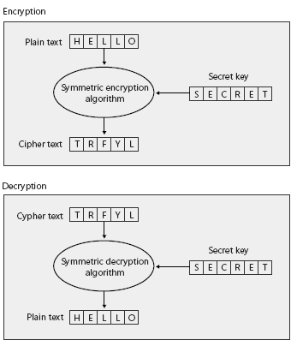
Encrypting and Decrypting Data with Symmetric Keys-1
Symmetric key encryption, also known as secret-key encryption, is a cryptography technique that uses a single secret key to both encrypt and decrypt data. Symmetric encryption algorithms (also called ciphers) process plain text with the secret encryption key to create encrypted data called cipher text. The cipher text cannot easily be decrypted into the plain text without possession of the secret key.

Slide 25
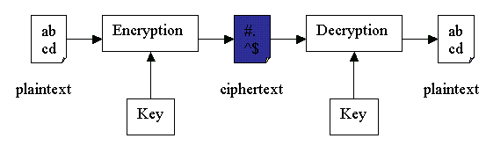

Slide 26
Encrypting and Decrypting Data with Symmetric Keys-2
Symmetric algorithms are extremely fast and are well suited for encrypting large quantities of data. Even though symmetric encryption is very secure, an attacker can identify the plain text, given the cipher text and enough time. To identify the plain text, the attacker needs to use only a brute force attack to sequentially generate symmetric keys until the attacker has tried every single possibility. Typically, the time required to try all keys is hundreds of years, if not longer, because the attacker would need to try at least 256 key possibilities. More secure symmetric algorithms use longer keys that would take exponentially longer to crack.
The disadvantage of secret-key encryption is that it presumes that two parties have already agreed on a key. Agreeing on a symmetric key is a challenge because the key itself cannot be encrypted. If you’ve decided to use encryption, it must be because you don’t trust your system to prevent an attacker from gaining access to your data. Therefore, users must find a secure way to exchange secret keys. After the secret keys are exchanged, encrypted data can be freely exchanged between the parties. However, keys should be changed on a regular basis for the same reasons that passwords should be changed regularly. Each time the key must be changed, users must resort to the secure communication mechanism.

Slide 27
The major vulnerability of secret-key algorithm is the need for sharing the secret-key. One way of solving this is by deriving the same secret key at both ends from a user supplied text string (password) and the algorithm used for this is called password-based encryption algorithm. Another solution is to securely send the secret-key from one end to other end. This is done using another class of encryption called asymmetric algorithm, which is discussed later.
Strength of the symmetric key encryption depends on the size of the key used. For the same algorithm, encrypting using longer key is tougher to break than the one done using smaller key. Strength of the key is not liner with the length of the key but doubles with each additional bit.

Slide 28
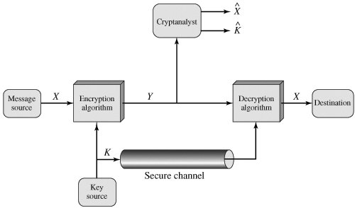
Symmetric Keys-3
Keys are often transferred by voice across the phone network, sent physically through the mail system, or carried to the recipient. After the shared secret has been established, the two peers can use it to encrypt and decrypt any number of messages.

Slide 29
Types of Attacks on Encrypted Messages
Type of Attack | Known to Cryptanalyst
Ciphertext only | Encryption algorithm Ciphertext
Known plaintext | Encryption algorithm Ciphertext One or more plaintext-ciphertext pairs formed with the secret key
Chosen plaintext | Encryption algorithm Ciphertext Plaintext message chosen by cryptanalyst, together with its corresponding ciphertext generated with the secret key
Chosen ciphertext | Encryption algorithm Ciphertext Purported ciphertext chosen by cryptanalyst, together with its corresponding decrypted plaintext generated with the secret key
Chosen text | Encryption algorithm Ciphertext Plaintext message chosen by cryptanalyst, together with its corresponding ciphertext generated with the secret key Purported ciphertext chosen by cryptanalyst, together with its corresponding decrypted plaintext generated with the secret key

Slide 30
Stream Ciphers and Block Ciphers
A stream cipher is one that encrypts a digital data stream one bit or one byte at a time. Examples of classical stream ciphers are the autokeyed Vigenère cipher and the Vernam cipher.
A block cipher is one in which a block of plaintext is treated as a whole and used to produce a ciphertext block of equal length. Typically, a block size of 64 or 128 bits is used.
A block cipher operates on a plaintext block of n bits to produce a ciphertext block of n bits. There are 2n possible different plaintext blocks and, for the encryption to be reversible (i.e., for decryption to be possible), each must produce a unique ciphertext block. Such a transformation is called reversible, or nonsingular. The following examples illustrate nonsingular and singular transformation for n = 2.

Slide 31
Example
Reversible Mapping
Plaintext Ciphertext
  00 11
01 10
10 00
11 01
Irreversible Mapping:
Plaintext Ciphertext
00 11
01 10
10 01
11 01

Slide 32
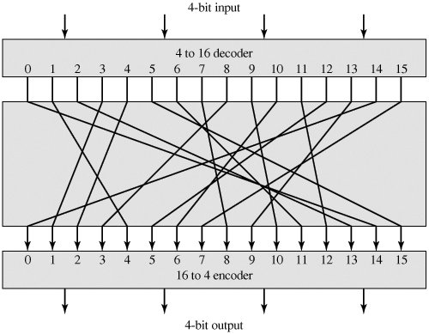
Example
illustrates the logic of a general substitution cipher for n = 4. The encryption and decryption mappings can be defined by a tabulation. This is the most general form of block cipher and can be used to define any reversible mapping between plaintext and ciphertext. Feistel refers to this as the ideal block cipher, because it allows for the maximum number of possible encryption mappings from the plaintext block .
0000 | 1110
0001 | 0100
0010 | 1101

Slide 33
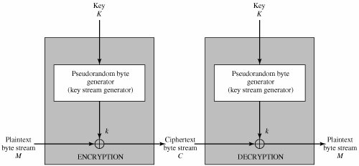
Stream Cipher Structure
A typical stream cipher encrypts plaintext one byte at a time, although a stream cipher may be designed to operate on one bit at a time or on units larger than a byte at a time.
The following figure is a representative diagram of stream cipher structure. In this structure a key is input to a pseudorandom bit generator that produces a stream of 8-bit numbers that are apparently random.

Slide 34


For now, we simply say that a pseudorandom stream is one that is unpredictable without knowledge of the input key. The output of the generator, called a keystream, is combined one byte at a time with the plaintext stream using the bitwise exclusive-OR (XOR) operation. For example, if the next byte generated by the generator is 01101100 and the next plaintext byte is 11001100, then the resulting ciphertext byte is

Slide 36
Symmetric Algorithms-1
Following are some of popular secret-key algorithms and the key size that they use:
  RC2 - 64 bits
  DES 64 bits
  3DES 192 bits
  AES 256 bits
  IDEA 128 bits
  CAST 128 bits (CAST256 uses 256 bits key)

Slide 37
DES
  DES stands for Digital Encryption Standard and was created in 1975 with some assistance from the National Security Agency (NSA). In 1981, DES became an accepted standard and was widely used. DES is a block cipher that uses a 56-bit key to create the key table. Then it goes through the process of combining a key from the key table with the block of plaintext. After the key and the plaintext have been combined, DES goes through 16 more changes (called rounds) to thoroughly mix up the ciphertext. To decrypt the data, DES just goes through all the changes in reverse order.
  Given that a 56-bit key has about 72 quadrillion different combinations of numbers, most people felt that DES would be secure for a very long time. What people failed to consider was that computers got faster and cheaper and that it wouldn’t cost very much to create a computer specifically to break DES. In 1999, DES was broken in less than 24 hours on a specially built computer.

Slide 38
Symmetric key crypto: DES
DES: Data Encryption Standard
US encryption standard [NIST 1993]
56-bit symmetric key, 64-bit plaintext input
How secure is DES?
  DES Challenge: 56-bit-key-encrypted phrase (“Strong cryptography makes the world a safer place”) decrypted (brute force) in 4 months
  no known “backdoor” decryption approach
making DES more secure:
  use three keys sequentially (3-DES) on each datum
  use cipher-block chaining: XOR the encrypted jth block with the j+1th block before applying DES

Slide 39

Symmetric key crypto: DES
DES operation
initial permutation
16 identical “rounds” of function application, each using a different 48 bit key derived from the 56 bit main key
final permutation

Slide 40
A desirable property of any encryption algorithm is that a small change in either the plaintext or the key should produce a significant change in the ciphertext. In particular, a change in one bit of the plaintext or one bit of the key should produce a change in many bits of the ciphertext. If the change were small, this might provide a way to reduce the size of the plaintext or key space to be searched.
With a key length of 56 bits, there are 256 possible keys, which is approximately 7.2 x 1016. Thus, on the face of it, a brute-force attack appears impractical. Assuming that, on average, half the key space has to be searched, a single machine performing one DES encryption per microsecond would take more than a thousand years to break the cipher.

Slide 41
Symmetric Algorithms-2
Triple DES
  Many years before DES was broken, cryptographers began working on its replacement. It wasn’t that DES was badly flawed; it was that the crypto community could see the end coming and they wanted to be prepared. So Triple DES (also referred to as 3DES) was created. Because a lot of software and hardware was already coded with DES, it made sense to make changes to an algorithm that was already in use, rather than creating an entirely new one. In that way, many of the older products were able to upgrade to 3DES (or a very similar variant) without having to completely rebuild the hardware or software.
  As its name implies, Triple DES does something three times more than normal DES. That triple threat comes from using three keys on each block of plaintext. Instead of using one 56-bit key from the key table, Triple DES encrypts the plaintext with the first key, encrypts that ciphertext with another 56-bit key, and then encrypts the ciphertext with another 56-bit key. That may seem like overkill, but it works. 3DES is also able to work with longer keys to make it more secure. The most commonly longer key lengths (at present) are 112 bits and 168 bits.

Slide 42
Symmetric Algorithms-3
  In order to crack this algorithm you would need to figure out three separate keys. Not only that, but the ciphertext will decrypt only when all three correct keys are used and in the correct order. It might be possible to guess one key, but you’d never know if it was correct until you combine it with the other two keys. The number of permutations is outrageously high, and no one wants to spend that amount of time attacking something of unknown value. What if you went to all the trouble to find all three keys, in the correct order, only to find the data was an e-mail message reminding everyone that there was leftover birthday cake in the break area? A lot of effort spent on nothing, I’d say.

Slide 43
The principal drawback of 3DES is that the algorithm is relatively sluggish in software. The original DES was designed for mid-1970s hardware implementation and does not produce efficient software code. 3DES, which has three times as many rounds as DES, is correspondingly slower. A secondary drawback is that both DES and 3DES use a 64-bit block size. For reasons of both efficiency and security, a larger block size is desirable.
Because of these drawbacks, 3DES is not a reasonable candidate for long-term use. As a replacement, NIST in 1997 issued a call for proposals for a new Advanced Encryption Standard (AES), which should have a security strength equal to or better than 3DES and significantly improved efficiency. In addition to these general requirements, NIST specified that AES must be a symmetric block cipher with a block length of 128 bits and support for key lengths of 128, 192, and 256 bits.

Slide 44
Symmetric Algorithms-4
AES
  AES stands for Advanced Encryption Standard. Many expect this algorithm to be the heir apparent to DES and 3DES. It’s the first algorithm that was created through organized competition.
  The contest was announced by NIST (National Institute of Standards and Technology) in 1997 in an attempt to find a good algorithm that would become the next government standard. In 1998, the list of competing algorithms had been whittled down to 15 candidates. Then the heavy duty testing began. The contestants began dropping like flies as weaknesses were found in most of the algorithms under consideration. By 1999, the cast of players had been cut to just five and another round of testing began.
  Late in 2000, NIST announced it had a winner — an algorithm called Rijndael (after Vincent Rijmen and Joan Daemen, pronounced rine-doll). It had survived all the tests, and people generally liked the way it worked. The government has called it their Advanced Encryption Standard (AES), but it isn’t quite the standard in the real world yet. Again, because it’s relatively new, there is some distrust and a feeling that it has not been tested enough for weaknesses. Regardless, there are products on the market that openly use AES and will continue to do so until it’s proven weak or breakable.

Slide 45
Algorithm Parameters-1
Encryption Mode:
There are two types of secret-key ciphers, block ciphers and stream ciphers:
  Block Ciphers convert fixed-length block of plain text into cipher text of the same length. Most of the block ciphers use a block size of 64 bits. When the message size is more than that of the block size, then the message is broken into multiple blocks and each block is encrypted separately. There are different modes in which a Block cipher can encrypt these blocks:
    Cipher Block Chaining (CBC), Electronic Codebook (ECB) or Cipher Feedback (CFB).
    In CBC Mode, each plain text block is XORed with the previous cipher text block before being encrypted.
    Some famous Block ciphers are DES, 3DES, IDEA, SAFER, Blowfish and Skipjack.
  Stream Ciphers operate on small group of bits, typically applying bitwise XOR operations to them using the key as a sequence of bits. Some famous stream ciphers include RC4 and SEAL.

Slide 46
Algorithm Parameters-2
Initialization Vector
  Since Block ciphers working on CBC modes XOR each block with the previous encrypted block, the first block of the message needs a byte array, of same block size, with which it will be XORed This byte array is called IV or Initialization Vector.
Following are some block ciphers with their normal block size
DES - 64 bits
3DES 64 bits
AES 128 bits
Padding
  Often last block of the message will be smaller that the expected block size in which case a predetermined string will be repeatedly added to the end of the block to make it to the expected size. For instance if the block size is 64 bits and the last block has only 40 bits then 24 bits of padding will be added to it. There were two ways to add the pad, either by adding zeros or the number of the bytes that needs to be added (in this case it will be 3).

Slide 47
Symmetric Key Encryption in .NET
Symmetric Algorithms are implemented using a three level inheritance pattern:
  The root level abstract class, SymmetricAlgorithm (System.Security.Cryptography.SymmetricAlgorithm), specifies that it is a Symmetric algorithm.
  Intermediate classes are named after particular type of symmetric algorithm that they implement and are also abstract.
  The final level class provides the complete implementation of the Symmetric Algorithms by either using the Cryptographic Service Providers of the windows CryptoAPI or by completely implementing the algorithm in .NET. While the former classes has CryptoServiceProvider suffix the later has Managed suffix.

Slide 48
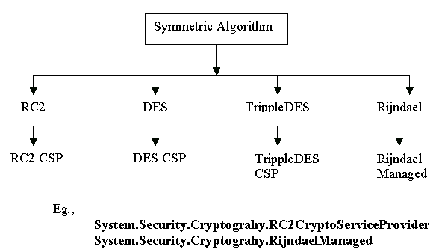
1

Slide 49
2
When the concrete class (RC2CryptoServiceProvider, DESCryptoService Provider, TrippleDESCryptoService Provider and RijndaelManaged) is instantiated, the default constructor generates a strong secret-key, initializes the IV, sets sensible values for padding and mode.
RijndaelManaged rj = new RijndaelManaged();
Console.WriteLine("AES Mode is : " + rj.Mode);
Console.WriteLine("AES Padding is : " + rj.Padding );
Console.WriteLine("AES Key Size : " + rj.KeySize);
This will generate an output as below
  AES Mode is : CBC
  AES Padding is : PKCS7
  AES Key Size : 256

Slide 50
3
Cryptographic namespaces uses the same Stream (System.IO.Stream) oriented design that permeates the .NET framework from networking (System.Net) to XML (System.XML). A new class called CryptoStream (System.Security.Cryptography.CryptoStream) derived from System.IO.Stream is used for both encryption and decryption of data.
Following snippet shows how to encrypt a string using RijndaelManaged (For full example refer TextEncrpytion Class)

Slide 51
Symmetric Algorithm Classes in the .NET -1
Most of the .NET Framework’s cryptography functionality is built into the System. Security.Cryptography namespace, including the four implementations of symmetric encryption algorithms

Slide 52
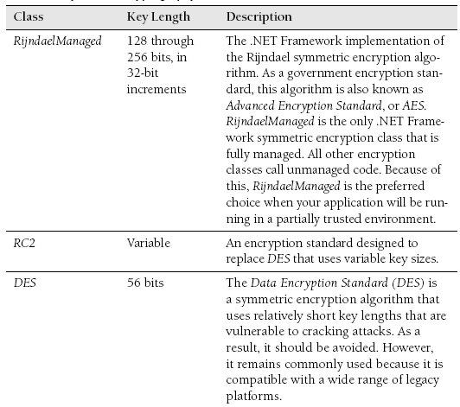
Symmetric Algorithm Classes in the .NET -2

Slide 53
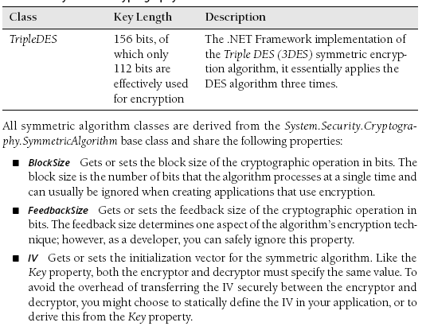
Symmetric Algorithm Classes in the .NET -3

Slide 54
Key Gets or sets the secret key for the symmetric algorithm. Keys are automatically generated if you have not specifically defined them. After encryption, you must store this value and transfer it to the decryptor. During decryption, you must specify the same key used during encryption.
KeySize Gets or sets the size of the secret key used by the symmetric algorithm in bits. When you create a symmetric algorithm object, the runtime will choose the largest key size supported by the platform. As a result, you can usually ignore this property. However, if the message’s recipient does not support the same key sizes as the sender, you must set this property to the highest value supported by both the encryptor and the decryptor.

Slide 55
LegalBlockSizes A KeySizes array that gets the block sizes that are supported by the symmetric algorithm. Each array member contains MinSize and MaxSize properties, which define the valid key ranges in bits; and a SkipSize property that specifies in bits the interval between valid key sizes.
LegalKeySizes A KeySizes array that gets the key sizes that are supported by the symmetric algorithm. Each array member contains MinSize and MaxSize properties that define the valid key ranges in bits, and a SkipSize property that specifies the interval between valid key sizes in bits.
Mode A property set to one of the CipherMode enumeration values that determines one aspect of the encryption algorithm’s behavior. This property is usually set to Cipher Block Chaining (CBC), the default. You should usually leave this set to CBC. If you do change this value, you must change it at both the encryptor and decryptor.
Padding A PaddingMode enumeration value, this property determines how the encryption algorithm fills out any difference between the algorithm’s block size and the length of the plain text. You should generally not change this property.

Slide 56
Additionally, the symmetric algorithm classes each share the following methods (standard object methods have been omitted):
  CreateDecryptor To decrypt messages, you must create a symmetric algorithm object and call this method to create an ICryptoTransform object that a Crypto-Stream object can use to decrypt the stream.
  CreateEncryptor Creates a symmetric encryptor object used by CryptoStream objects to encrypt a stream.
  GenerateIV Generates a random IV to be used for the algorithm. Generally, there is no need to call this method because IVs are automatically randomly generated unless you specifically define them. You will call this method only if you have defined IV and later need to use a different random IV.
  GenerateKey Generates a random key to be used for the algorithm. Like GenerateIV, you need to call this method only if you have already defined the Key property and later need to use a random key.
  ValidKeySize Determines whether the specified key size is valid for the current algorithm and returns a Boolean value. Use this method when you are working with an unknown symmetric algorithm class to verify that your key is valid for the given algorithm.

Slide 57
BEST PRACTICES Choosing a symmetric key algorithm
  Use the Rijndael algorithm whenever both the encryptor and decryptor are running on Windows XP or later operating systems; otherwise, use Triple DES. Out of all symmetric-key algorithms supported by the .NET Framework, the U.S. government–approved Rijndael algorithm is considered the most secure. This algorithm supports 128-, 192-, and 256-bit keys. Another reason to choose Rijndael is that it is the only implementation that is natively supported by the .NET Framework. The other algorithms must make calls to unmanaged code.

Slide 58
How to Encrypt and Decrypt Messages Using Symmetric Keys
After both the encryptor and decryptor have the same key, they can begin exchanging encrypted messages. The .NET Framework makes this process easy. In fact, using encryption is similar to reading and writing to standard files and streams, and it requires only a few additional lines of code. To encrypt or decrypt messages in your application, perform the following tasks:
Create a Stream object to interface with the memory or file that you will be reading from or writing to.
Create a SymmetricAlgorithm object.
Specify the algorithm’s key, the IV, or both.
Call SymmetricAlgorithm.CreateEncryptor() or SymmetricAlgorithm.CreateDecryptor() to create a ICryptoTransform object.
Create a CryptoStream object using the Stream object and the ICryptoTransform object.
Read from or write to the CryptoStream object just like any other Stream object.
The following console application demonstrates these steps by reading an unencrypted file (the C:\Boot.ini file), encrypting it with the Rijndael algorithm, and saving the encrypted results as a new file. The application requires the System.IO and System.Security.Cryptography namespaces.

Slide 59
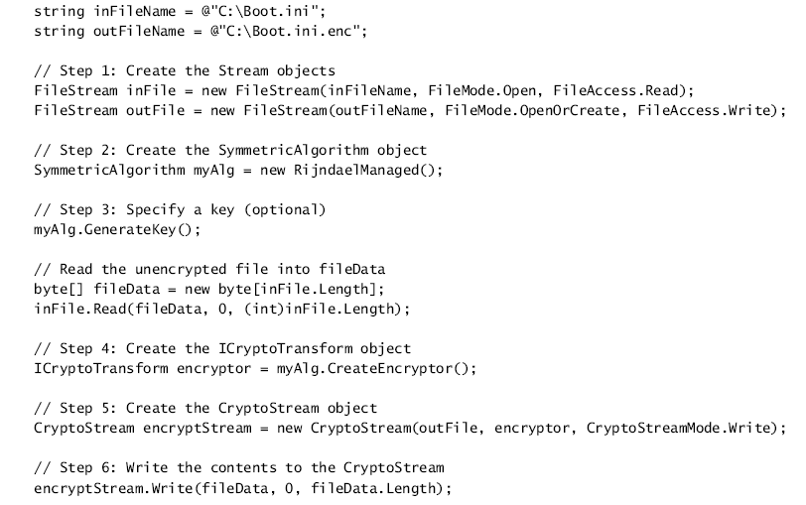
1

Slide 60
Example
// Encrypting and decrypting files using the Rijndael Managed encryption method.
using System;
using System.IO;
using System.Security.Cryptography;
class CryptoEx{
public static void Main(string[] args){
if (args.Length!=1){
Console.WriteLine("FileName Not Entered. Specify a filename to encrypt.");
return;}
string file = args[0];
string tempfile = Path.GetTempFileName();
// Open the file to read
FileStream fsIn = File.Open(file,FileMode.Open,FileAccess.Read);
FileStream fsOut = File.Open(tempfile, FileMode.Open,FileAccess.Write);
SymmetricAlgorithm symm = new RijndaelManaged(); //creating an instance
ICryptoTransform transform = symm.CreateEncryptor();
//and calling the CreateEncryptor method which creates a symmetric encryptor object.
CryptoStream cstream = new CryptoStream(fsOut,transform,CryptoStreamMode.Write);
BinaryReader br = new BinaryReader(fsIn);
cstream.Write(br.ReadBytes((int)fsIn.Length),0,(int)fsIn.Length);

Slide 61
2
cstream.FlushFinalBlock();
cstream.Close();
fsIn.Close();
fsOut.Close();
Console.WriteLine("Created Encrypted File {0}", tempfile);
fsIn = File.Open(tempfile,FileMode.Open,FileAccess.Read);
transform = symm.CreateDecryptor();
cstream = new CryptoStream(fsIn,transform,CryptoStreamMode.Read);
StreamReader sr = new StreamReader(cstream);
Console.WriteLine("Decrypted the File: " + sr.ReadToEnd());
fsIn.Close();
}

Slide 62
Lab
Lab: Encrypting and Decrypting Files
In this lab, you will write console applications that encrypt and decrypt files using a password. The console applications should take three parameters: the file name of the unencrypted file to read, the file name of the encrypted file to write, and the password.
Exercise 1: Write a Console Application to Encrypt Files
In this exercise, you create a console application that encrypts files using a password.
Exercise 2: Write a Console Application to Decrypt Files
In this exercise, you create a console application that decrypts files using a password.

Slide 63
Illustrates encrypting a string -1
using System;
using System.IO;
using System.Security.Cryptography;
public class Example19_9 {
public static void Main() {
// Create a new file to work with
FileStream fsOut = File.Create(@"c:\temp\encrypted.txt");
// Create a new crypto provider
TripleDESCryptoServiceProvider tdes =
new TripleDESCryptoServiceProvider();
// Create a cryptostream to encrypt to the filestream
CryptoStream cs = new CryptoStream(fsOut, tdes.CreateEncryptor(),
CryptoStreamMode.Write);
// Create a StreamWriter to format the output
StreamWriter sw = new StreamWriter(cs);
// And write some data
sw.WriteLine("'Twas brillig, and the slithy toves");
sw.WriteLine("Did gyre and gimble in the wabe.");
sw.Flush();
sw.Close();

Slide 64
2
// save the key and IV for future use
FileStream fsKeyOut = File.Create(@"c:\\temp\encrypted.key");
// use a BinaryWriter to write formatted data to the file
BinaryWriter bw = new BinaryWriter(fsKeyOut);
// write data to the file
bw.Write( tdes.Key );
bw.Write( tdes.IV );
// flush and close
bw.Flush();
bw.Close();
}}

Slide 65
3
using System;
using System.IO;
using System.Security.Cryptography;
public class Example19_10 {
public static void Main() {
// Create a new crypto provider
TripleDESCryptoServiceProvider tdes =
new TripleDESCryptoServiceProvider();
// open the file containing the key and IV
FileStream fsKeyIn = File.OpenRead(@"c:\temp\encrypted.key");
// use a BinaryReader to read formatted data from the file
BinaryReader br = new BinaryReader(fsKeyIn);
// read data from the file and close it
tdes.Key = br.ReadBytes(24);
tdes.IV = br.ReadBytes(8);

Slide 66
4
// Open the encrypted file
FileStream fsIn = File.OpenRead(@"c:\\temp\\encrypted.txt");
// Create a cryptostream to decrypt from the filestream
CryptoStream cs = new CryptoStream(fsIn, tdes.CreateDecryptor(),
CryptoStreamMode.Read);
// Create a StreamReader to format the input
StreamReader sr = new StreamReader(cs);
// And decrypt the data
Console.WriteLine(sr.ReadToEnd());
sr.Close();
}
}

Slide 67
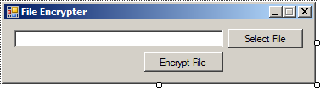
Encrypting Files
Start Visual Studio 2005 and in a new project put up a form similar to the one below; in there we have txtFilePath, btnSelFile, btnEncFile and three dialogs: openFile, saveKeyFile, saveEncFile.
Two using statements are needed at the top of Form1.cs:
using System.IO;
using System.Security.Cryptography;
First action comes from the Select File button (btnSelFile). Nothing exciting happens in its Click event, we just show the OpenFileDialog and store the file's path into the txtFilePath TextBox:

Slide 68
1
private void btnSelFile_Click(object sender, EventArgs e) {
if (openFile.ShowDialog() == DialogResult.OK) {
txtFilePath.Text = openFile.FileName;
}}
But here comes the actual encryption process, in the Click event of btnEncFile:
private void btnEncFile_Click(object sender, EventArgs e){
// After the user chose where he wants the key file saved
if (saveKeyFile.ShowDialog() == DialogResult.OK){
// And after the user chose where he wants the encrypted file saved
if (saveEncFile.ShowDialog() == DialogResult.OK) {
FileStream fsFileOut = File.Create(saveEncFile.FileName);
// The chryptographic service provider we're going to use
TripleDESCryptoServiceProvider cryptAlgorithm = new TripleDESCryptoServiceProvider();
// This object links data streams to cryptographic values
CryptoStream csEncrypt = new CryptoStream(fsFileOut, cryptAlgorithm.CreateEncryptor(), CryptoStreamMode.Write);
// This stream writer will write the new file
StreamWriter swEncStream = new StreamWriter(csEncrypt);
// This stream reader will read the file to encrypt
StreamReader srFile = new StreamReader(txtFilePath.Text);
// Loop through the file to encrypt, line by line
string currLine = srFile.ReadLine();

Slide 69
2
while (currLine != null) {
// Write to the encryption stream
swEncStream.Write(currLine);
currLine = srFile.ReadLine();
}
// Wrap things up
srFile.Close();
swEncStream.Flush();
swEncStream.Close();
// Create the key file
FileStream fsFileKey = File.Create(saveKeyFile.FileName);
BinaryWriter bwFile = new BinaryWriter(fsFileKey);
bwFile.Write(cryptAlgorithm.Key);
bwFile.Write(cryptAlgorithm.IV);
bwFile.Flush();
bwFile.Close();
}
}
}

Slide 70
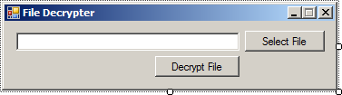
Decrypting Files
Now that you got your little encrypted file, it's not of much use unless you get to decrypt it. So create another Visual Studio 2005 application with a form looking much like the one for the encrypter:
txtFilePath, btnSelPath, btnDecFile, openFile, openKeyFile, saveDecFile are the elements of this form. You'll notice that instead of one OpenFileDialogs and two SaveFileDialogs, we have the opposite. That's because in this application we're going to open the encrypted file, then the key file and finally save the decrypted file.
Obviously we'll need these again:
using System.IO;
using System.Security.Cryptography;
In the Click event of the btnSelFile button we have the same story as in the previous application; this time we're opening the encrypted file:

Slide 71
1
private void btnSelFile_Click(object sender, EventArgs e)
{
if (openFile.ShowDialog() == DialogResult.OK)
{
txtFilePath.Text = openFile.FileName;
}
}
private void btnDecFile_Click(object sender, EventArgs e)
{
// After the encrypted file has been selected for opening
if (openKeyFile.ShowDialog() == DialogResult.OK)
{
// After the location where the decrypted file should be saved has been decided
if (saveDecFile.ShowDialog() == DialogResult.OK)
{
// The encrypted file
FileStream fsFileIn = File.OpenRead(txtFilePath.Text);
// The key
FileStream fsKeyFile = File.OpenRead(openKeyFile.FileName);
// The decrypted file
FileStream fsFileOut = File.Create(saveDecFile.FileName);

Slide 72
2
// Prepare the encryption algorithm and read the key from the key file
TripleDESCryptoServiceProvider cryptAlgorithm = new TripleDESCryptoServiceProvider();
BinaryReader brFile = new BinaryReader(fsKeyFile);
cryptAlgorithm.Key = brFile.ReadBytes(24);
cryptAlgorithm.IV = brFile.ReadBytes(8);
// The cryptographic stream takes in the encrypted file
CryptoStream csEncrypt = new CryptoStream(fsFileIn, cryptAlgorithm.CreateDecryptor(), CryptoStreamMode.Read);
// Write the new unecrypted file
StreamReader srCleanStream = new StreamReader(csEncrypt);
StreamWriter swCleanStream = new StreamWriter(fsFileOut);
swCleanStream.Write(srCleanStream.ReadToEnd());
swCleanStream.Close();
fsFileOut.Close();
srCleanStream.Close();
}
}
}

Slide 73



Friends and enemies: Alice, Bob, Trudy
well-known in network security world
Bob, Alice (lovers!) want to communicate “securely”
Trudy (intruder) may intercept, delete, add messages
Alice
Bob
channel
data, control messages
secure
sender
secure
receiver
data
data
Trudy

Slide 74
Who might Bob, Alice be?

Slide 75
There are bad guys (and girls) out there!
Q: What can a “bad guy” do?
A: a lot!
  eavesdrop: intercept messages
  actively insert messages into connection
  impersonation: can fake (spoof) source address in packet (or any field in packet)
  hijacking: “take over” ongoing connection by removing sender or receiver, inserting himself in place
  denial of service: prevent service from being used by others (e.g., by overloading resources)
more on this later ……

Slide 76

The language of cryptography
Alice’s
encryption
key
Bob’s
decryption
key
K
K
A
B
plaintext
encryption
algorithm
ciphertext
decryption
algorithm
plaintext
symmetric key crypto: sender, receiver keys identical
public-key crypto: encryption key public, decryption key secret (private)

Slide 78
Symmetric key cryptography
substitution cipher: substituting one thing for another
  monoalphabetic cipher: substitute one letter for another
plaintext: abcdefghijklmnopqrstuvwxyz
ciphertext: mnbvcxzasdfghjklpoiuytrewq
E.g.:
Plaintext: bob. i love you. alice
ciphertext: nkn. s gktc wky. mgsbc
Q: How hard to break this simple cipher?:
  brute force (how hard?)
  other?

Slide 79
Symmetric key cryptography
K
K
A-B
A-B
plaintext
message, m
encryption
algorithm
ciphertext
decryption
algorithm
plaintext
m = K ( )
K (m)
K (m)
A-B
A-B
A-B
symmetric key crypto: Bob and Alice share know same (symmetric) key: K
e.g., key is knowing substitution pattern in mono alphabetic substitution cipher
Q: how do Bob and Alice agree on key value?
A-B

Slide 80

Public Key Cryptography
symmetric key crypto
requires sender, receiver know shared secret key
Q: how to agree on key in first place (particularly if never “met”)?
public key cryptography
radically different approach [Diffie-Hellman76, RSA78]
sender, receiver do not share secret key
public encryption key known to all
private decryption key known only to receiver

Slide 81
Public key cryptography
+
Bob’s public
key
K
B
-
Bob’s private
key
K
B
plaintext
message, m
encryption
algorithm
ciphertext
decryption
algorithm
plaintext
message
+
K (m)
-
+
B
m = K (K (m))
B
B

Slide 82
Public key encryption algorithms
Requirements:
1
need K- ( ) and K + ( ) such that
-
+
K (K (m)) = m
B
B
2
+
given public key K , it should be impossible to compute private key K -
RSA: Rivest, Shamir, Adelson algorithm

Slide 83
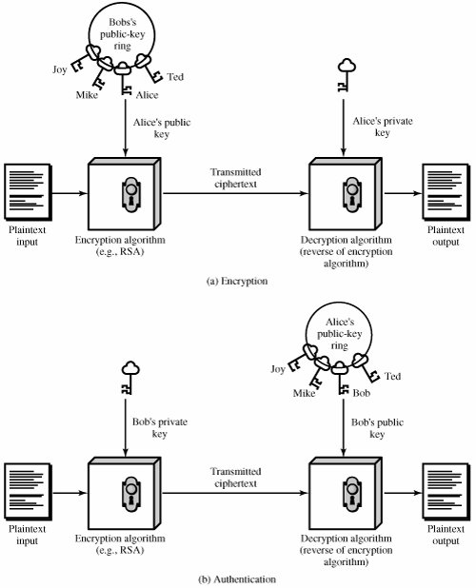

Slide 84
Applications for Public-Key Cryptosystems
Before proceeding, we need to clarify one aspect of public-key cryptosystems that is otherwise likely to lead to confusion. Public-key systems are characterized by the use of a cryptographic algorithm with two keys, one held private and one available publicly. Depending on the application, the sender uses either the sender's private key or the receiver's public key, or both, to perform some type of cryptographic function. In broad terms, we can classify the use of public-key cryptosystems into three categories:
  Encryption/decryption: The sender encrypts a message with the recipient's public key.
  Digital signature: The sender "signs" a message with its private key. Signing is achieved by a cryptographic algorithm applied to the message or to a small block of data that is a function of the message.
  Key exchange: Two sides cooperate to exchange a session key. Several different approaches are possible, involving the private key(s) of one or both parties.

Slide 85
Asymmetric Encryption Explained

Slide 86
Asymmetric encryption, often called "public key" encryption, allows Alice to send Bob an encrypted message without a shared secret key; there is a secret key, but only Bob knows what it is, and he does not share it with anyone, including Alice.
The concept of public-key cryptography evolved from an attempt to attack two of the most difficult problems associated with symmetric encryption. The first problem is that of key distribution and The second problem and one that was apparently unrelated to the first was that of "digital signatures."

Slide 87
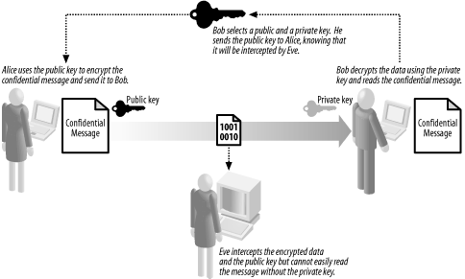

Slide 88
  Bob creates a pair of keys, one of which he keeps secret and one of which he sends to Alice.
  Alice composes a confidential message and encrypts it using the key that Bob has sent to her.
  Alice sends the encrypted data to Bob.
  Bob uses his secret key to decrypt the data and reads the confidential message.
The key that Bob sends to Alice is the public key, and the key he keeps to himself is the "private" key; jointly, they form Bob's "key pair."
The most striking aspect of asymmetric encryption is that Alice is not involved in selecting the key: Bob creates a pair of keys without any input or agreement from Alice and simply sends her the public key. Bob retains the private key and keeps it secret. Alice uses an asymmetric algorithm to encrypt a message with Bob's public key and sends him the encrypted data, which he decrypts using the private key.

Slide 89
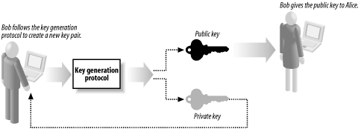
Asymmetric algorithms include a "key generation" protocol that Bob uses to create his key pair. Following the protocol results in the creation of a pair of keys that have a mathematical relationship—the exact detail of the protocol and the relationship between the keys is different for each algorithm.

Slide 90
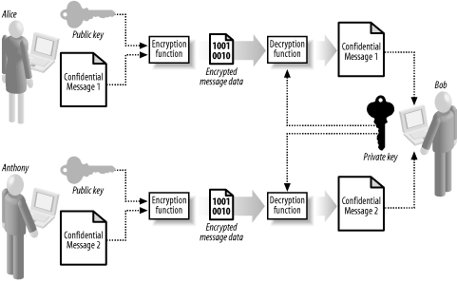
When we talk about an asymmetric encryption algorithm, we are actually referring to two related functions that perform specific tasks: an encryption function that encrypts a message using a public key, and a decryption function that uses a secret key to decrypt a message encrypted with the corresponding public key.
The encryption function can only encrypt data. Alice cannot decrypt ciphertext that she has created using the encryption function. This means that Bob can send his public key to several people, and each of them can create ciphertext that only Bob's secret key can decrypt.

Slide 91
The one-way nature of the encryption function means that messages created by one sender cannot be read by another (i.e., Alice cannot decrypt the ciphertext that Anthony has created, even though they both have Bob's public key). Bob can give out the public key to anyone who wants to send him a message, and he can even print his public key on his business card and hand it out to anyone who might want to send him a message. He can add the public key to an Internet directory of keys, allowing people Bob has never met to create messages that only he can read.
If Bob suspects that Eve has guessed his private key, he simply creates a new key pair and sends out the new public key to anyone who might send him a message. This is a lot easier than arranging to meet in a secure location to agree on a new symmetric secret key with every person that might want to communicate with him.
Bob's pair of keys allows Alice to send him encrypted messages, but Bob cannot use them to send a message back to Alice because of the one-way nature of the encryption and decryption functions. If Bob needs to send Alice a confidential message, Alice must create her own pair of keys and send the public key to Bob, who can then use the encryption function to create ciphertext that only Alice can decrypt with her private key.

Slide 92
The main limitation of public key encryption is that it is very slow relative to symmetric encryption and is not practical for encrypting large amounts of data. In fact, the most common use of public key encryption is to solve the key agreement problem for symmetric encryption algorithms.
In the following sections, we demonstrate how an asymmetric encryption algorithm works. We use the RSA algorithm for our illustration because it is the only one implemented in the .NET Framework. Ronald Rivest, Adi Shamir, and Leonard Adleman created the RSA algorithm in 1977, and the name is the first letter of each of the inventors' last names. The RSA algorithm is the basis for numerous security systems, and remains the most widely used and understood asymmetric algorithm.

Slide 93
Creating Asymmetric Keys
Most asymmetric algorithms use keys that are very large numbers, and the RSA algorithm is no exception.
We step through the RSA key generation protocol, using small test values. The protocol is as follows:
  Choose two large random prime numbers, p and q, of equal length and multiply them together to create n, the RSA key modulus.
  Select p as 23 and q as 31, so that the modulus, n, is:
  n = p x q = 23 x 31 = 713
Randomly choose e, the public exponent, so that e and (p - 1)(q - 1) are relatively prime.Numbers are "relatively" prime when they share no common factors except 1. For these test values select a value for e that has no common factors with 660. Select e as 19.
Compute the private exponent, d, where d = e⁻¹mod((p - 1)(q - 1)).
  For our example, we calculate d as follows:
  d = 19⁻¹ mod(22 x 30) = 139
The public key consists of e and n. The private key is d. Discard p and q, but do not reveal their values.
You can see how simple it is to create an RSA key pair. Bob sends the value of e (19) and n (713) to Alice and keeps the value of d (139) secret. Most asymmetric encryption algorithms use a similar approach to key generation.

Slide 94
Asymmetric Algorithm Security
Asymmetric algorithms use much longer keys than symmetric algorithms. In our examples, we selected small values to demonstrate the key generation protocol, but the numeric values used in practice contain many hundreds of digits.
Measure asymmetric key lengths in bits. The way to determine the number of bits differs between algorithms. The RSA algorithm specifies that the key length is the smallest number of bits needed to represent the value of the key modulus, n, using binary. Round up the number of bits to a factor of eight so that you can express the key using bytes; for example, consider a modulus represented by 509 bits to be a 512-bit key. Common lengths for keys are 512 and 1024-bits, but a 1024-bit asymmetric key does not provide 16 times more resistance to attack than a 64-bit symmetric key.
Most asymmetric algorithms rely on some form mathematical task that is difficult or time-consuming to perform. Cryptographers consider the RSA algorithm secure because it is hard to find the factors of a large number; given our example value for n (713), it would take some time to establish that the factors are the values you selected for p (23) and q (31). The longer the value of n, the longer it takes to determine the factors.

Slide 95
Therefore, the essence of security for RSA is that given only the public key e and n, it takes a lot of computation to discover the private key d. Once you know the factors p and q, it is relatively easy to calculate d and decrypt ciphertext. Bob makes it difficult for Eve to decrypt his messages by keeping secret the values of d, p and q.
The main risk with asymmetric algorithms is that someone may discover a technique to solve the mathematical problems quickly, undermining the security of the algorithm. New techniques to factor large numbers might make it a simple process to decrypt messages or to deduce the value of the private key from the public key, and this would render the RSA algorithm (and any others that rely on the same mathematical problem) insecure.

Slide 96
Creating the Encrypted Data
The protocol for encrypting data using an asymmetric algorithm is as follows:
  Break the plaintext into small blocks of data.
  Encrypt each small plaintext block by using the public key and the encryption function.
  Concatenate the encrypted blocks to form the ciphertext.
The length of the public key determines the size of the block to which we break the plaintext. Each algorithm specifies a rule for working out how many bytes of data should be in each block, and for the RSA protocol, we subtract 1 from the key length (in bits) and divide the result by 8. The integral part of the result tells you how many bytes of data should be in each block of plaintext passed that is to the encryption function. You can work out how many bytes should be in a plaintext block for a 1024-bit key, as follows:

Slide 97
The integral value of the result is 127, meaning that when using the RSA algorithm with a 1024-bit public key we should break the plaintext into blocks of 127 bytes. The small key that you generated to demonstrate the key generation protocol is 16 bits long (713 is 1011001001 in binary and the bit length is therefore rounded up to be 16 bits) and with a 16-bit key, we must use 1-byte blocks (the integral part of (10 - 1)/8 = 1.875 is 1).
Encrypt each data block by interpreting it as an integer value and compute a ciphertext block using the RSA encryption function shown below (m is the integer value of the plaintext block and c is the ciphertext block):
c = m^{e} mod n
The following Figure demonstrates how this process works for a 24-bit key, meaning that you process 2 bytes of plaintext at a time; the figure shows how the encryption function is applied to encrypt the string ".NET" into the ciphertext "35 7B AE 05 F1 6F."

Slide 98
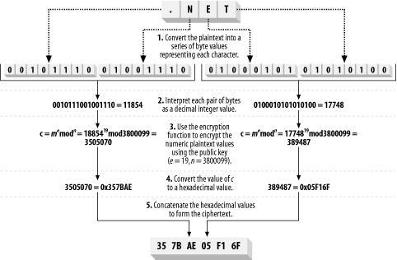

Slide 99
Decrypting data is the reverse of the encryption protocol:
  Break the ciphertext into small blocks of data that are the same length as the public key modulus.
  Decrypt each small ciphertext block by using the private key and the decryption function.
  Concatenate the decrypted blocks to form the restored plaintext.
  The decryption function is as follows (c is the value of the ciphertext block and m is the plaintext block):
  m = c^{d} mod n
Notice that the decryption function uses the secret key (d) and the modulus from the public key (n).
The following Figure demonstrates how this process works for our 24-bit key, meaning that we process 3 bytes of ciphertext at a time.

Slide 100
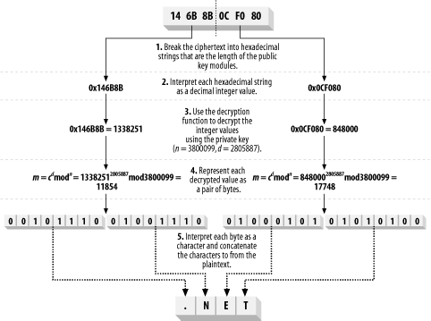

Slide 101
Asymmetric data padding
Asymmetric encryption algorithms rely on padding to protect against specific kinds of attack, in much the same way that symmetric algorithms rely on cipher feedback. Padding schemes also ensure that the encryption function does not have to process partial blocks of data.
Asymmetric padding schemes are a series of instructions that specify how to prepare data before encryption, and usually mix the plaintext with other data to create a ciphertext that is much larger than the original message.
The .NET Framework supports two padding schemes for the RSA algorithm: Optimal Asymmetric Encryption Padding (OAEP) and PKCS #1 v1.5. OAEP is a newer scheme that provides protection from attacks to which the PKCS #1 v1.5 scheme is susceptible. You should always use OAEP, unless you need to exchange encrypted data with a legacy application that expects PKCS #1 v1.5 padding.

Slide 102

Programming Asymmetrical Encryption
The .NET Framework takes the same approach to representing asymmetric algorithms as it does for symmetric algorithms and hashing algorithms; abstract classes extend the System.Security.Cryptography.AsymmetricAlgorithm class for each of the supported algorithms. Individual implementations of the algorithms extend the abstract class, supporting the possibility of more than one implementation of an algorithm .

Slide 103
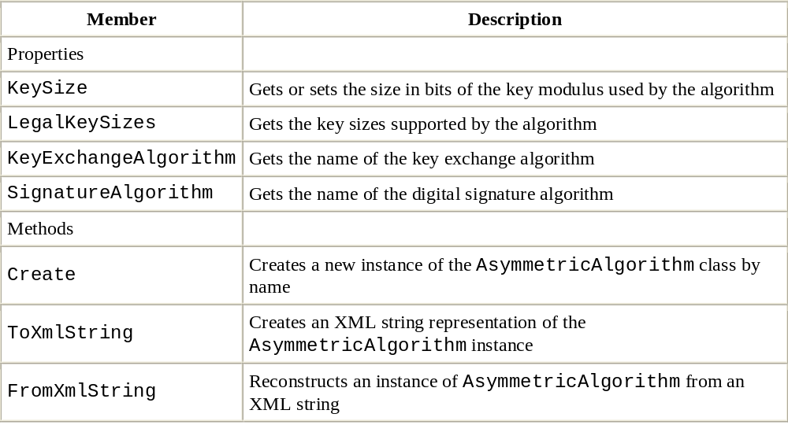
The AsymmetricAlgorithm class
Different asymmetric algorithms can take very different approaches to encrypting data, and the abstract AsymmetricAlgorithm class provides very little in the way of common functionality.

Slide 104
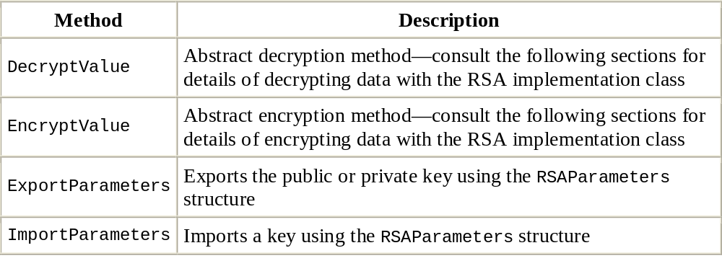
The RSA class
The RSA class is the abstract representation of the RSA algorithm and extends AsymmetricAlgorithm. This class provides the common functionality shared by any implementation of the underlying algorithm and allows the algorithm to be employed without regard to the implementation details.

Slide 105
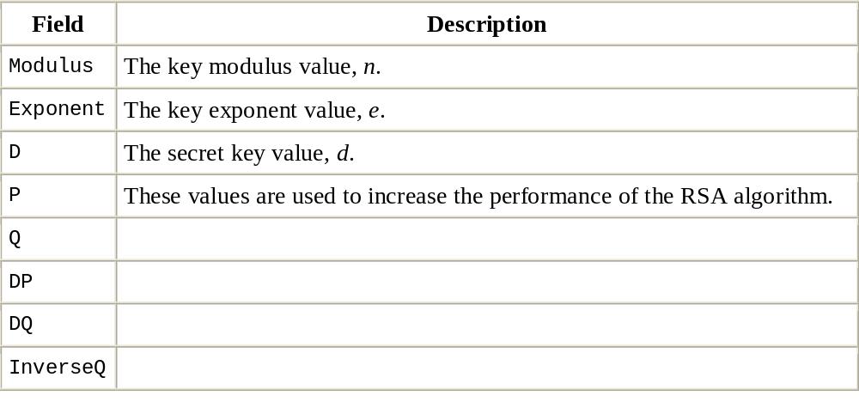
The EncryptValue and DecryptValue methods are not as useful as they seem, as we will explain in the next section. The value of the RSA class is the addition of the ImportParameters and ExportParameters methods, which allow the public or private keys to be imported into or exported from an instance of the class.
Members of the RSAParameters structure

Slide 106
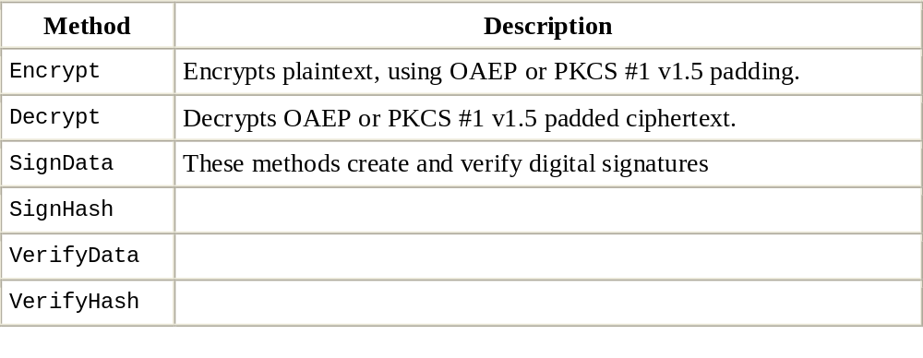
The RSACryptoServiceProvider Class
This class is the only asymmetric encryption implementation class contained in the .NET Framework. Unfortunately, while this class extends the abstract RSA class, it does not implement the EncryptValue and DecryptValue methods, meaning that you must work with the implementation class directly to use the RSA algorithm.

Slide 107
Using RSA Keys
Even though you cannot use the abstract classes to encrypt and decrypt data, the methods that they define do allow you to configure the keys used by instances of the RSACryptoServiceProvider class.
The AsymmetricAlgorithm class provides the LegalKeySizes property, which returns an array of the KeySizes structure, specifying all of the key lengths that the algorithm supports.
The .NET RSA implementation supports key lengths from 384 to 16384 bits, in 8-bit steps, and the size of key you wish to use is set using the KeySize property.
The RSA implementation will create a new key pair automatically if you have not imported a key value before you encrypt or decrypt data. You can export the details of this key using the ExportParameters method, which returns an instance of the RSAParameters structure. This method accepts a Boolean argument. If the argument is true, then the private key is exported; otherwise, only the details of the public key are included:
RSACryptoServiceProvider x_alg = new RSACryptoServiceProvider( );
// export only the public key
RSAParameters x_public_params = x_alg.ExportParameters(false);
// export the private key
RSAParameters x_private_params = x_alg.ExportParameters(true);

Slide 108
The most common use for the ExportParameters method is to export details of a key from one instance of an algorithm and then import them to another using the ImportParameters method:
// create an instance of the RSA algorithm
RSACryptoServiceProvider x_alg = new RSACryptoServiceProvider( );
// export only the public key
RSAParameters x_public_params = x_alg.ExportParameters(false);
// create a second instance of the algorithm
RSACryptoServiceProvider x_second_algorithm = new RSACryptoServiceProvider( );
// import the public key
x_second_algorithm.ImportParameters(x_public_params);

Slide 109
The RSAParameters structure is also useful if you need to export a key into a custom format. The following statements demonstrate how to export the public part of a key pair and write it out as a pair of hexadecimal strings:
// create an instance of the RSA algorithm
RSACryptoServiceProvider x_alg = new RSACryptoServiceProvider( );
// export only the public key
RSAParameters x_public_params = x_alg.ExportParameters(false);
Console.Write("n: ");
foreach (byte x_byte in x_public_params.Modulus) {
Console.Write("{0:X2} ", x_byte);
}
Console.WriteLine( );
Console.Write("e: ");
foreach (byte x_byte in x_public_params.Exponent) {
Console.Write("{0:X2} ", x_byte);
}

Slide 110
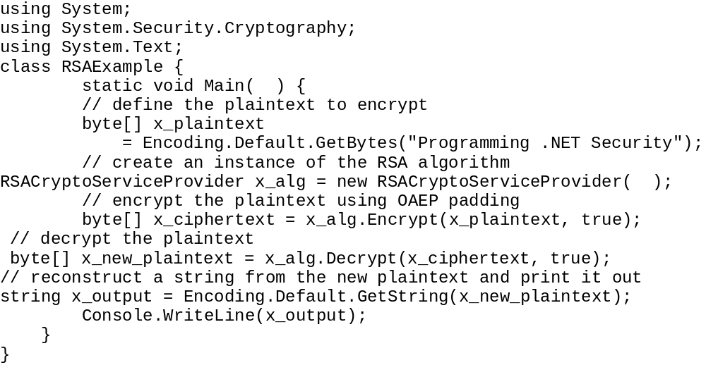
Encrypting and Decrypting Data
The RSACryptoServiceProvider class defines the Encrypt and Decrypt methods, each of which processes a byte array, as demonstrated by the following statements:

Slide 111
Exchange Symmetric Session Keys Securely
Problem
  You need to exchange symmetrically encrypted data with somebody, and you need a secure method of delivering the symmetric session key with the data.
Solution
  Use the key exchange mechanism implemented by the System.Security.Cryptography.RSACryptoServiceProvider class. This will asymmetrically encrypt your symmetric key using the intended recipient's public key. You can then send the encrypted symmetric key along with the encrypted data to the recipient. The recipient must decrypt the symmetric key using the private key, and then proceed to decrypt the data.

Slide 112
The .NET Framework class library includes support for key exchange using only the RSA algorithm, but you must choose between two formatting schemes: Optimal Asymmetric Encryption Padding (OAEP) and PKCS #1.
The following two classes implement the key exchange mechanism—one for each formatting scheme:
System.Security.Cryptography.RSAOAEPKeyExchangeFormatter
System.Security.Cryptography.RSAPKCS1KeyExchangeFormatter
To prepare a symmetric key for exchange you must create a formatter object of the desired type and then assign an asymmetric algorithm object (RSACryptoServiceProvider) to the formatter by calling the formatter's SetKey method. You must configure the asymmetric algorithm to use the recipient's public key. Once configured, call the formatter's CreateKeyExchange method and pass a byte array containing the symmetric session key that you want to format. The CreateKeyExchange method returns a byte array containing the key exchange data that you should send to the intended recipient.

Slide 113
Deformatting the exchanged key mirrors the formatting process. There are two deformatter classes—one for each formatting scheme.
System.Security.Cryptography.RSAOAEPKeyExchangeDeformatter
System.Security.Cryptography.RSAPKCS1KeyExchangeDeformatter
To deformat a formatted session key, create a deformatter object of the appropriate type and call its SetKey method to assign an asymmetric algorithm object. You must load your private key into the asymmetric algorithm. Finally, call the DecryptKeyExchange method passing in the key exchange data. The DecryptKeyExchange method returns a byte array containing the original symmetric session key.

Slide 114
The Main method then calls the example's FormatKeyExchange method passing a byte array containing the symmetric key and an RSAParameters object containing the recipient's public key. The FormatKeyExchange method returns a byte array containing the encrypted and formatted symmetric key, ready to send to the intended recipient. Next the Main method calls the example's DeformatKeyExchange method passing the formatted key exchange data and a CspParameters object that contains a reference to the MyKeys key container, which contains the recipient's private key. During the process, the Main method displays the original session key, the formatted exchange data, and finally the deformatted session key.

Slide 115
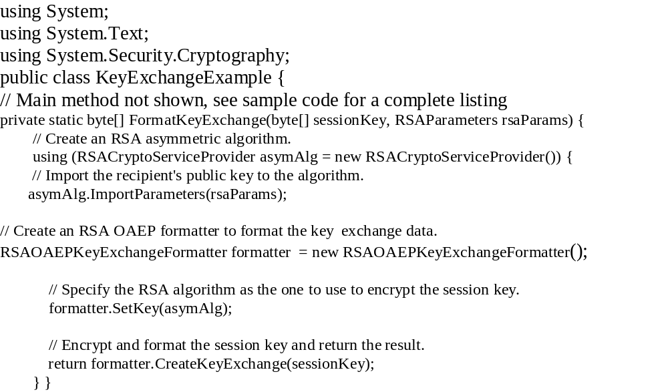

Slide 116
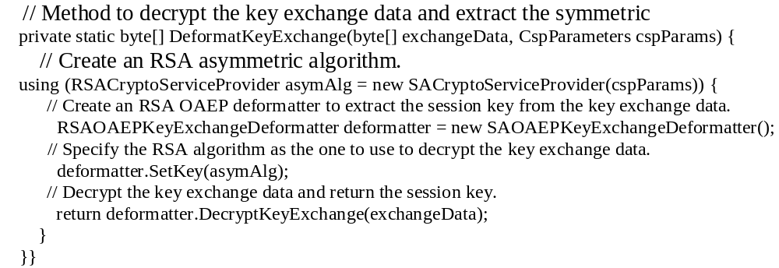

Slide 117
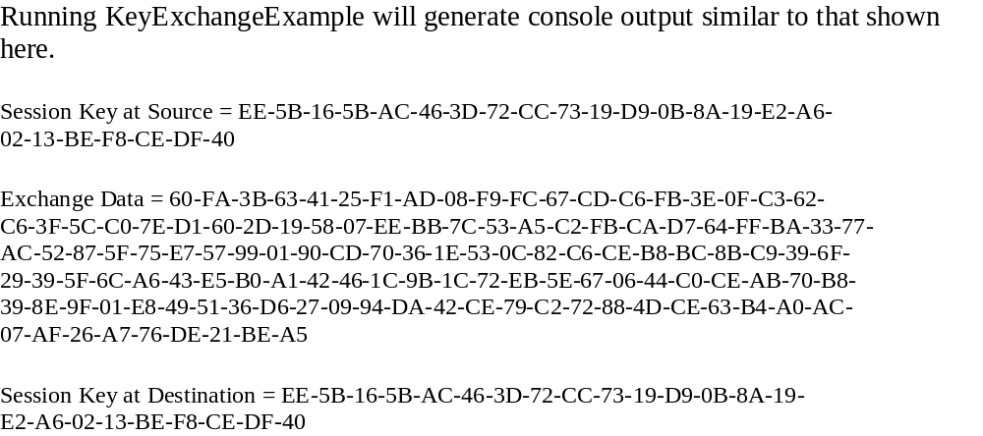

Slide 118
Digital Signatures
You use an asymmetric key pair to create a "signature" for a message by adding a signature function to the asymmetric algorithm. The recipient can verify the signature using a verification function. Asymmetric algorithms that support signature and verification functions are digital signature algorithms. Each digital signature is specific to an individual message or document, and if Alice signs a message, Bob can be confident that Eve has not sent him a forgery.
  Alice selects an asymmetric signature algorithm and follows the key generation protocol to create a new pair of keys. She keeps her private key secret and sends the public key to Bob.
  Alice composes a message and creates a signature using her private key.
  Alice sends the message and the signature to Bob.
  Bob uses Alice's public key to verify the signature. If the signature is valid, Bob can be confident that:
  Alice is truly the author of the message.
  Eve has not altered the message contents.

Slide 119
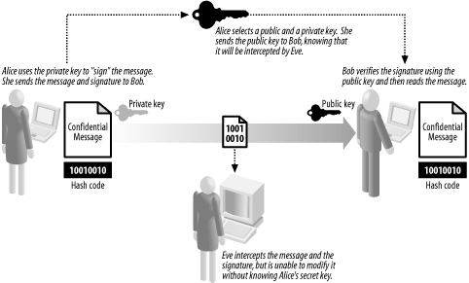

Slide 120
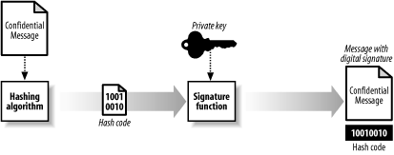
Notice that Alice, the sender of the message, creates the key pair and retains the private key; this is different from asymmetric encryption, where the recipient (Bob) is responsible for key creation. Digitally signing a message creates a separate piece of data, which Alice sends to Bob along with the message.
The relatively slow performance of asymmetric algorithms means that Alice does not sign the entire message she wants to send; instead, she creates a cryptographic hash code for the message and signs this instead. Subject to the limitations of hash code security , signing hash code for a message is equivalent to signing the message itself, but is much faster, because the hash code is less data to process with the asymmetric algorithm

Slide 121
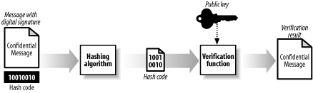
Bob verifies the signature by creating his own hash code and using the asymmetric signature verification and Alice's public key. Bob cannot verify the signature if the message is altered in any way, meaning that Eve cannot secretly tamper with the contents and Bob cannot alter a message and later claim that Alice had signed the altered version. Alice and Bob must use the same hash code algorithm; otherwise, Bob will not be able to verify valid signatures.

Slide 122
Digital signatures allow more than one person to sign a message or document, such as a contract. Each person signs the message using the basic protocol we described, and sends their signature to all of the other signatories. If Alice and Bob wish to sign a digital contract, the basic protocol that they use is as follows:
  Alice and Bob agree on the contents of the contract they will sign.
  Alice creates a hash code for the contract and signs it with her private key.
  Bob creates a hash code for the contract and signs it with his private key.
  Alice and Bob exchange digital signatures and public keys.
  Alice checks that Bob has used the correct hash code (and therefore has signed the expected version of the contract) and verifies the signature using his public key.
  Bob checks that Alice has used the correct hash code and verifies the signature using her public key.
Should there be any dispute, a third party (perhaps a judge or other arbitrator) can use Alice and Bob's pubic keys to verify that both Alice and Bob have signed the same contract. Neither party can alter the contract (because then the hash code would not match) nor deny that they signed the contract (because the third party can verify each separate signature).

Slide 123
Digital Signature Security
Digital signatures have two objectives: they must be cryptographically secure and they must provide equivalent security features to an ink signature on a printed document. We summarize the security features of digital signatures as follows:
  Eve should not be able to forge Alice's digital signature. Eve cannot create a fake signature unless she knows Alice's private key; as in almost all aspects of cryptography, digital signatures rely on the careful protection and management of keys. If Eve could forge Alice's signature, Eve could make it appear that Alice has signed any document.
  Eve should not be able to reuse one of Alice's digital signatures. Eve can only take Alice's signature from one document and associate it with another if both documents produce the same data hash code.
  Eve should not be able to alter a signed document. If Eve alters the content of a document, then Alice's signature will no longer be valid, because the altered document will produce a different data hash code to the one that Alice signed. Eve could alter a document successfully if it resulted in the same data hash code as the original (which is, in effect, the same as reusing Alice's signature).
  Alice should not be able to deny that she has signed a document. Alice cannot sign a document and then later claim that she did not, because we assume that she is the only person who knows her secret key. If she suspects that her key has been compromised, then she must create a new key pair

Slide 124
The .NET Framework Digital Signature Algorithms
The .NET Framework includes two asymmetric algorithms that support digital signatures, one is the RSA algorithm; this algorithm defines functions for both data encryption and digital signatures.
The second algorithm is the Digital Signature Algorithm (DSA), published as a U.S. FIPS in May 1994. DSA supports digital signatures but not data encryption. Initially created to provide a standard algorithm for digital signatures for federal projects, DSA has gained support in commercial projects gradually but still lags behind RSA in terms of adoption.

Slide 125
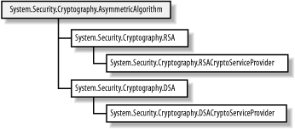
Programming Digital Signatures
The .NET Framework groups encryption and digital signature algorithms together as subclasses of the AsymmetricAlgorithm class. The following figure depicts the .NET class hierarchy for digital signature algorithms, which differs from the encryption algorithm hierarchy only because of the addition of the signature-only DSA support.

Slide 126
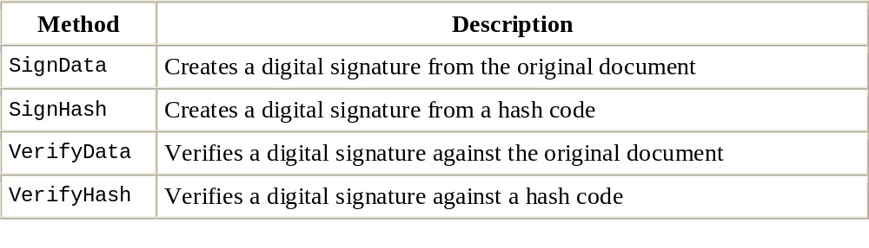
Using the Implementation Class
The RSACryptoServiceProvider and DSACryptoServiceProvider classes both define four methods related to digital signatures (DSACryptoServiceProvider implements these methods in addition to the CreateSignature and VerifySignature methods we discussed in the previous section).

Slide 127
The SignData method creates a signature by generating a hash code, formatting the hash code using PKCS #1, and signing the result. The corresponding VerifyData method creates a PKCS #1-formatted hash code and uses it to verify a signature.
For the RSA algorithm, the hash codes are generated using an instance of System.Security.Cryptography.HashAlgorithm, provided as an argument to the SignData and VerifyData methods. For the DSA algorithm, the SHA-1 hashing algorithm is always used to generate the hash codes.
The following statements demonstrate how to use the SignData method to create a signature for a byte array, and then verify the signature using the VerifyData method:

Slide 128
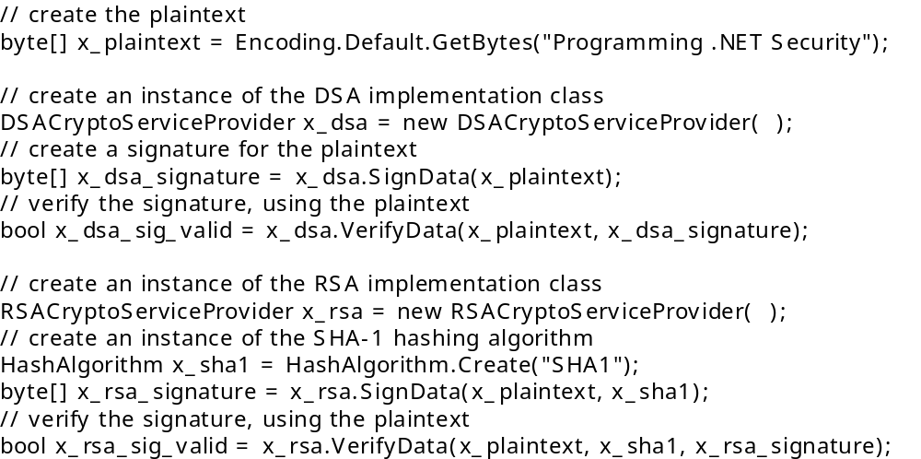
Example

