Slide 1

CanCare
Medical Application

Slide 2
Developed by:
1) Abd Al-Rahman Abd Al-Aty
2) Mohamed Gamal
3) Mohamed Hosam
4) Mahmoud Khaled

Slide 3
Main points:
About the application
The name and it’s relation with the logo!!
The new features

Slide 4
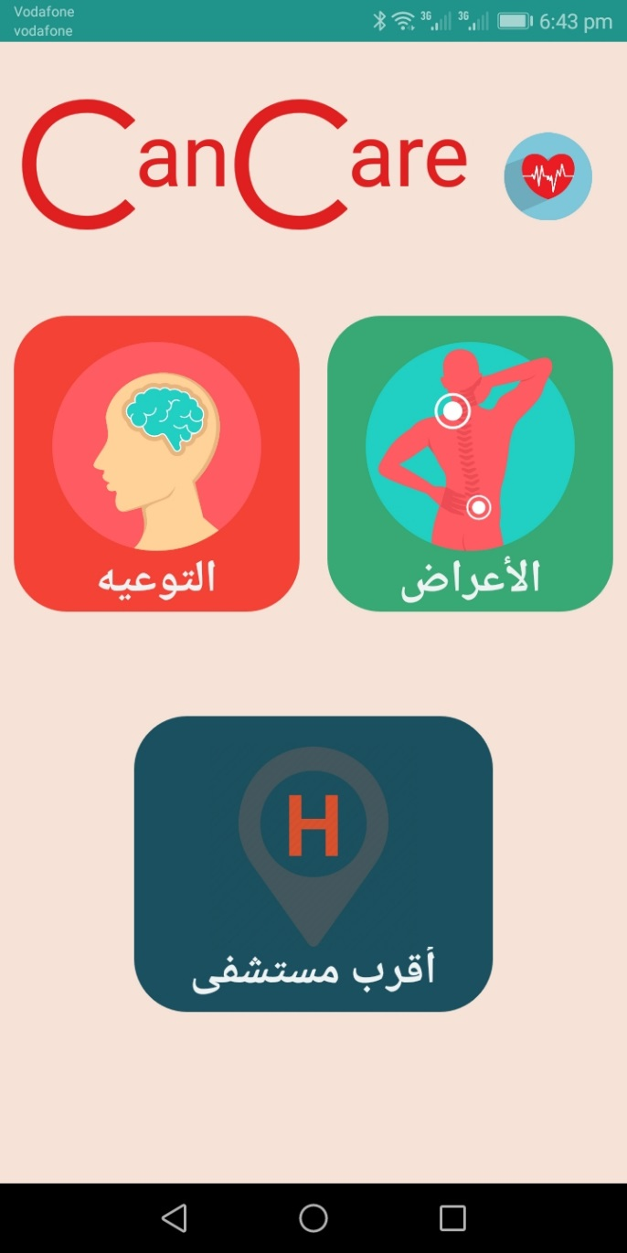
About the application
The idea of our application is an examination of the patient’s symptoms to give it to server to process it and come back with his disease to give him alert to check himself at any time.

Slide 5

The name and it’s relation with the logo!!
Our application name is CanCare that based on:
Our app is medical application CARE
Our workshop named CANdroid
CanCare

Slide 6
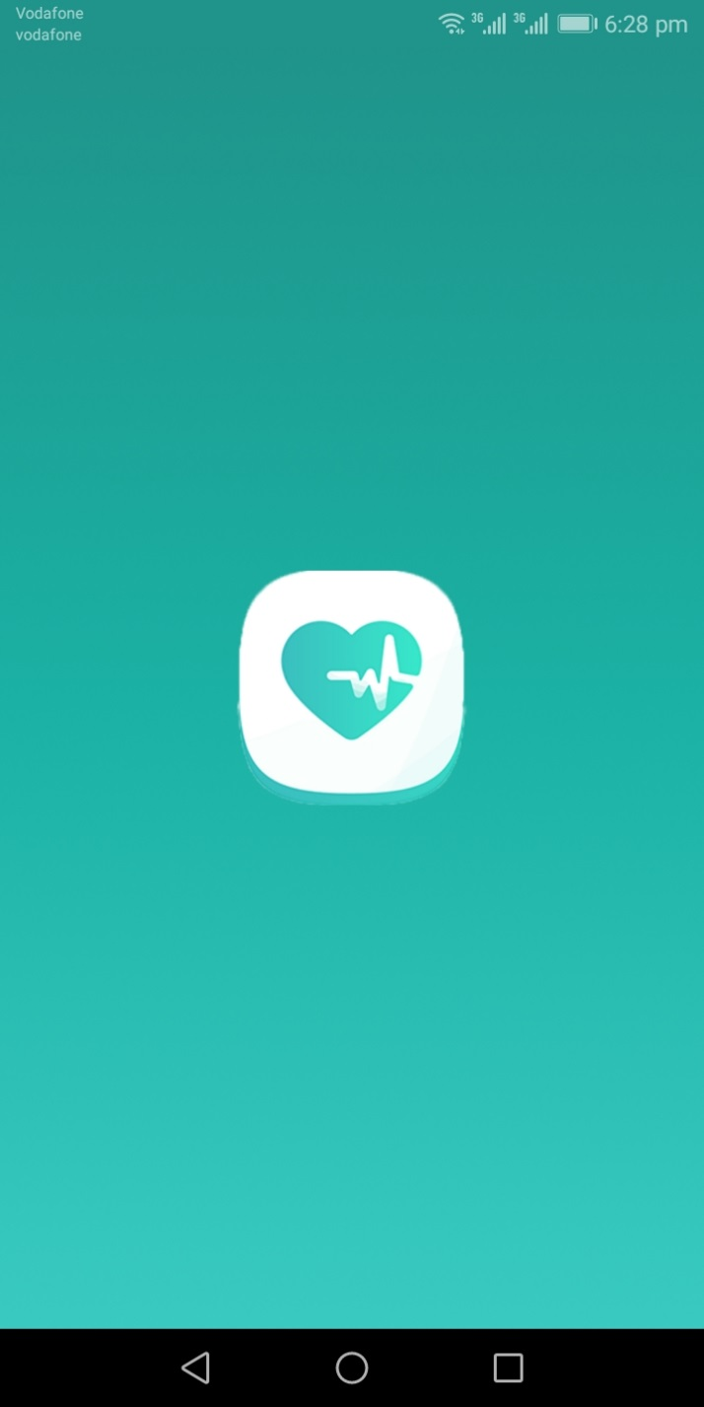
Application services:
Splash screen

Slide 7
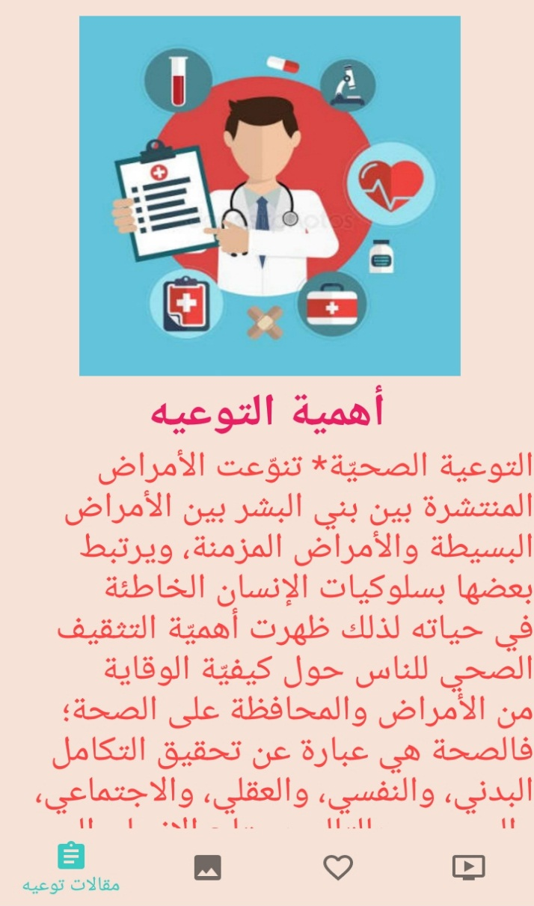
Application services
Awareness
Important of awareness
Navigation bar
Scroll view
fragment

Slide 8
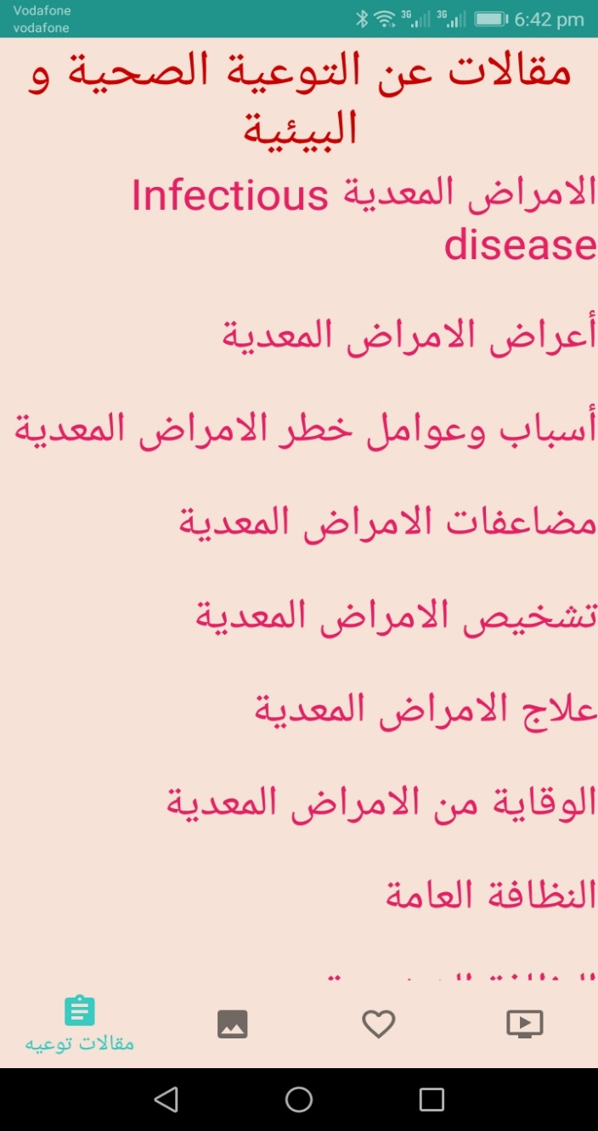
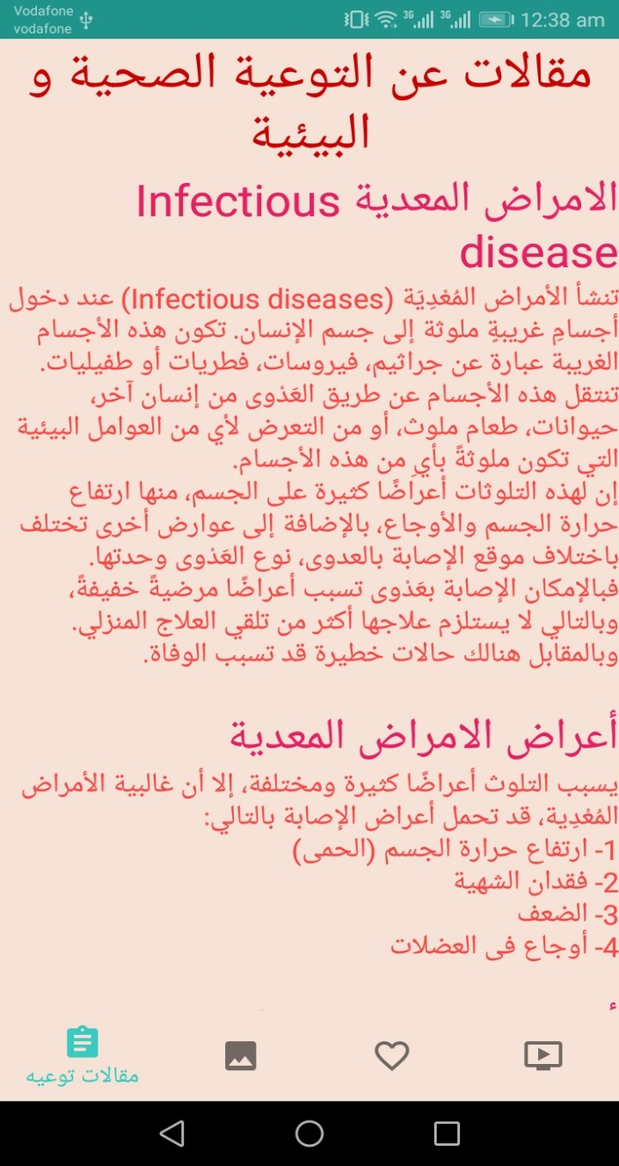
Articles about medical and environmental awareness

Slide 9
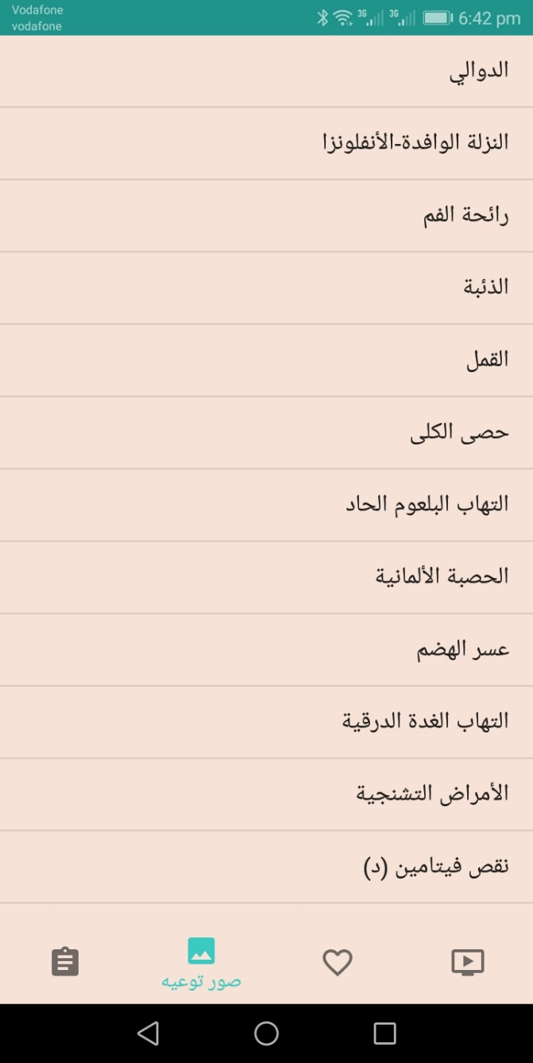
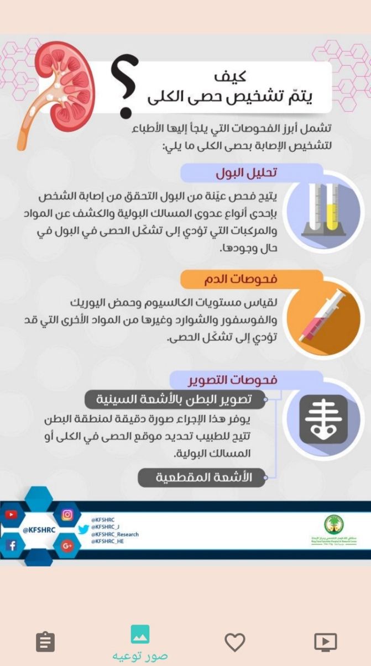
photos about medical and environmental awareness

Slide 10
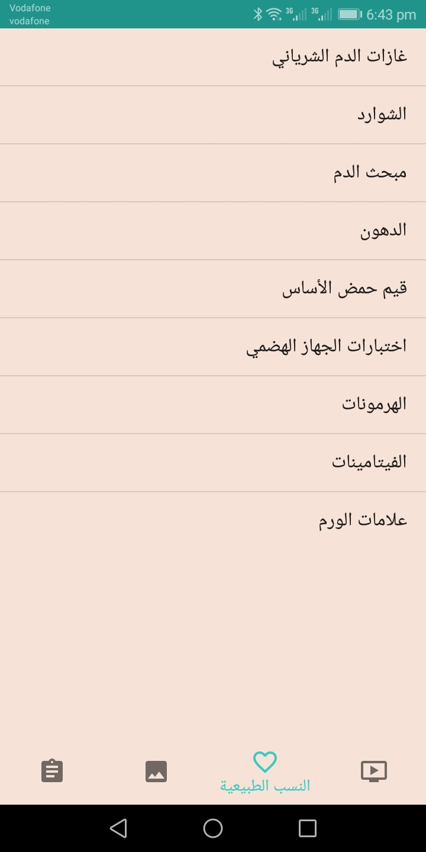
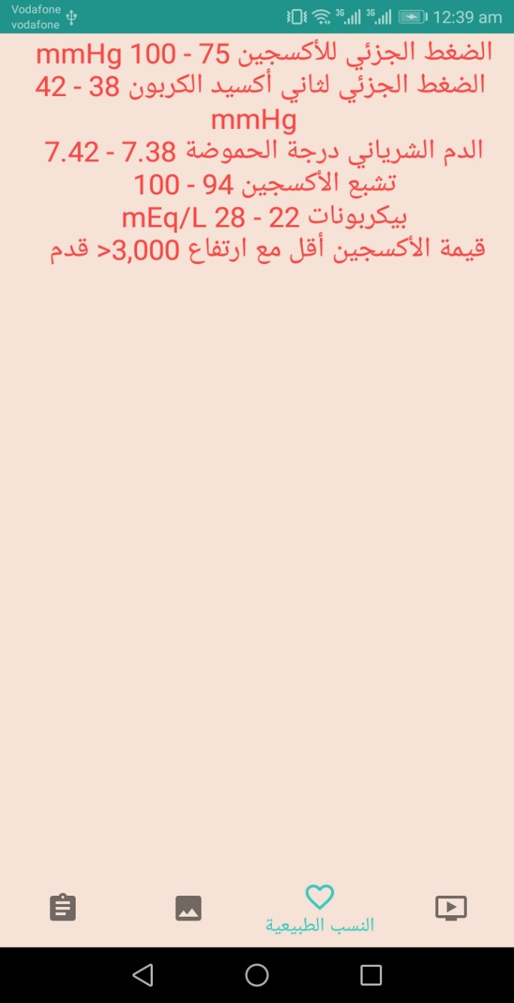
Normal percentage of human body

Slide 11
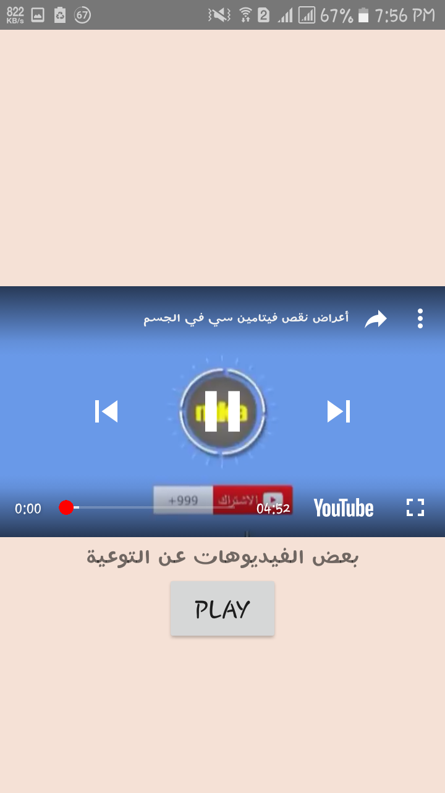
Videos about medical and environmental awareness

Slide 12
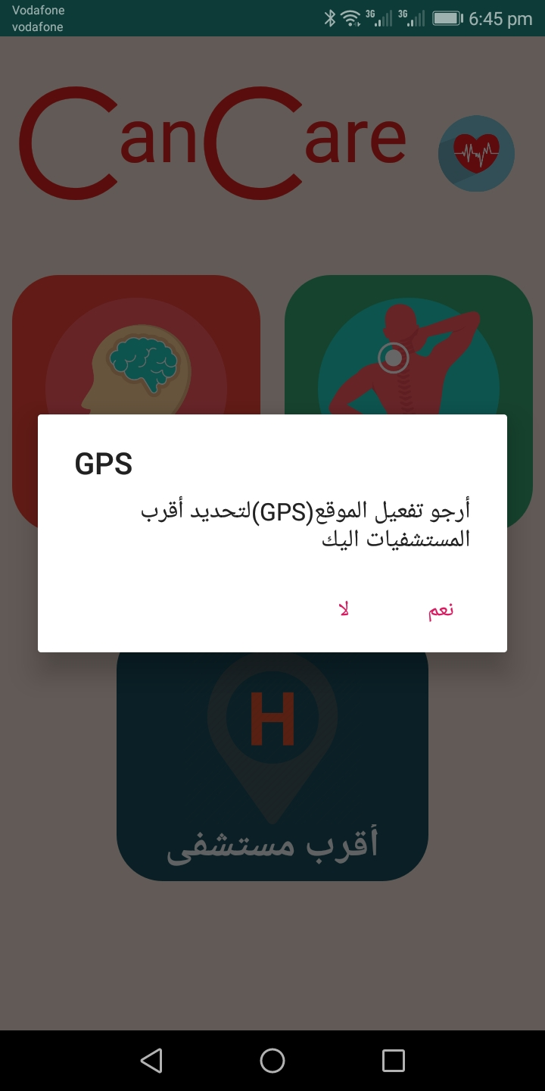
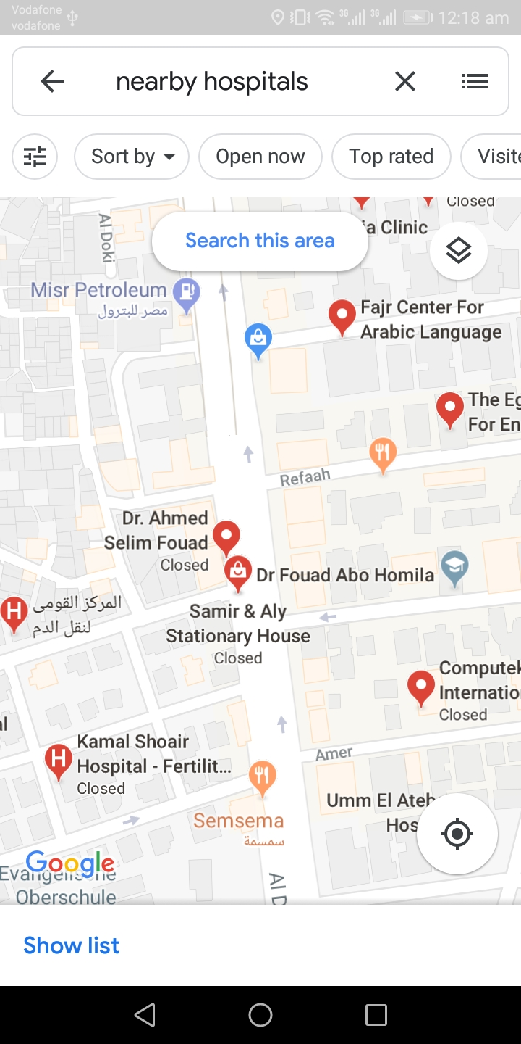
GPS and the nearest hospitals

Slide 13
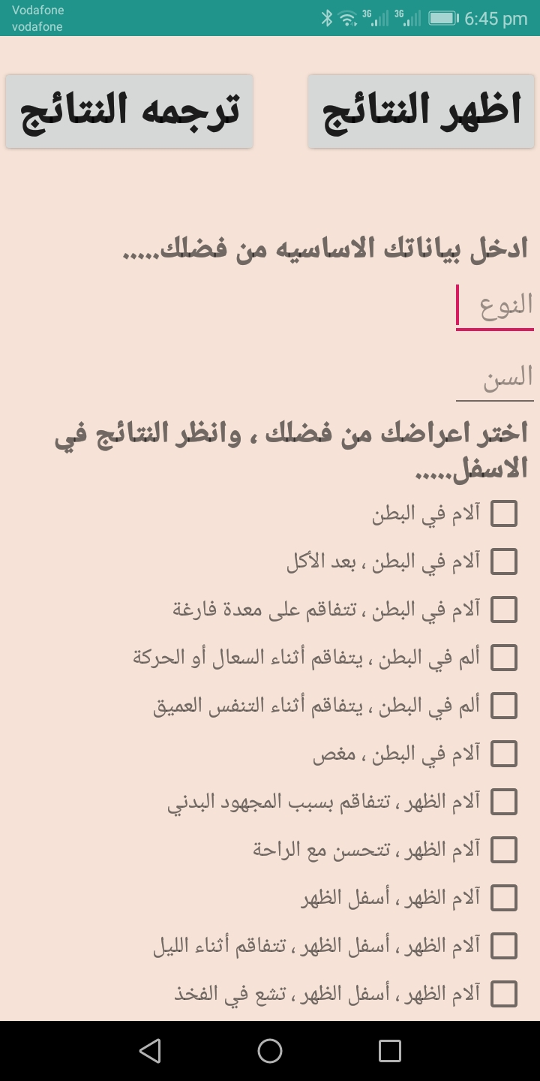
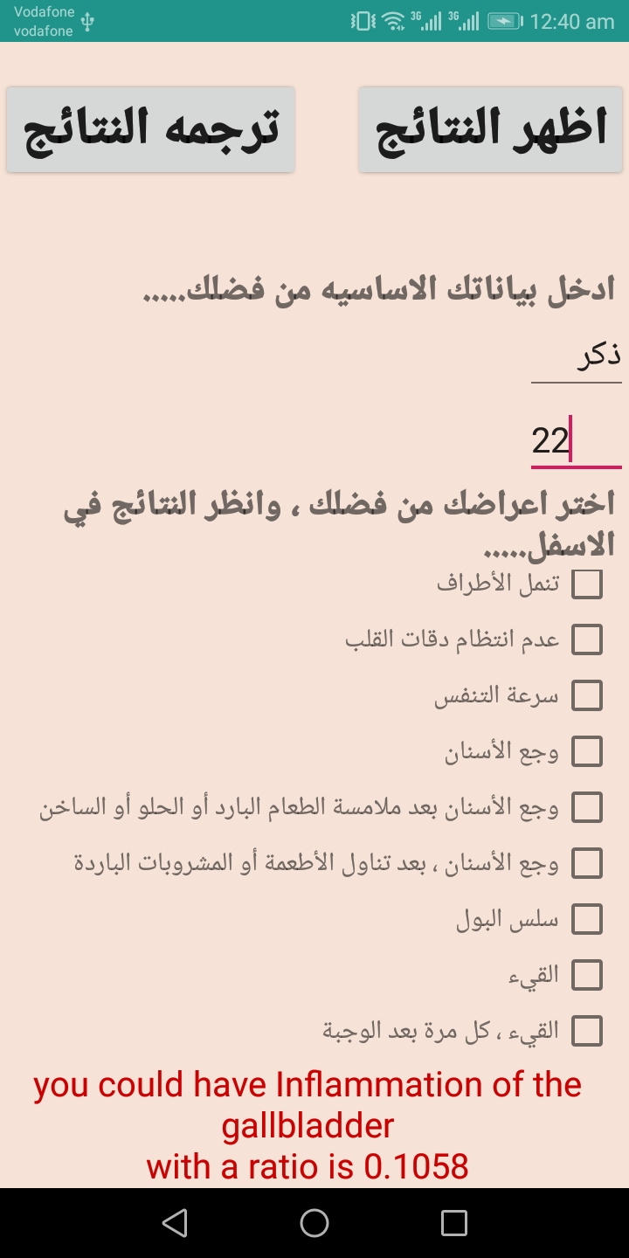
Select symptoms , get result and translate it

Slide 14
The new features
We put some new features in our application such as :
GPS
Navigation bar
Scroll view
Check box
Zoom in/out
List view
YouTube API
Translation
Validation

Slide 15
The end
Big Thank of all you
Any questions

