Slide 1
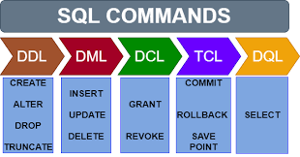

Slide 2


Slide 3
DCL language :-are used to control the user access to database, tables etc. Data control language(DCL) statements Some examples. Grant-gives user’s access privileges to database Revoke-withdraw access privilegs given with the Grant command
DCL –data control language

Slide 4
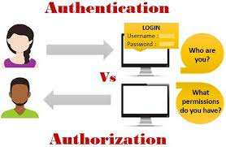

Slide 5
DCL
GUI
Commands
1)Grante
2)Revoke
3)deny

Slide 6
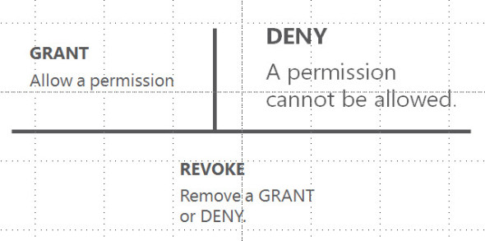
The REVOKE statement can be used to remove granted permissions, and the DENY statement can be used to prevent a principal from gaining a specific permission through a GRANT. Granting a permission removes DENY or REVOKE of that permission on the specified securable

Slide 7
https://www.guru99.com/sql-server-create-user.html
Click on this link to learn steps to create login ,user , granting permission

