Slide 1
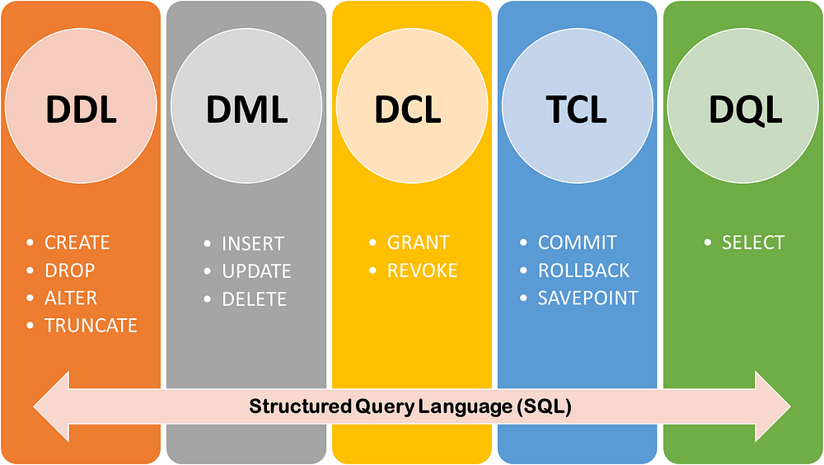

Slide 2


Slide 3
What is TCL?
TCL stands for Transaction Control Language in SQL. Transaction Control Language (TCL) is a set of special commands that deal with the transactions within the database. Basically, they are used to manage transactions within the database. TCL commands are also used for maintaining the consistency of the database. Transactional control commands (TCL commands) are used mostly in the DML Commands in SQL, such as INSERT, UPDATE, and DELETE

Slide 4
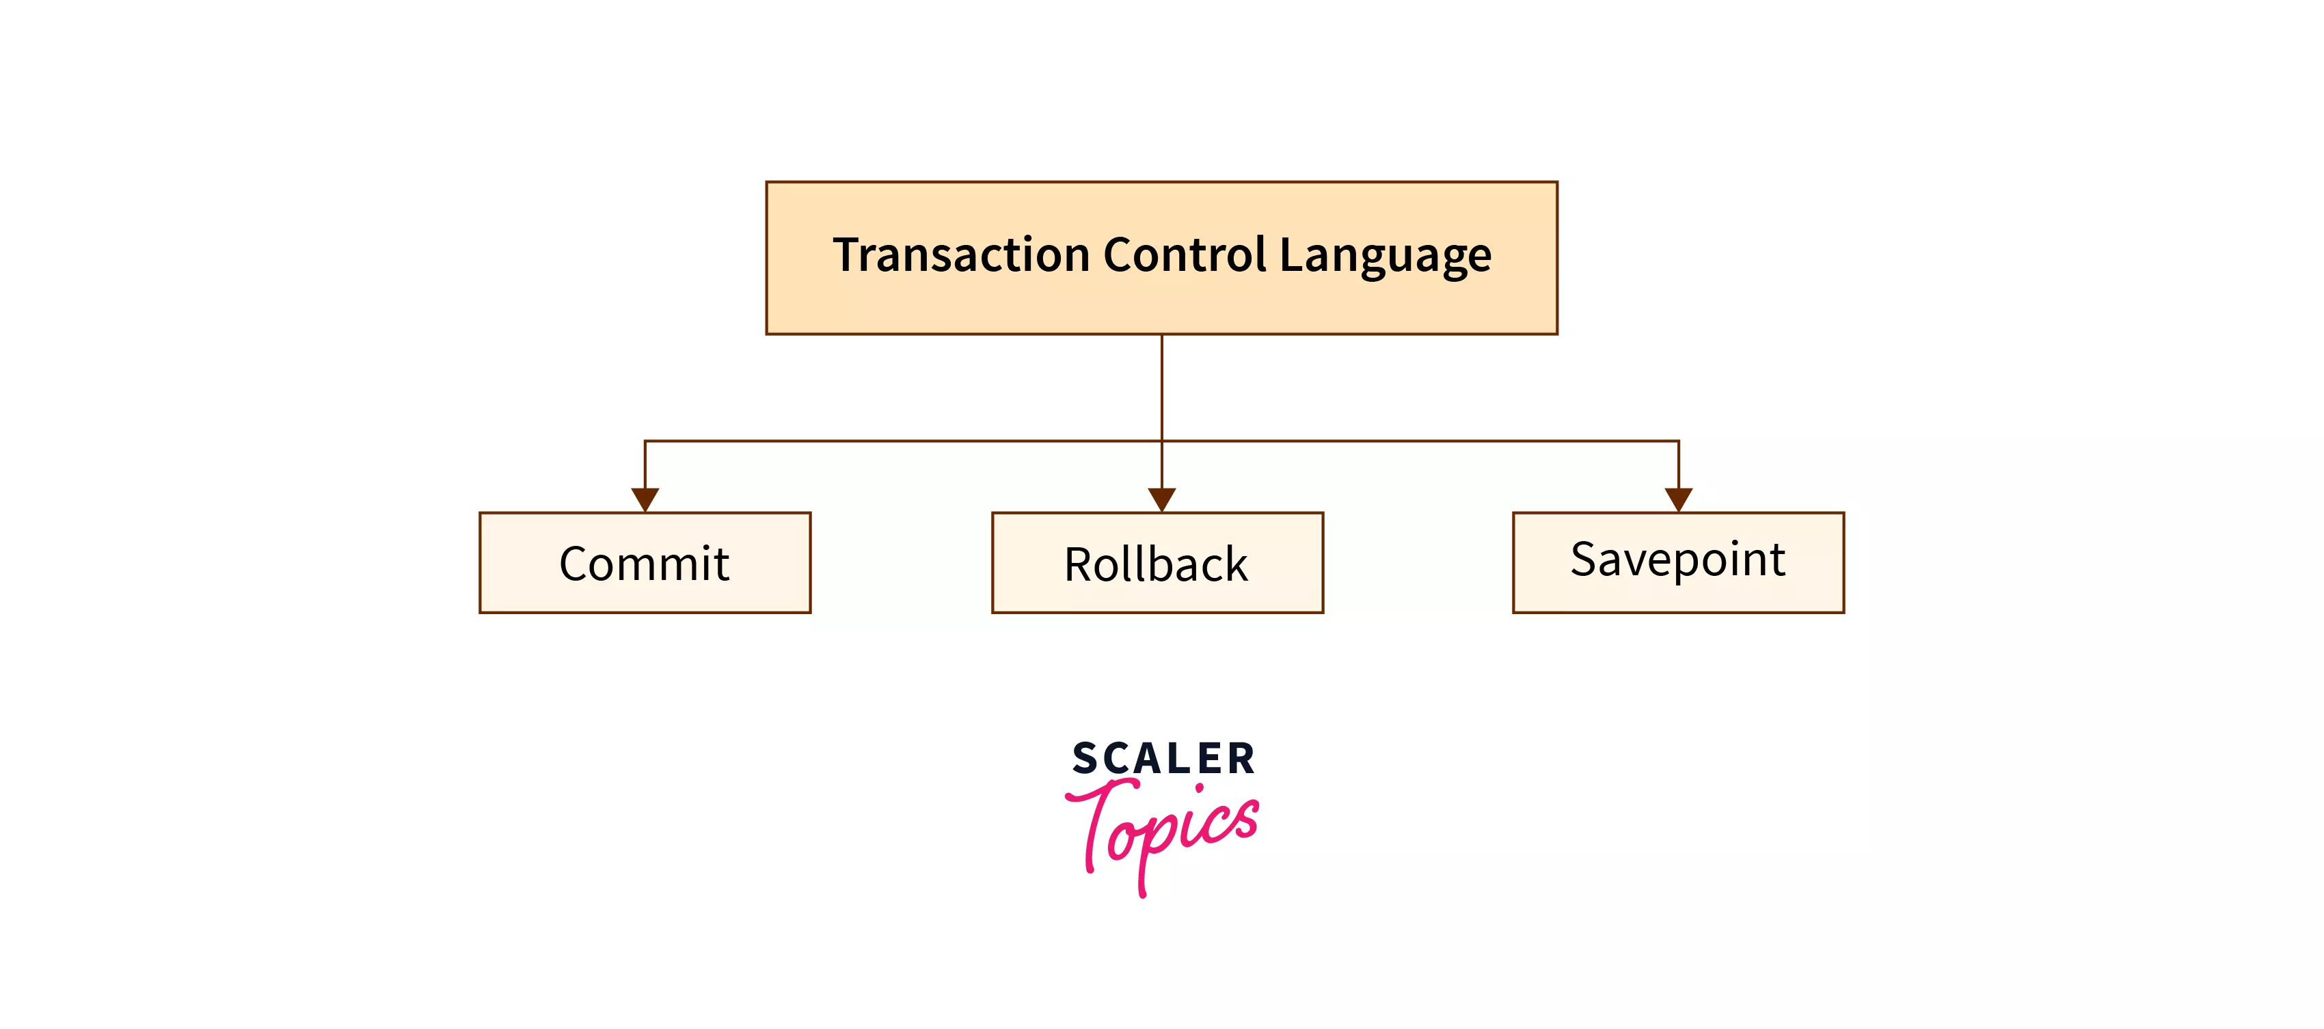

Slide 5
TCL commands
Commit :-This command is used to save all the transactions to the databases. it cannot be undone unless it is rolled back, save the change permanently in the database
Rollback :-Rollback command allows you to undo transactions that have not already been saved to the database. Restore the database to the last committed state
SAVEPOINT :-This command helps you to sets a savepoint within a transaction. is basically used to temporarily save a transaction so that we can roll back to that point (saved point) whenever required.

Slide 6
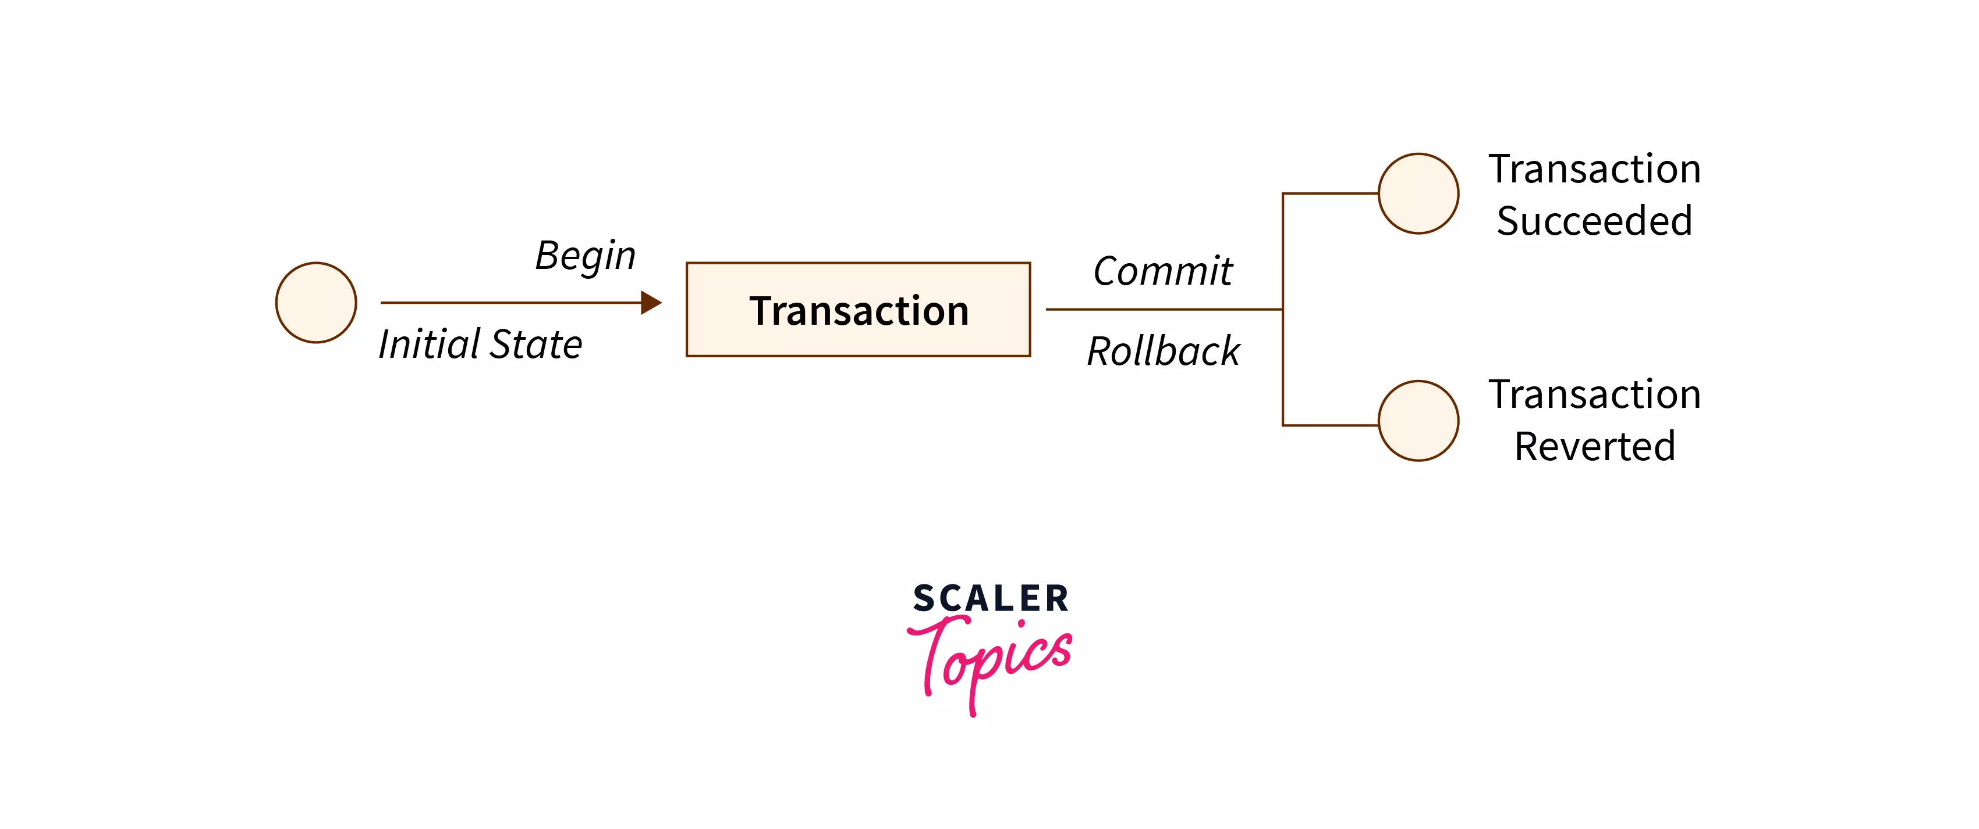

Slide 7
References
https://www.guru99.com/sql-commands-dbms-query.html
https://www.scaler.com/topics/tcl-commands-in-sql

