Slide 1
section3

Slide 2
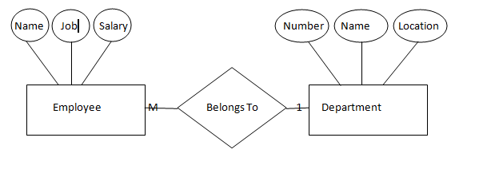
Department and employees

Slide 3
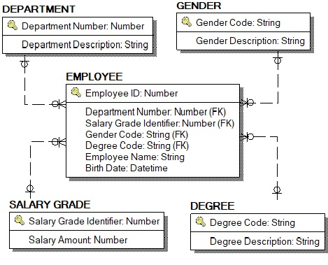
Erd schema.

Slide 4
SQL

Slide 5
1- SQL Concept
Introduction to SQL
Structure Query Language(SQL) is a database query language used for storing and managing data in Relational DBMS. SQL was the first commercial language introduced for Relational model of database.
Today almost all RDBMS( MySql, Oracle, Infomix, Sybase, SQL Server, MS Access) use SQL as the standard database query language. SQL is used to perform all types of data operations in RDBMS.

Slide 6
SQL Statements
SELECT
INSERT
UPDATE
DELETE
MERGE
CREATE
ALTER
DROP
RENAME
TRUNCATE
COMMENT
COMMIT
ROLLBACK
SAVEPOINT
GRANT
REVOKE
Data manipulation language (DML)
Data definition language (DDL)
Transaction control language(TCL)
Data control language (DCL)
Notes:
SQL Statements
Oracle SQL complies with industry-accepted standards. Oracle Corporation ensures future compliance with evolving standards by actively involving key personnel in SQL standards committees. Industry-accepted committees are the American National Standards Institute (ANSI) and the International Standards Organization (ISO). Both ANSI and ISO have accepted SQL as the standard language for relational databases.

Slide 7
SQL Command
SQL defines following ways to manipulate data stored in an RDBMS.
DDL: Data Definition Language
This includes changes to the structure of the table like creation of table, altering table, deleting a table etc.
All DDL commands are auto-committed. That means it saves all the changes permanently in the database.
Command | Description
create | to create new table or database
alter | for alteration
truncate | delete data from table
drop | to drop a table
rename | to rename a table
Notes:
مجموعه االاوامر الى محتاجها علشان ابنى الdb واى عنصر فى ال db

Slide 8
2- DDL Command
SQL: create command
create is a DDL SQL command used to create a table or a database in relational database management system.
Creating a Database
To create a database in RDBMS, create command is used. Following is the syntax,
CREATE DATABASE <DB_NAME>;

Slide 9
Example for creating Database
CREATE DATABASE Test;
The above command will create a database named Test, which will be an empty schema without any table.
To create tables in this newly created database, we can again use the create command.
Creating a Table
create command can also be used to create tables. Now when we create a table, we have to specify the details of the columns of the tables too. We can specify the names and datatypes of various columns in the create command itself.
Following is the syntax,

Slide 10
CREATE TABLE <TABLE_NAME>
(
column_name1 datatype1,
column_name2 datatype2,
column_name3 datatype3,
column_name4 datatype4
);
Example for creating Table
CREATE TABLE Student(
student_id INT,
name VARCHAR(100),
age INT);

Slide 11
Most commonly used datatypes for Table columns
Here we have listed some of the most commonly used datatypes used for columns in tables.
Datatype | Use
INT | used for columns which will store integer values.
FLOAT | used for columns which will store float values.
DOUBLE | used for columns which will store float values.
VARCHAR | Variable width character string
CHAR | Fixed width character string
DATE | used for columns which will store date values.
TEXT | used for columns which will store text which is generally long in length. For example, if you create a table for storing profile information of a social networking website, then for about me section you can have a column of type TEXT.

Slide 12
constraints

Slide 13

Including Constraints
Constraints enforce rules at the table level.
Constraints prevent the deletion of a table if there are dependencies.
The following constraint types are valid:
NOT NULL
UNIQUE
PRIMARY KEY
FOREIGN KEY
CHECK
Notes:
Constraints
The Oracle server uses constraints to prevent invalid data entry into tables.
You can use constraints to do the following:
Enforce rules on the data in a table whenever a row is inserted, updated, or deleted from that table. The constraint must be satisfied for the operation to succeed.
Prevent the deletion of a table if there are dependencies from other tables
Provide rules for Oracle tools, such as Oracle Developer
Data Integrity Constraints

Slide 14
Constraint Guidelines
Create a constraint at either of the following times:
At the same time as the table is created
After the table has been created
Define a constraint at the column or table level.
Notes:
Constraint Guidelines
All constraints are stored in the data dictionary. Constraints are easy to reference if you give them a meaningful name. Constraint names must follow the standard object-naming rules. If you do not name your constraint, the Oracle server generates a name with the format SYS_Cn, where n is an integer so that the constraint name is unique.
Constraints can be defined at the time of table creation or after the table has been created.
For more information, see “Constraints” in the Oracle Database SQL Reference.

Slide 15
Defining Constraints
Column-level constraint:
Table-level constraint:
CREATE TABLE employees(
employee_id NUMBER(6)
CONSTRAINT emp_emp_id_pk PRIMARY KEY,
first_name VARCHAR2(20),
...);
1
CREATE TABLE employees(
employee_id NUMBER(6),
first_name VARCHAR2(20),
...
job_id VARCHAR2(10) NOT NULL,
CONSTRAINT emp_emp_id_pk
PRIMARY KEY (EMPLOYEE_ID));
2
Notes:
Defining Constraints (continued)
Constraints are usually created at the same time as the table. Constraints can be added to a table after its creation and also temporarily disabled.
Both slide examples create a primary key constraint on the EMPLOYEE_ID column of the EMPLOYEES table.
1. The first example uses the column-level syntax to define the constraint.
2. The second example uses the table-level syntax to define the constraint.
More details about the primary key constraint are provided later in this lesson.

Slide 16
CHECK Constraint
Defines a condition that each row must satisfy
The following expressions are not allowed:
References to CURRVAL, NEXTVAL, LEVEL, and ROWNUM pseudocolumns
Calls to SYSDATE, UID, USER, and USERENV functions
Queries that refer to other values in other rows
..., salary NUMBER(2)
CONSTRAINT emp_salary_min
CHECK (salary > 0),...
Notes:
CHECK Constraint
The CHECK constraint defines a condition that each row must satisfy. The condition can use the same constructs as query conditions, with the following exceptions:
References to the CURRVAL, NEXTVAL, LEVEL, and ROWNUM pseudocolumns
Calls to SYSDATE, UID, USER, and USERENV functions
Queries that refer to other values in other rows
A single column can have multiple CHECK constraints that refer to the column in its definition. There is no limit to the number of CHECK constraints that you can define on a column.
CHECK constraints can be defined at the column level or table level.
CREATE TABLE employees
(...
salary NUMBER(8,2) CONSTRAINT emp_salary_min
CHECK (salary > 0),
...

Slide 17
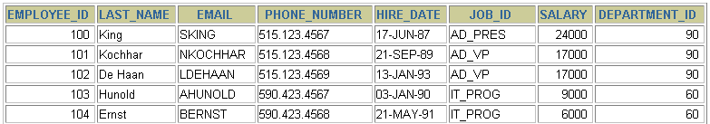
NOT NULL Constraint
Ensures that null values are not permitted for the column:
…
NOT NULL constraint
(No row can contain a null value for this column.)
NOT NULL
constraint
Absence of NOT NULL constraint (Any row can contain a null value for this column.)
Notes:
NOT NULL Constraint
The NOT NULL constraint ensures that the column contains no null values. Columns without the NOT NULL constraint can contain null values by default. NOT NULL constraints must be defined at the column level.

Slide 18
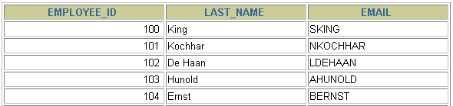
UNIQUE Constraint
UNIQUE constraint
EMPLOYEES
…
INSERT INTO
Allowed
Not allowed: already exists
Notes:
UNIQUE Constraint
A UNIQUE key integrity constraint requires that every value in a column or set of columns (key) be unique—that is, no two rows of a table can have duplicate values in a specified column or set of columns. The column (or set of columns) included in the definition of the UNIQUE key constraint is called the unique key. If the UNIQUE constraint comprises more than one column, that group of columns is called a composite unique key.
UNIQUE constraints enable the input of nulls unless you also define NOT NULL constraints for the same columns. In fact, any number of rows can include nulls for columns without NOT NULL constraints because nulls are not considered equal to anything. A null in a column (or in all columns of a composite UNIQUE key) always satisfies a UNIQUE constraint.
Note: Because of the search mechanism for UNIQUE constraints on more than one column, you cannot have identical values in the non-null columns of a partially null composite UNIQUE key constraint.

Slide 19
UNIQUE Constraint
Defined at either the table level or the column level:
CREATE TABLE employees(
employee_id NUMBER(6),
last_name VARCHAR2(25) NOT NULL,
email VARCHAR2(25),
salary NUMBER(8,2),
commission_pct NUMBER(2,2),
hire_date DATE NOT NULL,
...
CONSTRAINT emp_email_uk UNIQUE(email));
Notes:
UNIQUE Constraint (continued)
UNIQUE constraints can be defined at the column level or table level. A composite unique key is created by using the table-level definition.
The example in the slide applies the UNIQUE constraint to the EMAIL column of the EMPLOYEES table. The name of the constraint is EMP_EMAIL_UK..
Note: The Oracle server enforces the UNIQUE constraint by implicitly creating a unique index on the unique key column or columns.

Slide 20
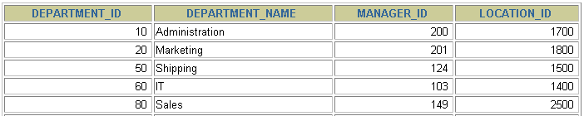
PRIMARY KEY Constraint
DEPARTMENTS
PRIMARY KEY
…
Not allowed
(null value)
INSERT INTO
Not allowed
(50 already exists)
Notes:
PRIMARY KEY Constraint
A PRIMARY KEY constraint creates a primary key for the table. Only one primary key can be created for each table. The PRIMARY KEY constraint is a column or set of columns that uniquely identifies each row in a table. This constraint enforces uniqueness of the column or column combination and ensures that no column that is part of the primary key can contain a null value.
Note: Because uniqueness is part of the primary key constraint definition, the Oracle server enforces the uniqueness by implicitly creating a unique index on the primary key column or columns.

Slide 21
EXAMPLE
create table employees(
emp_id int primary key identity(1,1),
Emp_name varchar(200) not null,
Address varchar(200) not null,
D_birth date ,
salary float check (salary >=3000),
);

