Slide 1
section4
sql

Slide 2
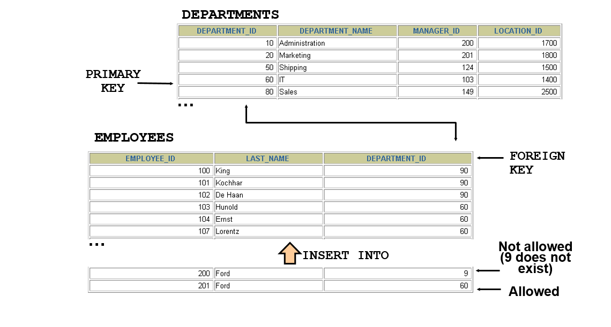
FOREIGN KEY Constraint
The FOREIGN KEY constraint is used to prevent actions that would destroy links between tables.
A FOREIGN KEY is a field (or collection of fields) in one table, that refers to the PRIMARY KEY in another table.

Slide 3
FOREIGN KEY Constraint
Defined at either the table level or the column level:
CREATE TABLE employees(
employee_id NUMBER(6),
last_name VARCHAR2(25) NOT NULL,
email VARCHAR2(25),
salary NUMBER(8,2),
commission_pct NUMBER(2,2),
hire_date DATE NOT NULL,
...
department_id NUMBER(4),
CONSTRAINT emp_dept_fk FOREIGN KEY (department_id)
REFERENCES departments(department_id),
CONSTRAINT emp_email_uk UNIQUE(email));
Notes:
FOREIGN KEY Constraint (continued)
FOREIGN KEY constraints can be defined at the column or table constraint level. A composite foreign key must be created by using the table-level definition.
The example in the slide defines a FOREIGN KEY constraint on the DEPARTMENT_ID column of the EMPLOYEES table, using table-level syntax. The name of the constraint is EMP_DEPTID_FK.
The foreign key can also be defined at the column level, provided the constraint is based on a single column. The syntax differs in that the keywords FOREIGN KEY do not appear. For example:
CREATE TABLE employees
(...
department_id NUMBER(4) CONSTRAINT emp_deptid_fk
REFERENCES departments(department_id),
...
)

Slide 4
FOREIGN KEY Constraint: Keywords
FOREIGN KEY: Defines the column in the child table at the table-constraint level
REFERENCES: Identifies the table and column in the parent table
ON DELETE CASCADE: Deletes the dependent rows in the child table when a row in the parent table is deleted
ON DELETE SET NULL: Converts dependent foreign key values to null
Notes:
FOREIGN KEY Constraint: Keywords
The foreign key is defined in the child table, and the table containing the referenced column is the parent table. The foreign key is defined using a combination of the following keywords:
FOREIGN KEY is used to define the column in the child table at the table-constraint level.
REFERENCES identifies the table and column in the parent table.
ON DELETE CASCADE indicates that when the row in the parent table is deleted, the dependent rows in the child table are also deleted.
ON DELETE SET NULL converts foreign key values to null when the parent value is removed.
The default behavior is called the restrict rule, which disallows the update or deletion of referenced data.
Without the ON DELETE CASCADE or the ON DELETE SET NULL options, the row in the parent table cannot be deleted if it is referenced in the child table.

Slide 5
SQL: ALTER command
ALTER COMMAND IS USED FOR ALTERING THE TABLE STRUCTURE, SUCH AS,
to add a column to existing table
to rename any existing column
to change datatype of any column or to modify its size.
to drop a column from the table.

Slide 6
ADD new column
Using ALTER command we can add a column to any existing table. Following is the syntax,
ALTER TABLE table_name ADD column_name datatype;
Here is an Example for this:
alter table employees
add e_address varchar(30) ;

Slide 7
ALTER Command: Add multiple new Columns
Using ALTER command we can even add multiple new columns to any existing table.
Here is an Example for this,
alter table employees add
country vachar(20) ,
contracted int
Gender varchar(10) ;

Slide 8
change datatype column
To change the data type of a column in a table, use the following syntax:
alter table employees
alter COLUMN Lname varchar(100);

Slide 9
ALTER TABLE - DROP COLUMN
To delete a column in a table, use the following syntax (notice that some database systems don't allow deleting a column):
ALTER TABLE table_name DROP COLUMN column_name;
Example
ALTER TABLE Customers DROP COLUMN Email;

Slide 10
ALTER Command: Drop a Column
ALTER command can also be used to drop or remove columns. Following is the syntax,
Here is an example for this,
ALTER TABLE Persons DROP COLUMN DateOfBirth;

Slide 11

TRUNCATE command
TRUNCATE command removes all the records from a table. But this command will not destroy the table's structure. When we use TRUNCATE command on a table its (auto-increment) primary key is also initialized. Following is its syntax,
Here is an example explaining it,
truncate table employees;
The above query will delete all the records from the table student.

Slide 12
DROP command
DROP command completely removes a table from the database. This command will also destroy the table structure and the data stored in it. Following is its syntax,
Here is an example explaining it,
The above query will drop the database with name Test from the system.

