Slide 1
Chicago crime analysis
Group 1:
AbdelRahman Ammar 202102787
Omar Ackef
202101592

Slide 2
agenda
Introduction
Tools and Technologies
Dataset
Tasks 1-3
Conclusion

Slide 3
Introduction
What the Project is About:
"This project analyzes Chicago crime data using Big Data tools to uncover patterns and trends."
Why It Matters
"Understanding crime distribution can assist in resource allocation, policy-making, and enhancing public safety."
Goals:
Utilize scalable data processing with Apache Spark and Apache Sedona.
Perform geospatial analysis to map crime intensity by ZIP code.
Analyze temporal trends in crime types over specific timeframes.

Slide 4



Tools and technologies
Big Data Tools:
Apache Spark
Apache Sedona
Visualization Tools:
QGIS
Matplotlib
GeoPandas
File Formats:
CSV
Parquet
GeoJSON

Slide 5
Dataset
The data was sourced from the Chicago Police Department's publicly available crime records.
Key Attributes:
Case Number: Unique identifier for each crime.
Primary Type: Crime category (e.g., Theft, Assault, Robbery).
Date: Timestamp of the crime.
Location Description: The type of location (e.g., Street, Apartment).
X and Y Coordinates: Geographic coordinates of the crime.
Community Area: The community area where the crime occurred.
FBI Code: Classification code for the crime.
The dataset sample used contains 10,000 sample rows for testing and analysis

Slide 6
Task 1: Data preparation
Objective: Prepare raw crime data for analysis by cleaning and enriching it with geospatial attributes.
Steps:
Load Raw Data: Crime data was loaded into a Spark DataFrame from a CSV file.
Clean Data: Renamed columns with spaces (e.g., Primary Type → PrimaryType) for compatibility.
Enrich Data with Geospatial Attributes: Performed a spatial join using Apache Sedona to associate each crime record with a ZIP code. Operation: ST_Contains(ZIP.geometry, ST_Point(X, Y)).
Save Processed Data: Saved the dataset as a Parquet file for efficient querying and storage.
Output: A dataset containing original crime attributes and the added ZIPCode field.

Slide 7
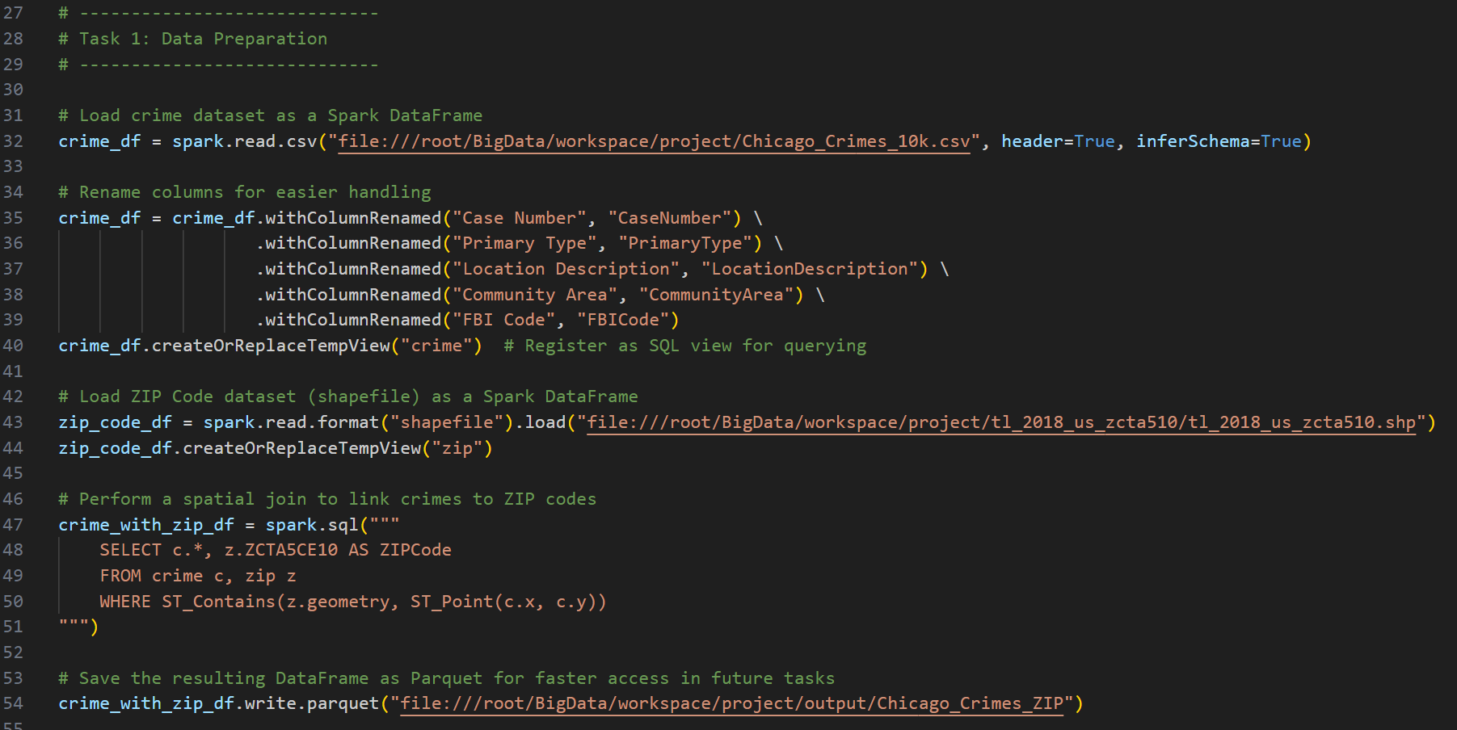
Code snippet

Slide 8
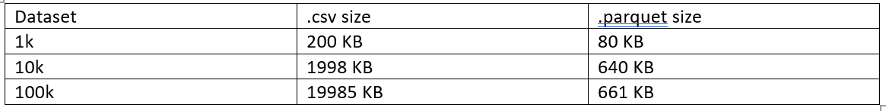
Why parquet?
Efficient Data Storage:
Parquet is a columnar storage format optimized for performance and space efficiency.
Only the columns required for a query are read, reducing I/O overhead.
Compatibility with Big Data Tools:
Designed for use with Big Data frameworks like Apache Spark, making it a natural choice for this project.
Easily integrates with distributed processing systems.
Supports Complex Data Types: Handles nested data structures, making it ideal for datasets with hierarchical attributes.
Compression: Built-in compression reduces the storage footprint, saving space while maintaining fast access.
Scalable and Query-Friendly:
Optimized for large-scale querying and analysis across distributed systems.
Improves query performance compared to row-based formats like CSV.
Why Not CSV?
CSV is row-based and inefficient for large datasets due to its lack of indexing and compression.""Parquet offers schema support and handles missing or null values better."

Slide 9
Task 2: spatial analysis
Objective:
Analyze the spatial distribution of crimes across Chicago by aggregating crime counts by ZIP code and visualizing the results.
Steps:
Load Data: Used the Parquet file from Task 1 as input.
Aggregate Crime Data: Grouped crimes by ZIPCode and calculated the total number of crimes for each ZIP code using Spark SQL.
Join with Geospatial Data: Combined crime counts with ZIP code geometries from a shapefile using Apache Sedona.
Save GeoJSON Output: Exported the results in GeoJSON format for visualization.
Create Choropleth Map: Imported the GeoJSON file into QGIS to create a choropleth map showing crime distribution across ZIP codes.
Optionally automated map generation using GeoPandas and Matplotlib.
Output:
GeoJSON file with crime counts and ZIP code geometries.
Choropleth map visualizing crime intensity.

Slide 10
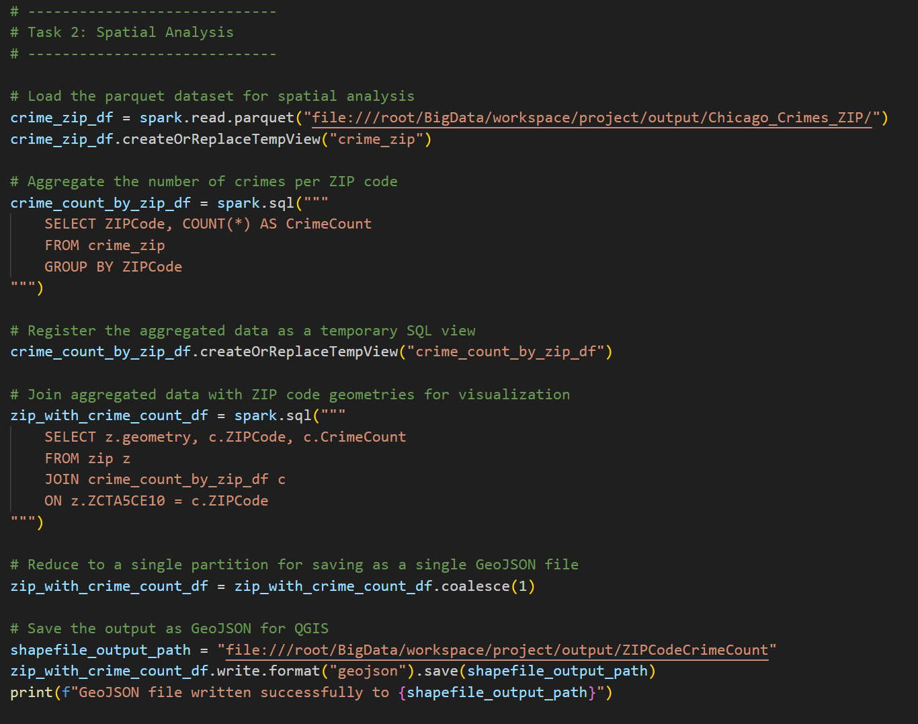
Code snippet

Slide 11
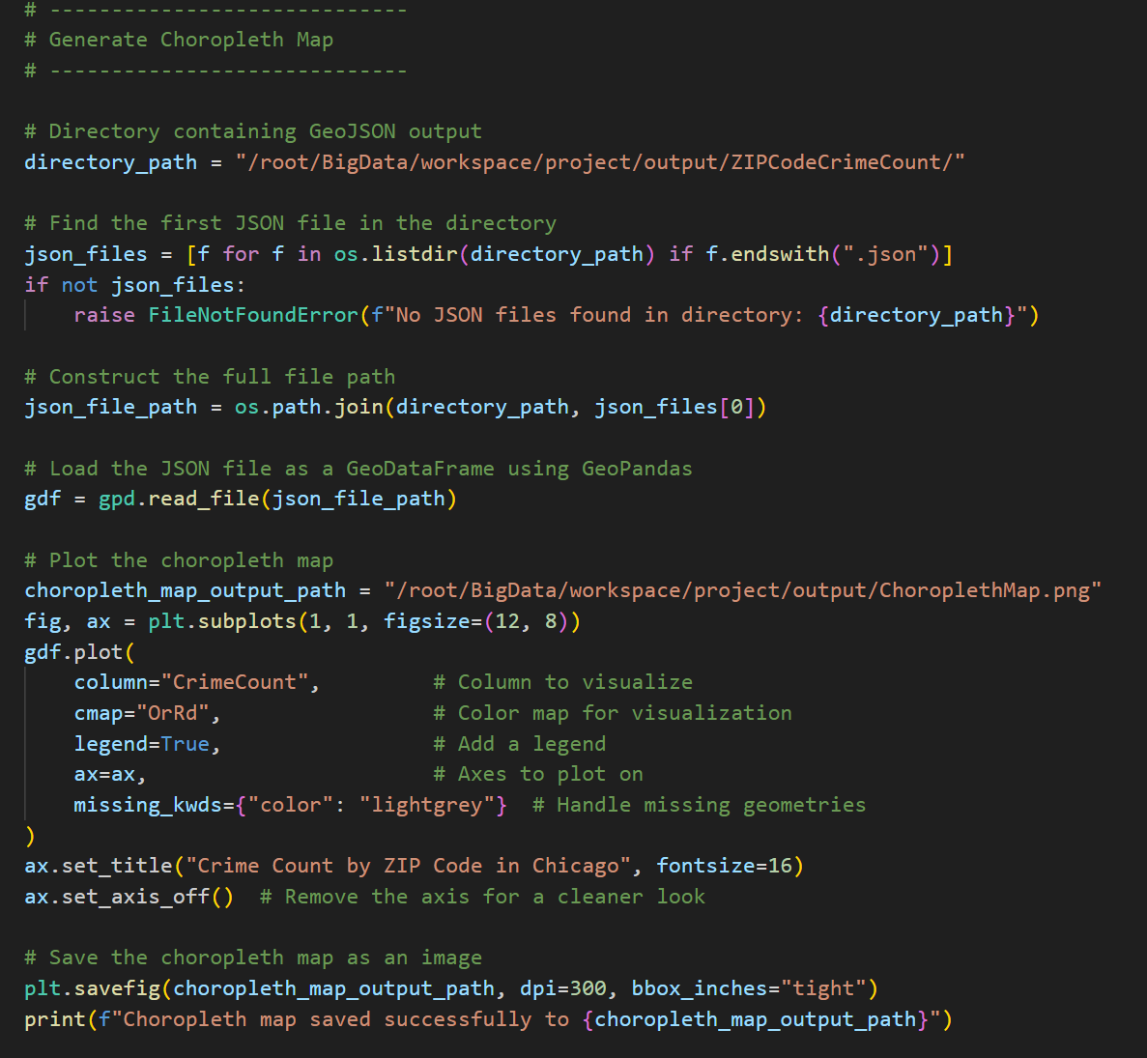
Automating choropleth map generation

Slide 12
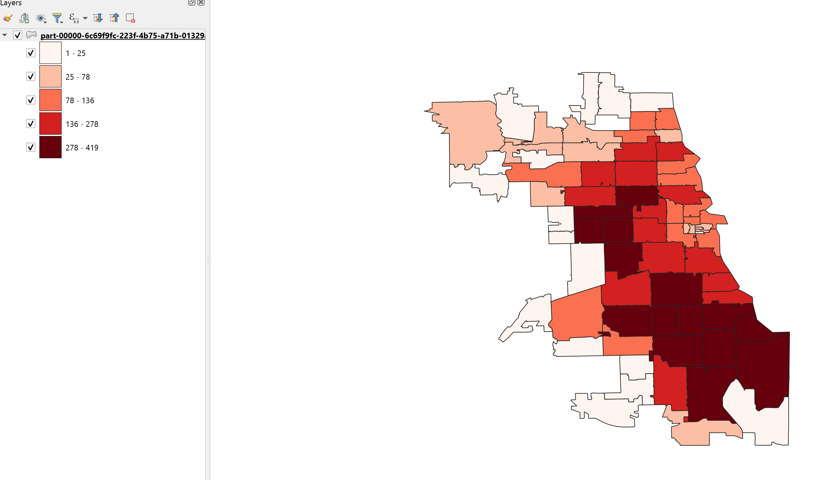
Choropleth map using qgis

Slide 13
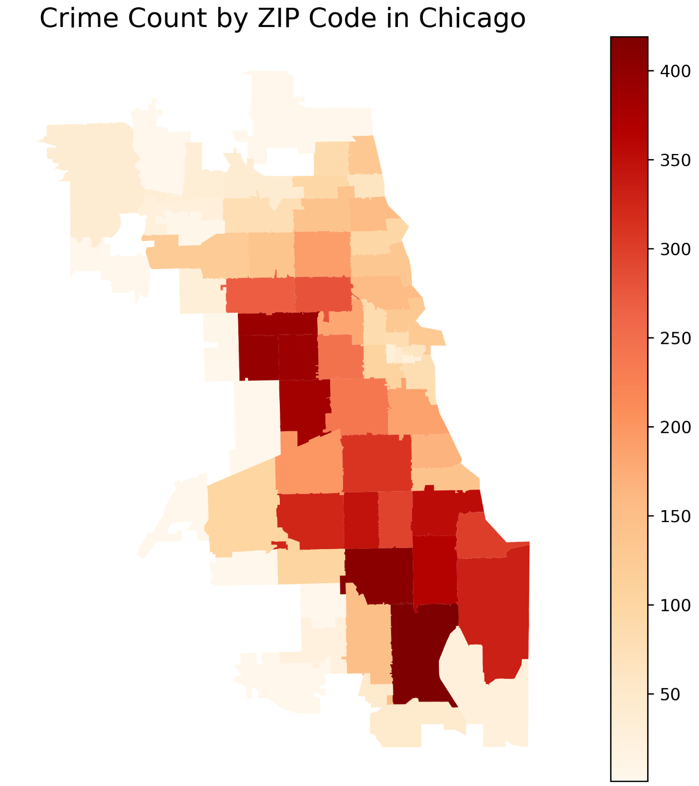
Choropleth map using geopandas

Slide 14
Task 3: temporal analysis
Objective:
Analyze crime trends over a specific date range and visualize the distribution of crimes by type.
Steps:
Load Data: Used the Parquet file from Task 1 for temporal analysis.
Filter Data by Date Range:
Accepted user-provided start and end dates as command-line arguments (e.g., 01/01/2018 to 12/31/2018).
Filtered the dataset using the Date column.
Aggregate Crimes by Type: Grouped the filtered crimes by PrimaryType and calculated the total number of crimes for each type using Spark SQL.
Aggregate Crimes by Type: Grouped the filtered crimes by PrimaryType and calculated the total number of crimes for each type using Spark SQL.
Save Results: Saved the aggregated results as a CSV file for reference and further use.
Generate Bar Chart: Visualized the number of crimes by type using Matplotlib.
Output:
CSV file showing crime counts by type within the specified date range.
Bar chart visualizing the distribution of crimes by type.

Slide 15
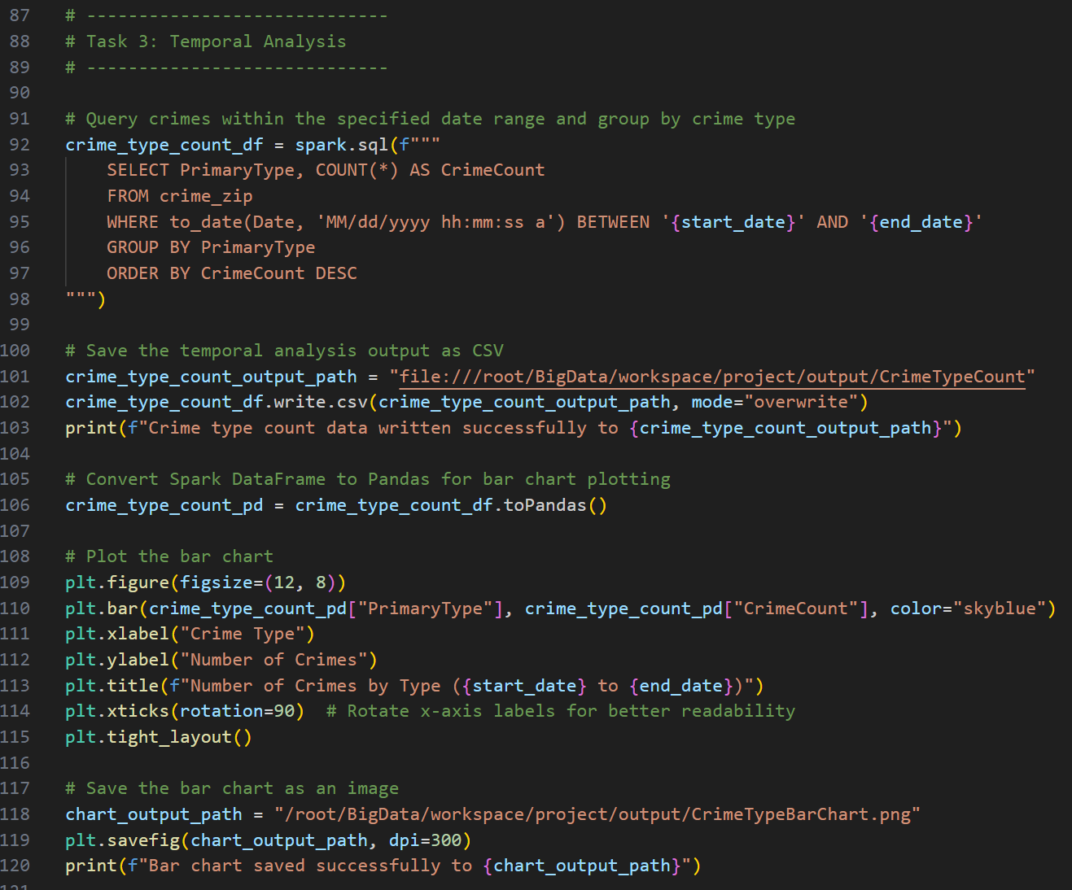
Code snippet

Slide 16
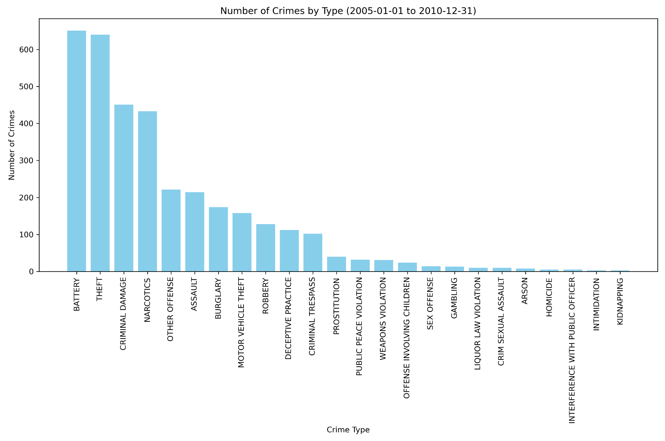
Bar chart

Slide 17
conclusion
Summary of Achievements:
Successfully analyzed and visualized Chicago crime data using Big Data tools.
Utilized Apache Spark and Sedona for scalable geospatial and temporal analysis.
Created insightful visualizations, including a choropleth map and bar chart.
Key Takeaways:
Scalability: Big Data tools like Spark and Sedona enabled efficient handling of large datasets.
Geospatial Insights: Mapped crime intensity across Chicago's ZIP codes.
Temporal Trends: Identified crime patterns over user-specified date ranges.
Future Work:
Real-Time Data Integration: Incorporate streaming tools like Apache Kafka to process live crime data.
Advanced Visualizations: Develop interactive dashboards using tools like Plotly or Tableau.
Predictive Analytics: Apply machine learning models to predict crime hotspots and future trends.
Larger Datasets: Expand analysis to include the entire Chicago crime dataset for comprehensive insights.

