Slide 1
Statistics with Python
Abdelrahman Ayad
September 24, 2021

Slide 2
Notes:
The McGill initiative on Computational Medicine was formed in 2017 and aims to deliver inter-disciplinary research programs and empower the use of data in health research and health care delivery
Located at the Genome Center
They have a newsletter were you can subscribe to
more info on the web site

Slide 3
Personal Introduction
Abdelrahman Ayad
PhD student – ECE department McGill University
Research area: modern power systems and energy systems modeling
Triathlon, skydiving, and reading

Slide 4
Workshop agenda
Setting the expectations – Today’s workshop
Part I: Stats review
Part II: Python modules
Part III: Dealing with Data in Python
Part IV: Group exercise
Coding competition
Q&A

Slide 5
Materials on github
Github repo: https://github.com/abdelrahman-ayad/MiCM-StatsPython-F21

Slide 6
Statistics with Python
Learning objectives of today’s workshop:
Review main concepts of statistics
Name and use 3-4 Python libraries used for statistics
Visualize data in Python
Answer some statistics questions using data in Python

Slide 7
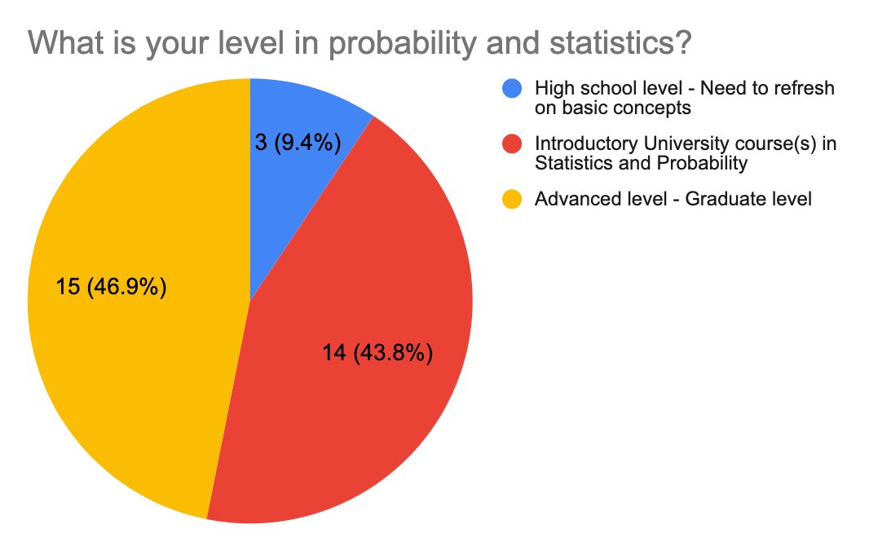
Statistics with Python
Responses of survey questions

Slide 8
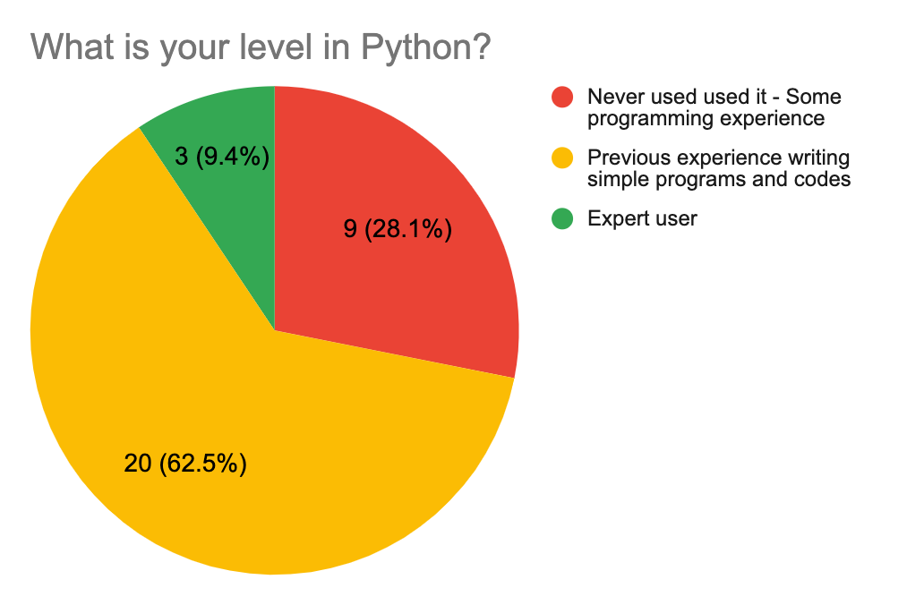
Statistics with Python
Responses of survey questions

Slide 9
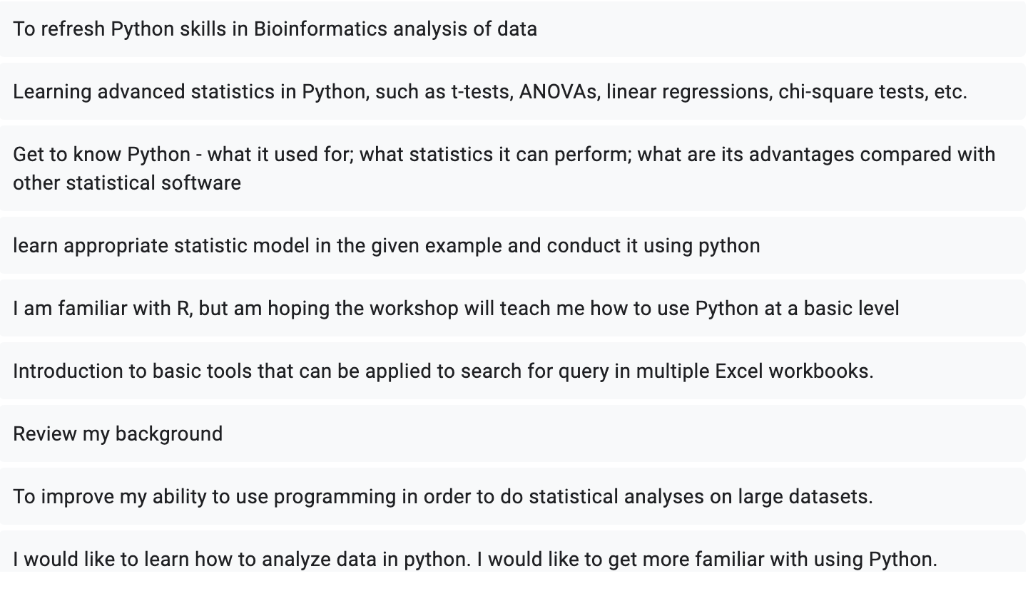
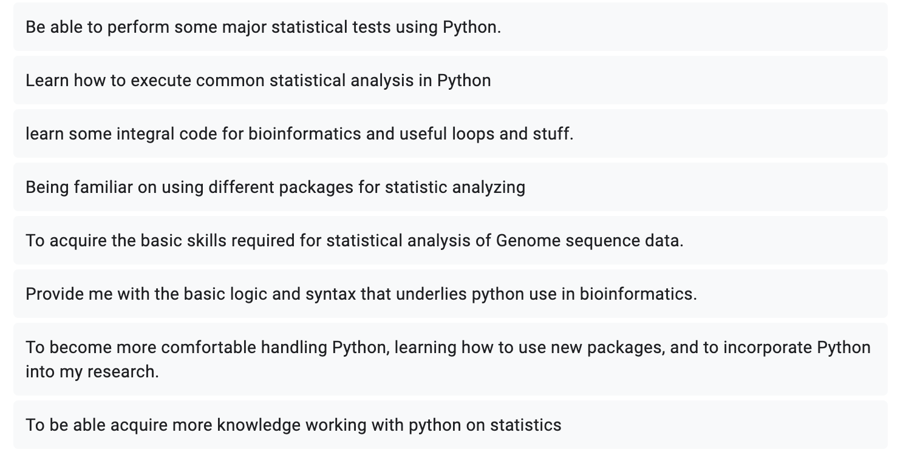
Statistics with Python
Responses of survey questions

Slide 10
Statistics with Python
Python
Statistics
Data
This workshop

Slide 11
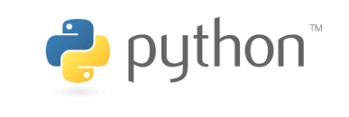
Python 101
Python: A high-level general-purpose programming language
Made to easy-to-read
Object oriented language, works for small and large-scale projects
Very popular for Machine Learning and Data Science applications
Many, many resources online to self-learn, but Google remains your best friend ☺

Slide 12
Python 101
Python: An open-source language
Python users depend on community contribution to provide libraries and modules
Simply install the library and import it to use it in your code

Slide 13
Python 101
Some important Libraries
Numpy: Fundamental for scientific computing. Comprehensive mathematical functions, random number generators, etc..
Pandas: Data analysis and manipulation tool
Matplotlib: Visualizations in Python (static, animated, and interactive)
Scipy: Collection of mathematics, science, and engineering tools
Statsmodels: Classes and functions for the estimation of many different statistical models
Others: seaborn, scikit-learm, TensorFlow, etc.,

Slide 14
Python 101
Some of the topics covered today
Intro to Python
Data analysis with Pandas
Time series analysis

Slide 15
Python 101
How to run Python
Easiest way is to install anaconda/conda
Today we’re using Google Colab notebooks
Jupyter notebooks are another good option

Slide 16
Python 101
Colab notebooks

Slide 17

Break
15 minutes

Slide 18
References
https://github.com/john-science/python-bootcamp
https://software.intel.com/content/www/us/en/develop/training/course-time-series-analysis.html
https://jakevdp.github.io/PythonDataScienceHandbook/
References in the notebooks

Slide 19

Questions?

Slide 20
Questions?
Github repo
https://github.com/abdelrahman-ayad/MiCM-StatsPython-F21
Contact info:
abdelrahman.ayad@mcgill.ca

