Slide 1
Statistics with Python
Abdelrahman Ayad
September 24, 2021

Slide 2
Notes:
The McGill initiative on Computational Medicine was formed in 2017 and aims to deliver inter-disciplinary research programs and empower the use of data in health research and health care delivery
Located at the Genome Center
They have a newsletter were you can subscribe to
more info on the web site

Slide 3
Personal Introduction
Abdelrahman Ayad
PhD student – ECE department McGill University
Research area: modern power systems and energy systems modeling
Triathlon, skydiving, and reading

Slide 4
Workshop agenda
Setting the expectations – Today’s workshop
Part I: Stats review
Part II: Python modules
Part III: Dealing with Data in Python
Part IV: Group exercise
Coding competition
Next steps
Q&A

Slide 5
Materials on github
Github repo:

Slide 6
Statistics with Python
Learning objectives of today’s workshop:
Review main concepts of statistics
Name and use 3-4 Python libraries used for statistics
Visualize data in Python
Answer some statistics questions using data in Python

Slide 7
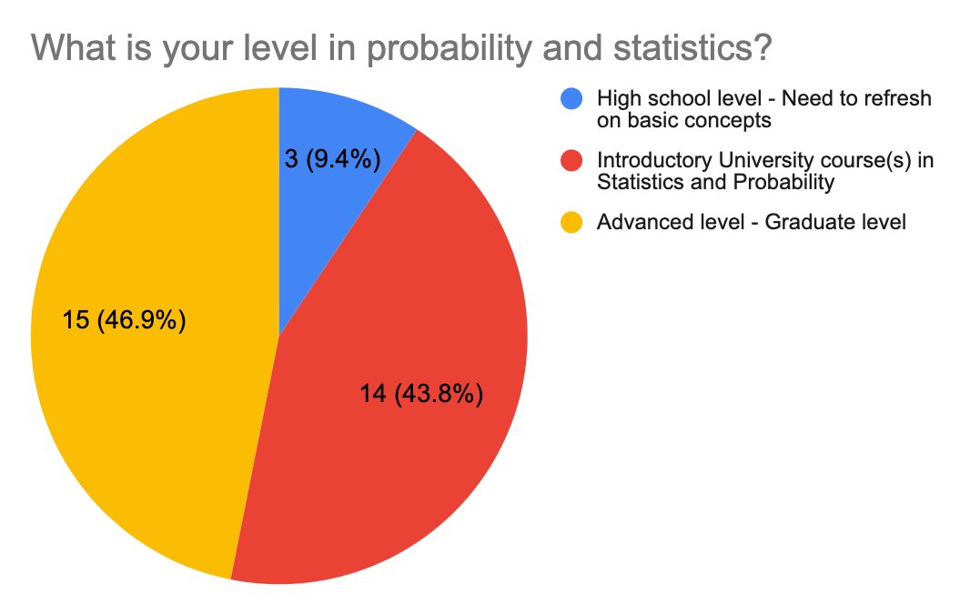
Statistics with Python
Responses of survey questions

Slide 8
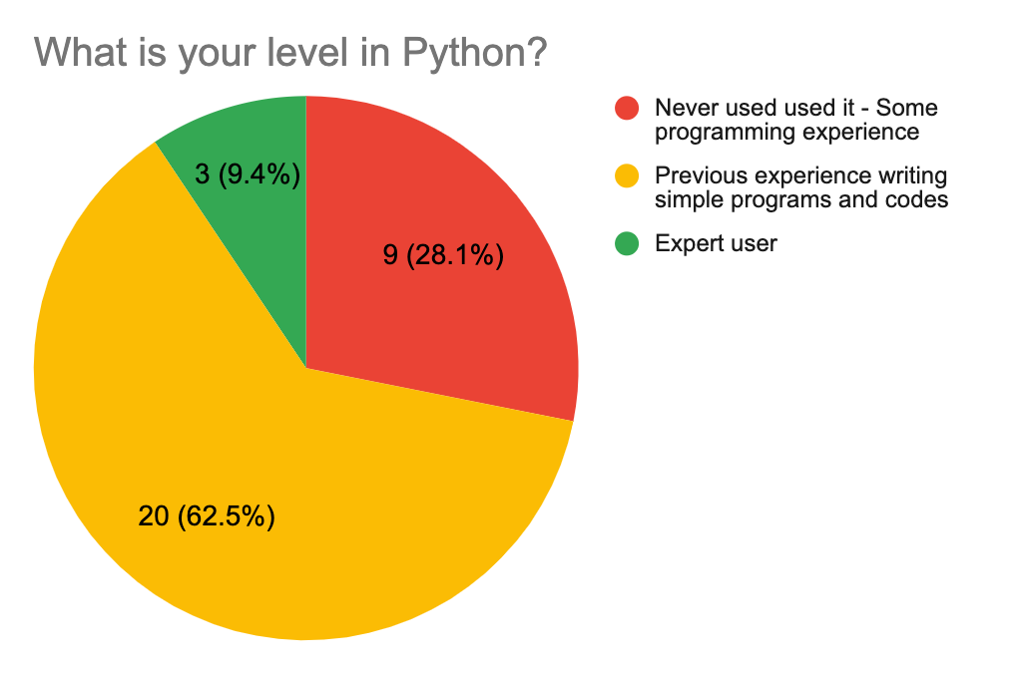
Statistics with Python
Responses of survey questions

Slide 9
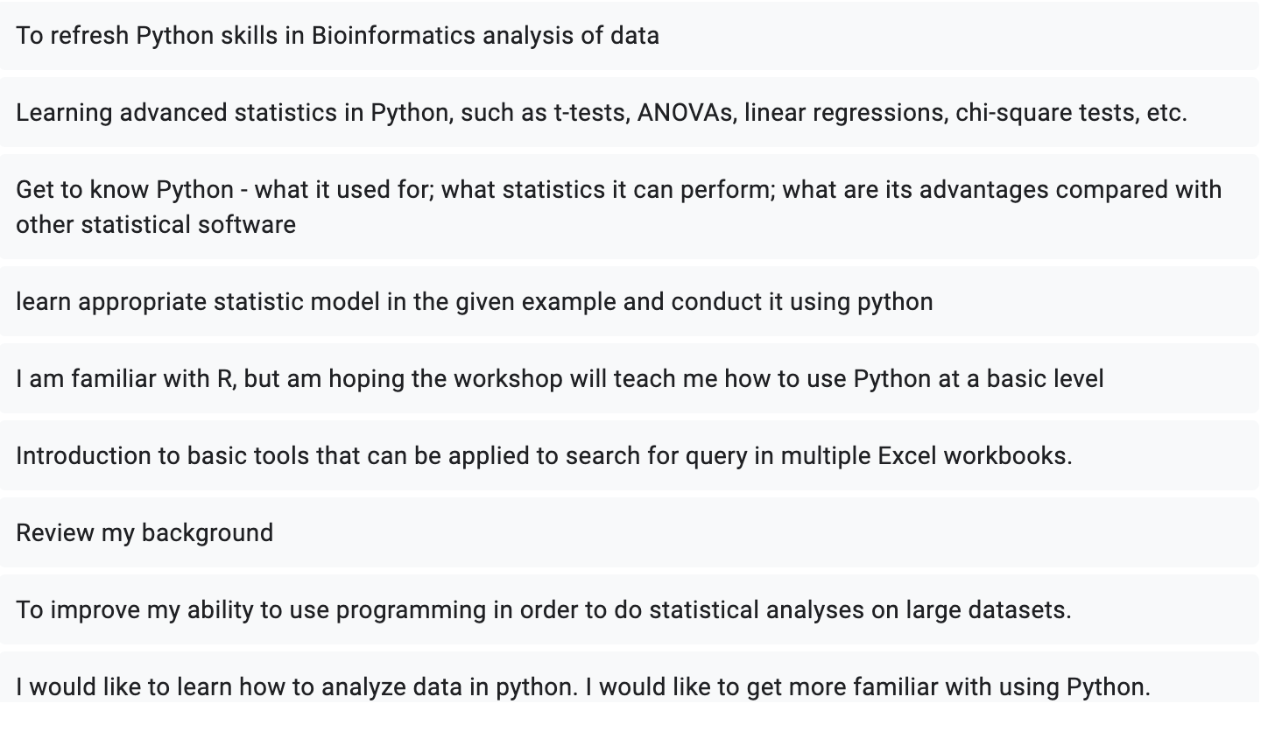
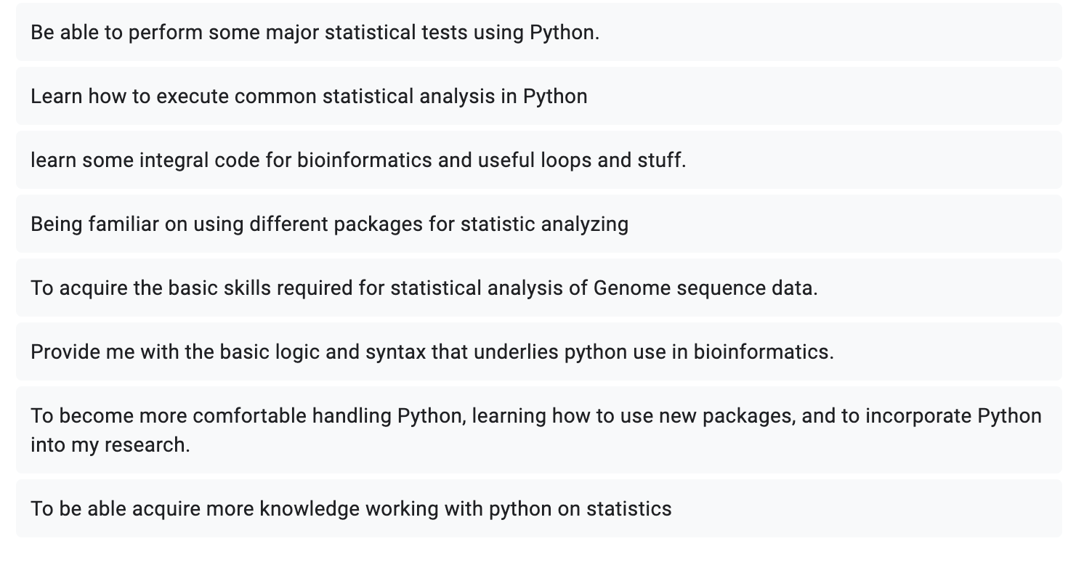
Statistics with Python
Responses of survey questions

Slide 10
Statistics with Python
Python
Statistics
Data
This workshop

Slide 11

Python 101
Python: A high-level general-purpose programming language
Made to easy-to-read
Object oriented language, works for small and large-scale projects
Very popular for Machine Learning and Data Science applications
Many, many resources online to self-learn, but Google remains your best friend ☺

Slide 12
Python 101
Python: An open-source language
Python users depend on community contribution to provide libraries and modules
Simply install the library and import it to use it in your code

Slide 13
Python 101
Some important Libraries
Numpy: Fundamental for scientific computing. Comprehensive mathematical functions, random number generators, etc..
Pandas: Data analysis and manipulation tool
Matplotlib: Visualizations in Python (static, animated, and interactive)
Scipy: Collection of mathematics, science, and engineering tools
Statsmodels: Classes and functions for the estimation of many different statistical models
Others: seaborn, scikit-learm, TensorFlow, etc.,

Slide 15

Performance metrics
Accuracy is only one metric
Definition: proportion of correct cases to all cases
$$Accuracy=\frac{True Positive+True Negative}{Tue Positive+True Negative+False Positive+False Negative}$$
Actual
 | Positive | Negative
Positive | True positive | False Positive
Negative | False Negative | True Negative
Predicted

Slide 16
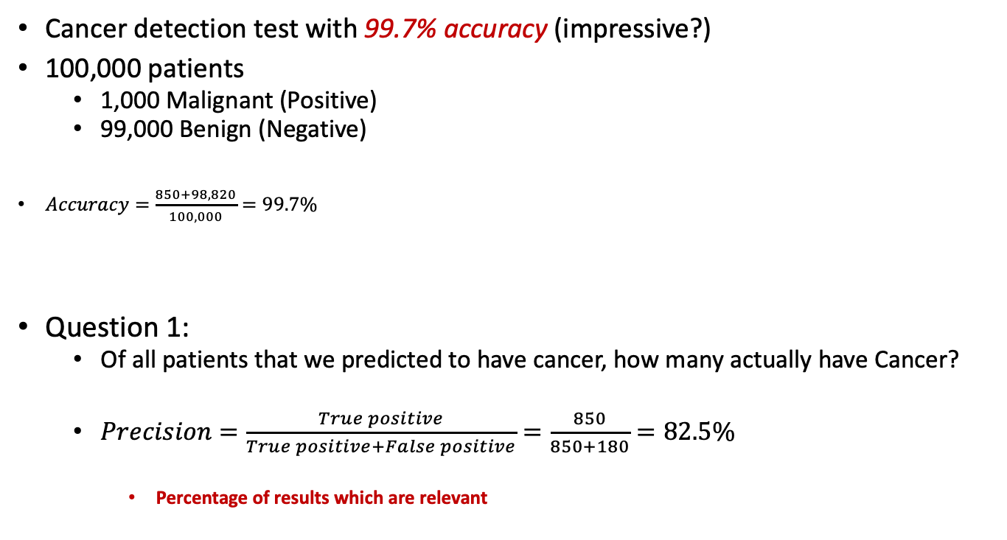
Performance metrics
Cancer detection test with 99.7% accuracy (impressive?)
100,000 patients
1,000 Malignant (Positive)
99,000 Benign (Negative)
$Accuracy=\frac{850+98,820}{100,000}=99.7\%$
Question 1:
Of all patients that we predicted to have cancer, how many actually have Cancer?
$Precision=\frac{True positive}{True positive+False positive}=\frac{850}{850+180}=82.5\%$
Percentage of results which are relevant
Actual
 | Positive | Negative
Positive | 850 | 180
Negative | 150 | 98, 820
Total | 1,000 | 99,000
Predicted

Slide 17
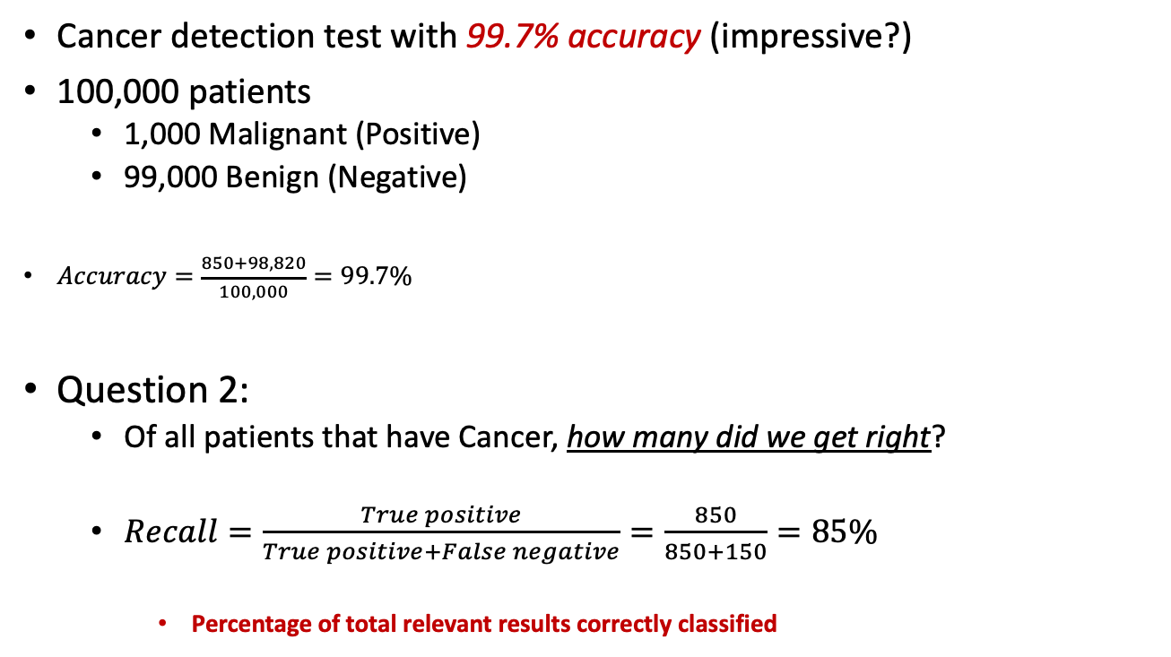
Performance metrics
Cancer detection test with 99.7% accuracy (impressive?)
100,000 patients
1,000 Malignant (Positive)
99,000 Benign (Negative)
$Accuracy=\frac{850+98,820}{100,000}=99.7\%$
Question 2:
Of all patients that have Cancer, how many did we get right?
$Recall=\frac{True positive}{True positive+False negative}=\frac{850}{850+150}=85\%$
Percentage of total relevant results correctly classified
Actual
 | Positive | Negative
Positive | 850 | 180
Negative | 150 | 98, 820
Total | 1,000 | 99,000
Predicted

Slide 18
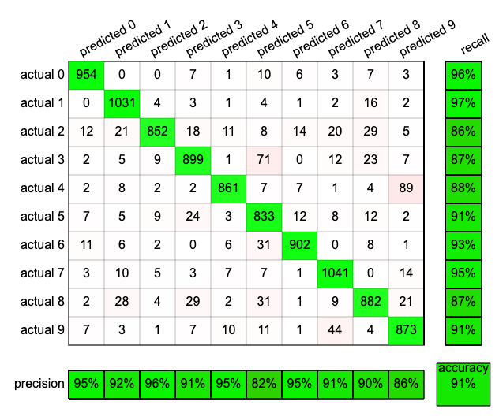
Performance metrics
Confusion matrix
For binary and multi-class classification
Correct elements are the diagonals
https://ml4a.github.io/demos/confusion_mnist/

Slide 19
Performance metrics
Accuracy is only one metric
Precision and recall
Confusion matrix
Critical for unbalanced datasets

Slide 20

Break
15 minutes

Slide 21
Next steps
Introductory books:
The Elements of Statistical Learning
Information Theory, Inference, and Learning Algorithms
Understanding Machine Learning: From Theory to Algorithms
Dive into Deep Learning
Online resources
Online courses: EdX, Coursera, ...
Datasets and competitions: Kaggle, IEEEDataPort, …
Online articles: Towards Data Science, Medium, …
Google is great ☺

Slide 22
References
http://cs231n.stanford.edu/
https://www.siamak.page/courses/COMP551F20/index.html
https://homes.cs.washington.edu/~pedrod/papers/cacm12.pdf
https://www.siamak.page/courses/COMP551F20/index.html
http://d2l.ai/index.html
https://software.intel.com/content/www/us/en/develop/training/course-time-series-analysis.html
http://cs109.github.io/2015/pages/videos.html
https://www.ibm.com/cloud/machine-learning
The Elements of Statistical Learning
Information Theory, Inference, and Learning Algorithms
Understanding Machine Learning: From Theory to Algorithms
Dive into Deep Learning

Slide 23

Questions?

Slide 24
Questions?
Github repo
https://github.com/abdelrahman-ayad/MiCM-introML-W21
Contact info:
abdelrahman.ayad@mcgill.ca

