Slide 1
Alexandria National University
Faculty of Computer and Information Science
🎓
Student Management System
(SMS)
Final Project Report • Software Engineering Course • May 2026
Ahmed Yasser (2305127) • Ahmed Alsayed (2305121) • Abdul Rahman Rabie (2305098) • Mohamed Ahmed (2305178)

Slide 2
Table of Contents
01
Requirements Phase
Problem Statement, System Scope, Functional & Non-Functional Requirements
02
Design Phase
System Architecture, UML Diagrams (Use Case, Sequence, Activity, Class, State Machine)
03
Implementation Phase
Technologies & Tools, Grading Formula, Key Implementation Details
04
Testing Phase
Unit, Integration & System Testing, Test Cases Results
05
Maintenance Phase
Modular Design, Referential Integrity, Extensibility

Slide 3
01 Requirements Phase
⚠ Problem Statement
Many universities still depend on paper-based or disconnected digital systems to manage student records, course registrations, and academic grading. This creates data inconsistency, delayed grade reporting, and a poor experience for students, teachers, and administrative staff.
Alexandria National University (ANU) required a centralized, secure, web-based platform that brings all academic management tasks into a single unified system.
System Scope — Four User Roles
👑 Admin
🛡 Staff
📚 Teacher
🎓 Student
Complete control over all system entities and data
Identical permissions to the Admin role
Manages assigned courses and enters student grades
Self-service portal for enrollment, grade viewing, and GPA tracking

Slide 4
Functional Requirements — Admin / Staff & Teacher Portal
👑 Admin / Staff Portal
📚 Teacher Portal
Manage students: add, edit, view, and delete records
Manage teachers: add, edit, view, and delete records
Manage courses: create courses and assign to teachers
Manage departments: add and edit department information
Manage enrollments: enroll or drop students from any course
Manage user accounts: create, edit, and delete accounts
Real-time dashboard with bar chart (by dept) & donut chart (by status)
Auto-create student record + assign student ID on user creation
Open student profile and directly enroll or drop from courses
View all courses assigned to the logged-in teacher
View the list of students enrolled in each course
Enter grades per student:
Midterm Exam — 30%
Assignments — 20%
Final Exam — 50%
System calculates numeric grade and letter grade automatically
A teacher may only grade students in their own assigned courses

Slide 5
Functional Requirements — Student Portal
📊 Personal Dashboard
📋 Course Grades View
🔍 Browse Available Courses
View GPA, total credits earned, and current enrollment status at a glance.
See all enrolled courses along with grades and enrollment status.
Filter courses by semester; student's own department is listed first for convenience.
✅ Self-Enrollment
🗑 Drop Courses
📈 GPA Tracking
Enroll in available courses with one click; duplicate enrollments are automatically prevented.
Drop any course that has not yet received a grade.
Real-time GPA calculation based on completed courses and earned credits.

Slide 6
Non-Functional Requirements
⚡ Performance
API responses and dashboard stats load within 2 seconds under normal load
All database queries use indexed columns to avoid full-table scans
🔒 Security
Passwords stored as bcrypt hashes
All SQL queries use prepared statements (no SQL injection)
User content rendered in DOM passes through escHtml() to prevent XSS
Sessions managed server-side
Teacher grade endpoints verify authorization before any update
🖥 Usability
📈 Scalability
SPA design eliminates page reloads — navigation between sections is instant
Feedback (success / error) delivered via toast notifications
Modular design supports large student populations
8 independent PHP controllers — changes are isolated
🔧 Reliability
Graceful error handling throughout all system layers
Role-based routing ensures users only access permitted areas

Slide 7
02 Design Phase — System Architecture
Three-Tier Architecture
1
Presentation Layer
HTML5 + CSS3 + Vanilla JavaScript
Single-Page Application (SPA). All views rendered dynamically inside a single index.html file without page reloads.
2
Application Layer
PHP 8 RESTful API — 8 Independent Controllers
Frontend communicates with backend using fetch() with JSON payloads. Thin api.js wrapper centralizes all API calls.
3
Data Layer
MySQL Database — 6 Tables
departments, students, teachers, courses, enrollments, users. ref_id links login accounts to academic records, separating authentication from academic identity.
Key Design Decisions:
SPA pattern — eliminates round-trip page loads, improving perceived performance. Auto-create student record — backend creates student record and assigns ID when student user is created without a linked record.

Slide 8
UML Diagrams — Overview
Five UML diagrams model the system from different perspectives:
Fig 1 | Use Case Diagram
Fig 2 | Sequence Diagram
Fig 3 | Activity Diagram
Shows the 4 actors (Admin, Staff, Teacher, Student) and all operations each can perform. Admin and Staff share identical permissions.
Illustrates the full message flow for the Student Self-Enroll scenario — from 'Show Available Courses' click through to a confirmed enrollment.
Models the Student Course Registration flow step-by-step, including decision points for 'courses available' and 'already enrolled'.
Fig 4 | Class Diagram
Fig 5-6 | State Machine Diagrams
Models the 6 main entities: User, Student, Teacher, Course, Department, and Enrollment — with their attributes, methods, and relationships.
Three state machines: Student Status (Active/Inactive/Suspended/Graduated), Enrollment Status (Enrolled/Completed/Dropped/Failed), and User Session.

Slide 9
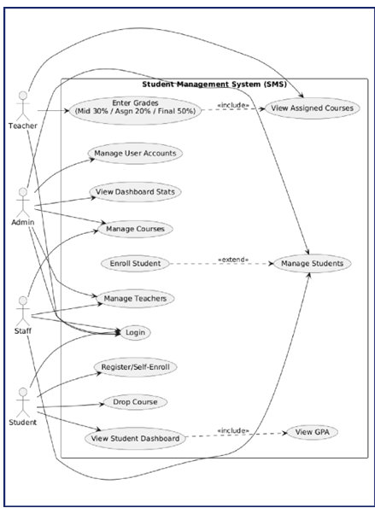
Use Case Diagram — Actors & Operations
👑 Admin & Staff
Manage Users, Students, Teachers, Courses, Departments
Enroll/Drop students
View real-time dashboard stats
📚 Teacher
View assigned courses
View enrolled students
Enter grades (Mid 30% / Asgn 20% / Final 50%)
🎓 Student
Register/Self-Enroll in courses
Drop courses (ungraded only)
View student dashboard & GPA

Slide 10
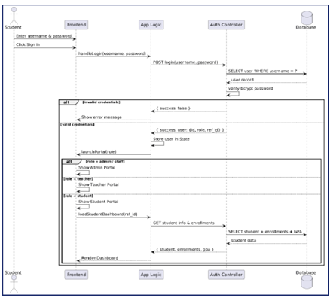
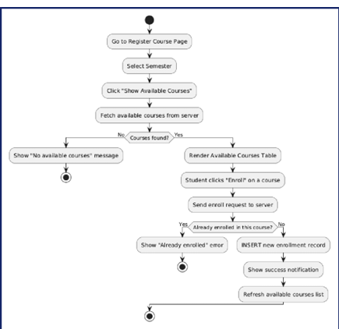
Sequence Diagram & Activity Diagram
Fig 2 | Sequence Diagram — Student Self-Enroll
Fig 3 | Activity Diagram — Course Registration Flow
[ Insert Sequence Diagram Image Here
(Figure 2 from the report) ]
[ Insert Activity Diagram Image Here
(Figure 3 from the report) ]
Flow: Enter credentials → handleLogin() → POST /login → SELECT user → verify bcrypt → role-based portal launch → load student dashboard with GPA & enrollments.
Go to Register Course Page
Select Semester → Click 'Show Available Courses'
Fetch available courses from server
If no courses: show 'No available courses' message
If courses found: render table → student clicks 'Enroll'
If already enrolled: show error; otherwise INSERT enrollment
Show success notification → refresh available courses list

Slide 11
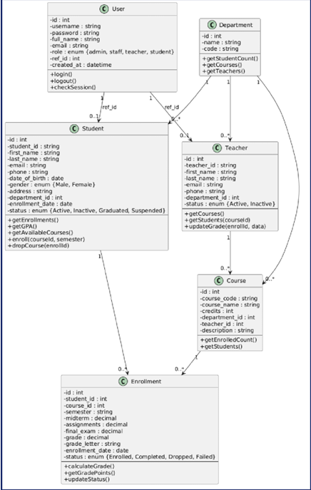
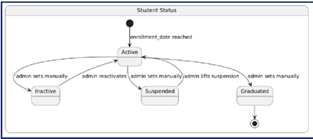
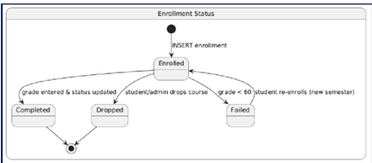
Class Diagram & State Machine Diagrams
Fig 4 | Class Diagram — 6 Main Entities
Figs 5-6 | State Machine Diagrams
[ Insert Class Diagram Image Here
(Figure 4 from the report) ]
[ Insert Student Status
State Machine (Fig 5) ]
[ Insert Enrollment Status
State Machine (Fig 6) ]
Student Status:
Active → Inactive / Suspended / Graduated
Entities: User, Student, Teacher, Course, Department, Enrollment — linked via ref_id and foreign keys.
Enrollment Status:
Enrolled → Completed / Dropped / Failed
User Session:
Unauthenticated → Authenticated → Portal Views

Slide 12
03 Implementation Phase — Technologies & Tools
🌐
Frontend
HTML5, CSS3, Vanilla JavaScript
Single-Page Application (SPA) — no framework used
⚙
Backend
PHP 8 — RESTful API
8 independent controllers, each handling one resource domain
🗄
Database
MySQL
6 tables — all queries use prepared statements for security
📊
Charts
Native JavaScript Charts
Bar chart (students by dept) and donut chart (by status) on admin dashboard
📐 Grading Formula:
Grade = (Midterm × 30%) + (Assignments × 20%) + (Final Exam × 50%)
A ≥90 | B+ ≥85 | B ≥80 | C+ ≥75 | C ≥70 | D+ ≥65 | D ≥60 | F <60

Slide 13
04 Testing Phase
🔬 Unit Testing
🔗 Integration Testing
🖥 System Testing
Individual PHP controller functions and JavaScript functions tested in isolation to confirm each unit behaves correctly for valid and invalid inputs.
API endpoints tested with various payloads to verify correct interaction between the application layer and the database.
Complete end-to-end user scenarios executed manually in the browser to confirm that all components work together as expected.
Test Cases — Results
Test ID | Test Case | Expected Result | Status
TC-01 | Student Login | Portal loads correctly for student role | ✔ Pass
TC-04 | Self-Enroll | Enrollment created successfully in database | ✔ Pass
TC-06 | Teacher Grade Entry | Overall grade auto-calculated from formula | ✔ Pass
TC-08 | Auto-create Student Record | Student record created + ID assigned on user creation | ✔ Pass

Slide 14
05 Maintenance Phase
The system is designed for high maintainability through modular, independent components.
🧩 Independent PHP Controllers
📁 Centralized API Wrapper
Each of the 8 PHP controllers is independent — a fix in one controller does not affect others. Changes are fully isolated.
The central api.js wrapper means any backend URL change requires editing a single file — not scattered throughout the codebase.
🔗 Referential Integrity
🔒 Safe SQL Patterns
The database uses foreign keys and ON DELETE rules (e.g., deleting a teacher sets course.teacher_id to NULL), maintaining data integrity automatically.
All SQL uses prepared statements. Adding new queries follows a consistent, safe pattern — no risk of introducing SQL injection.
➕ Easily Extensible Roles
📋 Production Monitoring
New user roles can be added by: (1) extending the role enum, (2) creating a new portal section in app.js, and (3) adding a new PHP controller — no changes to existing code required.
System logs and error reporting should be enabled in production for proactive monitoring and issue resolution.

Slide 15
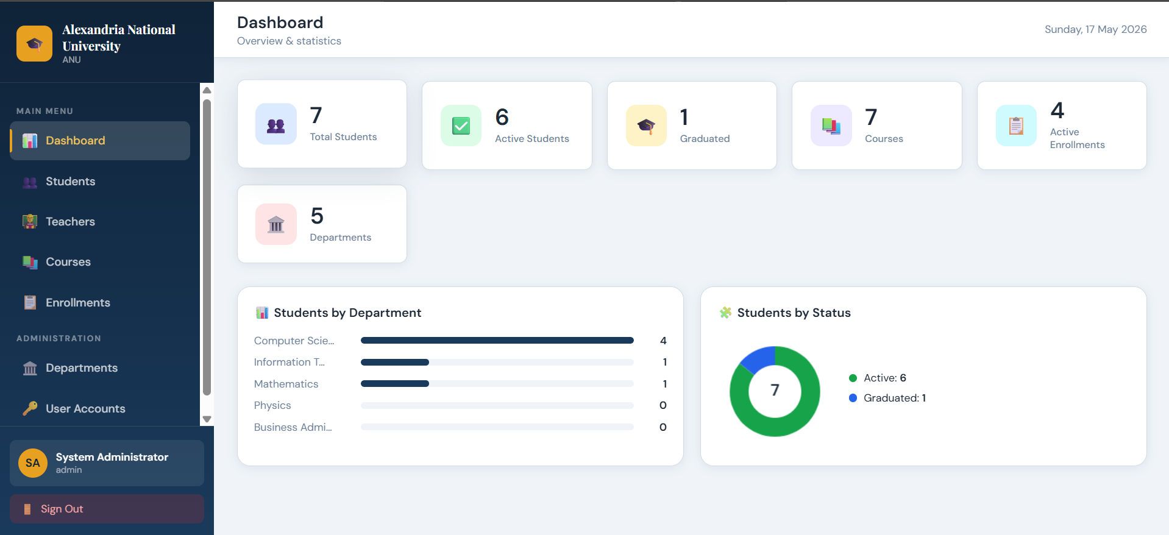
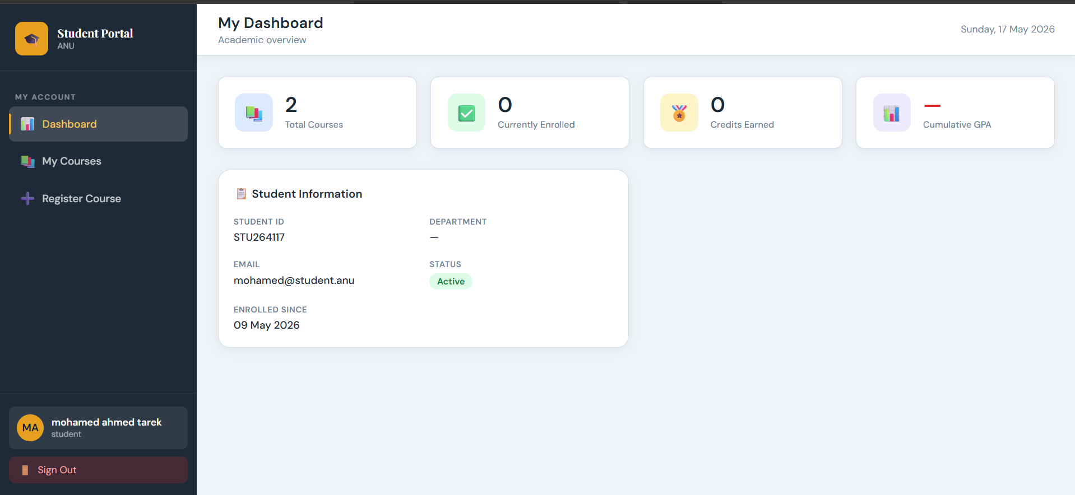
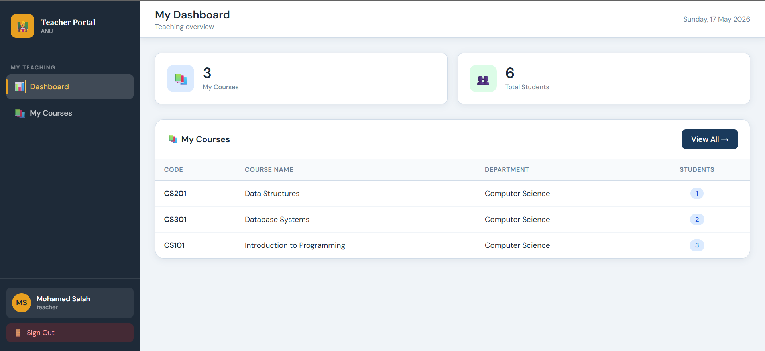
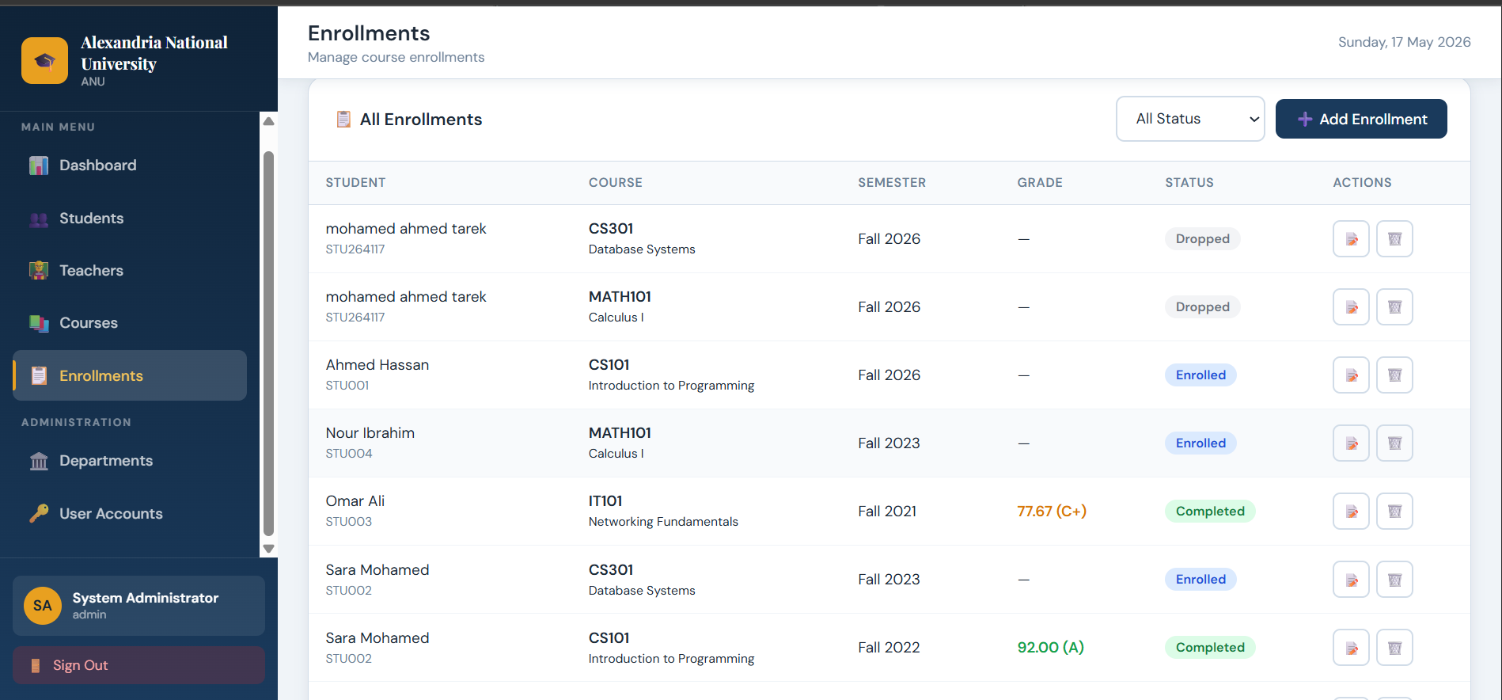
Project Screenshots
[ Insert Screenshot:
Admin Dashboard ]
[ Insert Screenshot:
Student Portal — GPA & Enrollments ]
[ Insert Screenshot:
Teacher Grade Entry ]
[ Insert Screenshot:
Course Registration ]

Slide 16
Conclusion
✅ Fully centralized, role-based web platform for ANU
✅ Secure: bcrypt passwords, prepared SQL statements, XSS prevention
✅ SPA architecture delivering instant navigation without page reloads
✅ Automated grade calculation with letter grade assignment
✅ All 4 test cases passed — Unit, Integration & System Testing
✅ Modular, extensible design ready for future role additions
The Student Management System successfully replaces paper-based processes
with a secure, efficient, and scalable digital solution.
Ahmed Yasser • Ahmed Alsayed • Abdul Rahman Rabie • Mohamed Ahmed
Alexandria National University — May 2026

