Slide 1
Angular Course
By Abdelrahman Haridy Abharworks.com

Slide 2
Content
Building and maintain Single page applications using Angular:
Angular Getting Started
Angular Building Blocks
Data Binding
Displaying Data and Handling Events
sharing data between components
How to use ng-bootstrap & FontAwsome?
Modules
Directives
Task #1 ( doctors list )
Building Reusable Components
Pipes
Task #2 ( loading button )
Forms and Validation?
Task #3 ( Signup Form )
Routing and Navigation
Task #4 ( Get Doctor data )
Services
HTTP Services
Mocks API ( GET,POST, Delete, Update )
Authentication and authorization
Postman and JWT
~ Deployment

Slide 3
What is Angular?!
Angular is a development platform, built on TypeScript. As a platform, Angular includes:
A component-based framework for building scalable web applications
A collection of well-integrated libraries that cover a wide variety of features, including routing, forms management, client-server communication, and more
A suite of developer tools to help you develop, build, test, and update your code

Slide 4
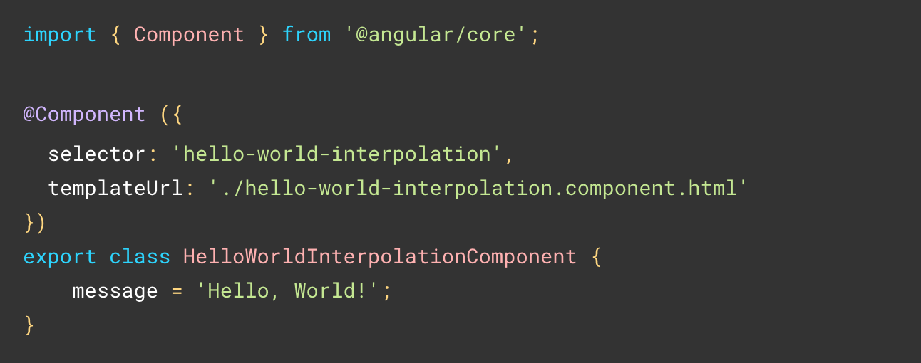
The essentials
Components are the building blocks that compose an application.
Templates: Every component has an HTML template that declares how that component renders.
Dependency injection lets you declare the dependencies of your TypeScript classes without taking care of their instantiation.

Slide 5
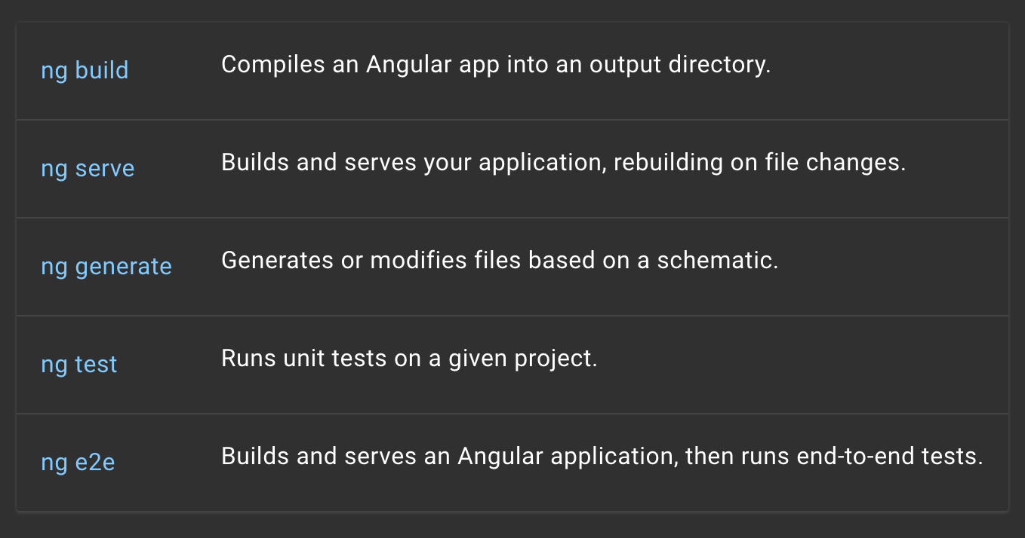
The Angular CLI is the fastest, straightforward, and recommended way to develop Angular applications. The Angular CLI makes a number of tasks trouble-free. Here are some examples:
Book Title

Slide 6
First-party libraries
Angular Router
Angular Forms
Angular HttpClient
Advanced client-side navigation and routing
form participation and validation
client-server communication
Angular Animations
Angular PWA
Angular Schematics
Rich system for driving animations
Tools for building Progressive Web Applications (PWAs)
Neptune is the farthest planet from the Sun

