Slide 1
Airline Flight Scheduler 2
Isaac Gillette, Trang Le, Abdelrahman Saad, Bojun Zhong

Slide 2
Overview
Project Overview
Design
Implementation
Demonstration
Reflection

Slide 3
Project overview

Slide 4
Project Description
A system designed to keep track of flights and the different components of a flight
This project is designed to view all flights in system, search for a flight, cancel a flight, and to change crew members
In sprint 1, we implemented the classes by splitting into 4 package (Airplane package, Airport package, Flight package, and Person package) -- Each person is assigned to finish 1 package.
In sprint 2, we changed the structure and implemented a 3-tier architecture (Frontend, Backend, and Logic)

Slide 5
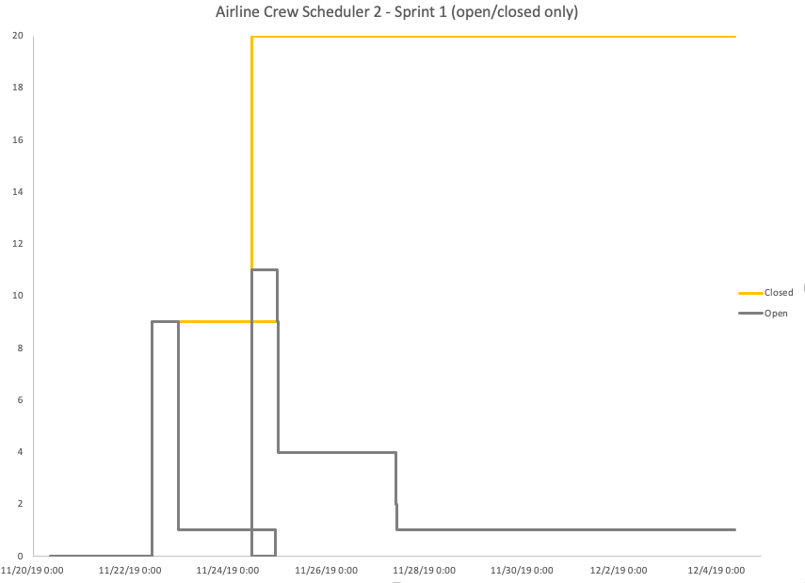
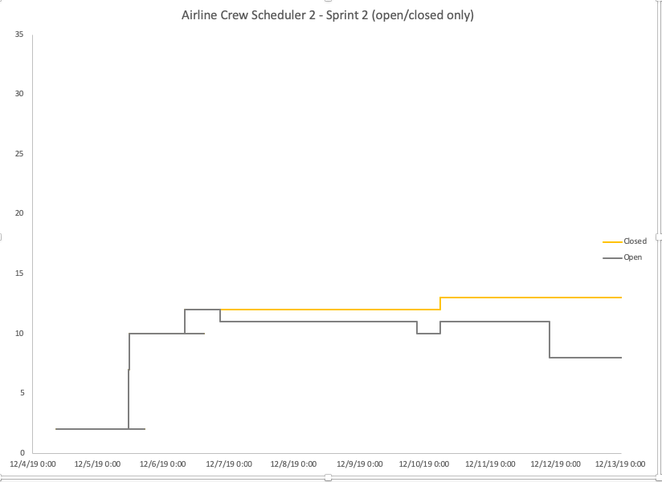
Burndown chart
Sprint 1
Sprint 2

Slide 6
Design

Slide 7
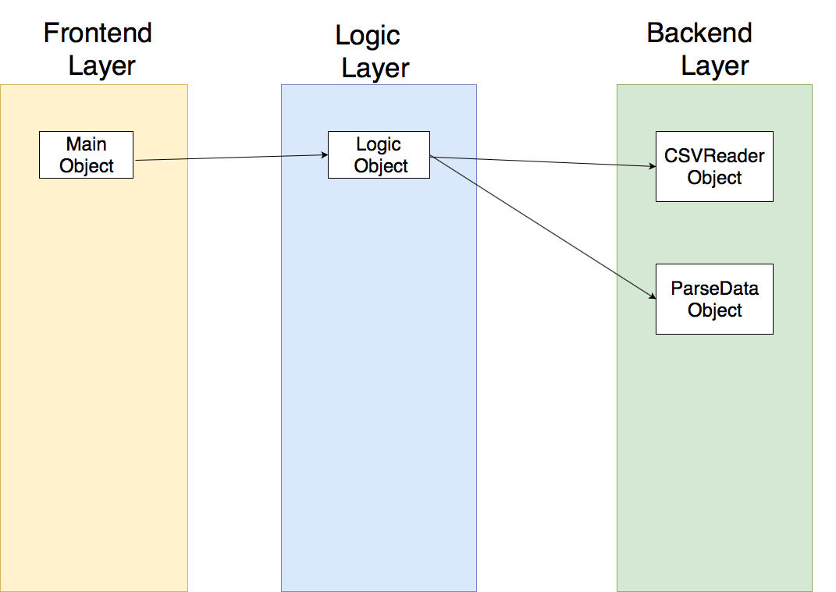
Subsystem Decomposition
For our system, we have chosen to do a 3-tier architecture

Slide 8
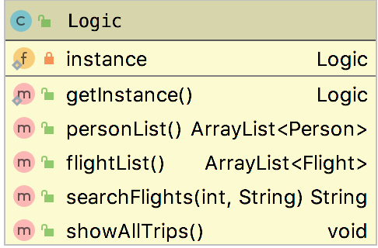
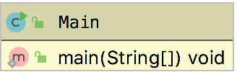
Class diagram – Frontend & Logic subsystem

Slide 9
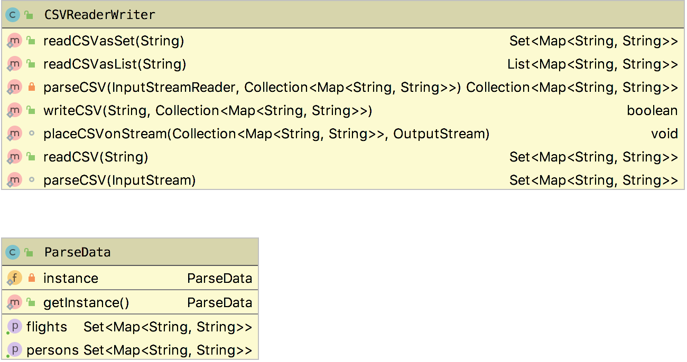
Class diagram – backend subsystem

Slide 10
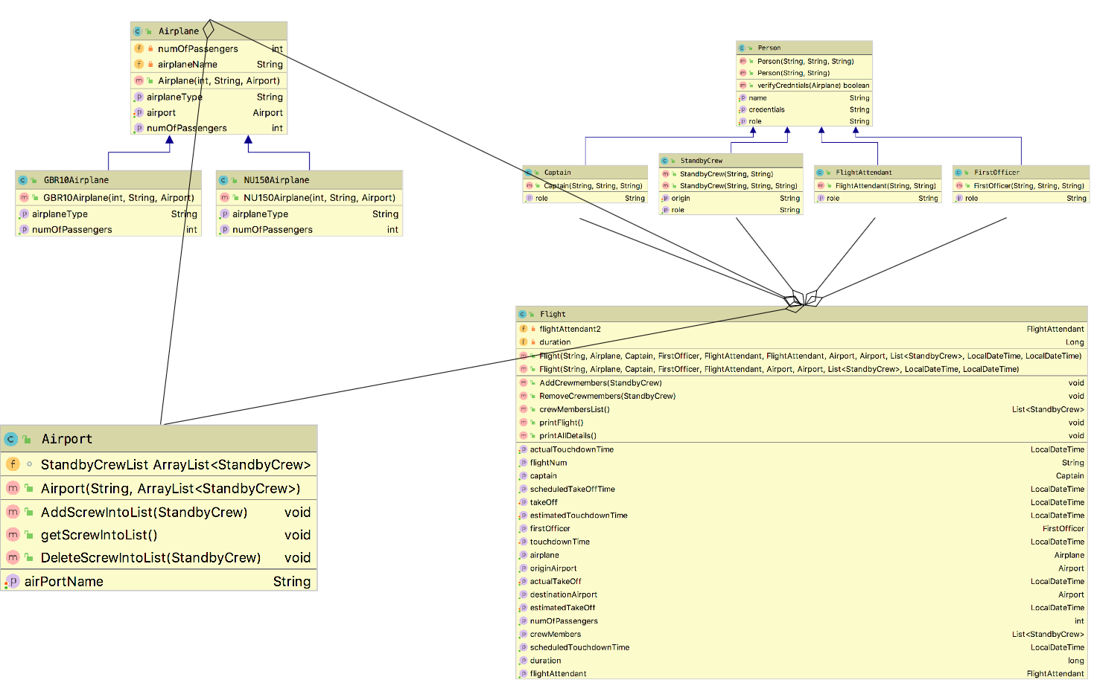
Class diagram – whole system

Slide 11
implementation

Slide 12
Implementation
For Sprint 1, we implemented the basic classes of the system – Person (Captain, Flight Attendant, First Officer, Standby Crew), Flight, Airport, Airplane (GBR10, NU150)
For Sprint 2- Declared 3-tier architecture and created classes for Logic (Logic.java) and Backend (parseData.java), and implemented the functionalities for the system (view all flights, search for flights, cancel flights, and change crew members)

Slide 13
Demonstration

Slide 14
Reflection

Slide 15
Reflection – what went well
The group members are very enthusiastic about scrum meeting, and members were always on time to meetings
The communication between the group members is in place. Every time everyone meets, they are very concerned about what they do, and point out the shortcomings between teammates in time, and guide the members to do what and how to do it.

Slide 16
Reflection – what didn’t go well
Did not discuss about architecture at the start of sprint, which resulted in inefficient work, duplication of work by team members -- resulted in wasted work
Deciding how to split work among members
Caused members of the group to not know what to do next and what are the goals to be achieved at this stage Better communication

Slide 17
Reflection – lessons learned
Being more organized helps
Increased teamwork experience (Learned how to cooperate and communicate with team members)

