Slide 1
Croissant windows digital forensics tools
Presented by :
Abdelrahman Ahmed amin
Id : 21510435
Supervisor : DR . Sanna Taha

Slide 2
Contents of this template
Problem of the project
Aims and Objectives
Comparing tools
Functional Requirements & Non- Functional Requirements
Diagram
User Interface
Real life example
Further Works

Slide 3

Problem of the project
The traditional methods of digital forensic investigation are often manual, fragmented, and time-consuming, which poses a significant challenge for analysts working under tight timelines in dynamic cyber environments. Investigators must manually sift through vast volumes of browser, registry, and system artifacts, which increases the risk of oversight and delays threat detection. In the face of rapidly evolving attack vectors and increasing data complexity, there is a pressing need for an automated forensic collection and analysis framework. Such a tool would streamline artifact extraction, improve evidence visibility, and enable faster and more accurate incident response.

Slide 4
Aims and abjectives
Develop a comprehensive framework to automate and enhance the digital forensic investigation process
Eliminate the inefficiencies of manual artifact collection during incident response
Integrate new techniques to extract deeper insights from browser, registry, file system, and network artifacts
Centralize and correlate multiple forensic data sources into one unified analysis platform
Introduce previously unused sources and methods to uncover hidden or overlooked evidence

Slide 5
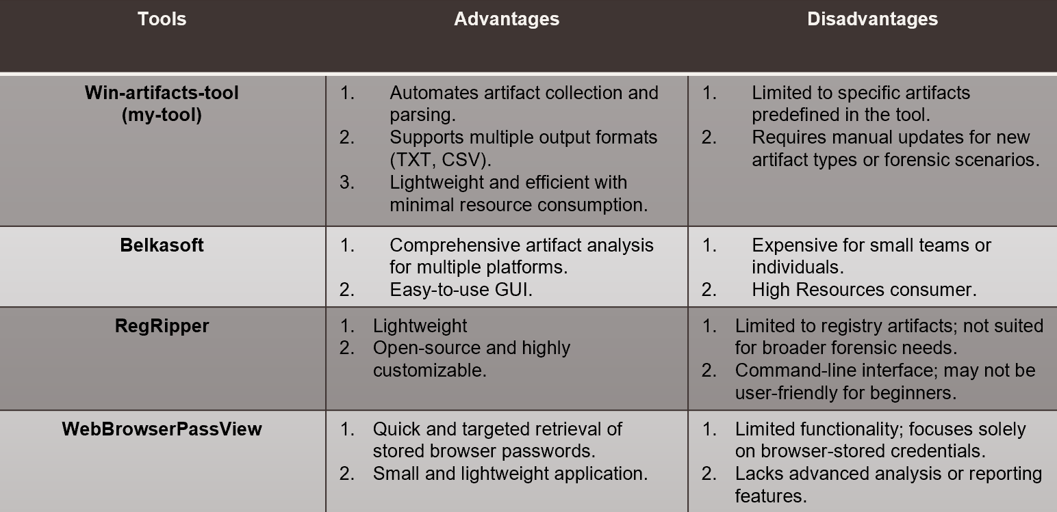
Comparing Tools

Slide 6
Functional Requirements
Accept a selected user or directory to automatically extract and parse browser artifacts (history, downloads, cookies, cache)
Retrieve registry artifacts related to user activity, system configuration, and persistence mechanisms
Accept multiple users or hive files to analyze multiple profiles in a single run
Identify and extract file system artifacts such as recently accessed files, deleted files, and program execution traces
Capture and log PowerShell and command-line activity for timeline reconstruction
Collect process, service, and network connection artifacts for system activity correlation
Export all parsed forensic data into readable and analyst-friendly TXT or CSV formats
Provide a terminal-based interface that guides the analyst step-by-step, including artifact selection and output options

Slide 7
Non-Functional Requirements
Usability: Designed for forensic analysts of all skill levels, the tool offers a straightforward command-line interface with clear prompts and brief documentation
Performance: Efficiently processes large volumes of browser, registry, and system artifacts with minimal delay, even on resource-constrained systems
Display & Output: Supports saving results in readable .txt files, structured for easy analysis and reporting
Scalability: Handles multiple users and large forensic data sets without loss in performance or functionality
Security: Prioritizes secure handling of forensic data and is free of any hidden backdoors or unsafe code practices
Compatibility: Fully compatible with Windows systems, where most forensic artifacts are collected and analyzed
Documentation: Includes clear and concise documentation to guide users through installation, usage, and troubleshooting
Maintainability: Built with modular code structure and thorough inline comments to support future updates, bug fixes, and feature additions

Slide 8
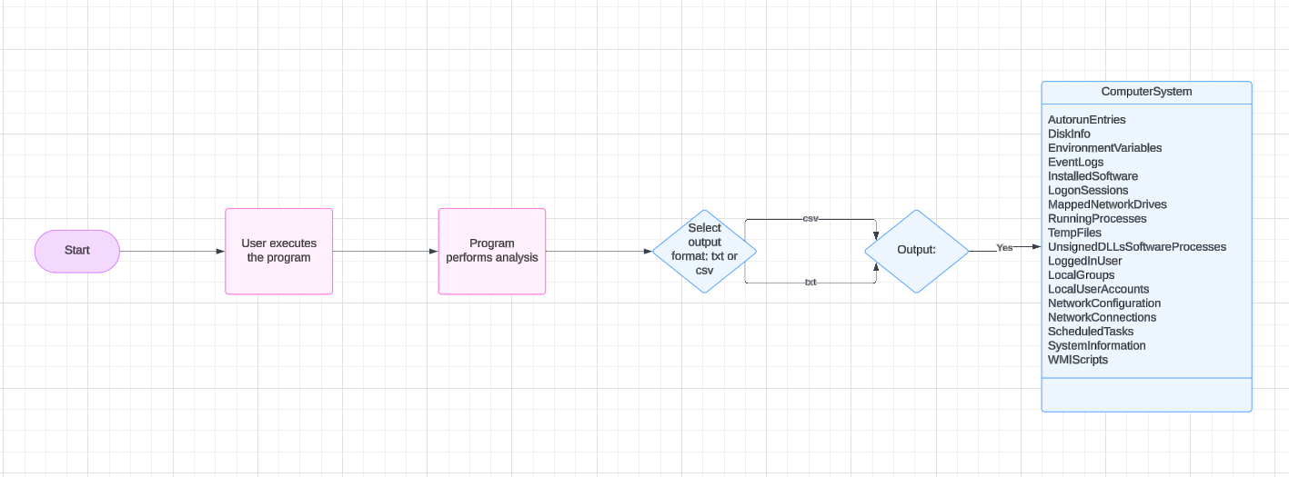
Use case diagram

Slide 9
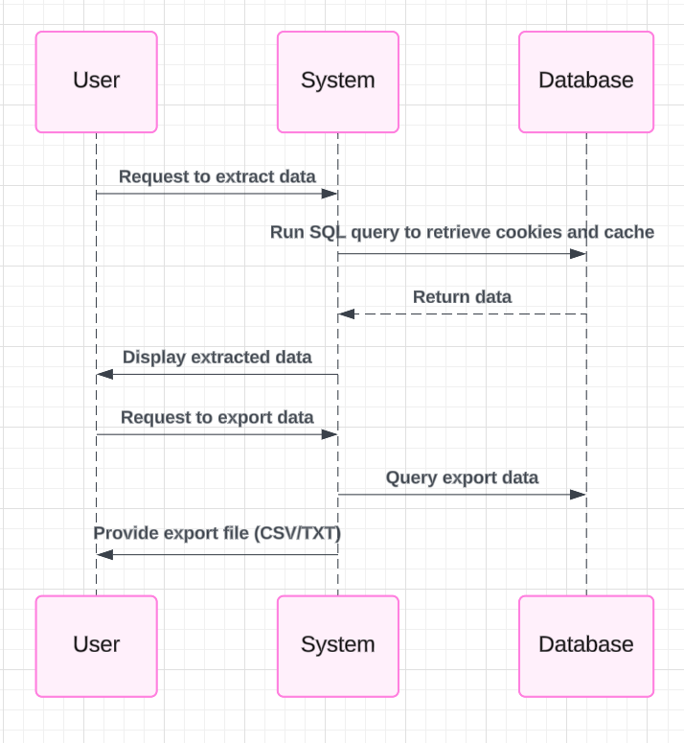
Sequence Diagram

Slide 10
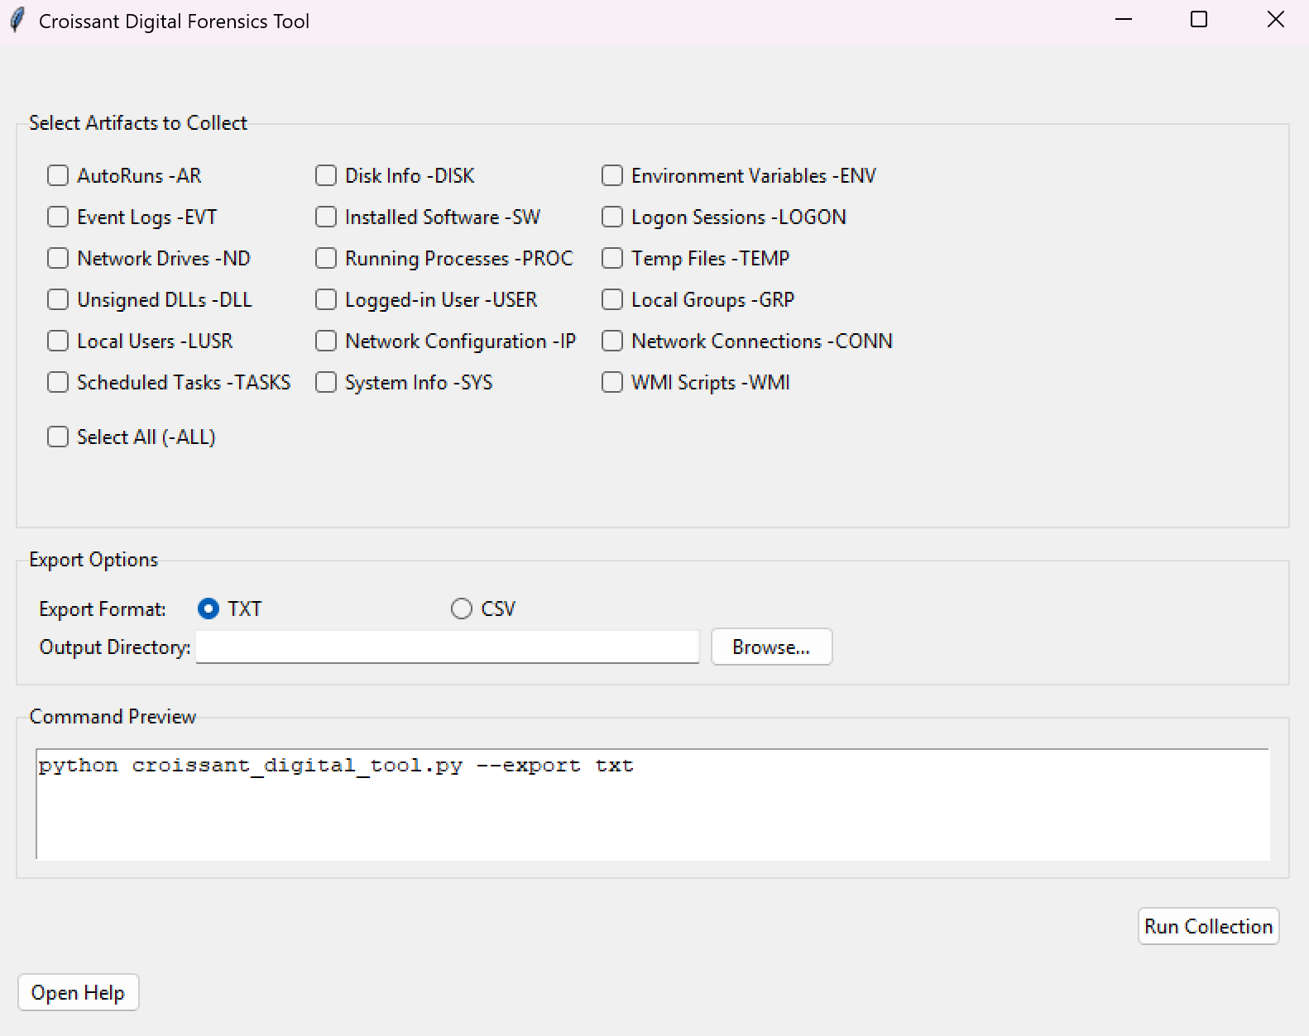
User Interface

Slide 11
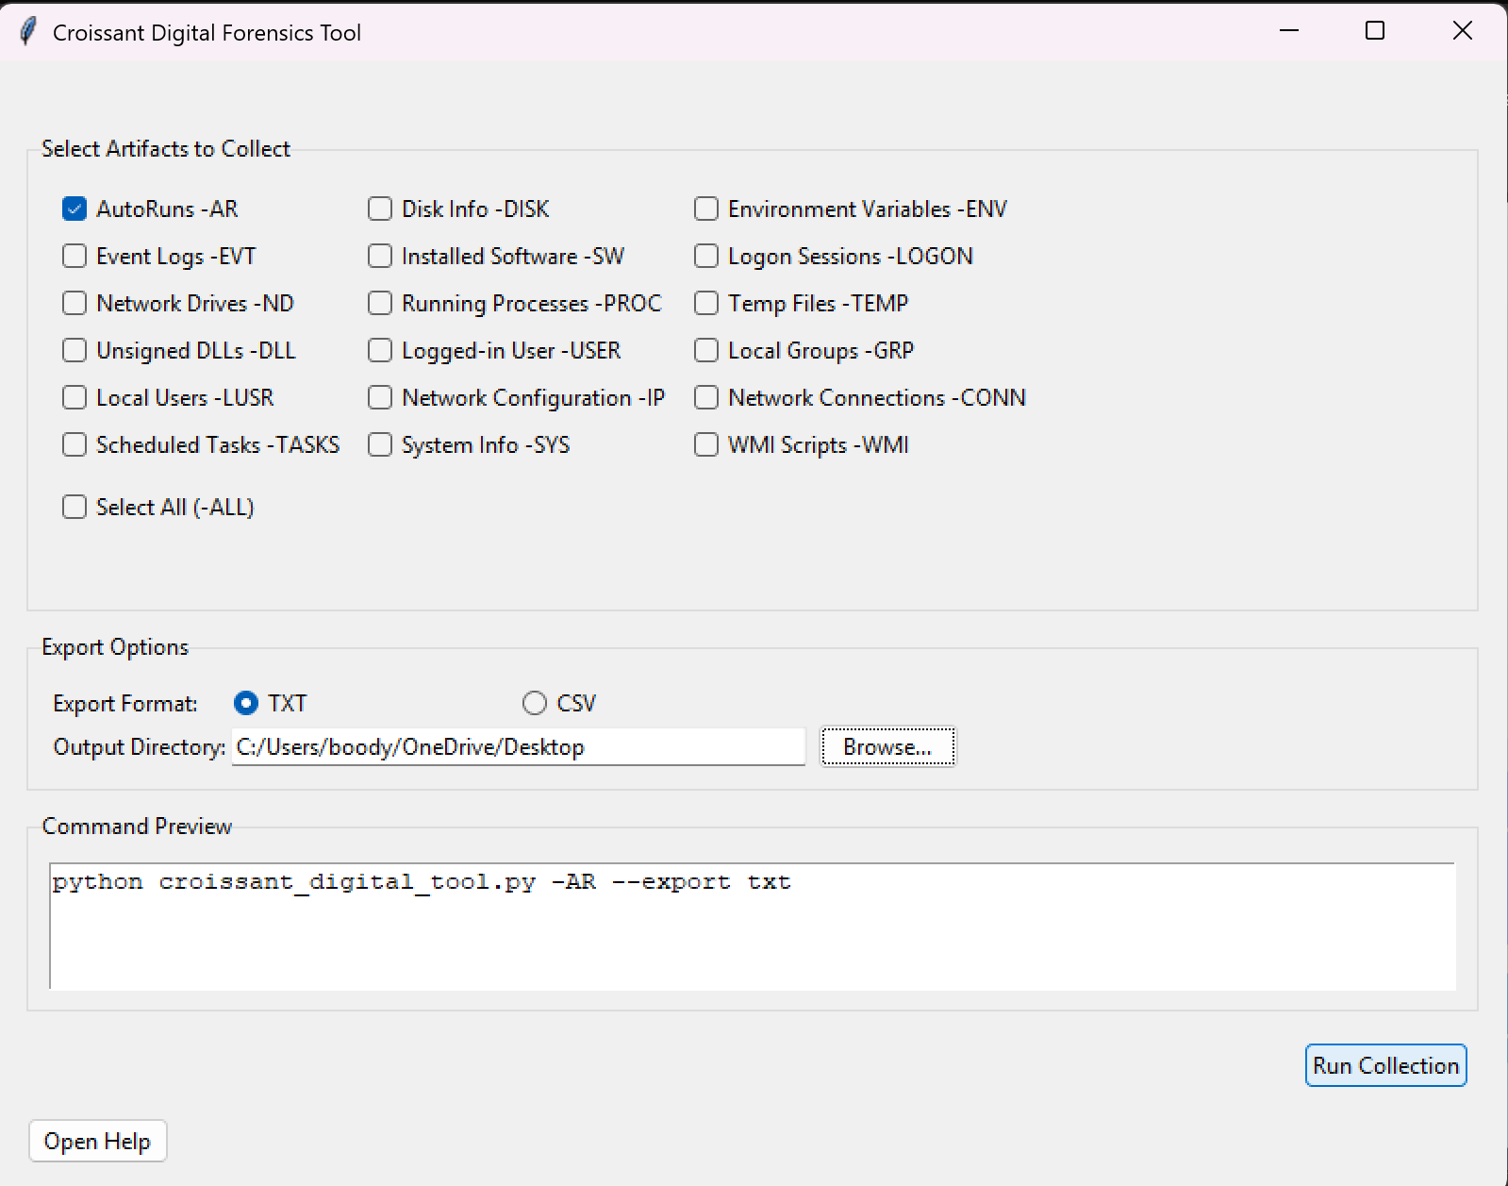
Example running function on the tool

Slide 12
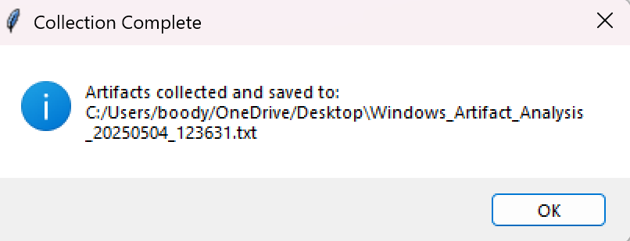
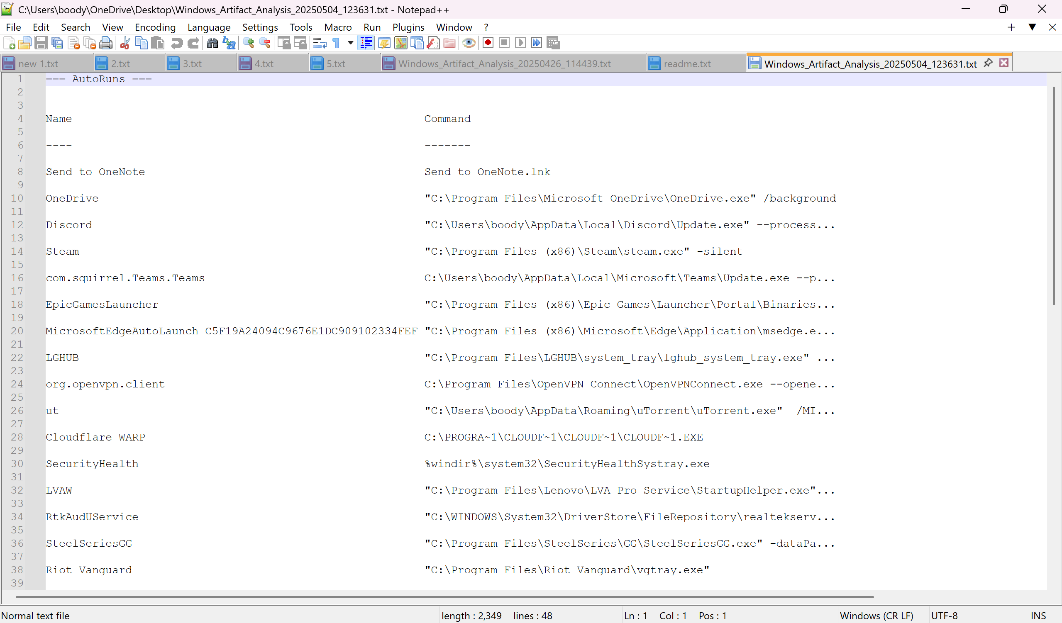
Output

Slide 13
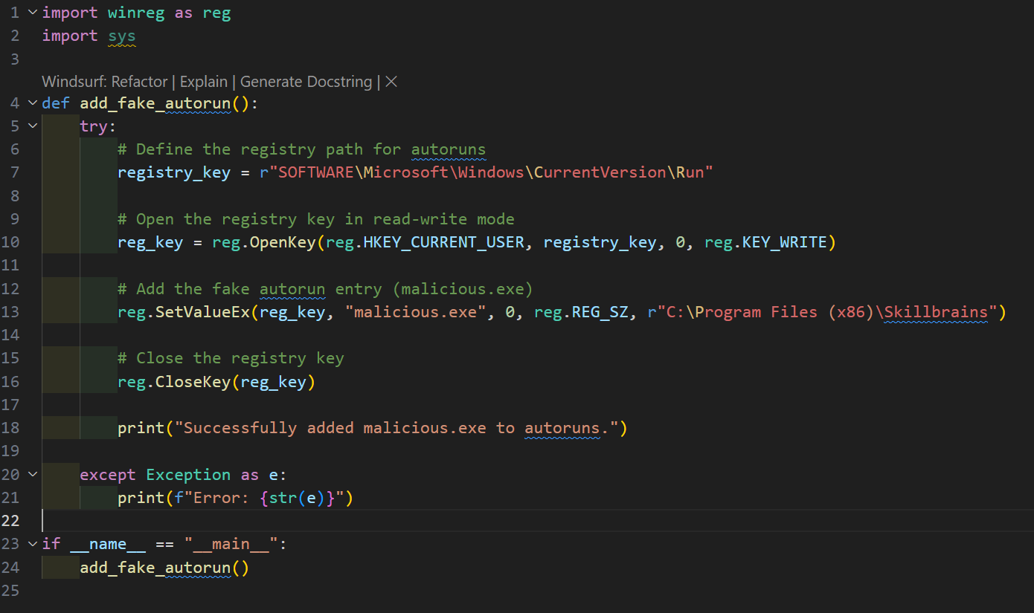
Real life example
So to make this an real life scenario I wrote a small malware that edit in registry hive and add a program called malicious.exe in the Auto runs now lets compare before and after the malware

Slide 14
Real life example
Before the malware

Slide 15
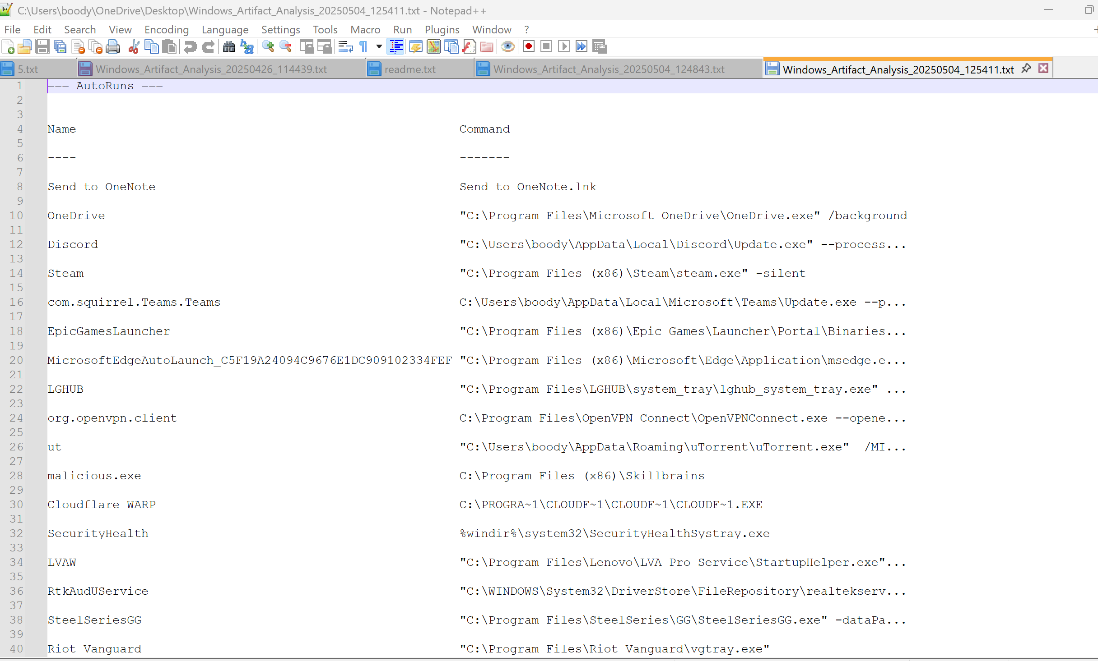
Real life example
after the malware

Slide 16
Further Works
Remote Automation: Enable remote control to run the tool and retrieve data from anywhere, enhancing flexibility and efficiency.
AI Chatbot Integration: Develop an AI chatbot to assist non-technical users with real-time guidance and tool navigation.
Enhanced Artifact Collection: Expand data collection to include mobile, cloud, and IoT forensics, broadening evidence coverage.
Real-Time Data Processing: Implement real-time data analysis for up-to-the-minute insights during active investigations.
SIEM Integration: Integrate with SIEM platforms like Splunk and QRadar for seamless cybersecurity infrastructure support.

Slide 17
That is the End Thanks for listening

