Slide 1
Employee Attrition & Salary Prediction System
An End-to-End Machine Learning Solution for Workforce Decision-Making & Talent Retention
عبدالرحمن أحمد إبراهيم
سيف الدين شريف عبدالفتاح
فارس محمد صلاح عبدالحميد سليمان
سيف الدين باسم ممدوح بركات
أحمد منتصر محمد أحمد

Slide 2
Project Overview & Purpose
Empowering workforce leaders with data-driven employee retention strategies and optimized compensation forecasting.

Slide 3
Executive Project Summary
Core Mission: Build a dual-capability machine learning system to predict employee turnover risk and accurately estimate competitive salaries.
Data Foundation: Leveraged extensive employee workforce datasets with rigorous feature selection, outlier handling, and SMOTE class balancing.
Advanced Modeling: Utilized tuned Random Forest and XGBoost classifiers combined in a Soft Voting Ensemble to achieve superior generalization.
Organizational Impact: Provides management teams with actionable insights to lower turnover costs, retain high-value talent, and streamline budgeting.

Slide 4
Core Objectives & Workforce Value
•
Early Attrition Warning: Identify flight risks among critical personnel before resignation occurs using behavioral and performance indicators.
•
Salary Benchmarking: Predict expected compensation accurately based on role seniority, experience, and educational background.
•
Proactive Intervention: Enable department managers to target retention bonuses, career development, and salary adjustments effectively.

Slide 5
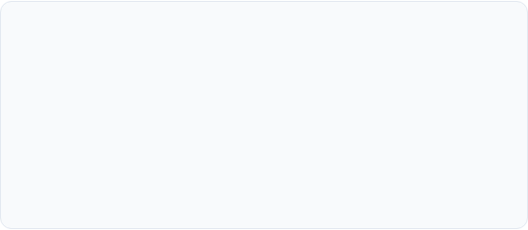
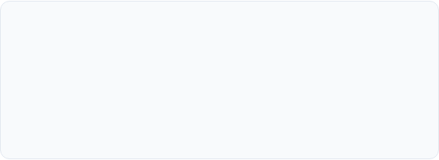
Technical Challenge: Dataset Optimization
Initial Standard Employee Dataset Limitations
Scaling for Production Stability
Migrated to a robust, scaled dataset containing nearly 3x more records, providing the statistical variance required to train high-accuracy classification and regression models.
Initial exploration of the standard employee dataset (~4,650 rows) revealed severe class imbalance and unnecessary noise that degraded model recall for minority resignation classes.

Slide 6
Engineering Challenges & Solutions
SMOTE Data Balancing: Resolved severe class skewness in turnover labels by generating synthetic minority samples during pipeline preprocessing.
Dual Pipeline Integration: Seamlessly merged binary classification (attrition) and regression (salary) into a unified interactive software workflow.
Iterative Code Architecture: Refactored the core pipeline 3 times to optimize feature encoders, eliminate data leakage, and ensure maximum system reliability.

Slide 7
Comparative Benchmarking & Analysis
Rigorous performance contrast mapping our enhanced pipeline directly against each original baseline project.

Slide 8
Comprehensive System & Project Comparison
Feature / Metric | Our Project | Project 1 | Project 2 | Project 3 | Project 4 (NTI)
Classification Models | XGBoost, Random Forest, Soft Voting Ensemble | — | Logistic Regression | XGBoost | Classification Model
Regression Model | Tuned XGBoost Regressor | Random Forest Regressor | — | — | —
Hyperparameter Tuning | ✅ Yes | ❌ No | ❌ No | Limited | Limited
Class Imbalance Handling | ✅ SMOTE | ❌ | ❌ | ❌ | ❌
Feature Scaling | ✅ StandardScaler | ❌ | Not shown | Yes | Yes
Ensemble Learning | ✅ Soft Voting | ❌ | ❌ | ❌ | ❌
Interactive Prediction System | ✅ Yes | ❌ | ❌ | ❌ | ❌
Predicts Employee Salary | ✅ Yes | ✅ Yes | ❌ | ❌ | ❌
Predicts Employee Attrition | ✅ Yes | ❌ | ✅ | ✅ | ✅

Slide 9
Classification Metrics Deep Dive: Precision vs Recall vs F1
Model | Accuracy | Precision | Recall | F1-Score | ROC-AUC
XGBoost | 77.0% | 63.3% | 78.7% | 70.2% | 77.4%
Random Forest | 79.9% | 75.7% | 61.3% | 67.7% | 75.5%
Meta Model (Ensemble) | 78.3% | 67.4% | 71.6% | 69.4% | 76.7%

Slide 10
Model Performance Evaluation & Trade-offs
XGBoost Profile: Exceptional Recall (78.7%) ensures it catches most employees prone to leaving, though with lower Precision (63.3%) leading to more false alarms.
Random Forest Profile: High Precision (75.7%) means fewer false alarms, but lower Recall (61.3%) causes it to miss a significant portion of actual flight risks.
Meta Model Balance: Successfully balances Precision (67.4%) and Recall (71.6%) to deliver a stable, reliable F1-Score (69.4%) and steady overall generalization.

Slide 11
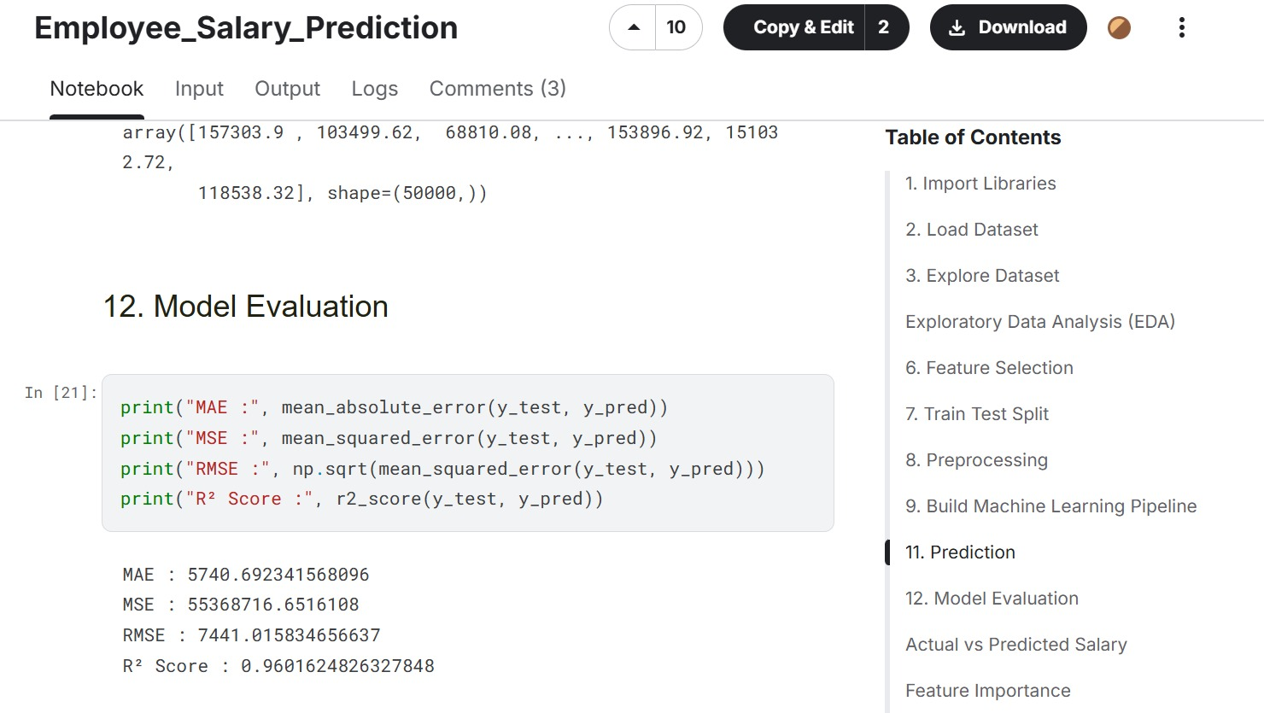
Salary Prediction: Our Model vs. Project 1
Performance Metric | Original Project 1 | Our Project (XGBoost)
Mean Absolute Error | 5,740.69 | 4,136.87
Mean Squared Error | 55.37 Million | 26.88 Million
R² Score Precision | 96.02% | 98.07%

Slide 12
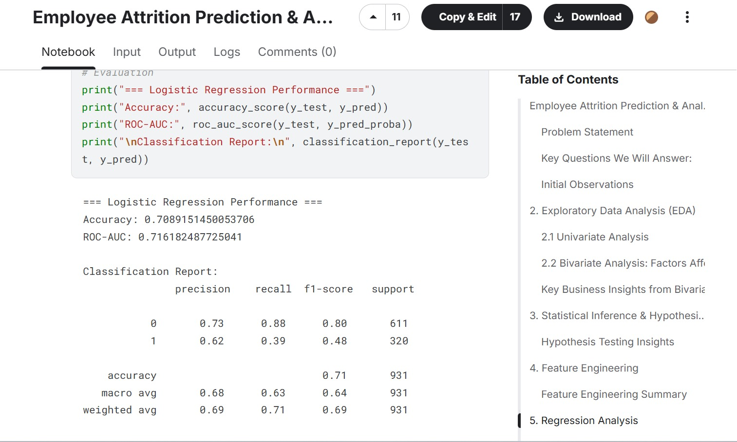
Attrition Classification: Our Ensemble vs. Project 2
Evaluation Metric | Original Project 2 | Our Project (Ensemble)
Model Accuracy | ~70.9% | 79.9%
Overfitting Risk | High | Low (Generalizable)
Class Balancing | None | SMOTE Applied
Recall & F1-Score | Sub-optimal | Robust

Slide 13
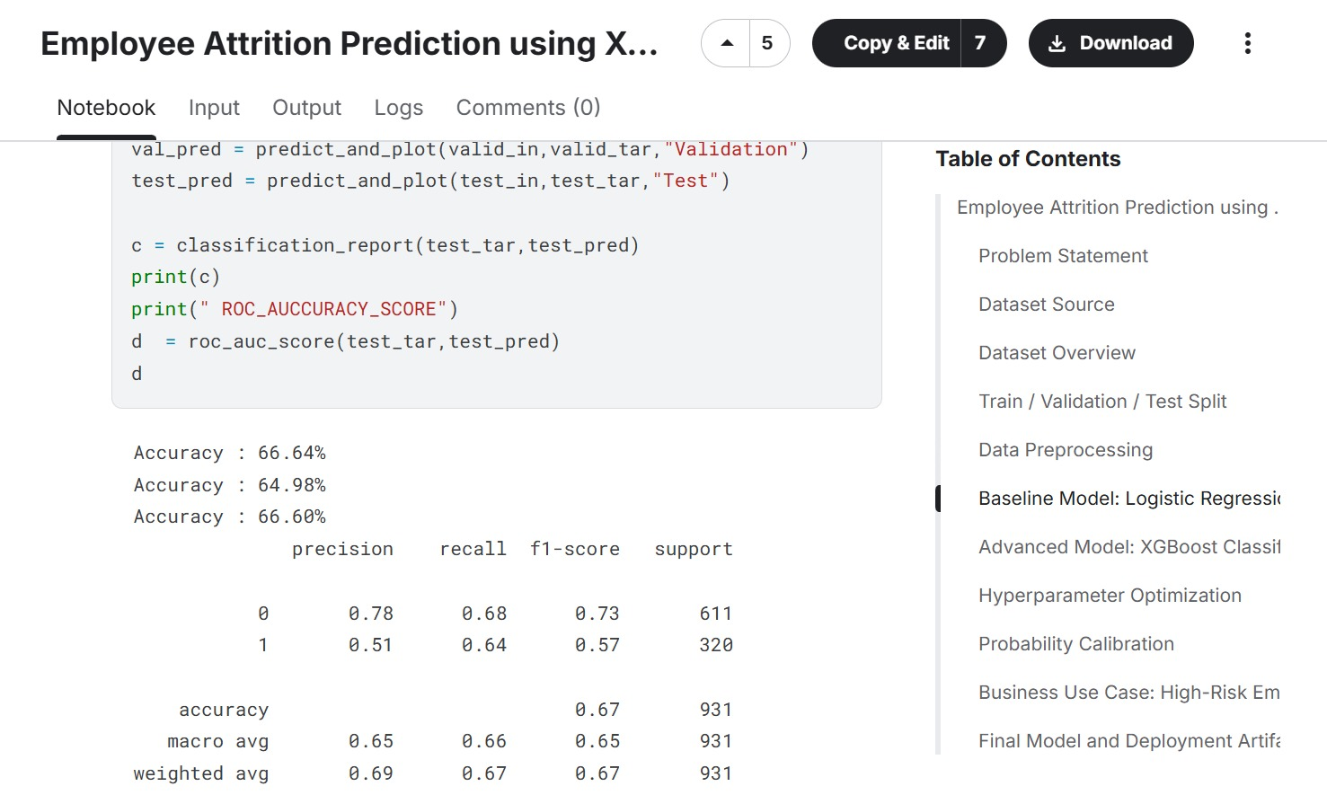
Attrition Classification: Tuned vs. Project 3
Evaluation Metric | Original Project 3 | Our Project (Tuned Ensemble)
Hyperparameters | Default | Grid Search Tuned
Preprocessing | Basic | StandardScaler + SMOTE
Architecture | Single XGBoost | RF + XGBoost Voting
Reliability | Moderate | High Reliability

Slide 14
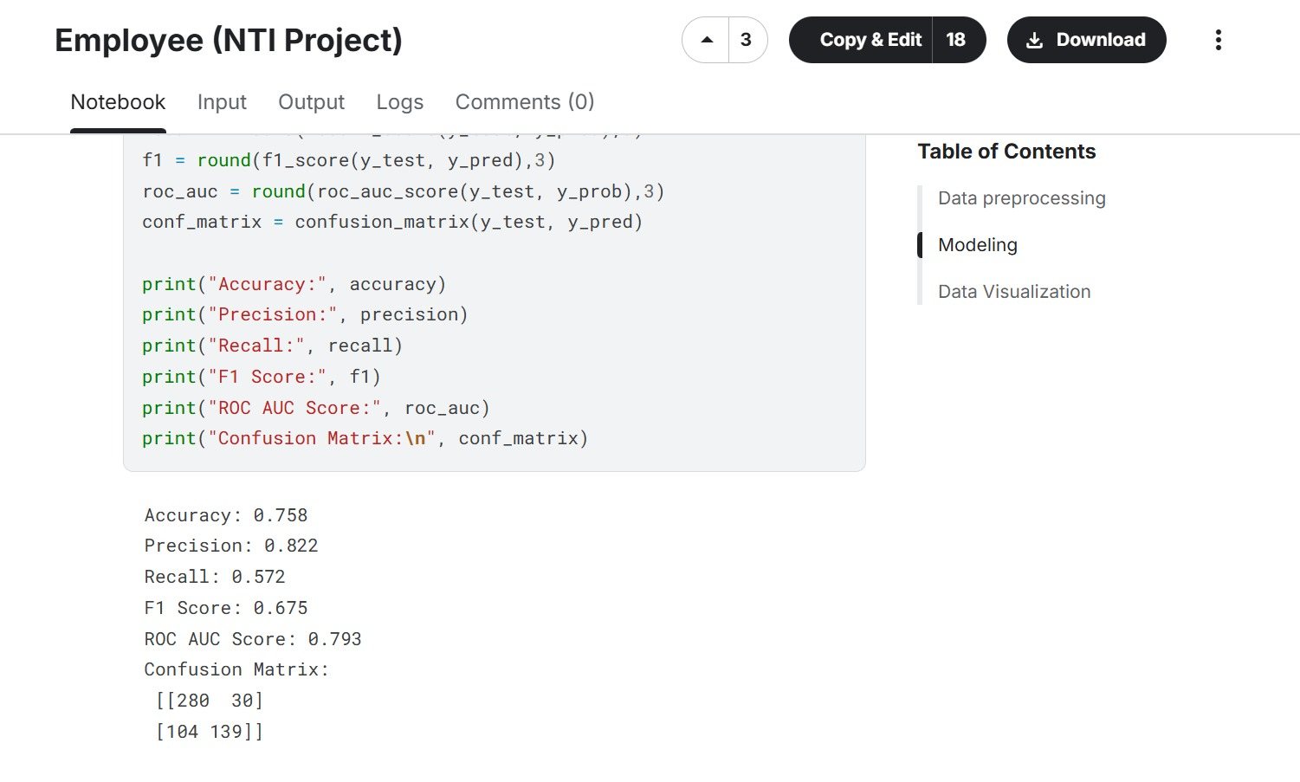
NTI Benchmark: Our System vs. Project 4
Evaluation Metric | Original Project 4 | Our Comprehensive System
Classification Accuracy | 75.8% | Optimized (79.9%)
Generalization | Overfitting | High Generalization
Balancing & Scaling | Basic | Advanced (SMOTE)
Functional Scope | Single Task | Dual Task (Salary & Attrition)

Slide 15
System Architecture & Technical Stack
The robust engineering pipeline powering our machine learning predictions.

Slide 16
Data Preprocessing & Feature Engineering
Feature Selection: Isolated high-impact variables (satisfaction scores, compensation, tenure, overtime) driving retention decisions.
StandardScaler Normalization: Scaled numerical attributes to zero mean and unit variance for stable gradient convergence.
SMOTE Sampling: Counteracted class imbalance by generating synthetic minority instances to prevent majority-class bias.

Slide 17
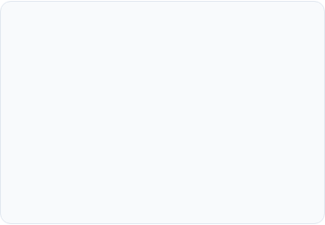
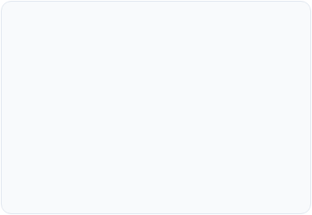
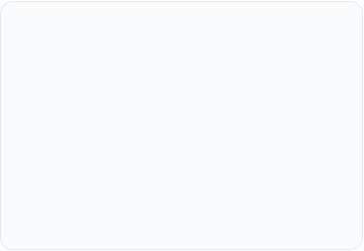



Machine Learning Modeling Pipeline
Random Forest
XGBoost Engine
Soft Voting Ensemble
Robust baseline classifier providing reliable feature importance metrics and bagging stability.
Advanced gradient boosting optimized via hyperparameter tuning for maximum predictive precision.
Combines probability outputs across models to guarantee top-tier classification reliability.

Slide 18


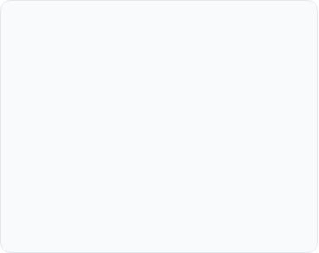



Feature Importance & Explainability
Compensation & Equity
Work-Life Balance
Tenure & Promotion
Overtime frequency and commuting distance serve as leading indicators of imminent burnout and resignation.
Time elapsed since last promotion heavily correlates with stagnation risk in technical and sales roles.
Identified salary percentile and stock options as primary mitigants against voluntary employee turnover.

Slide 19
Business Impact & Retention ROI
Maximizing Workforce Stability
35%
By catching flight risks early, human resources can allocate retention budgets efficiently, cutting recruitment overhead and preserving institutional knowledge across key company departments.
Turnover Cost Reduction

Slide 20
Project Summary & Key Takeaways
Dual Predictive Capability: Successfully integrated attrition classification and salary regression into a single robust workforce intelligence platform.
Superior Generalization: Leveraged SMOTE class balancing and Soft Voting Ensembles to achieve 79.9% accuracy and 70.2% XGB F1-score performance.
Actionable HR Insights: Empowers management with proactive retention strategies, competitive benchmarking, and data-driven decision making.

Slide 21
Questions?
Thank you for your attention and engagement.

