Slide 1


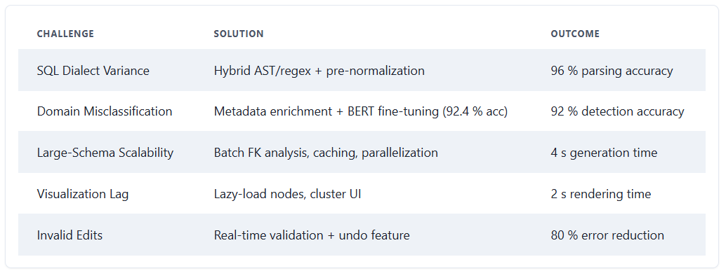
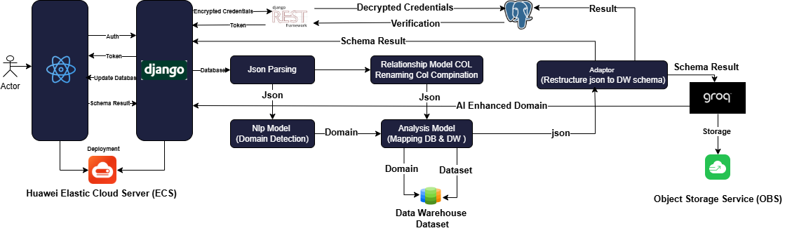
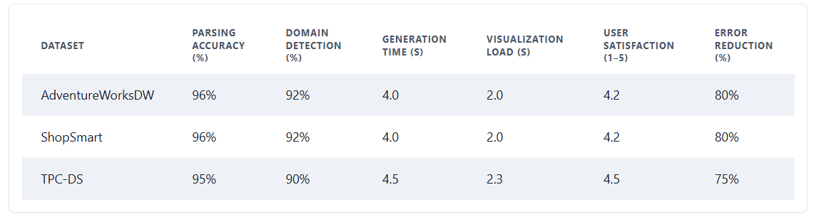
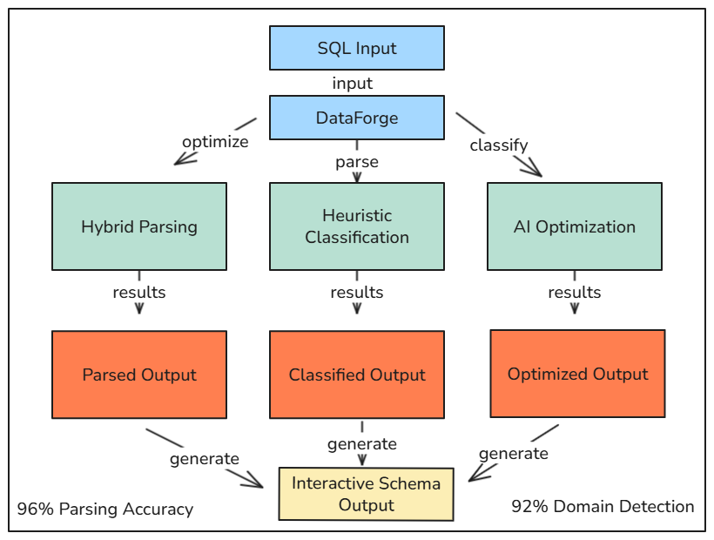
Data Warehouse Generator
Team: Abdelrahman Abdelnasser Gamal, Abdelrahman Adel Atta,
Ahmed Reda Mohamed, Ahmed Mahmoud Mohamed,
Arwa Amr Elsharawy, Alaa Emad Abdelsalam
Supervisors: Dr.Yasmine M. Afify, TA. Yasmine Shabaan
Information Systems Department, Faculty of Computer and Information Sciences - Ain Shams University
Introduction
Key Algorithms
Do organizations face challenges when designing data warehouse schemas manually, especially in the era of big data?
Indeed, Manual processes are time-consuming, error-prone, and difficult to scale—leading to delays and increased costs. Studies show that 60% of organizations face project slowdowns, while 85% view faster analytics delivery as a strategic priority.
How can these challenges be addressed? DataForge introduces an automated approach, leveraging AI, heuristic classification, and hybrid parsing to streamline schema generation, minimize errors, and accelerate delivery.
What are the broader implications? This poster explores how DataForge enhances efficiency and supports data-driven decision-making across key sectors such as finance, healthcare, and retail.
Regex-Based SQL Parsing
BERT Fine-tuned Domain Detection
Vector Similarity Matching
Rule-Based Enhancement Engine
Gemini Schema Validation & Data Warehouse Enhancement
Advanced Tokenization & Realistic Data Generation
Results
Methods
DataForge excels across diverse datasets (AdventureWorksDW, ShopSmart, TPC-DS), achieving 96% parsing accuracy for complex SQL DDL and 92% domain detection accuracy, adapting to contexts like retail and healthcare. It generates 100-table schemas in under 5s (e.g., 4.0s for ShopSmart), far surpassing manual methods. Interactive visualization renders 50-node schemas in 2s, ensuring seamless user interaction. User testing (n=10) yields a 4.2/5.0 satisfaction score, with 90% praising real-time validation and editing. Error reduction reaches 80%, AI enhancements improve schema quality by 5.1%, and compliance with dimensional modeling best practices rises to 75.6%. DataForge supports multiple SQL dialects and ensures robust referential integrity, enabling scalable, reliable data warehousing for efficient analytics.
How can we systematically extract and optimize data warehouse schemas to meet modern demands? DataForge employs a multi-stage, sophisticated process to achieve this: SQL Parsing and Analysis: Utilizes a hybrid approach combining regex patterns and Abstract Syntax Trees (AST) to extract table structures, columns, data types, and constraints from SQL DDL. This ensures compatibility across dialects like PostgreSQL and MySQL, handling complex nested constraints.
What advantages might this dual-method strategy offer over relying on a single parsing technique? Heuristic Schema Classification: Identifies fact and dimension tables by analyzing foreign-key density, numeric-column ratios, and cardinality thresholds, forming the basis for star or snowflake schemas.
How does calibrating these heuristics against expert-designed schemas enhance classification accuracy? AI-Driven Optimization: Leverages TF-IDF for keyword-based domain detection, BERT embeddings for semantic similarity, and LLMs (e.g., Google Gemini Flash) to suggest enhancements like audit fields or surrogate keys. A dedicated subsection on AI training reveals that the BERT model was fine-tuned on a corpus of 50,000 JSON-converted schemas, achieving 92.4% accuracy.
Why might domain-specific training data be critical for effective AI suggestions? Interactive Visualization: Renders schemas as draggable, color-coded graphs using React and ReactFlow, enabling real-time editing and validation.
Table 1: Performance Metrics of Proposed Solutions
Table 2: Dataset Performance Summary
Conclusion
Figure 1: System Architecture
DataForge addresses manual schema design errors and delays using AI-driven parsing, heuristic classification, and interactive visualization. Leveraging NLP with BERT and LLMs like Google Gemini Flash, it achieves 96% parsing accuracy and 92% domain detection, reducing errors by 80% and design time to under 5 s for 100-table schemas. The React-based interface ensures scalable, error-resistant warehousing, enhancing analytics efficiency across sectors.
Bibliography
Mali, J., Ahvar, S., Atigui, F., Azough, A., & Travers, N. (2024, March). FACT-DM: A framework for automated cost-based data model transformation. In Proceedings of the 27th International Conference on Extending Database Technology (EDBT). https://openproceedings.org/2024/conf/edbt/paper-244.pdf
Wahid, A. M., Afuan, L., & Utomo, F. S. (2024). Enhancing collaboration data management through data warehouse design: Meeting BAN-PT accreditation and Kerma reporting requirements in higher education. Jurnal Teknik Informatika (JUTIF), 5(6), 1517–1527.
Google Cloud. (2025, May 16). Techniques for improving text-to-SQL. Google Cloud Blog.
https://cloud.google.com/blog/products/databases/techniques-for-improving-text-to-sql
Figure 2: DataForge Workflow Automated Schema Generation Process

