Slide 1

DataForge
Automated Data Warehouse Schema Generatorwith AI-Driven Enhancements
Faculty of Computer and Information Sciences - Ain Shams University
(Information Systems Department)

Slide 2
Our Team
Abdelrahman Abdelnasser Gamal Mohamed
Abdelrahman Adel Atta Mohamed
Ahmed Reda
Ahmed Mahmoud
Arwa Elsharawy
Alaa Emad
Under Supervision of:
Dr. Yasmine Afify
TA. Yasmine Shabaan

Slide 3
Table of Contents
Introduction
Problem Definition
Objective
Related Works
System Architecture
Functional Requirements
Use Case Diagram
Software & Hardware Tools
Time Plan
References
Conclusion

Slide 4
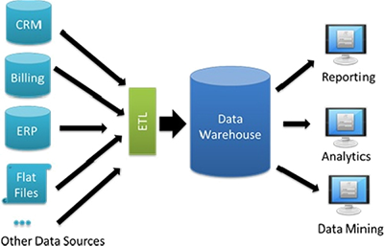
Data Warehouse
A data warehouse is a centralized repository that stores large volumes of data from multiple sources, enabling efficient analysis and reporting.
Key Features:
Integration: Combines data from various operational systems (e.g., sales, marketing, finance) into a unified format.
Historical Data Storage: Maintains historical records, allowing for trend analysis over time.
Optimized for Querying: Designed to handle complex queries and large-scale data analysis quickly.

Slide 5
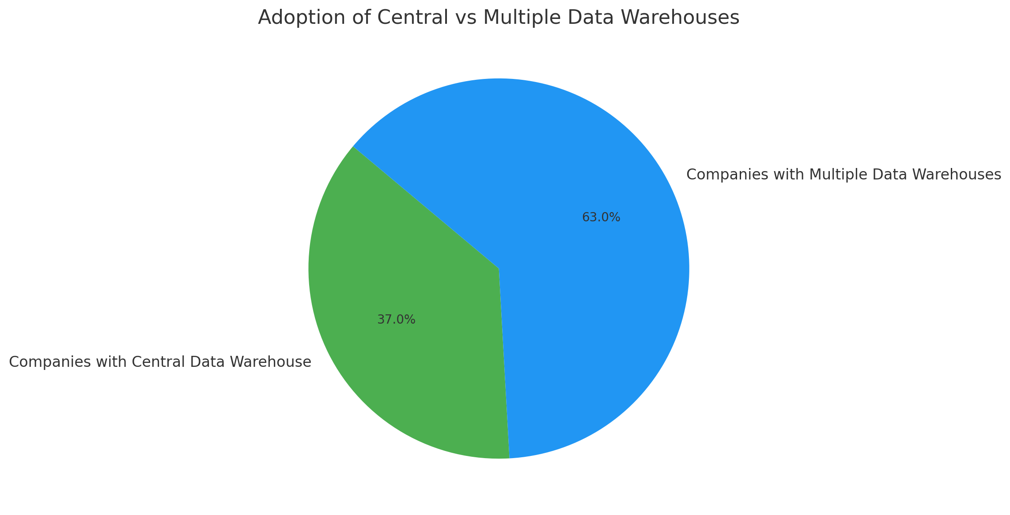
The Growing Importance of Data Warehousing
Data-Driven Decision Making:
In today’s business landscape, data warehouses are essential for consolidating and analyzing vast amounts of information from diverse sources.
Current Adoption Rates:
37% of companies have a central data warehouse.
A significant 63% of organizations utilize multiple data warehouses, highlighting the complexity of data management needs.
Economic Impact of Data Quality:
Poor data quality costs the U.S. economy $3.1 trillion annually.
Companies lose between $9.7 billion and $14.2 billion each year due to insufficient data quality, affecting customer relationships and profitability.

Slide 6
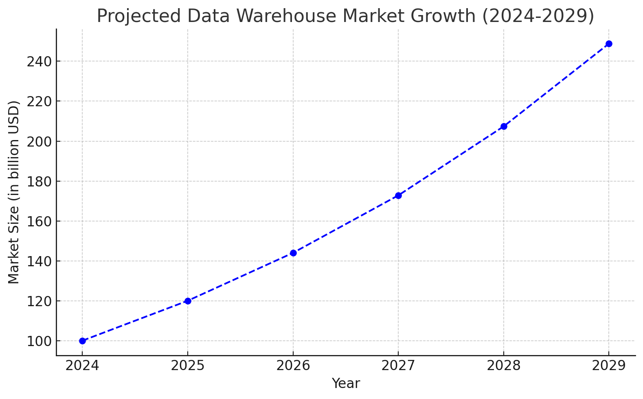
Challenges and Market Growth in Data Warehousing
Implementation Challenges:
Duration:
Data warehouse implementation typically takes 6-9 months.
Cost: Initial implementation costs start at around $70,000, with larger projects ranging up to $485,000.
Investment Trends:
Market Growth:
The data warehouse market is projected to grow by 20% annually over the next five years.
Expected market size increase of $14.56 billion by 2029.

Slide 7
Time-Consuming Process: Manually parsing SQL files and designing schemas can be labour-intensive, delaying data integration projects.
Human Error: Mistakes in identifying relationships or defining keys can lead to inefficient queries and unreliable data insights.
Problem Definition
Designing data warehouse schemas involves identifying and organizing fact and dimension tables, defining primary and foreign keys, and ensuring consistency across various data sources. Manual schema generation poses several challenges:
Scalability Issues: As data volumes and complexity increase, maintaining and updating schemas manually becomes impractical.
Time-Consuming Process
Human Error
Scalability Issues
Lack of Optimization
Limited Flexibility
Lack of Optimization: Without automated tools, optimizing schemas for performance and scalability is challenging, potentially leading to suboptimal data structures.
Limited Flexibility: Manual processes may not easily accommodate dynamic changes, or specific customization needs from different business domains.

Slide 8
Objective
The primary objective of the DataForge project is to develop an automated tool that streamlines the creation of data warehouse schemas. Specifically, the project aims to:
1. Automate Schema Parsing
3. Generate Fact & Dimension Tables
5. Enable User Customization
Efficiently parse SQL files to extract table definitions, columns, and relationships.
Automatically identify and create fact tables.
Allow users to edit and modify the generated schemas post-generation to accommodate specific business needs and preferences.
2. Ensure Scalability and Accuracy
4. Enhance Schemas with AI
6. Provide Interactive Visualization
Handle large and complex databases while maintaining high accuracy in schema generation and optimization.
Utilize AI services to detect domains, missing tables or columns, and generate enhanced schemas.
Offer a user-friendly interface that visualizes the schemas, allowing users to interact with the schema structure.

Slide 9
Related Works
Several tools and frameworks exist for data warehouse schema design and automation
01
A comprehensive data integration platform that offers tools for ETL (Extract, Transform, Load) processes, including schema mapping and data transformation.
02
An enterprise data integration solution that provides features for data profiling, mapping, and transformation, aiding in schema design.
Talend Data Integration
Informatica PowerCenter
03
A platform for building enterprise-level data integration and transformation solutions, including schema generation tools.
MODERN INFOGRAPHIC
Microsoft SQL Server Integration Services (SSIS)
ER/Studio
04
A data modelling tool that supports the design and visualization of complex data warehouse schemas, offering features like reverse engineering from existing databases.
DBT (Data Build Tool)
05
A command-line tool that enables data analysts and engineers to transform data in their warehouse more effectively by managing data models and transformations.

Slide 10
Related Works
Fast Comparison
Some Existing Tools Features
ETL processes, schema mapping.
AI-driven enhancements.
Data profiling, mapping, transformation.
Data
Forge
Existing Tools
Interactive visualization tailored for automated schema generation.
Data integration and transformation solutions.
User-driven customization capabilities.
Data modeling and visualization, reverse engineering.

Slide 11
System Architecture
Components
Data Flow
Modular Design
Frontend:
SchemaGraph.jsx: interactive schema graphs.
SchemaResult.jsx: results after schema generation.
SchemaEditor.jsx: Allows users to edit generated schemas.
Upload: Users upload SQL database files through the frontend interface.
Parsing & Generation: Backend processes uploaded SQL files, parses the schemas, and generates the results.
AI Enhancements: AI services analyze and optimize the generated schemas, providing suggestions for improvements or missing elements.
Storage: Generated schemas and AI suggestions are stored in a database or external storage (Amazon S3) for future retrieval.
Visualization & Editing: The frontend visualizes schemas through interactive graphs and allows users to edit or customize the generated schemas.
Frontend:
React-based interactive user interface with components for schema visualization and editing.
Backend:
Models: Represent schema data and user inputs.
Views: Handle API requests for schema uploads, processing, and returning results.
Serializers: Convert data between JSON and database.
Utilities: Handle parsing, schema generation, and domain detection.
AI Services: Utilize AI for schema enhancements and suggestions (Gemini API).
Backend:
Django powered by Django REST Framework (DRF) for handling requests, parsing, and schema generation.

Slide 12
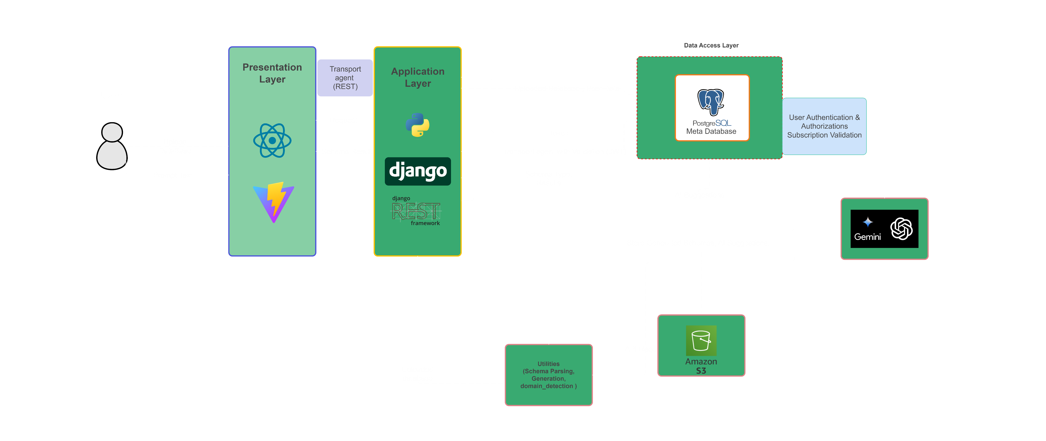
System Architecture
Diagram

Slide 13
Functional Requirements
01 User Authentication
02 Schema Upload & Parsing
03 Schema Generation & Visualization
Account creation, login, secure session management.
Extract tables, columns, data types, keys, and Extract tables, columns, data types, keys.
Categorize tables, define primary and foreign keys and Interactive graphs distinguishing fact and dimension tables.
04 AI-Driven Enhance& Prompt
05 Schema Editing & Error Handling
06 Responsive Design & Performance
Request additional AI suggestions or optimizations & Domain detection, suggest missing elements, optimize schemas.
Modify generated schemas: add/remove/alter tables and columns, Meaningful error messages and feedback.
Accessible across devices and screen sizes and Efficient handling of large and complex schemas.
07 Accuracy & Efficiency
Continuously track schema generation accuracy and optimize performance through real-time feedback and AI corrections.

Slide 14
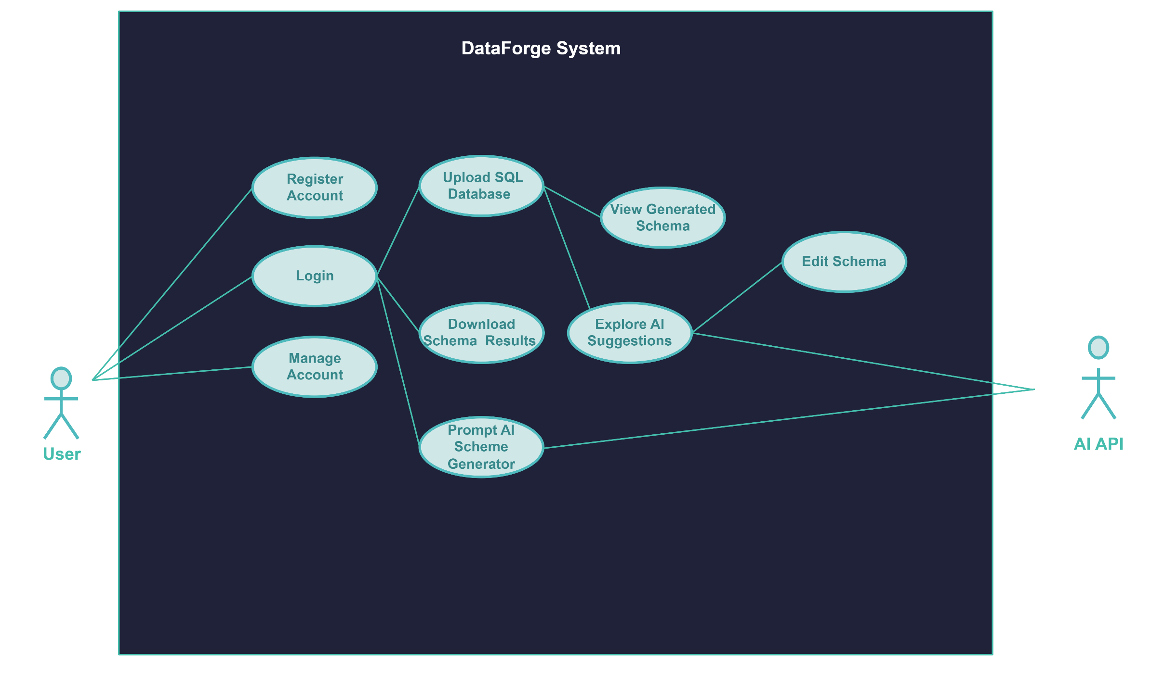
Use Case Diagram
Actors:
User
AI API (Gemini)
Use Cases:
Register Account
Login
Upload SQL Schema
View Generated Schema
Explore AI Suggestions
Edit Schema
Prompt AI for Enhancements
Download Schema Report
Manage Account

Slide 15
Software & Hardware Tools
Software Tools
Hardware Tools
Frontend:
React, ReactFlow, Framer Motion, Axios, Tailwind CSS
Backend:
Django, Django REST Framework (DRF), Python 3.12
Database:
PostgreSQL
AI Services:
OpenAI API , Gemini API
Development Tools:
Visual Studio Code, Git, Postman
Deployment:
Docker, AWS
Development Machines:
PersonalComputers with sufficient processing power.
Servers:
Cloud Servers (AWS EC2)
Storage:
Cloud Storage Services (AWS S3)

Slide 16
Timeline Section
Weeks | Phase | Tasks
1-2 | Project Planning & Requirement Analysis | Define scope, gather requirements, design system architecture, select tools.
3-4 | Backend Development - Parsing & Generation | Implement SQL parsing, develop schema generation logic, set up Django models and APIs.
5-6 | AI Integration & Enhancements | Integrate AI services, develop suggestions for missing elements, incorporate AI into schema.
7-8 | Frontend Development - Visualization & Editing | Develop React components, implement ReactFlow for visualization, integrate SchemaEditor.jsx.
9 | Testing & Quality Assurance | Unit testing, frontend testing, implement error handling, validate data integrity.
10 | Deployment & Documentation | Containerize with Docker, deploy to cloud, prepare comprehensive documentation.
11 | User Feedback & Iteration | Conduct user testing, gather feedback, address issues, optimize performance.
12 | Final Review & Presentation Preparation | Finalize components, prepare presentation materials, conduct final review.
1-2 Weeks
3-4 Weeks
5-6 Weeks
7-8 Weeks
9 Weeks
10 Weeks
11-12 Weeks
Project Planning & Requirement Analysis
Backend Development
AI Integration & Enhancements
Frontend Development
Testing & Quality Assurance
User Feedback & Iteration
User Feedback & Final Review

Slide 17
Conclusion
Summary
Benefits
DataForge automates and optimizes data warehouse schema generation.
Combines backend processing, AI enhancements, and interactive frontend visualization.
Empowers users with customization capabilities for tailored schema designs.
Reduces manual effort and errors.
Enhances scalability and performance of data warehouses.
Provides AI-driven insights and optimizations.

Slide 18
References
G2.com. (2024). Data warehouse statistics. G2. https://www.g2.com/articles/data-warehouse-statistics
ExistBI.com. (2023). Key statistics on data warehousing. ExistBI. https://www.existbi.com/blog/key-statistics-data-warehouse/
TrustRadius.com. (2022). Data warehouse statistics. TrustRadius. https://solutions.trustradius.com/buyer-blog/data-warehouse-statistics/
Data-Vault.com. (n.d.). Data warehouse market size. Data-Vault. https://data-vault.com/data-warehouse-market-size/
CIO.com. (2024). The 15 most in-demand tech jobs for 2024. CIO. https://www.cio.com/article/230935/hiring-the-most-in-demand-tech-jobs-for-2021.html
Hays.ca. (2024). Top 10 in-demand tech jobs 2024. Hays.ca. https://www.hays.ca/career-advice/article/top-10-in-demand-tech-jobs-2024

Slide 19
Thanks

