Slide 1
DATA ANALYSIS AND BASELINE MODELS
Detecting Manufacturing Defects
Unsupervised anomaly detection on the MVTec AD dataset
5,354 images · 15 product categories · 73 defect types · 1,258 pixel-level masks

Slide 2
What this presentation covers
The problem
A factory needs to catch defective parts automatically. Defects are rare, varied, and mostly unseen when the system is built.
The data
MVTec AD: 15 product categories shot under controlled conditions, with a pixel-accurate mask for every defect in the test set.
What the data allows
Six design decisions, each forced by a specific measurement rather than by habit.
Two baselines
A convolutional autoencoder trained from scratch, and PaDiM on frozen pretrained features. One works far better, and the EDA explains why.

Slide 3
The dataset at a glance
Measured from the images, not quoted from the paper
5,354
15
73
1,258
images total
categories (5 textures, 10 objects)
distinct defect types
pixel-level defect masks
Training images
3,629
all defect-free — no anomalies at all
Test images
1,725
467 normal, 1,258 anomalous (72.9%)
Median defect size
1.54%
of the image; 39.7% of defects cover under 1%
Resolutions
6
from 700x700 to 1024x1024; 3 categories are single-channel

Slide 4
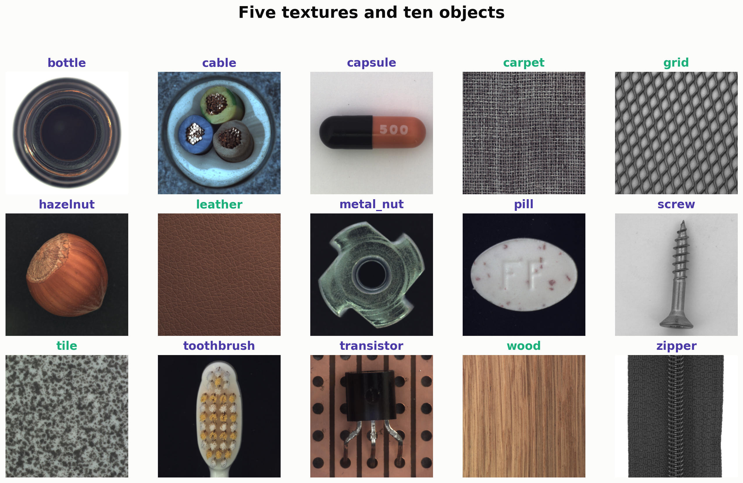
Fifteen categories, two visual regimes
Five textures and ten centred objects
Textures repeat across the whole frame; objects sit in a fixed pose. The two behave differently under augmentation, so they are handled separately.

Slide 5
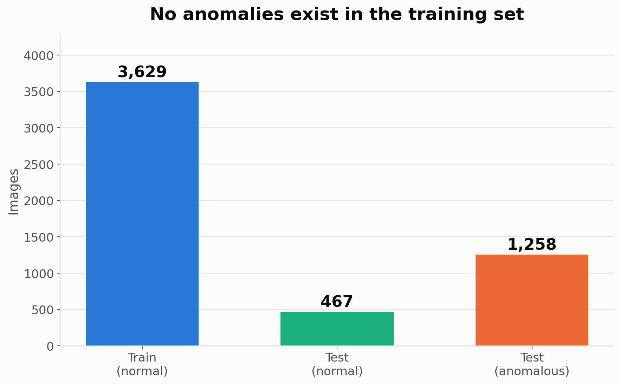
The training set contains no defects at all
This single fact decides the entire modelling approach
With 0 anomalies among 3,629 training images, a supervised classifier cannot be fitted. The task is one-class: learn 'normal', then measure deviation.

Slide 6
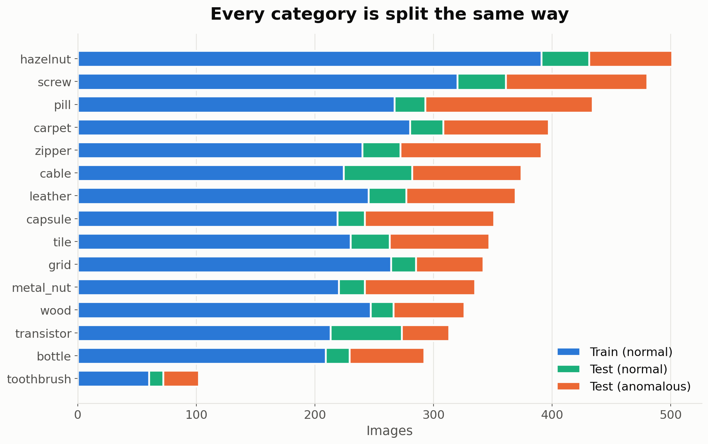
The same one-class split in every category
Train is always defect-free; anomalies appear only at test time
Category size ranges from toothbrush (60 training images) to hazelnut (391). Small categories give the least stable scores.

Slide 7
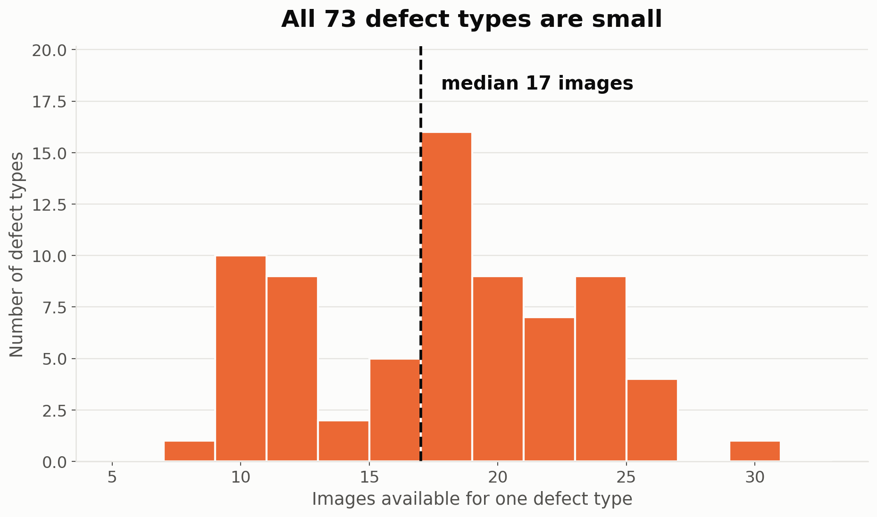
Defects are many, and each one is rare
73 category-specific defect types across the test split
The median defect type has only 17 images (minimum 8). Learning one class per defect is not viable — the model must flag anything unlike normal.

Slide 8
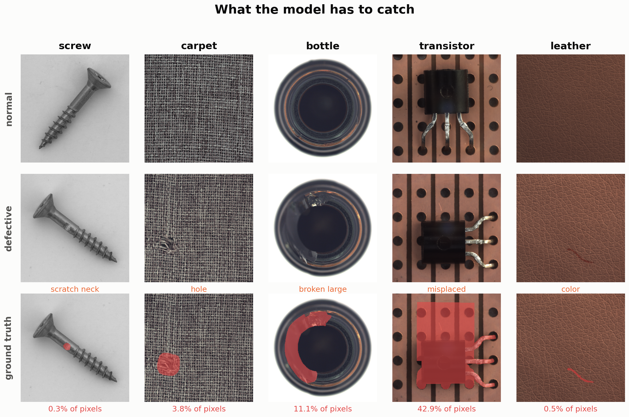
What the model has to catch
Ground-truth masks mark every defective pixel
Defects range from a barely visible scratch on a screw to a completely misplaced transistor. The same detector has to cover both extremes.

Slide 9
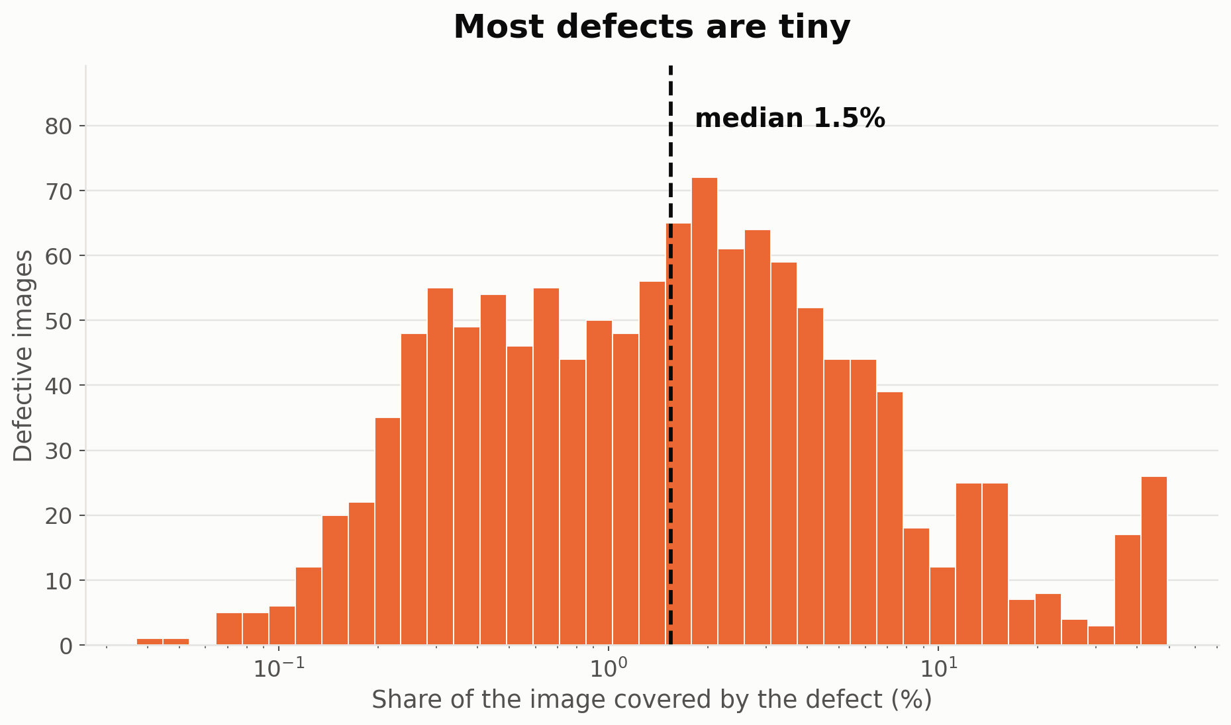
Most defects are very small
Measured directly from the 1,258 ground-truth masks
Median defect covers 1.54% of its image and 39.7% cover under 1%. Resizing to 224x224 would shrink a typical small defect to a handful of pixels.

Slide 10
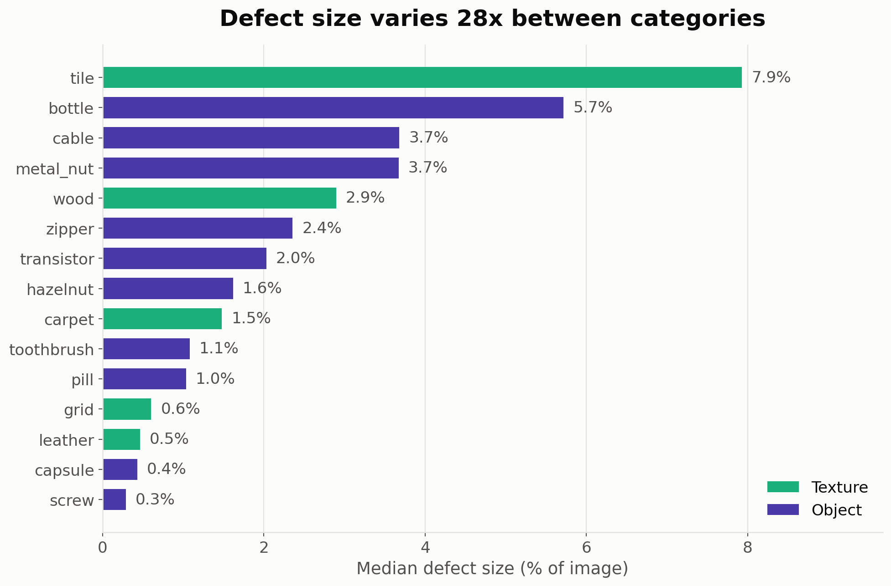
Defect size varies hugely between categories
From 0.037% to 49.3% of the image
Screw and capsule defects are an order of magnitude smaller than tile or bottle defects, so one detection threshold across categories would not work.

Slide 11
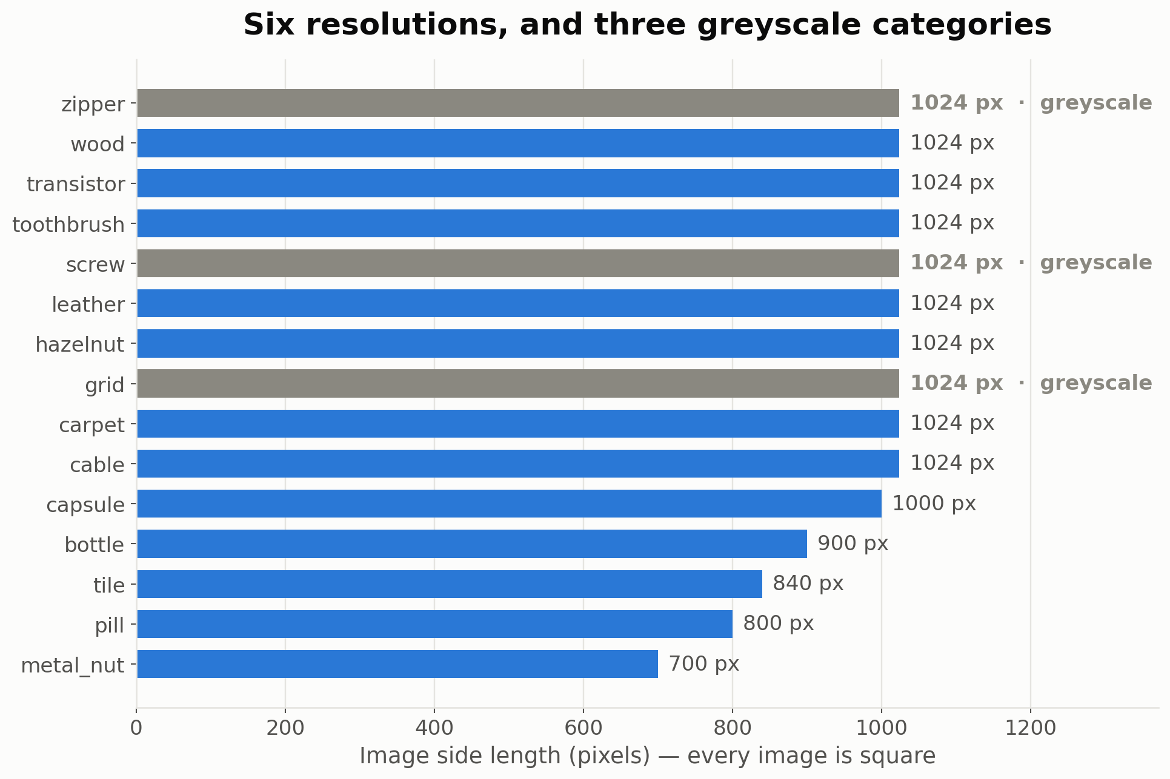
Images are high-resolution but not uniform
6 distinct resolutions; all images square
1,213 images in grid, screw, zipper are stored single-channel and must be expanded to three before a pretrained backbone will accept them.

Slide 12
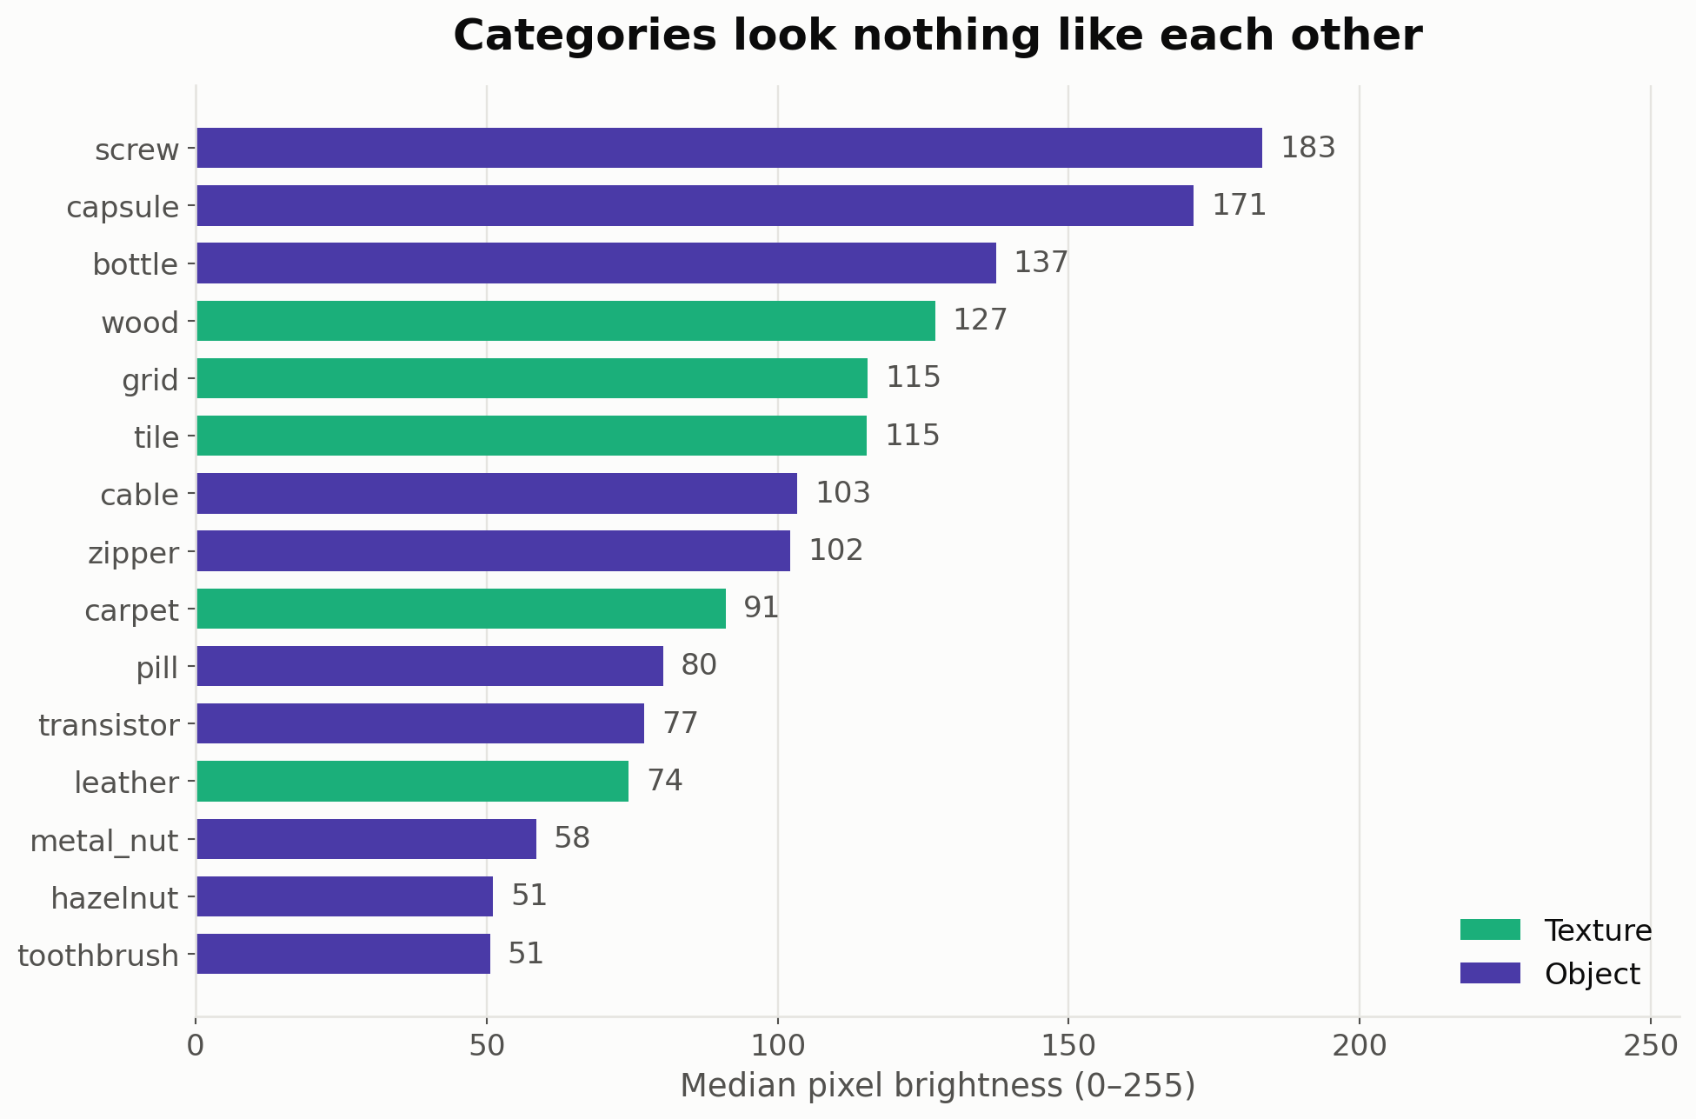
Categories look nothing like each other
Median brightness, measured per category
Brightness spans roughly 48 to 185 on a 0-255 scale. One global normalisation would leave several categories badly off-centre.

Slide 13
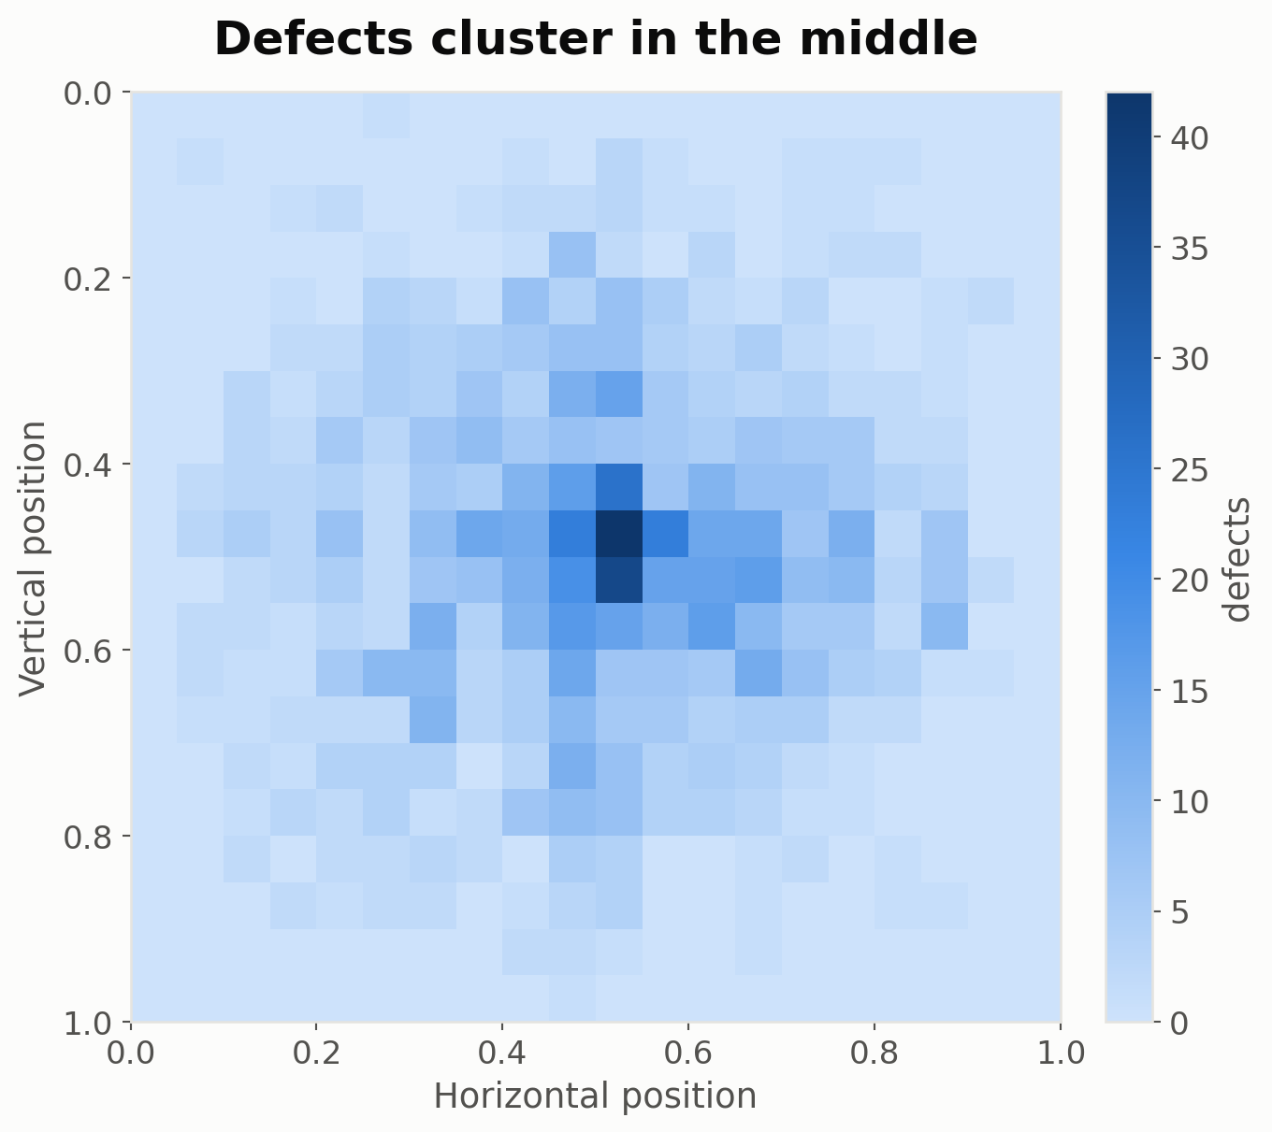
Defects sit near the image centre
A property of how the dataset was photographed, not of defects in general
48% of defects fall within 0.2 of the centre. A real production line would not centre defects, so this bias must not be learned — no centre-cropping.

Slide 14
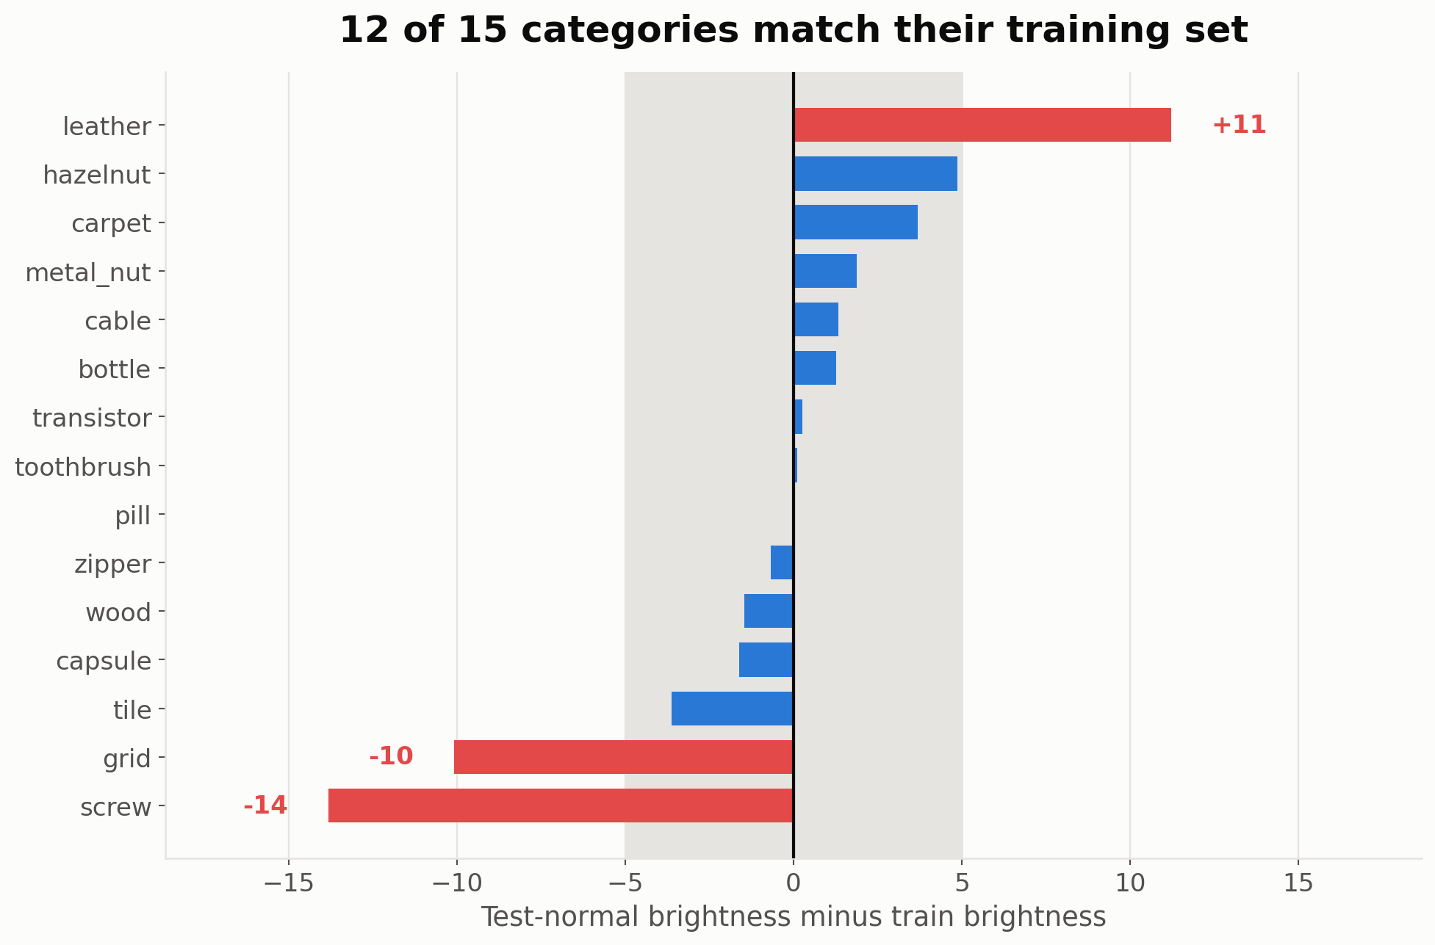
Test normals match the training distribution
Checked rather than assumed — a one-class model depends on it
12 of 15 categories agree within ±5 intensity levels. screw, grid and leather drift up to 13.8, so normalisation statistics are computed per category.

Slide 15
Six findings, six design decisions
Each decision traces back to a measurement in this deck
WHAT THE DATA SHOWS
WHAT IT FORCES US TO DO
0 anomalies in 3,629 training images
One-class method — a supervised classifier is impossible
73 defect types, median 17 images each
Detect deviation from normal, do not model defect classes
72.9% of the test split is anomalous
Report AUROC — accuracy is misleading at this base rate
Median defect covers 1.54% of the image
Keep resolution high; score per patch, not per image
6 resolutions, 3 single-channel categories
Loader resizes consistently and expands channels
Brightness spans 48-185; 3 categories drift
One model and one normalisation per category

