Slide 1
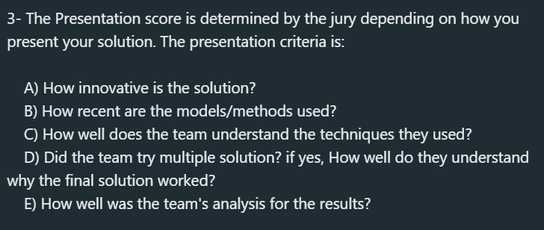

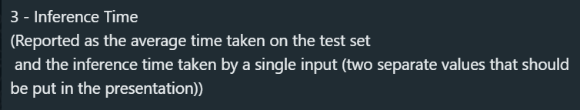
Code: multiple approaches examined and tested
Using Segmentation Models // UNet + ResNet34 // IOU ~ 0.52
Using Segmentation Models // UNet + ResNext50 // IOU ~ 0.48
Using Segmentation Models // PSPNet + ResNext50 // IOU ~ 0.47
Using Segmentation Models // UNet + EfficientNetB0 // IOU ~ 0.61
Using SegFormer ~ Segmentation Transformer
Evaluate: evaluation metrics for results
Optimizer = Adam optimizer
Loss = Dice loss
Metrics = IOU ~ Intersection Over Union
Iterate: do it all over again
Multiple approaches examined and tested
Segmentation approaches:
- Segmentation Models // UNet + ResNet34 // IOU ~ 0.52
- Segmentation Models // UNet + ResNext50 // IOU ~ 0.48
- Segmentation Models // PSPNet + ResNext50 // IOU ~ 0.47
- Segmentation Models // UNet + EfficientNetB0 // IOU ~ 0.61
- SegFormer ~ Segmentation Transformer
Optimizers:
- Adam optimizer
- RMSprop optimizer
Learning rates:
- 0.001 = default value → best results
- 0.01 → noisy but good → takes almost as much time as default
- 0.1 → downright bad results → almost no convergence
Slides content
Who are we? → team members → BME senior students
Problem definition → multiclass segmentation
Why? → imaging segmentation (maybe we’re a little biased)
ML cycle : data → code → evaluate → iterate
Data: already provided
Img resize to (256, 256)
Read the data with encodings accordingly
Split provided data into train and test sets with an 80, 20 % split

Slide 2
ResNet34 > ResNext50
Less #Params → 21.5 M vs. 25.0 M → not much improvement in accuracy
EfficientNetB0 > ResNet34
Less #Params → 5.3 M vs. 21.5 M → faster training
Adam > RMSprop
Adam → used 1st and 2nd moment
RMSprop → uses 2nd moment
Learning rates: 0.001 > 0.01 > 0.1
0.001 → best results → default value for a reason
0.01 → noisy but good → takes almost as much time as default
0.1 → downright bad results → almost no convergence
Inference time
Single output = 35 s on average ( < 200 ms )
Whole test set =
Slides content
Innovative / Recent solution?
Architectures have been around for a while
Changing encoding block + hyperparameters approach
Depending on previous experience
Final results are good or bad based on one’s own perspective
(PDF) Exploration of Optimized Semantic Segmentation Architectures for edge-Deployment on Drones (researchgate.net)
UNet > PSPNet
Architecture is more optimized for segmentation tasks
UNet → specifically designed for MRI segmentation

