Slide 1


Android malware hybrid detection and categorization
Abdelrahman Amgad – 211685
Abdelrahman Muhammed – 213383
Supervisor: Dr Wael El Sersy

Slide 2

Content
1
Introduction
6
Proposed solution
2
Data sets
Background
7
2
8
conclusion
3
Motivation
2
4
9
References
Problem statement
5
Objectives
10

Slide 3
Introduction 1/2
Android recently became the most popular operating system in the world.
Malicious apps are a method of manipulating users into downloading an app to steal personal information
Most cybercriminals use this method nowadays and leads to ransomware and more

Slide 4
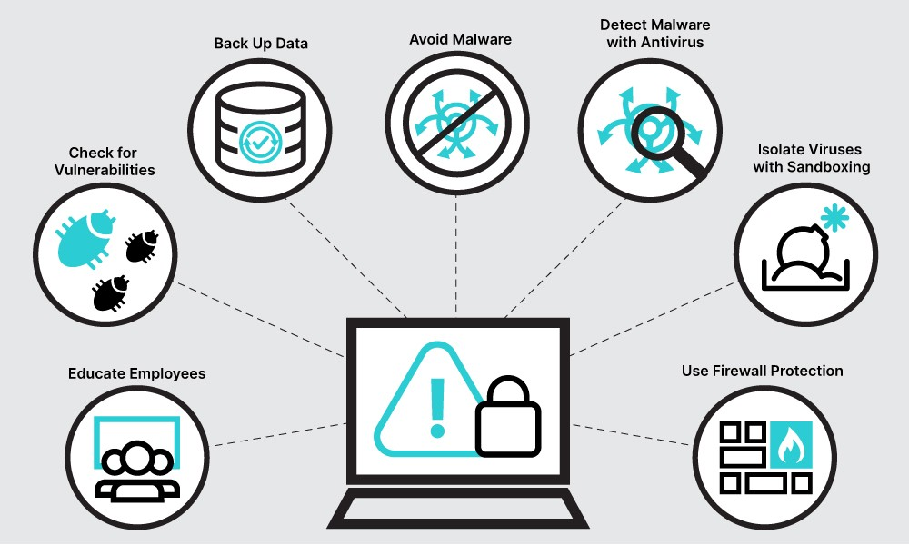
Introduction 2/2
Malicious attacks are continuous and need to keep track of the system
A framework for android malware detection and categorization.
By combining network traffic and program code using hybrid malware detection.
Analyze android malware based on behavior that involves use of permission.

Slide 5
Background
1
Traditional feature codes based method
Checks memory corruption and buffer overflow
2
Machine learning based method
static and dynamic techniques

Slide 6
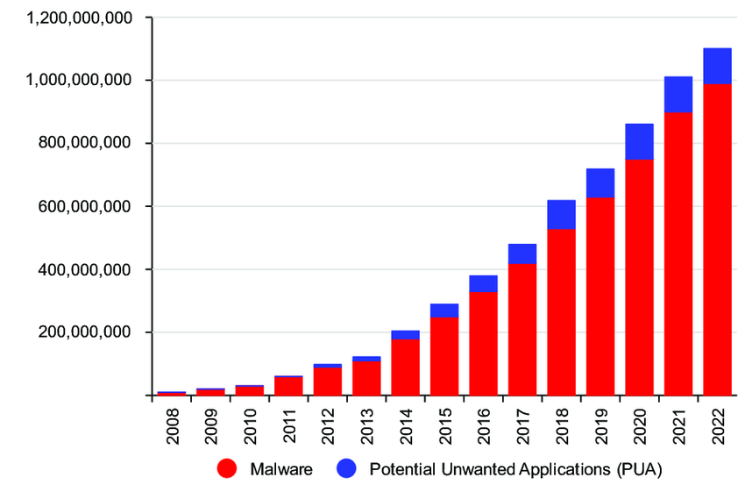
Motivation
The need for a hybrid approach that combine network traffic and program code features is emphasized.
Accurately detecting and categorizing malware families is mostly important.

Slide 7
Problem statements
Malware detection system encounters difficulties --> how relatively low in accuracy
Algorithm uses only static features, So the efficiency is based on these features alone. It does predict the malware with much accuracy when dynamic features are considered along with static features.
Lack of features when extracting APK files.
Problem with detecting and categorizing malware especially with the presence of obfuscation techniques

Slide 8
OBJECTIVE
1.
Build a high-performance neural network model for detecting Android malwares
2.
Build our dedicated dataset contains features of APK malwares.
3.
Build a website with capability of detecting and labeling Android malwares

Slide 9

Proposed Solution
Build a text-based model for android malware detection and categorization, then integrate into our system
Create a specific dataset for this context to address the problem

Slide 10
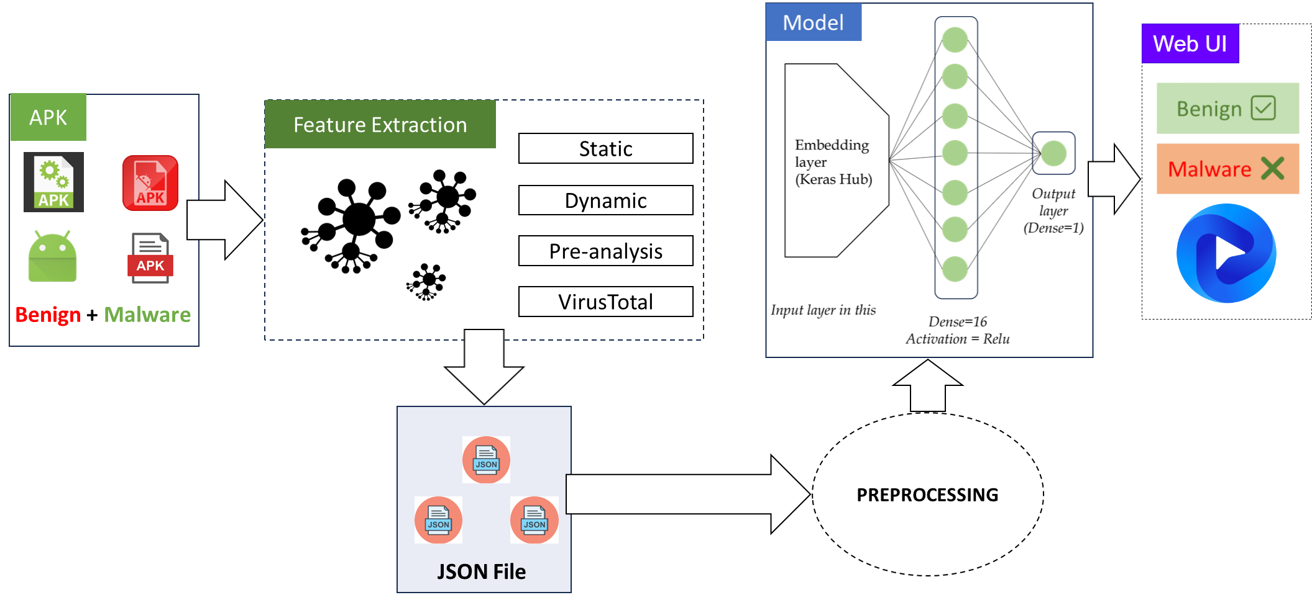
System Architecture
Figure 1 : Main processing flowchart

Slide 11
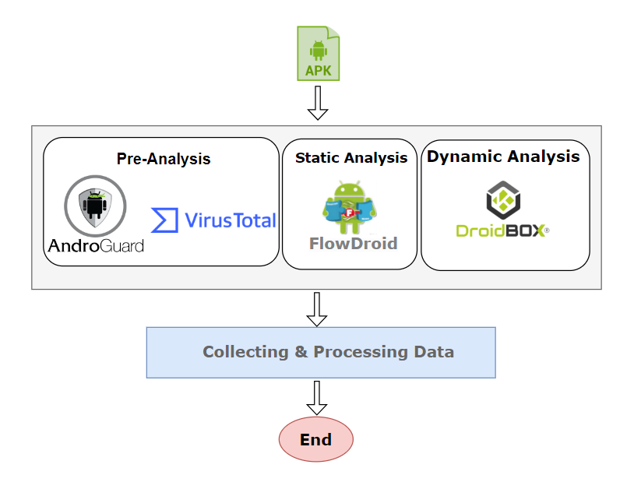
Feature Extraction
Objective – Check valid APKs, collect all features in 3 groups of analysis:
Pre-analysis
Static analysis
Dynamic analysis
Feature Extraction workflow

Slide 12
Feature Extraction
STATIC & DYNAMIC ANALYSIS
API calls | List of names of API has been called
Main activity | Name of main activity
Opcodes | List of executing Opcodes
Package name | List of package name defined or executed
Permissions | File’s all permission
Intent Receivers | File’s all receivers
Intent Services | File’s all services
Intent activities | All activities of files
Strings | All strings that file contains
System commands | All system commands that file executed or declared
FlowDroid | Path to FlowDroid’s features file
PRE-ANALYSIS & VIRUS TOTAL
Filename | Name of file
VT_positives | Number of antivirus show positive to malware
VT_engines | Number of using antivirus
AVClass | List of detailed labels of each antivirus
Md5 | File’s MD5 hash
Sha1 | File’s SHA1 hash
Sha256 | File’s SHA256 hash
Pre-analysis features
Dynamic and static features

Slide 13
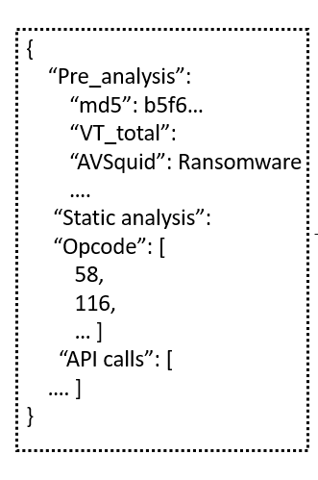
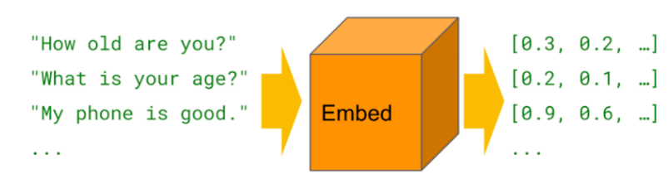
Pre-processing
Tokenize sentences
Filter redundant elements for our model
Remove unnecessary characters/strings: double quotes
Remove unnecessary key: hash function (MD5, SHA1, SHA256), filename, …
Apply word-embedding to transform sentences to vector
Our each of JSON document would be converted to 2-D vector

Slide 14
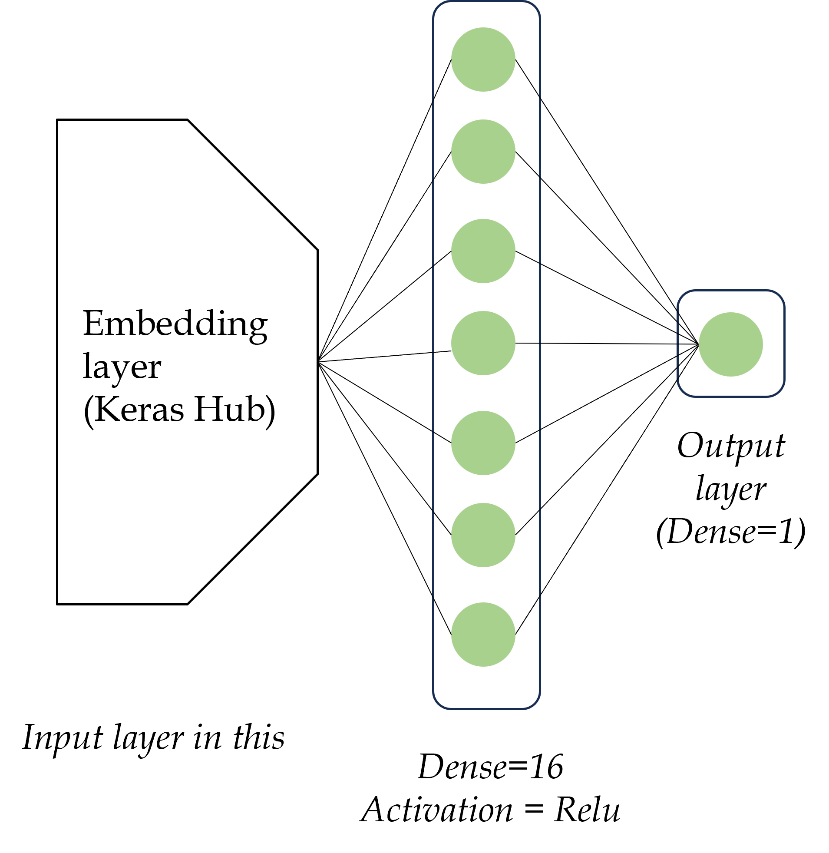
Detection model
Model
Our model contains 3 main layers:
An embedding layer to map word to vector
A dense with 16 units and using Relu as activation function
A dense with 1 units to output binary result for “Benign” or “Malware” labels
Our model

Slide 15
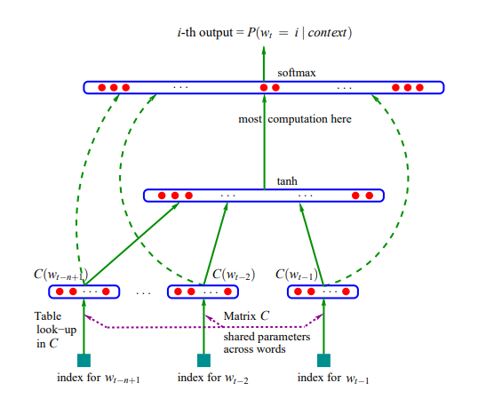
Embedding Layer
- Mapping layer C from word to vector
- Hyperbolic tangent layer
- Softmax layer
Word-embedding Layer
Notes:
learning a statistical model of the distribution of word sequences, rather than learning the role of words in a sentence

Slide 16

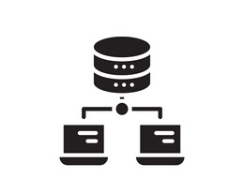
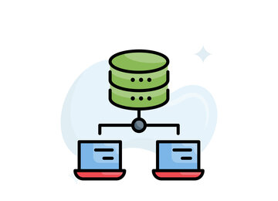

Our Android malware dataset
Feature Extraction
Static
Dynamic
Pre-analysis
Our dataset
VirusTotal
CIC 2020 Malware Collection

Slide 17
CICMaldroid dataset
Type | Number of samples
Risk ware | 2,546
Adware | 1,253
Banking | 2,100
Malware | 5,899
Benign | 1,795
Total | 7,694
Type | Number of samples
Risk ware | 2,370
Adware | 1,402
Banking | 2,096
Malware | 5,868 (59.7%)
Benign | 4,126 (41.3%)
Total | 9,994
CIC Dataset 2020 (APK)
Our dataset (JSON)
Features of dataset
Large, new, abundant, all-rounded from many malware types
Serve for numerous context, applicable for further research or used in machine learning training model

Slide 18


Conclusion
Summary
Deliver high-performance malware detection model
Research the applicability of NLP in android malware detection
Limitation
Not perform flexibility on various scenarios
It takes a lot of time to finish one apk detection
Dataset is not large enough
Future work
Research and apply more model to produce multi-class classification more accurately
Collect and gather more APK files from other public resources to build a large dataset

Slide 19
Thank You

