Slide 1
Meeting 1
Main parts of the project and project GitHub repositories

Slide 2
Main parts of the project
There are 7 parts in this project

Slide 3
1st part: Admin Module
Admin module will be implemented in Web.
Admin Could do the following: - Register Doctors\Hospital\Ambulance Users. - View all users reports.

Slide 4
2nd part: User Module
User module will be implemented in Web and Mobile.
User Could do the following: - Register\Login. - Edit profile\View Profile. - Show User Barcode. - Request an Ambulance. - View his medical History. - Make reports.

Slide 5
3rd part: Ambulance Module
Ambulance module will be implemented in Web.
Ambulance Could do the following: - Login. - Edit profile\View Profile. - View Users Requests and his\her medical details. - Make report.

Slide 6
4th part: Hospital Module
Hospital module will be implemented in Web.
Hospital Could do the following: - Login. - Edit profile\View Profile. - Add Visit/Scan user barcode. - Register users. - See insurance percentage. - Make report.

Slide 7
5th part: Doctor Module
Doctor module will be implemented in Web and Mobile.
Doctor Could do the following: - Login. - Edit profile\View Profile. - Add Visit medical prescription/Scan user barcode. - See user medical history. - Make report.

Slide 8
6th part: ANN Module
ANN module will be implemented in Desktop.
ANN do the following: - Identify the insurance percentage of the users who couldn’t pay for the service.

Slide 9
7th part: Database
This part should be negotiated from all team members because it’s the base of the project.
Recommended : - Google Firebase Because it’s online and we could access it from any where. - MySQL There is a web site which offers free database hosting but we will need a Web API to be made to connect the mobile apps to our database.

Slide 10
project GitHub repositories
What is GitHub? And how we will use it in our project?

Slide 11
What is GitHub?
GitHub is a Website that provides hosting for software development version control using Git.
What version control is used for? - Keeping track of the project history.(Every commit is a restore point, Tasks is registered with the person who made them) - Editing the project from any device. - Keeping the project files safe in a less storage space.

Slide 12
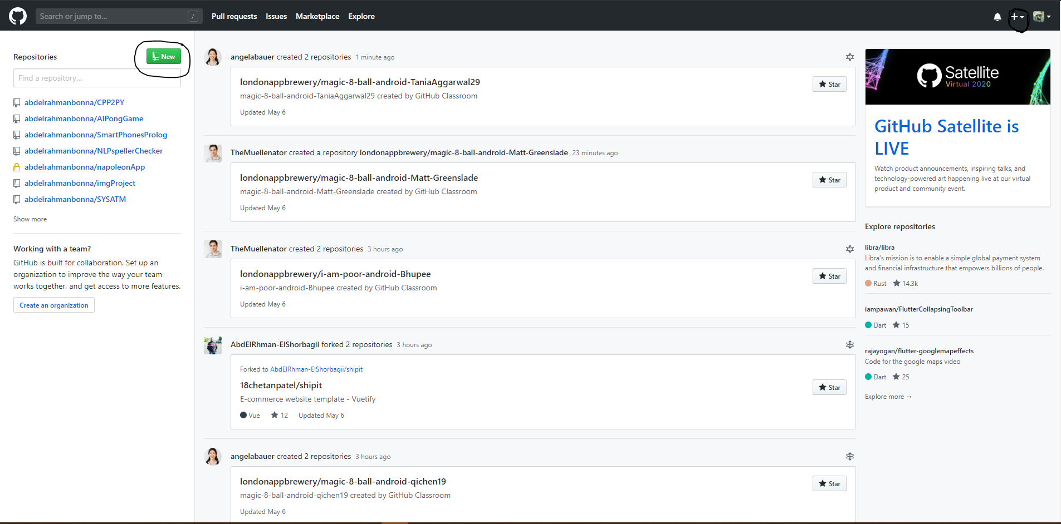
How to make a repository?

Slide 13
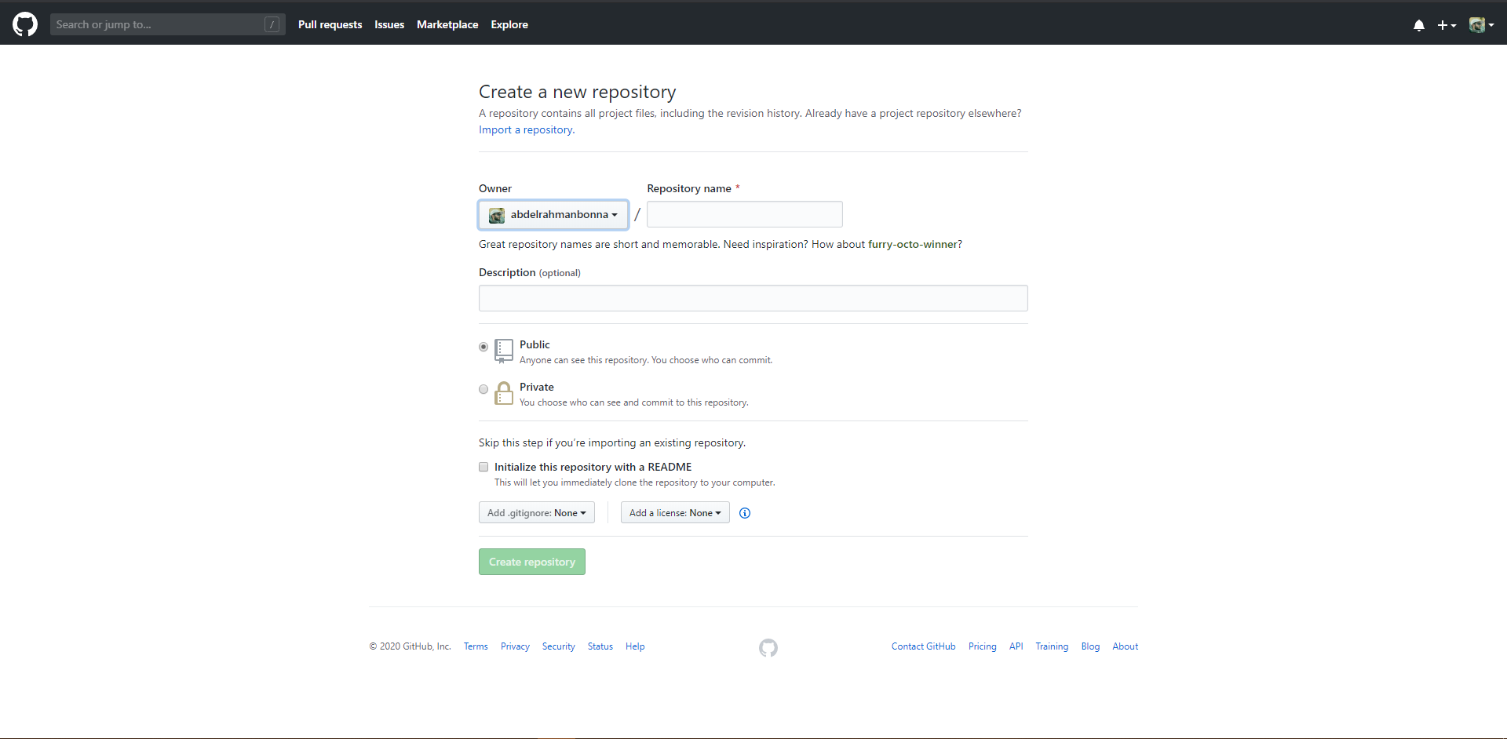
How to make a repository?

Slide 14
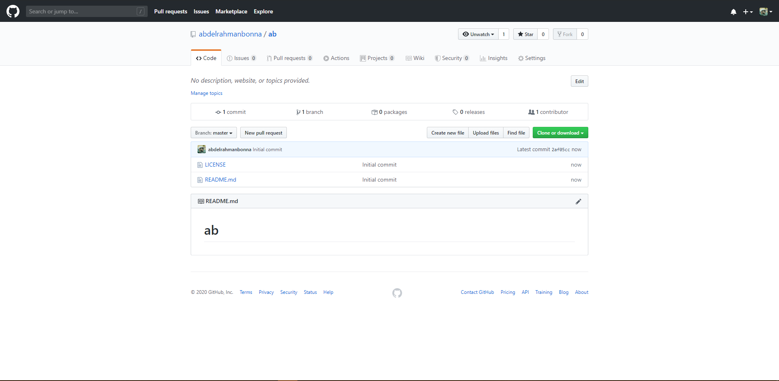
How to make a repository?

Slide 15
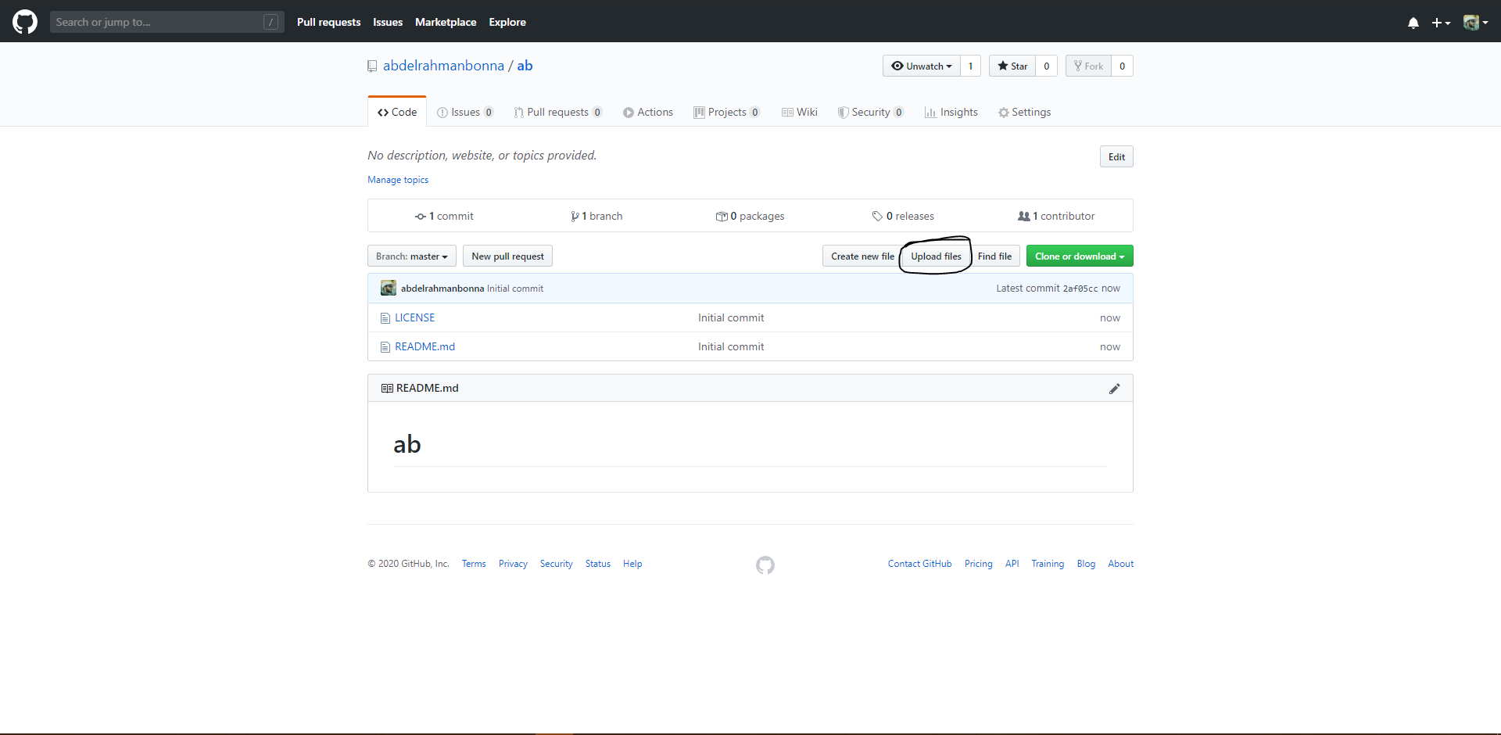
How to upload a file?

Slide 16
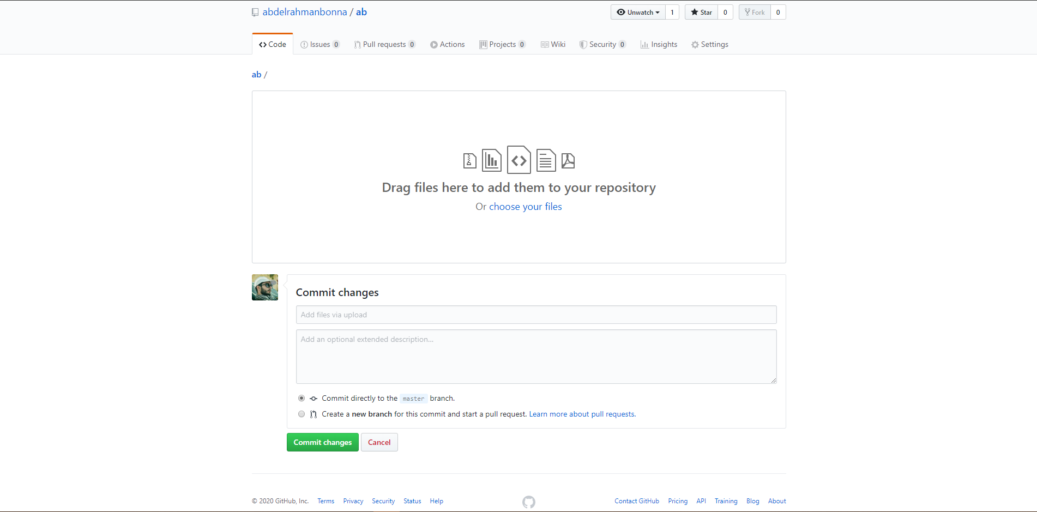
How to upload a file?

Slide 17
The end

