Slide 1
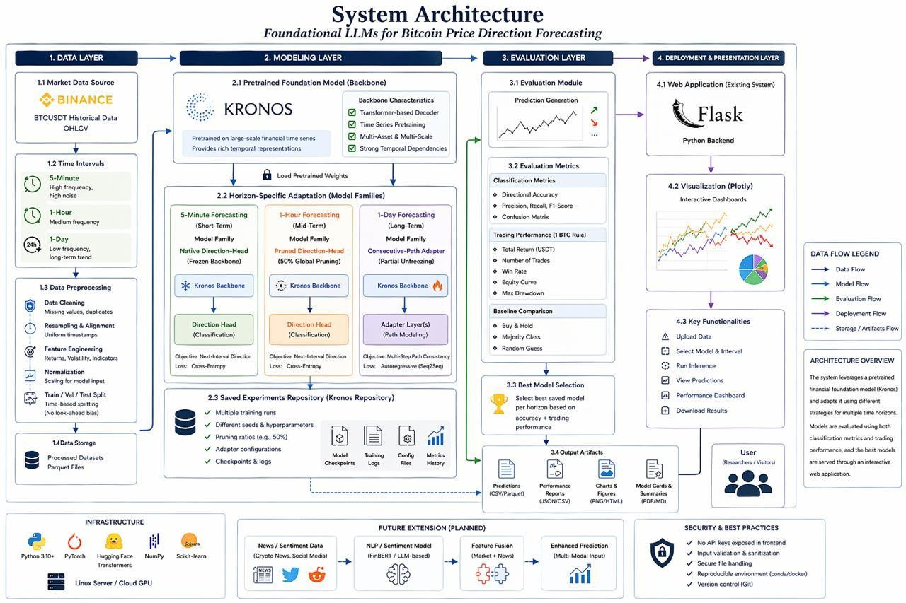
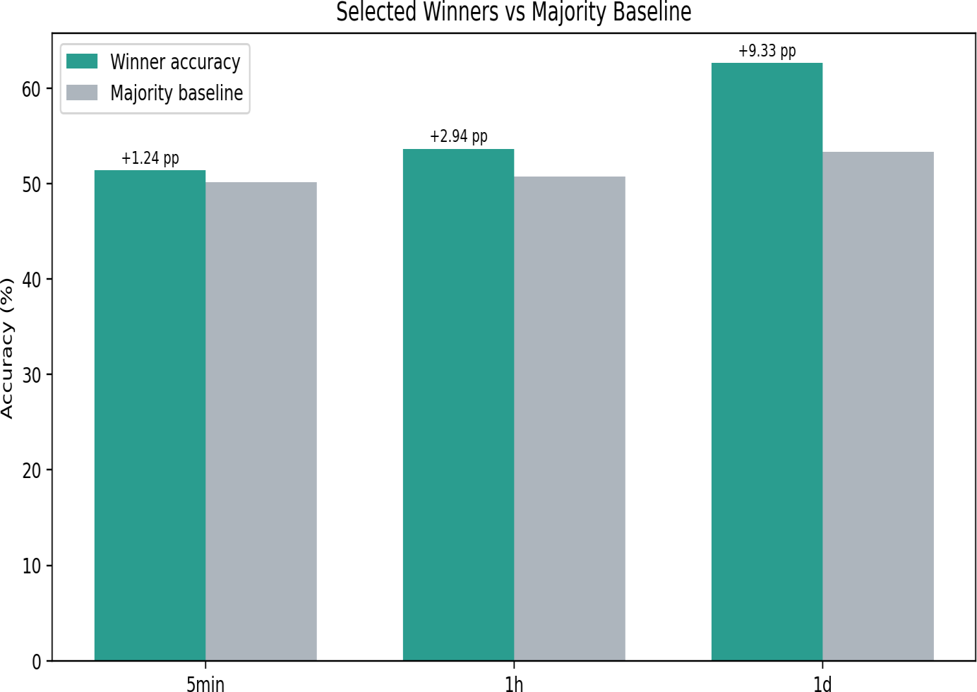
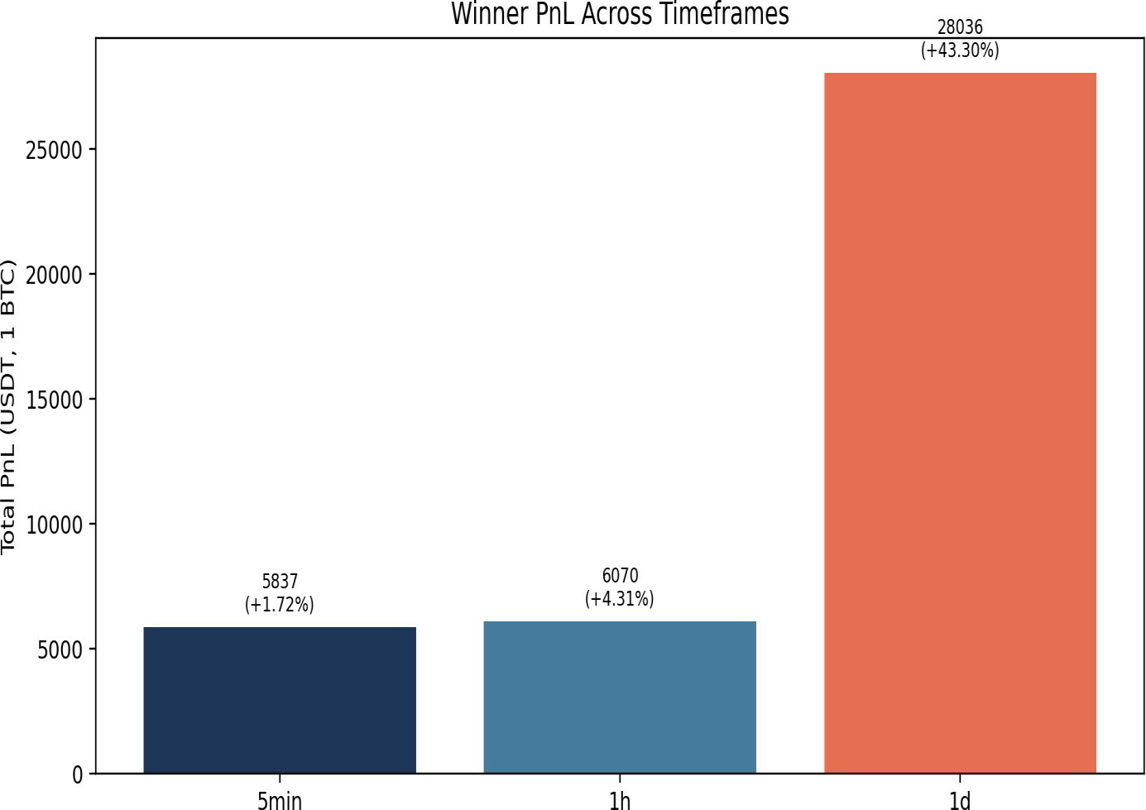
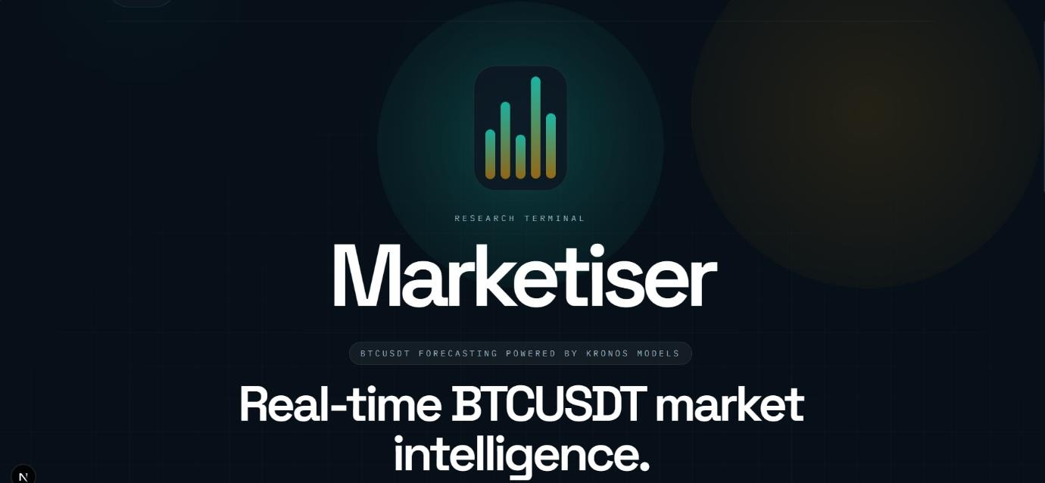
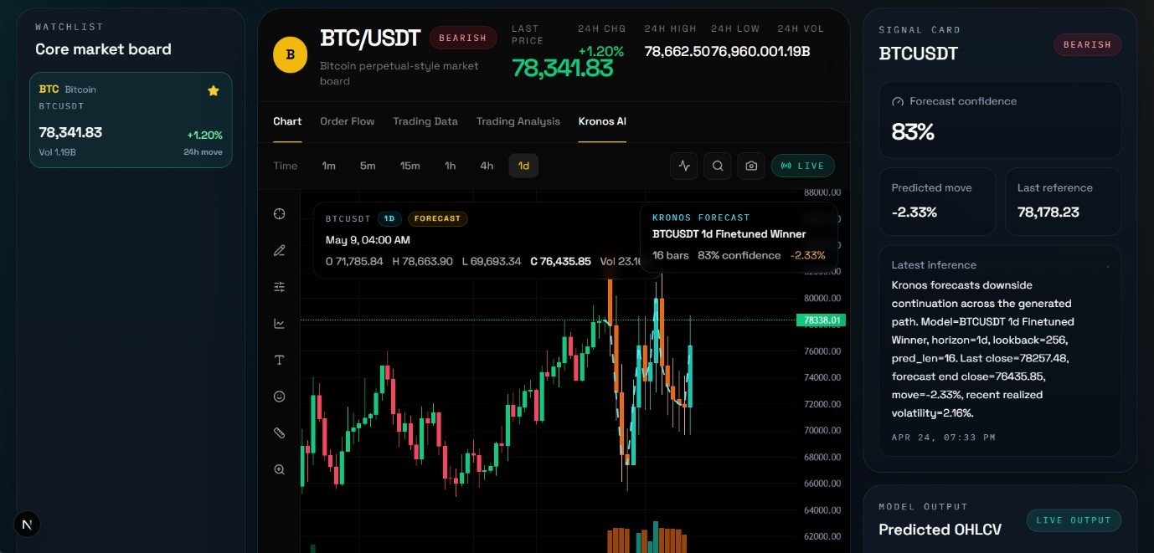
FOUNDATIONAL LLMs FOR BITCOIN PRICE DIRECTION FORECASTING
Abdelrahman Osman | 700041232
Supervised by: Dr. Shengcai Liao
PROBLEM
Bitcoin direction forecasting is not one prediction problem. Horizon choice changes the signal-to-noise ratio, effective sample size, and the type of downstream decision the model must support:
MODEL FAMILIES & ADAPTATION STRATEGIES
Native Direction-Head Fine-Tuning
Pruned Direction-Head Transfer (50% Sparsity)
Applies global magnitude pruning to a direction-head checkpoint. Moderate pruning acts as regularization, improving generalization during interval transfer.
Best for 1-hour.
Consecutive-Path Autoregressive Adapter
Predicts structured multi-step future paths rather than a single next-bar label. Last 6 transformer layers unfrozen for path-consistent 1-day forecasting.
Short horizons (5-min) are dominated by micro-movements and rapid reversals where gains above chance are modest.
Medium horizons (1-hour) reduce noise but still require fast adaptation to changing local conditions.
Long horizons (1-day) require multi-bar path consistency over fewer evaluation points.
A single adaptation strategy cannot optimally serve all three regimes simultaneously.
Attaches a lightweight classifier to a frozen Kronos backbone. Best for 5- minute direct same-interval classification. Only 691K of 103M parameters trainable.
DATASET & TRAINING PIPELINE
BTCUSDT OHLCV data across three resolutions:
SOLUTION
Using the Kronos financial foundation model, we evaluate three distinct adaptation strategies — one per forecasting horizon — and select the strongest deployment candidate at each interval. The result is an interval-aware framework that explicitly matches the adaptation mechanism to the forecasting regime.
SYSTEM ARCHITECTURE
5-minute: 2018–2025, 512-bar lookback, batch 64, LR 5×10⁻⁴, 10 epochs, cross-entropy directional loss
1-hour: Pruned from 5-min direction-head via global magnitude sparsity sweep (25%/50%/75%)
1-day: 1-minute data 2017–2024, 256-step lookback, 16-step horizon, LR 3×10⁻⁶, consecutive-path-only loss, last 6 layers unfrozen
RESULTS
5-MINUTE | 1-HOUR | 1-DAY
51.40% | 53.67% | 62.67%
Directional Accuracy | Directional Accuracy | Directional Accuracy
5,836.58 USDT | 6,069.51 USDT | 28,035.71 USDT
Frictionless PnL | Frictionless PnL | Frictionless PnL
Margin: +1.24 pp | Return: 1.72% | Margin: +2.94 pp | Return: 4.31% | Margin: +9.33 pp | Return: 43.30%
Native Direction-Head | 50% Pruned Direction-Head | Consecutive-Path Adapter
The system has four layers: Data ingestion → Kronos-based modeling (direction-head & path adapters) → Evaluation (accuracy, PnL) → Next.js + FastAPI deployment terminal with live Binance integration.
TECHNOLOGIES & TOOLS
Kronos
Pretrained financial foundation model
PyTorch
Deep learning training framework
FastAPI
web backend for inference
Figure 1: Directional accuracy of each horizon winner vs majority baseline Figure 2: Frictionless 1 BTC directional-trading PnL per horizon (USDT)
KEY FINDING: 1-HOUR PRUNING SWEEP
Lightweight charts
Real-time
market chart
Binance API
Live trading integration
Python
Core language for all pipelines
Variant | Accuracy | Margin vs Base | Total PnL | Comp. Return
Dense | 52.80% | +2.07 pp | -2,726.83 USDT | -7.23%
Pruned 25% | 53.14% | +2.40 pp | -516.73 USDT | -4.02%
Pruned 50% ★ | 53.67% | +2.94 pp | 6,069.51 USDT | 4.31%
Pruned 75% | 51.40% | +0.67 pp | -2,936.27 USDT | -5.45%
COMPARISON WITH RELATED WORK
CONCLUSION
Kronos
Financial foundation model — used as backbone, we study adaptation across horizons rather than proposing a new model.
The winning adaptation strategy changes with the forecasting horizon — a single universal model cannot serve all regimes optimally. This
project delivers an interval-aware deployment framework with three key conclusions:
5-minute: Direct same-interval direction-head supervision is best. Gains above chance are modest (+1.24 pp) but positive and
consistent.
1-hour: Moderate pruning (50% sparsity) acts as regularization, producing the only positive hourly PnL in the sweep and a +2.94 pp margin.
1-day: Path-consistent objectives with partial backbone unfreezing (last 6 layers) deliver 62.67% accuracy and 28,035 USDT PnL — the largest economic effect in the project.
Chronos
General time-series tokenization — we narrow to BTCUSDT finance and compare interval-specific transfer choices.
TFT
Interpretable supervised forecasting — we instead study pretrained-model adaptation and horizon-dependent objective choice.
WEB APPLICATION DEMO
Fischer & Krauss
LSTM directional prediction — we extend to crypto and compare multiple horizon-specific transfer families.
FUTURE WORK
News-based prediction branch — integrate sentiment and event signals alongside price-history signals.
Realistic trading frictions — add fees, slippage, spread, and latency to evaluation.
Multi-asset evaluation — extend the same protocol beyond BTCUSDT to
other liquid crypto pairs.
FastAPI + Lightweight charts live BTCUSDT forecasting dashboard with Binance trading integration
Spring 2026 | ITBP481: Senior Graduation Project II | College of Information Technology | United Arab Emirates University
April 2026

