Slide 1

✓
CONDITIONAL GO · CONSOLIDATED SCORE 4.0 / 5
RP
INDEPENDENT PROJECT______
ANALYSIS · COMMITTEE______
BRIEFING______
Requirement
Pilot
An evidence-grounded, human-in-the-loop, agentic requirements engineering platform — deep analysis of the reference document dated 30 September 2026.
Analysis briefing · October 2026
Prepared for the supervisor and defense committee
Companion to the 27-page written analysis report (11 sections · 5 figures · 10 tables)

Slide 2
RP
AGENDA
Briefing roadmap
01
Verdict at a Glance
✓
What the platform is, and how it scores across six assessment dimensions.
02
Novelty & Contribution
⚗
Ten planned contributions; two defensible research cores (N2, N7), eight disciplined increments.
03
Feasibility, Architecture & Risk
⚒
Sound, conservative design; schedule arithmetic with zero buffer; eleven risks, four newly identified.
04
Actions & Recommendation
✓
Twelve actions across three time horizons, the descope ladder, and four conditions attached to the go.

Slide 3


01 / 04
Verdict at a Glance
“An exceptionally well-prepared graduation project — honest about the literature, precise about its mechanisms, disciplined about evaluation.”
6 dimensions scored
4 conditions attached
No structural flaws found

Slide 4
What is RequirementPilot?
Rather than generating polished requirements from a single prompt, RequirementPilot conducts structured stakeholder interviews, distinguishes explain-why questions from extraction tasks, and grounds every requirement in versioned evidence. Humans approve each transition — no requirement gap is ever silently filled by a model.
10
7
8
3
planned contributions (N1–N10)
research questions with quantitative metrics
recent systems benchmarked in the literature review
evidence languages — English, Egyptian Arabic, code-switched
♟
Team of four · 6-month (24-week) graduation project window · Integration-first positioning that explicitly forbids overclaiming novelty.

Slide 5
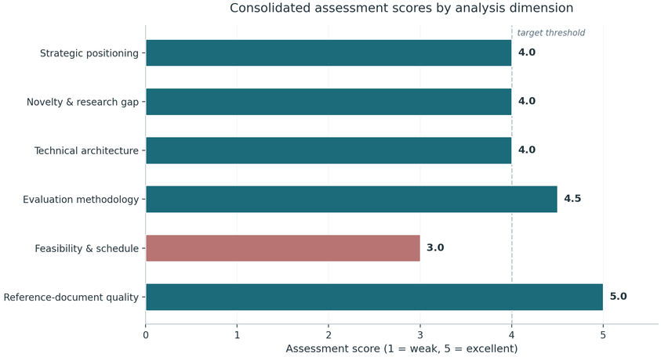
Consolidated verdict — conditional go at 4.0 / 5
Strategic positioning
4.0
integration-first, honestly framed / framing A–D not yet chosen
Novelty & research gap
4.0
N2 + N7 defensible cores / self-assessed matrix, no search protocol
Technical architecture
4.0
determinism-first, authority-aware retrieval / context, concurrency, observability unspecified
Evaluation methodology
4.5
strategies, not models; full ablation map / no power analysis or IAA plan
Feasibility & schedule
3.0
clear MVP and M1 gate / 26 weeks of work in 24; benchmark last
Reference-document quality
5.0
comprehensive, honest, actionable / none material
⚑
Proceed — subject to four conditions, detailed in Part 04.

Slide 6
02 / 04
Novelty & Contribution
Two defensible research cores — impact-aware question selection and an Arabic code-switching benchmark — carried by eight useful but individually incremental contributions.
Assessment basis: analyst scoring of the ten contributions against recent systems (RECOVER, LENS, OntoAgent, ReqElicitGym, ProReFiCIA, AraREQ, MAAD, MedNegotiator).

Slide 7
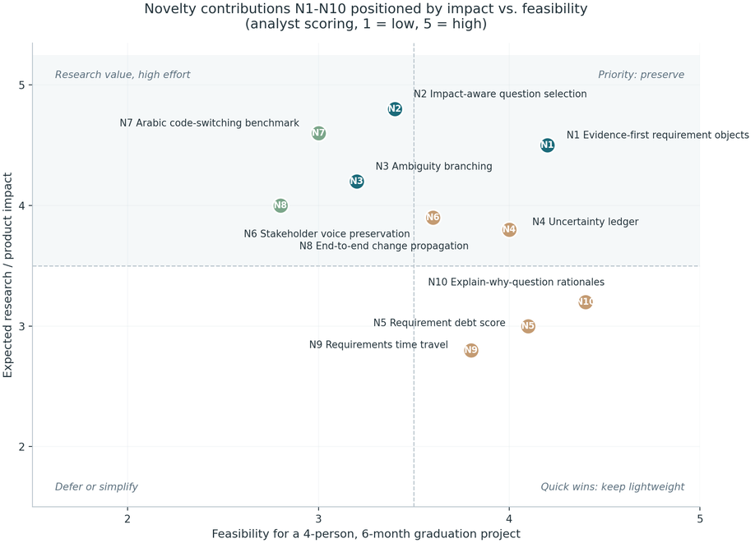
SECTION 02 · NOVELTY & CONTRIBUTION
Ten contributions positioned by impact vs. feasibility
PROTECT — core of the thesis
N2 Impact-aware question selection · N7 Arabic / code-switched benchmark — individually defensible, ablation-critical, independently publishable.
KEEP — lightweight
N1 Evidence-first objects · N3 Ambiguity branching · N4 Uncertainty ledger · N5 Requirement debt score · N6 Voice preservation · N10 Rationale explanations — valuable engineering, not headline research.
DEFER — descope candidates
N8 Cross-artifact change propagation · N9 Requirements time travel — Phase B material; first cuts when time compresses.
Scores are analyst estimates on a 1–5 scale; the matrix is self-assessed by the team, hence Action 2 (systematic search protocol).

Slide 8
SECTION 02 · NOVELTY & CONTRIBUTION
The defensible core: N2 and N7
N2 — Impact-aware question selection
N7 — Egyptian Arabic / code-switched benchmark
impact 4.8
feasibility 3.4
impact 4.6
feasibility 3.0
Deterministic utility scoring decides which question the interviewer asks next — no black-box agent loop
The system's central claim stands or falls with this mechanism: ablation-critical
Weakness: utility weights are currently unjustified guesses → pilot ablation on the first 20 scenarios in month 3 (Action 7)
First requirements benchmark of its kind for Egyptian Arabic and code-switching; independently publishable
Aligned with team skills — dedicated NLP/Arabic member — and with the local context
Weakness: currently scheduled in months 5–6, too late to evaluate properly → production from month 2 (Action 6)
✓
Why these two are defensible: both are measurable, both have drawn boundaries (exact dialect, task, benchmark limits), and both match available skills and data.

Slide 9
03 / 04
Feasibility, Architecture & Risk
Sound, deliberately conservative engineering — set against schedule arithmetic with zero buffer and a risk cluster concentrated in execution, not in the idea.
03
Architecture 4.0 / 5
Schedule 3.0 / 5
11 risks mapped

Slide 10
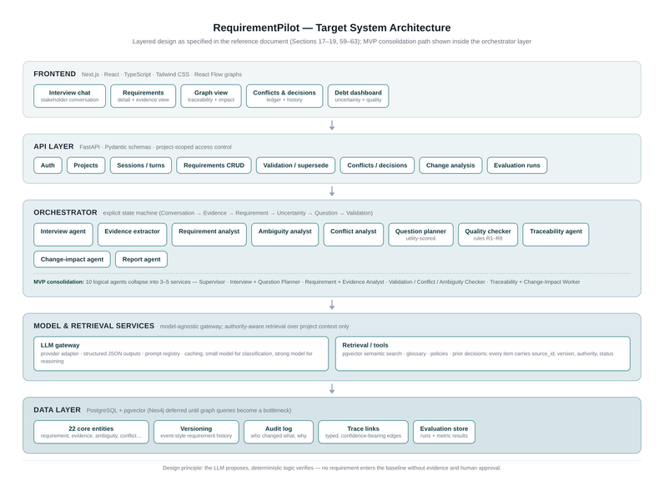
SECTION 03 · FEASIBILITY, ARCHITECTURE & RISK
Architecture: conservative by design — and right
✓
What is strong
✓Explicit state machine instead of a heavyweight agent framework — no hidden non-determinism in a system whose thesis is determinism
✓Evidence is a first-class object: 22-entity model, event-style requirement versioning (never overwrite; author, source, reason, timestamp stored)
✓Authority-aware retrieval: approved policies (authority 1.00 / 0.95) cannot be silently overridden by AI inference (0.3×)
✓Eight hallucination controls wrapped around the human approval gate.
⊗
What is unspecified
✕
Context management, concurrency, and observability are not yet designed → run graph-query and infrastructure spikes before Phase 3 (Action 5).

Slide 11
4.5
SECTION 03 · FEASIBILITY, ARCHITECTURE & RISK
Evaluation methodology — the strongest dimension (4.5 / 5)
✓
⇄
✦
7 research questions
Disciplined baselines
Layered data strategy
Each RQ carries named metrics — extraction accuracy (RQ1), utility of asked questions, conflict-detection quality, trace-link precision — and the design evaluates interview strategies, not model impressions.
Four interview strategies — single-shot generation, unrestricted conversational LLM, ontology-guided interviewer, impact-aware planner — crossed with a four-language matrix, plus three artifact-validation baselines.
Public corpora first: PURE (79 documents, 34,268 sentences), PROMISE and SWARD where licensing permits; ReqElicitGym (101 scenarios) for baseline runs; real conversations only where permissions allow.
⚠
Missing before any data collection: statistical power analysis, random seeds, significance testing plan, and an inter-annotator agreement threshold → fixed by Action 3 (weeks 1–2).

Slide 12
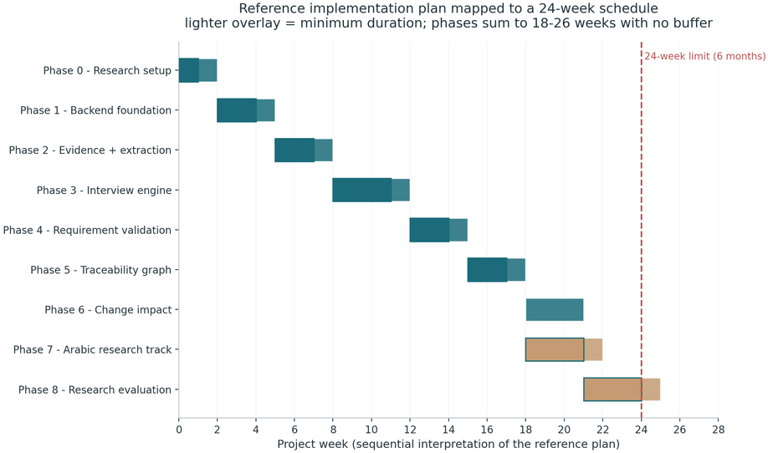
SECTION 03 · FEASIBILITY, ARCHITECTURE & RISK
Schedule feasibility — the weakest dimension (3.0 / 5)
1
Arithmetic: nine phases sum to 18–26 weeks against a 24-week window — zero buffer at maximum durations
Composition: the two most valuable contributions are the two most expensive — planner ablations need Phase 3 stable; the Arabic benchmark sits in months 5–6
2
3
Concentration: the question planner is a single-owner critical path (Member 1) — co-assign in month 3 (Action 8)
Team: sensible four-way split (LLM/interview · NLP/Arabic/data · backend/graph · frontend/QA), but execution-side risk is underweighted in the document.
4

Slide 13
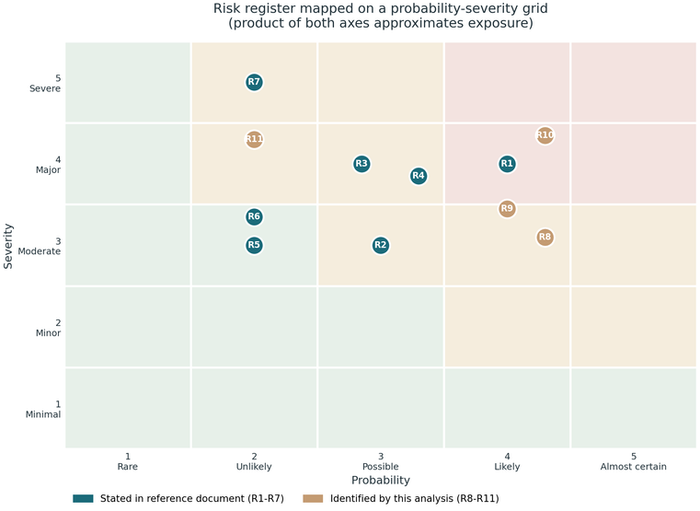
Risk register — 11 risks; four identified by this analysis
RANKED BY EXPOSURE (P × S)
R10
Benchmark produced too late
4.0 × 4.35
start scenario production month 2; evaluate on the first 50 (NEW)
R1
Scope explosion across 10 contributions
4.0 × 4.0
freeze MVP and RQ set; enforce the descope ladder (doc)
R8
Annotation quality, no IAA protocol
4.3 × 3.1
written guidelines, double annotation on a sample, report kappa (NEW)
R9
Evaluator recruitment fails in month 6
4.0 × 3.0
book evaluators in month 2; pay or course credit (NEW)
R7
Hallucinated requirements
2.0 × 5.0
evidence-first design, validation rules, human approval (doc)
Legend: teal = stated in the reference document (R1–R7); tan = identified by this analysis (R8–R11). Also watch R11 ethics/privacy (2.0 × 4.3): request Track C permissions in week 1; Track A stands alone.

Slide 14
04 / 04
Actions & Recommendation
Twelve actions ordered by the deadline by which they stop being cheap — three horizons, one descope ladder, four conditions on the go decision.
04
12 actions
3 horizons
4 conditions

Slide 15
Twelve actions across three horizons
WEEKS 1–3 — Foundations
MONTHS 2–3 — Momentum
MONTHS 5–6 — Endgame
1
Freeze framing (A–D), RQ wording, descope ladder
Benchmark production cadence: 10 scenarios/week → 60–80 ready by month 4
6
10
Hold the what-not-to-build list; integrations as demo videos only
2
Systematic-search protocol: queries, criteria, cutoff
7
Pilot utility ablation on the first 20 scenarios
3
Annotation guidelines + statistical analysis plan (power, seeds, IAA target)
12
Publication: benchmark + strategy comparison as a short paper
8
Co-assign the planner; prompt versioning, logging, cost accounting
4
Request Track C permissions; design Track A to stand alone
Graph-query spikes against the relational schema
9
Book human evaluators (students and practitioners)
✦
ONGOING
5
11
Descope ladder as needed: N9 → N8 depth → N5 calibration → benchmark scale
⚡
The critical three: Actions 1, 3 and 6 — freeze the contract, define the statistics, start the benchmark now.

Slide 16
Recommendation: proceed — under four conditions
1
Freeze the research contract — RQs and the minimum viable contribution locked before Phase 3
⚿
Never descoped
Question planner (N2) · Evidence model · Arabic benchmark (N7)
2
Move the benchmark left — scenario production and annotation guidelines begin in month 2, not month 5
3
Define the statistics first — sample sizes, seeds and IAA thresholds before any data collection
✦
Descoped in order
N9 Requirements time travel → N8 Change-propagation depth → N5 Debt-score calibration → Benchmark scale
4
Adopt the descope ladder — change-impact and requirement-debt features are sacrificed first, by rule
These conditions are not reservations about the idea — they are the discipline the document itself prescribes, applied to its own plan.

Slide 17
“
"No requirement gap is ever silently filled by a model — and no plan gap silently filled by optimism."
Conditional go · 4.0 / 5 — held to its own standard, RequirementPilot should be accepted with distinction and leave behind a citable benchmark and a replication-ready evaluation harness.
Month 2
Month 3
Month 6
— 60–80 scenarios + frozen RQs
— pilot ablation results
— defense + short-paper submission
Thank you — questions welcome__________

