Slide 1
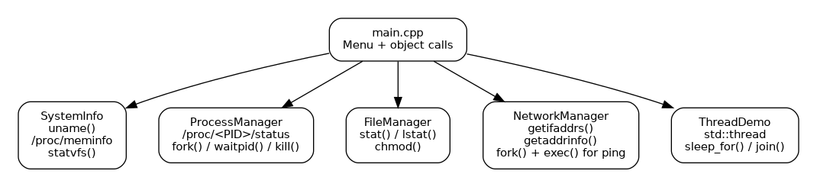
Linux System Manager
C++17 • Linux APIs • OOP • Processes • Files • Networking • Threads
Terminal-based manager built around five focused classes
Uses /proc and Linux APIs instead of shell shortcuts
Includes safe signal testing, documentation and test cases
Built and verified with g++ using C++17

Slide 2
Project Architecture
main.cpp stays small; each Linux topic is handled by its own class.
SystemInfo — uname(), /proc/meminfo, statvfs()
ProcessManager — /proc, fork(), waitpid(), kill()
FileManager — stat()/lstat() and chmod()
NetworkManager — getifaddrs(), DNS, fork()+exec() ping
ThreadDemo — three std::thread workers and join()

Slide 3
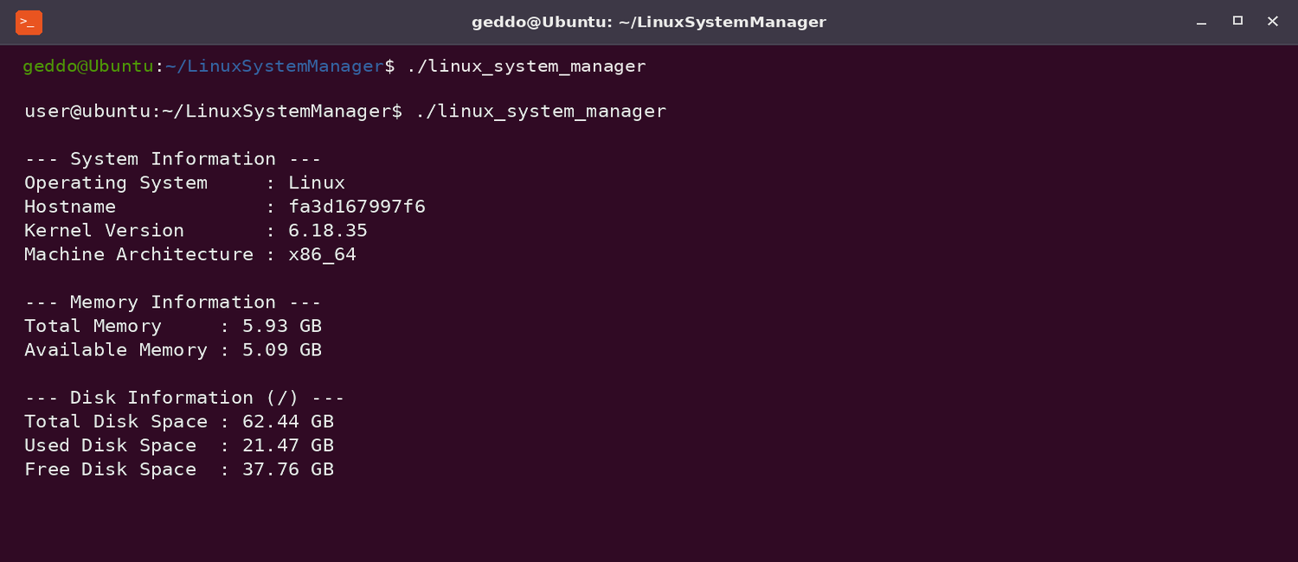
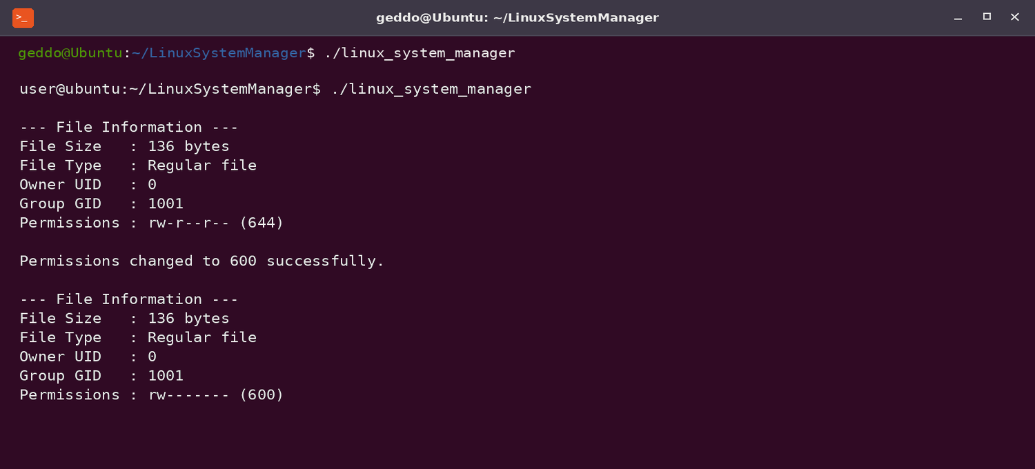
System and File Management
Direct Linux information with simple, readable output.
SystemInfo
uname() • /proc/meminfo • statvfs()
FileManager
lstat() • chmod() • octal permissions

Slide 4
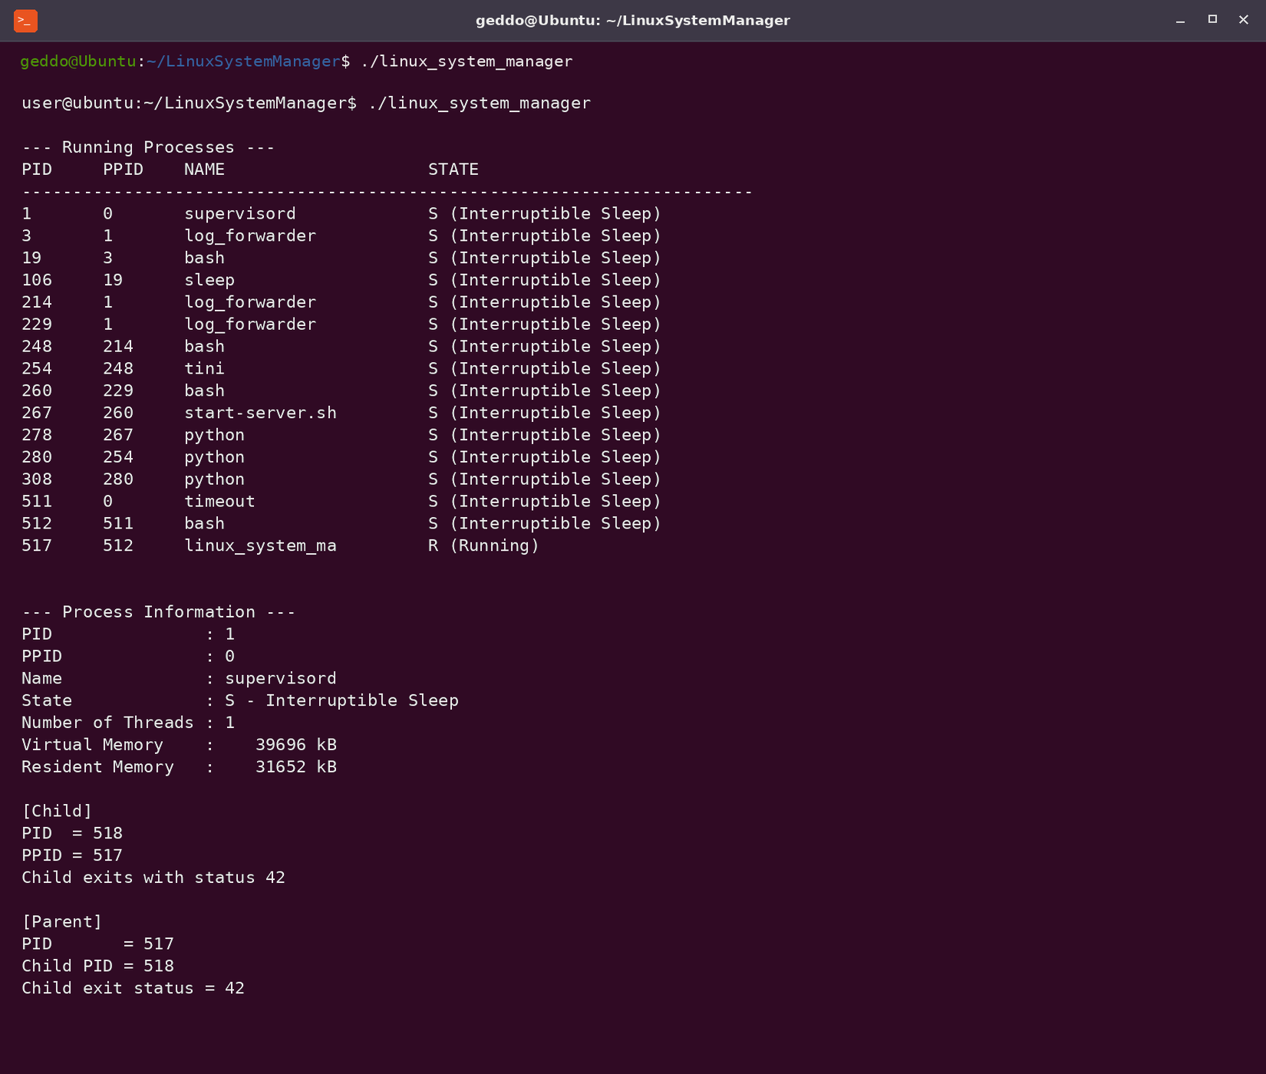
Process Management
The main learning focus: /proc, process states, fork, wait and signals.
Scans numeric folders in /proc
Reads PID, PPID, name, state, thread count and memory
Creates a child with fork()
Child exits with status 42
Parent waits using waitpid()

Slide 5
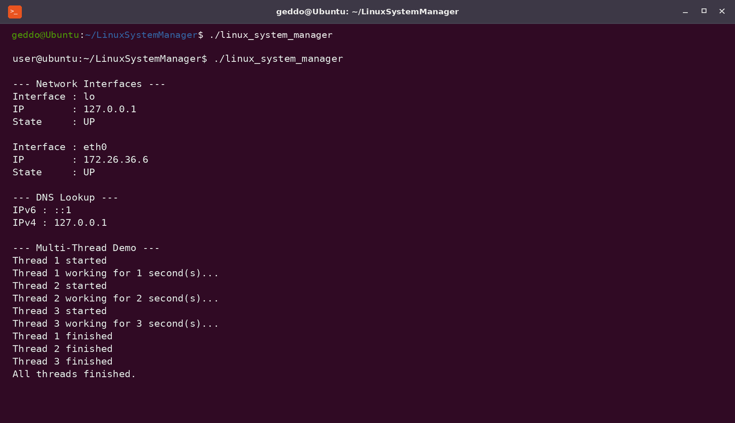
Networking and Threads
Basic networking remains API-driven; multithreading uses three workers.
getifaddrs() lists IPv4 interfaces and UP/DOWN state
DNS uses getaddrinfo() and getnameinfo()
Ping is executed with fork() + execlp() + waitpid()
No system() is used for the required functionality
Three threads sleep independently and join before returning

Slide 6
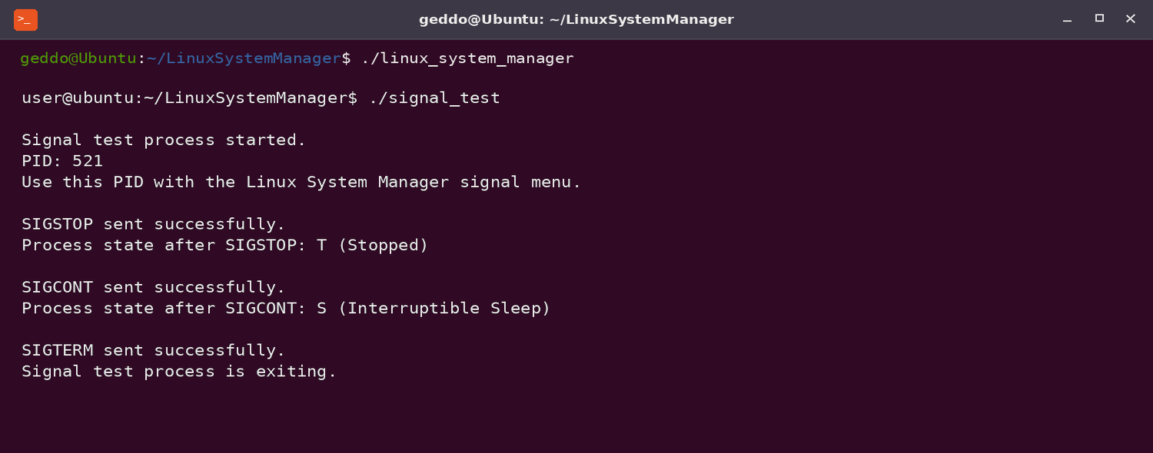
Signals and Safe Testing
A dedicated helper process avoids experimenting on random system processes.
SIGSTOP changes the test process to stopped state T
SIGCONT resumes the process
SIGTERM lets the helper exit cleanly
SIGKILL is supported but cannot be caught
PID 1 and the manager process itself are blocked for safety

Slide 7
Build, Testing and Deliverables
Everything required for submission is included in one project folder.
Build
Source code + headers
Makefile
README and API explanations
Architecture diagram
Screenshots
Test cases
Build verification
Final presentation
make
./linux_system_manager
make clean
Verified with -std=c++17 -Wall -Wextra -pedantic -pthread
Manual test cases cover valid and invalid input, processes, signals, files, permissions, networking and threads.

