Slide 1
Genetic Algorithms
An algorithm is a set of instructions that is repeated to solve a problem.
A genetic algorithm conceptually follows steps inspired by the biological processes of evolution.
Genetic Algorithms follow the idea of SURVIVAL OF THE FITTEST- Better and better solutions evolve from previous generations until a near optimal solution is obtained.

Slide 2
Genetic Algorithms
Also known as evolutionary algorithms, genetic algorithms demonstrate self organization and adaptation similar to the way that the fittest biological organism survive and reproduce.
A genetic algorithm is an iterative procedure that represents its candidate solutions as strings of genes called chromosomes.
Generally applied to spaces which are too large

Slide 3
Genetic Algorithms
Genetic Algorithms are often used to improve the performance of other AI methods such as expert systems or neural networks.
The method learns by producing offspring that are better and better as measured by a fitness function, which is a measure of the objective to be obtained (maximum or minimum).

Slide 4
Genetic Algorithm
Genetic algorithms are a part of evolutionary computing, which is a rapidly growing area of artificial intelligence.
Based on Darwinian principles of biological evolution.
First proposed by Prof. John Holland and his colleague at Univ. of Michigan.

Slide 5
Biological Background: 1
Chromosomes are strings of DNA and serves as a model for the whole organism.
A chromosome consists of genes.
Each gene encodes a trait.
Complete set of genetic material (all chromosomes) is called genome.
Particular set of genes in genome is called genotype.

Slide 6
Biological Background: 2
During reproduction, first occurs recombination (or crossover).
Genes from parents form in some way the whole new chromosome.
The new created offspring can then be mutated. Mutation means, that the elements of DNA are a bit changed. This changes are mainly caused by errors in copying genes from parents.
The fitness of an organism is measured by success of the organism in its life.

Slide 7
Search Space
The space of all feasible solutions (it means objects among those the desired solution is) is called search space (also state space).
Each point in the search space represent one feasible solution.
The looking for a solution is then equal to a looking for some extreme (minimum or maximum) in the search space.
Search methods: hill climbing, tabular search, simulated annealing and genetic algorithm.

Slide 8
Simple GA
{
initialize population;
evaluate population;
while TerminationCriteriaNotSatisfied
{
select parents for reproduction;
perform crossover and mutation;
repair();
evaluate population;
}
}
Every loop called
generation

Slide 9
Concepts
Population:set of individuals each representing a possible solution to a given problem.
Gene:a solution to problem represented as a set of parameters, these parameters known as genes.
Chromosome:genes joined together to form a string of values called chromosome.
Fitness score(value):every chromosome has fitness score can be inferred from the chromosome itself by using fitness function.

Slide 10
Stochastic operators
Selection replicates the most successful solutions found in a population at a rate proportional to their relative quality
Recombination (Crossover) decomposes two distinct solutions and then randomly mixes their parts to form novel solutions
Mutation randomly perturbs a candidate solution
Recombination

Slide 11
Simulated Evolution
We need the following
  Representation of an individual
  Fitness Function
  Reproduction Method
  Selection Criteria

Slide 12
Representing an Individual
An individual is data structure representing the “genetic structure” of a possible solution.
Genetic structure consists of an alphabet (usually 0,1)

Slide 13
Binary Encoding
Most Common – string of bits, 0 or 1.
Chrom: A = 1 0 11 0 0 1 0 1 1
Chrom: B = 1 1 1 1 1 1 0 0 0 0
Gives you many possibilities
Example Problem: Knapsack problem
The problem: there are things with given value and size. The knapsack has given capacity. Select things to maximize the values.
Encoding: Each bit says, if the corresponding thing is in the knapsack

Slide 14
Permutation Encoding
Used in “ordering problems”
Every chromosome is a string of numbers, which represents number is a sequence.
  Chrom A: 1 5 3 2 6 4 7 9 8
  Chrom B: 8 5 7 7 2 3 1 4 9
Example: Travelling salesman problem
The problem: cities that must be visited.
Encoding says order of cities in which salesman willl visit.

Slide 15
Another Example
To find optimal quantity of three major ingredients (sugar, milk, sesame oil) denoting ounces.
  Use an alphabet of 1-9 denoting ounces..
  Solutions might be 1-1-1, 2-1-4, 3-3-1.

Slide 16
Value Encoding
Used for complicated values (real numbers) and when binary coding would be difficult
Each chromosome is a string of some values.
  Chrom A: 1.2323 5.3243 0.4556
  Chrom B: abcdjeifjdhdierjfd
  Chrom C: (back), (back), (right), (forward), (left)
Example: Finding weights for neural nets.
The problem: find weights for network
Encoding: Real values that represent weights

Slide 17
Rule base system
Given a rule (if color=red and size=small and shape=round then object=apple.
Assume that each feature has finite set of values (e.g., size = small,large)
Represent the value as a substring of length equl to the number of possible values. For example, small = 10, large = 01.
The entire rule would be 100 10 01 0100 – set of rules concatenating the values together.

Slide 18
How offspring are produced - Reproduction
Reproduction- Through reproduction, genetic algorithms produce new generations of improved solutions by selecting parents with higher fitness ratings or by giving such parents a greater probability of being contributors and by using random selection

Slide 19
How offspring are produced
(Recombination) Crossover- Many genetic algorithms use strings of binary symbols for chromosomes, as in our Knapsack example, to represent solutions. Crossover means choosing a random position in the string (say, after 2 digits) and exchanging the segments either to the right or to the left of this point with another string partitioned similarly to produce two new off spring.

Slide 20
Crossover Example
Parent A 011011
Parent B 101100
“Mate the parents by splitting each number as shown between the second and third digits (position is randomly selected)
01*1011 10*1100

Slide 21
Crossover Example
Now combine the first digits of A with the last digits of B, and the first digits of B with the last digits of A
This gives you two new offspring
  011100
  101011
If these new solutions, or offspring, are better solutions than the parent solutions, the system will keep these as more optimal solutions and they will become parents. This is repeated until some condition (for example number of populations or improvement of the best solution) is satisfied.

Slide 22
How offspring are produced
Mutation- Mutation is an arbitrary change in a situation. Sometimes it is used to prevent the algorithm from getting stuck. The procedure changes a 1 to a 0 to a 1 instead of duplicating them. This change occurs with a very low probability (say 1 in 1000)

Slide 23
Genetic Algorithm Operators
Mutation and Crossover
Parent 1
1 0 1 0 1 1 1
Parent 2
1 1 0 0 0 1 1
Child 1
1 0 1 0 0 1 1
Child 2
1 1 0 0 1 1 0
Mutation

Slide 24
Crossover Operators
Single­point crossover:
Parent A: 1 0 0 1 0| 1 1 1 0 1
Parent B: 0 1 0 1 1 |1 0 1 1 0
Child AB: 1 0 0 1 0 1 0 1 1 0
Child BA: 0 1 0 1 1 1 1 1 0 1
Two­point crossover:
Parent A: 1 0 0|1 0 1 1| 1 0 1
Parent B: 0 1 0* 1 1 1 0* 1 1 0
Child AB: 1 0 0 1 1 1 0 1 0 1
Child BA: 0 1 0 1 0 1 1 1 1 0

Slide 25
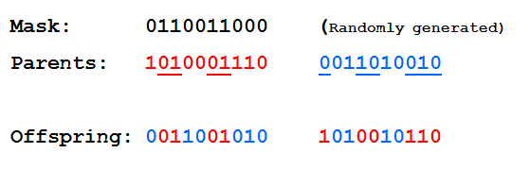
Uniform Crossover
- A random mask is generated
- The mask determines which bits are copied from one parent and which from the other parent
- Bit density in mask determines how much material is taken from the other parent.

Slide 26
Examples
Mutation:
  The recipe example:
  1-2-3 may be changed to 1-3-3 or 3-2-3, giving two new offspring. How often? How many digits change? How big? (parameters to adjust)

Slide 27
More examples:
Crossover
Recipe :
Parents 1-3-3 & 3-2-3. Crossover point after the first digit. Generate two offspring: 3-3-3 and 1-2-3.
Can have one or two point crossover.

Slide 28
Crossover – Permutation Encoding
Single point crossover - one crossover point is selected, till this point the permutation is copied from the first parent, then the second parent is scanned and if the number is not yet in the offspring it is added
(1 2 3 4 5| 6 7 8 9) + (4 5 3 6 8| 9 7 2 1) = (1 2 3 4 5 6 8 9 7)
Mutation
Order changing - two numbers are selected and exchanged
(1 2 3 4 5 6 8 9 7) => (1 8 3 4 5 6 2 9 7)

Slide 29
Crossover – Value Encoding
Crossover
All crossovers from binary encoding can be used
Mutation
Adding a small number (for real value encoding) - to selected values is added (or subtracted) a small number
(1.29 5.68 2.86 4.11 5.55) => (1.29 5.68 2.73 4.22 5.55)

Slide 30
Selection Criteria
Fitness proportionate selection, rank selection methods.
  Fitness proportionate – each individual, I, has the probability fitness(I)/sum_over_all_individual_j Fitness(j), where Fitness(I) is the fitness function value for individual I.
  Rank selection – sorts individual by fitness and the probability that an individual will be selected is proportional to its rank in this sorted list.

Slide 31
Fitness Function
Represents a rank of the “representation”
It is usually a real number.
The function usually has a value between 0 and 1 and is monotonically increasing.
One can have a subjective judgment (e.g. 1-5 for recipe 2-1-4.)
Similarly the length of the route in the traveling salesperson problem is a good measure, because the shorter the route, the better the solution.

Slide 32
Outline of the Basic Genetic Algorithm
[Start] Generate random population of n chromosomes (suitable solutions for the problem)
[Fitness] Evaluate the fitness f(x) of each chromosome x in the population
[New population] Create a new population by repeating following steps until the new population is complete

Slide 33
Outline of the Basic Genetic Algorithm
[Selection] Select two parent chromosomes
from a population according to their fitness (the better fitness, the bigger chance to be selected) The idea is to choose the better parents.
[Crossover] With a crossover probability cross over the parents to form a new offspring (children). If no crossover was performed, offspring is an exact copy of parents.
[Mutation] With a mutation probability mutate new offspring at each locus (position in chromosome).

Slide 34
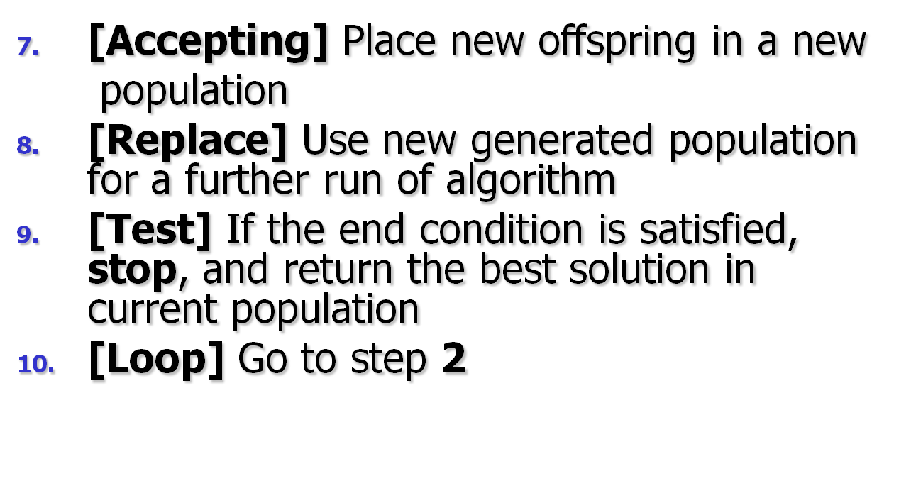
Outline of the Basic Genetic Algorithm

Slide 35
Flow Diagram of the Genetic Algorithm Process
Describe
Problem
Generate
Initial
Solutions
Step 1
Test: is initial
solution good enough?
Yes
Stop
No
Step 2
Select parents
to reproduce
Step 3
Apply crossover process
and create a set of offspring
Apply random mutation
Step 4
Step 5

Slide 36
Components of a GA
A problem definition as input, and
Encoding principles (gene, chromosome)
Initialization procedure (creation)
Selection of parents (reproduction)
Genetic operators (mutation, recombination)
Evaluation function (environment)
Termination condition

Slide 37
Representation (encoding)
Possible individual’s encoding
  Bit strings (0101 ... 1100)
  Real numbers (43.2 -33.1 ... 0.0 89.2)
  Permutations of element (E11 E3 E7 ... E1 E15)
  Lists of rules (R1 R2 R3 ... R22 R23)
  Program elements (genetic programming)
  ... any data structure ...

Slide 38
Representation (cont)
When choosing an encoding method rely on the following key ideas
Use a data structure as close as possible to the natural representation
Write appropriate genetic operators as needed
If possible, ensure that all genotypes correspond to feasible solutions
If possible, ensure that genetic operators preserve feasibility

Slide 39
Initialization
Start with a population of randomly generated individuals, or use
- A previously saved population
- A set of solutions provided by a human expert
- A set of solutions provided by another heuristic algorithm

Slide 40
Selection

Slide 41
Selection
1- Fitness Proportionate Selection
Derived by Holland as the optimal trade-off between exploration and exploitation
Drawbacks
Different selection for f₁(x) and f₂(x) = f₁(x) + c
Super individuals cause convergence (that may be premature)

Slide 42
3- Tournament Selection
Tournament Selection:
– randomly select two individuals and the one
with the highest rank goes on and reproduces
– cares only about the one with the higher rank,
not the spread between the two fitness scores
– puts an upper and lower bound on the chances
that any individual to reproduce for the next
generation equal to: (2s – 2r + 1) / s²
􀁺 s is the size of the population
􀁺 r is the rank of the "winning" individual
– can be generalized to select best of n individuals

Slide 43
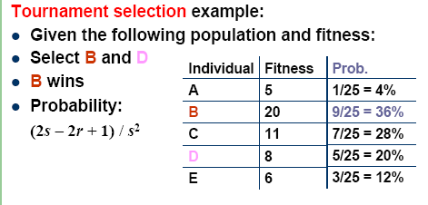

Slide 44
Recombination (Crossover)
* Enables the evolutionary process to move toward promising regions of the search space
* Matches good parents’ sub-solutions to construct better offspring

Slide 45
Mutation
Purpose: to simulate the effect of errors that happen with low probability during duplication
Results:
- Movement in the search space
- Restoration of lost information to the population

Slide 46
Evaluation (fitness function)
Solution is only as good as the evaluation function; choosing a good one is often the hardest part
Similar-encoded solutions should have a similar fitness

Slide 47
Termination condition
Examples:
A pre-determined number of generations or time has elapsed
A satisfactory solution has been achieved
No improvement in solution quality has taken place for a pre-determined number of generations

Slide 48
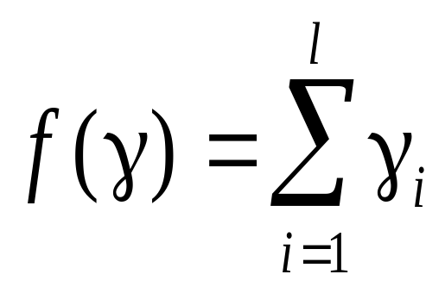
The MAXONE Problem
Problem instance: a string of l binary cells, γ ∈ {0, 1}^{l} :
Fitness:
Objective: maximize the number of ones in the string.

Slide 49
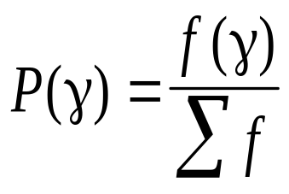
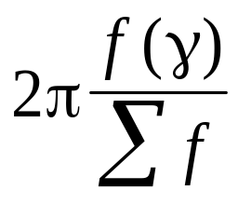
Fitness Proportionate Selection
Probability of γ being selected:
Implementation: “Roulette Wheel”
γ

Slide 50
Mutation
1
0
1
1
0
0
1
1
0
1
p_{mut}
1
0
1
1
1
0
1
1
0
0
independent Bernoulli transcription errors

Slide 51
Example: Recombination & Mutation
0111011011 → 0111011011 → 0111111011 f = 8
0111011011 → 0111011011 → 0111011011 f = 7
110|1100010 → 1100101100 → 1100101100 f = 5
010|0101100 → 0101100010 → 0101100010 f = 4
1|100110011 → 1100110011 → 1100110011 f = 6
1|100110011 → 1100110011 → 1000110011 f = 5
0110001010 → 0110001010 → 0110001010 f = 4
1101011011 → 1101011011 → 1101011011 f = 7
011000|1010 → 0110001011 → 0110001011 f = 5
110101|1011 → 1101011010 → 1101011010 f = 6
TOTAL = 57

Slide 52
Example :
Suppose a Genetic Algorithm uses chromosomes of the form x=abcdefgh with a fixed length of eight genes . Each gene can be any digit between 0 and 9 . Let the fitness of individual x be calculated as :
f(x) =(a+b)-(c+d)+(e+f)- ( g+h)
And let the initial population consist of four individuals x1, ... ,x4 with the following chromosomes :
X1 = 6 5 4 1 3 5 3 2
F(x1) =(6+5)-(4+1)+(3+5)-(3+2) = 9
X2 = 8 7 1 2 6 6 0 1
F(x2) = (8+7)-(1+2)+(6+6)-(0+1) = 23
X3 = 2 3 9 2 1 2 8 5
F(x3) = (2+3)-(9+2)+(1+2)-(8+5) = -16
X4= 4 1 8 5 2 0 9 4
F(x4) = (4+1)-(8+5)+(2+0)-(9+4) = -19
The arrangement is ( assume maximization )
X2 x1 x3 x4
( the fittest individual ) ( least fit individual )

Slide 53
Put the calculations in table for simplicity
Individuals | String Representation | Fitness | Arrangement Assume maximization
X1 | 65413532 | 9 | X2(fittest individual)
X2 | 87126601 | 23 | X1(second fittest individual)
X3 | 23921285 | -16 | X3 (third fittest individual)
X4 | 41852094 | -19 | X4 (least fit individual)
So Average fitness :-0.75 Best : 23 Worst : -19
Average fitness = ( 9+23+ -16 + -19)/ 4 =-0.75

Slide 54
` X2 = 8 7 1 2 6 6 0 1
X1 = 6 5 4 1 3 5 3 2
Offspring 1 = 8 7 1 2 3 5 3 2
Offspring 2 = 6 5 4 1 6 6 0 1
X1 = 6 5 4 1 3 5 3 2
X3 = 2 3 9 2 1 2 8 5
Offspring 3 = 6 5 9 2 1 2 3 2
Offspring 4 = 2 3 4 1 3 5 8 5
Middle crossover
crossover
crossover

Slide 55
X2 = 8 7 1 2 6 6 0 1
X3 = 2 3 9 2 1 2 8 5
Offspring 5 = 8 3 1 2 6 6 8 1
Offspring 6 = 2 7 1 2 6 2 8 1

Slide 56
Offspring 1 = 8 7 1 2 3 5 3 2
F (Offspring 1) =(8+7)-(1+2)+(3+5)-(3+2) = 15
Offspring 2 = 6 5 4 1 6 6 0 1
F (Offspring 2) =(6+5)-(4+1)+(6+6)-(0+1) = 17
Offspring 3 = 6 5 9 2 1 2 3 2
F (Offspring 3) =(6+5)-(9+2)+(1+2)-(3+2) = -2
Offspring 4 = 2 3 4 1 3 5 8 5
F (Offspring 4) =(2+3)-(4+1)+(3+5)-(8+5) = -5
Offspring 5 = 8 3 1 2 6 6 8 1
F (Offspring 5) =(8+3)-(1+2)+(6+6)-(8+1) = 11
Offspring 6 = 2 7 1 2 6 2 8 1
F (Offspring 6) =(2+7)-(1+2)+(6+2)-(8+1) = 5

Slide 57
Put the calculation in table for simplicity
Individuals | String Representation | Fitness
Offspring 1 | 87123532 | 15
Offspring 2 | 65416601 | 17
Offspring 3 | 65921232 | -2
Offspring 4 | 23413585 | -5
Offspring 5 | 87921201 | 11
Offspring 6 | 23926601 | 5
Average fitness : 6.833 Best : 17 Worst : -5
So that , the overall fitness is improved , since the average is better and worst is improved .
Average fitness = (15+17+ -5 + -2 + 11+5 )/ 6 = 6.8333

Slide 58
Example: The Knapsack Problem
You are going on an overnight hike and have a number of items that you could take along. Each item has a weight (in pounds) and a benefit or value to you on the hike(for measurements sake let’s say, in US dollars), and you can take one of each item at most. There is a capacity limit on the weight you can carry (constraint). This problem only illustrates one constraint, but in reality there could be many constraints including volume, time, etc.

Slide 59
GA Example: The Knapsack Problem
Item: 1 2 3 4 5 6 7
Benefit: 5 8 3 2 7 9 4
Weight: 7 8 4 10 4 6 4
Knapsack holds a maximum of 22 pounds
Fill it to get the maximum benefit
Solutions take the form of a string of 1’s and 0’s
Solutions: Also known as strings of genes called Chromosomes
  1. 0101010
  2. 1100100
  3. 0100111

Slide 60
Example: The Knapsack Problem
We represent a solution as a string of seven 1s and 0s and the fitness function as the total benefit, which is the sum of the gene values in a string solution times their representative benefit coefficient.
The method generates a set of random solutions (initial parents), uses total benefit as the fitness function and selects the parents randomly to create generations of offspring by crossover and mutation.

Slide 61
Knapsack Example
Typically, a string of 1s and 0s can represent a solution.
Possible solutions generated by the system using Reproduction, Crossover, or Mutations
  1. 0101010
  2. 1100100
  3. 0100111

Slide 62
Knapsack Example
Solution 1
Item | 1 | 2 | 3 | 4 | 5 | 6 | 7
Solution | 0 | 1 | 0 | 1 | 0 | 1 | 0
Benefit | 5 | 8 | 3 | 2 | 7 | 9 | 4
Weight | 7 | 8 | 4 | 10 | 4 | 6 | 4
Benefit 8 + 2 + 9 = 19
Weight 8 + 10 + 6 = 24

Slide 63
Knapsack Example
Solution 2
Item | 1 | 2 | 3 | 4 | 5 | 6 | 7
Solution | 1 | 1 | 0 | 0 | 1 | 0 | 0
Benefit | 5 | 8 | 3 | 2 | 7 | 9 | 4
Weight | 7 | 8 | 4 | 10 | 4 | 6 | 4
Benefit 5 + 8 + 7 = 20
Weight 7 + 8 + 4 = 19

Slide 64
Knapsack Example
Solution 3
Item | 1 | 2 | 3 | 4 | 5 | 6 | 7
Solution | 0 | 1 | 0 | 0 | 1 | 1 | 1
Benefit | 5 | 8 | 3 | 2 | 7 | 9 | 4
Weight | 7 | 8 | 4 | 10 | 4 | 6 | 4
Benefit 8 + 7 + 9 + 4 = 28
Weight 8 + 4 + 6 + 4 = 22

Slide 65
Knapsack Example
Solution 3 is clearly the best solution and has met our conditions, therefore, item number 2, 5, 6, and 7 will be taken on the hiking trip. We will be able to get the most benefit out of these items while still having weight equal to 22 pounds.
This is a simple example illustrating a genetic algorithm approach.

Slide 66
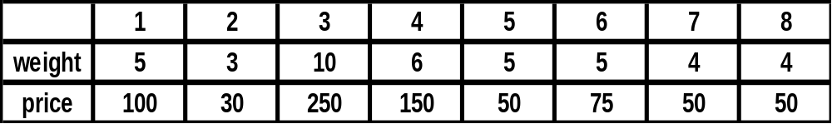
Knapsack Problem
To understand GA must work with the following problem:
(Knap Sack Problem)
Thief wants to steal gold store.
Thief has a bag(the bag can hold a specific weight).
Every piece of gold has a specific weight and price.
Thief wants to steal gold with high price but the weight must equal or less than the weight that bag can hold it.
If we gave every gold piece a specific number 1,2,3,…,n(suggest n=8 in this example).

Slide 67
1-Encoding (representation)(gene,chromosome)
Chromosome Bit strings (101101010100).
Real numbers (43.1,45.2,66.3,11.0).
Permutation of elements (E11 E3 E7 … E1 E15).
Integer Numbers (11,12,54,98,625,1).
Any data structures.
In knap sack problem can represent any solution as chromosome by using bit string of length 8.
Ex:- 1 1 0 1 0 0 0 1
8 7 6 5 4 3 2 1
1(gene):this piece taken, 0(gene):this piece untaken.
could be:

Slide 68
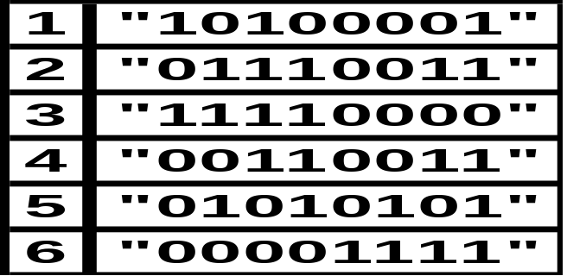
2-Initialize population
Implementers specify population size .
To initialize population create chromosomes randomly and store them in list of length the population size.
In our problem lets take population size 6 chromosomes.
We can initialize population a following:

Slide 69
3-Evaluation of population.
Giving every chromosome in population fitness value by using fitness function.
Fitness functions will differ according to the problem and encoding technique.
Fitness function returns a single numerical(fitness) which reflex the utility or the ability of the individual which that chromosome represents.
Fitness function can calculate : strength, weight, width, maximum load,cost,construction time or combination of all these.
Fitness value well be stored with chromosome.
chromosome
Fitness function
Fitness value

Slide 70
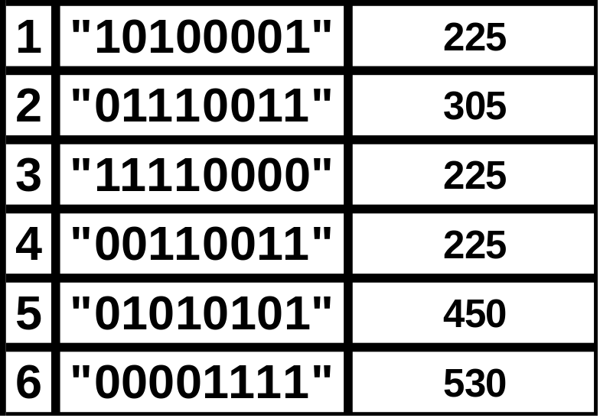
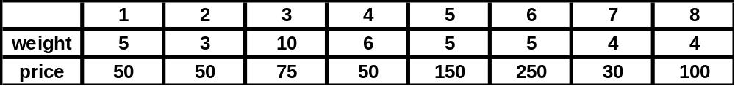
-
In our example we will make fitness function as the sum of price of all gold pieces.
-To complete our example must apply fitness function on all chromosomes.
Chromosome fitness value

Slide 71
4-Selection of new parents(reproduction)
Individuals are selected from population randomly or by using any selection method to improve the population itself.
Good individuals will probably be selected several times in a generation ,poor ones may not be at all.
Methods of selection
Random ,Best, Tournament, Roulette wheel, Truncation, Rank, Exponential, Boltzman, Steady state, Interactive and binary tournament selection.
In our example we will use Truncation selection with parameter 3.
search best 3 chromosomes and then select 6 chromosomes randomly from these three chromosomes and store them as new population to be used in the next step.

Slide 72
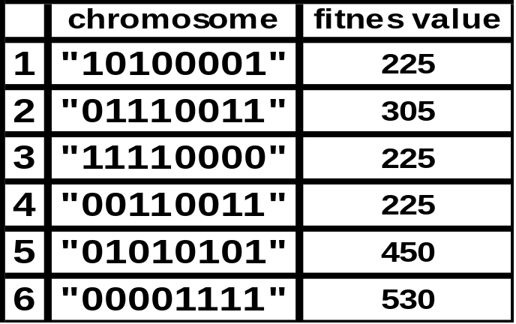
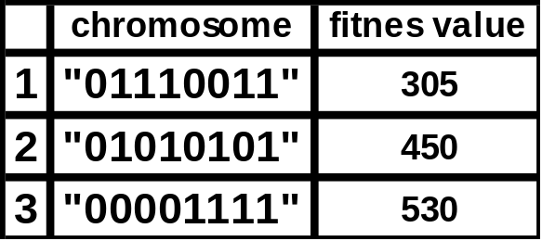
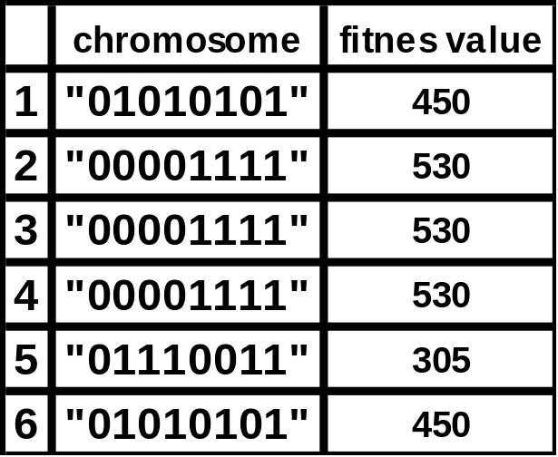
Old population
Search best 3 chromosomes
New population

Slide 73
5-Crossover
Crossover is performed with probability Pcross (crossover probability or crossover rate ) between two selected individuals, called parents, by exchanging parts of their genes to form two new individuals called offsprings.
The simplest method know as single point crossover.
Single point crossover take 2 individual and cut their chromosome strings at randomly chosen position, to produce 2 head segments and 2 tail segments .The tail segments are then swapped over to produce 2 new full length chromosomes.
Pcross (crossover probability or crossover rate ) is typically between 0.6 and 1.0
There is also Multi-Point, Uniform, Bit Simulated, Problem Centered and specialized crossover techniques.

Slide 74
we will do it just for first two parents.
Pcross=0.6
Select two parent(1,2)
Generate random number between 0.0-1.0(0.3)
0.3<=0.6(yes) apply crossover
generate random number between 1-8(3)
old 0 1 0 1 0 1 0 1 0 0 0 0 1 1 1 1
new 0 1 0 1 0 1 1 1 0 0 0 0 1 1 0 1 swap tails
Do this for each pair in population.

Slide 75
6-Mutation
Applied to each child individually after crossover .
It alters some of genes in chromosome with small probability .
Must specify Pmut(mutation probability that is relatively small) therefore a few number of chromosomes will be mutated.
In our example:
suppose Pmut =0.2
generate number between 0-1 (0.01)
0.01<=0.2(yes) apply mutation.
Generate number between 1-8(6)
0 1 0 1 0 1 0 1 => 0 1 1 1 0 1 0 1
Do this for each chromosome in population.

Slide 76
Termination Criteria
There exist three termination condition type:
1-Time:in seconds, in minutes and may be in hours according to the problem that you have it.
2-Number of generations: in hundreds, in thousands may be in millions according to the problem you have it.
3-convergence: when 95% of populations have the same fitness value we can say the convergence started to appear and the user can stop its genetic program to take the result.

Slide 77
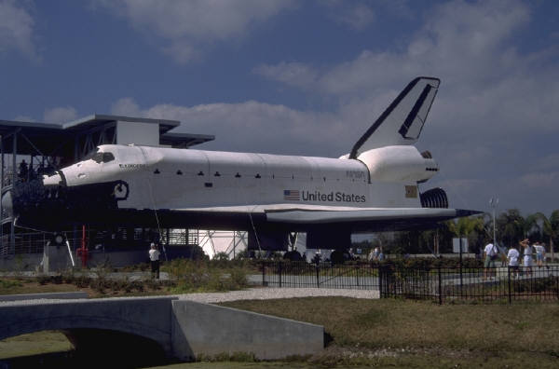
The Knapsack Problem
The knapsack problem, though simple, has many important applications including determining what items to take on a space ship mission.

Slide 78
Another Example:
The Traveling Salesman Problem (TSP)
The traveling salesman must visit every city in his territory exactly once and then return to the starting point; given the cost of travel between all cities, how should he plan his itinerary for minimum total cost of the entire tour?
TSP ∈ NP-Complete
Note: we shall discuss a single possible approach to approximate the TSP by GAs

Slide 79
TSP (Representation, Evaluation, Initialization and Selection)
A vector v = (i₁ i_{2…} i_{n}) represents a tour (v is a permutation of {1,2,…,n})
Fitness f of a solution is the inverse cost of the corresponding tour
Initialization: use either some heuristics, or a random sample of permutations of {1,2,…,n}
We shall use the fitness proportionate selection

Slide 80
TSP (Crossover1)
OX – builds offspring by choosing a sub-sequence of a tour from one parent and preserving the relative order of cities from the other parent and feasibility
Example:
p₁ = (1 2 3 4 5 6 7 8 9) and
p₂ = (4 5 2 1 8 7 6 9 3)
First, the segments between cut points are copied into offspring
o₁ = (x x x 4 5 6 7 x x) and
o₂ = (x x x 1 8 7 6 x x)

Slide 81
TSP (Crossover2)
Next, starting from the second cut point of one parent, the cities from the other parent are copied in the same order
The sequence of the cities in the second parent is 9 – 3 – 4 – 5 – 2 – 1 – 8 – 7 – 6
After removal of cities from the first offspring we get 9 – 3 – 2 – 1 – 8
This sequence is placed in the first offspring
o₁ = (2 1 8 4 5 6 7 9 3), and similarly in the second
o₂ = (3 4 5 1 8 7 6 9 2)

Slide 82
TSP (Inversion)
The sub-string between two randomly selected points in the path is reversed
Example:
(1 2 3 4 5 6 7 8 9) is changed into (1 2 7 6 5 4 3 8 9)
Such simple inversion guarantees that the resulting offspring is a legal tour

Slide 83
Genetic Algorithms
Genetic Algorithms are a type of machine learning for representing and solving complex problems.
They provide a set of efficient, domain-independent search heuristics for a broad spectrum of applications.
A genetic algorithm interprets information that enables it to reject inferior solutions and accumulate good ones, and thus it learns about its universe.

Slide 84
Genetic Algorithm Application Areas
Dynamic process control
Induction of rule optimization
Discovering new connectivity topologies
Simulating biological models of behavior and evolution
Complex design of engineering structures
Pattern recognition
Scheduling
Transportation
Layout and circuit design
Telecommunication
Graph-based problems

