Slide 1
COMPUTER VISION FINAL PROJECT
FreshLens
Retail Product Recognition System
CNN and transfer learning for 84 general product categories
Team Members
1- Abdelrahman Mohamed Hafez
2- Mohamed Tamer Mohamed
3- Yousef Mohamed Abdelaziz
4- Khaled Said
5- Abdelrahman Mohamed Tolba
6- Abdelrahman Emad Ahmed
7- Ahmed Mahmoud Mohamed
ITI Summer Training
FRESHLENS / ITI SUMMER TRAINING
01
Notes:
Introduce FreshLens as a student computer vision project. The system classifies one product image into a general category. Explain the complete workflow: data audit, model comparison, evaluation and local application.
[Sources]
User-supplied FreshLens project, final combined model export and executed training notebook.
[/Sources]

Slide 2
01 / PROBLEM AND OBJECTIVE
One image. One general product category.
84
Help users identify products
from uploaded photographs.
supported categories
Predict the general type rather than
distinguishing individual varieties.
Apple · Banana · Tomato
Return a category and the top three scores.
Scope: classification, without object detection or counting.
FRESHLENS / ITI SUMMER TRAINING
02
Notes:
The goal is product classification, not a complete inventory system. Explain why grouping varieties under general types better matches the intended interface. A softmax score is not a guarantee that an answer is correct.
[Sources]
User-supplied FreshLens project, final combined model export and executed training notebook.
[/Sources]

Slide 3
02 / DATASET AUDIT
Five sources, different contributions
Source
Image files
Contribution
100×100
184,838
Controlled images
Original Size
104,444
Controlled images
3-Body Problem
49,236
Duplicates of 100×100
Multi
756
Natural photos to review
Meta
0
Reference information
File counts are not independent training examples.
FRESHLENS / ITI SUMMER TRAINING
03
Notes:
The audit identified all 49,236 three-body files as exact matches of files in the 100×100 source. They were not added as extra examples. Multi images required review and cropping. Original labels were mapped to 84 categories. Source documentation and licenses are preserved in the project.
[Sources]
Fruits-360: https://github.com/fruits-360
Project: training_assets/Dataset_Audit/source_summary.csv and exact_duplicates_across_sources.csv
[/Sources]

Slide 4
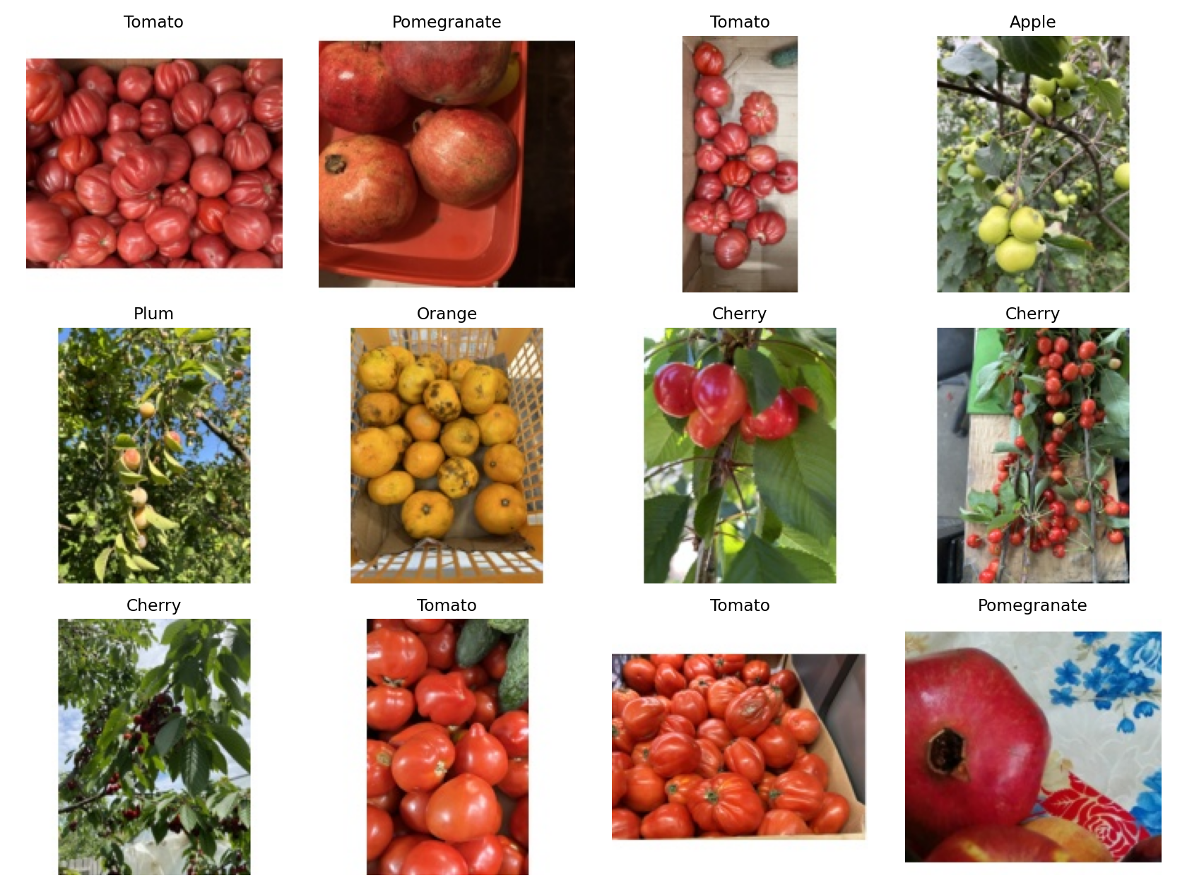
03 / DATA PREPARATION
Consistent inputs; stronger split checks
Prepare each image
1 Correct orientation and convert to RGB
2 Crop reviewed product regions
3 Pad to a white 160 × 160 frame
4 Encode JPEG at quality 95
Actual natural training examples
Remove exact duplicates • Group varieties and capture years
FRESHLENS / ITI SUMMER TRAINING
04
Notes:
The application uses the same input pipeline, including TensorFlow JPEG decoding and normalization inside the model. Controlled images use normalized variety groups. Natural images use 2018 for validation, 2022 for test, and other known years for training. These proxies reduce overlap risks but do not prove independent objects. The project selected 626 dated natural regions before final duplicate checks.
[Sources]
Project: inference.py, reports/training_examples.png, reports/split_manifest.csv, reports/multi_annotations.csv
[/Sources]

Slide 5
04 / MODELS AND TRAINING
Compare learning from scratch and transfer
01
02
03
CNN
MobileNetV2
Fine-tuning
From scratch
Frozen base
Adapt selected layers
Three convolution / pooling blocks
Global average pooling
Dense layer and dropout
ImageNet feature extractor
Freeze base weights
Train an 84-class head
Start from the best head
Last 30 base layers,
excluding batch normalization
Smaller learning rate
Adam • Cross-entropy • Augmentation • Early stopping
FRESHLENS / ITI SUMMER TRAINING
05
Notes:
The CNN has three convolution/pooling blocks. Both MobileNet experiments begin with ImageNet-pretrained features. Fine-tuning unfreezes the final 30 base layers except batch normalization. The natural training images were oversampled to about one quarter of rows per epoch. This repeats existing scenes rather than creating new scenes. Best checkpoints use validation loss.
[Sources]
User-supplied FreshLens project, final combined model export and executed training notebook.
[/Sources]

Slide 6
05 / EVALUATION
Select on validation; report on test
Subset
Images
Categories
Controlled validation
36,172
25
Natural validation
81
25
Controlled test
47,875
37
Natural test
116
17
Selection = lowest mean controlled / natural validation loss
Accuracy, macro precision, recall and F1 are reported by domain.
FRESHLENS / ITI SUMMER TRAINING
06
Notes:
The natural test covers only 17 of the 84 supported categories. Macro metrics average over categories present in each subset. Each domain has equal weight in the selection loss. Logged validation accuracy is unweighted, unlike weighted validation loss. Training curves also reflect augmentation and oversampling. Test results never change the selection.
[Sources]
Project: reports/validation_comparison.csv, reports/test_comparison.csv and reports/model_selection.csv
[/Sources]

Slide 7
06 / FINAL RESULTS
Transfer learning helps; reliability is limited
SELECTED MODEL
MobileNetV2
Frozen base
35.34%
natural-photo test accuracy
Selected-model macro F1: 34.39% controlled • 25.17% natural
FRESHLENS / ITI SUMMER TRAINING
07
Notes:
Exact accuracy values: CNN controlled 24.18%, natural 9.48%; frozen base controlled 48.25%, natural 35.34%; fine-tuned controlled 50.40%, natural 31.03%. Macro F1: CNN 13.65% and 4.81%; frozen base 34.39% and 25.17%; fine-tuned 36.84% and 25.23%. The frozen-base checkpoint was selected using validation loss. Fine-tuning slightly improved controlled accuracy but reduced natural accuracy. Earlier high scores used a different split protocol and are not directly comparable.
[Sources]
Project: reports/test_comparison.csv and reports/model_selection.csv
[/Sources]

Slide 8
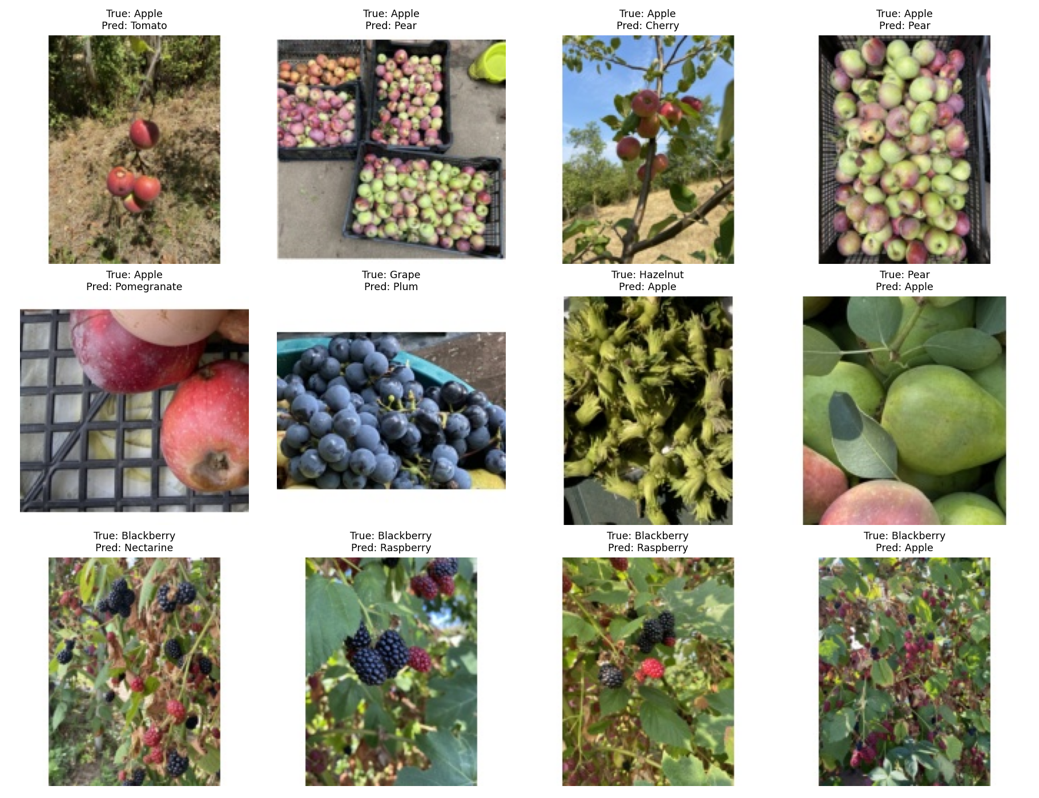
07 / FRESHLENS APPLICATION
A working app with visible evidence
Recognize
Upload one product image
View the top three predictions
Run locally on CPU
Explore
Light and Dark modes
Model comparisons and learning curves
Confusion matrices and error examples
Actual exported prediction-error evidence
FRESHLENS / ITI SUMMER TRAINING
08
Notes:
Demonstrate the real application live: upload, analyze and then open Model results & evidence. This slide shows actual exported error examples, not an application screenshot. Learning curves exist for all three runs; per-class reports and errors are available only for the selected model. The app performs inference without training. A high score can still be wrong.
[Sources]
Project: Retail_Combined_App/app.py and reports/prediction_errors.png
[/Sources]

Slide 9
08 / BUSINESS IMPACT
Potential value requires human review
Potential uses
Current limits
Assist product lookup
Support image labeling
Organize retail catalogs
Limited accuracy on natural photos
No trained unknown-product category
No detection or inventory counting
No retail deployment or cost savings were measured.
FRESHLENS / ITI SUMMER TRAINING
09
Notes:
Describe the business uses as possible future assistance, not demonstrated savings. The current model is an educational prototype and is unsuitable for unattended retail decisions. A staff member must review predictions. The small natural test set and limited category coverage constrain the conclusions.
[Sources]
User-supplied FreshLens project, final combined model export and executed training notebook.
[/Sources]

Slide 10
09 / CONCLUSIONS AND NEXT STEPS
Better data is the next priority
Built and evaluated
Improve next
A complete audit-to-application workflow.
Transfer learning exceeded the CNN.
More files did not guarantee better
real-world recognition.
Collect diverse natural images.
Improve labels and session separation.
Use a larger independent test set.
Study calibration and input rejection.
Data diversity, label quality and honest evaluation matter.
Thank You Questions & discussion
FRESHLENS / ITI SUMMER TRAINING
10
Notes:
Close by connecting the original goal to the evidence. We delivered a working pipeline, but reliable recognition still needs better natural-image data and stronger independent evaluation. Calibration and rejection of unsupported products are future work, not existing features. Invite questions.
[Sources]
User-supplied FreshLens project, final combined model export and executed training notebook.
[/Sources]

