Slide 1
MEDI DASH
MEDI DASH
Online Medical System
A Comprehensive Healthcare Management Platform
Digital Healthcare
Management Platform
2026
HEALTHCARE MADE SIMPLE

Slide 2
MEDI DASH
CONTENTS
01
02
03
04
Introduction
Related Works
Analysis Phase
System Design
Vision, objectives, problem statement, methodology
Digital transformation, existing systems, gaps
Requirements, UML diagrams, system context
Architecture, DFD, database schema
05
06
07
08
AI Chatbot
Implementation
Testing
Conclusion
AI objectives, architecture, features
Website and mobile application
Unit, integration, system, UAT testing
Results summary and future development

Slide 3
MEDI DASH
01
CHAPTER 01
INTRODUCTION
Project Foundation
& Strategic Direction
Vision, Objectives, Problem Statement,
Methodology & Technologies

Slide 4
MEDI DASH
Our Vision
Health is life's most important priority, yet managing medical needs remains challenging. Our Online Medical System transforms healthcare delivery through digital innovation.
Patient
Doctor
Web & Mobile
Portal & App
For Patients
▸ Easy appointment booking
▸ Doctor selection by specialty & rating
▸ Medical history access anytime
MEDI DASH PLATFORM
For Doctors
Time
Savings
Organized
Records
Elderly
Accessible
▸ Schedule management
▸ Patient communication tools
▸ Electronic prescription tools

Slide 5
MEDI DASH
Project Objectives
Five key goals driving our healthcare innovation
01
02
03
Automation
Efficiency
Accessibility
Replace manual clinic management with an automated digital system
Reduce time, cost, and effort required for all healthcare processes
04
05
Choice
Inclusivity
Enable patients to choose doctors based on cost and rating
Support all age groups, especially elderly patients
Our Mission: Making healthcare accessible, efficient, and user-friendly for everyone

Slide 6
MEDI DASH
Problem Statement
CHALLENGES IN TRADITIONAL HEALTHCARE
Data Management Issues
Data loss risks, redundancy, and difficult retrieval processes
Information Gap
OUR SOLUTION
Patients lack info about nearby clinics, services, and doctors
Booking Inefficiency
A comprehensive digital platform that addresses all challenges through
Manual appointment booking wastes time and causes delays
Memory Challenges
Elderly patients struggle to remember medication and appointments
System Fragmentation
AUTOMATION
INTEGRATION
No integrated system for organizing medical records smoothly
USER-FRIENDLY

Slide 7
MEDI DASH
Agile Development Methodology
What is Agile Methodology?
THE AGILE SPRINT CYCLE
Iterative & Incremental
Customer-Centric
PLAN
DESIGN
DEVELOP
Building in small sprints (2–4 weeks)
Delivering value to users early and often
DEPLOY
TEST
Continuous Feedback
Adaptability
Testing and reviewing after every sprint
Welcome changes even late in development
Each sprint cycle: 2–4 weeks
Agile methodology ensures iterative development with continuous stakeholder feedback, making it ideal for the evolving requirements of healthcare systems.

Slide 8
MEDI DASH
Why Agile for Medical Systems
Safety & Compliance
Rapid Response to User Needs
Medical regulations like HIPAA are strict. Agile allows for continuous auditing and ensuring security standards are met at every stage of development, not just at the end.
Doctors might find that e-prescribing needs a different workflow. Agile lets us pivot quickly without restarting the entire project, saving time and resources.
Risk Mitigation
Stakeholder Alignment
By testing small parts of the system early, we catch critical bugs (like data errors) before they can affect actual patients in production.
Keeps doctors, clinic managers, and developers in constant communication, ensuring the final product solves real-world medical problems.

Slide 9
MEDI DASH
Technologies and Tools
Modern technologies for a robust healthcare platform
Layer | Technology | Description
Web Back-End | ASP.NET | Server-side framework for robust API development and business logic
Web Front-End | HTML | Structure and content markup for web interfaces
Web Front-End | CSS | Styling and layout with responsive design principles
Web Front-End | JavaScript | Interactive functionality and dynamic user experience
Web Front-End | React | Modern component-based UI framework for scalable interfaces
Mobile App | Flutter | Cross-platform development for iOS and Android
Database | SQL Server | Relational database management for structured healthcare data
AI | Python | AI chatbot development with NLP and machine learning
2

Slide 10
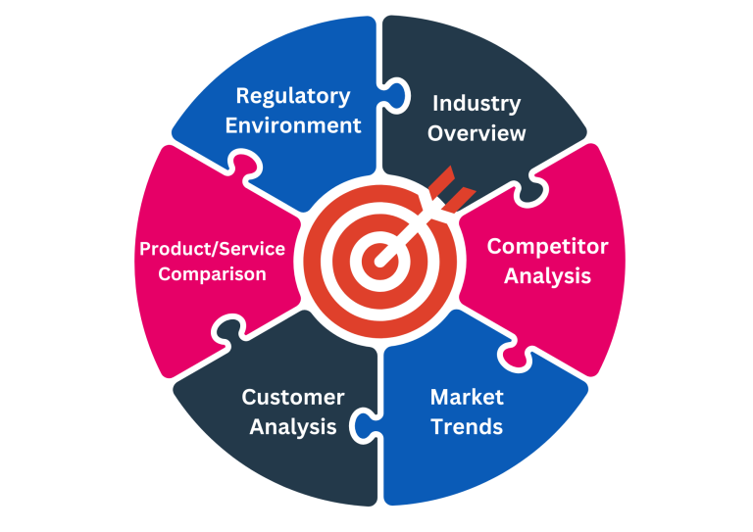
MEDI DASH
02
CHAPTER 02
RELATED WORKS
Market Analysis
& Competitive Landscape
Healthcare Digital Transformation, Existing Systems,
Gaps & Proposed Solution

Slide 11
MEDI DASH
Healthcare Digital Transformation
Industry Evolution
Telemedicine
Integration
Healthcare driven by technological advancements and changing patient expectations
Virtual consultations replacing traditional in-person visits for routine care
Unified platforms connecting all aspects of comprehensive patient care
Patient Expectations
COVID-19 Impact
Patients now expect the same convenience in healthcare as in e-commerce and digital banking — instant access, transparent pricing, and seamless experiences.
The pandemic accelerated digital transformation, demonstrating the viability and necessity of remote healthcare services for continuous patient care.
The healthcare industry has experienced a paradigm shift toward digitalization, driven by technological advancements and changing patient expectations.

Slide 12
MEDI DASH
Existing Systems — Telemedicine
Teladoc Health
Doctor On Demand
Practo
24/7 virtual consultations, mental health services, and chronic condition management.
Video consultations for urgent care, mental health, and preventive care.
Doctor search, appointment booking, online consultations, and health records.
✓ Extensive provider network, global presence
✓ User-friendly, same-day appointments
✓ Large provider database in India/SE Asia
✗ US-focused, higher costs for uninsured
✗ Limited diagnostic capabilities
✗ Inconsistent service quality
Telemedicine Platforms excel at virtual consultations but lack comprehensive care integration.

Slide 13
MEDI DASH
Existing Systems — Integrated Platforms
Zocdoc
HealthTap
mfine
Doctor discovery, appointment scheduling, and patient reviews with comprehensive provider info.
Virtual consultations, AI symptom checker, and prescription management with 24/7 doctor access.
Teleconsultations, diagnostic tests, and health packages with an integrated approach.
✓ Comprehensive provider information
✓ AI symptom checker, 24/7 access
✓ Integrated diagnostics approach
✗ Lacks diagnostic integration
✗ Limited regional availability
✗ Regional limitations
Common Issue: Most platforms excel in individual segments but lack seamless integration.

Slide 14
MEDI DASH
Identified Gaps
Critical limitations in existing digital healthcare systems
1
Fragmented
2
User Experience
3
Data Silos
4
Limited Follow-up
Disconnection between scheduling, records, and care tools
Disjointed transitions between search, scheduling, and consultations
EMRs rarely centralized across independent clinics or apps
Inadequate automation for tracking patient adherence
5
Geographic Limits
6
Price Transparency
7
Diagnostic Gaps
8
Communication
Regional constraints on provider databases and usability
Lack of upfront clarity on consultation fees and costs
Weak pipelines linking virtual assessment to lab systems
Insufficient real-time channels post-consultation
These 8 critical gaps represent the core opportunities that MediDash is designed to address.

Slide 15
MEDI DASH
Proposed Solution
MediDash comprehensive solution addressing all identified gaps
Telemedicine
E-Prescriptions
Health Records
Seamless video, audio, and chat consultations with doctors
Electronic prescriptions with digital signature and tracking
Centralized electronic health records across all touchpoints
Real-time Communication
Transparent Pricing
Continuous channels between patients and doctors
Upfront cost clarity for all consultations and services

Slide 16
MEDI DASH
03
CHAPTER 03
ANALYSIS PHASE
Requirements Analysis
& System Modeling
System Description, Requirements,
UML Diagrams & System Context

Slide 17
MEDI DASH
System Description & Stakeholders
Comprehensive healthcare ecosystem
PRIMARY USERS
Patients
Doctors
Administrators
Seeking consultations, prescriptions, and diagnostic services through an intuitive digital platform
Licensed practitioners providing virtual consultations and electronic prescriptions
System managers overseeing operations, compliance, and user management
SECONDARY STAKEHOLDERS
Payment Gateways
Regulatory Authorities
Third-party payment processors handling billing transactions
Healthcare bodies ensuring compliance and data protection standards

Slide 18
MEDI DASH
Functional Requirements — Part 1
User Registration & Auth
Appointment Management
Virtual Consultation
▸ Email and phone registration for patients
▸ Secure login with multi-factor authentication
▸ Doctor credential verification process
▸ Role-based access control (Patient, Doctor, Admin)
▸ Doctor search by specialty and availability
▸ Book available time slots in real-time
▸ Reschedule and cancel appointments
▸ Appointment reminders via SMS and email
▸ Video and chat support
▸ Medical history access during consultation

Slide 19
MEDI DASH
Functional Requirements — Part 2
Prescription Management
Payment & Billing
Health Records
▸ Electronic prescription creation
▸ Medication details and dosage tracking
▸ Digital signature for authenticity
▸ Prescription history and renewal
▸ Invoice generation per consultation
▸ Multiple payment methods supported
▸ Receipt and refund management
▸ Transparent fee breakdown
▸ Electronic health records (EHR)
▸ Document uploads and management
▸ Role-based access control

Slide 20
MEDI DASH
Functional Requirements — Part 3
Notifications
Administrative Functions
▸ Email and SMS alerts for key events
▸ In-app messaging between users
▸ Appointment reminders and confirmations
▸ Medication dosage reminders
▸ Doctor credential verification
▸ User account management
▸ System monitoring and analytics
▸ Report generation and export
All functional requirements are designed to ensure seamless healthcare delivery across every touchpoint — from patient registration through administrative oversight.

Slide 21
MEDI DASH
Non-Functional Requirements
Ensuring reliable and efficient healthcare delivery
DATA REQUIREMENTS
User Data — Patients (personal info, medical history, allergies), Doctors (license, specialization, fees), Admins (name, email, role, access level)
Appointment & Prescription Data — Patient/doctor IDs, date/time, consultation type, status, fees, medication details, dosage, frequency, digital signature
QUALITY ATTRIBUTES
Usability
Security & Privacy
Performance
Compatibility & Scale
Intuitive interface for all user types and technical skill levels
Authentication, authorization, and encryption for sensitive medical data
Fast booking, real-time notifications, quick record access, minimal loading
Multi-platform support, hospital integration, scalable architecture

Slide 22
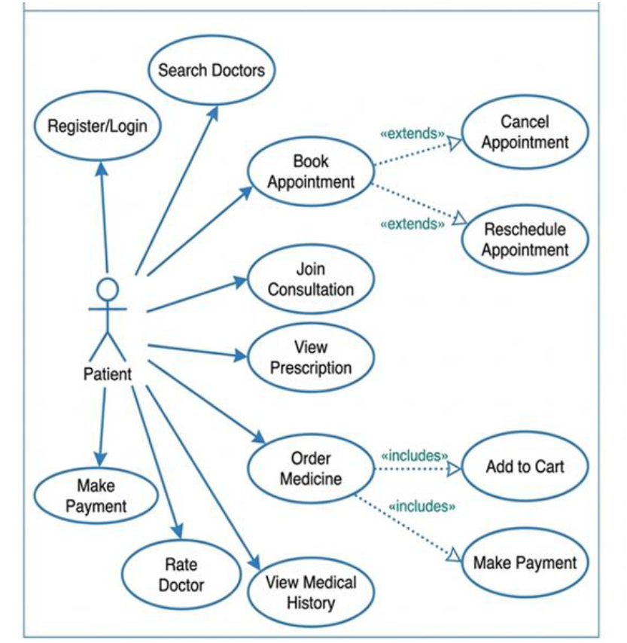
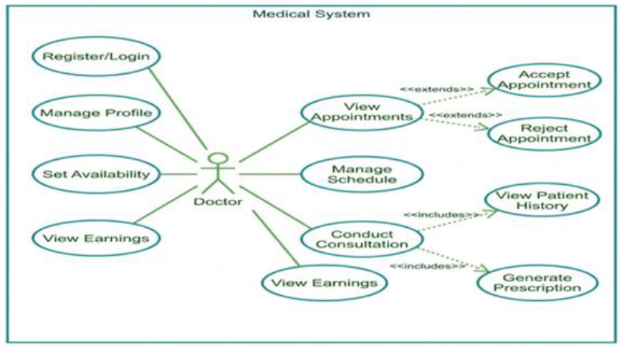
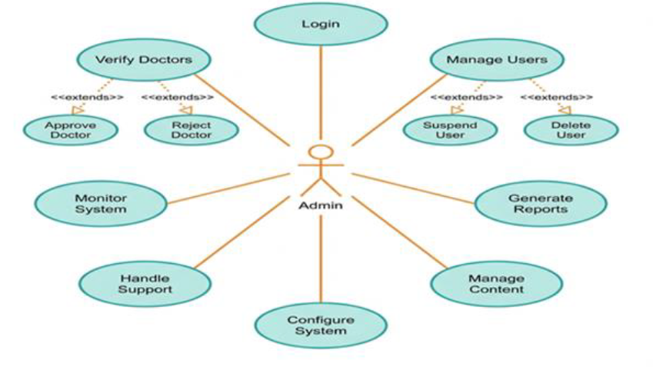
MEDI DASH
Use Case Diagram
USE CASE DIAGRAM PLACEHOLDER
Actors: Patient, Doctor, Administrator
Use Cases: Register, Book Appointment, Consult, View Records, Manage Prescriptions, Verify Doctors, Generate Reports
◆ Insert your Use Case Diagram here ◆
2

Slide 23
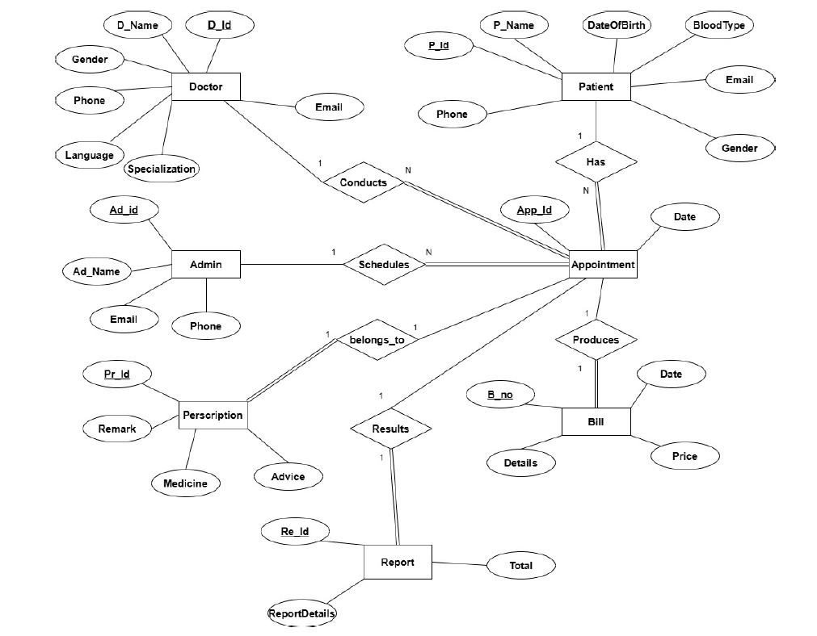
MEDI DASH
Entity Relationship Diagram
ENTITY RELATIONSHIP DIAGRAM PLACEHOLDER
Core Entities: User, Patient, Doctor, Admin, Appointment, Consultation,
Prescription, Medication, Payment, HealthRecord, Notification
◆ Insert your ERD here ◆
2

Slide 24
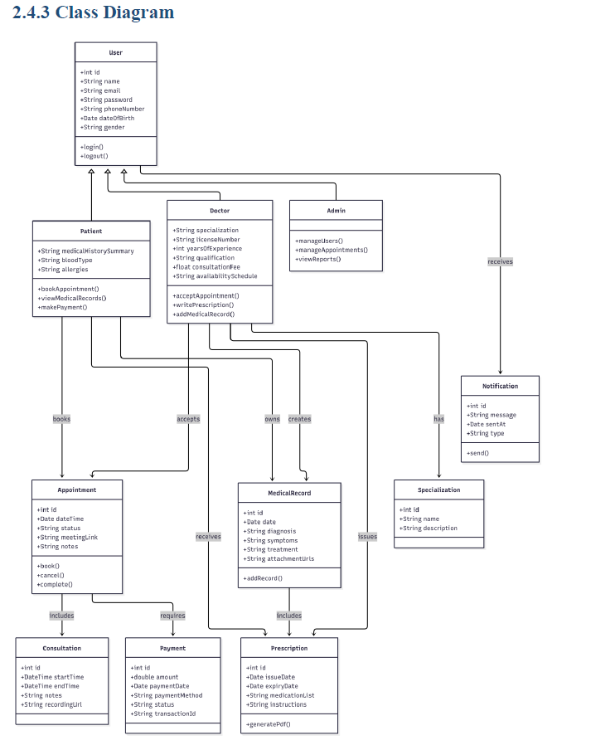
MEDI DASH
Class Diagram
CLASS DIAGRAM PLACEHOLDER
Core Classes: User (Patient, Doctor, Admin), Appointment, Consultation,
Prescription, Medication, Payment, HealthRecord, Notification
◆ Insert your Class Diagram here ◆
25/52

Slide 25
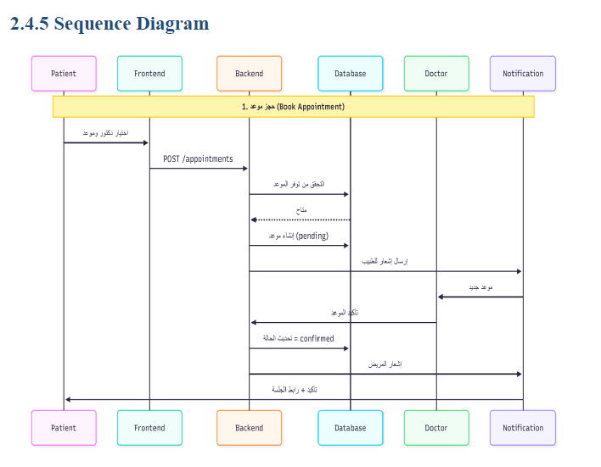
MEDI DASH
Sequence Diagram
SEQUENCE DIAGRAM PLACEHOLDER
Key Scenarios: Appointment Booking Flow, Virtual Consultation Flow,
Prescription Generation Flow, Payment Processing Flow
◆ Insert your Sequence Diagram here ◆
26/52

Slide 26
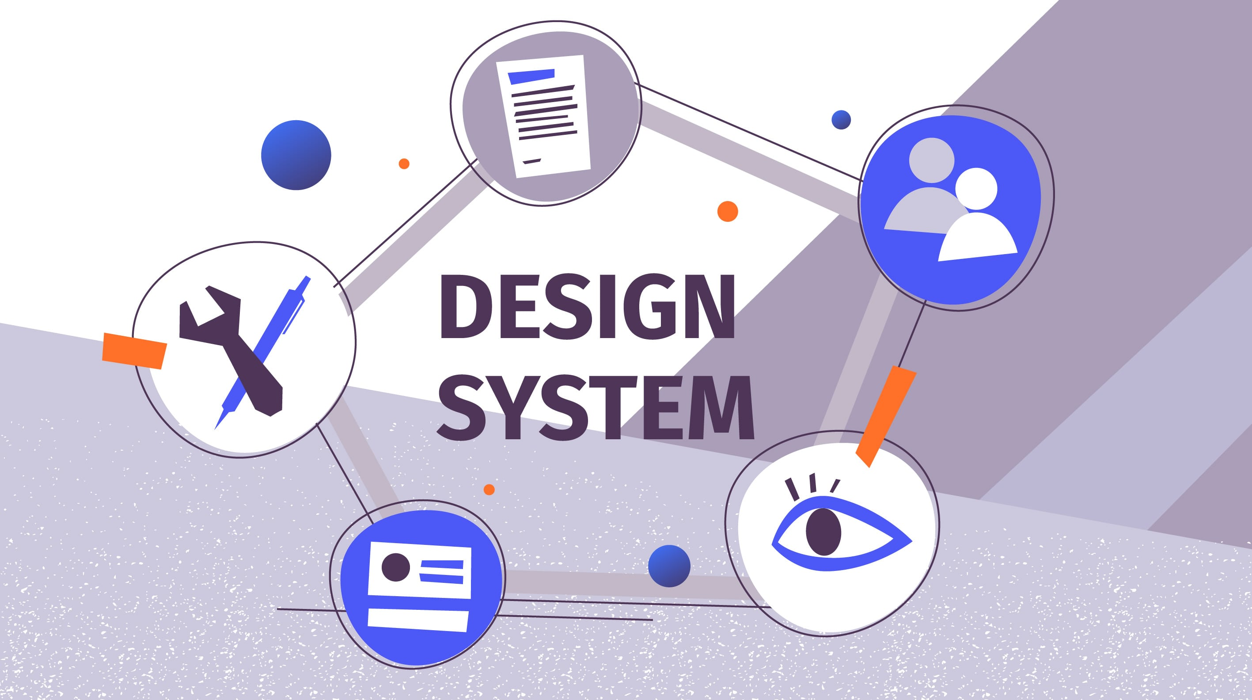
MEDI DASH
04
CHAPTER 04
SYSTEM DESIGN PHASE
Architecture Design
& Data Modeling
System Architecture, Data Flow,
DFD & Database Design

Slide 27
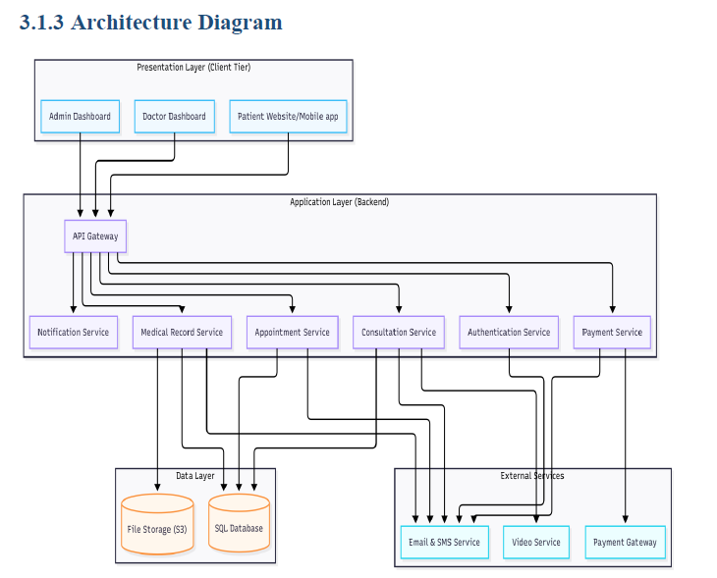
MEDI DASH
System Architecture Diagram
3-TIER SYSTEM ARCHITECTURE PLACEHOLDER
Presentation Layer — Web Client, Mobile App, Admin Dashboard
Application Layer — API Gateway, Business Logic, AI Chatbot Service
Data Layer — SQL Server Database, File Storage, Cache Layer
◆ Insert your Architecture Diagram here ◆

Slide 28
MEDI DASH
Data Flow Overview
KEY DATA FLOWS
Registration
Appointments
Consultation
Patient profile data flow
Booking and confirmation flow
Session and prescription flow
Payment
Health Records
Notifications
Processing and receipt flow
Storage and retrieval flow
Trigger and delivery flow

Slide 29
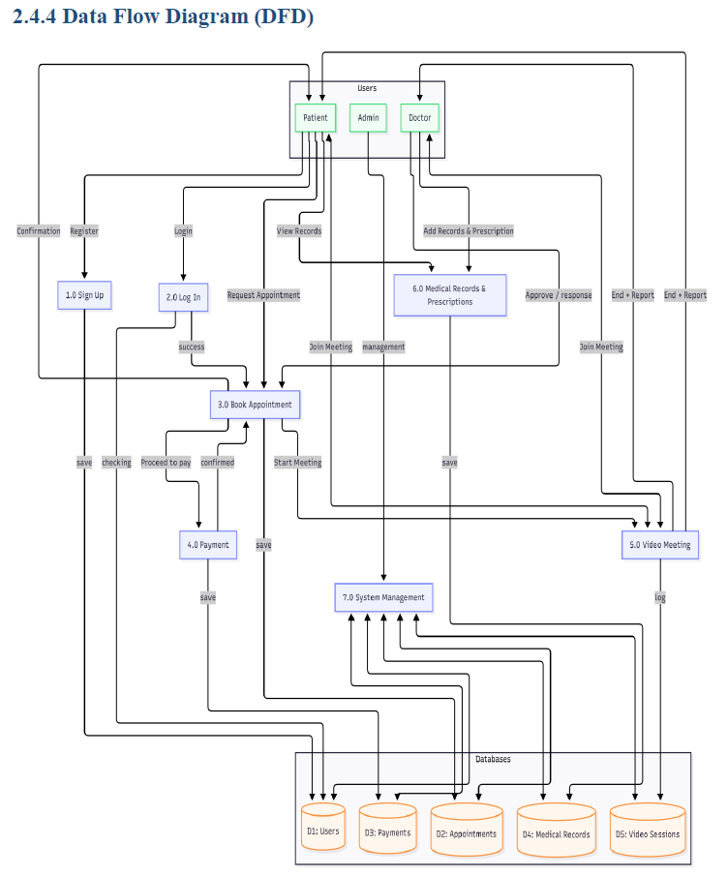
MEDI DASH
DFD
DFD LEVEL 0 — CONTEXT DIAGRAM PLACEHOLDER
External Entities: Patient, Doctor, Administrator, Payment Gateway, Notification Service
Central Process: Online Medical System
◆ Insert your DFD Level 0 here ◆
30/52

Slide 30
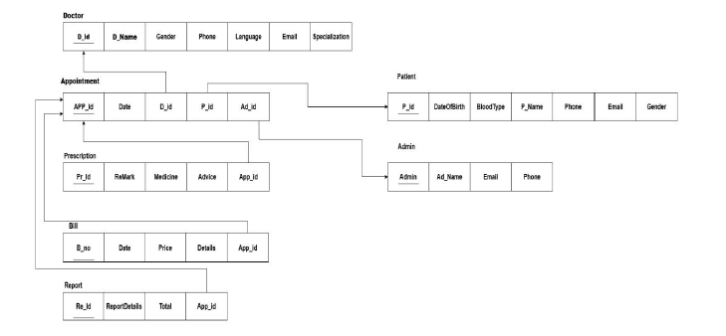
MEDI DASH
Database Design Schema — Overview
DATABASE SCHEMA — OVERVIEW PLACEHOLDER
Core Tables: Users, Patients, Doctors, Admins, Appointments, Consultations,
Prescriptions, Medications, Payments, HealthRecords, Notifications
◆ Insert your Database Schema Overview here ◆

Slide 31

MEDI DASH
05
CHAPTER 05
AI CHATBOT
Intelligent Patient
Support
Intelligent Patient Support
AI Objectives, Architecture,
Technologies & Features

Slide 32
MEDI DASH
AI Chatbot Introduction
AI-Powered Healthcare Chatbot
Intelligent assistant designed to help patients 24/7
24/7 Availability
Symptom Assessment
MEDIDASH AI ASSISTANT
Instant responses anytime, anywhere for patient convenience
Preliminary guidance and symptom evaluation
Your intelligent healthcare companion — providing instant support, symptom checking, and seamless doctor referrals around the clock.
Health Q&A
Answers to common health questions and concerns

Slide 33
MEDI DASH
Objectives of the AI Chatbot
1
24/7 Patient Support
2
Symptom Assessment
3
Health Q&A
Provide round-the-clock patient support with instant responses to inquiries
Perform preliminary symptom assessment and guidance for patients
Answer common health questions and concerns from patients
4
Doctor Escalation
5
Reduce Admin Burden
6
Patient Engagement
Enable seamless escalation to human doctors when needed
Reduce administrative burden through automation of routine inquiries
Improve patient engagement through proactive communication
Six core objectives driving the AI Chatbot development for enhanced patient care

Slide 34
MEDI DASH
AI Technologies Used
Python
NLP
Core AI development language — powering the chatbot backend with robust machine learning libraries and frameworks
Natural Language Processing — for understanding patient queries in conversational language and extracting intent
Machine Learning
EHR Integration API
For symptom assessment and personalized recommendations based on patient history and medical data
For accessing patient medical records and providing context-aware responses with full health history

Slide 35
MEDI DASH
Features of the AI Chatbot
KEY FEATURES
Natural Language Processing
Multi-language Support
Personalized Recommendations
Understanding patient queries
Accessibility for diverse populations
Based on medical history
Emergency Detection
EHR Integration
Analytics Dashboard
Immediate escalation protocols
Context-aware responses
Continuous improvement insights
BENEFITS
Reduced Wait Times
Improved Engagement
Decreased Admin Burden
Instant responses eliminate long waiting periods
Proactive communication and support
Automated handling of routine inquiries

Slide 36

MEDI DASH
06
CHAPTER 06
IMPLEMENTATION
Web & Mobile
Deployment
Web & Mobile Deployment
Website and Mobile Application
Demonstration

Slide 37
MEDI DASH
Website Video Demonstration
WEBSITE VIDEO PLACEHOLDER
Click here to view Website Video →
Website implementation showcase. Customize the link above with your website video URL.

Slide 38
MEDI DASH
Mobile Application Video Demonstration
MOBILE APPLICATION VIDEO PLACEHOLDER
Click here to view Mobile App Video →
Mobile application implementation showcase. Customize the link above with your mobile app video URL.

Slide 39

MEDI DASH
07
CHAPTER 07
TESTING
Quality Assurance
& Validation
Quality Assurance & Validation
Unit, Integration, System, UAT
& Performance Testing

Slide 40
MEDI DASH
Testing Strategy
Comprehensive testing approach covering all system layers
Unit Testing
Integration Testing
System Testing
UAT
Performance
Modules tested for isolated functionality
Cross-module interactions validated for data integrity
End-to-end scenarios verified against requirements
Feedback collected from real-world end-users
Load metrics and concurrency stability
Testing processes including Unit, Integration, System, and User Acceptance testing fully executed.

Slide 41
MEDI DASH
Unit & Integration Testing
Unit Testing
Integration Testing
▸ Individual modules successfully tested for isolated functionality
▸ Each component verified independently to ensure correct behavior
▸ All critical functions validated with edge case coverage
▸ Automated test suites for regression prevention
▸ Cross-module interactions validated for data integrity
▸ API endpoints tested for proper request/response handling
▸ Database operations verified for consistency across connected modules
▸ Third-party service integrations confirmed working

Slide 42
MEDI DASH
System & UAT Testing
System Testing
User Acceptance Testing (UAT)
▸ End-to-end scenarios verified against all system requirements
▸ Complete user workflows tested from registration through consultation and payment
▸ Security vulnerabilities identified and resolved
▸ Data integrity confirmed across all system operations
▸ Feedback collected and confirmed by real-world end-users
▸ Both patients and doctors validated the system meets their needs
▸ Usability testing confirmed intuitive interface design
▸ All critical user journeys completed successfully

Slide 43
MEDI DASH
Performance & Testing Summary
Performance Testing
Testing Summary
▸ Load metrics and concurrency stability achieved
▸ System tested under expected user loads
▸ Response times within acceptable thresholds
▸ Scalability confirmed for growing user base
✓ All major tests passed successfully
✓ Quality assurance standards met
✓ System ready for production deployment
✓ Confidence in reliability and performance
ALL TESTS PASSED
The system meets all quality standards and is ready for deployment.

Slide 44

MEDI DASH
08
CHAPTER 08
CONCLUSION
Results & Future
Roadmap
Results & Future Roadmap
Summary of Achieved Results &
Possible Extensions

Slide 45
MEDI DASH
Summary of Achieved Results
The Online Medical System successfully delivered:
A fully functional web application built with ASP.NET and React
A cross-platform mobile application built with Flutter
An integrated AI-powered chatbot for 24/7 patient support
Complete appointment, consultation, and prescription management
Secure user authentication and role-based access control
A centralized electronic health records system
A comprehensive, integrated healthcare management platform successfully delivered.

Slide 46
MEDI DASH
Future Development
Possible extensions and enhancements
Wearable Integration
AI Diagnostics
Insurance Module
Integration with wearable health devices (smartwatches, monitors)
Advanced AI diagnostics with medical imaging support
Insurance and health coverage management module
Multi-Hospital Network
Voice Assistant
Multi-hospital / multi-clinic network support for expanded healthcare coverage
Voice assistant support for elderly and accessibility needs

Slide 47
MEDI DASH
THANK YOU
شكراً لكم
MEDI DASH
Online Medical System
Building the Future of Digital Healthcare
2026

