Slide 1

Online Medical System
A Comprehensive Healthcare Management Platform
2025

Slide 2
Contents
01
Introduction & Overview
02
Related Works
Project vision and purpose
Surveys and comparison
03
Development Methodology
04
Tools & Technologies
Agile approach
Technical stack
05
System Analysis & Design
06
Implementation
Research and literature survey
Screenshots of web app, mobile app, AI

Slide 3
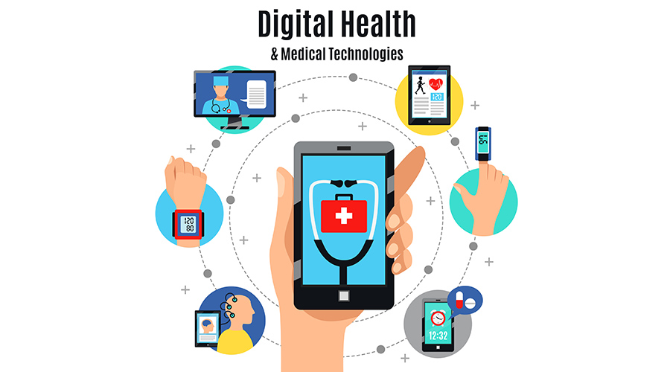
01
Introduction &
Overview
Understanding the vision and purpose of the Online Medical System

Slide 4

Project Overview
Our Vision
Health is life's most important priority, yet managing medical needs remains challenging. Our Online Medical System transforms healthcare delivery through digital innovation.
For Patients
For Doctors
Easy appointment booking, doctor selection, medical history access
Schedule management, patient communication, prescription tools
Key Benefits
Time & effort savings
Organized medical information
Accessible for elderly users

Slide 5
Project Objectives
Five key goals driving our healthcare innovation
1
2
3
4
5
Automation
Efficiency
Accessibility
Choice
Inclusivity
Replace manual clinic management with an automated digital system
Reduce time, cost, and effort required for all healthcare processes
Facilitate easy retrieval of patient medical history and information
Enable patients to choose doctors based on cost and rating
Support all age groups, especially elderly patients
Our mission: Making healthcare accessible, efficient, and user-friendly for everyone

Slide 6

Problem Statement
Challenges in traditional healthcare management
Data Management Issues
Information Gap
Data loss risks
Patients lack sufficient information about nearby clinics, services, and available doctors
Data redundancy
Difficult retrieval
Booking Inefficiency
Memory Challenges
Manual appointment booking wastes time and causes delays for patients and staff
Elderly patients struggle to remember medication doses and scheduled appointments
System Fragmentation
Our Solution
Absence of an integrated system makes organizing medical records and providing smooth healthcare experience difficult
A comprehensive digital platform that addresses all these challenges through automation, integration, and user-friendly design.

Slide 7

02
Related
Works
Background research and literature survey

Slide 8
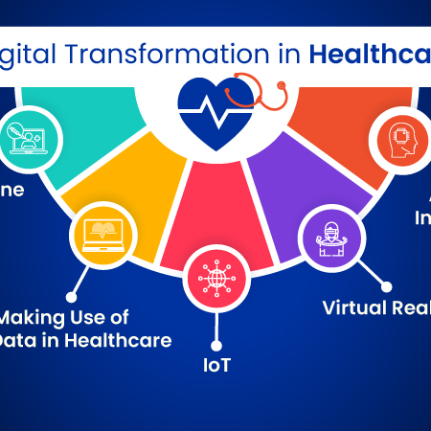
Healthcare Digital Transformation
The paradigm shift toward digital healthcare delivery
Industry Evolution
The healthcare industry has experienced a paradigm shift toward digitalization, driven by technological advancements and changing patient expectations.
Telemedicine
Integration
Virtual consultations replacing traditional visits
Unified platforms for comprehensive care
Patient Expectations
COVID-19 Impact
Patients now expect the same convenience in healthcare as in e-commerce and digital banking.
Accelerated transformation, demonstrating viability of remote healthcare services

Slide 9
Review of Existing Systems
Analysis of current healthcare platforms globally
Telemedicine
E-Pharmacy
Integrated
Teladoc Health
1mg (Tata 1mg)
Zocdoc
24/7 virtual consultations, mental health services
Online medicine ordering, diagnostic tests
Doctor discovery, scheduling, reviews
Limited pharmacy integration
Limited telemedicine
No prescriptions
Doctor On Demand
PharmEasy
HealthTap
Video consultations for urgent care
Medicine delivery, subscription models
Virtual consultations, AI symptom checker
No integrated pharmacy
Separate consultation service
Limited pharmacy partnerships
Practo
Doctor search, appointment booking
Limited e-pharmacy
Common Issue: Most platforms excel in ONE area but lack seamless integration across services

Slide 10
Identified Gaps & Proposed Solution
Addressing 10 critical limitations in existing systems
10 Identified Gaps
1
Fragmented Services - No seamless integration
2
User Experience - Disjointed transitions
3
Data Silos - Records not centralized
4
Limited Follow-up - No adherence monitoring
5
Prescription Issues - Weak verification
6
Geographic Limits - Regional constraints
7
Price Transparency - Limited cost visibility
8
Diagnostic Gaps - Poor integration
Our Comprehensive Solution
9
Communication - Insufficient channels
10
Trust Issues - Quality concerns
Telemedicine consultations
Electronic prescriptions
Centralized health records
Real-time communication
Transparent pricing

Slide 11
03
Development
Methodology
Agile method

Slide 12
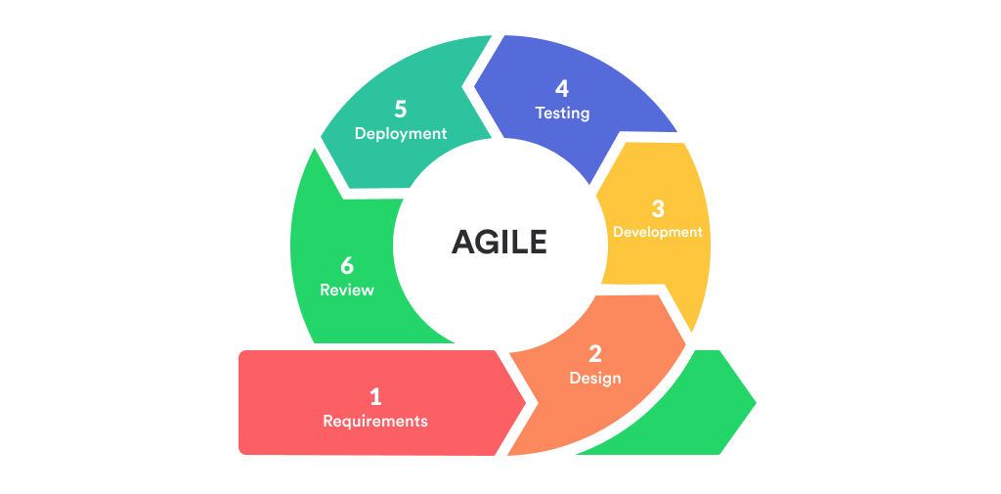
What is Agile Methodology?
Iterative & Incremental Approach
Customer-Centric
Instead of building the whole system at once, we break it into small, manageable chunks called "Sprints" (usually 2-4 weeks).
Focuses on delivering value to the user (doctors/patients) early and often.
Continuous Feedback
Adaptability
We test and review the product after every sprint to make sure we are on the right track.
Agile welcomes changes, even late in the development process, which is crucial for the evolving medical field.

Slide 13
Why Agile for Online Medical Systems?
Safety & Compliance
Rapid Response to User Needs
Medical regulations (like HIPAA) are strict. Agile allows for continuous auditing and ensuring security standards are met at every stage.
Doctors might find a specific feature (like e-prescribing) needs a different workflow. Agile lets us pivot quickly without restarting the project.
Risk Mitigation
Stakeholder Alignment
By testing small parts of the system early, we catch critical bugs (like data errors) before they affect actual patients.
Keeps doctors, clinic managers, and developers in constant communication, ensuring the final product actually solves real-world medical problems.

Slide 14

04
Technologies
& Tools
Technical stack and development tools powering our system

Slide 15


Technology Stack
Modern technologies for a robust healthcare platform
Web Back-End
Web Front-End
ASP.NET
HTML
Server-side framework
Structure and content
CSS
Styling and layout
AI
JavaScript
Interactive functionality
React
python
Modern UI framework
Mobile App
Database
Flutter
SQL Server
Cross-platform development
Relational database management

Slide 16

05
System Analysis
& Design
Architecture, stakeholders, and system specifications and diagrams

Slide 17
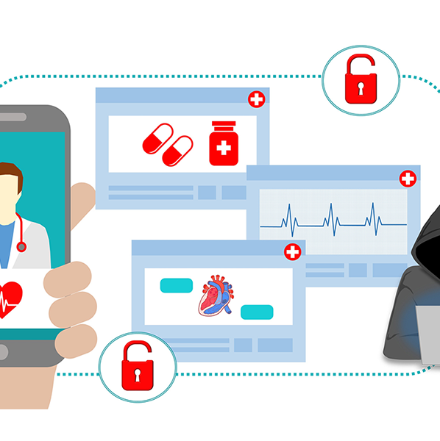
System Context & Stakeholders
Comprehensive healthcare ecosystem
Primary Users
Patients
Seeking consultations, prescriptions, medications, and diagnostic services
Doctors
Licensed practitioners providing virtual consultations and prescriptions
Administrators
System managers overseeing operations, compliance, and user management
Secondary Stakeholders
Payment Gateways
Regulatory Authorities
Third-party payment processors
Healthcare and pharmaceutical bodies

Slide 18
Functional Requirements
Key capabilities our system must support
User Registration & Authentication
Appointment Management
Virtual Consultation
Prescription Management
Doctor search by specialty
Video, audio, chat support
Electronic prescription creation
Email/phone registration
Book available time slots
Medical history access
Medication details tracking
Secure login with MFA
Reschedule & cancel
File sharing capability
Digital signature
Doctor credential verification
Payment & Billing
Health Records
Notifications
Administrative Functions
Invoice generation
Electronic health records
Email & SMS alerts
Doctor verification
Multiple payment methods
Document uploads
In-app messaging
User account management
Receipt & refund management
Role-based access control
Appointment reminders
System monitoring

Slide 19
Data & Non-Functional Requirements
Ensuring reliable and efficient healthcare delivery
Data Requirements
Non-Functional Requirements
User Data
Usability
Patients: Personal info, medical history, allergies
Doctors: License, specialization, fees
Admins: Name, email, role, access level
Easy to use, intuitive interface for all user types and technical skill levels
Security & Privacy
Protect sensitive medical data with authentication, authorization, and encryption
Appointment Data
Patient/doctor IDs, date/time, consultation type, status, fees, notes
Performance
Fast booking, real-time notifications, quick record access, minimal loading times
Prescription Data
Prescription ID, medication details, dosage, frequency, digital signature
Compatibility & Scalability
Multi-platform support, hospital integration, scalable for growing users and data
Transaction & Health Records
Transaction details, document uploads, file organization

Slide 20
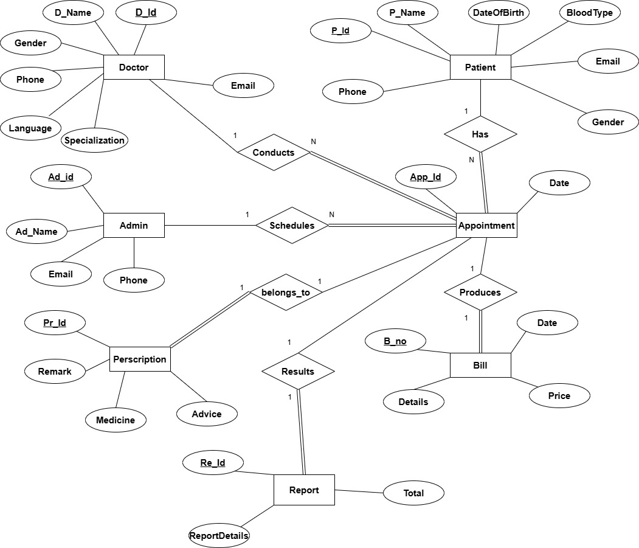
ERD Diagram
This slide is intentionally left blank
Insert your Entity Relationship Diagram here

Slide 21
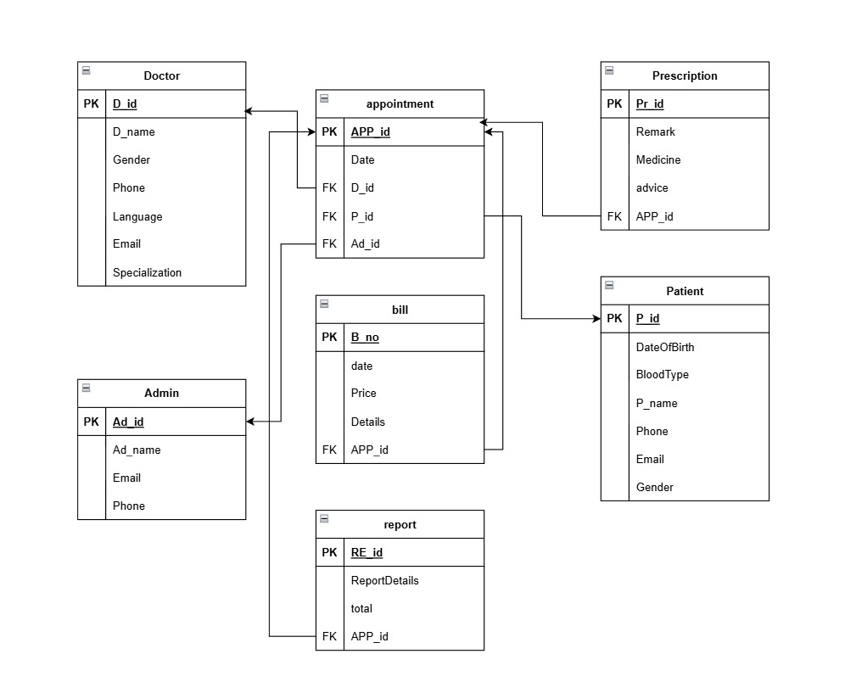
schema
Database Schema
This slide is intentionally left blank
Insert your Database Schema Diagram here

Slide 22
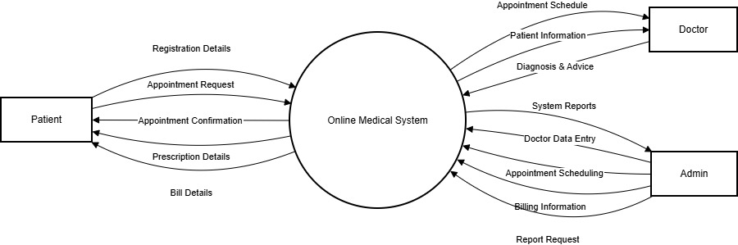
dfd level 0
DFD Diagram
This slide is intentionally left blank
Insert your Data Flow Diagram here

Slide 23
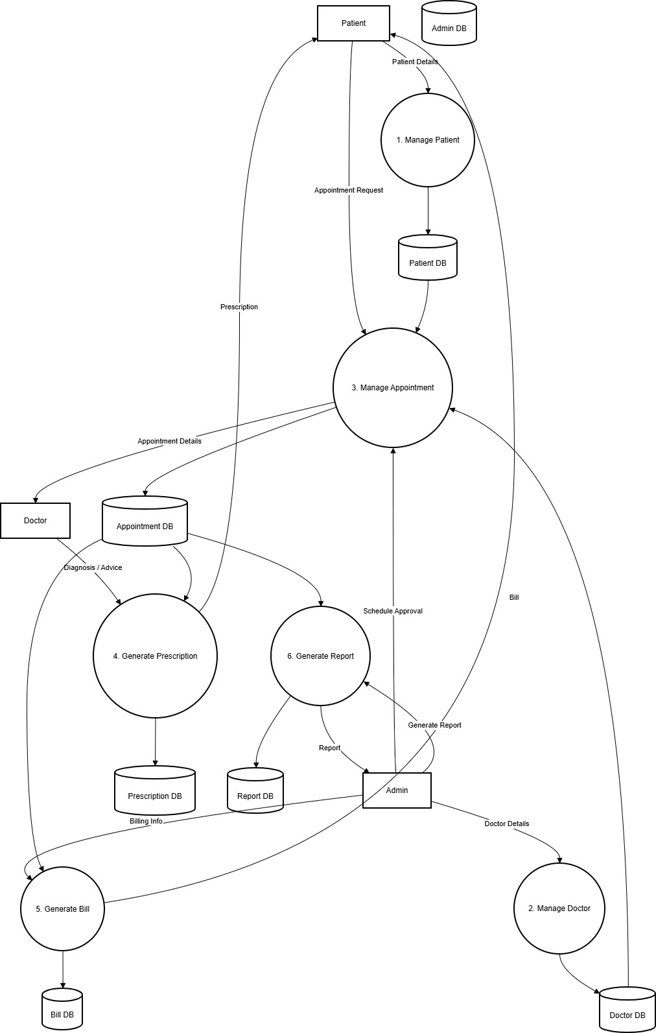
dfd level 1
System Architecture
This slide is intentionally left blank
Insert your System Architecture Diagram here

Slide 24
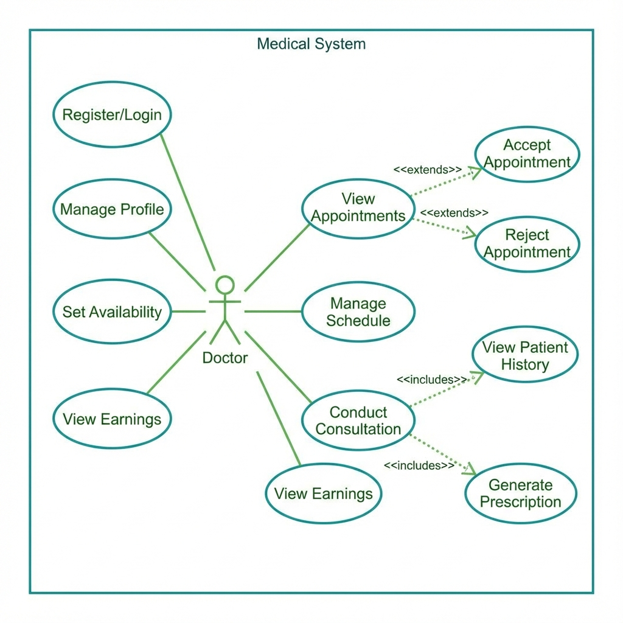
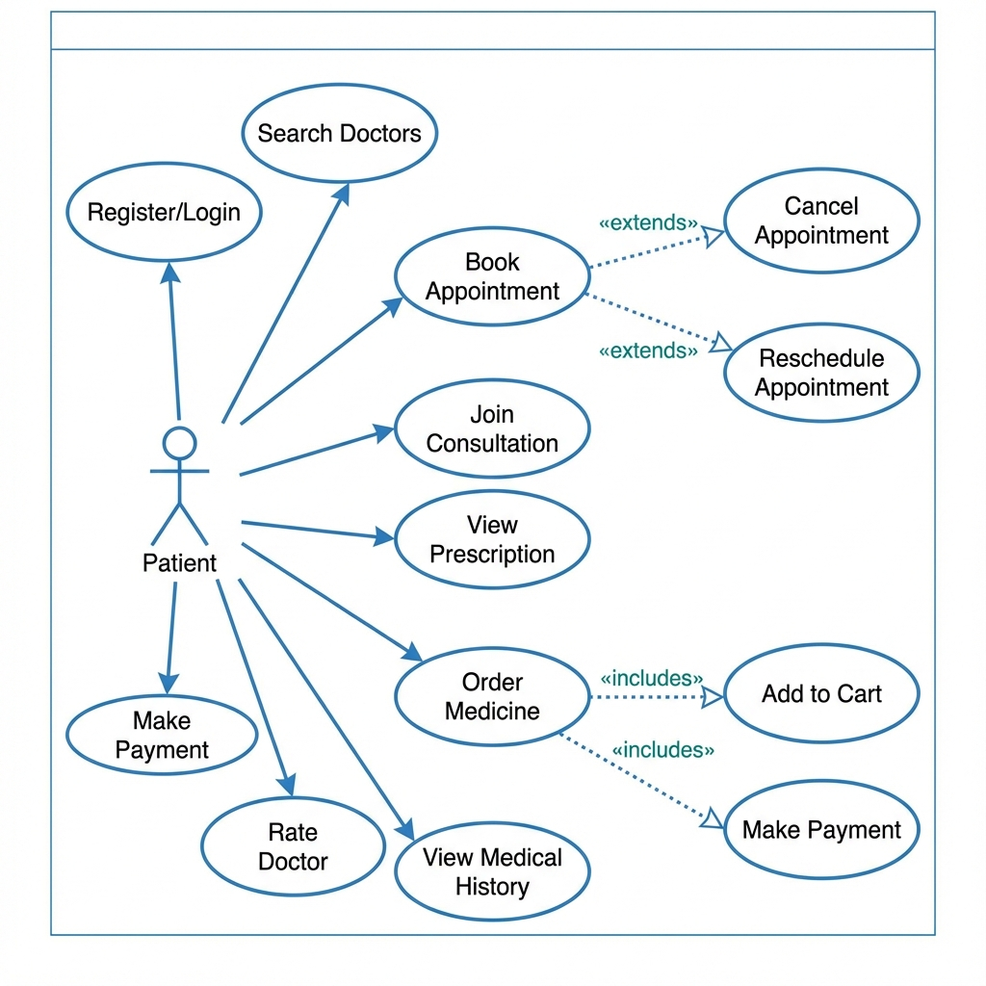
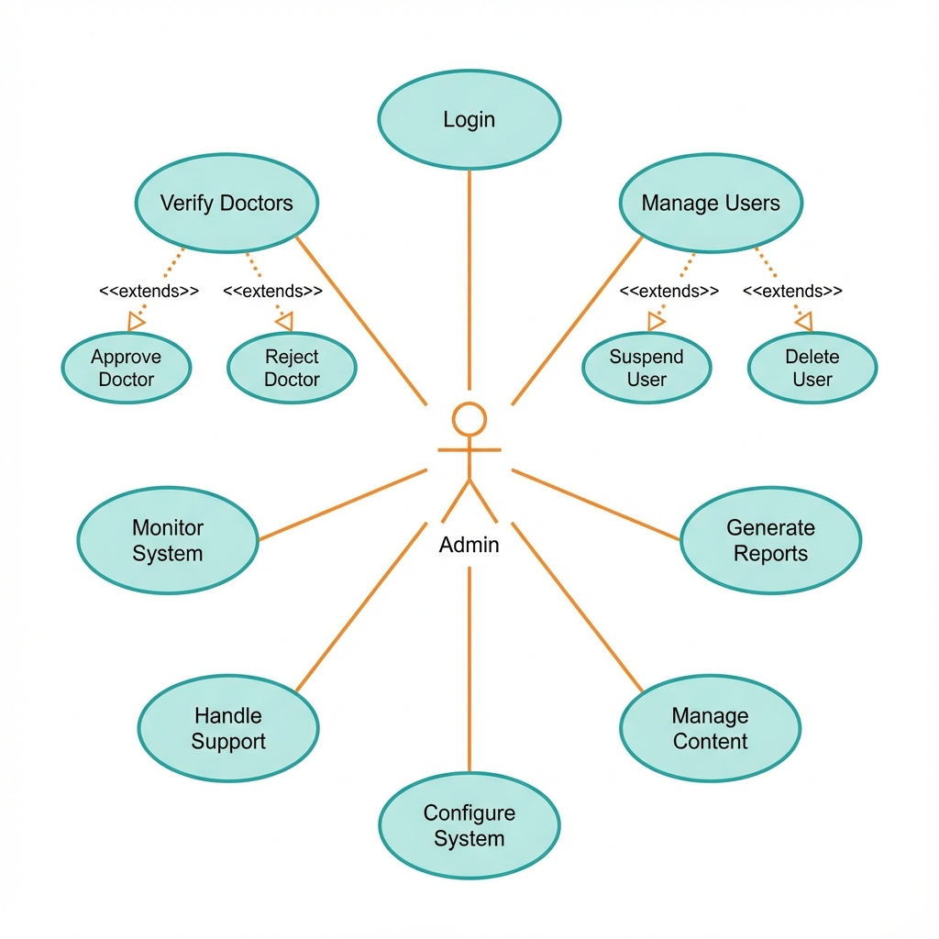
use cases
Use Case Diagram
This slide is intentionally left blank
Insert your Use Case Diagram here

Slide 25
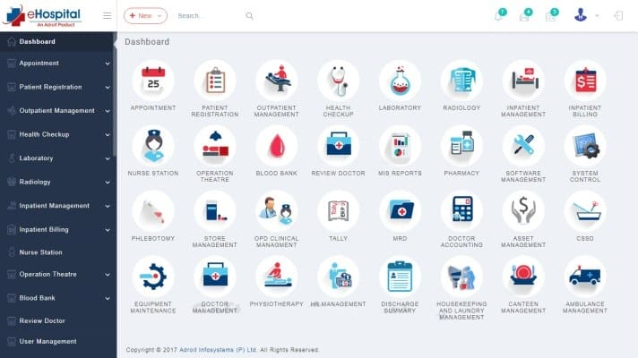
06
Implementation
Screenshots of the web & app and AI

Slide 26

AI-Powered Healthcare Chatbot
Intelligent assistant designed to help patients 24/7
24/7 Availability
Symptom Assessment
Instant responses anytime, anywhere for patient convenience
Preliminary guidance and symptom evaluation
Health Q&A
Doctor Handoff
Answers to common health questions and concerns
Seamless escalation to human doctors when needed

Slide 27
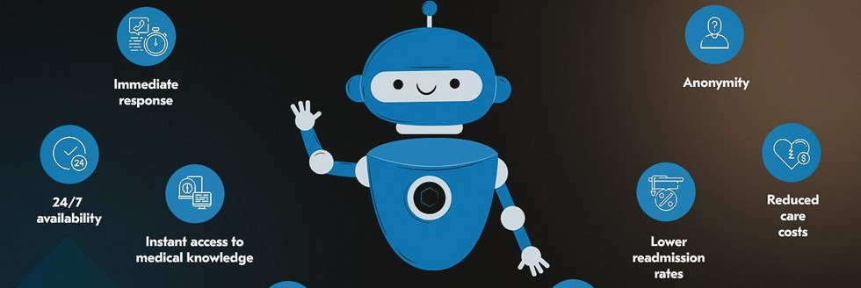
Chatbot Features & Benefits
Advanced capabilities for enhanced patient care
Key Features
Natural Language Processing
Understanding patient queries in conversational language
Multi-language Support
Accessibility for diverse patient populations
Personalized Recommendations
Benefits
Based on individual medical history and preferences
Reduced Wait Times
Emergency Detection
Instant responses eliminate long waiting periods
Immediate escalation protocols for urgent cases
Improved Patient Engagement
Proactive communication and support
EHR Integration
Context-aware responses with patient record access
Decreased Administrative Burden
Automated handling of routine inquiries
Analytics Dashboard
Continuous improvement through data insights

Slide 28
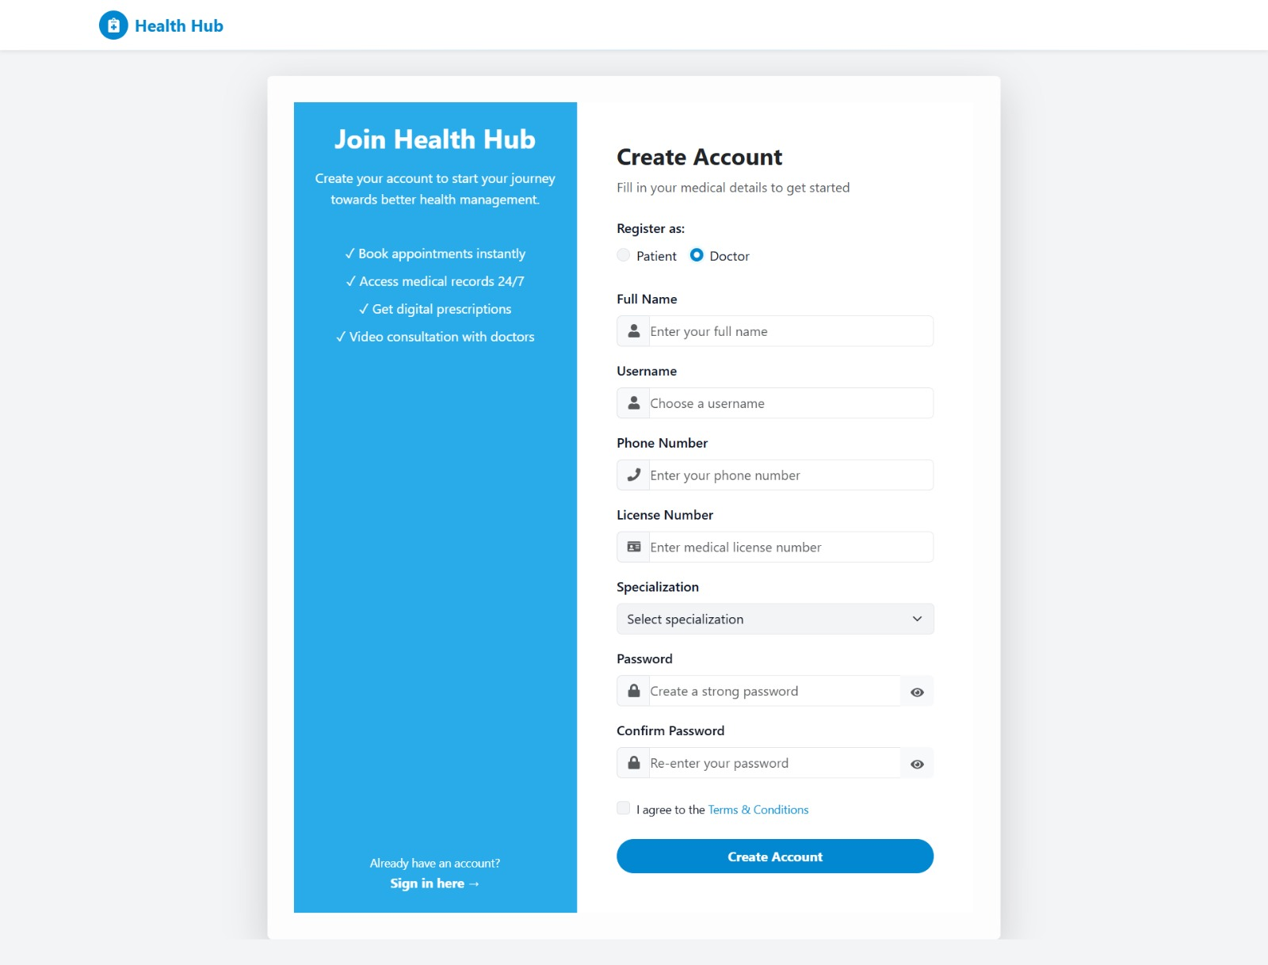
website
Screenshot Placeholder
This slide is intentionally left blank
Insert your screenshot or diagram here

Slide 29
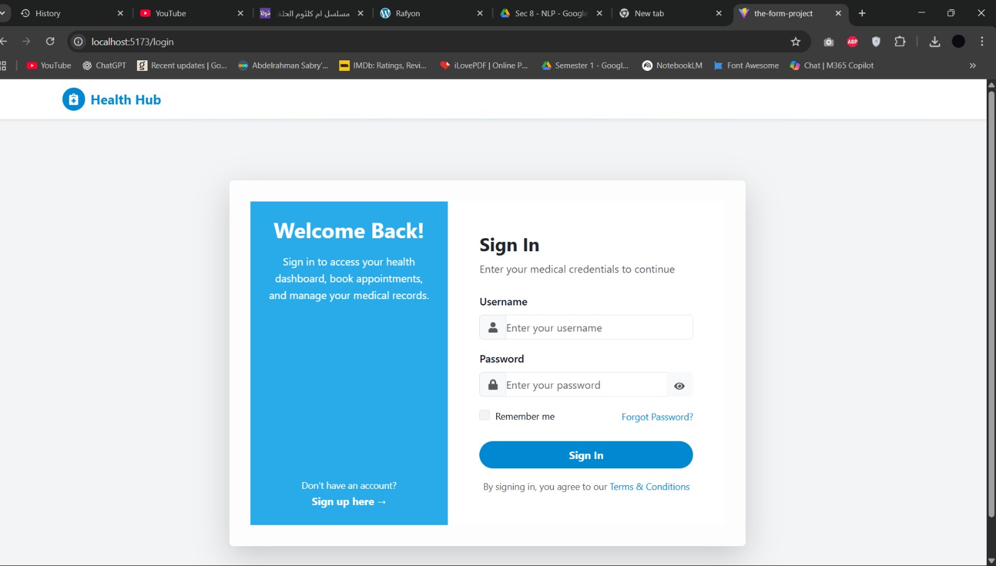
Screenshot Placeholder
This slide is intentionally left blank
Insert your screenshot or diagram here

Slide 30
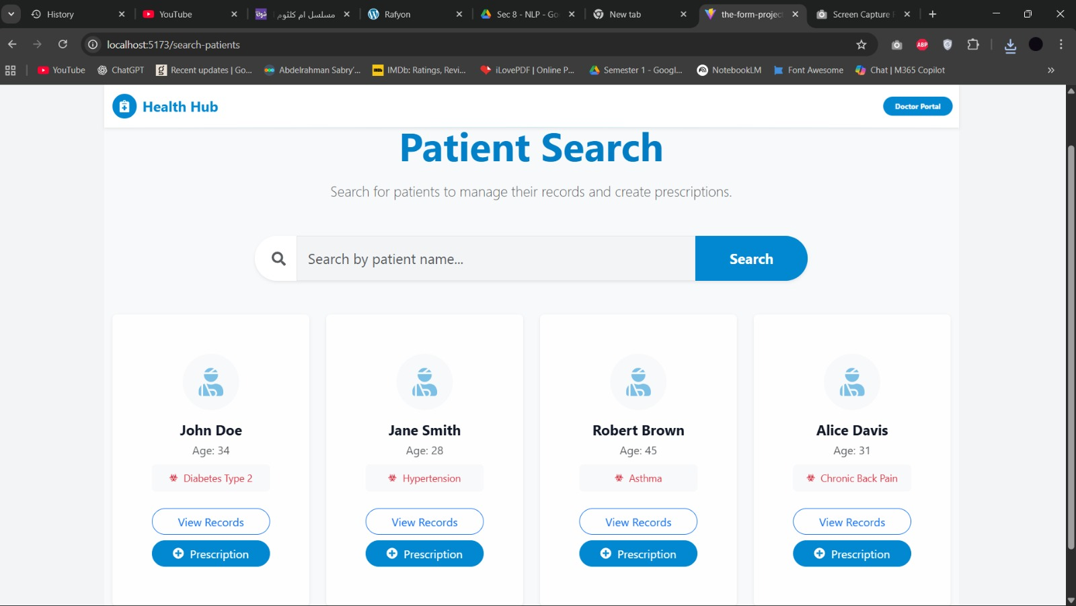
Screenshot Placeholder
This slide is intentionally left blank
Insert your screenshot or diagram here

Slide 31
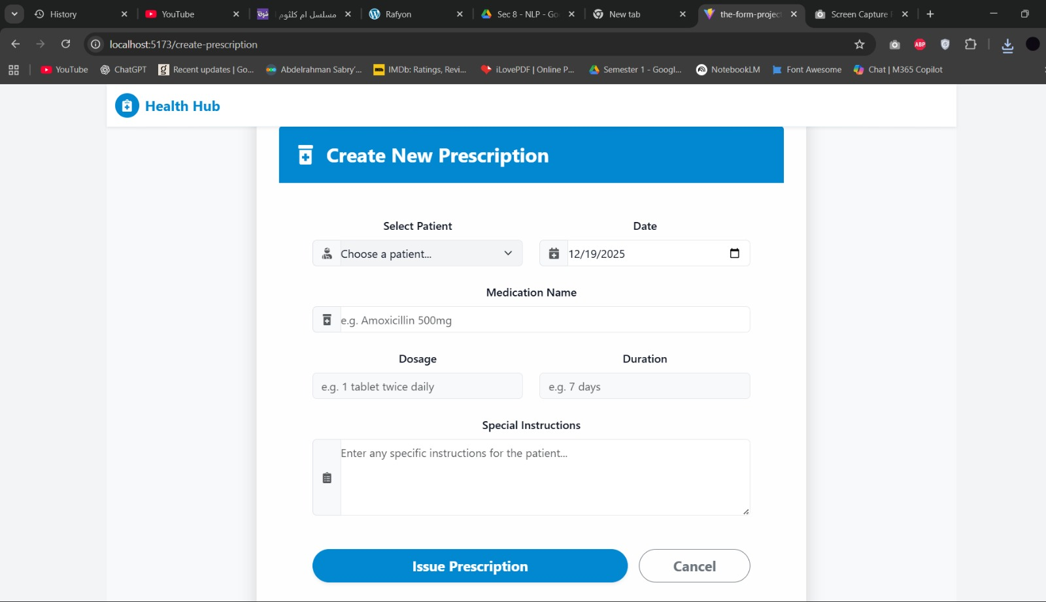
Screenshot Placeholder
This slide is intentionally left blank
Insert your screenshot or diagram here

Slide 32
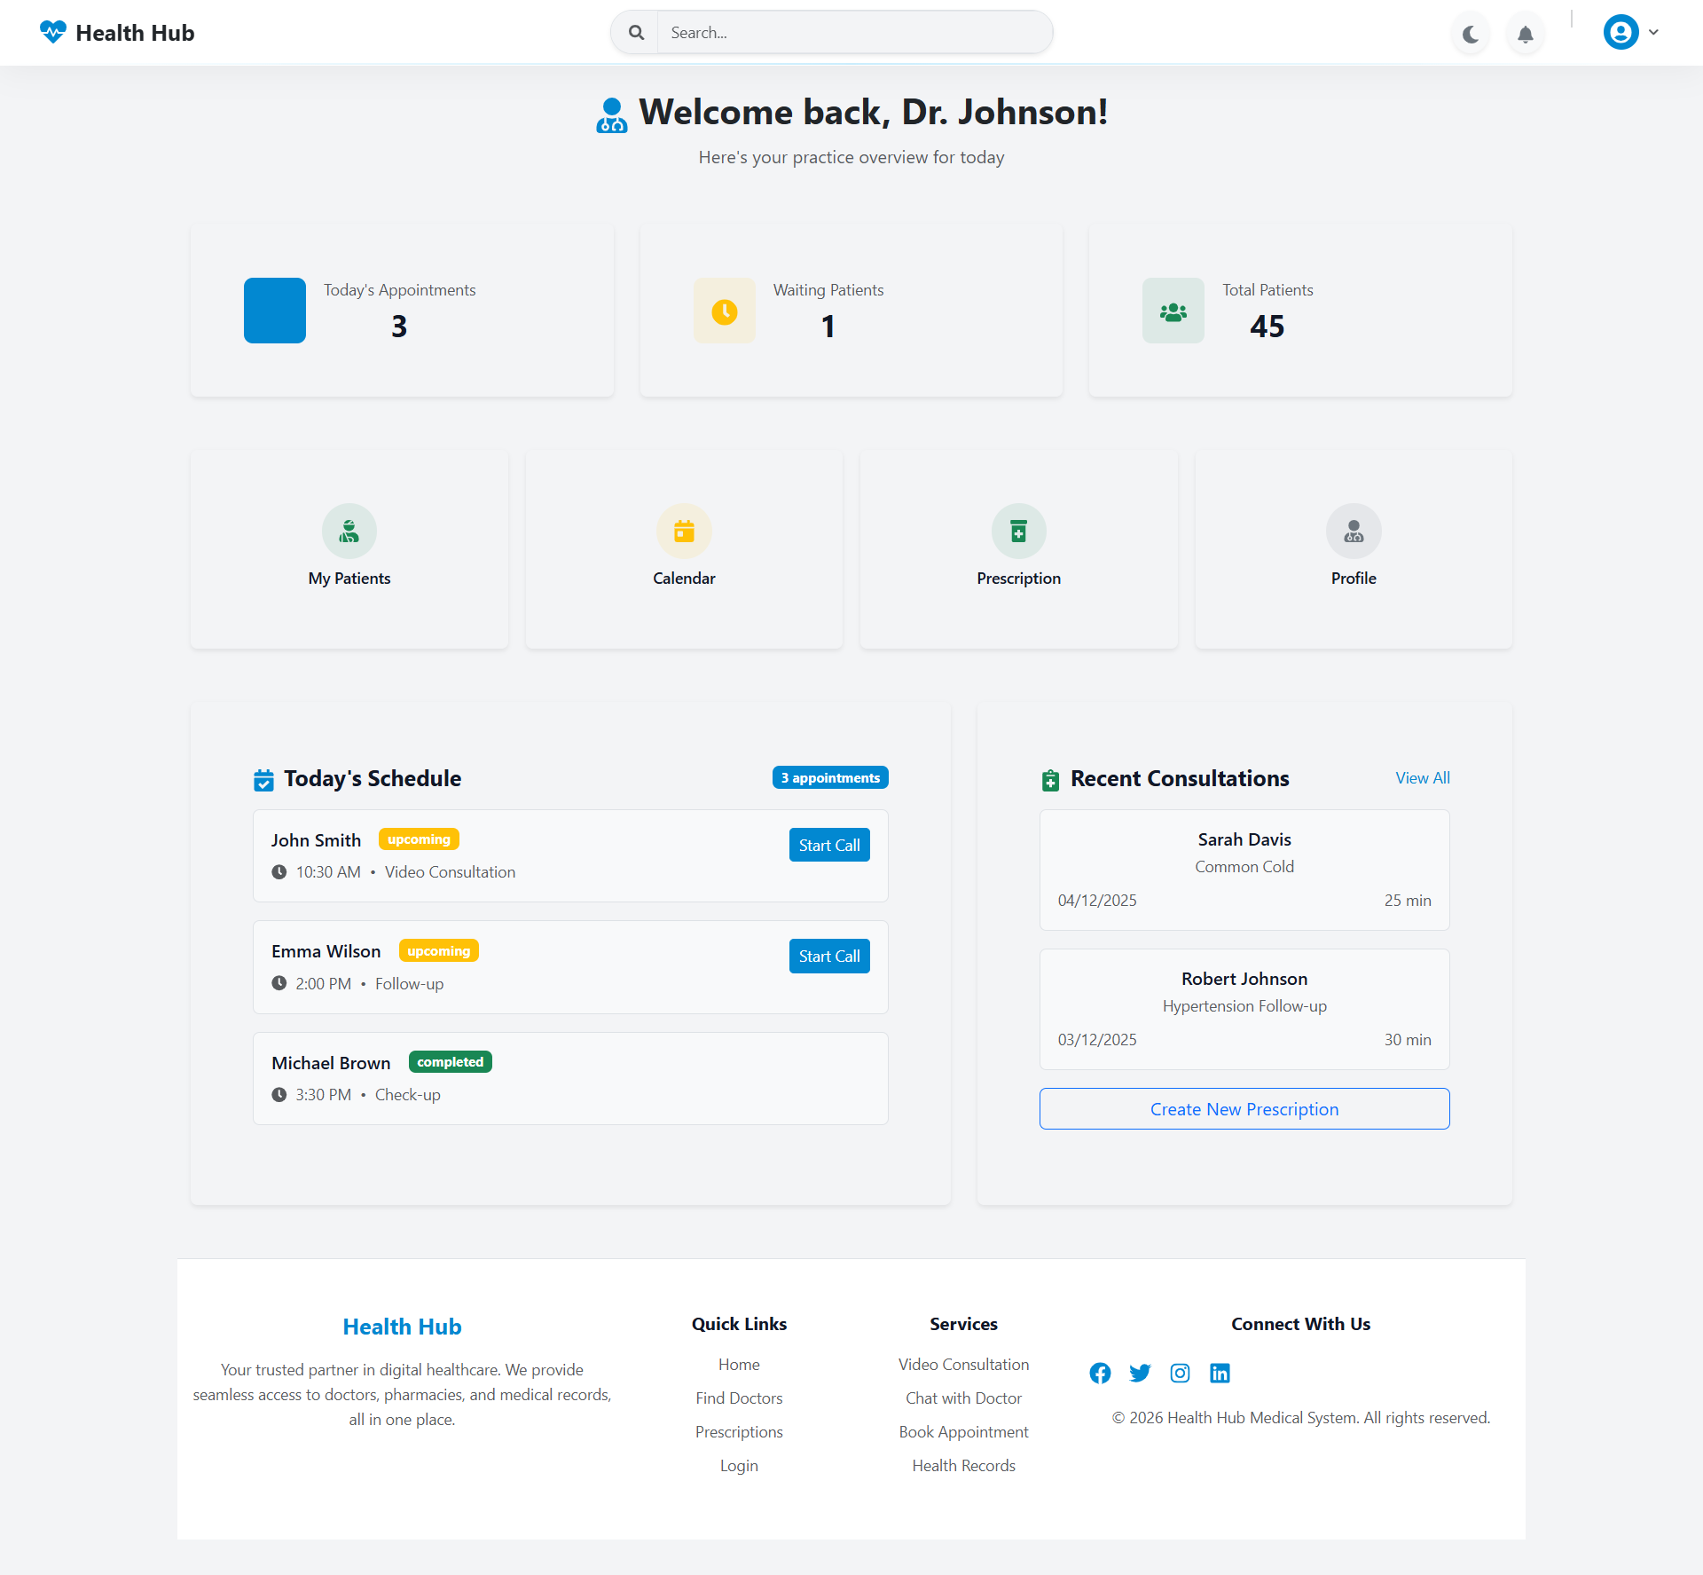
Screenshot Placeholder
This slide is intentionally left blank
Insert your screenshot or diagram here

Slide 33
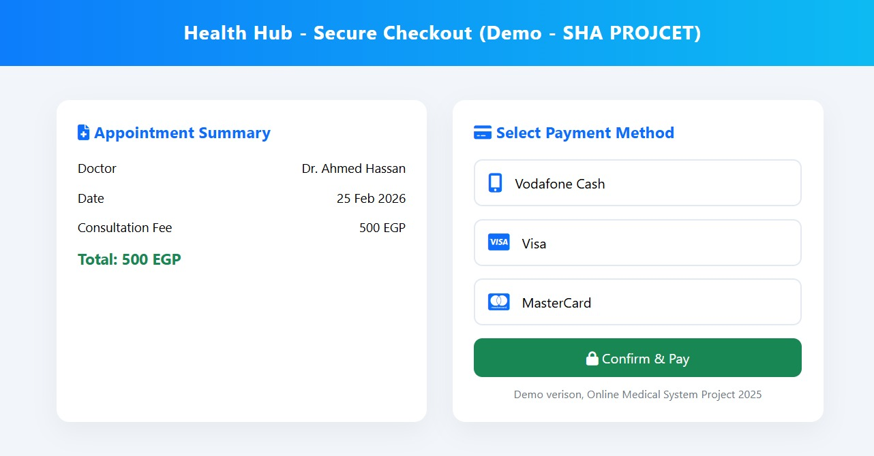

Slide 34
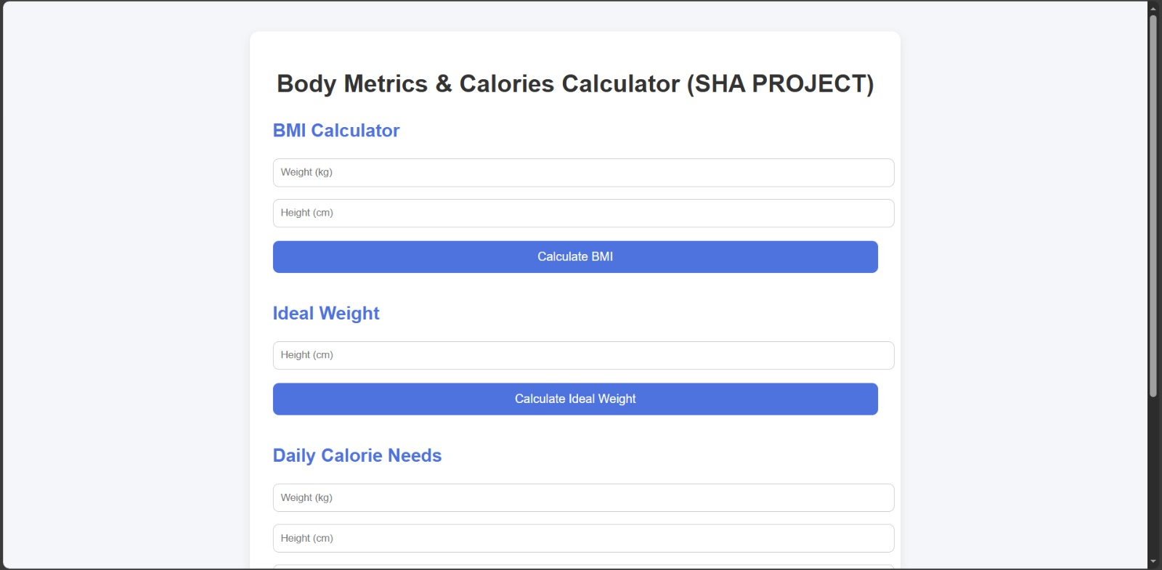
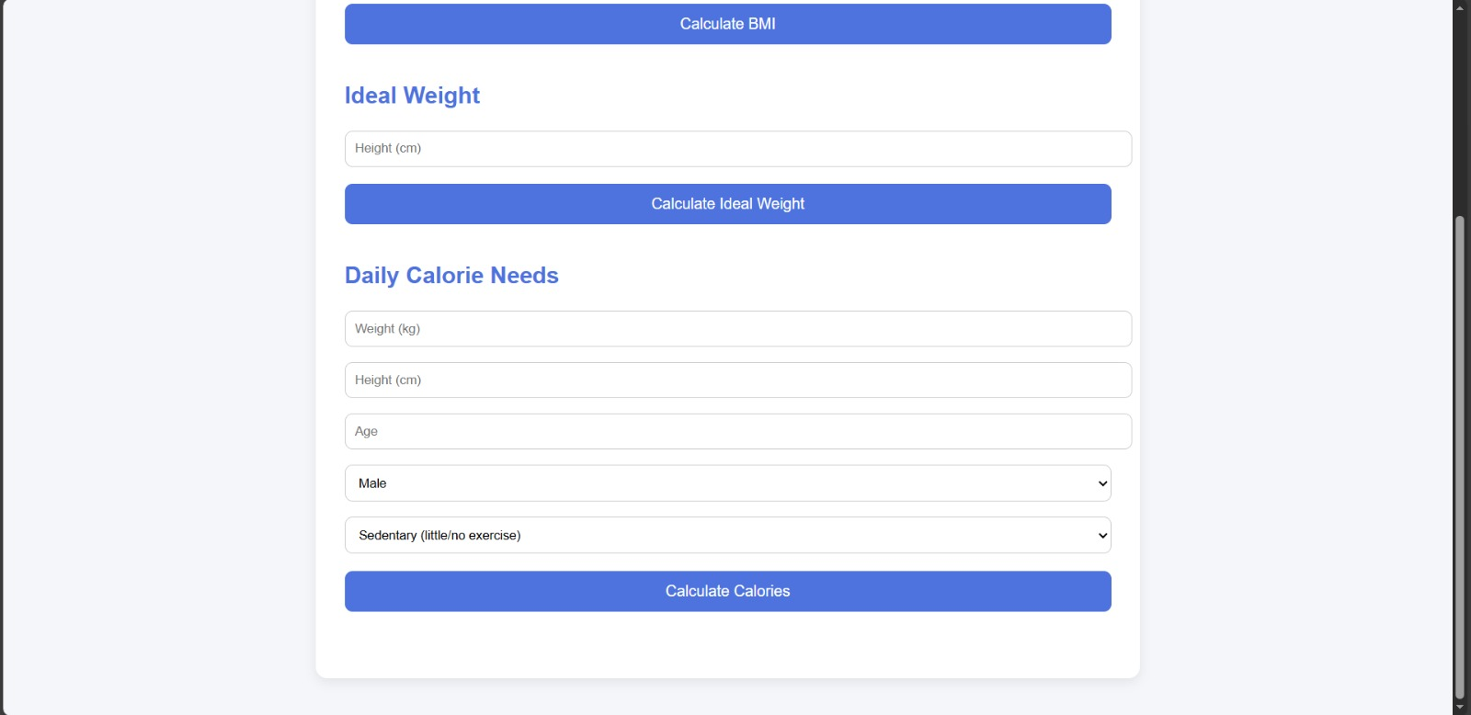

Slide 35
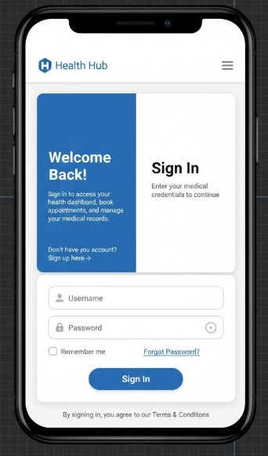
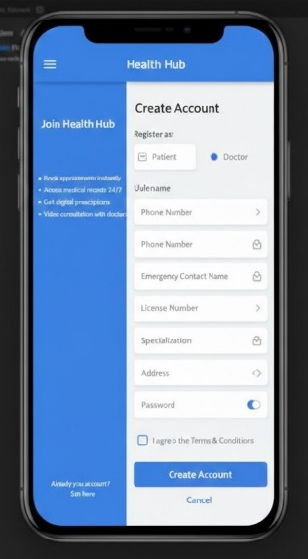
Mobile application

Slide 36
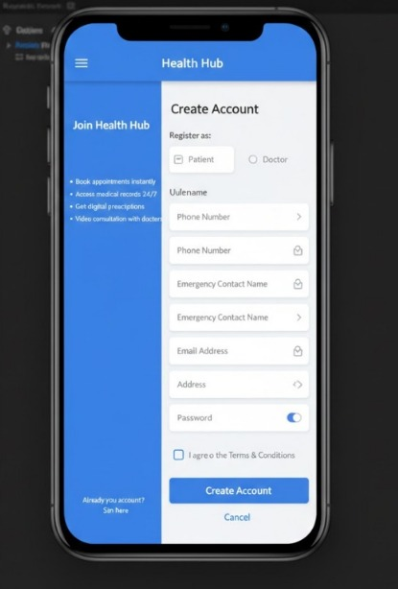
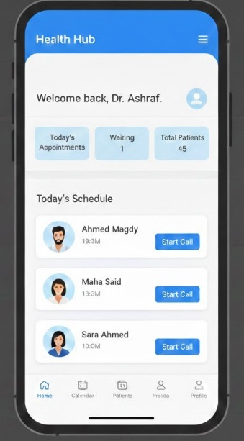

Slide 37
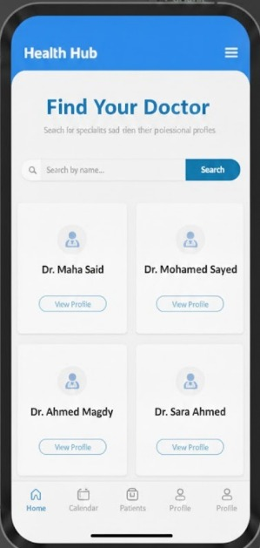

Slide 38
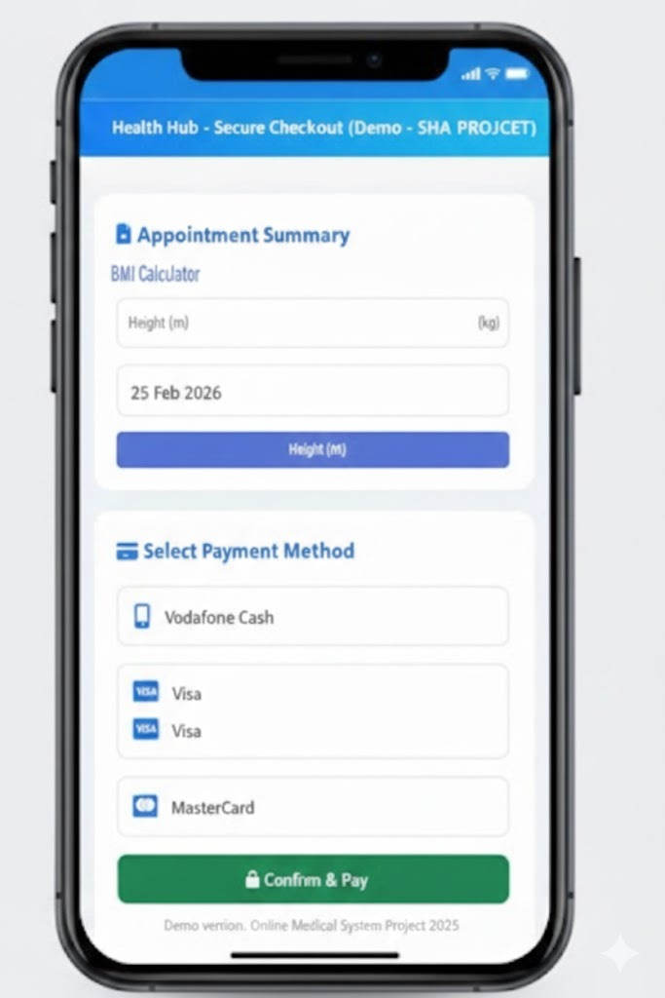
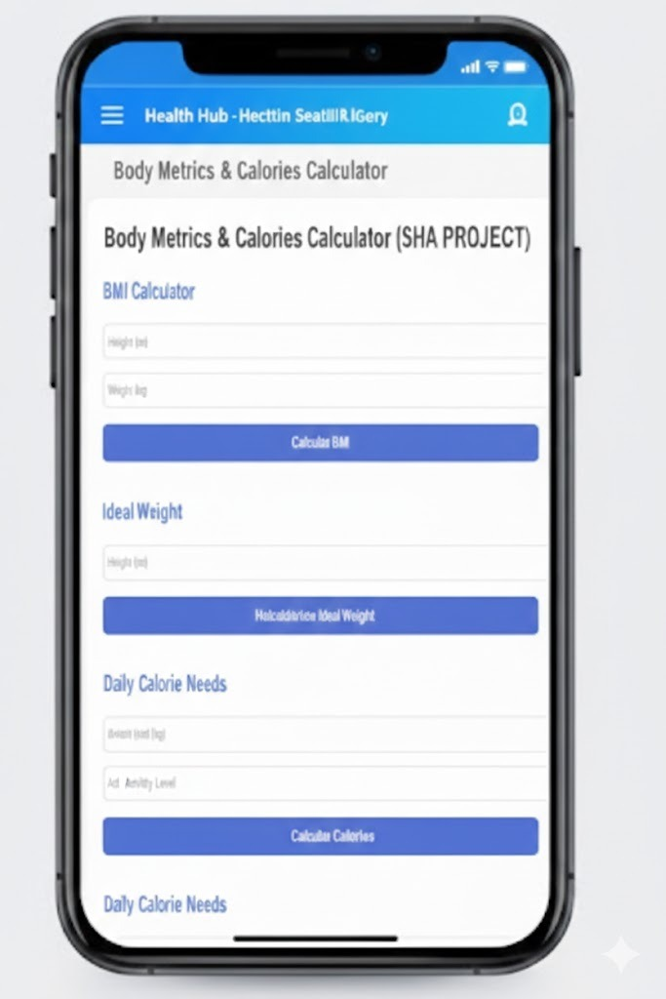

Slide 39
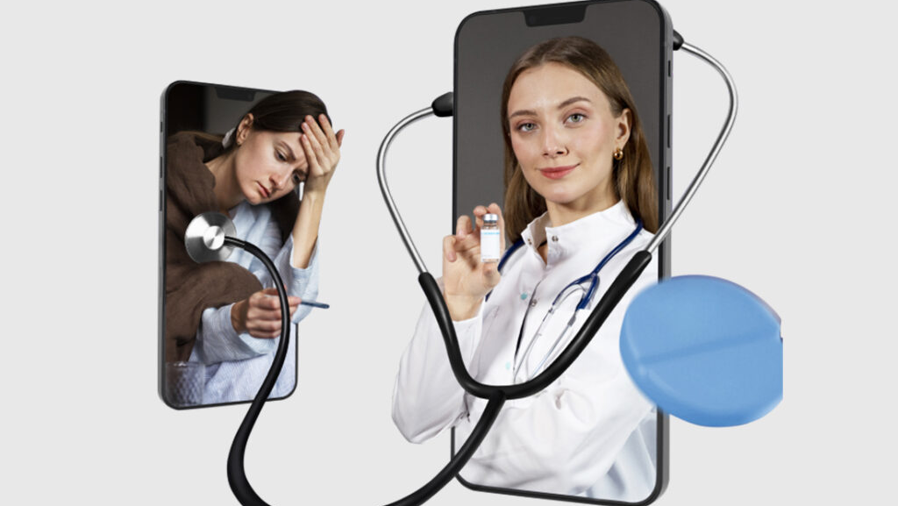
Thank You
Building the Future of Digital Healthcare
Contact us for more information

