Slide 1

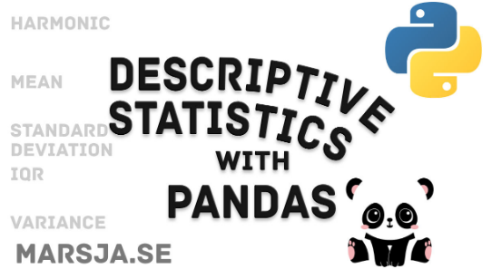

Understand Your Data

Slide 2
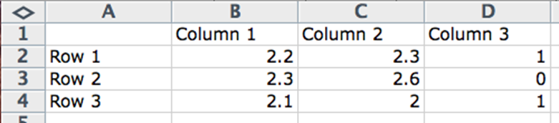
Data in machine learning
Column: column describes data of a single type.
Row: A row describes a single entity or observation and the columns describe properties about that entity or observation.
Cell: A cell is a single value in a row and column.
Notes:
For example, you could have a column of weights or heights or prices. All the data in one column will have the same scale and
have meaning relative to each other.
==
The more rows you have, the more examples from the problem domain that you have.
==
Cell: A cell is a single value in a row and column. It may be a real value (1.5) an integer (2) or a category (red).
==
This is how you probably think about data, columns, rows and cells. Generally, we can call
this type of data: tabular data. This form of data is easy to work with in machine learning.
There are dierent avors of machine learning that give dierent perspectives on the eld. For
example there is a the statistical perspective and the computer science perspective.

Slide 3
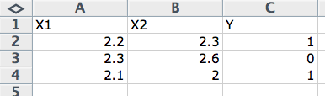
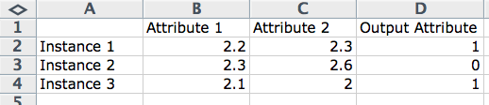
Data in machine learning
Statistical Learning Perspective
Computer Science Perspective
Output = f(Input)
OutputVariable = f(InputVariables)
OutputVariable = f(InputVector)
Y = f(X), X=X1, X2 and X3
OutputAttribute = Program(InputAttributes)
Output = Program(InputF eatures)
Prediction = Program(Instance)
Notes:
The statistical perspective frames data in the context of a hypothetical function (f) that the machine learning algorithm is trying to learn. That is, given some input variables (input), what is the predicted output variable (output).
Output = f(Input)
Those columns that are the inputs are referred to as input variables. Whereas the column of data that you may not always have and that you would like to predict for new input data in the future is called the output variable. It is also called the response variable.
OutputV ariable = f(InputV ariables)
Typically, you have more than one input variable. In this case the group of input variables are referred to as the input vector.
OutputV ariable = f(InputV ector)
If you have done a little statistics in your past you may know of another more traditional
terminology.
DependentV ariable = f(IndependentV ariables)
The data is described using a short hand in equations and descriptions of machine learning
algorithms.

Slide 4
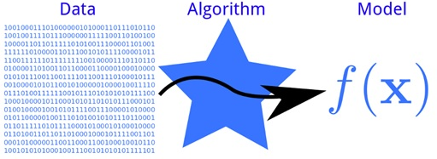
Models and Algorithms
Model = Algorithm(Data)
Notes:
the model as the specic representation learned from data
and the algorithm as the process for learning it.

Slide 5
Learning a Function
Y = f(X) + e
This error might be error such as not having enough attributes to sufficiently characterize the best mapping from X to Y .
This error is called irreducible error.
Notes:
This error might be error such as not having enough attributes to sufficiently characterize the best mapping from X to Y . This error is called irreducible error because no matter how good we get at estimating the target function (f), we cannot reduce this error. This is to say, that the problem of learning a function from data is a difficult problem and this is the reason why the field of machine learning and machine learning algorithms exist.

Slide 6
Peek at Your Data
preg plas pres skin test mass pedi age class
0 6 148 72 35 0 33.6 0.627 50 1
1 1 85 66 29 0 26.6 0.351 31 0
2 8 183 64 0 0 23.3 0.672 32 1
3 1 89 66 23 94 28.1 0.167 21 0
4 0 137 40 35 168 43.1 2.288 33 1
5 5 116 74 0 0 25.6 0.201 30 0
6 3 78 50 32 88 31.0 0.248 26 1
7 10 115 0 0 0 35.3 0.134 29 0
8 2 197 70 45 543 30.5 0.158 53 1
9 8 125 96 0 0 0.0 0.232 54 1
10 4 110 92 0 0 37.6 0.191 30 0
11 10 168 74 0 0 38.0 0.537 34 1
12 10 139 80 0 0 27.1 1.441 57 0
13 1 189 60 23 846 30.1 0.398 59 1
14 5 166 72 19 175 25.8 0.587 51 1
15 7 100 0 0 0 30.0 0.484 32 1
16 0 118 84 47 230 45.8 0.551 31 1
17 7 107 74 0 0 29.6 0.254 31 1
18 1 103 30 38 83 43.3 0.183 33 0
19 1 115 70 30 96 34.6 0.529 32 1
head() function
# View first 20 rows
from pandas import read_csv
filename = "pima-indians-diabetes.data.csv"
names = ['preg', 'plas', 'pres', 'skin', 'test', 'mass', 'pedi', 'age', 'class']
data = read_csv(filename, names=names)
peek = data.head(20)
print(peek)

Slide 7
Dimensions of Your Data
Too many rows and algorithms may take too long to train. Too few and perhaps you do not have enough data to train the algorithms.
Too many features and some algorithms can be distracted or suffer poor performance due to the curse of dimensionality.

Slide 8
Dimensions of Your Data
shape
# Dimensions of your data
from pandas import read_csv
filename = "pima-indians-diabetes.data.csv"
names = ['preg', 'plas', 'pres', 'skin', 'test', 'mass', 'pedi', 'age', 'class']
data = read_csv(filename, names=names)
shape = data.shape
print(shape)
(768, 9)

Slide 9
Data Type For Each Attribute
dtypes property.
# Data Types for Each Attribute
from pandas import read_csv
filename = "pima-indians-diabetes.data.csv"
names = ['preg', 'plas', 'pres', 'skin', 'test', 'mass', 'pedi', 'age', 'class']
data = read_csv(filename, names=names)
types = data.dtypes
print(types)
preg int64
plas int64
pres int64
skin int64
test int64
mass float64
pedi float64
age int64
class int64
dtype: object

Slide 10
Descriptive Statistics
Count.
Mean.
Standard Deviation.
Minimum Value.
25th Percentile.
50th Percentile (Median).
75th Percentile.
Maximum Value.

Slide 11
Descriptive Statistics
Descriptive Statistics
# Statistical Summary
from pandas import read_csv
from pandas import set_option
filename = "pima-indians-diabetes.data.csv"
names = ['preg', 'plas', 'pres', 'skin', 'test', 'mass', 'pedi', 'age', 'class']
data = read_csv(filename, names=names)
set_option('display.width', 100)
set_option('precision', 3)
description = data.describe()
print(description)
preg plas pres skin test mass pedi age class
count 768.000 768.000 768.000 768.000 768.000 768.000 768.000 768.000 768.000
mean 3.845 120.895 69.105 20.536 79.799 31.993 0.472 33.241 0.349
std 3.370 31.973 19.356 15.952 115.244 7.884 0.331 11.760 0.477
min 0.000 0.000 0.000 0.000 0.000 0.000 0.078 21.000 0.000
25% 1.000 99.000 62.000 0.000 0.000 27.300 0.244 24.000 0.000
50% 3.000 117.000 72.000 23.000 30.500 32.000 0.372 29.000 0.000
75% 6.000 140.250 80.000 32.000 127.250 36.600 0.626 41.000 1.000
max 17.000 199.000 122.000 99.000 846.000 67.100 2.420 81.000 1.000

Slide 12
Class Distribution (Classication Only)
# Class Distribution
from pandas import read_csv
filename = "pima-indians-diabetes.data.csv"
names = ['preg', 'plas', 'pres', 'skin', 'test', 'mass', 'pedi', 'age', 'class']
data = read_csv(filename, names=names)
class_counts = data.groupby('class').size()
print(class_counts)
class
0 500
1 268
dtype: int64

Slide 13
Descriptive Statistics
Correlations Between Attributes
# Pairwise Pearson correlations
from pandas import read_csv
from pandas import set_option
filename = "pima-indians-diabetes.data.csv"
names = ['preg', 'plas', 'pres', 'skin', 'test', 'mass', 'pedi', 'age', 'class']
data = read_csv(filename, names=names)
set_option('display.width', 100)
set_option('precision', 3)
correlations = data.corr(method='pearson')
print(correlations)
preg plas pres skin test mass pedi age class
preg 1.000 0.129 0.141 -0.082 -0.074 0.018 -0.034 0.544 0.222
plas 0.129 1.000 0.153 0.057 0.331 0.221 0.137 0.264 0.467
pres 0.141 0.153 1.000 0.207 0.089 0.282 0.041 0.240 0.065
skin -0.082 0.057 0.207 1.000 0.437 0.393 0.184 -0.114 0.075
test -0.074 0.331 0.089 0.437 1.000 0.198 0.185 -0.042 0.131
mass 0.018 0.221 0.282 0.393 0.198 1.000 0.141 0.036 0.293
pedi -0.034 0.137 0.041 0.184 0.185 0.141 1.000 0.034 0.174
age 0.544 0.264 0.240 -0.114 -0.042 0.036 0.034 1.000 0.238
class 0.222 0.467 0.065 0.075 0.131 0.293 0.174 0.238 1.000
Notes:
Correlation refers to the relationship between two variables and how they may or may not
change together. The most common method for calculating correlation is Pearson's Correlation
Coecient, that assumes a normal distribution of the attributes involved. A correlation of -1
or 1 shows a full negative or positive correlation respectively. Whereas a value of 0 shows no
correlation at all. Some machine learning algorithms like linear and logistic regression can suer
poor performance if there are highly correlated attributes in your dataset.

Slide 14
Descriptive Statistics
Skew of Univariate Distributions
# Skew for each attribute
from pandas import read_csv
filename = "pima-indians-diabetes.data.csv"
names = ['preg', 'plas', 'pres', 'skin', 'test', 'mass', 'pedi', 'age', 'class']
data = read_csv(filename, names=names)
skew = data.skew()
print(skew)
preg 0.902
plas 0.174
pres -1.844
skin 0.109
test 2.272
mass -0.429
pedi 1.920
age 1.130
class 0.635
dtype: float64

Slide 15
Understand Your Data With Visualization
Univariate Plots
Histograms.
Density Plots.
Box and Whisker Plots.
Multivariate Plots
Correlation Matrix Plot.
Scatter Plot Matrix.

Slide 16
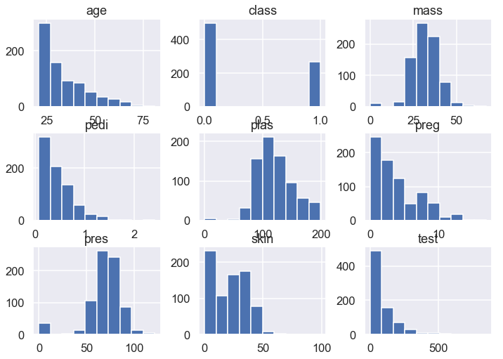
Understand Your Data With Visualization
Histograms
# Univariate Histograms
from matplotlib import pyplot
from pandas import read_csv
filename = 'pima-indians-diabetes.data.csv'
names = ['preg', 'plas', 'pres', 'skin', 'test', 'mass', 'pedi', 'age', 'class']
data = read_csv(filename, names=names)
data.hist()
pyplot.show()

Slide 17
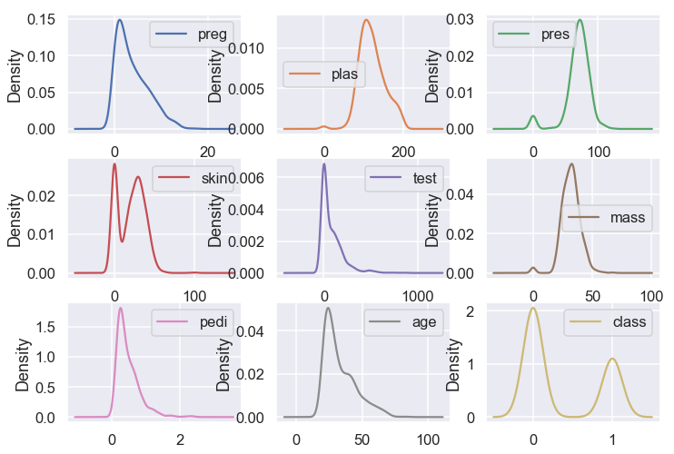
Understand Your Data With Visualization
Density Plots
# Univariate Density Plots
from matplotlib import pyplot
from pandas import read_csv
filename = 'pima-indians-diabetes.data.csv'
names = ['preg', 'plas', 'pres', 'skin', 'test', 'mass', 'pedi', 'age', 'class']
data = read_csv(filename, names=names)
data.plot(kind='density', subplots=True, layout=(3,3), sharex=False)
pyplot.show()

Slide 18
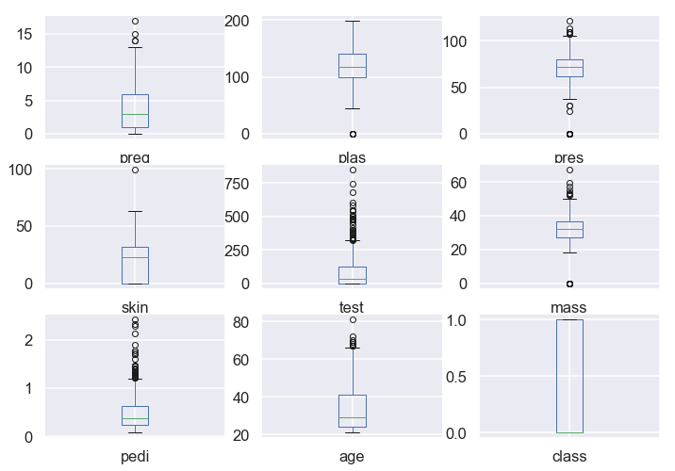
Understand Your Data With Visualization
Box and Whisker Plots
# Box and Whisker Plots
from matplotlib import pyplot
from pandas import read_csv
filename = "pima-indians-diabetes.data.csv"
names = ['preg', 'plas', 'pres', 'skin', 'test', 'mass', 'pedi', 'age', 'class']
data = read_csv(filename, names=names)
data.plot(kind='box', subplots=True, layout=(3,3), sharex=False, sharey=False)
pyplot.show()

Slide 19
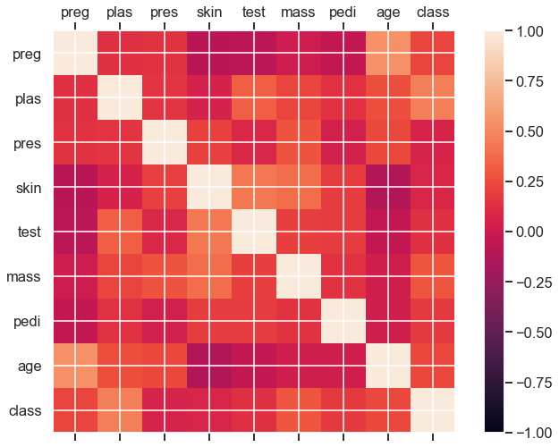
Understand Your Data With Visualization
Density Plots
# Correction Matrix Plot
from matplotlib import pyplot
from pandas import read_csv
import numpy
filename = 'pima-indians-diabetes.data.csv'
names = ['preg', 'plas', 'pres', 'skin', 'test','mass', 'pedi', 'age', 'class']
data = read_csv(filename, names=names)
correlations = data.corr()
# plot correlation matrix
fig = pyplot.figure()
ax = fig.add_subplot(111)
cax = ax.matshow(correlations, vmin=-1, vmax=1)
fig.colorbar(cax)
ticks = numpy.arange(0,9,1)
ax.set_xticks(ticks)
ax.set_yticks(ticks)
ax.set_xticklabels(names)
ax.set_yticklabels(names)
pyplot.show()

Slide 20
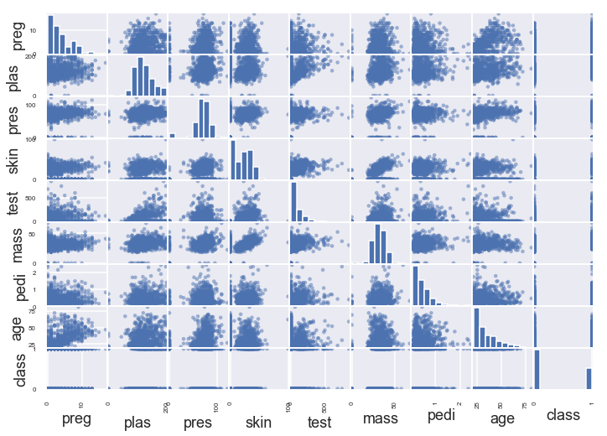
Understand Your Data With Visualization
# Scatterplot Matrix
from matplotlib import pyplot
from pandas import read_csv
from pandas.tools.plotting import scatter_matrix
filename = "pima-indians-diabetes.data.csv"
names = ['preg', 'plas', 'pres', 'skin', 'test', 'mass', 'pedi', 'age', 'class']
data = read_csv(filename, names=names)
scatter_matrix(data)
pyplot.show()

Slide 21
Prepare Your Data For Machine Learning
Rescale data.
Standardize data.
Normalize data.
Binarize data.

Slide 22
Prepare Your Data For Machine Learning
# Rescale data (between 0 and 1)
from pandas import read_csv
from numpy import set_printoptions
from sklearn.preprocessing import MinMaxScaler
filename = 'pima-indians-diabetes.data.csv'
names = ['preg', 'plas', 'pres', 'skin', 'test', 'mass', 'pedi', 'age', 'class']
dataframe = read_csv(filename, names=names)
array = dataframe.values
Rescale Data
# separate array into input and output components
X = array[:,0:8]
Y = array[:,8]
scaler = MinMaxScaler(feature_range=(0, 1))
rescaledX = scaler.fit_transform(X)
# summarize transformed data
set_printoptions(precision=3)
[[0.353 0.744 0.59 0.354 0. 0.501 0.234 0.483]
[0.059 0.427 0.541 0.293 0. 0.396 0.117 0.167]
[0.471 0.92 0.525 0. 0. 0.347 0.254 0.183]
[0.059 0.447 0.541 0.232 0.111 0.419 0.038 0. ]
[0. 0.688 0.328 0.354 0.199 0.642 0.944 0.2 ]]

Slide 23
Prepare Your Data For Machine Learning
Standardize Data
# Standardize data (0 mean, 1 stdev)
from sklearn.preprocessing import StandardScaler
from pandas import read_csv
from numpy import set_printoptions
filename = 'pima-indians-diabetes.data.csv'
names = ['preg', 'plas', 'pres', 'skin', 'test', 'mass', 'pedi', 'age', 'class']
dataframe = read_csv(filename, names=names)
array = dataframe.values
# separate array into input and output components
X = array[:,0:8]
Y = array[:,8]
scaler = StandardScaler().fit(X)
rescaledX = scaler.transform(X)
# summarize transformed data
set_printoptions(precision=3)
print(rescaledX[0:5,:])
[[ 0.64 0.848 0.15 0.907 -0.693 0.204 0.468 1.426]
[-0.845 -1.123 -0.161 0.531 -0.693 -0.684 -0.365 -0.191]
[ 1.234 1.944 -0.264 -1.288 -0.693 -1.103 0.604 -0.106]
[-0.845 -0.998 -0.161 0.155 0.123 -0.494 -0.921 -1.042]
[-1.142 0.504 -1.505 0.907 0.766 1.41 5.485 -0.02 ]]

Slide 24
Prepare Your Data For Machine Learning
# Normalize data (length of 1)
from sklearn.preprocessing import Normalizer
from pandas import read_csv
from numpy import set_printoptions
filename = 'pima-indians-diabetes.data.csv'
names = ['preg', 'plas', 'pres', 'skin', 'test', 'mass', 'pedi', 'age', 'class']
dataframe = read_csv(filename, names=names)
Normalize Data
array = dataframe.values
# separate array into input and output components
X = array[:,0:8]
Y = array[:,8]
scaler = Normalizer().fit(X)
normalizedX = scaler.transform(X)
# summarize transformed data
set_printoptions(precision=3)
print(normalizedX[0:5,:])
[[0.034 0.828 0.403 0.196 0. 0.188 0.004 0.28 ]
[0.008 0.716 0.556 0.244 0. 0.224 0.003 0.261]
[0.04 0.924 0.323 0. 0. 0.118 0.003 0.162]
[0.007 0.588 0.436 0.152 0.622 0.186 0.001 0.139]
[0. 0.596 0.174 0.152 0.731 0.188 0.01 0.144]]

Slide 25
Prepare Your Data For Machine Learning
Binarize Data (Make Binary)
# binarization
from sklearn.preprocessing import Binarizer
from pandas import read_csv
from numpy import set_printoptions
filename = 'pima-indians-diabetes.data.csv'
names = ['preg', 'plas', 'pres', 'skin', 'test', 'mass', 'pedi', 'age', 'class']
dataframe = read_csv(filename, names=names)
array = dataframe.values
# separate array into input and output components
X = array[:,0:8]
Y = array[:,8]
binarizer = Binarizer(threshold=0.0).fit(X)
binaryX = binarizer.transform(X)
# summarize transformed data
set_printoptions(precision=3)
print(binaryX[0:5,:])
[[1. 1. 1. 1. 0. 1. 1. 1.]
[1. 1. 1. 1. 0. 1. 1. 1.]
[1. 1. 1. 0. 0. 1. 1. 1.]
[1. 1. 1. 1. 1. 1. 1. 1.]
[0. 1. 1. 1. 1. 1. 1. 1.]]

Slide 26
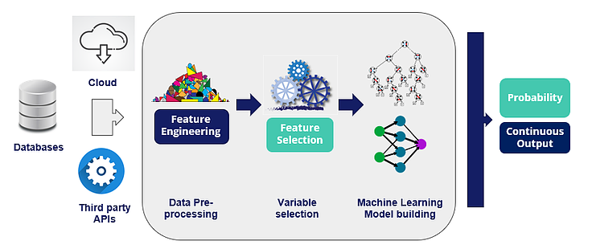
Feature Selection For Machine Learning

Slide 27
Feature Selection For Machine Learning
Feature selection is a process where you automatically select those features in your data that contribute most to the prediction variable or output in which you are interested.
Three benefits of performing feature selection before modeling your data are:
Reduces Ovefirtting.
Improves Accuracy.
Reduces Training Time.
Notes:
. Reduces Overfitting: Less redundant data means less opportunity to make decisions
based on noise.
. Improves Accuracy: Less misleading data means modeling accuracy improves.
. Reduces Training Time: Less data means that algorithms train faster.

Slide 28
Feature Selection For Machine Learning
Univariate Selection.
Recursive Feature Elimination.
Principle Component Analysis.
Feature Importance
http://scikit-learn.org/stable/modules/feature_selection.html

Slide 29
Feature Selection For Machine Learning
# Feature Extraction with Univariate Statistical Tests (Chi-squared for classification)
from pandas import read_csv
from numpy import set_printoptions
from sklearn.feature_selection import SelectKBest
from sklearn.feature_selection import chi2
# load data
filename = 'pima-indians-diabetes.data.csv'
Univariate Selection
names = ['preg', 'plas', 'pres', 'skin', 'test', 'mass', 'pedi', 'age', 'class']
dataframe = read_csv(filename, names=names)
array = dataframe.values
X = array[:,0:8]
Y = array[:,8]
# feature extraction
test = SelectKBest(score_func=chi2, k=4)
fit = test.fit(X, Y)
# summarize scores
set_printoptions(precision=3)
print(fit.scores_)
features = fit.transform(X)
[ 111.52 1411.887 17.605 53.108 2175.565 127.669 5.393 181.304]
[[148. 0. 33.6 50. ]
[ 85. 0. 26.6 31. ]
[183. 0. 23.3 32. ]
[ 89. 94. 28.1 21. ]
[137. 168. 43.1 33. ]]
Notes:
Univariate Selection
Statistical tests can be used to select those features that have the strongest relationship with
the output variable. The scikit-learn library provides the SelectKBest class2 that can be used
with a suite of dierent statistical tests to select a specic number of features. The example
below uses the chi-squared (chi2) statistical test for non-negative features to select 4 of the best
features from the Pima Indians onset of diabetes dataset.

Slide 30
Feature Selection For Machine Learning
Recursive Feature Elimination
# Feature Extraction with RFE
from pandas import read_csv
from sklearn.feature_selection import RFE
from sklearn.linear_model import LogisticRegression
# load data
filename = 'pima-indians-diabetes.data.csv'
names = ['preg', 'plas', 'pres', 'skin', 'test', 'mass', 'pedi', 'age', 'class']
dataframe = read_csv(filename, names=names)
array = dataframe.values
X = array[:,0:8]
Y = array[:,8]
# feature extraction
model = LogisticRegression()
rfe = RFE(model, 3)
fit = rfe.fit(X, Y)
print("Num Features: %d“, fit.n_features_)
print("Selected Features: %s“,fit.support_)
print("Feature Ranking: %s“, fit.ranking_)
Num Features: 3
Selected Features: [ True False False False False True True False]
Feature Ranking: [1 2 3 5 6 1 1 4]
Notes:
The Recursive Feature Elimination (or RFE) works by recursively removing attributes and
building a model on those attributes that remain. It uses the model accuracy to identify which attributes (and combination of attributes) contribute the most to predicting the target attribute.
You can learn more about the RFE class3 in the scikit-learn documentation.

Slide 31
Feature Selection For Machine Learning
Principal Component Analysis
# Feature Extraction with PCA
from pandas import read_csv
from sklearn.decomposition import PCA
# load data
filename = 'pima-indians-diabetes.data.csv'
names = ['preg', 'plas', 'pres', 'skin', 'test', 'mass', 'pedi', 'age', 'class']
dataframe = read_csv(filename, names=names)
array = dataframe.values
Explained Variance:
[0.889 0.062 0.026]
[[-2.022e-03 9.781e-02 1.609e-02 6.076e-02 9.931e-01 1.401e-02
5.372e-04 -3.565e-03]
[-2.265e-02 -9.722e-01 -1.419e-01 5.786e-02 9.463e-02 -4.697e-02
-8.168e-04 -1.402e-01]
[-2.246e-02 1.434e-01 -9.225e-01 -3.070e-01 2.098e-02 -1.324e-01
-6.400e-04 -1.255e-01]]
X = array[:,0:8]
Y = array[:,8]
# feature extraction
pca = PCA(n_components=3)
fit = pca.fit(X)
# summarize components
print("Explained Variance: %s") % fit.explained_variance_ratio_
print(fit.components_)

Slide 32
Feature Selection For Machine Learning
# Feature Importance with Extra Trees Classifier
from pandas import read_csv
from sklearn.ensemble import ExtraTreesClassifier
# load data
filename = 'pima-indians-diabetes.data.csv'
names = ['preg', 'plas', 'pres', 'skin', 'test', 'mass', 'pedi', 'age', 'class']
dataframe = read_csv(filename, names=names)
Feature Importance
array = dataframe.values
X = array[:,0:8]
Y = array[:,8]
# feature extraction
model = ExtraTreesClassifier()
model.fit(X, Y)
print(model.feature_importances_)
[0.109 0.258 0.093 0.076 0.076 0.148 0.106 0.136]
Notes:
Bagged decision trees like Random Forest and Extra Trees can be used to estimate the importance
of features. In the example below we construct a ExtraTreesClassifier classier for the Pima
Indians onset of diabetes dataset.

Slide 33

Evaluate the Performance with Resampling
Notes:
Univariate Selection
Statistical tests can be used to select those features that have the strongest relationship with
the output variable. The scikit-learn library provides the SelectKBest class2 that can be used
with a suite of different statistical tests to select a specic number of features. The example
below uses the chi-squared (chi2) statistical test for non-negative features to select 4 of the best
features from the Pima Indians onset of diabetes dataset.

Slide 34
Evaluate Machine Learning Algorithms
Train and Test Sets.
k-fold Cross Validation.
Leave One Out Cross Validation.
Repeated Random Test-Train Splits.

Slide 35
Evaluate Machine Learning Algorithms
# Evaluate using a train and a test set
from pandas import read_csv
from sklearn.model_selection import train_test_split
from sklearn.linear_model import LogisticRegression
filename = 'pima-indians-diabetes.data.csv'
names = ['preg', 'plas', 'pres', 'skin', 'test', 'mass', 'pedi', 'age', 'class']
dataframe = read_csv(filename, names=names)
array = dataframe.values
Split into Train and Test Sets
X = array[:,0:8]
Y = array[:,8]
test_size = 0.33
seed = 7
X_train, X_test, Y_train, Y_test = train_test_split(X, Y, test_size=test_size,
random_state=seed)
model = LogisticRegression()
model.fit(X_train, Y_train)
result = model.score(X_test, Y_test)
print("Accuracy: “, result*100.0)
Accuracy: 75.591%

Slide 36
Evaluate Machine Learning Algorithms
# Evaluate using Cross Validation
from pandas import read_csv
from sklearn.model_selection import KFold
from sklearn.model_selection import cross_val_score
from sklearn.linear_model import LogisticRegression
filename = 'pima-indians-diabetes.data.csv'
names = ['preg', 'plas', 'pres', 'skin', 'test', 'mass', 'pedi', 'age', 'class']
dataframe = read_csv(filename, names=names)
K-fold Cross Validation
array = dataframe.values
X = array[:,0:8]
Y = array[:,8]
num_folds = 10
seed = 7
kfold = KFold(n_splits=num_folds, random_state=seed)
model = LogisticRegression()
results = cross_val_score(model, X, Y, cv=kfold)
print("Accuracy: “, results.mean()*100.0, results.std()*100.0)
Accuracy: 76.951% (4.841%)

Slide 37
Evaluate Machine Learning Algorithms
# Evaluate using Leave One Out Cross Validation
from pandas import read_csv
from sklearn.model_selection import LeaveOneOut
from sklearn.model_selection import cross_val_score
from sklearn.linear_model import LogisticRegression
filename = 'pima-indians-diabetes.data.csv'
names = ['preg', 'plas', 'pres', 'skin', 'test', 'mass', 'pedi', 'age', 'class']
dataframe = read_csv(filename, names=names)
Leave One Out Cross Validation
array = dataframe.values
X = array[:,0:8]
Y = array[:,8]
num_folds = 10
loocv = LeaveOneOut()
model = LogisticRegression()
results = cross_val_score(model, X, Y, cv=loocv)
print("Accuracy: “, results.mean()*100.0, results.std()*100.0)
Accuracy: 76.823% (42.196%)

Slide 38
Evaluate Machine Learning Algorithms
# Evaluate using Shuffle Split Cross Validation
from pandas import read_csv
from sklearn.model_selection import ShuffleSplit
from sklearn.model_selection import cross_val_score
from sklearn.linear_model import LogisticRegression
filename = 'pima-indians-diabetes.data.csv'
names = ['preg', 'plas', 'pres', 'skin', 'test', 'mass', 'pedi', 'age', 'class']
dataframe = read_csv(filename, names=names)
Repeated Random Test-Train Splits
array = dataframe.values
X = array[:,0:8]
Y = array[:,8]
n_splits = 10
test_size = 0.33
seed = 7
kfold = ShuffleSplit(n_splits=n_splits, test_size=test_size, random_state=seed)
model = LogisticRegression()
results = cross_val_score(model, X, Y, cv=kfold)
print("Accuracy: “, results.mean()*100.0, results.std()*100.0)
Accuracy: 76.496% (1.698%)
Notes:
Another variation on k-fold cross validation is to create a random split of the data like the
train/test split described above, but repeat the process of splitting and evaluation of the
algorithm multiple times, like cross validation. This has the speed of using a train/test split and
the reduction in variance in the estimated performance of k-fold cross validation. You can also
repeat the process many more times as needed to improve the accuracy. A down side is that
repetitions may include much of the same data in the train or the test split from run to run,
introducing redundancy into the evaluation. The example below splits the data into a 67%/33%
train/test split and repeats the process 10 times.

Slide 39
Evaluate Machine Learning Algorithms
What Techniques to Use When
Generally k-fold cross validation is the gold standard for evaluating the performance of a machine learning algorithm on unseen data with k set to 3, 5, or 10.
Using a train/test split is good for speed when using a slow algorithm and produces performance estimates with lower bias when using large datasets.
Techniques like leave-one-out cross validation and repeated random splits can be useful intermediates when trying to balance variance in the estimated performance, model training speed and dataset size.
Notes:
Another variation on k-fold cross validation is to create a random split of the data like the
train/test split described above, but repeat the process of splitting and evaluation of the
algorithm multiple times, like cross validation. This has the speed of using a train/test split and
the reduction in variance in the estimated performance of k-fold cross validation. You can also
repeat the process many more times as needed to improve the accuracy. A down side is that
repetitions may include much of the same data in the train or the test split from run to run,
introducing redundancy into the evaluation. The example below splits the data into a 67%/33%
train/test split and repeats the process 10 times.

Slide 40

Machine Learning Algorithm Performance Metrics

Slide 41
Machine Learning Algorithm Performance Metrics
For classification metrics, the Pima Indians onset of diabetes dataset is used as demonstration. This is a binary classification problem where all of the input variables are numeric.
For regression metrics, the Boston House Price dataset is used as demonstration. this is a regression problem where all of the input variables are also numeric.
http://scikit-learn.org/stable/modules/generated/sklearn.cross_validation.cross_val_score.html

Slide 42
Performance Metrics
Classification Metrics
Classification Accuracy.
Logarithmic Loss.
Area Under ROC Curve.
Confusion Matrix.
Classification Report.
Notes:
Classification problems are perhaps the most common type of machine learning problem and as
such there are a myriad of metrics that can be used to evaluate predictions for these problems.
In this section we will review how to use the following metrics:

Slide 43
Performance Metrics
Classication Accuracy
# Cross Validation Classification Accuracy
from pandas import read_csv
from sklearn.model_selection import KFold
from sklearn.model_selection import cross_val_score
from sklearn.linear_model import LogisticRegression
filename = 'pima-indians-diabetes.data.csv'
names = ['preg', 'plas', 'pres', 'skin', 'test', 'mass', 'pedi', 'age', 'class']
dataframe = read_csv(filename, names=names)
array = dataframe.values
X = array[:,0:8]
Y = array[:,8]
kfold = KFold(n_splits=10, random_state=7)
model = LogisticRegression()
scoring = 'accuracy'
results = cross_val_score(model, X, Y, cv=kfold, scoring=scoring)
print("Accuracy: ",results.mean(), results.std())
Accuracy: 0.770 (0.048)
Notes:
Classification accuracy is the number of correct predictions made as a ratio of all predictions
made. This is the most common evaluation metric for classification problems, it is also the most
misused. It is really only suitable when there are an equal number of observations in each class
(which is rarely the case) and that all predictions and prediction errors are equally important,
which is often not the case.

Slide 44
Performance Metrics
Logarithmic Loss
# Cross Validation Classification LogLoss
from pandas import read_csv
from sklearn.model_selection import KFold
from sklearn.model_selection import cross_val_score
from sklearn.linear_model import LogisticRegression
filename = 'pima-indians-diabetes.data.csv'
names = ['preg', 'plas', 'pres', 'skin', 'test', 'mass', 'pedi', 'age', 'class']
dataframe = read_csv(filename, names=names)
array = dataframe.values
X = array[:,0:8]
Y = array[:,8]
kfold = KFold(n_splits=10, random_state=7)
model = LogisticRegression()
scoring = 'neg_log_loss'
results = cross_val_score(model, X, Y, cv=kfold, scoring=scoring)
print("Logloss: “,results.mean(), results.std())
Accuracy: 0.770 (0.048)
Notes:
Is a performance metric for evaluating the predictions of probabilities
of membership to a given class. The scalar probability between 0 and 1 can be seen as a measure
of confidence for a prediction by an algorithm. Predictions that are correct or incorrect are rewarded or punished proportionally to the condence of the prediction.

Slide 45
Performance Metrics
Area Under ROC Curve
# Cross Validation Classification ROC AUC
from pandas import read_csv
from sklearn.model_selection import KFold
from sklearn.model_selection import cross_val_score
from sklearn.linear_model import LogisticRegression
filename = 'pima-indians-diabetes.data.csv'
names = ['preg', 'plas', 'pres', 'skin', 'test', 'mass', 'pedi', 'age', 'class']
dataframe = read_csv(filename, names=names)
array = dataframe.values
X = array[:,0:8]
Y = array[:,8]
kfold = KFold(n_splits=10, random_state=7)
model = LogisticRegression()
scoring = 'roc_auc'
results = cross_val_score(model, X, Y, cv=kfold, scoring=scoring)
print("AUC: ",results.mean(), results.std())
AUC: 0.824 (0.041)
Notes:
Area under ROC Curve (or AUC for short) is a performance metric for binary classification
problems. The AUC represents a model's ability to discriminate between positive and negative
classes. An area of 1.0 represents a model that made all predictions perfectly. An area of
0.5 represents a model that is as good as random. ROC can be broken down into sensitivity
and specificity. A binary classification problem is really a trade-o between sensitivity and
specificity.

Slide 46
Performance Metrics
# Cross Validation Classification Report
from pandas import read_csv
from sklearn.model_selection import train_test_split
from sklearn.linear_model import LogisticRegression
from sklearn.metrics import classification_report
filename = 'pima-indians-diabetes.data.csv'
names = ['preg', 'plas', 'pres', 'skin', 'test', 'mass', 'pedi', 'age', 'class']
dataframe = read_csv(filename, names=names)
Classication Report
array = dataframe.values
X = array[:,0:8]
Y = array[:,8]
test_size = 0.33
seed = 7
X_train, X_test, Y_train, Y_test = train_test_split(X, Y, test_size=test_size,
random_state=seed)
model = LogisticRegression()
model.fit(X_train, Y_train)
predicted = model.predict(X_test)
report = classification_report(Y_test, predicted)
print(report)
precision recall f1-score support
0.0 0.77 0.87 0.82 162
1.0 0.71 0.55 0.62 92
accuracy 0.76 254
macro avg 0.74 0.71 0.72 254
weighted avg 0.75 0.76 0.75 254
Notes:
The scikit-learn library provides a convenience report when working on classification problems
to give you a quick idea of the accuracy of a model using a number of measures. The
classification report() function displays the precision, recall, F1-score and support for each
class.

Slide 47
Performance Metrics
Regression Metrics
Mean Absolute Error.
Mean Squared Error.
R2.
Notes:
Classification accuracy is the number of correct predictions made as a ratio of all predictions
made. This is the most common evaluation metric for classification problems, it is also the most
misused. It is really only suitable when there are an equal number of observations in each class
(which is rarely the case) and that all predictions and prediction errors are equally important,
which is often not the case.

Slide 48
Performance Metrics
Mean Absolute Error
# Cross Validation Regression MAE
from pandas import read_csv
from sklearn.model_selection import KFold
from sklearn.model_selection import cross_val_score
from sklearn.linear_model import LinearRegression
filename = 'housing.csv'
names = ['CRIM', 'ZN', 'INDUS', 'CHAS', 'NOX', 'RM', 'AGE', 'DIS', 'RAD', 'TAX', 'PTRATIO',
'B', 'LSTAT', 'MEDV']
dataframe = read_csv(filename, delim_whitespace=True, names=names)
array = dataframe.values
X = array[:,0:13]
Y = array[:,13]
kfold = KFold(n_splits=10, random_state=7)
model = LinearRegression()
scoring = 'neg_mean_absolute_error'
results = cross_val_score(model, X, Y, cv=kfold, scoring=scoring)
print("MAE: “,results.mean(), results.std())
MAE: -4.005 (2.084)
Notes:
The Mean Absolute Error (or MAE) is the sum of the absolute differences between predictions
and actual values. It gives an idea of how wrong the predictions were. The measure gives an
idea of the magnitude of the error, but no idea of the direction (e.g. over or under predicting).

Slide 49
Performance Metrics
Mean Squared Error
# Cross Validation Regression MSE
from pandas import read_csv
from sklearn.model_selection import KFold
from sklearn.model_selection import cross_val_score
from sklearn.linear_model import LinearRegression
filename = 'housing.csv'
names = ['CRIM', 'ZN', 'INDUS', 'CHAS', 'NOX', 'RM', 'AGE', 'DIS', 'RAD', 'TAX', 'PTRATIO',
'B', 'LSTAT', 'MEDV']
dataframe = read_csv(filename, delim_whitespace=True, names=names)
array = dataframe.values
X = array[:,0:13]
Y = array[:,13]
num_folds = 10
kfold = KFold(n_splits=10, random_state=7)
model = LinearRegression()
scoring = 'neg_mean_squared_error'
results = cross_val_score(model, X, Y, cv=kfold, scoring=scoring)
print("MSE: “,results.mean(), results.std())
MSE: -34.705 (45.574)
Notes:
The Mean Squared Error (or MSE) is much like the mean absolute error in that it provides a
gross idea of the magnitude of error. Taking the square root of the mean squared error converts
the units back to the original units of the output variable and can be meaningful for description
and presentation. This is called the Root Mean Squared Error (or RMSE).

Slide 50
Performance Metrics
R2 Metric
# Cross Validation Regression R^2
from pandas import read_csv
from sklearn.model_selection import KFold
from sklearn.model_selection import cross_val_score
from sklearn.linear_model import LinearRegression
filename = 'housing.csv'
names = ['CRIM', 'ZN', 'INDUS', 'CHAS', 'NOX', 'RM', 'AGE', 'DIS', 'RAD', 'TAX', 'PTRATIO',
'B', 'LSTAT', 'MEDV']
dataframe = read_csv(filename, delim_whitespace=True, names=names)
array = dataframe.values
X = array[:,0:13]
Y = array[:,13]
kfold = KFold(n_splits=10, random_state=7)
model = LinearRegression()
scoring = 'r2'
results = cross_val_score(model, X, Y, cv=kfold, scoring=scoring)
print("R^2: “,results.mean(), results.std())
R^2: 0.203 (0.595)
Notes:
The R2 (or R Squared) metric provides an indication of the goodness of t of a set of predictions
to the actual values. In statistical literature this measure is called the coeffcient of determination.
This is a value between 0 and 1 for no-t and perfect t respectively.

