Slide 1
ML with python BY Abdelraman S. Mohamed
Understand Your Data, Create Accurate Models and Work Projects End-To-End

Slide 2
Python
(Analyze Data)
(Prepare Data)
(Evaluate Algorithms)
(Improve Results)
(Present Results)
Python Ecosystem for Machine Learning.
Python and SciPy Crash Course.
Load Datasets from CSV.
Descriptive Statistics & Visualizations.
Pre-Process Data.
Feature Selection.
Resampling Methods.
Algorithm Evaluation Metrics.
Spot-Check Classification & Regression Algorithms.
Model Selection.
Pipelines.
Ensemble Methods.
Algorithm Parameter Tuning.
Model Finalization.

Slide 3

Python
Python Ecosystem for Machine Learning.
Python and SciPy Crash Course.
Load Datasets from CSV.

Slide 4
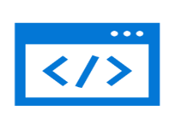

Python Ecosystem for Machine Learning
Flexible programming language
Great starter language
Great advanced language
Wonderful community
Designed to be human readable

Slide 5
Python Ecosystem for Machine Learning
SciPy
Used for mathematics, science and engineering, comprised of the following core modules:
NumPy
Matplotlib
Pandas
Notes:
. NumPy: A foundation for SciPy that allows you to efficiently work with data in arrays.
. Matplotlib: Allows you to create 2D charts and plots from data.
. Pandas: Tools and data structures to organize and analyze your data.
=========
To be effective at machine learning in Python you must install and become familiar with SciPy. Specifically:
. You will prepare your data as NumPy arrays for modeling in machine learning algorithms.
. You will use Matplotlib (and wrappers of Matplotlib in other frameworks) to create plots and charts of your data.
. You will use Pandas to load explore and better understand your data.

Slide 6
Python Ecosystem for Machine Learning
scikit-learn
Develop and practice machine learning in Python.
Algorithms for classification, regression, clustering and more.
It also provides tools for evaluating models, tuning parameters and pre-processing data.

Slide 7
Python Ecosystem Installation
How To Install Python
See downloading python in the python beginners guide https://wiki.python.org/moin/beginnersguide/download
Install SciPy https://scipy.org/install.html
Install scikit-learn https://scikit-learn.org/stable/install.html

Slide 8
Python Ecosystem Installation
How To Install Python
Anaconda https://www.anaconda.com/products/individual#windows
Notes:
If you are not confident at installing software on your machine, there is an easier option for you.
There is a distribution called Anaconda that you can download and install for free7. It supports
the three main platforms of Microsoft Windows, Mac OS X and Linux. It includes Python,
SciPy and scikit-learn. Everything

Slide 9
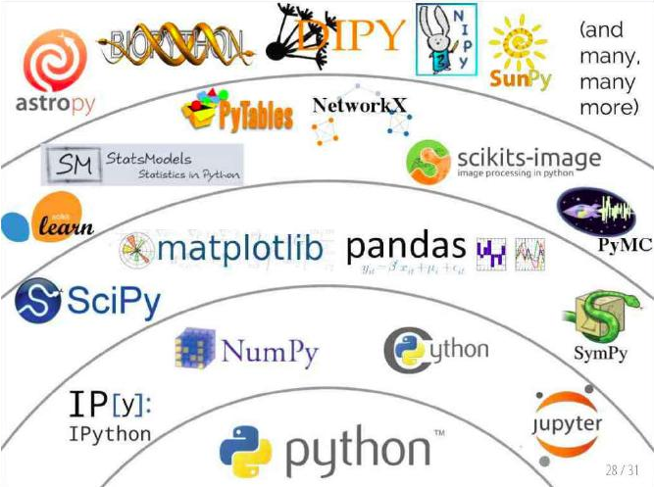
Crash Course in Python and SciPy

Slide 10
Python Crash Course
 Assignment.
 Flow Control.
 Data Structures.
 Functions.

Slide 11
Assignment
Strings
h
11
hello world
# Strings
data = 'hello world'
print(data[0])
print(len(data))
print(data)

Slide 12
Assignment
Numbers
123.1
10
# Numbers
value = 123.1
print(value)
value = 10
print(value)

Slide 13
Assignment
Boolean
# Boolean
a = True
b = False
print(a, b)
(True, False)

Slide 14
Assignment
Multiple Assignment
# Multiple Assignment
a, b, c = 1, 2, 3
print(a, b, c)
(1, 2, 3)

Slide 15
Assignment
No Value
# No value
a = None
print(a)
None

Slide 16
Assignment
Boolean
# Boolean
a = True
b = False
print(a, b)
(True, False)

Slide 17
Flow Control
If-Else conditions.
For-Loops .
While-Loops.

Slide 18
Flow Control
If-Then-Else Conditional
value = 99
if value == 99:
print('That is fast')
elif value > 200:
print('That is too fast')
else:
print('That is safe')

Slide 19
Flow Control
0
1
2
3
4
5
6
7
8
9
For-Loop
# For-Loop
for i in range(10):
print(i)

Slide 20
Flow Control
0
1
2
3
4
5
6
7
8
9
While-Loop
# While-Loop
i = 0
while i < 10:
Print(i)
i += 1

Slide 21
Data Structures
Tuples.
Lists.
Dictionaries.

Slide 22
Data Structures
Tuple
Tuples are read-only collections of items.
a = (1, 2, 3)
print (a)
(1, 2, 3)

Slide 23
Data Structures
Zeroth Value: 1
List Length: 4
1
2
3
4
List
mylist = [1, 2, 3]
print("Zeroth Value: ", mylist[0])
mylist.append(4)
print("List Length:", len(mylist))
for value in mylist:
print (value)

Slide 24
Data Structures
Dictionaries are mappings of names to values, like key-value pairs.
mydict = {'a': 1, 'b': 2, 'c': 3}
print("A value: ", mydict['a'])
mydict['a'] = 11
print("A value: ", mydict['a'])
print("Keys: ",mydict.keys())
print("Values: ", mydict.values())
for key in mydict.keys():
print (mydict[key])
A value: 1
A value: 11
Keys: dict_keys(['a', 'b', 'c'])
Values: dict_values([11, 2, 3])
11
2
3
Dictionary

Slide 25
Functions
def mysum(x, y):
return x + y
# Test sum function
result = mysum(1, 3)
print(result)
4

Slide 26
NumPy Crash Course
Create Array
# define an array
import numpy
mylist = [1, 2, 3]
myarray = numpy.array(mylist)
print(myarray)
print(myarray.shape)
[1 2 3]
(3,)

Slide 27
Access Data
[[1 2 3]
[3 4 5]]
(2, 3)
First row: [1 2 3]
Last row: [3 4 5]
Specific row and col: 3
Whole col: [3 5]
Access Array
# access values
import numpy
mylist = [[1, 2, 3], [3, 4, 5]]
myarray = numpy.array(mylist)
print(myarray)
print(myarray.shape)
print("First row: ",myarray[0])
print("Last row: ", myarray[-1])
print("Specific row and col: ", myarray[0, 2])
print("Whole col: ", myarray[:, 2])

Slide 28
NumPy Crash Course
Arithmetic
# arithmetic
import numpy
myarray1 = numpy.array([2, 2, 2])
myarray2 = numpy.array([3, 3, 3])
print("Addition:", myarray1 + myarray2)
print("Multiplication: “, myarray1 * myarray2)
Addition: [5 5 5]
Multiplication: [6 6 6]

Slide 29
Matplotlib Crash Course
Line Plot
The library is generally used as follows:
Call a plotting function with some data (e.g. .plot()).
Call many functions to setup the properties of the plot (e.g. labels and colors).
Make the plot visible (e.g. .show()).

Slide 30
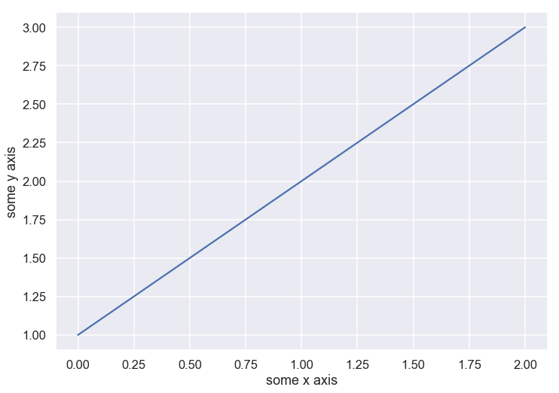
Matplotlib Crash Course
Line Plot
# basic line plot
import matplotlib.pyplot as plt
import numpy
myarray = numpy.array([1, 2, 3])
plt.plot(myarray)
plt.xlabel('some x axis')
plt.ylabel('some y axis')
plt.show()

Slide 31
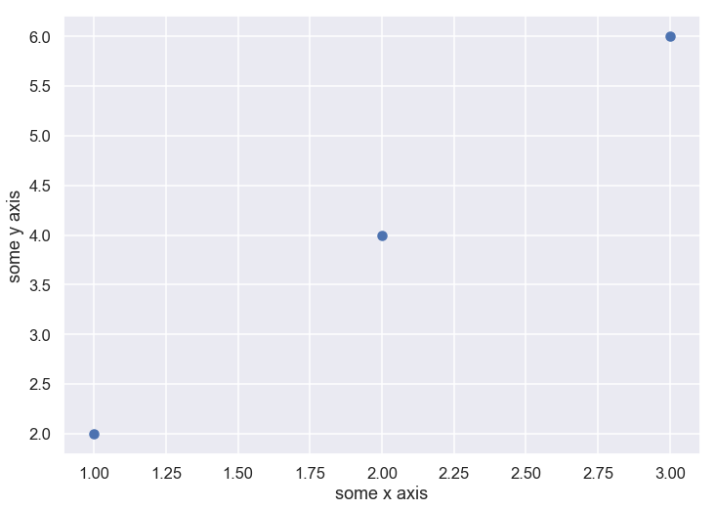
Matplotlib Crash Course
Scatter Plot
# basic scatter plot
import matplotlib.pyplot as plt
import numpy
x = numpy.array([1, 2, 3])
y = numpy.array([2, 4, 6])
plt.scatter(x,y)
plt.xlabel('some x axis')
plt.ylabel('some y axis')
plt.show()

Slide 32
Pandas Crash Course
Series
a 1
b 2
c 3
dtype: int32
1
1
# series
import numpy
import pandas
myarray = numpy.array([1, 2, 3])
rownames = ['a', 'b', 'c']
myseries = pandas.Series(myarray, index=rownames)
print(myseries)
print(myseries[0])
print(myseries['a'])

Slide 33
Pandas Crash Course
one two three
a 1 2 3
b 4 5 6
method 1:
one column: a 1
b 4
Name: one, dtype: int32
method 2:
one column: a 1
b 4
Name: one, dtype: int32
# dataframe
import numpy
import pandas
myarray = numpy.array([[1, 2, 3], [4, 5, 6]])
rownames = ['a', 'b']
colnames = ['one', 'two', 'three']
mydataframe = pandas.DataFrame(myarray, index=rownames, columns=colnames)
print(mydataframe)
print("method 1:")
print("one column: “, % mydataframe['one'])
print("method 2:")
print("one column: “, % mydataframe.one)
DataFrame

Slide 34
CSV

Slide 35
How To Load Machine Learning Data
Load CSV
Load CSV Files with the Python Standard Library.
Load CSV Files with NumPy.
Load CSV Files with Pandas.
To know more about csv files https://tools.ietf.org/html/rfc4180

Slide 36
How To Load Machine Learning Data
Load CSV Files with the Python Standard Library
# Load CSV Using Python Standard Library
import csv
import numpy
filename = 'pima-indians-diabetes.data.csv'
raw_data = open(filename, 'r')
reader = csv.reader(raw_data, delimiter=',', quoting=csv.QUOTE_NONE)
x = list(reader)
data = numpy.array(x).astype('float')
print(data.shape)
(768, 9)

Slide 37
How To Load Machine Learning Data
Load CSV Files with NumPy
Load CSV using NumPy
from numpy import loadtxt
filename = 'pima-indians-diabetes.data.csv'
raw_data = open(filename, 'rb')
data = loadtxt(raw_data, delimiter=",")
print(data.shape)
(768, 9)

Slide 38
How To Load Machine Learning Data
Load CSV Files with NumPy
# Load CSV from URL using NumPy
from numpy import loadtxt
from urllib import urlopen
url = 'https://goo.gl/vhm1eU'
raw_data = urlopen(url)
dataset = loadtxt(raw_data, delimiter=",")
print(dataset.shape)
(768, 9)

Slide 39
How To Load Machine Learning Data
Load CSV Files with Pandas
# Load CSV using Pandas
from pandas import read_csv
filename = 'pima-indians-diabetes.data.csv'
names = ['preg', 'plas', 'pres', 'skin', 'test', 'mass', 'pedi', 'age', 'class']
data = read_csv(filename, names=names)
print(data.shape)
(768, 9)

Slide 40
How To Load Machine Learning Data
Load CSV Files with Pandas
from pandas import read_csv
url = 'https://goo.gl/vhm1eU'
names = ['preg', 'plas', 'pres', 'skin', 'test', 'mass', 'pedi', 'age', 'class']
data = read_csv(url, names=names)
print(data.shape)
(768, 9)

Slide 41
How To Load Machine Learning Data
Load CSV Files with Pandas
# Load CSV using Pandas
from pandas import read_csv
filename = 'pima-indians-diabetes.data.csv'
names = ['preg', 'plas', 'pres', 'skin', 'test', 'mass', 'pedi', 'age', 'class']
data = read_csv(filename, names=names)
print(data.shape)
(768, 9)

