Slide 1

Epm213s-Electrical Measurements
Transducers ProJect
Name | ID
Abdelrahman Sherif Medhat | 2300100
Omar Ahmed Mohamed | 2300206
Omar Ashraf Abdelhamid | 2301056
Omar Khaled Abdelaty | 2300366
Zeyad Osama Mohamed | 2300678

Slide 2


ObJectives
Exploring the real life application of transducers.
Focus on LDR & Ultrasonic Sensor.
Highlighting how simple sensors can contribute to infrastructure.
Building a smart street model.
4 AIMS

Slide 3
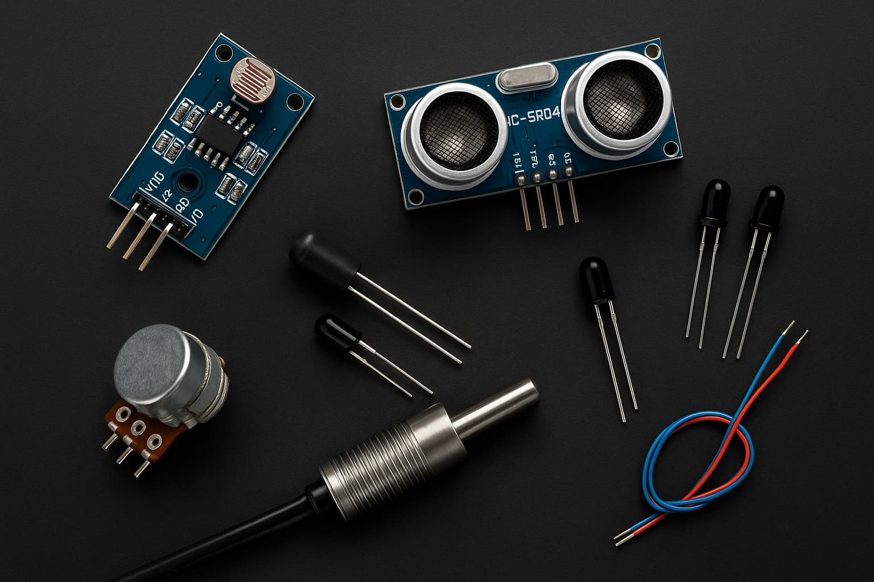
What are Transducers ?
Transducers convert one form of energy into another.
They are crucial in automation and control systems.
Examples:
LDR, Ultrasonic Sensor, Thermocouple,
potentiometer.

Slide 4
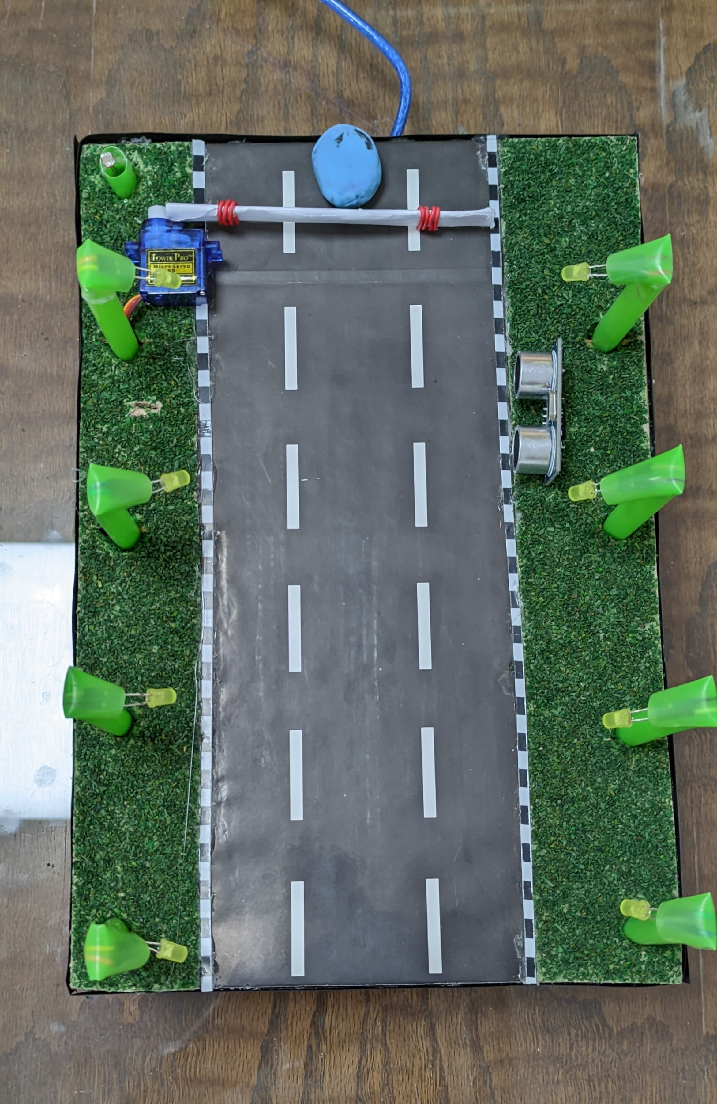
Smart Street model
Car
LDR
Auto Barrier gate
Lampposts light up at night and turn off during the day to save electricity.
Automatic barrier gate opens when cars approach and closes after they pass to regulate traffic
Ultrasonic Sensor
Servo Motor
Lampposts
LED

Slide 5
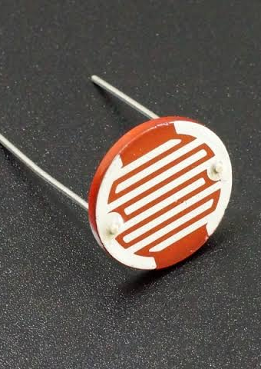
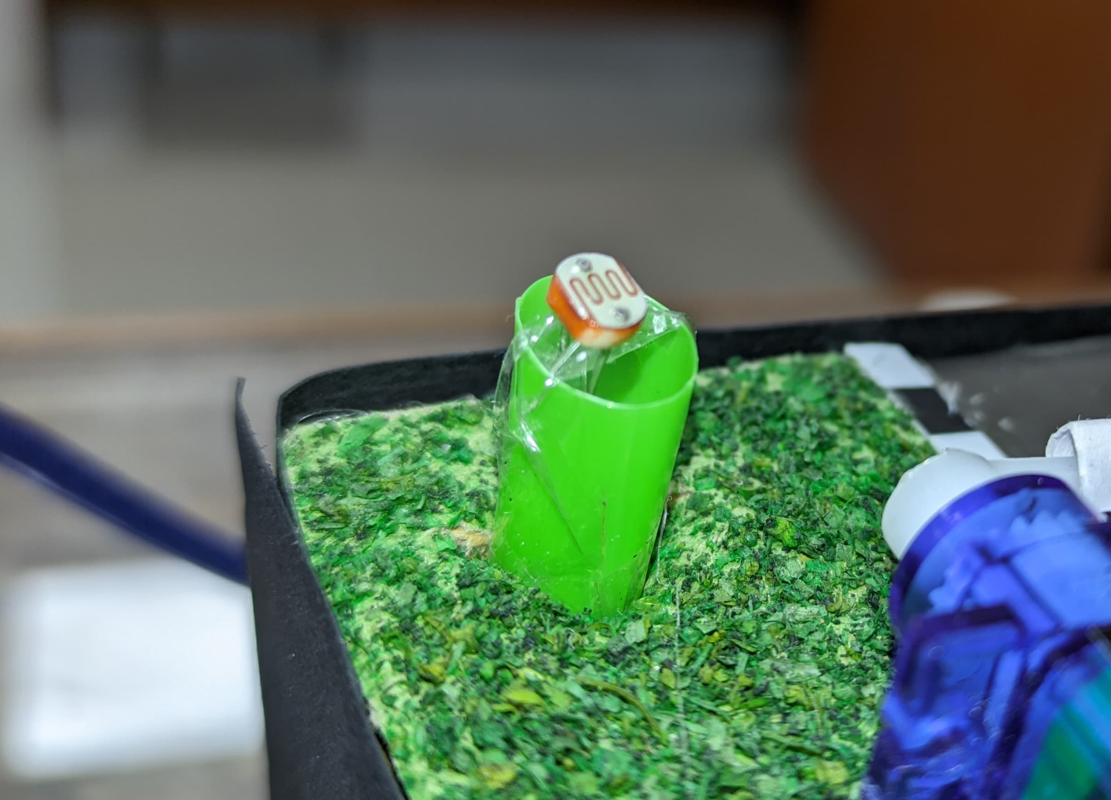
LDR Functionality
Passive Transducer.
The LDR detects light intensity.
Controlled via Arduino and breadboard setup.
Photo of LDR in our circuit

Slide 6
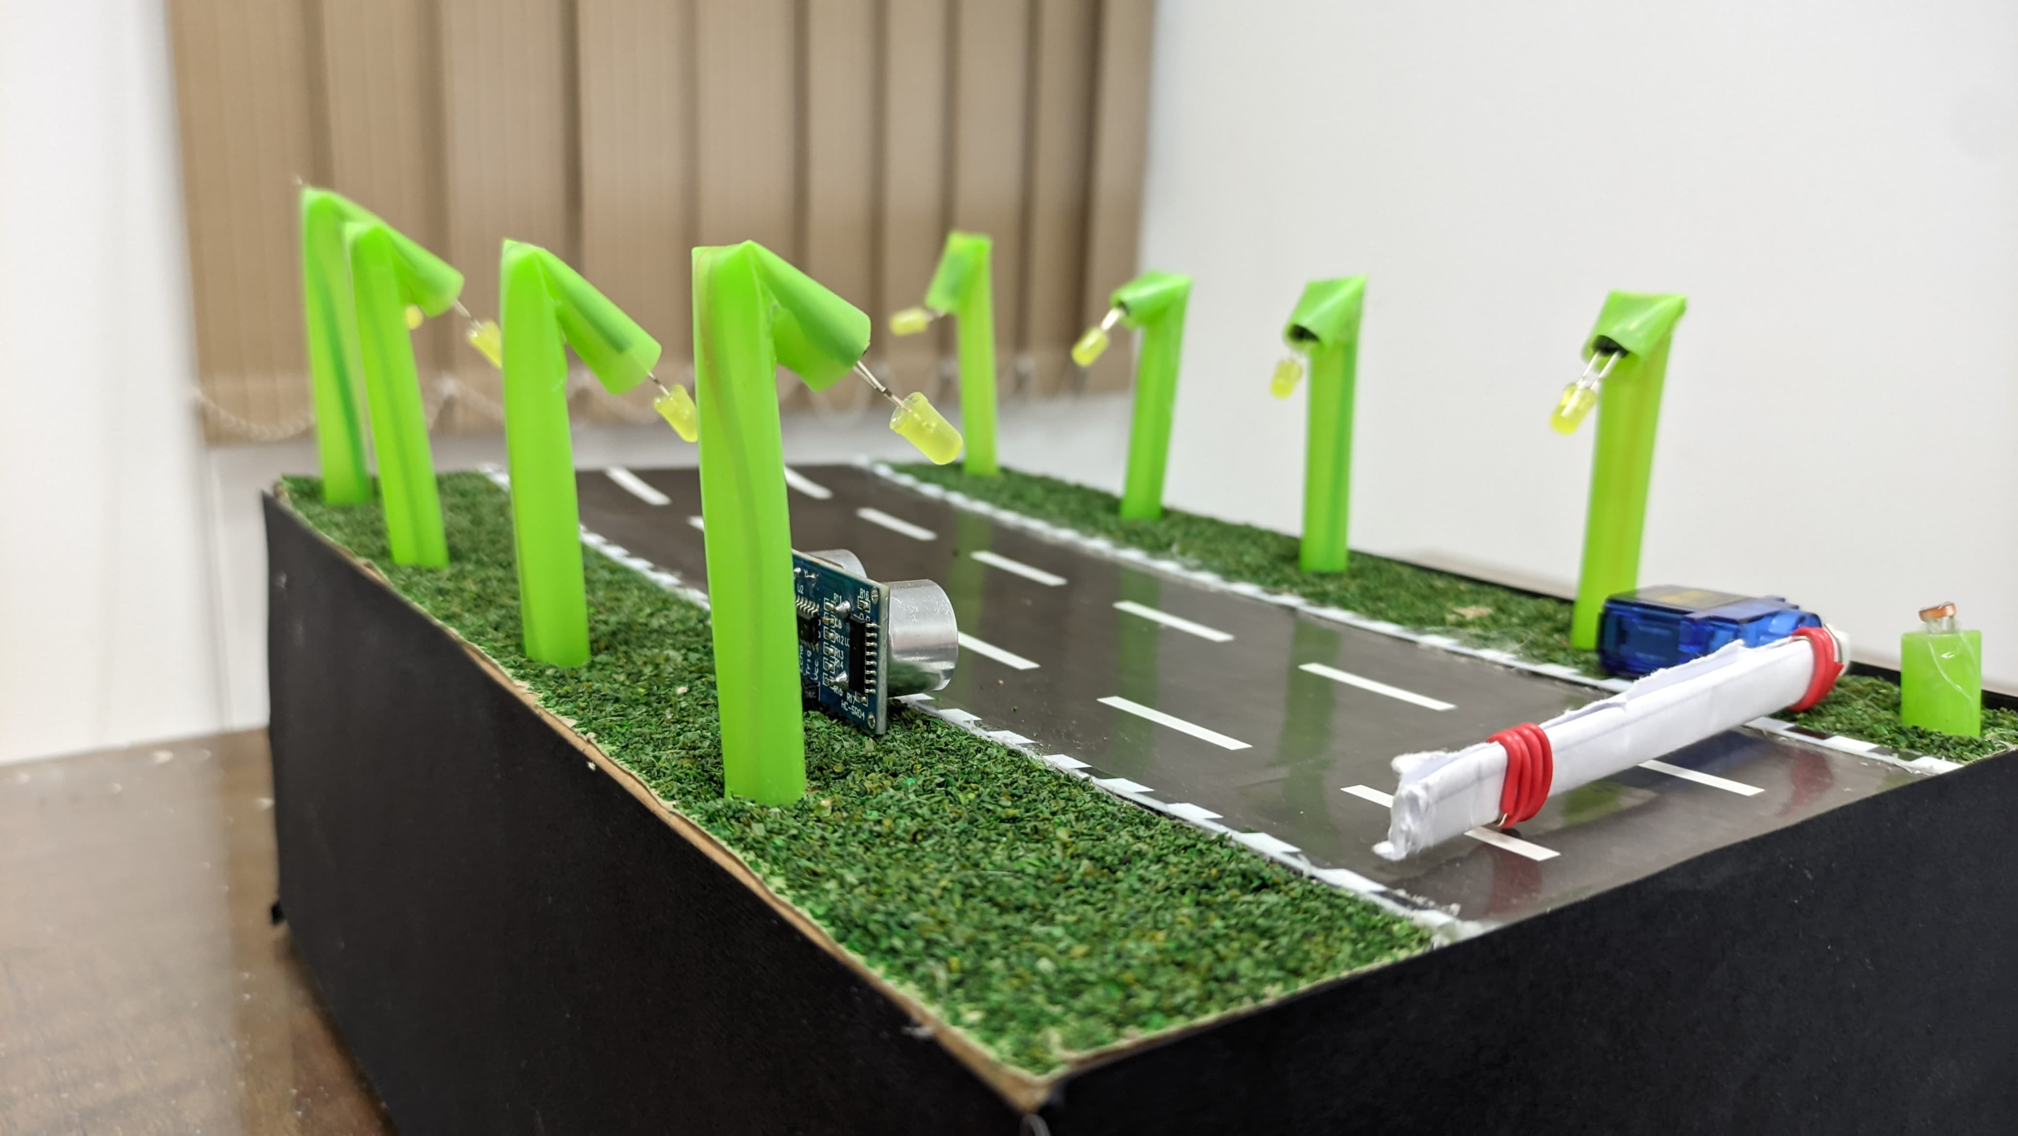
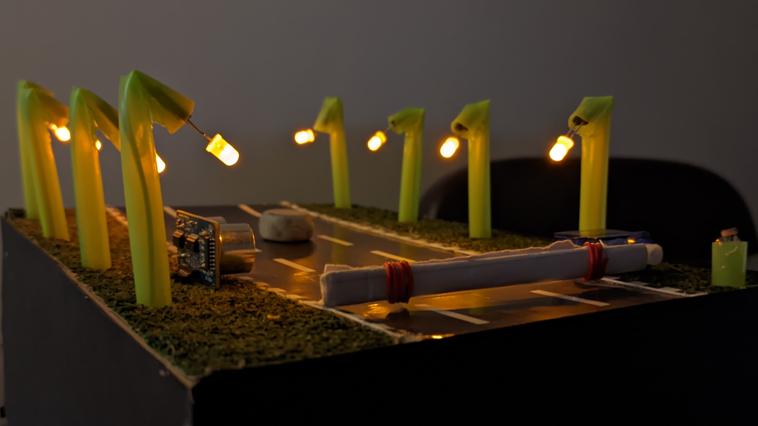
LDR Functionality
-If light level > threshold: LEDs stay OFF (day).
-If light level < threshold: LEDs turn ON (night).

Slide 7
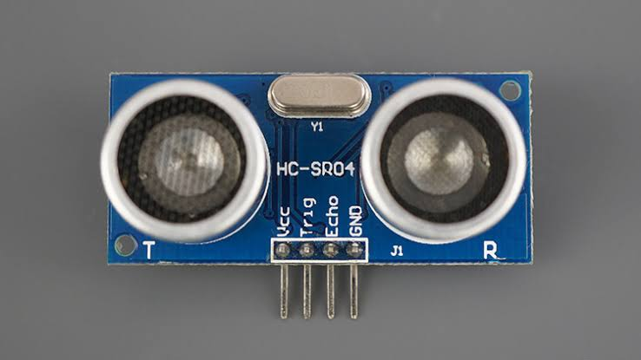
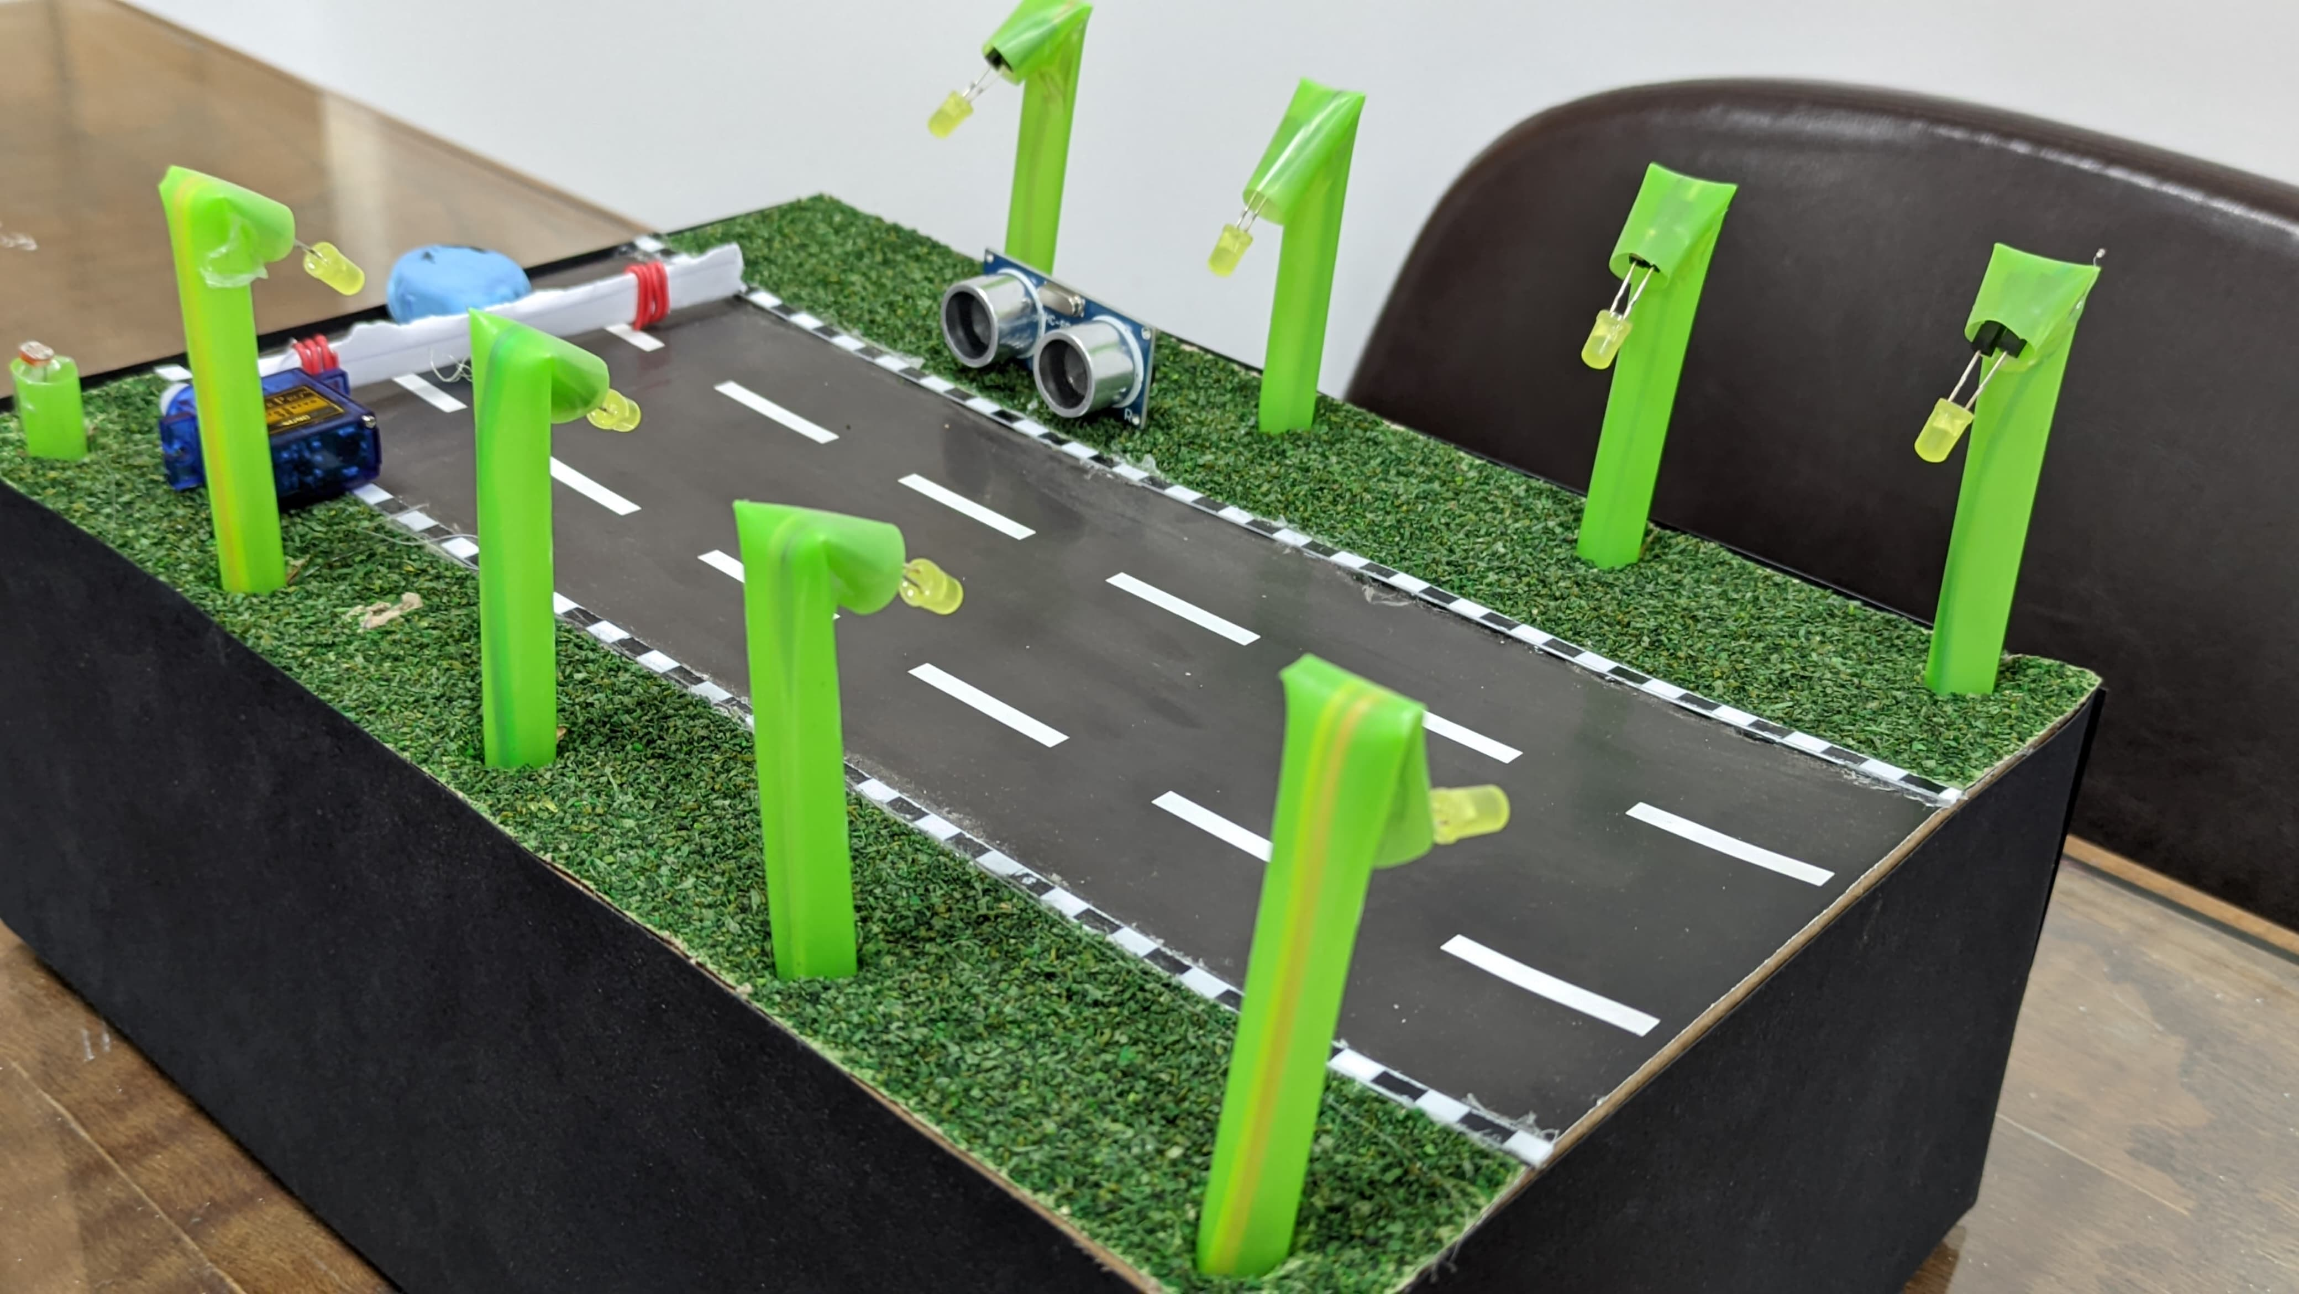
Ultrasonic Functionality
Active Transducer.
An Ultrasonic sensor detects nearby objects.
When an object approaches, it triggers a servo motor to raise a gate/barrier.
Ultarsonic we used in our circuit

Slide 8
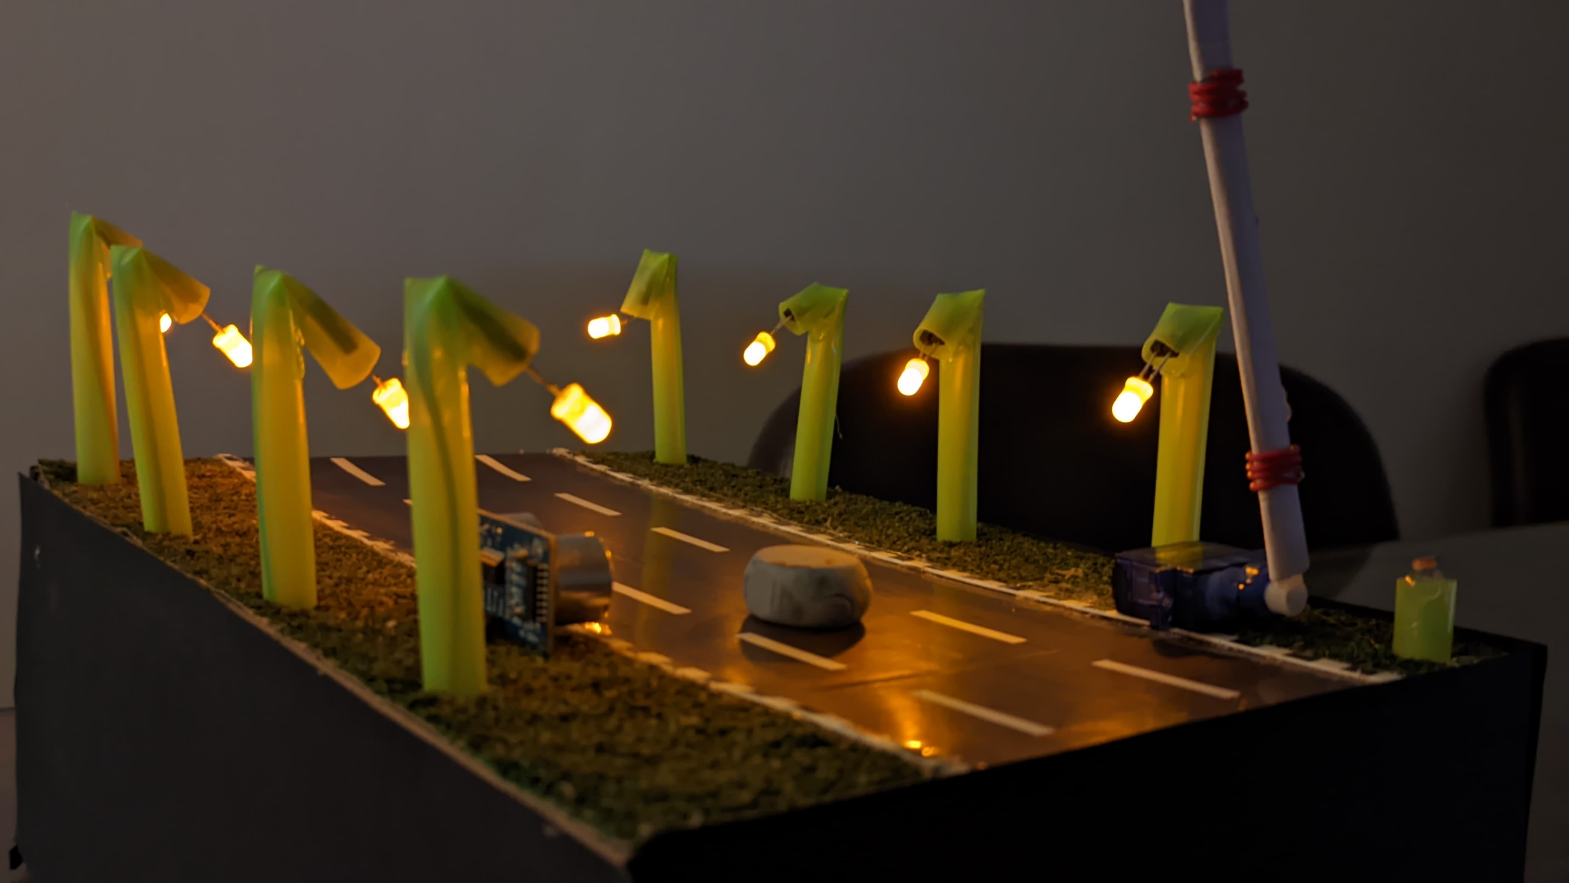
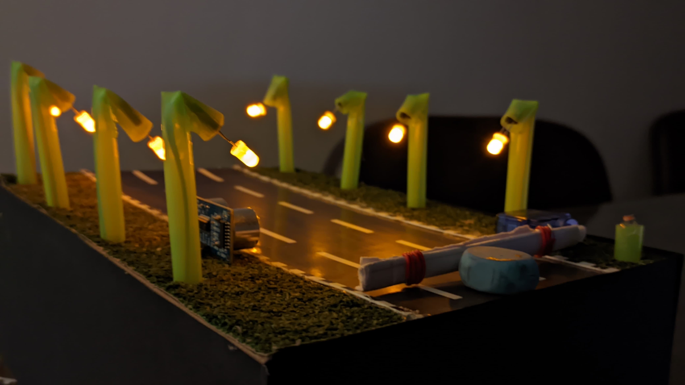
Ultrasonic Functionality
Car Still Far ?!
Ultrasonic sensor gives no voltage to Servo motor.
Barrier gate doesnot open.
Car Approached ?!
Ultrasonic sensor gives high voltage to Servo motor.
Barrier gate open as shown.
Car Passed by ?!
Ultrasonic sensor returns zero voltage again to Servo motor.
Barrier gate close again.

Slide 9
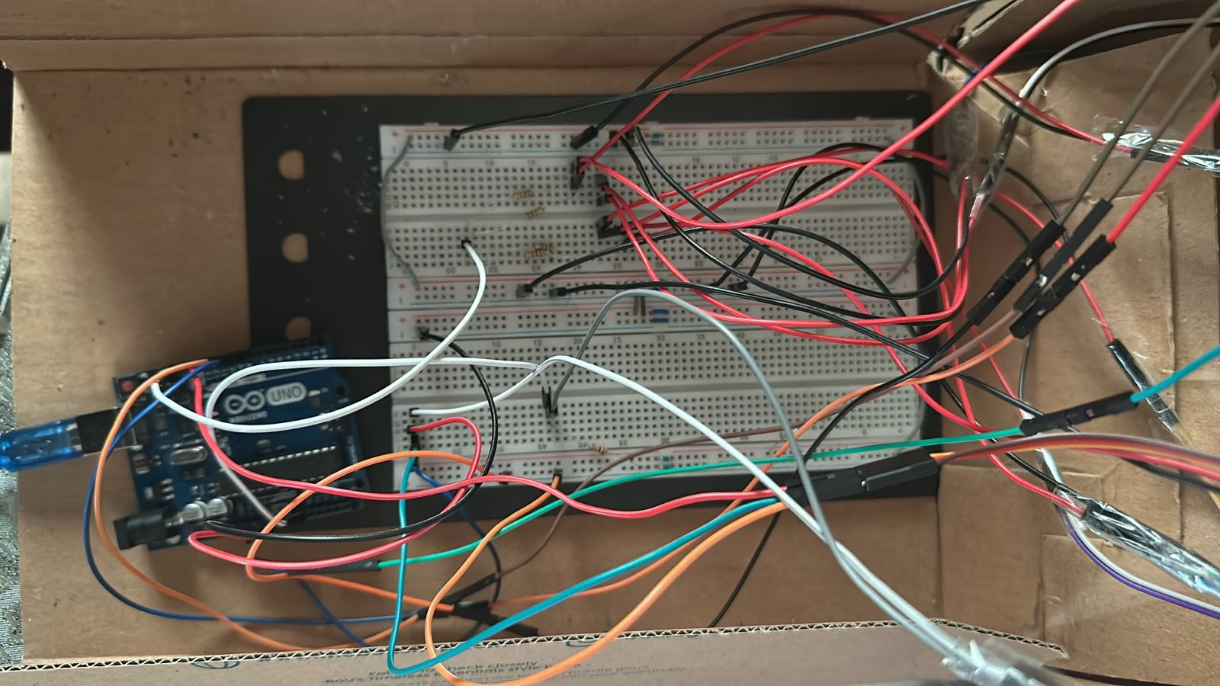
Circuit and Components
Arduino UNO was used to read sensors and control outputs.
Components: Breadboard, Jumpers, LEDs, LDR, Ultrasonic Sensor, Servo Motor, Straws, Rectangular box. Decoration.
Our Circuit Implemented on Bread Board

Slide 10
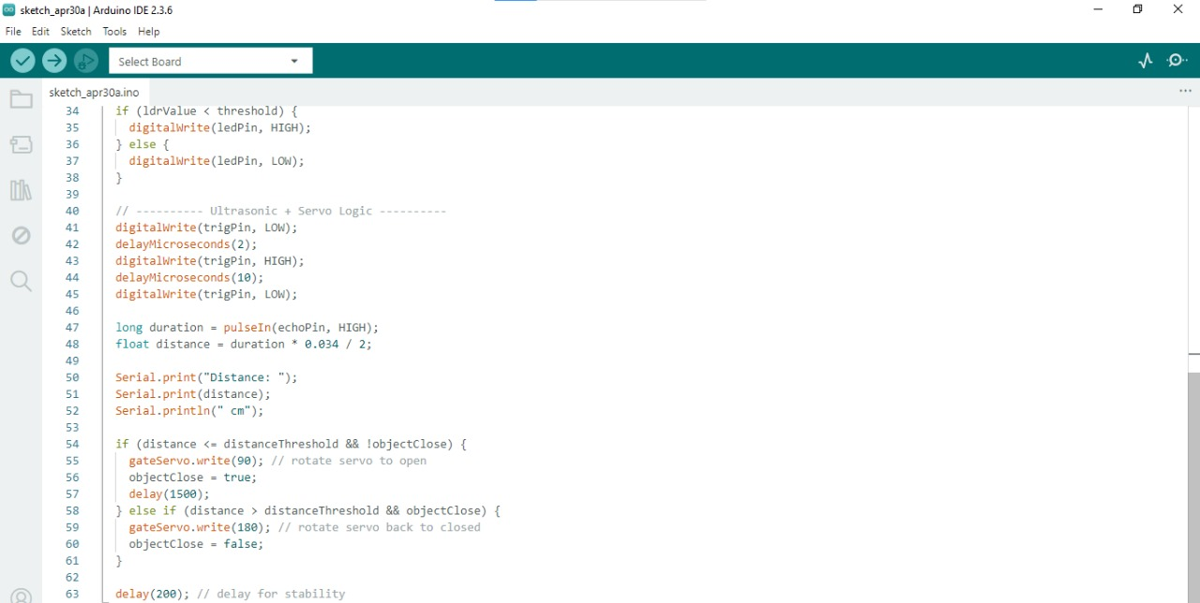
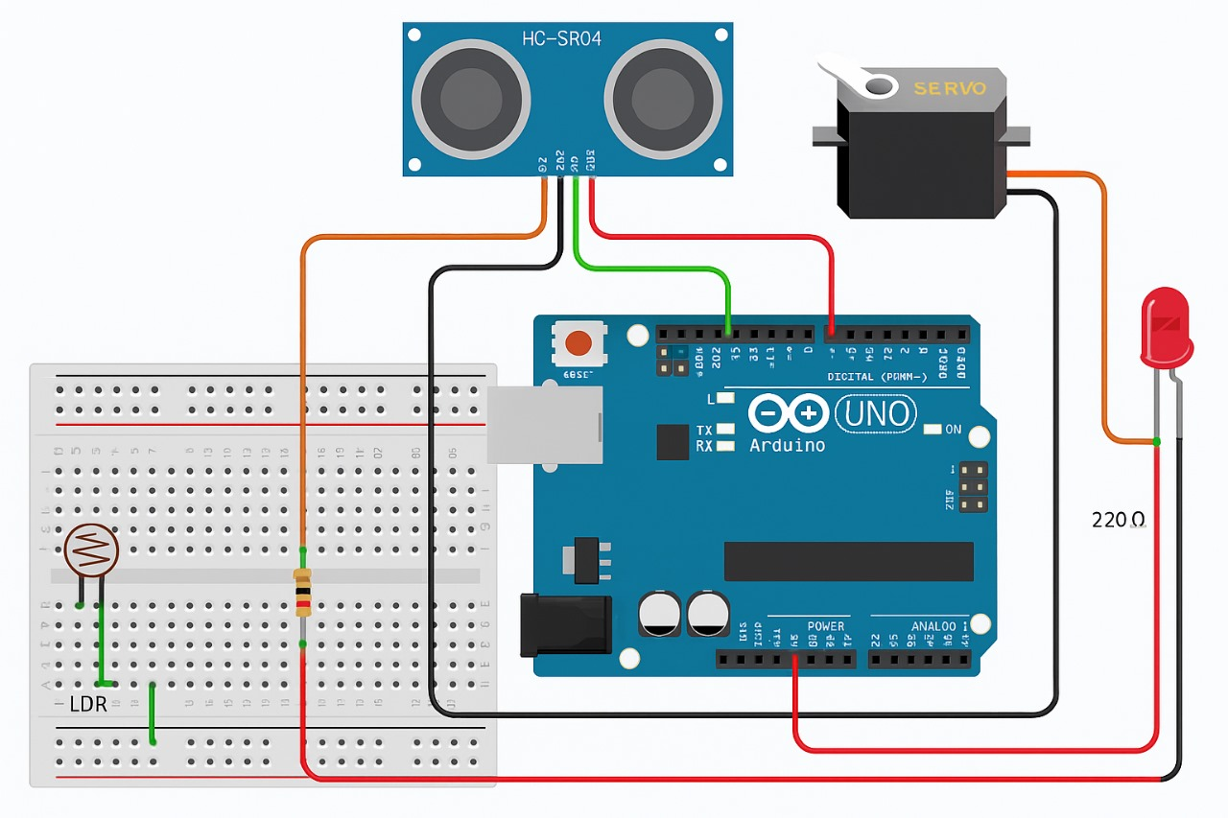
Circuit Diagram and Code

Slide 11
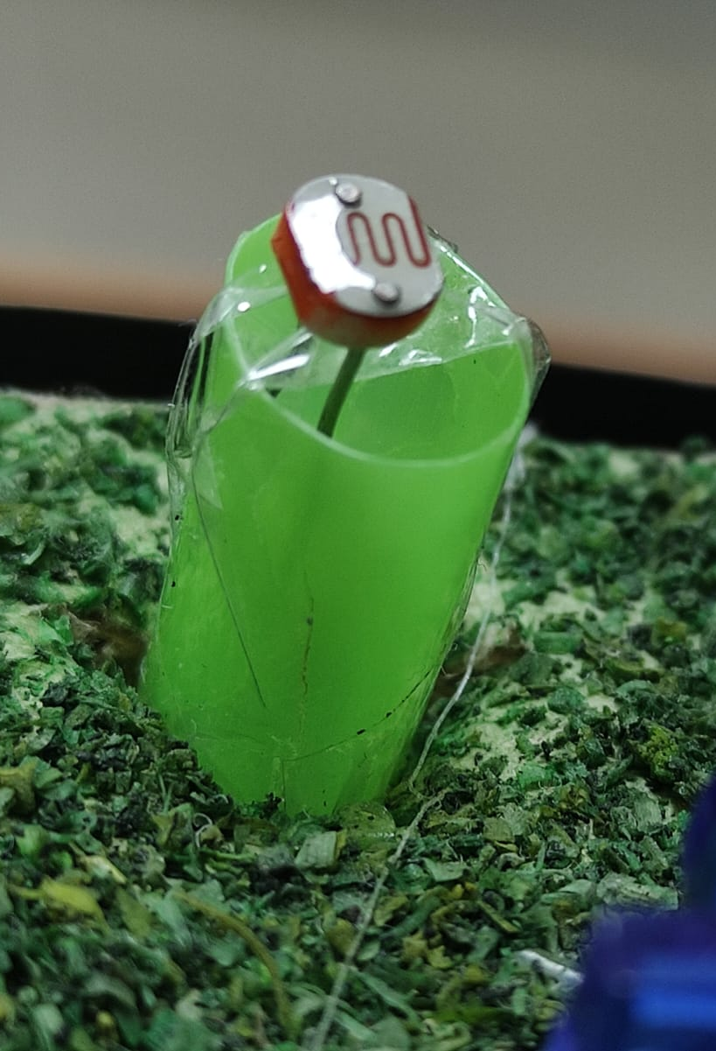
Challenges and Solutions
Calibrating light threshold accurately.
Positioning sensors correctly inside the model.
Stable power supply and signal handling

Slide 12
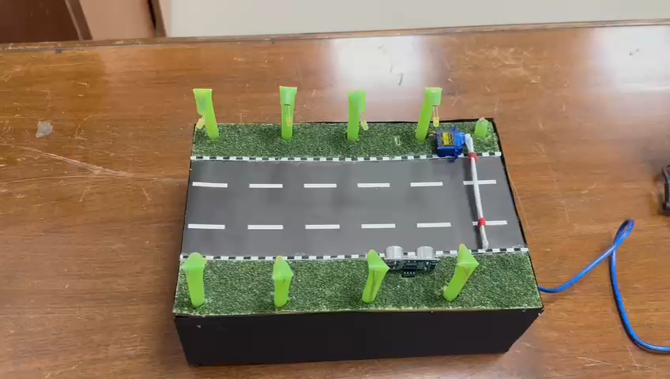
Let’s Try !!
Video

Slide 13
THANK YOU !

