Slide 1
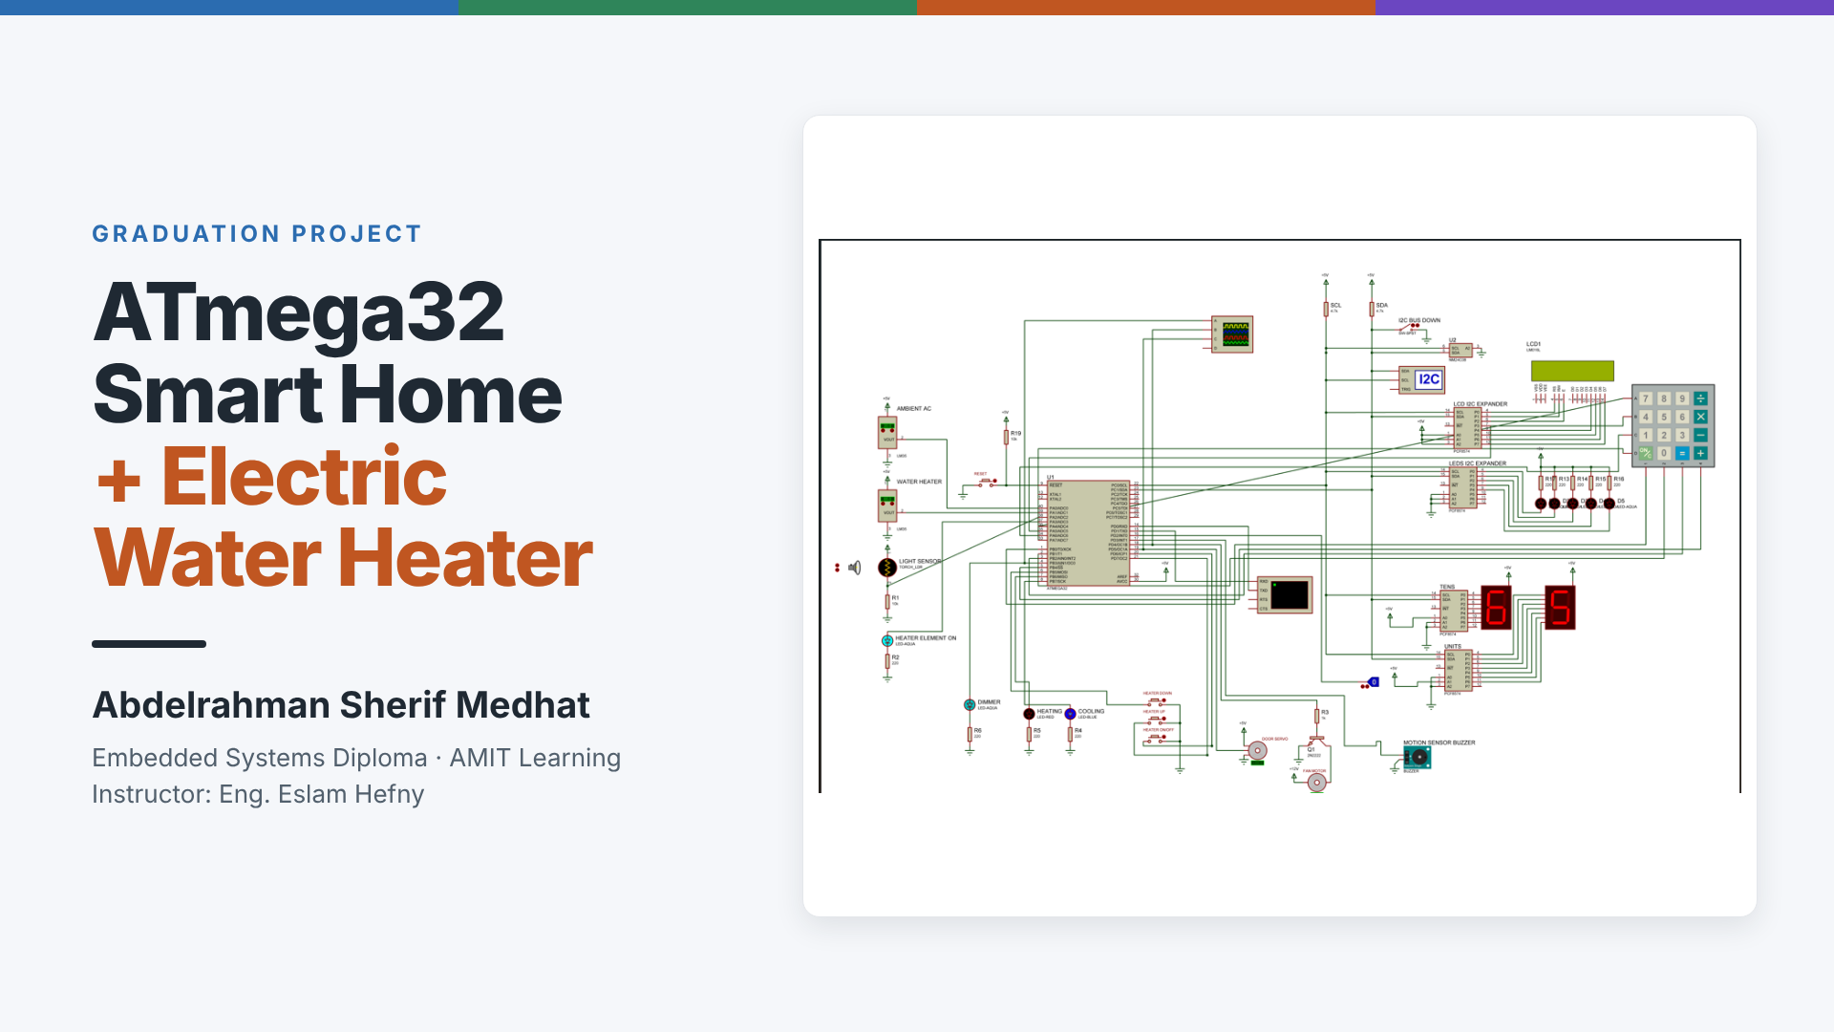
Notes:
ATmega32 Smart Home + Electric Water Heater, the graduation project of the AMIT Learning Embedded Systems Diploma (onsite, 14 Sep 2025 – 8 Apr 2026, instructor Eng. Eslam Hefny). Individual project by Abdelrahman Sherif Medhat; the course project is designed for teams of up to six. Picture: the complete Proteus schematic running the final firmware.

Slide 2
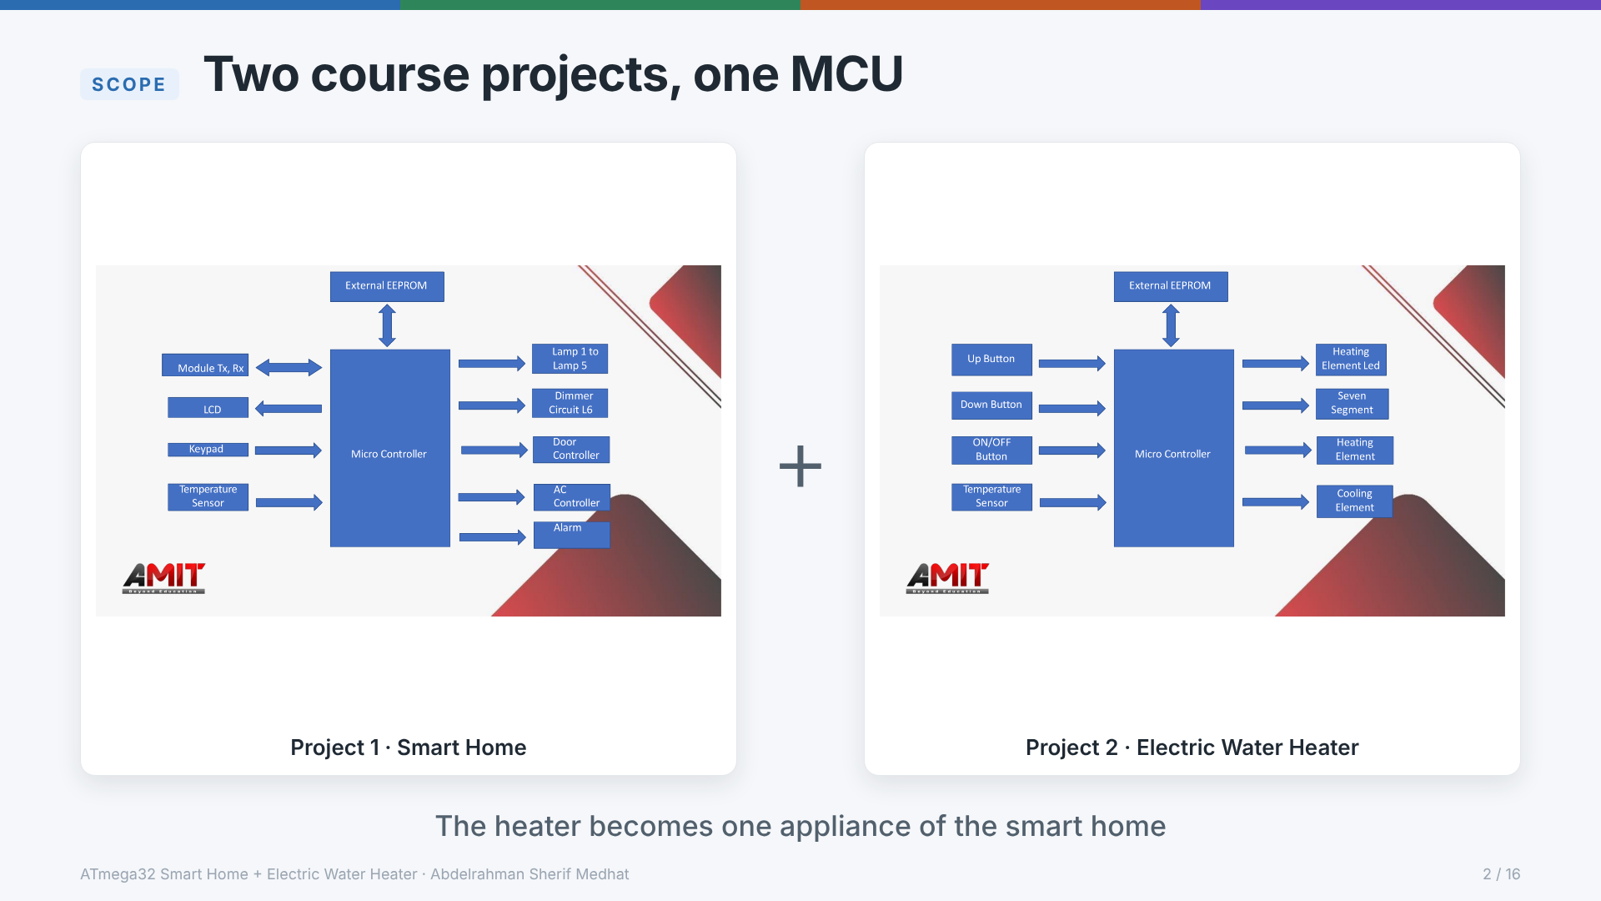
Notes:
The course offered the Smart Home and the Electric Water Heater as two separate projects (block diagrams from the course brief). This project builds both on one ATmega32. The heater keeps its own panel (Up / Down / ON-OFF buttons, two-digit display, status LED), and its state and set temperature are also reachable from the UART terminal and from the keypad/LCD menu.

Slide 3
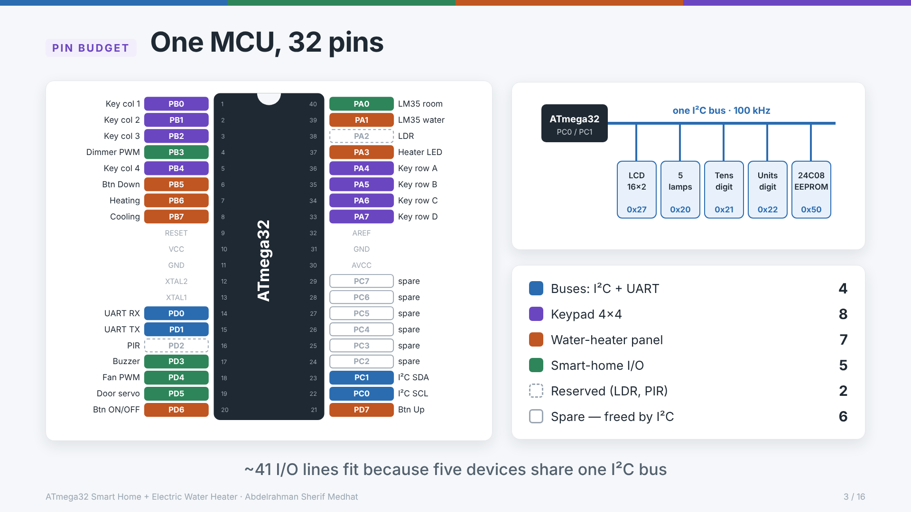
Notes:
About 41 I/O lines were needed, but the ATmega32 has 32. Moving the LCD (0x27), the five lamps (0x20) and each 7-segment digit (0x21, 0x22) onto PCF8574 expanders, next to the 24C08 EEPROM (0x50), puts five devices on two pins (PC0/PC1). All 32 pins are assigned: PA2 and PD2 are reserved for the optional LDR and PIR, and PC2–PC7 became spare when the 7447 display was replaced (D-20). Source: docs/pin_map.md.

Slide 4
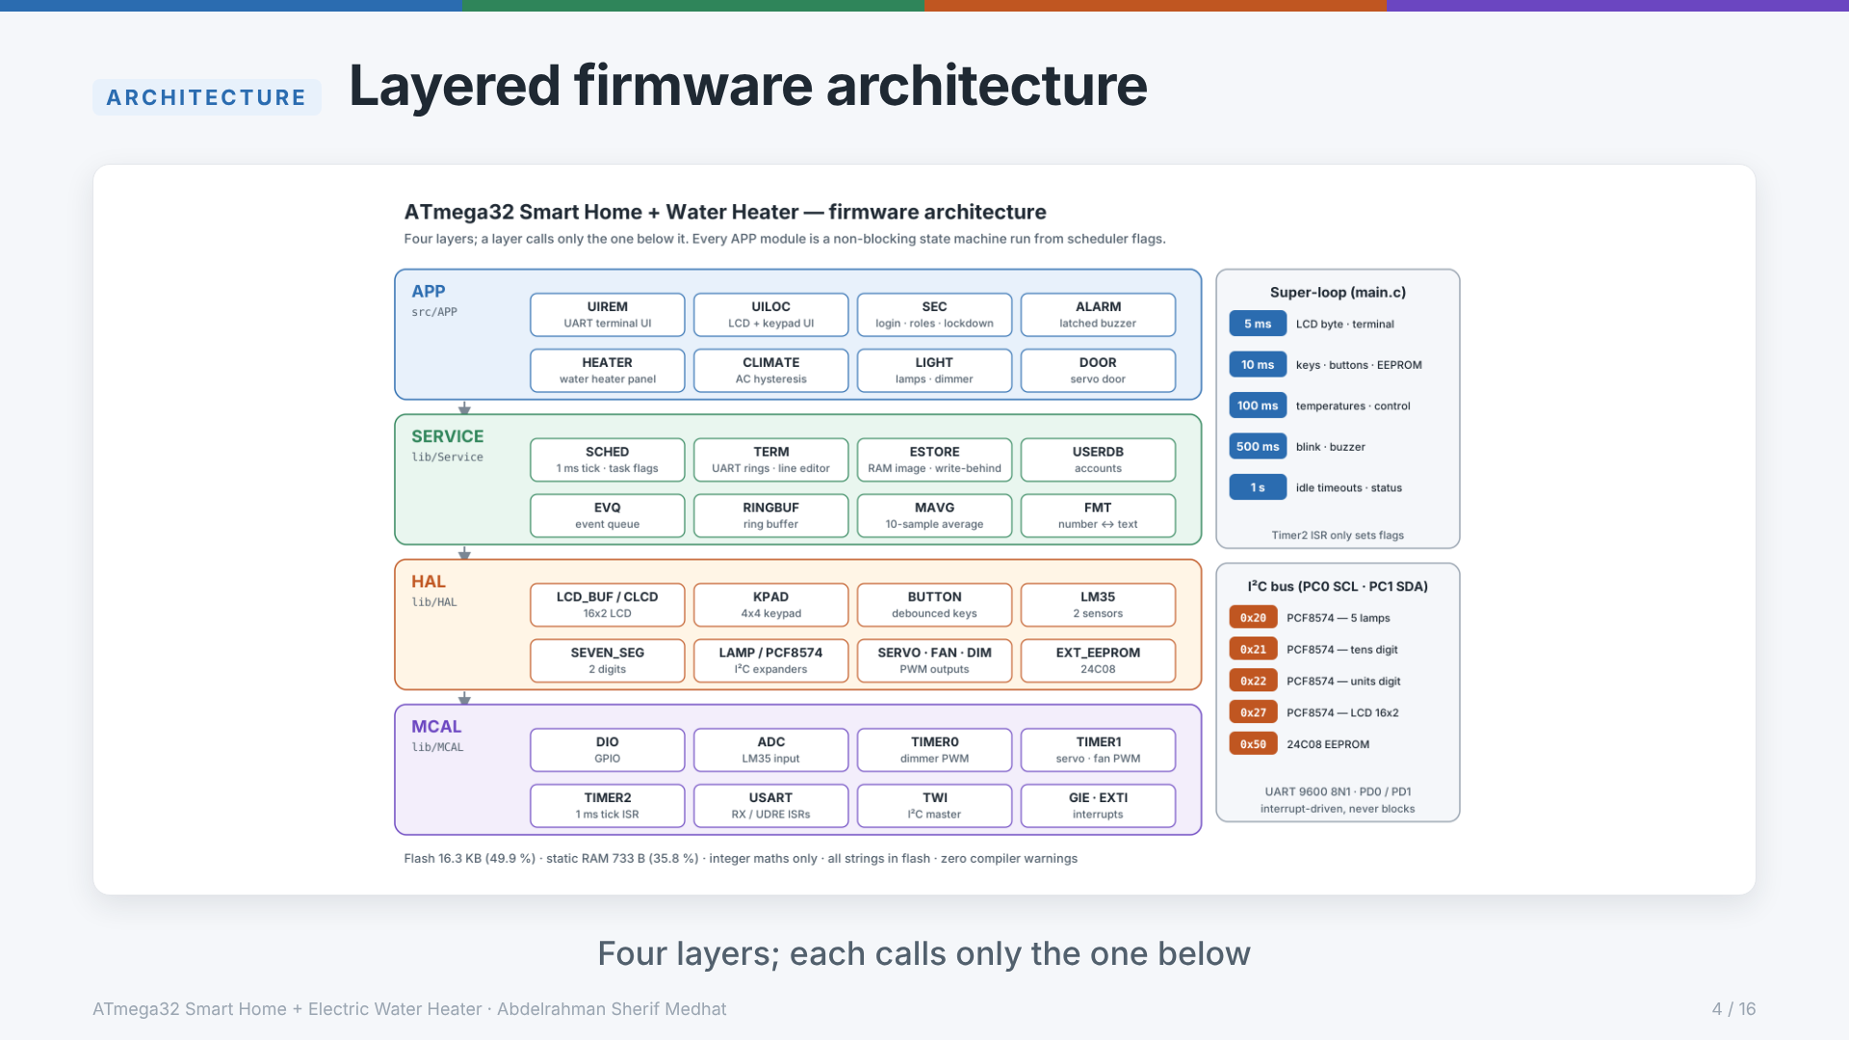
Notes:
MCAL → HAL → SERVICE → APP. A layer only calls the one below it; APP code never touches a register or pin. 42 modules: 3 course drivers used as they are, 9 course drivers fixed or extended, 30 new. Pins and constants live only in the _cfg.h files. Interrupts reach upper layers only through callbacks. Source: docs/architecture.md § 1.

Slide 5
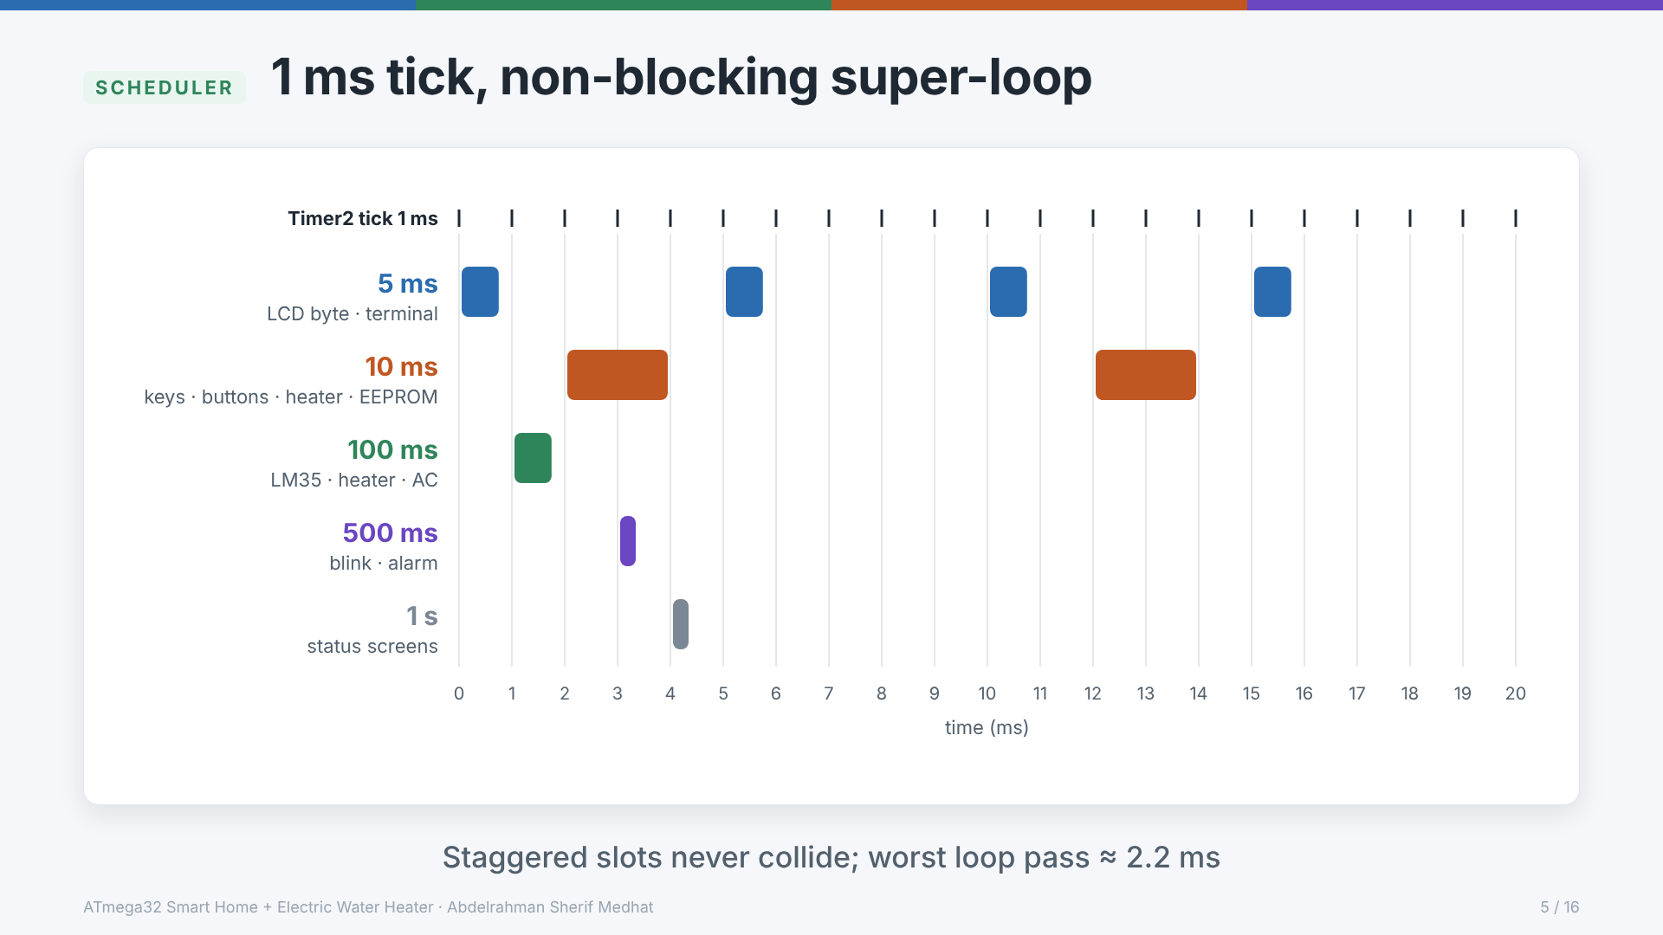
Notes:
Timer2 in CTC mode, prescaler 64, OCR2 = 249 gives exactly 1.000 ms. The ISR only decrements five counters and sets task flags (<10 µs). main() runs a super-loop that checks the flags. The periods start at offsets 0, 2, 1, 3 and 4 ms, so no two periods are ever due in the same millisecond. The worst pass is the 10 ms slot when an EEPROM page is written: about 2.2 ms. Nothing blocks longer than ~2 ms after boot; the UART is interrupt-driven through ring buffers. Block widths in the picture are the worst-case task times. Source: architecture.md § 4.

Slide 6
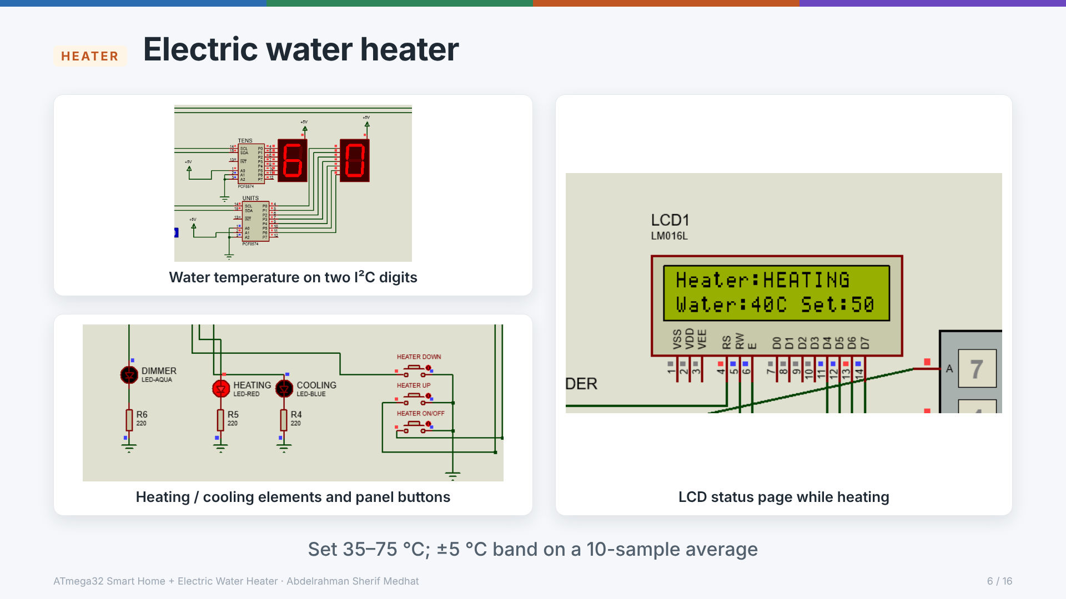
Notes:
Set temperature 35–75 °C in 5 °C steps, initial 60 °C, saved in the external EEPROM. The water LM35 is sampled every 100 ms; decisions use the average of the last 10 samples. Below set − 5 °C the heating element turns on; above set + 5 °C the cooling element turns on. Up/Down enters the setting mode: the display blinks the set value once per second and returns to the water temperature after 5 s without a press. Heater LED blinks while heating, is steady while cooling. ON/OFF acts on release. Source: architecture.md § 5.6.

Slide 7
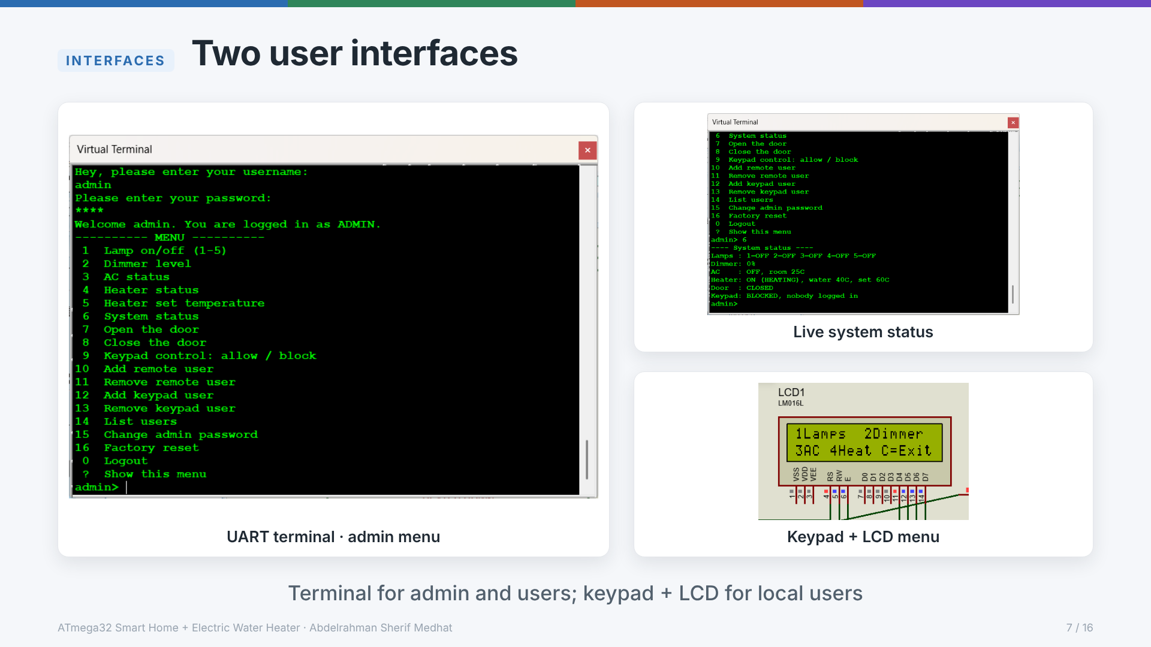
Notes:
UART terminal at 9600 8N1 (Virtual Terminal in Proteus, HC-05 Bluetooth on real hardware): lamps, dimmer, AC, heater, door and user management; every change made elsewhere is reported live. Keypad + 16×2 LCD for keypad users: same functions except the door and user management; the PIN is shown as *. Admin logs in only from the terminal. First-boot login is admin / 1234. Source: uart_protocol.md, architecture.md § 5.7–5.8.

Slide 8
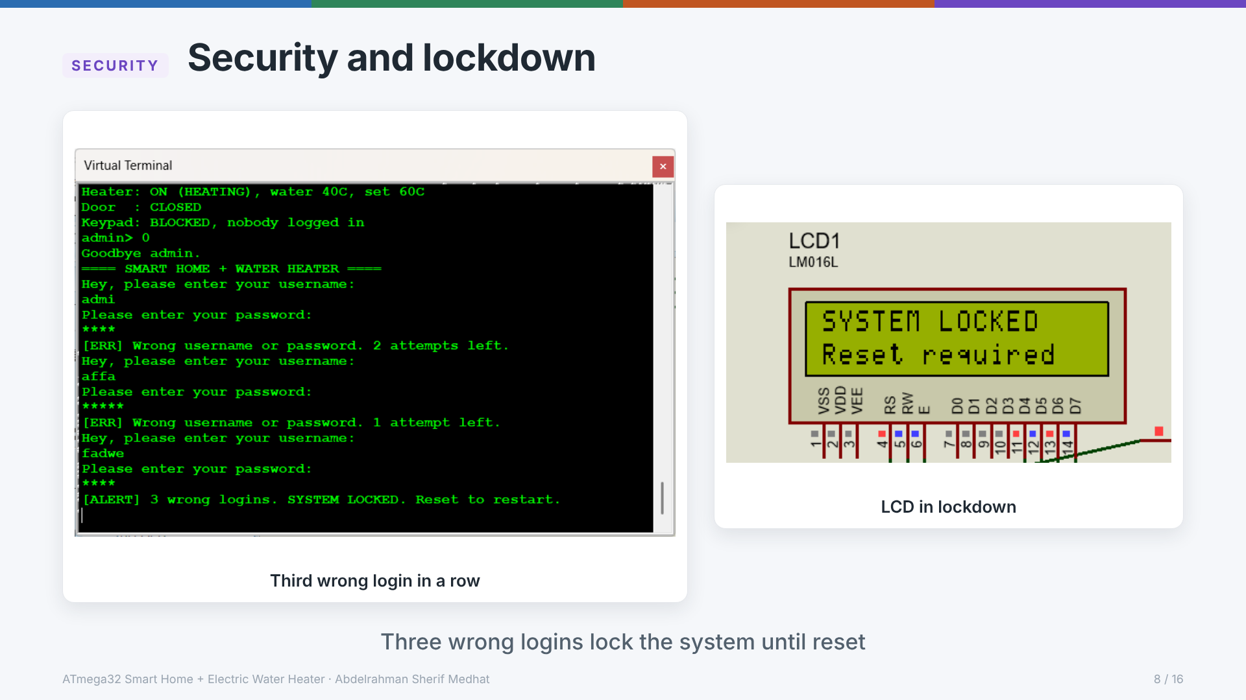
Notes:
Admin (terminal only) and users (terminal or keypad) have separate user lists stored in EEPROM. One attempt is a name + password pair, and the reply never tells which half was wrong. The 3rd wrong attempt in a row from one source triggers the latched ALARM: heater and AC forced off, buzzer 0.5 s on / 0.5 s off, both UIs locked. Only an MCU reset leaves the lockdown. Source: architecture.md § 5.1–5.2.

Slide 9
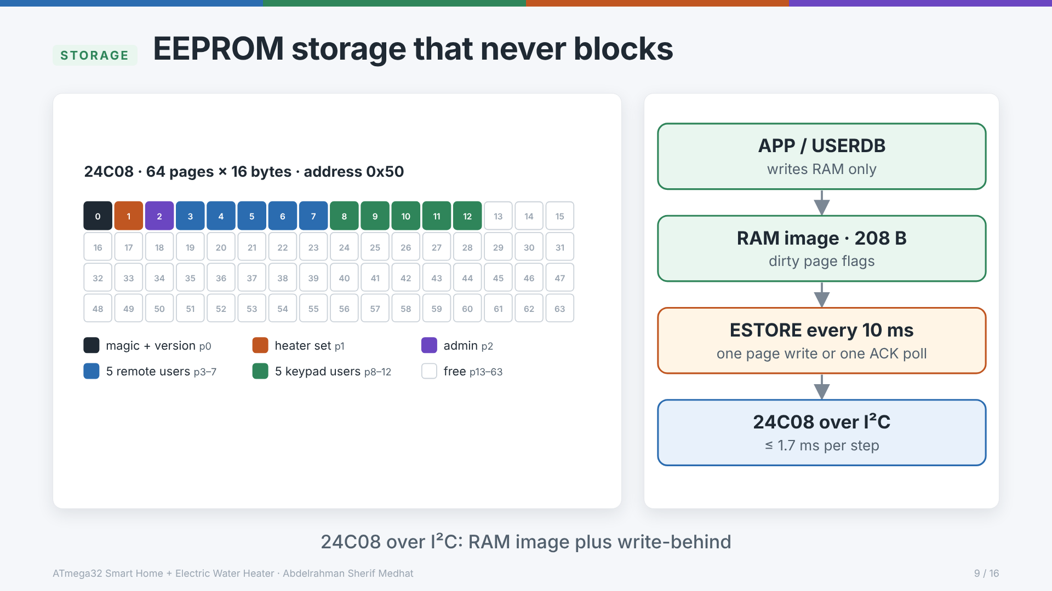
Notes:
The 24C08 is used for page 0 (magic byte + layout version), page 1 (heater set temperature), page 2 (admin) and pages 3–12 (five remote and five keypad users, 16 bytes each). The magic byte has its own page, so a power failure while saving the set temperature cannot trigger a factory reset. All writers change a 208-byte RAM image; ESTORE writes one dirty page per 10 ms slot and uses ACK polling for the 5 ms write cycle. The Proteus EEPROM model has no write delay, so the polling succeeds at once in simulation. Source: eeprom_map.md.

Slide 10
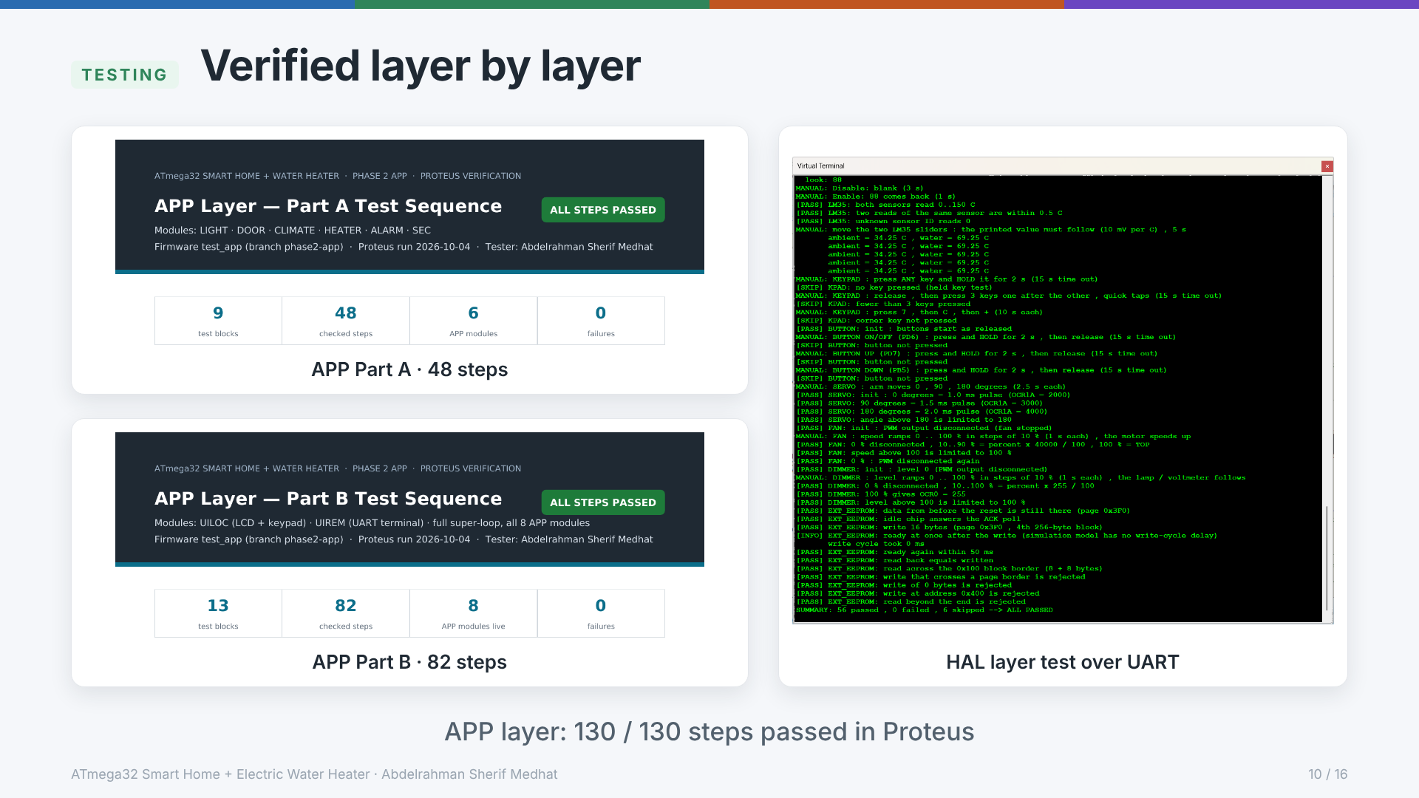
Notes:
One test program per layer (test_mcal, test_hal, test_service, test_app), each printing [PASS]/[FAIL] lines over the UART. The APP layer was then verified step by step on the full schematic: Part A 48 steps, Part B 82 steps, all passed (docs/test_app_partA_sequence.pdf, partB). The HAL run shown ends 56 passed, 0 failed, 6 skipped — the skipped checks are manual keypad/button steps not pressed during that run. 126 requirement-ID tags in the code; the test plan's coverage table maps each requirement to its steps.

Slide 11
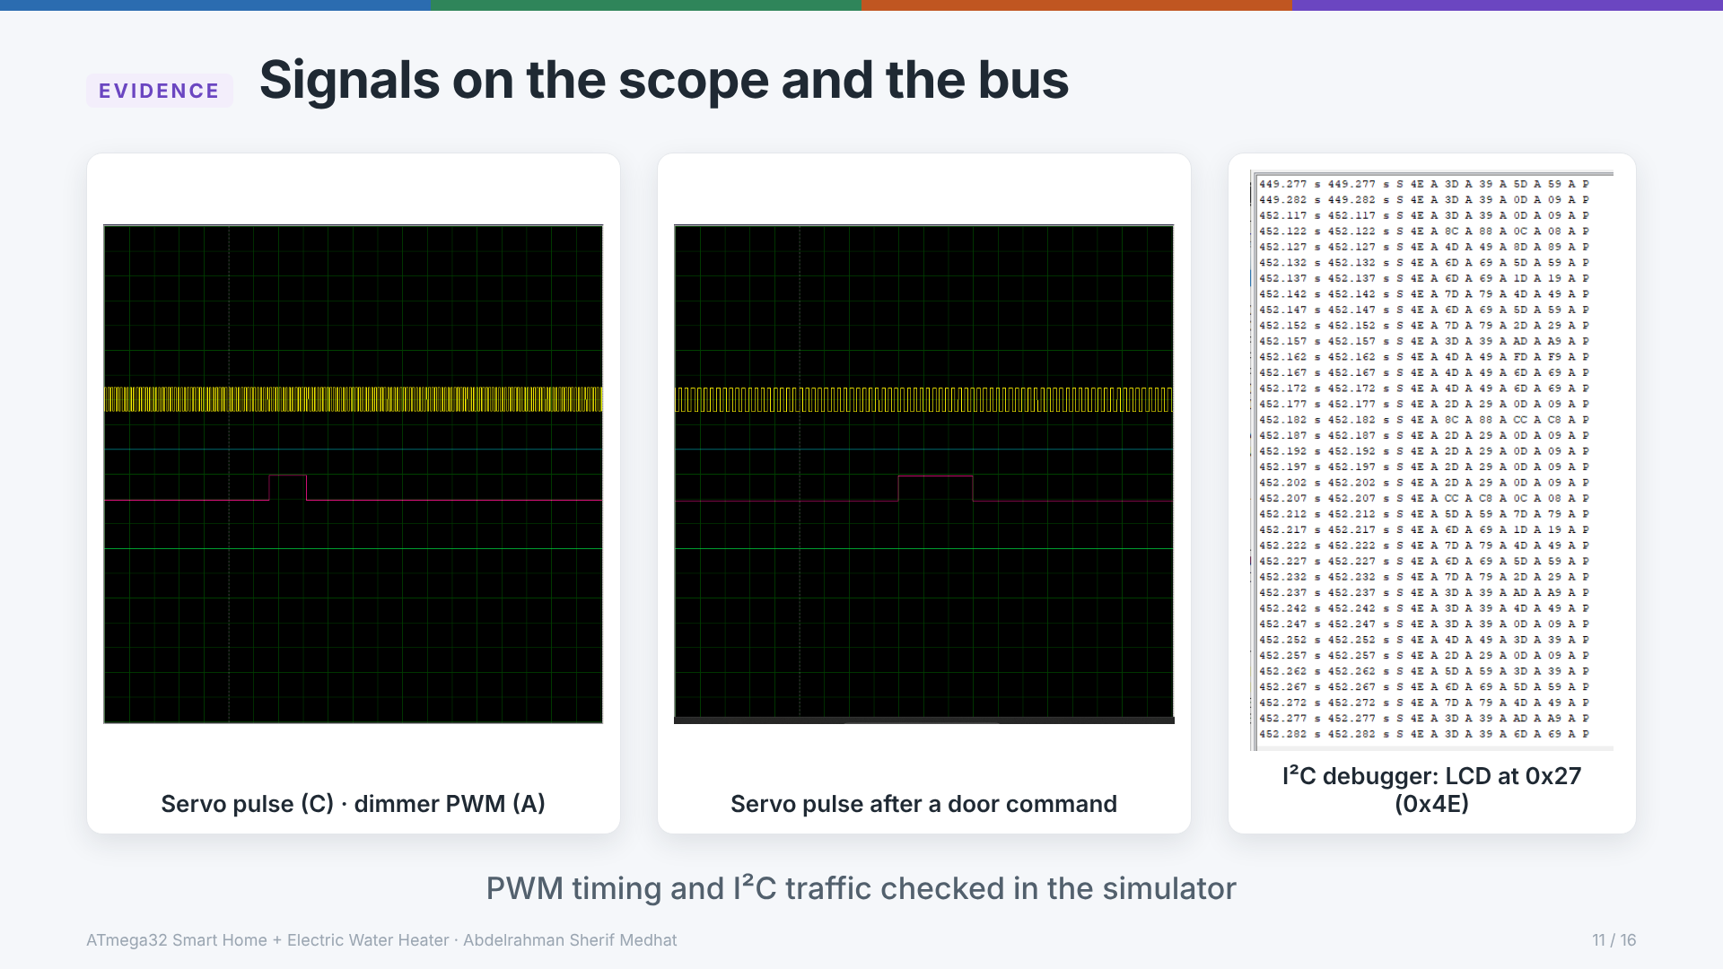
Notes:
Oscilloscope wiring from the test plan: A = PB3 dimmer (Timer0 fast PWM ≈ 7.8 kHz), B = PD4 AC fan, C = PD5 door servo (Timer1, 20 ms period). The two captures show the servo pulse width changing between two door positions. The I²C debugger shows the LCD traffic: 0x4E is the write address of the PCF8574 at 0x27, each LCD byte sent as one 4-byte transaction (high nibble E=1/E=0, low nibble E=1/E=0).

Slide 12
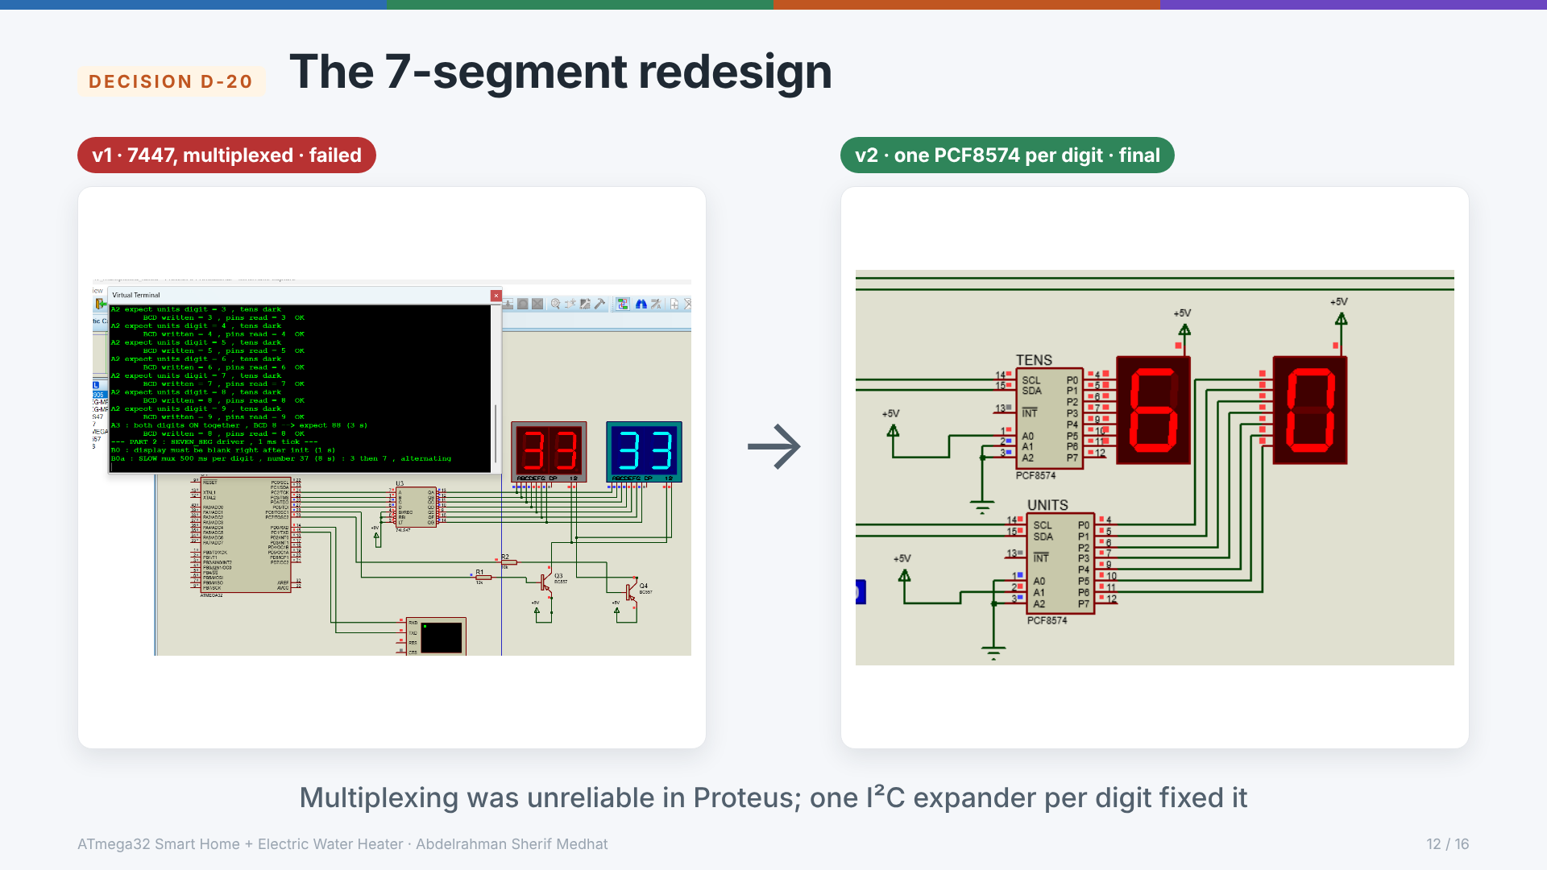
Notes:
First design: one 7447 BCD decoder with the two digits multiplexed from the 1 ms tick and PNP digit drivers. The capture shows the bench test: the driver should alternate 3 and 7 for the number 37, but both displays show 33 (the 74LS47 output reaches both digits). In Proteus it showed 37 as 33 and the same symbol on both digits: both digits conducted at once (slow PNP model). A test bench proved the pins and the generated code were correct; a 1 ms dead time did not fix it. Decision D-20: one PCF8574 per common-anode digit (tens 0x21, units 0x22). No multiplexing, no tick hook, and PC2–PC7 became spare. Source: hal_summary.md § 3.

Slide 13
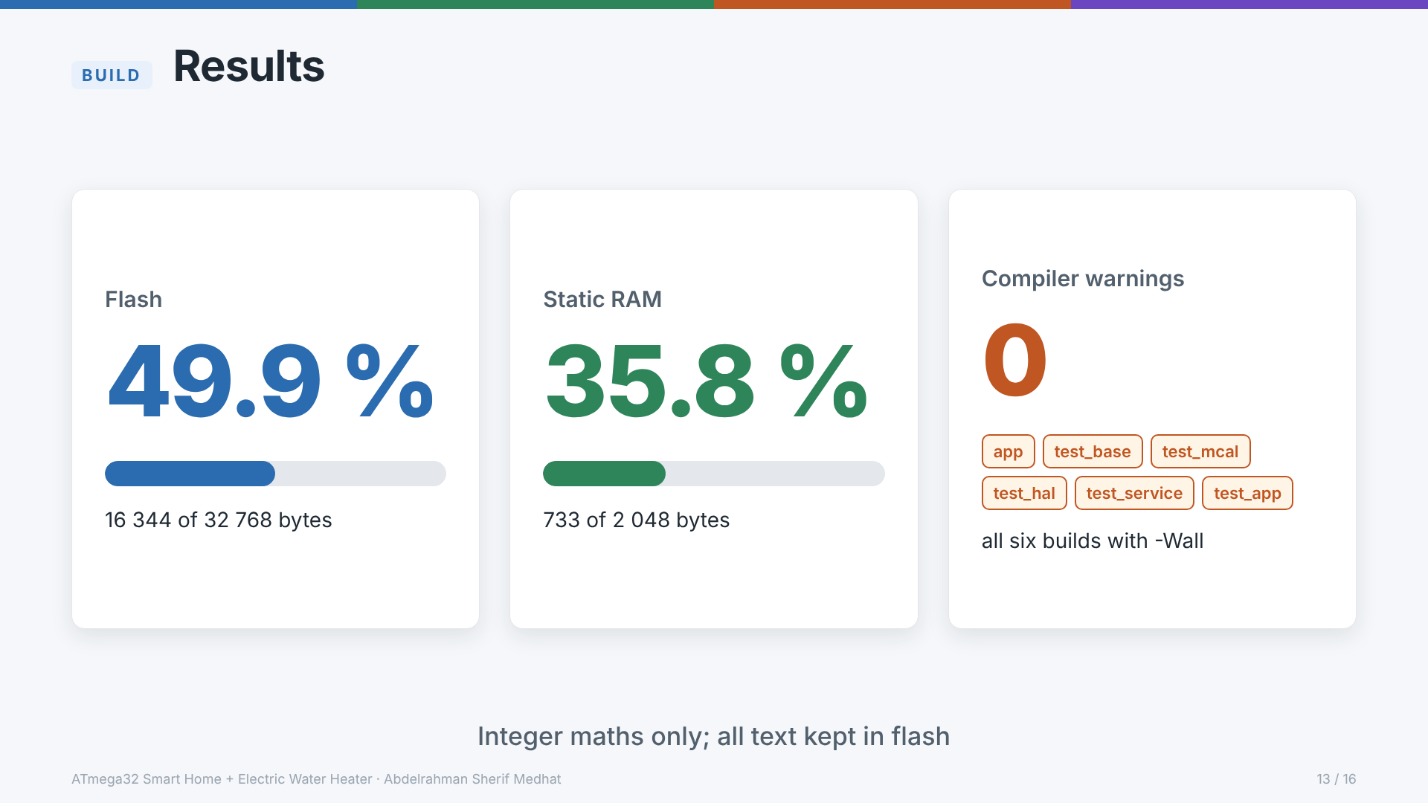
Notes:
PlatformIO avr-gcc build of the app environment: flash 16 344 bytes (49.9 %), static RAM 733 bytes (35.8 %). All six environments (app, test_base, test_mcal, test_hal, test_service, test_app) build with -Wall and zero warnings. Integer maths only; every string lives in flash (__flash) so it costs no RAM.

Slide 14
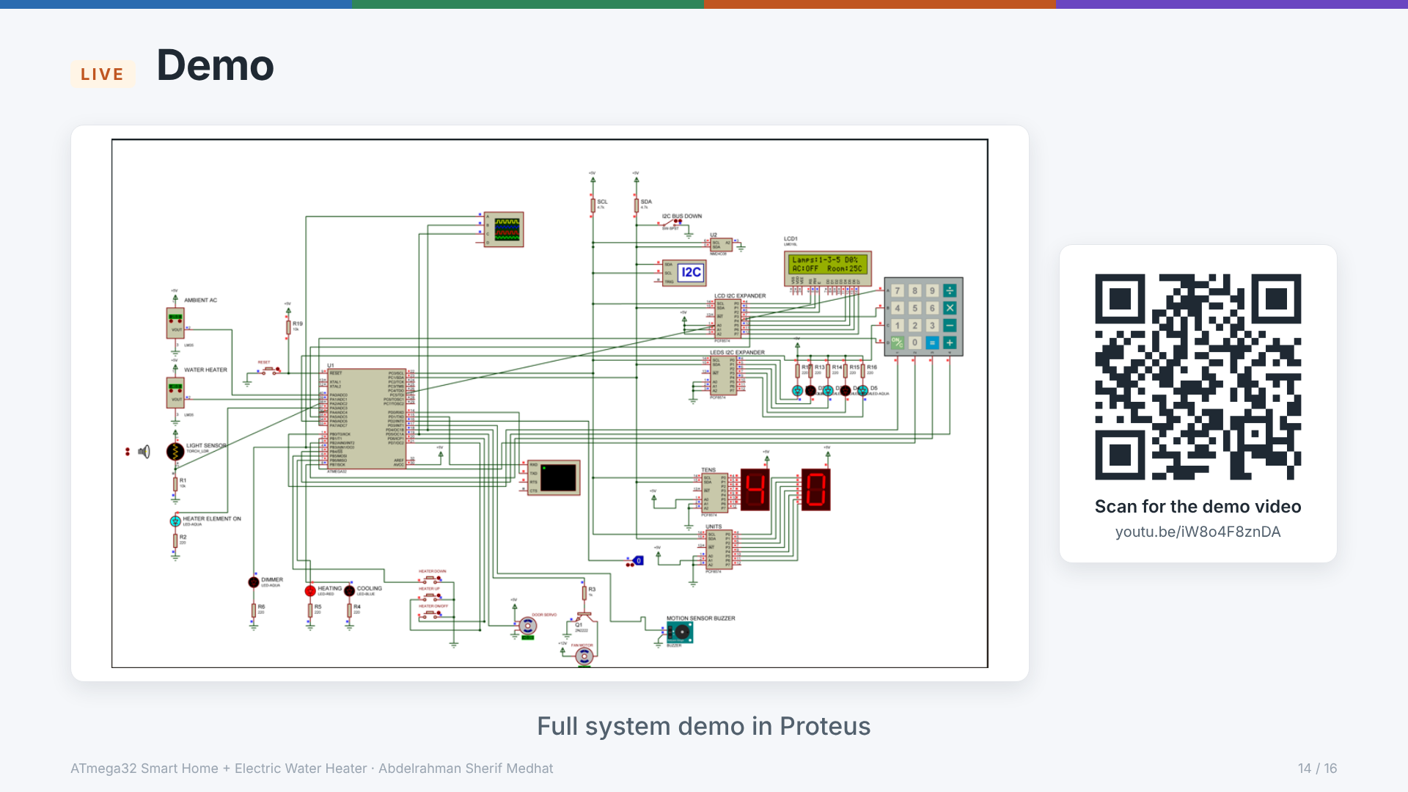
Notes:
Play the demo video (link also on the picture: click it in slideshow mode). Suggested order: terminal login as admin, lamps and dimmer, heater ON and setting mode with Up/Down, AC fan on the room LM35, door open/close, keypad login, then three wrong logins to show the lockdown.

Slide 15
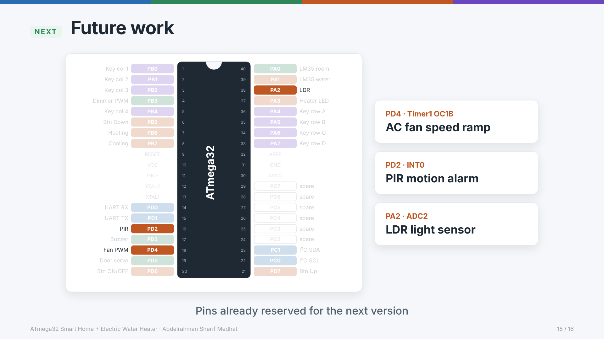
Notes:
Not built in v1 (specification decision 15), but the pins stay reserved so no rewiring is needed: AC fan speed ramp on the existing Timer1 PWM (PD4), PIR motion alarm on INT0 (PD2), LDR on ADC2 (PA2) with the divider already in the schematic. Real hardware also needs a transistor driver for the buzzer (pin_map C-9).

Slide 16

Notes:
Thanks. Course drivers (the MCAL/HAL base set) are by Eng. Eslam Hefny, AMIT Learning; bugs found in them were fixed in their own style and are listed in specification.md § 4. Project code, simulation and documentation by Abdelrahman Sherif Medhat. Repository: github.com/abdelrahmansherifmedhat1134/embedded-diploma.

