Slide 1

Disease Recurrence Analysis
Abdelrehim Sabri (500998232)

Slide 2
overview
Purpose
Predict type of disease a patient might have
What?
Worked on Patients’ data
How?
Prepare Data
Choose Model
Evaluate Model
Summary
Created, implemented and evaluated models
Help hospital hire enough doctors
Recommendation
Limitation
Conclusion

Slide 3

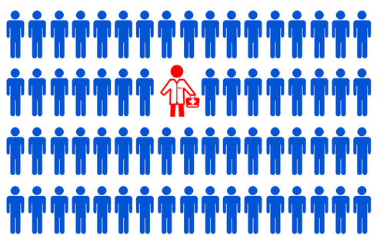


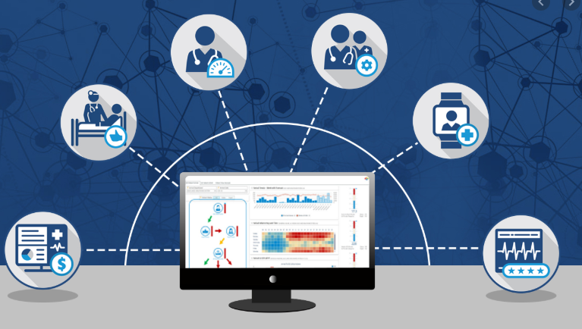

Patients and doctors
As population grow
Doctor spend more time in the diagnosis
Result more time and money spend on find correct disease
Doctors check patient profile for better diagnosis and treatment
Hospital Send Data for Data Mining
Doctors Get Help From Data Mining on Possible Disease

Slide 4
Data preparation
Data preparation
Data Set Characteristics: Multivariate | Date: 2016 | Area: Medical | Number of instances: 2000 Missing Values: 0
Attributes Characteristics | 3 continuous numeric attributes |  | Age Avg Commute Daily internet use
 | 2 discretized numeric attributes |  | Children Available Vehicles
 | 8 qualitative variables |  | Gender Military Service Ancestry Education Martial Status Type of employment Zip code Disease

Slide 5
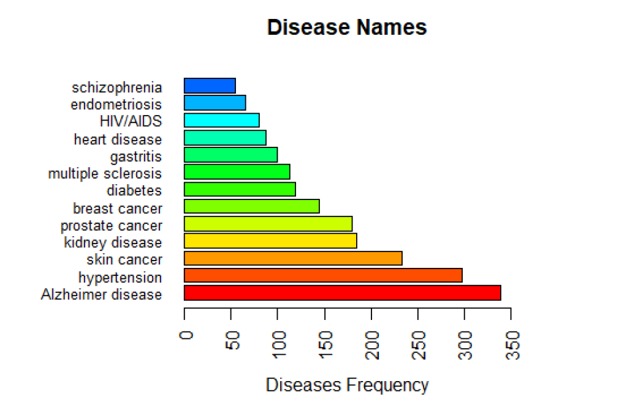
Discretization for attributes
Diseases | Attribute Type
Alzheimer | Num: 0 1
skin_cancer | Num: 0 1
hypertension | Num: 0 1
hiv_aids | Num: 0 1
Diabetes | Num: 0 1
heart_disease | Num: 0 1
breast_cancer | Num: 0 1
Endometriosis | Num: 0 1
multiple_sclerosis | Num: 0 1
schizophrenia | Num: 0 1
kidney_disease | Num: 0 1
Gastritis | Num: 0 1
prostate_cancer | Num: 0 1

Slide 6
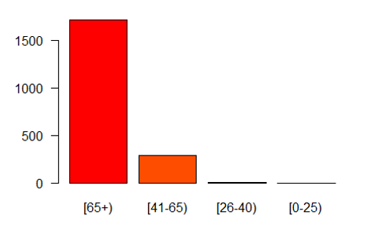
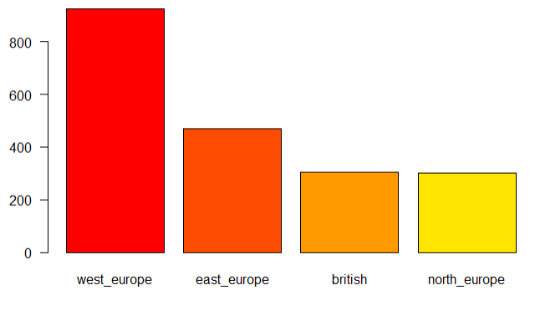
Discretization for attributes
Age
Bin | Class ‘age’
0-25 | 0
26-40 | 25
41-50 | 40
50-65 | 50
Age > 65 | 65
Ancestry
Bin | Class ‘ancestry’
Ukraine, Russia, Poland, Czech Republic, Hungary | east_europe
Austria, Belgium, France, Germany, Italy, Netherlands, Portugal, Spain, Switzerland | west_europe
Sweden, Finland, Denmark | north_europe
England, Scotland, Ireland | British

Slide 7
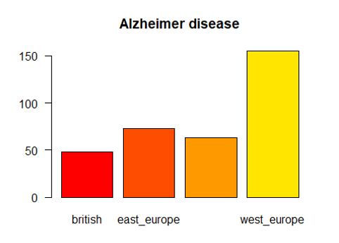
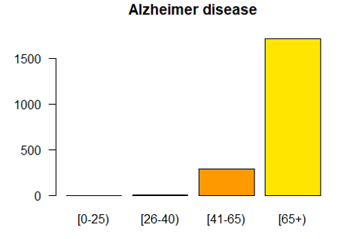
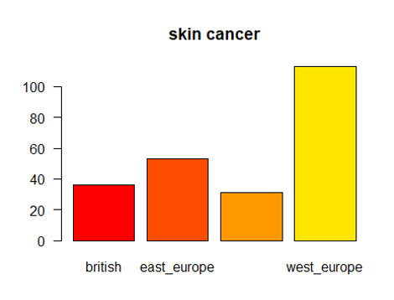
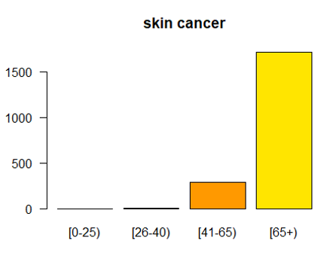
Summary of discretized attributes
Table of Age (binned) by Disease
Table of Ancestry (binned) by Disease

Slide 8
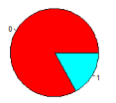

balanced or imbalanced?
Null Hypothesis
Our data is balanced
Method
One-Sample Binomial Test
Result
P value=0.000
Reject null hypothesis
Conclusion
Our data is imbalanced
1: Diagnosed
0: Not Diagnosed

Slide 9

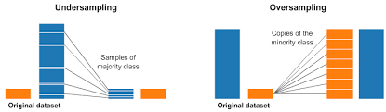
Approach to handling Imbalanced Datasets
What should I do when my data is imbalanced?
Do nothing (Not recommended)
Under-sampling
Oversampling
Neighbor-based approaches
Adjusting class weights
Synthesizing new examples (SMOTE and descendants)

Slide 10
Under-sample / over-sample / SMOTE
Under-Sample
Advantages
Improve run time and storage problems by reducing the number of training data samples when the training data set is huge
Disadvantages
It can discard potentially useful information which could be important for building rule classifiers
The sample chosen by random under sampling may be a biased sample
Over-Sample
Advantages
No information loss
Outperforms under sampling
Disadvantages
It increases the likelihood of overfitting since it replicates the minority class events
SMOTE
Advantages
Mitigates the problem of overfitting caused by random oversampling
No loss of useful information
Disadvantages
SMOTE does not take into consideration neighboring examples from other classes
SMOTE is not very effective for high dimensional data

Slide 11
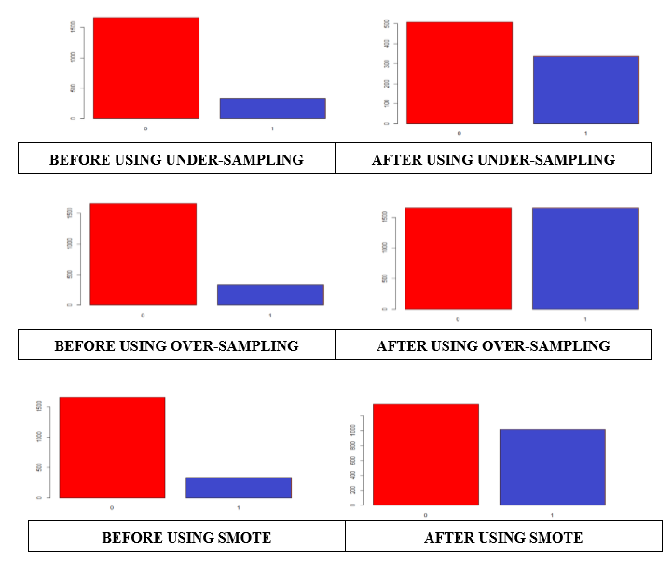
Under-sample / over-sample / SMOTE Results

Slide 12
Selected Attributes
Selected Attributes | Ranks | p-value | Pearson Chi-square Value | df
daily_internet_use | 1 | 0.0000 | 1612.5000 | 573
avg_commute | 2 | 0.0000 | 2853.5000 | 1520
employmnet_status | 3 | 0.0000 | 37.4110 | 3
zipcode | 4 | 0.0000 | 48.1410 | 12
ancestry | 5 | 0.0006 | 17.2010 | 3
marital_status | 6 | 0.0033 | 8.6472 | 1
age | 7 | 0.0062 | 12.3620 | 3
children | 8 | 0.0126 | 17.8620 | 7
available_vehicles | 9 | 0.0620 | 8.9663 | 4
military_service | 10 | 0.1426 | 2.1493 | 1
education | 11 | 0.7514 | 1.2066 | 1
gender | 12 | 0.8622 | 0.0301 | 1
** Pearson Chi-Square Value is significant at the 1% level * Pearson Chi-Square Value is significant at the 5% level

Slide 13
Predictive Analysis
Data
Balanced
Algorithm
Random Forest
Naïve Bayes
Attribute
13 attributes
Splitting dataset
Training : Testing
Cross validation (10-Folds)
Logistic Regression
0 selected attributes

Slide 14
Outline of Predictive Analysis logistic regression Alzheimer / hypertension / skin cancer
Split 70/30
Over Sample
Logistic Regression
10-Fold Cross Validation
Split 70/30
Under Sample
Logistic Regression
10-Fold Cross Validation
Split 70/30
SMOTE
Logistic Regression
10-Fold Cross Validation
10 Iterations
10 Iterations
10 Iterations
10 Iterations
10 Iterations
10 Iterations

Slide 15
Outline of Predictive Analysis Random Forest Alzheimer / hypertension / skin cancer
Split 70/30
Over Sample
Random Forest
10-Fold Cross Validation
Split 70/30
Over Sample
Logistic Regression
10-Fold Cross Validation
Split 70/30
Under Sample
Random Forest
10-Fold Cross Validation
Split 70/30
SMOTE
Random Forest
10-Fold Cross Validation
10 Iterations
10 Iterations
10 Iterations
10 Iterations
10 Iterations
10 Iterations

Slide 16
Outline of Predictive Analysis NAiVe Bayes Alzheimer / hypertension / skin cancer
Split 70/30
Over Sample
Naïve Bayes
10-Fold Cross Validation
Split 70/30
Over Sample
Logistic Regression
10-Fold Cross Validation
Split 70/30
Under Sample
Naïve Bayes
10-Fold Cross Validation
Split 70/30
SMOTE
Naïve Bayes
10-Fold Cross Validation
10 Iterations
10 Iterations
10 Iterations
10 Iterations
10 Iterations
10 Iterations

Slide 17
Summary of Predictive Analysis
Results after 10-iterations |  | Under-sample |  |  |  | Over-sample |  |  |  | SMOTE
 |  | Accuracy | Precision | Recall | F1 | Accuracy | Precision | Recall | F1 | Accuracy | Precision | Recall | F1
Logistic Regression | mean | 0.7907 | 0.843 | 0.9215 | 0.8804 | 0.5393 | 0.8673 | 0.5309 | 0.6583 | 0.7107 | 0.837 | 0.8124 | 0.82444
 | min | 0.78 | 0.8391 | 0.9004 | 0.8726 | 0.52 | 0.8459 | 0.502 | 0.6364 | 0.6983 | 0.8333 | 0.7928 | 0.815494
 | max | 0.8117 | 0.8489 | 0.9562 | 0.8947 | 0.555 | 0.8827 | 0.5578 | 0.6723 | 0.7283 | 0.8414 | 0.8347 | 0.836837
Random Forest | mean | 0.813 | 0.8455 | 0.9502 | 0.8947 | 0.5843 | 0.8974 | 0.5681 | 0.6956 | 0.7645 | 0.8405 | 0.8869 | 0.862965
 | min | 0.7967 | 0.8394 | 0.9243 | 0.8838 | 0.5567 | 0.8907 | 0.5359 | 0.6692 | 0.7433 | 0.8369 | 0.8546 | 0.847826
 | max | 0.83 | 0.8529 | 0.9781 | 0.9059 | 0.6083 | 0.9063 | 0.5996 | 0.7192 | 0.7833 | 0.8446 | 0.9084 | 0.87524
Naïve Bayes | mean | 0.7955 | 0.8413 | 0.9327 | 0.8815 | 0.2313 | 0.9423 | 0.0890 | 0.1579 | 0.7427 | 0.8341 | 0.8645 | 0.8464
 | min | 0.6717 | 0.8333 | 0.7271 | 0.7875 | 0.1867 | 0.8814 | 0.0279 | 0.0543 | 0.6033 | 0.8304 | 0.6474 | 0.7320
 | max | 0.8367 | 0.8588 | 1.0000 | 0.9111 | 0.3133 | 1.0000 | 0.2072 | 0.3355 | 0.8067 | 0.8420 | 0.9622 | 0.8928

Slide 18
summary
Conclusion
Recommendation
Limitation

Slide 19

Conclusion
Preprocessed the data : emphasized on balancing, discretization and feature selection
Used more than 3 algorithms: J48, KNN, Naïve Bayes, Logistic regression, and Random Forest but zeroed on 3
All the measures (precision, recall, and specificity) give important information about how well is the calcification model
Precision: Out of all the examples that predicted as positive, how many are really positive?
Recall: Out of all the positive examples, how many are predicted as positive?
Specificity: Out of all the people that do not have the disease, how many got negative results?

Slide 20

recommendation
The richer dataset in patient lab test, the better is the prediction
The dataset should give patient profile since young age for better analysis
Each disease should have its own study and dataset with right attributes

Slide 21

limitation
Absence of any attribute pertaining to the patient’s blood type, blood pressure, cholesterol, and weight
No data related when the patient migrated to US
Small size of the collected data compared to the number of diseases

Slide 22

Thank you
Q & A

