Slide 1
MACHINE LEARNING PROJECT
Diabetes Prediction
A Comparative Study of Logistic Regression and Support Vector Machines
PREPARED BY
SUPERVISED BY
Abdelrhman Ehab Soliman
Dr. Kholoud Amer
Mohamed Elmogy
Dr. Yasmin Mahmoud
🔗 github.com/abdelrhman-elnajjar/Diabetes_Prediction_ML

Slide 2
Outline
01
Problem Statement
05
Support Vector Machine
Why diabetes prediction matters
Linear kernel results
02
Dataset Overview
06
Model Comparison
100,000 patient records, 9 features
Which model performs best?
03
Methodology
07
Conclusion
Preprocessing, split, scaling
Key takeaways & future work
04
Logistic Regression
Training, evaluation, threshold tuning
2

Slide 3
Growing global burden
Diabetes affects hundreds of millions worldwide and is often diagnosed late.
Early detection saves lives
THE PROBLEM
Identifying at-risk patients early allows timely intervention and lifestyle changes.
Can we predict diabetes before it's diagnosed?
Data-driven screening
Routine clinical measurements (glucose, HbA1c, BMI) can power predictive models.
Our goal
Build and compare classical ML models to classify patients as diabetic or not.
3

Slide 4
Dataset Overview
Diabetes Prediction Dataset
100,000
96,146
9
KEY OBSERVATION
Class Imbalance
Original Records
After Removing Duplicates
Features
Only 8.5% of patients in the dataset have diabetes.
Feature Columns
This means accuracy alone is misleading — a model predicting "no diabetes" every time would still score ~91% accuracy.
gender
age
hypertension
heart_disease
smoking_history
bmi
HbA1c_level
blood_glucose_level
diabetes (target)
We rely on Precision, Recall, F1, and ROC-AUC instead.
4

Slide 5
Methodology & Preprocessing
1
2
3
4
Clean
Encode
Split
Scale
Removed 3,854 duplicate records; verified zero missing values.
Label-encoded categorical features: gender & smoking_history.
70% training / 30% testing, stratified to preserve class ratio.
Standardized features (mean=0, std=1) using StandardScaler.
Two classical ML algorithms were trained and evaluated using an identical pipeline for a fair comparison: Logistic Regression and Support Vector Machine (Linear kernel).
5

Slide 6
Logistic Regression — Results
Evaluated at default threshold = 0.5
95.86%
86.18%
63.22%
72.94%
95.94%
Accuracy
Precision
Recall
F1 Score
ROC-AUC
Confusion Matrix
⚠ CLINICAL INSIGHT
Pred: No
Pred: Yes
936 missed diagnoses
Actual: No
26,041
258
At threshold 0.5, the model misses 37% of real diabetes cases (False Negatives) — the most costly error in a medical context.
Actual: Yes
936
1,609
This motivated our threshold-tuning experiment on the next slide.
6

Slide 7
Threshold Tuning
Balancing Precision and Recall for a medical use-case
SELECTED THRESHOLD
t = 0.3
Precision
71.4%
Recall
71.4%
F1 Score
71.4%
False Negatives
936 → 727
Chosen because Precision and Recall converge — reducing missed diagnoses without excessive false alarms.
7

Slide 8
Support Vector Machine — Results
Linear kernel, threshold = 0.3 (matched to Logistic Regression for fair comparison)
94.93%
71.65%
70.49%
71.06%
95.76%
Accuracy
Precision
Recall
F1 Score
ROC-AUC
Confusion Matrix
MODEL BEHAVIOR
Pred: No
Pred: Yes
Conservative Classifier
Actual: No
26,589
710
Training took ~4 minutes (vs. seconds for Logistic Regression), reflecting SVM's higher computational cost on ~67K training rows.
Actual: Yes
751
1,794
5-Fold Cross-Validation Mean F1: 72.24% — confirming stable performance across folds.
8

Slide 9
Model Comparison
Logistic Regression vs. SVM (Linear) — both at threshold = 0.3
9

Slide 10
KEY TAKEAWAY
Both models perform almost identically —
so the deciding factor isn't just accuracy.
Recall Matters Most
Logistic Regression Wins Slightly
Speed & Simplicity
In healthcare, missing a real diabetes case (False Negative) is far costlier than a false alarm.
Marginally higher Recall (71.4% vs 70.5%) and ROC-AUC (95.9% vs 95.8%).
Logistic Regression trained in seconds; SVM took ~4 minutes for a near-identical result.
10

Slide 11
Conclusion & Future Work
CONCLUSION
FUTURE WORK
Logistic Regression is recommended as the final model — best Recall/AUC trade-off with minimal training cost.
Explore RBF kernel SVM and ensemble methods (e.g., Random Forest) for further comparison.
Both models achieved ROC-AUC above 95%, showing strong discriminative power.
Apply class-weighting or resampling (SMOTE) as an alternative to threshold tuning.
Threshold tuning (0.5 → 0.3) reduced missed diabetes cases by over 20% with only ~1% accuracy trade-off.
Deploy the final model behind a simple GUI for real-time prediction.
11

Slide 12
Deployment
The saved model is loaded once at startup — it is never retrained per request
1
2
3
4
Preprocess
Saved Model
Threshold
Prediction
User input is label-encoded and scaled with the saved encoders.
Loads the trained Logistic Regression model from model.joblib.
Outputs a probability, compared against threshold = 0.30.
Returns Diabetes or No Diabetes with the probability score.
The model was trained once and saved with joblib (model.joblib, scaler.joblib, encoders.joblib). The Streamlit app loads these saved artifacts on startup and never retrains.
GITHUB REPOSITORY
LIVE DEMO / STREAMLIT APP
🔗 github.com/abdelrhman-elnajjar/Diabetes_Prediction_ML
🔗 diabetes-ml-project-2026.streamlit.app
12

Slide 13
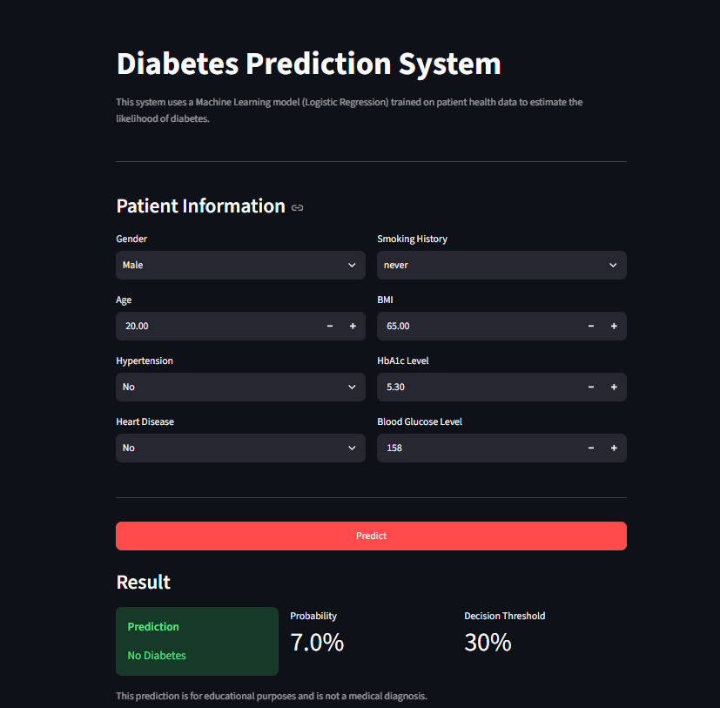
Live Demo
Streamlit / Live Demo — publicly accessible, no installation required
The final Logistic Regression model was deployed using Streamlit. Users can enter patient information and receive a diabetes prediction, probability, and decision threshold through the web interface.
The deployed application loads the saved model and preprocessing components and does not retrain the model for each user.
🔗 Open Live Demo
🔗 github.com/abdelrhman-elnajjar/Diabetes_Prediction_ML
Streamlit prediction interface
13

Slide 14
Project Team
PREPARED BY
SUPERVISED BY
Abdelrhman Ehab Soliman
Dr. Kholoud Amer
Mohamed Elmogy
Dr. Yasmin Mahmoud
Diabetes Prediction System — A Machine Learning Project
14

Slide 15
Thank You
Questions & Discussion
Abdelrhman Ehab Soliman • Mohamed Elmogy
Supervised by Dr. Kholoud Amer & Dr. Yasmin Mahmoud
🔗 github.com/abdelrhman-elnajjar/Diabetes_Prediction_ML

